Slide 1
ML r&d to production
Andre da Palma, Kare - Engineering

Slide 2
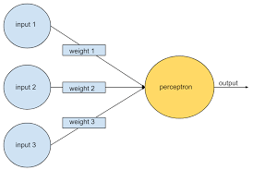
What is a ML model?
“Machine learning algorithms build a mathematical model based on sample data, known as "training data", in order to make predictions or decisions without being explicitly programmed to perform the task”

Slide 3
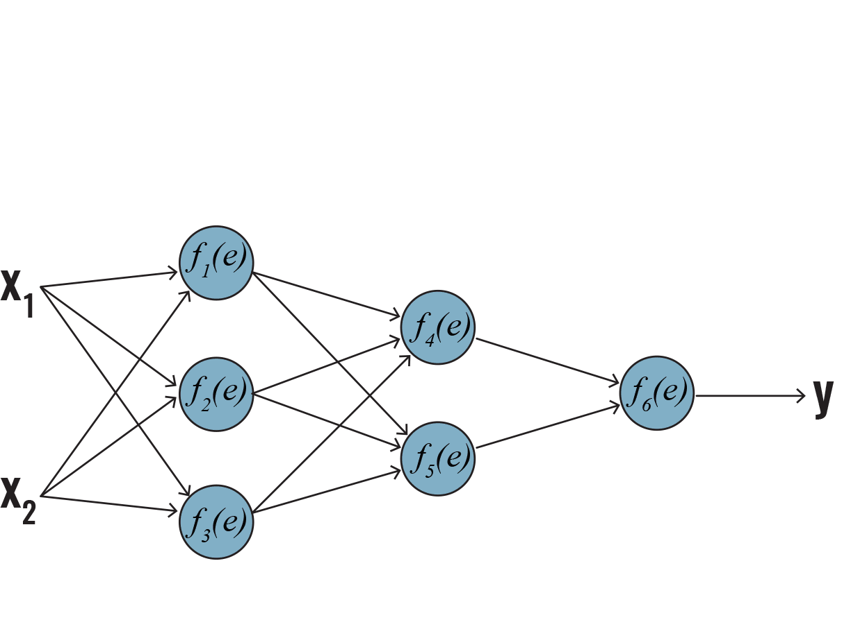
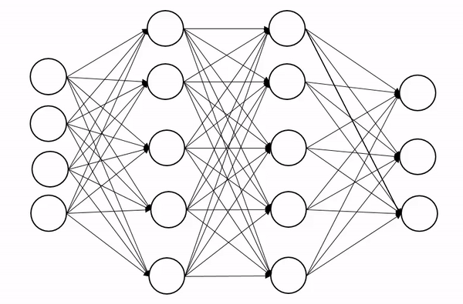
Objective
Input (X) / Output (Y)
Adjust Weights(W) in order to reduce error
Adjust model hyperparameters
Export best set of Weights(LTM)

Slide 4
Process overview
Find and curate a dataset
Create a model (tensorflow, torch, keras etc...)
Train model
Evaluate and record results
Export model (preferably in universal format)
Load and serve model export

Slide 5
Common issues
Lack of a systematic model development process
Code fragmentation during model development
Model and dataset versioning
Not clear how to use and monitor the model
Hard to create a build pipeline
Code quality neglected during early stages

Slide 6









Teams and process overview
R&D (produce and train models)
Platform/Back-end (run/integrate the with a application)
DevOps (establish CD/CI processes)
CI/Pipeline
CI
Export to
Load from
Deploy to
data/datasets
Production platform
Model development
Shared storage

Slide 7
R&D projects framework
Structure project as a framework
Create top level classes for main concepts (e.g: Model, Task, Datasets, Model and Task configurations)
Models export should contain weights, architecture and hyper-parameter configurations
Models should be re-buildable from previous exports
Account for usage of multiple frameworks in same project
Make it easy to hook revelant tasks on CI pipeline

Slide 8
R&D project structure
# Example
./repo/
./bin/
create_project.py
./common/
./datasets/
./raw/
yahoo.py
locations.py
./models/
./arci/
train.sh
evaluate.sh
model.py
./linear_regression/
train.sh
evaluate.sh
model.py
Package individual projects
Common and utils modules
Utility commands for common tasks(e.g create new project)
Projects with train and evaluation hooks
E.g at:
- https://github.com/NTMC-Community/MatchZoo

Slide 9
R&D datasets as classes
Datasets are under version control (git, svn, hg)
Datasets shared between multiple models
Changes are tracked
# Example
from common.datasets.raw import yahoo
# keras
from keras.datasets import cifar10
# tensorflow
import tensorflow_datasets as tfds
mnist_train = tfds.load(name="mnist", split="train")

Slide 10
R&D model class
Consistent API for model development
Common methods well defined
Account for multiple ML frameworks
# Example
class RnDModel(object):
def __init__(self, config):
self.config = config
def train():
def evaluation():
def predict():
def build():
def export():
def load():
# Keras
from keras.models import Model
from keras.layers import Input, Dense
class MyModel(RnDModel):
def build(self):
a = Input(shape=(32,))
b = Dense(32)(a)
self.model = Model(inputs=a, outputs=b)
return self.model
# tensorflow
class MyModel(RndModel):
def build(self):
self.X = tf.placeholder(tf.float32)
self.M = tf.Variable(np.random.rand())
self.B = tf.Variable(np.random.rand())
# model: Y = M*X + B
self.model = tf.add(tf.multiply(self.M, self.X), self.B)

Slide 11
R&D model and task config
Configuration of model structure
Configuration of tasks(train, evaluation)
Exportable and loadable from and to a common file format (e.g: json)
# example
class Config(object):
def __init__():
self.export_path =
def to_json():
def from_json():
def export():
def load():
# json config example
{
”train”: {
”epochs”: 10,
”optimizer”: “adam”
},
”model”: {
”layers”: 10,
”layer_size”: 200
}
}

Slide 12
R&D task classes
Task entry points are important for automation
ML pipelines depend on call consistency
Tasks are very similar between models (almost allways)
# Example
class Job(object):
def __init__(self, config):
self.config = config
self.job_dir =
self.model_version =
def run():
# config
class Train(Job):
def run():
model = create_model(self.config)
model.train()
model.export()
class Evaluation(job):
def run():
model = load_model(self.config)
results = model.evaluation()
self.create_report(results)

Slide 13
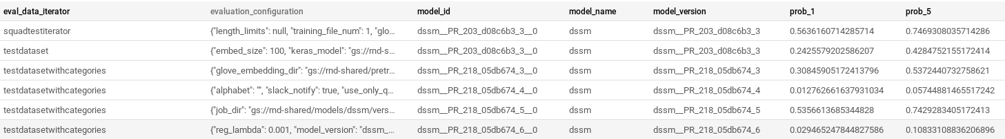
R&D report log classes
Record key result metrics for each model task
Save records in a database
Keep track of model performance
Record job configuration originated each result
Keep historic of train and evaluations

Slide 14

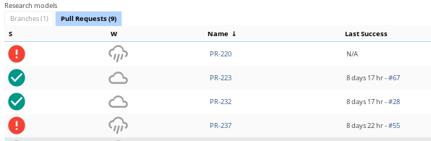
CI build pipeline
Similar to other build pipelines
Pull Requests are also buildable (usefull for experimentation)
Common stages (unit/integration test, pre-process, train and evaluate)
Allow choice for which model pipeline to start

Slide 15
Model version
Unique
Commit IDs should be part of the version
Consider hyper-param optimization when creating a version ID template
Should be useful to identify and recover model and its settings
# example
Version template:
{model_name}__{branch_name}__{commit}__{build_NR}__{trial_ID}

Slide 16
Model export
Contain weights/LTM files (obviously…)
Should contain relevant configuration (useful to know how to use the model)
Should contain set of predictions (useful for testing)
[andrefsp@debian ~]$ gsutil ls gs://rnd-shared/models/dssm/versions/dssm__PR_185_97de673_89/job/export/
gs://rnd-shared/models/dssm/versions/dssm__PR_185_97de673_89/job/export/
gs://rnd-shared/models/dssm/versions/dssm__PR_185_97de673_89/job/export/config.json
gs://rnd-shared/models/dssm/versions/dssm__PR_185_97de673_89/job/export/io_conf.json
gs://rnd-shared/models/dssm/versions/dssm__PR_185_97de673_89/job/export/saved_model.pb
gs://rnd-shared/models/dssm/versions/dssm__PR_185_97de673_89/job/export/test_embeddings.csv
gs://rnd-shared/models/dssm/versions/dssm__PR_185_97de673_89/job/export/vectorizer.json
gs://rnd-shared/models/dssm/versions/dssm__PR_185_97de673_89/job/export/word_embed_vectorizer.json
gs://rnd-shared/models/dssm/versions/dssm__PR_185_97de673_89/job/export/variables/

Slide 17
Model serving
Model embedding (load model on code)
Model micro-services with packaging tools (e.g: docker)
Model servers (e.g TensorServe)

Slide 18
Model deployment
Loads the model form the export location
Performs adequacy test
Resumes normal operation
Where model is loaded depends on model specifications (loaded on server, loaded when compiling etc...)
# golang tensorflow
import (
tf "github.com/tensorflow/tensorflow/tensorflow/go"
)
model, err := tf.LoadSavedModel(
”path/to/export/”, tags, nil,
)
# golang pytorch
import (
"github.com/orktes/go-torch"
)
module, err := torch.LoadJITModule(
"path/to/export/model.pt",
)

Slide 19



Deployment adequacy tests
Checks if model is being used correctly after load
Use pre-processing examples provided on export
# adequacy_test.csv (with pre processing)
Input,Y
“normal name”,”0.87”
“strange ~ name”,”0.12”
“sentence~ requ1res preprocessing”,”0.1”
# adequacy_test.csv (Y = 2*X+1)
Input,Y
“1.0”,”3.0”
“2.0”,”5.0”
“3.0”,”7.0”

Slide 20


Deployment infra-structure
Depends on model requirements(e.g: memory, GPU etc.)
Container orchestration tools make it easier and flexible
Must consider different serving strategies (embedding vs serving)
Kubernetes cluster
Node pool 1
(High memory)
node 1
node 2
node 3
Node pool 2
(GPU)
node 1
Node pool 3
(standard)
node 1
node 2
node 3

Slide 21
Thanks
Model and dataset versioning tools:
- DVC (https://dvc.org/)
- MLFlow (https://mlflow.org/)
Pipeline and ML flow and model serving tools:
- Kubeflow (https://www.kubeflow.org)
- RedisAI (https://oss.redislabs.com/redisai/)
Check out:
- https://www.tensorflow.org/tfx/guide/serving
- https://pytorch.org/blog/model-serving-in-pyorch/
Repos:
- https://github.com/NTMC-Community/MatchZoo

