Slide 1
location information
for consumers
app providing local conditions
André Gasser, Attila Horvath, Tobias Schäuble

Slide 2
motivation
the idea
app that provides environmental information
such as: nuclear power plants, train stations, shopping malls, motorways, …
based on personal preferences, the app generates a heat map
e.g.: user is looking for a new place of residence
he wishes motorway exits and shopping malls nearby and nuclear power plants far away
André Gasser, Attila Horvath, Tobias Schäuble
Notes:
Tobias

Slide 3
stakeholders
house builders
gis company
women
tourists
we
all ages
state
estate agent
find a new place to go
relocating living area
companies
men
André Gasser, Attila Horvath, Tobias Schäuble
Notes:
Tobias

Slide 4
goals
Build a simple prototype within 7 weeks
Features
Fetch basic data set from a cloud web service
Store/cache data locally to save bandwidth
Visualize data on a heatmap
Allow the user to set his own preferences
Store personal preferences
André Gasser, Attila Horvath, Tobias Schäuble
Notes:
Tobias

Slide 5
background / related work
huge amount of geographic information
Example database: www.geo.admin.ch, www.swisstopo.admin.ch, www.datahub.io
Google Maps API developers.google.com/maps
MapBox API www.mapbox.com
Google Places
André Gasser, Attila Horvath, Tobias Schäuble
Notes:
Tobias

Slide 6
locations
genetic farming
motorways
flight routes
crime
population concentration
nature
rivers
train stations
streets
national parks
water quality
power supply lines
airports
ports
nuclear power plants
noise
ozonosphere
particulate matter
ship lines
gdb
shops
André Gasser, Attila Horvath, Tobias Schäuble
Notes:
Tobias

Slide 7
design / architecture
UML
André Gasser, Attila Horvath, Tobias Schäuble
Notes:
André

Slide 8
design / architecture
schema
André Gasser, Attila Horvath, Tobias Schäuble
Notes:
André

Slide 9
design / architecture
code
Pref
André Gasser, Attila Horvath, Tobias Schäuble
Notes:
Attila

Slide 10
implementation
Data Update Mechanism
Checks for new data once a week and invokes a download if necessary
Stores / caches data in SQLite database
Settings Activity
Uses a custom slider control
Stores settings in shared preferences
André Gasser, Attila Horvath, Tobias Schäuble
Notes:
André

Slide 11
implementation
v1
André Gasser, Attila Horvath, Tobias Schäuble
Notes:
Tobias

Slide 12
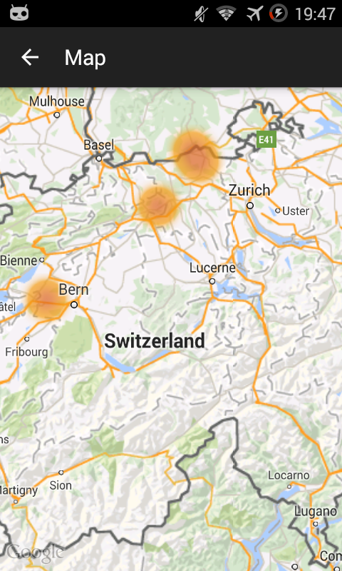
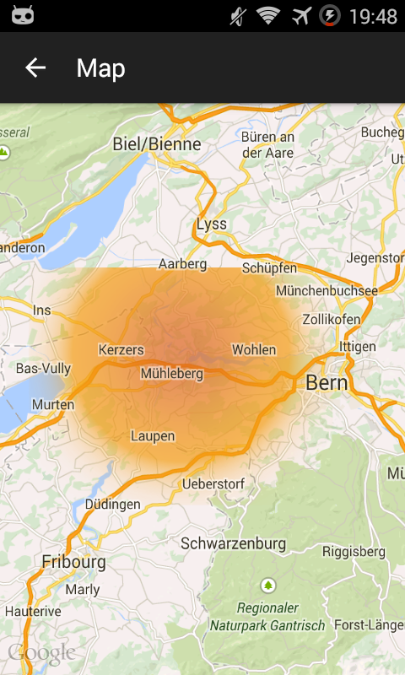
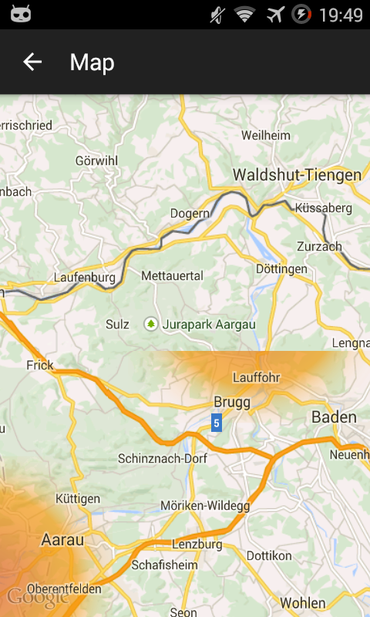
challenges
google heatmap
André Gasser, Attila Horvath, Tobias Schäuble
Notes:
Tobias

Slide 13
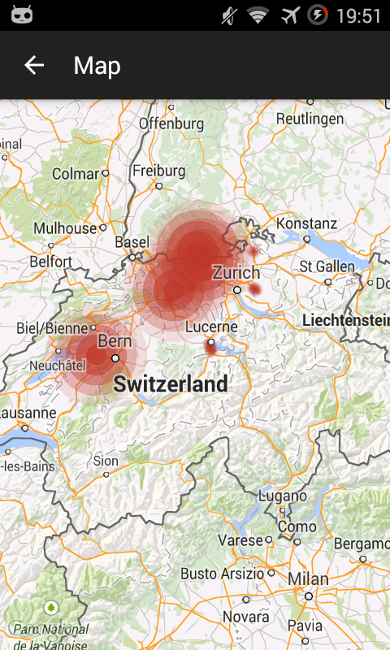
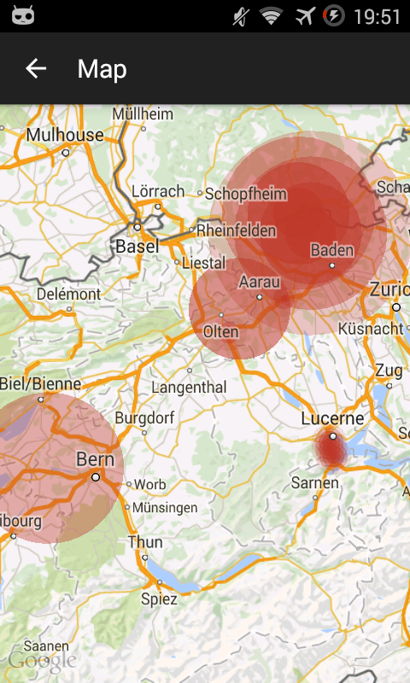
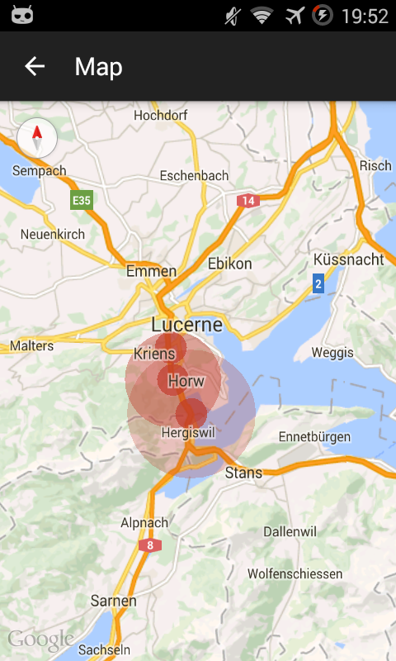
challenges
google circle
André Gasser, Attila Horvath, Tobias Schäuble
Notes:
Tobias

Slide 14
challenges
mapbox
André Gasser, Attila Horvath, Tobias Schäuble
Notes:
André

Slide 15
evaluation / testing
During Development
Run on different Android devices such as Samsung Galaxy S2, Nexus 2, Nexus 7 Tablet, ...
Manual / explorative testing by end users
Watch them as the use the app
Collect feedback
André Gasser, Attila Horvath, Tobias Schäuble
Notes:
André

Slide 16
discussion
Summary
Lesson Learned
André Gasser, Attila Horvath, Tobias Schäuble
Notes:
Attila

