Slide 1
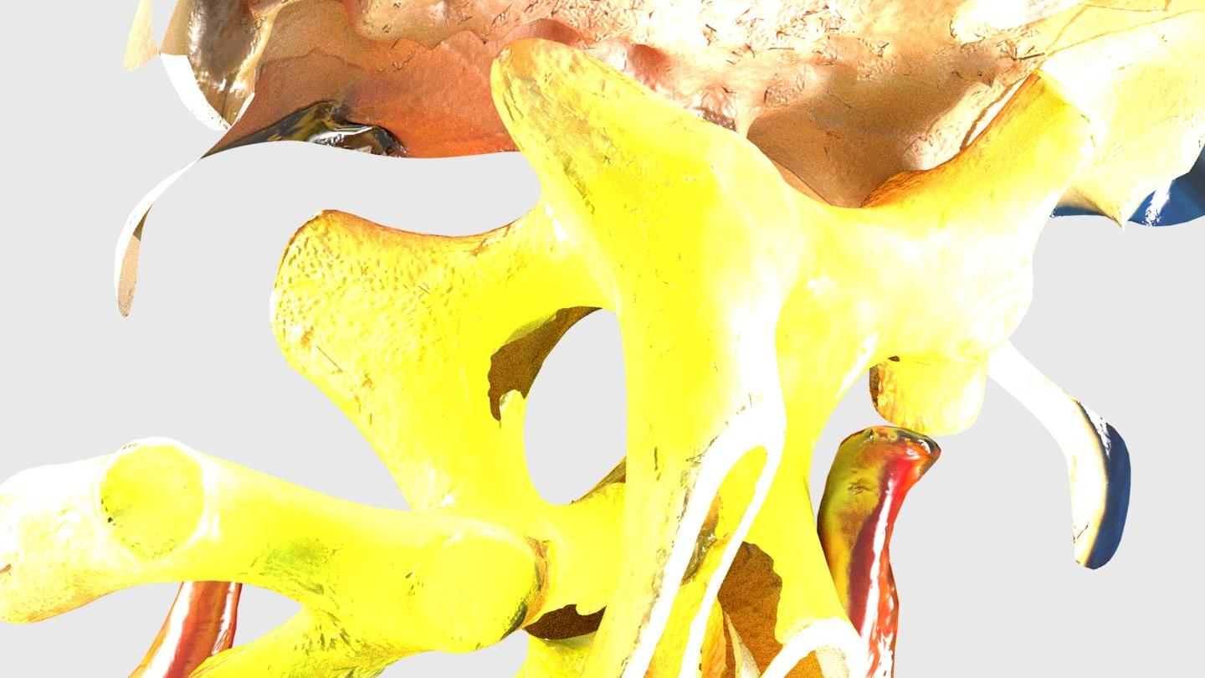
INFODECK
INFODECK
Self-Contained
Systems

Slide 2
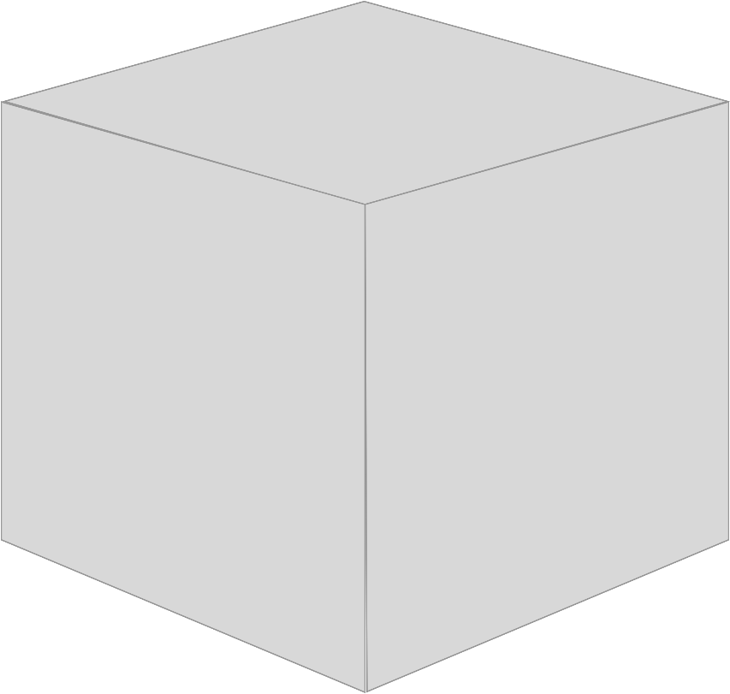
A monolith contains numerous things inside of a single system …

Slide 3
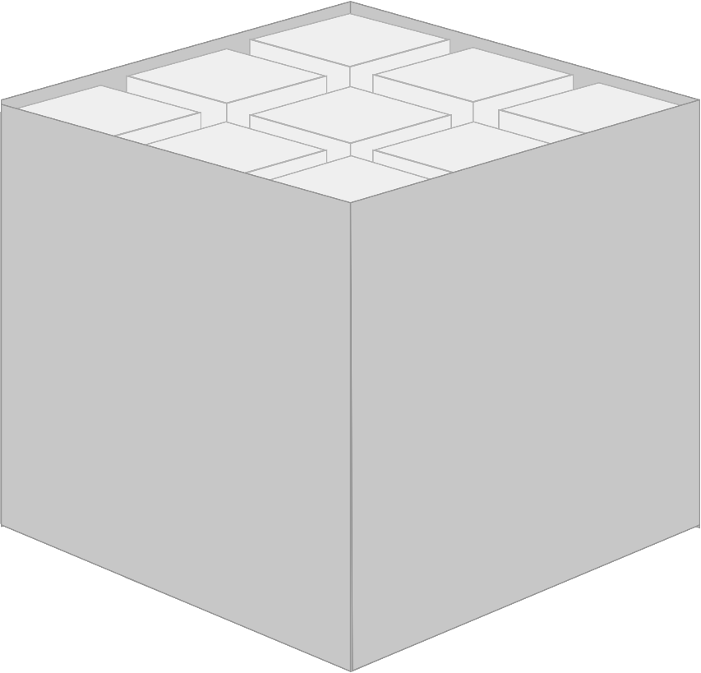
Various Domains

Slide 4
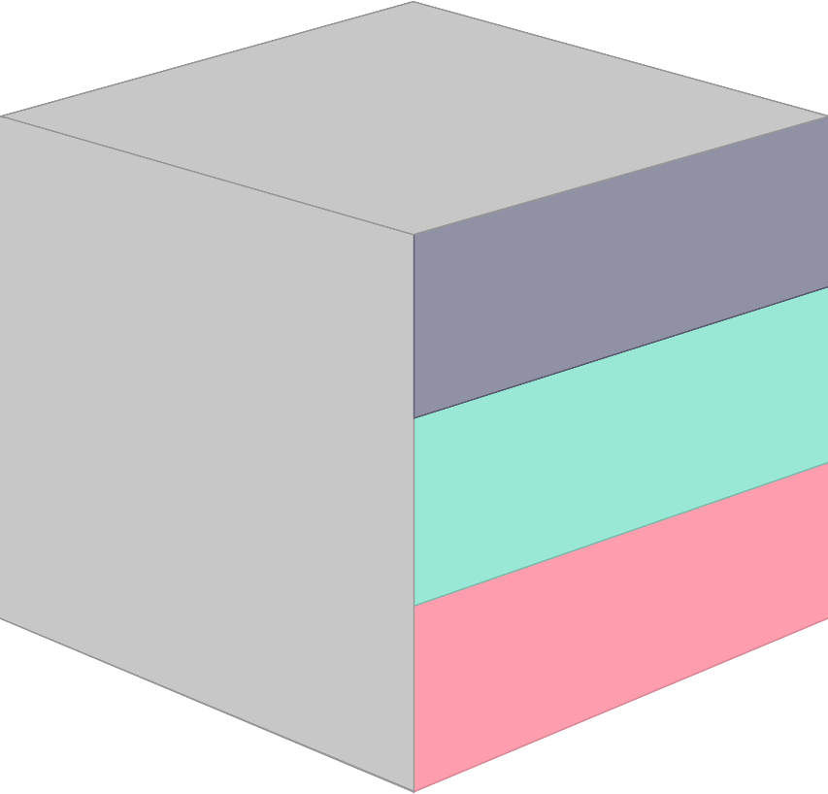
User interface Business logic Persistence

Slide 5
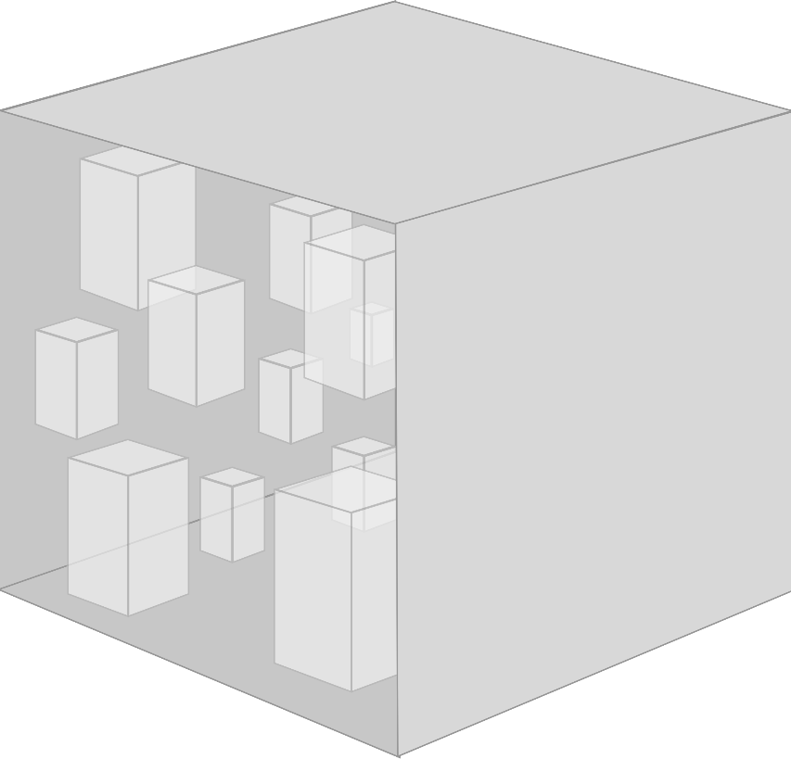
… as well as a lot of modules, components, frameworks and libraries.

Slide 6
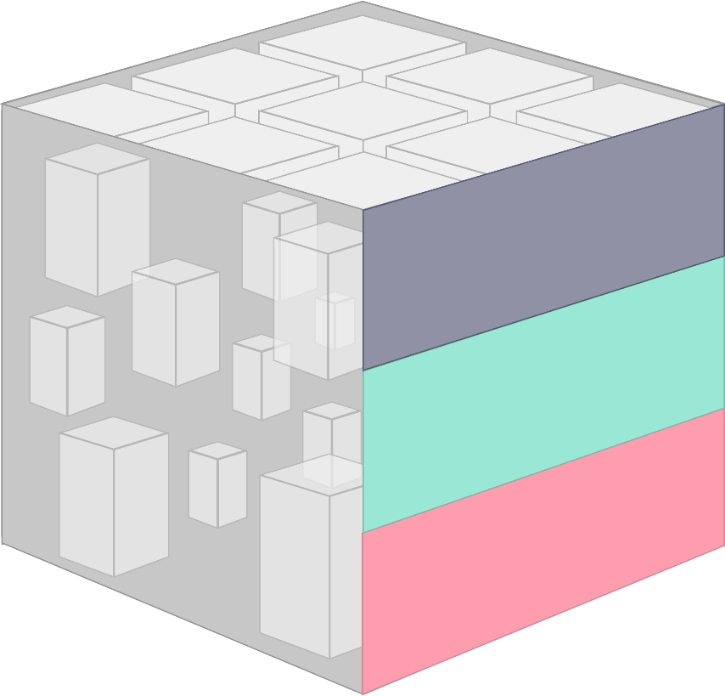
With all these layers in one place, a monolith tends to grow.

Slide 7

With all these layers in one place, a monolith tends to grow.

Slide 8
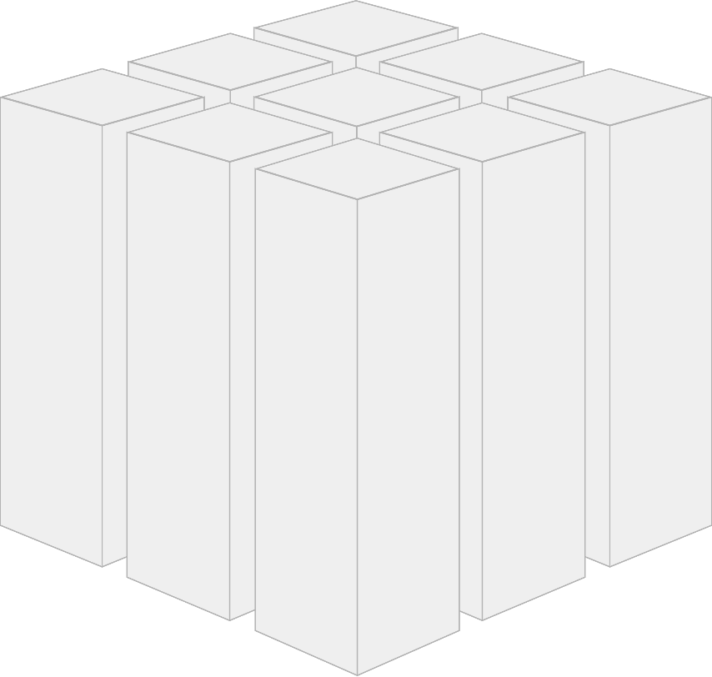
If you cut a monolithic system along its very domains …

Slide 9
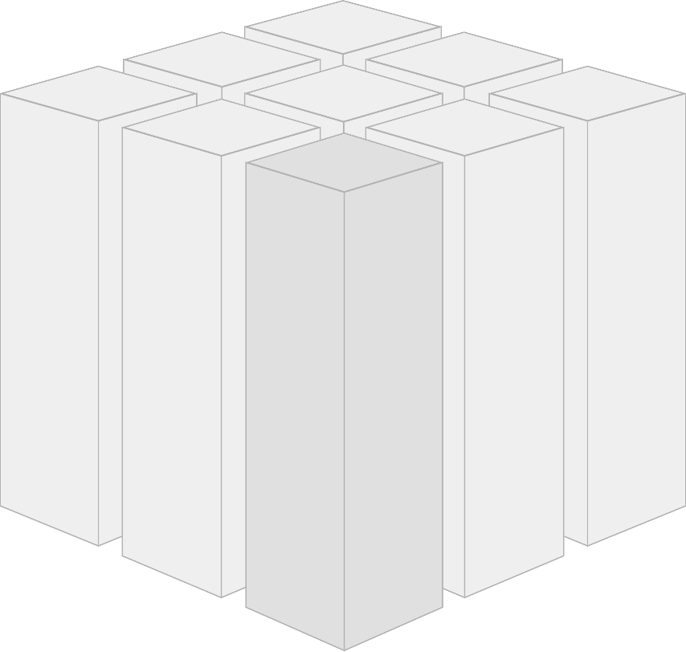
… and wrap every domain in a separate, replaceable web application …

Slide 10
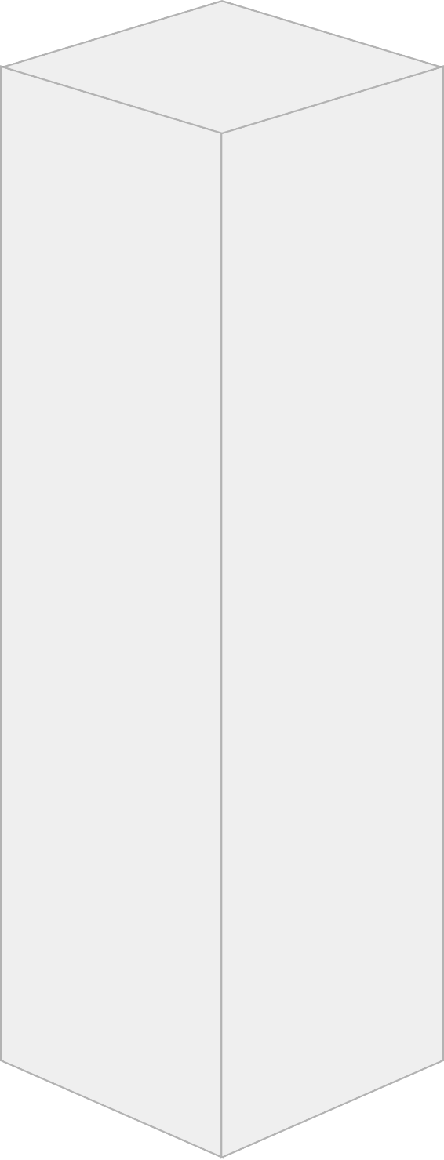
… then that application can be referred to as a self-contained system (SCS).

Slide 11
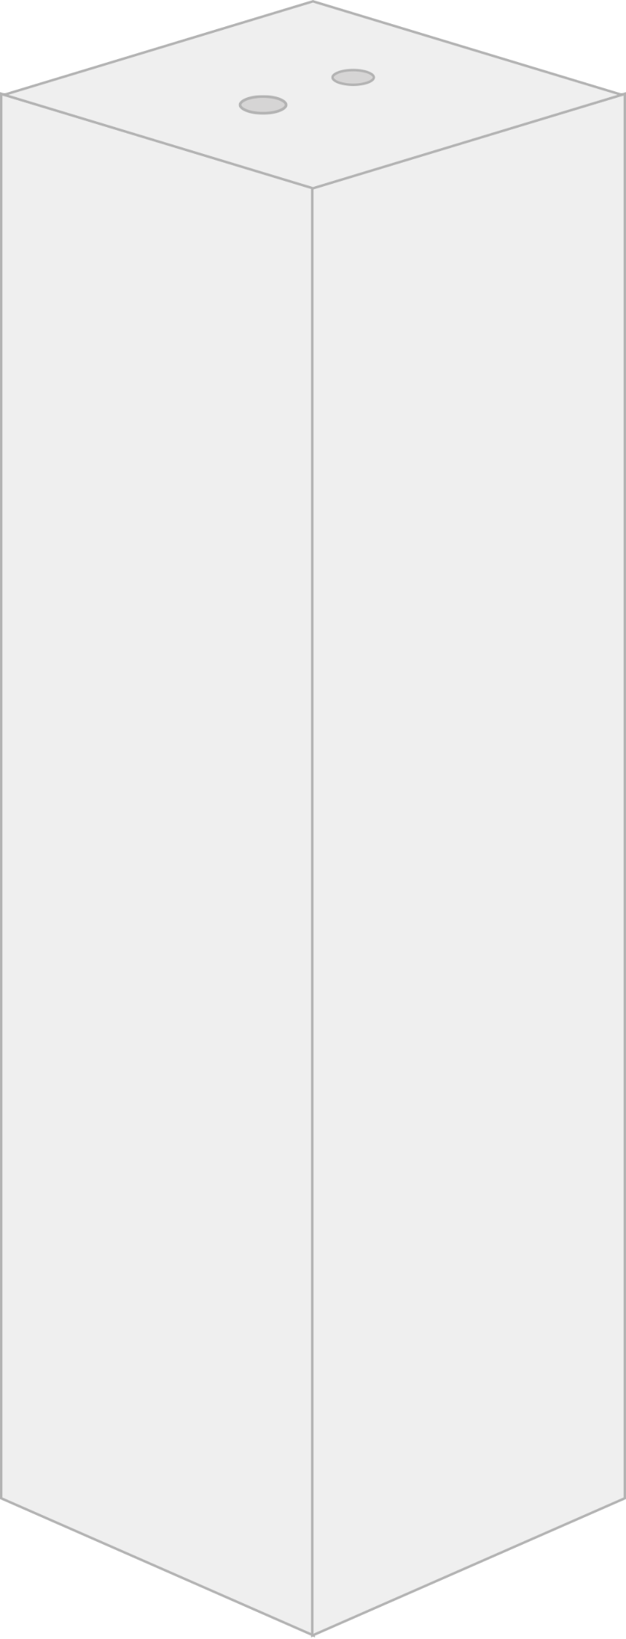
On its outside, an SCS is a decentralized unit that is communicating with other systems via RESTful HTTP or lightweight messaging.

Slide 12
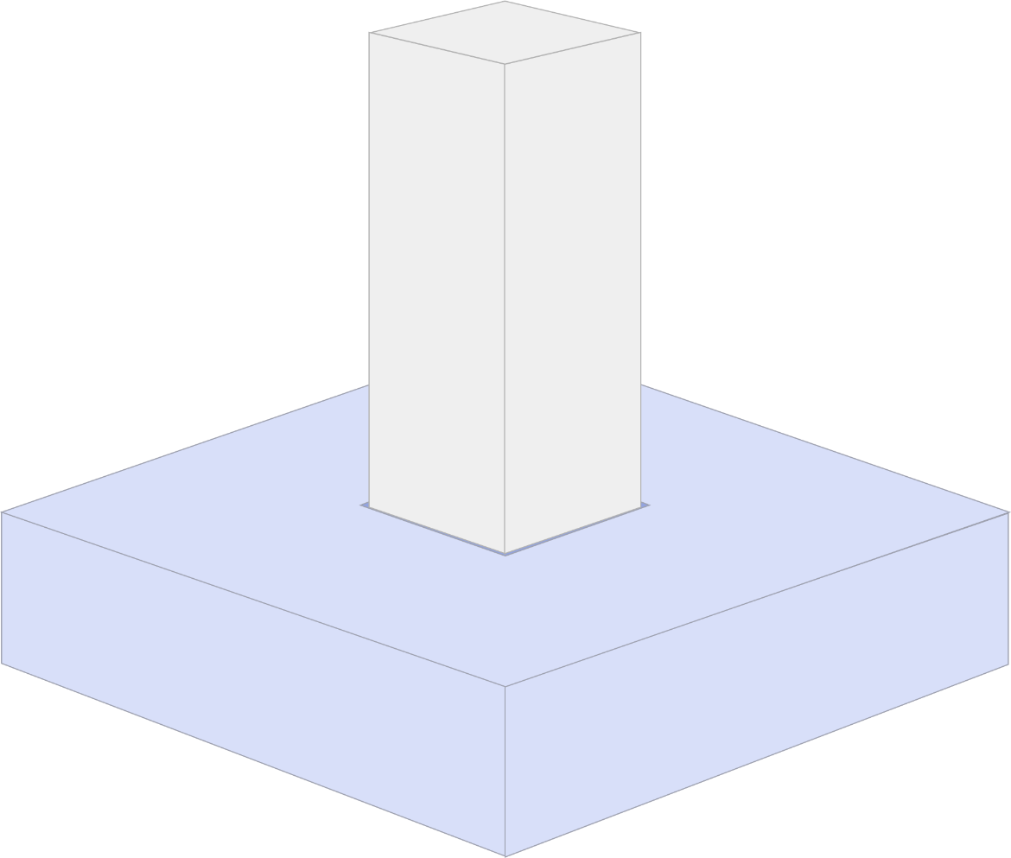
Therefore self-contained systems can be individually developed for different platforms.

Slide 13
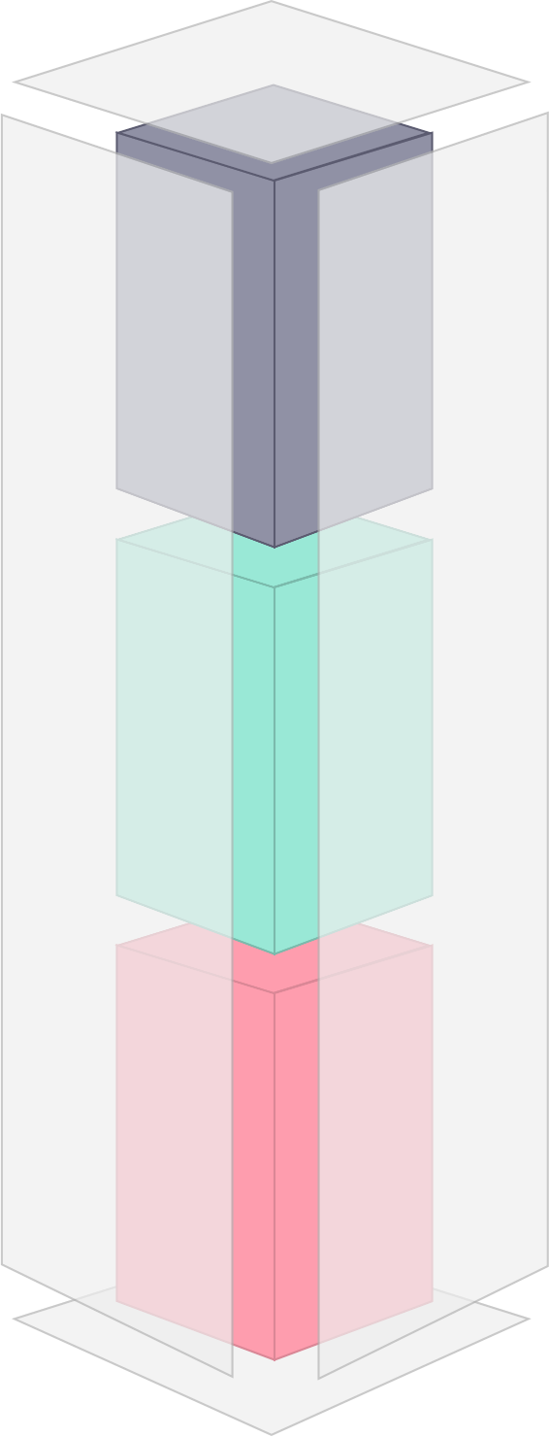
An SCS contains its own user interface, specific business logic and separate data storage

Slide 14
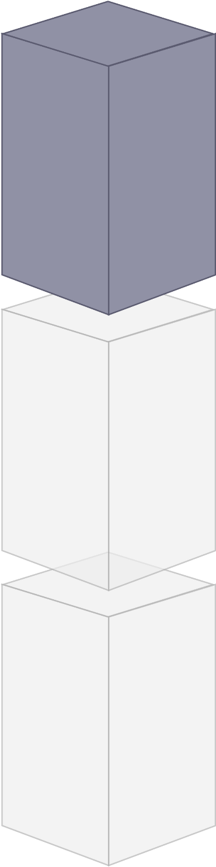
The user interface consists of web technologies that are composed according to ROCA principles.

Slide 15
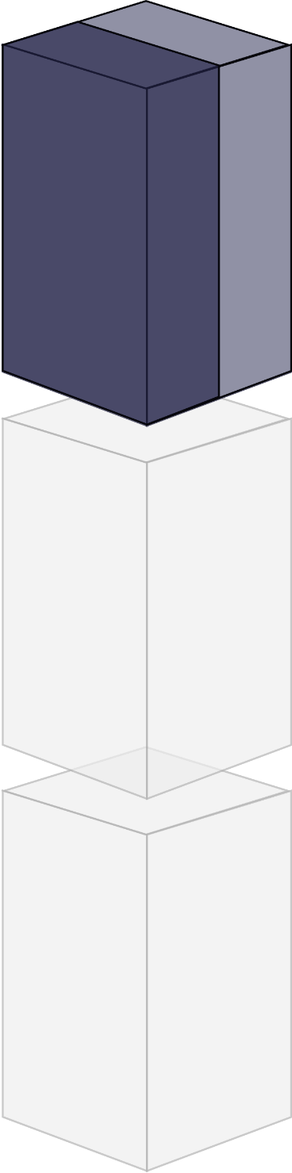
Besides a web interface a self-contained system can provide an optional API.

Slide 16
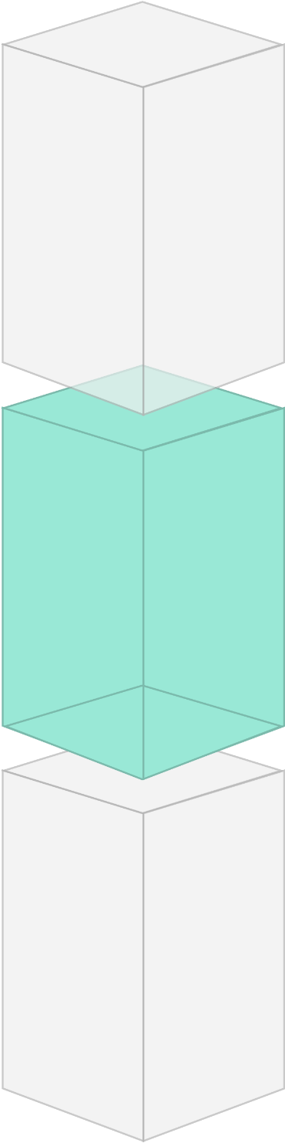
The business logic part only solves problems that arise in its core domain. This logic is only shared with other systems over a well defined interface.

Slide 17
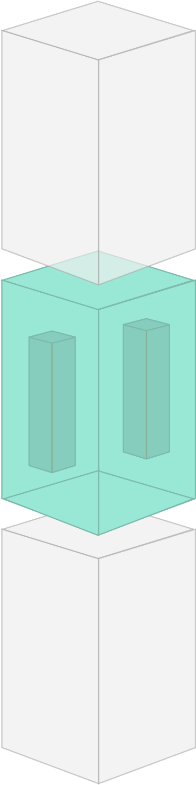
The business logic can consist of microservices to solve domain specific problems.

Slide 18
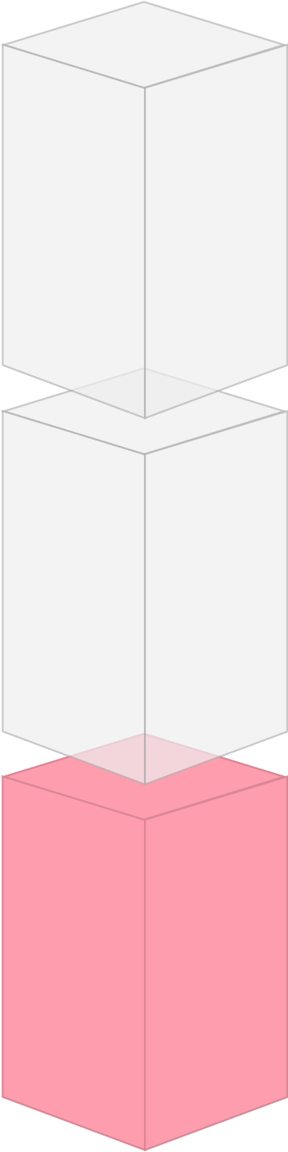
Every SCS brings its own data storage and with it redundant data depending on the context and domain.

Slide 19
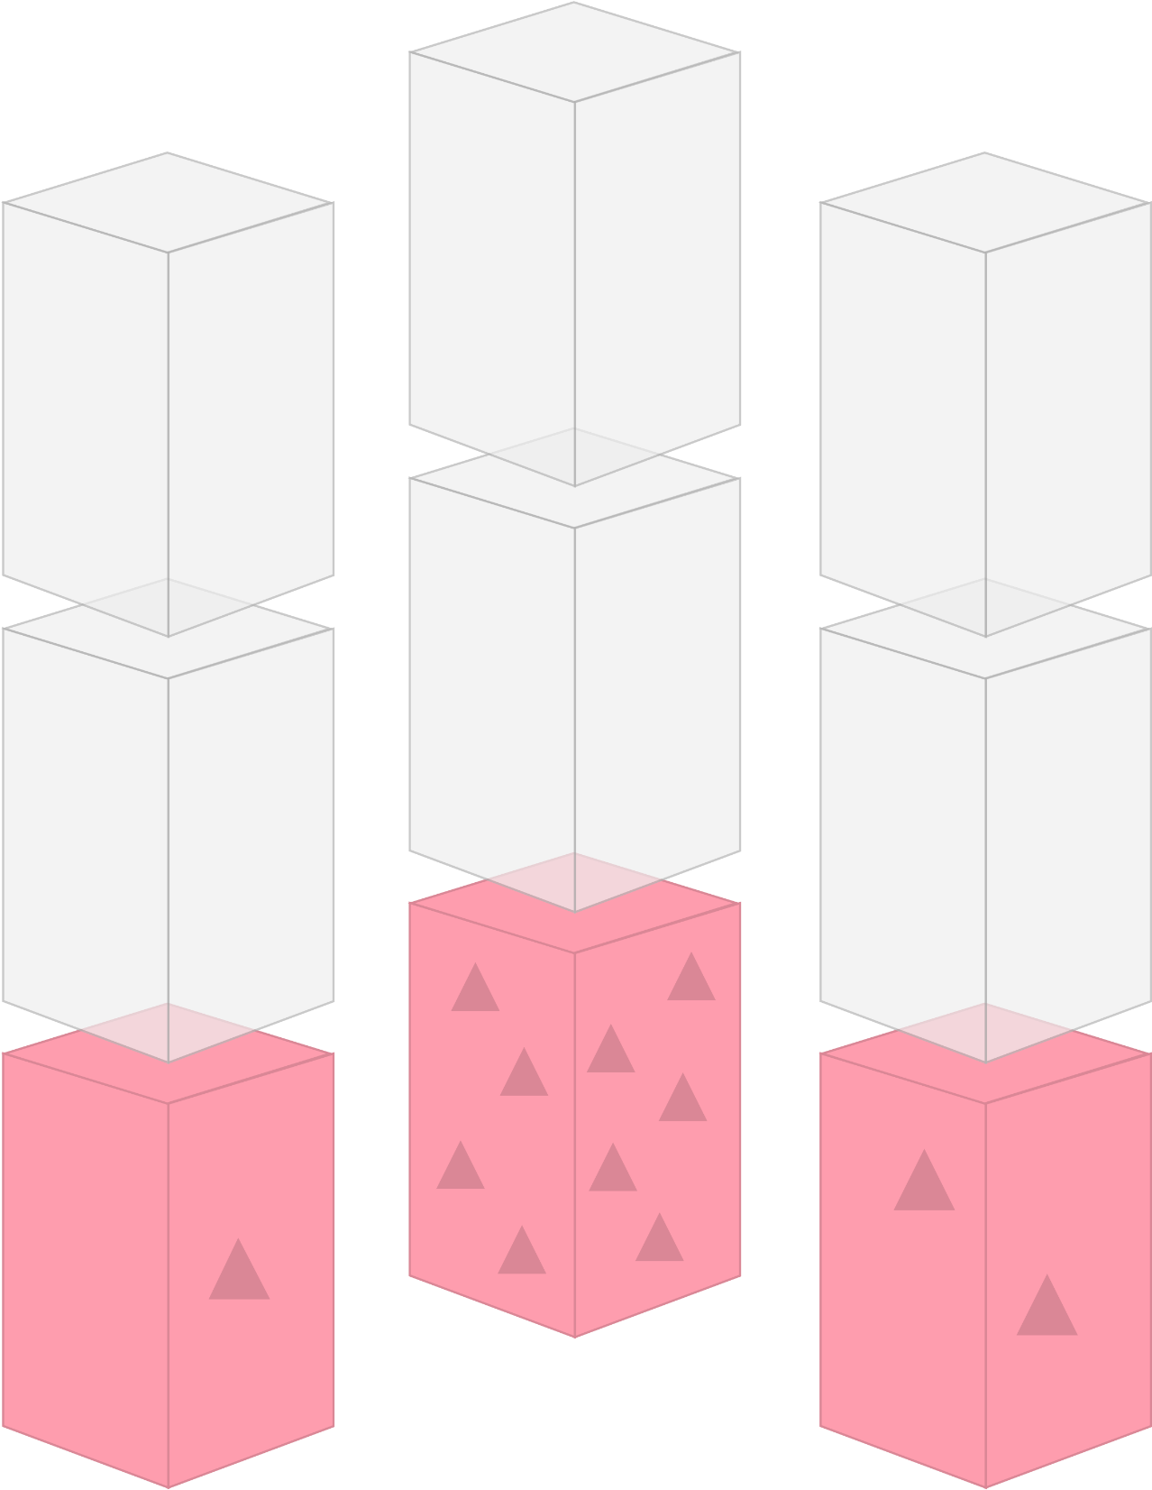
These redundancies are tolerable as long as the sovereignty of data by its owning system is not undermined.

Slide 20
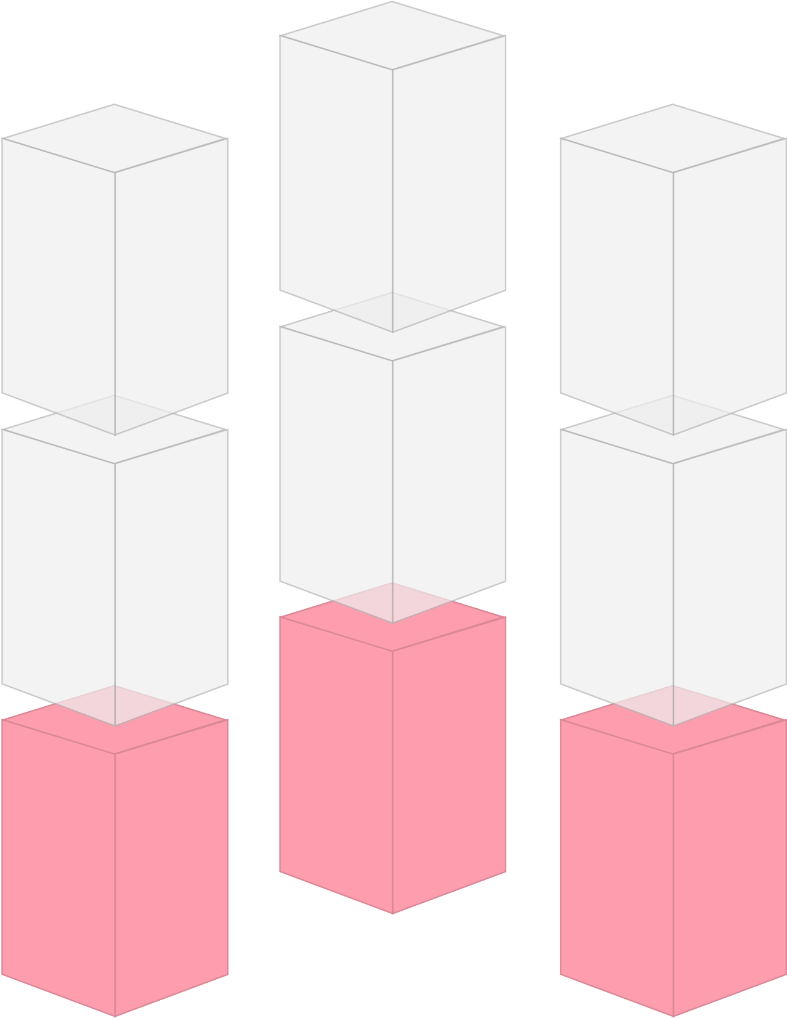
This enables polyglot persistence, which means a database can be chosen to solve a domain specific problem rather than to fulfill a technical urge.
CouchDB
Neo4J
Oracle

Slide 21
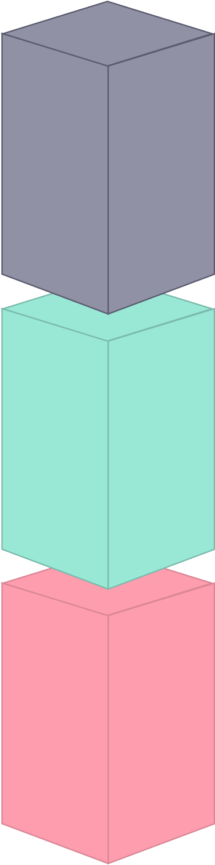
Inside of a self-contained system a bunch of technical decisions can be made independently from other systems, such as programming language, frameworks, tooling or workflow.

Slide 22
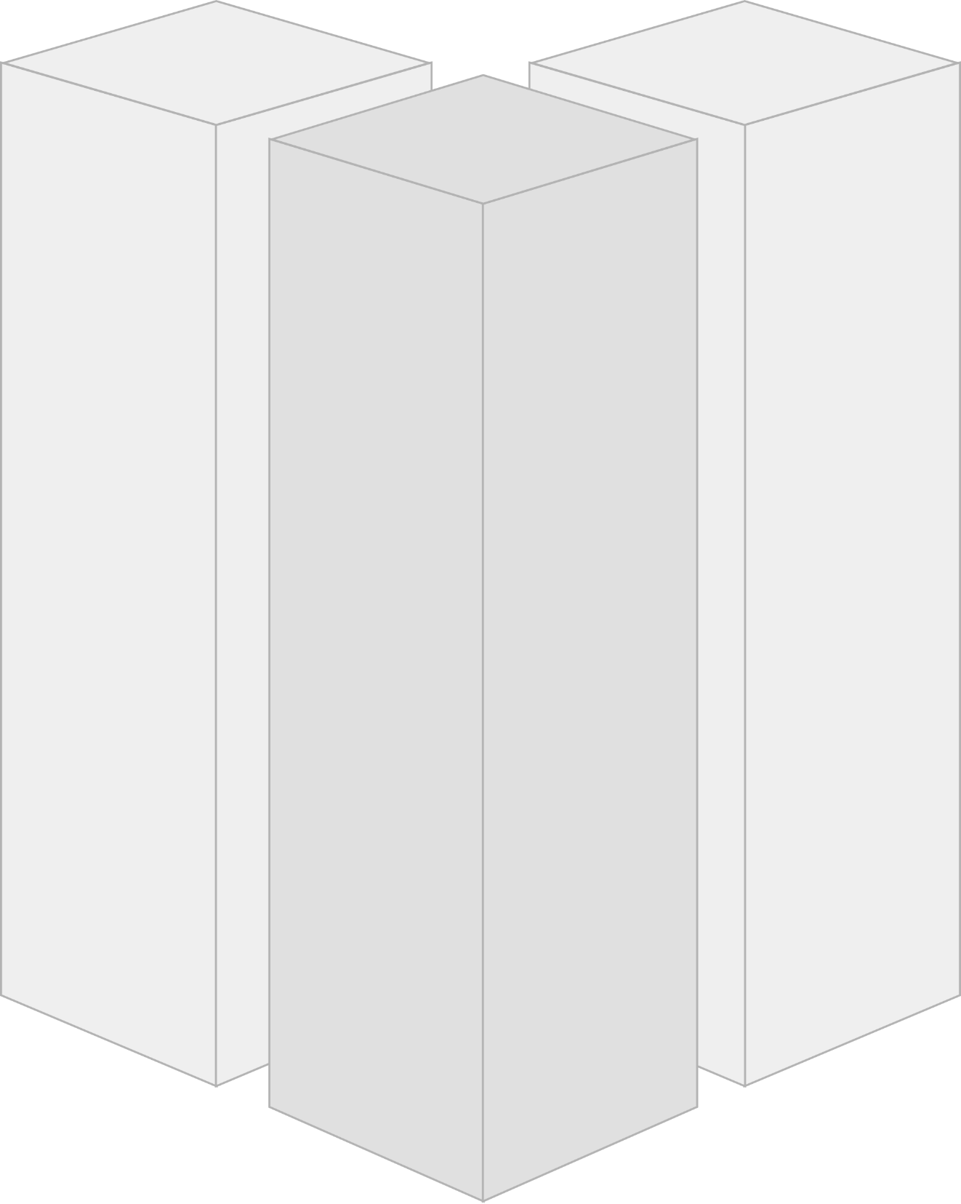
Team 2
Team 3
The manageable domain specific scope enables the development, operation and maintenance of an SCS by a single team.
Team 1

Slide 23
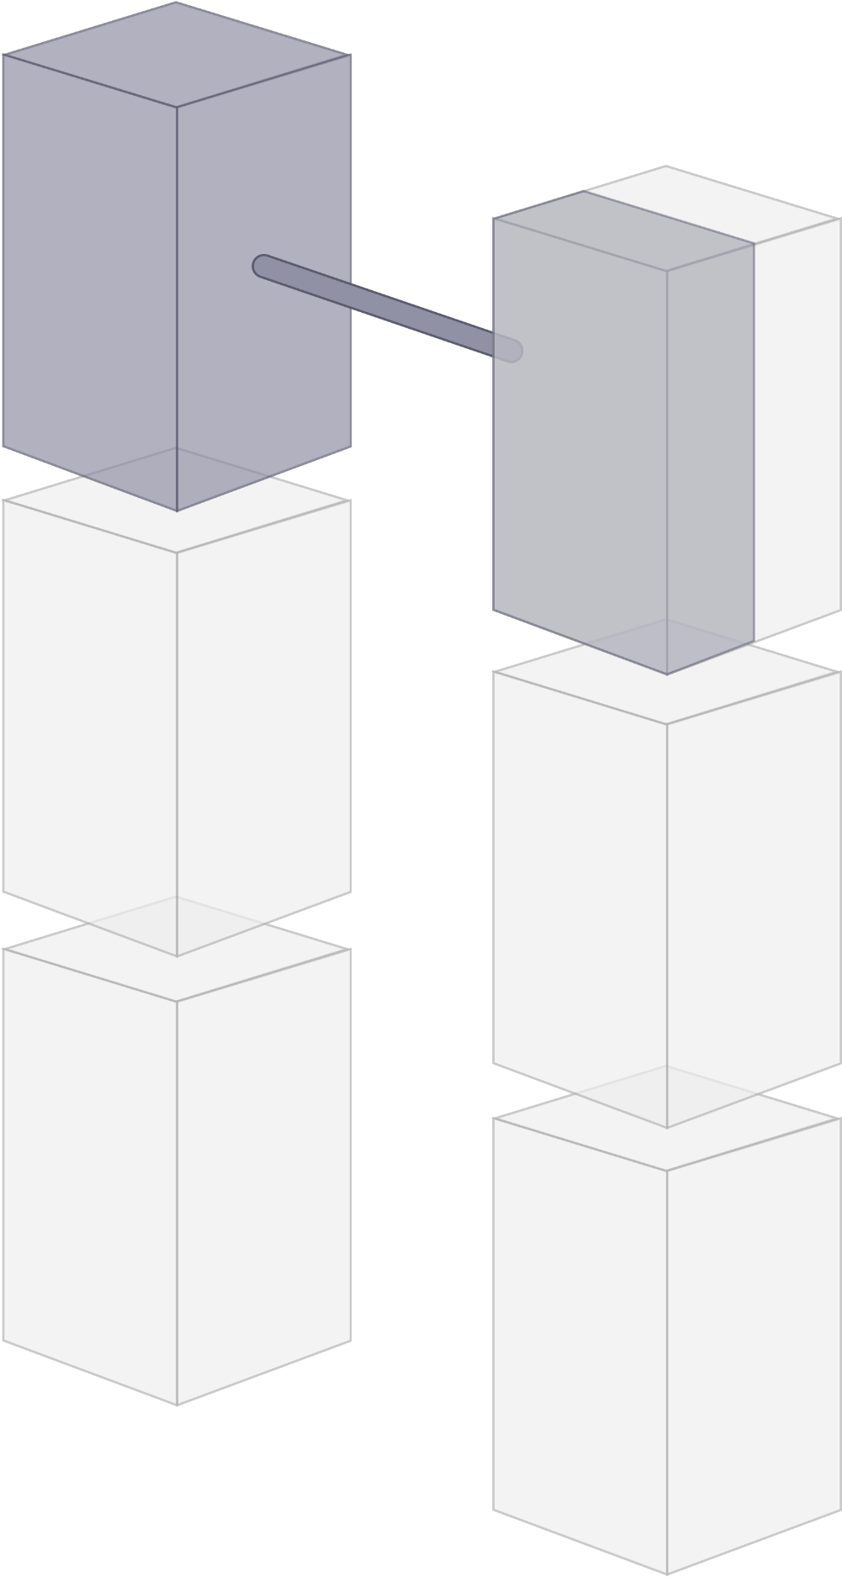
Self-contained Systems should be integrated over their web interfaces to minimize coupling to other systems.

Slide 24
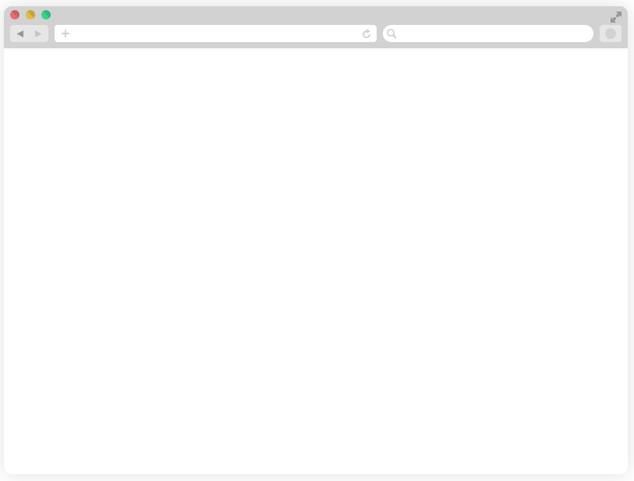
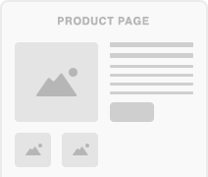
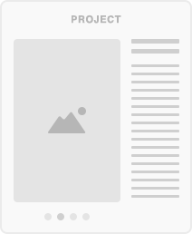
System 1
System 2
Therefore simple hyperlinks can be used to navigate between systems.

Slide 25

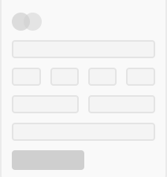
System 1
System 2
A redirection can be used to ensure navigation works in both directions.

Slide 26

System 1
System 2
Hyperlinks can also support the dynamic inclusion of content that is served by another application into the web interface of a self-contained system.

Slide 27
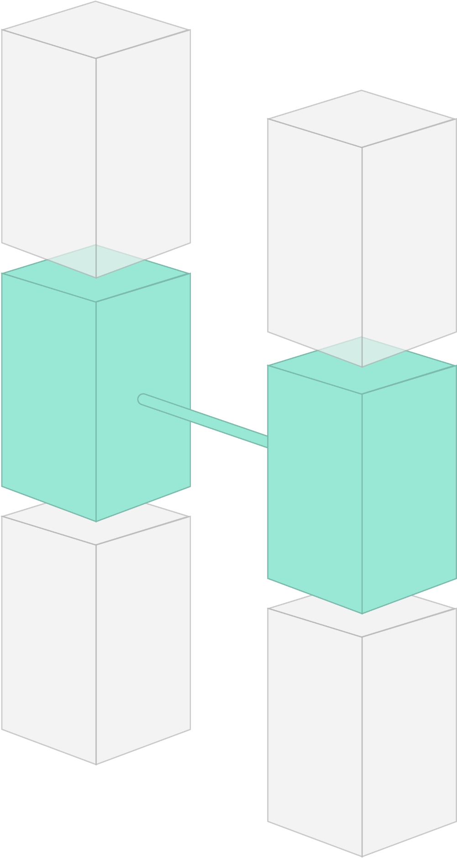
To further minimize coupling to other systems, synchronous remote calls inside the business logic should be avoided.

Slide 28
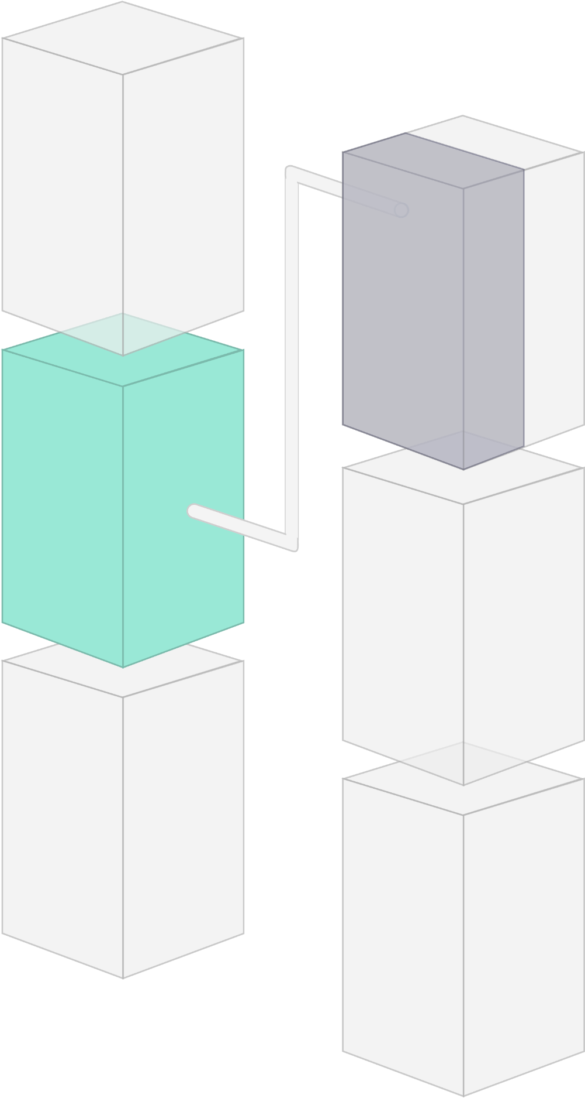
Instead remote API calls should be handled asynchronously to reduce dependencies and prevent error cascades.

Slide 29
This implies that – depending on the desired rate of updates – the data model’s consistency guarantees are relaxed.

Slide 30
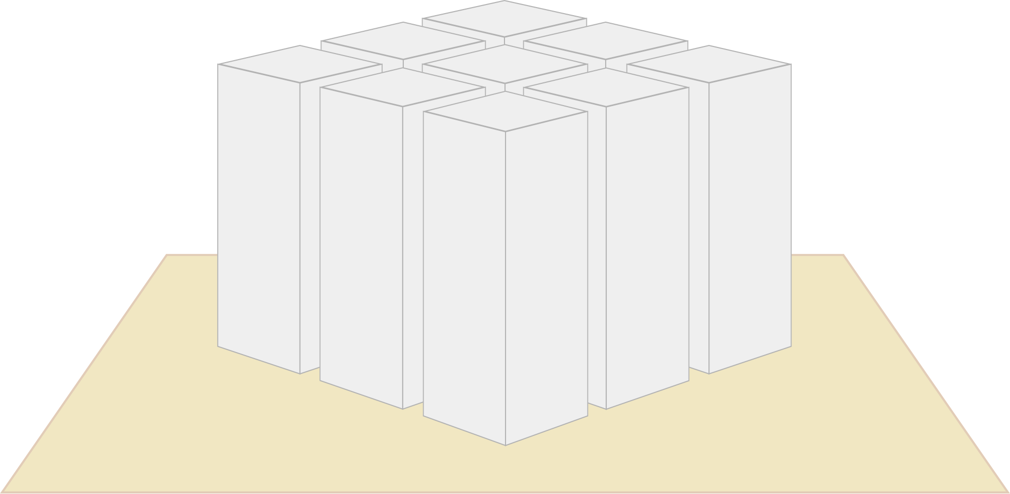
An integrated system of systems like this has many benefits.

Slide 31
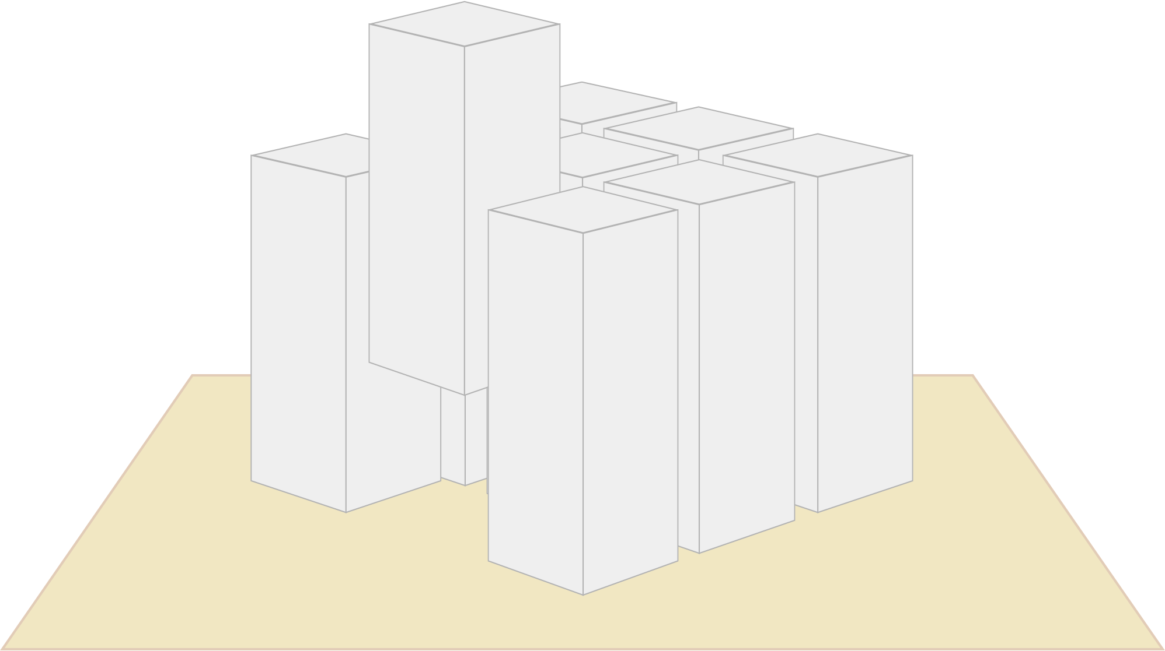
Overall resilience is improved through loosely coupled, replaceable systems.

Slide 32
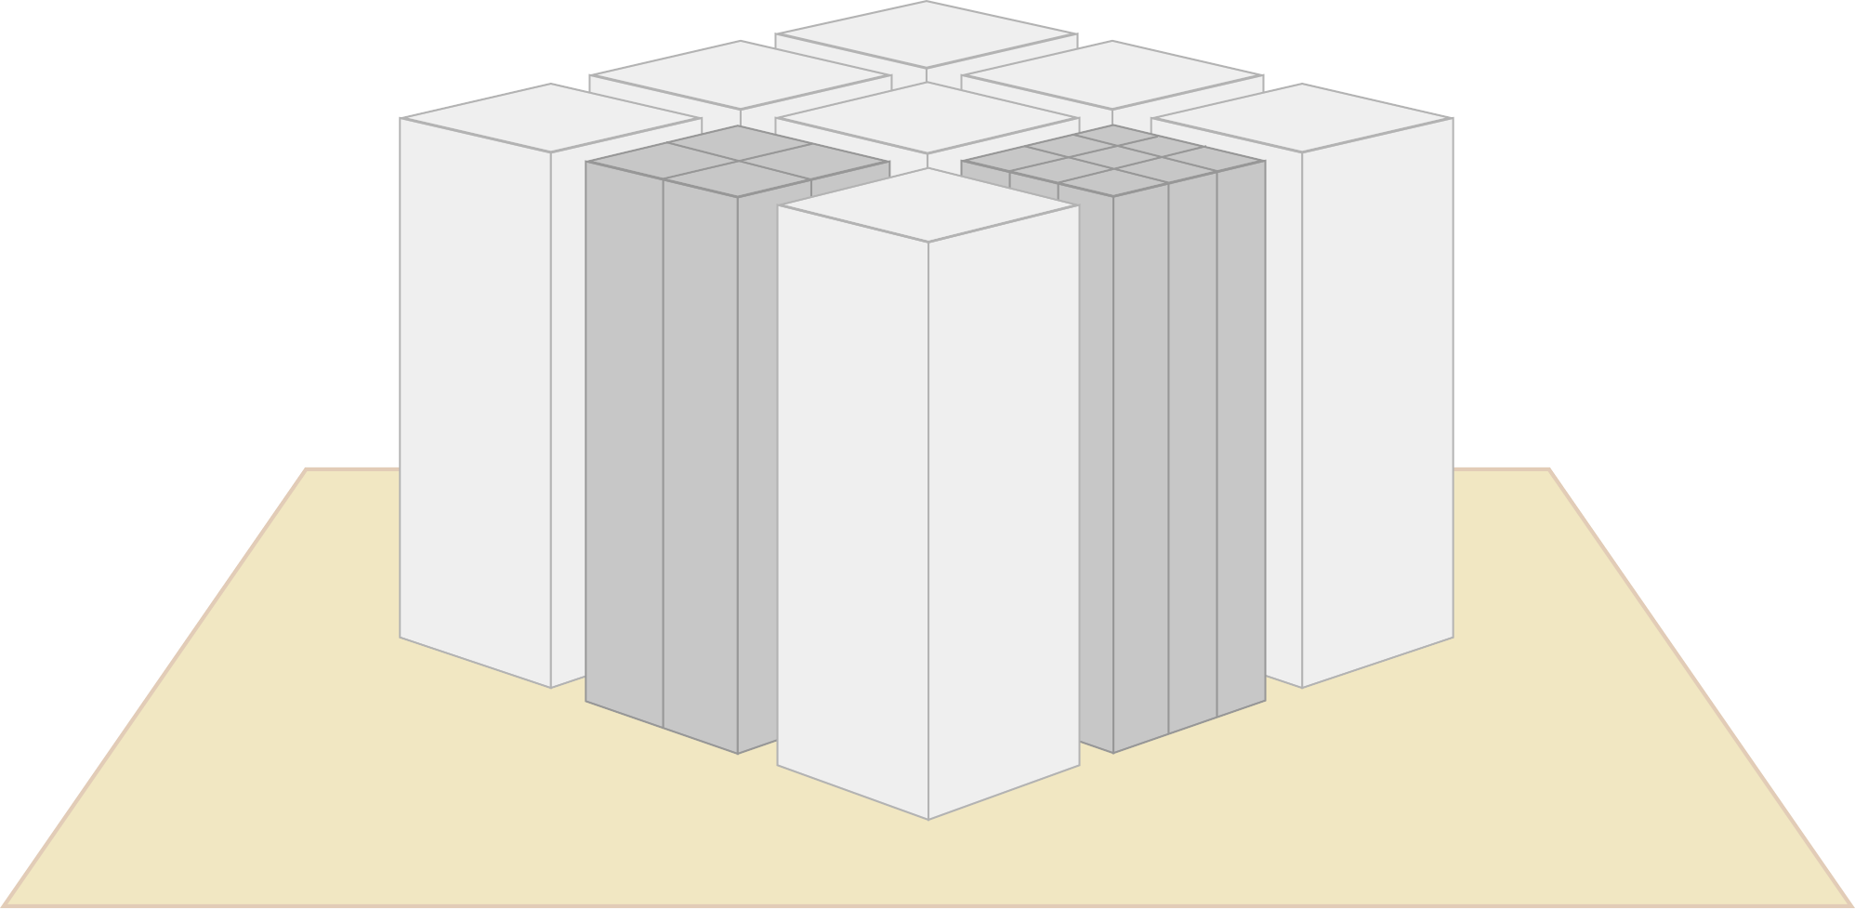
Some systems can be individually scaled to serve varying demands.

Slide 33
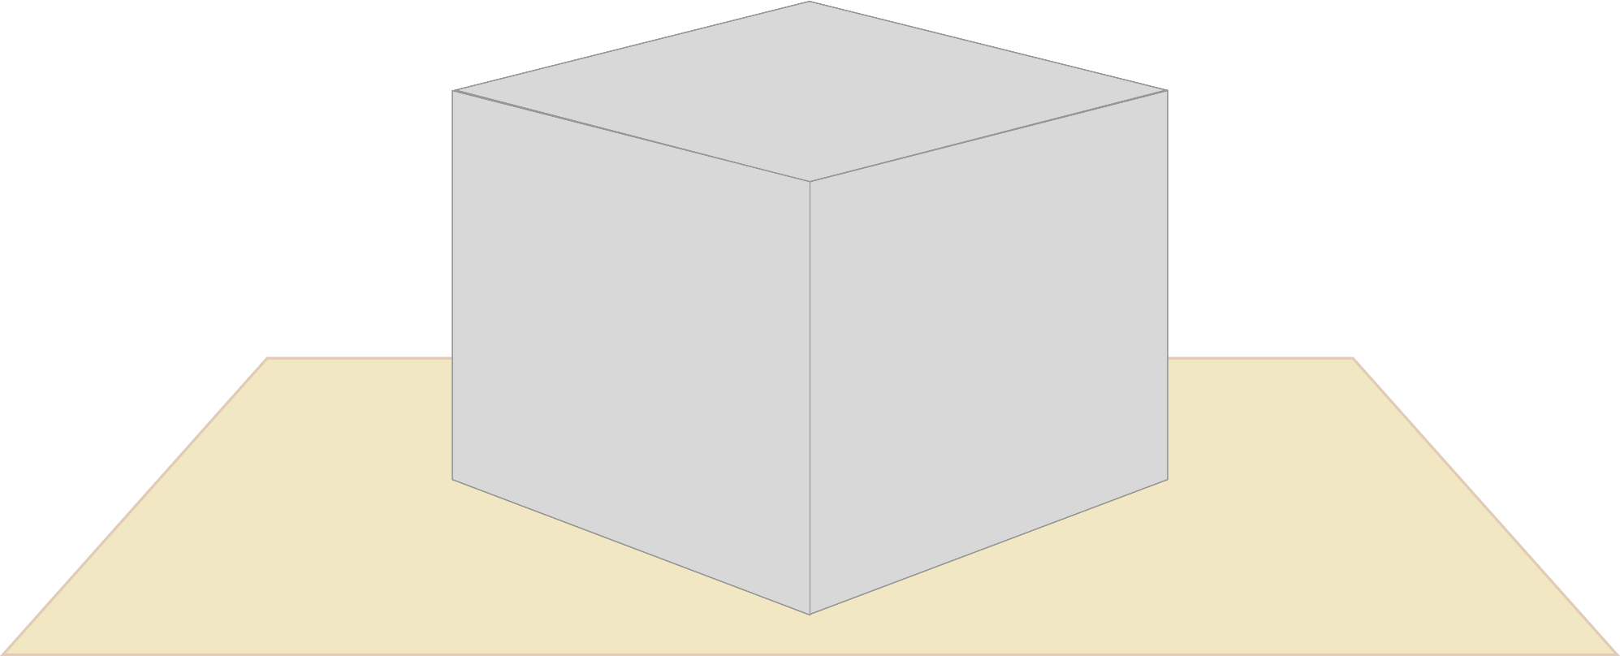
Version 1
It is not necessary to perform a risky big bang release to migrate an outdated, monolithic system into a system of systems.

Slide 34
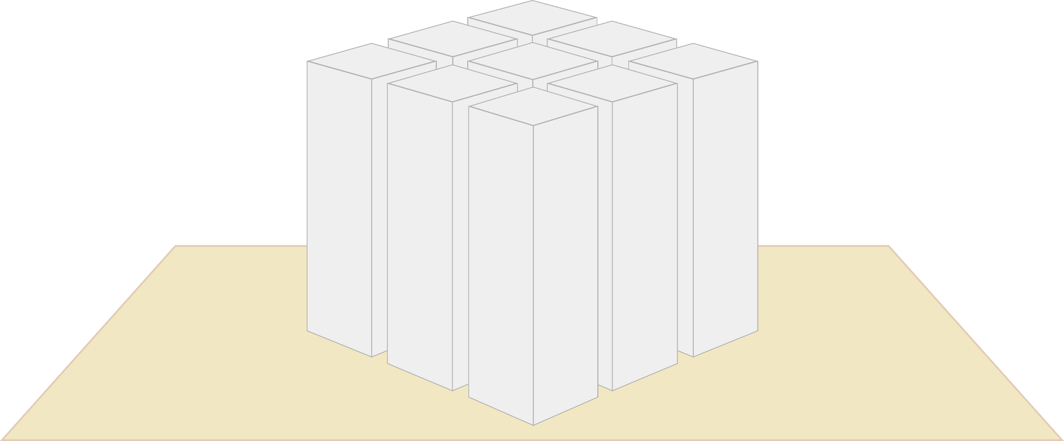
Version 2
It is not necessary to perform a risky big bang release to migrate an outdated, monolithic system into a system of systems.

Slide 35
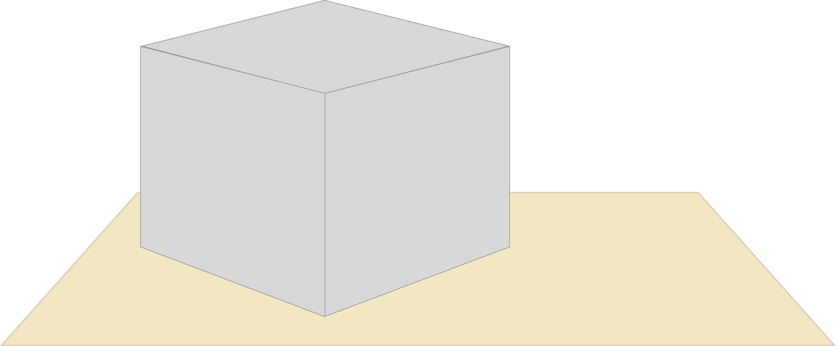
Instead a migration can happen in small, manageable steps which minimize the risk of failure and lead to an evolutionary modernization of big and complex systems.

Slide 36
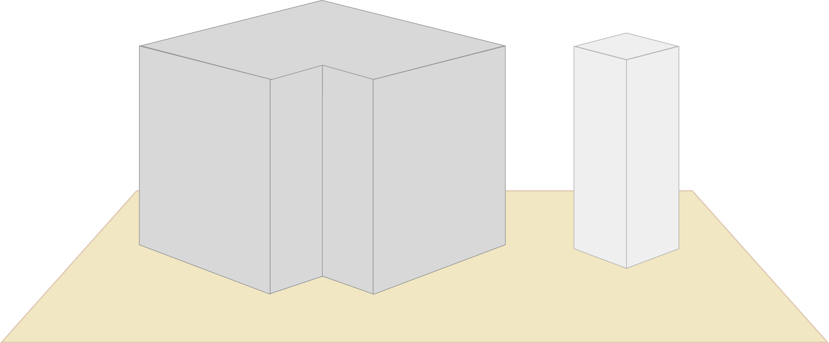
Instead a migration can happen in small, manageable steps which minimize the risk of failure and lead to an evolutionary modernization of big and complex systems.

Slide 37
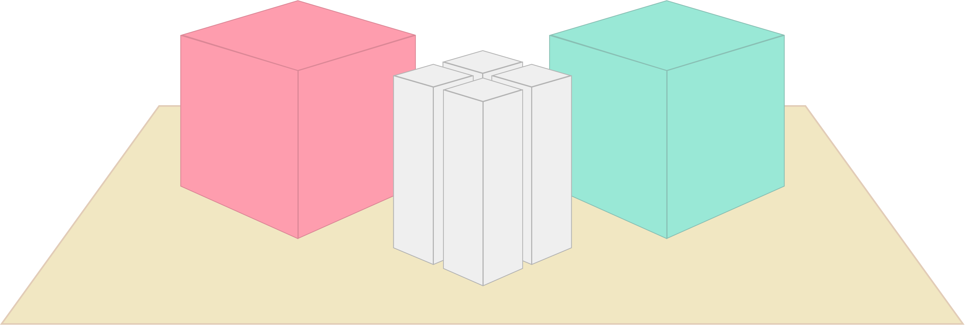
In reality a system of systems consists of individually developed software and standard products.

Slide 38
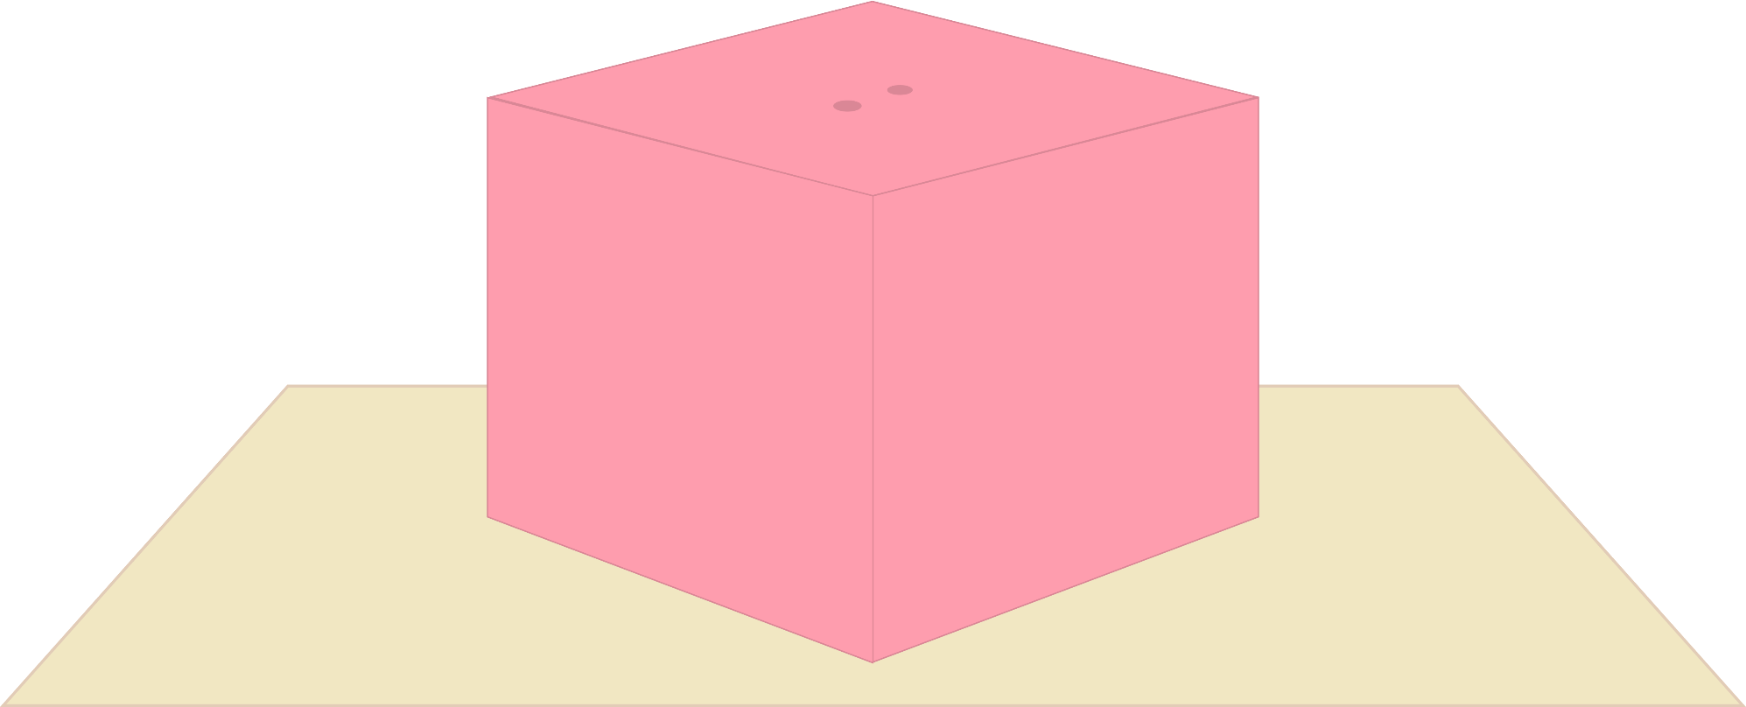
A product that fits well in a system of systems can be chosen by the following aspects: It has to solve a defined set of tasks and provide the same integration mechanisms that a self-contained system offers.

Slide 39
This ensures that products can be replaced safely by other products once their lifetime has ended.

Slide 40
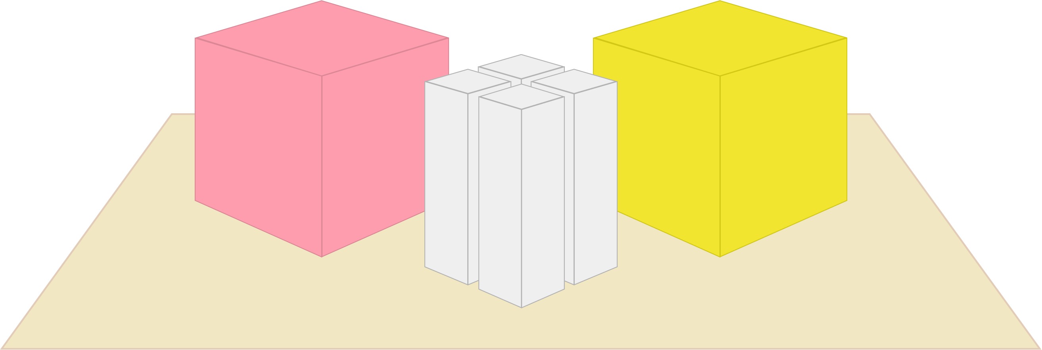
This ensures that products can be replaced safely by other products once their lifetime has ended.

Slide 41
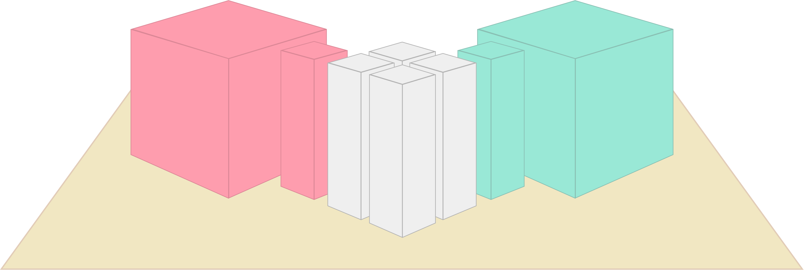
If a product with such integration mechanisms can not be found, it should at least be possible to extend that product with uniform interfaces that integrate well with the rest of the system.

Slide 42
You can find more interesting content about self-contained systems, microservices, monoliths, REST or ROCA at https://www.innoq.com
If you have questions or feedback please do not hesitate to contact us info@innoq.com

