Slide 1
Mirnov coils signal correction
André Torres
08/18
https://github.com/andregtorres/ISTTOK

Slide 2
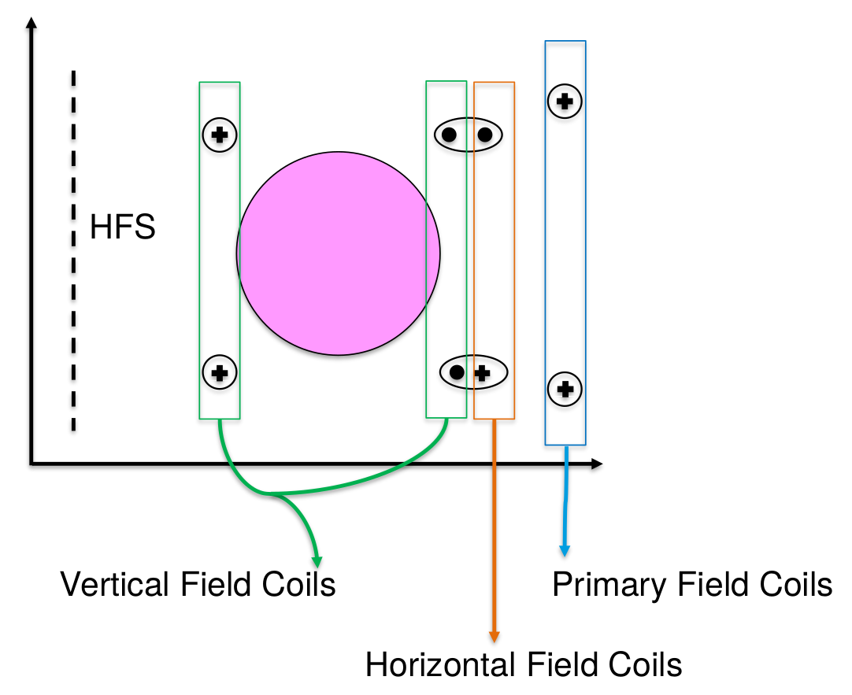
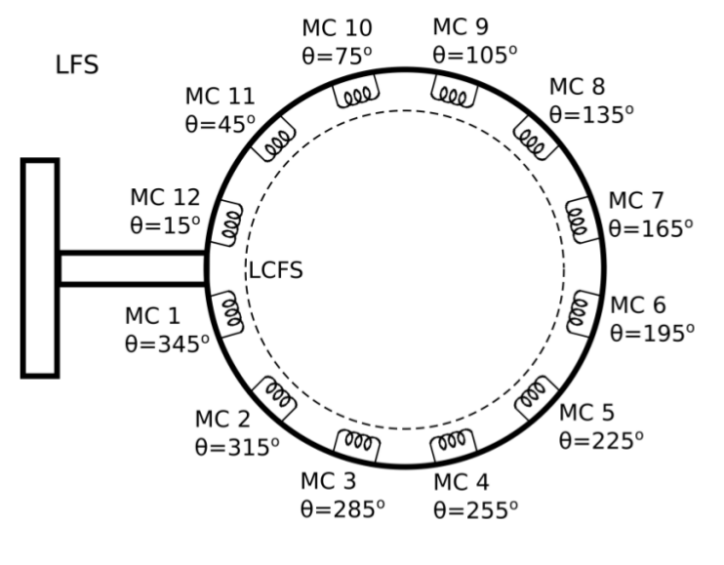

Slide 3
Coper shell filter
‘Informatic shots’ with a Heaviside waveform on the PF coils (Vertical, Horizontal and Primary)
First order filter assumed
Exponential fitted to get time constant and gain
A on the PF coils→ V.s on the Mirnovs

Slide 4
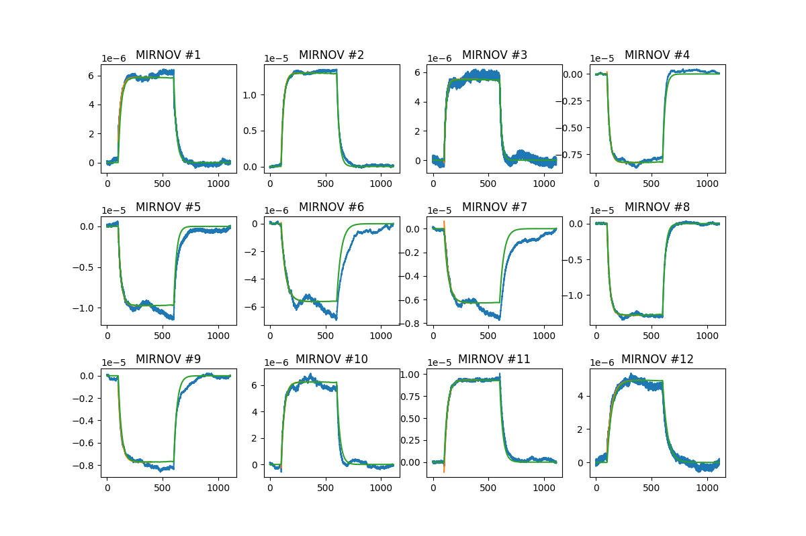
Vertical coils

Slide 5
Vertical coils
Fit from 100 to 400 ms
mirnov | angle | Tau (ms) | R² | Gain (Vs/A)
1 | 345 | 25,01 | 9,76E-01 | 1,73E-08
2 | 315 | 22,47 | 9,94E-01 | 3,83E-08
3 | 285 | 17,25 | 9,19E-01 | 1,62E-08
4 | 255 | 22,47 | 9,78E-01 | -2,44E-08
5 | 225 | 24,58 | 9,76E-01 | -2,88E-08
6 | 195 | 39,23 | 9,50E-01 | -1,67E-08
7 | 165 | 36,56 | 9,77E-01 | -1,86E-08
8 | 135 | 23,12 | 9,87E-01 | -3,78E-08
9 | 105 | 29,06 | 9,77E-01 | -2,28E-08
10 | 75 | 27,77 | 9,56E-01 | 1,84E-08
11 | 45 | 28,29 | 9,97E-01 | 2,75E-08
12 | 15 | 42,78 | 9,79E-01 | 1,45E-08

Slide 6
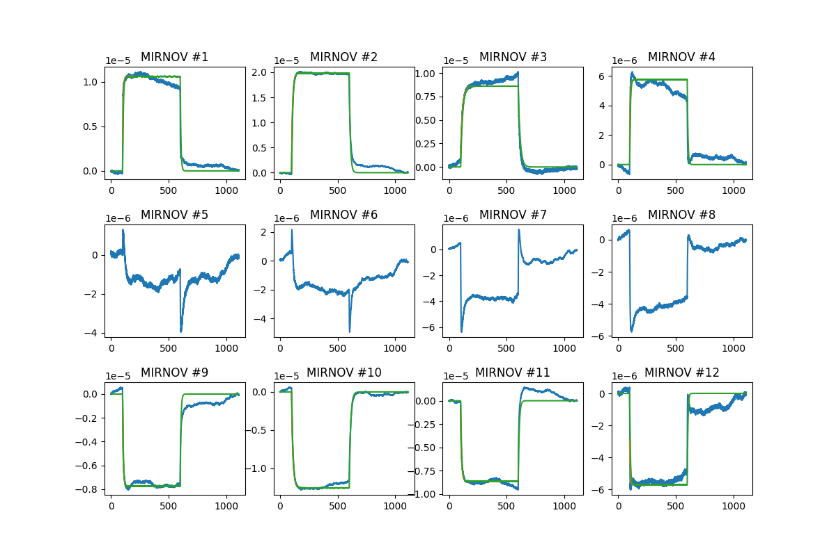
Horizontal coils

Slide 7
Horizontal coils
Fit from 100 to 200 ms
mirnov | angle | Tau (ms) | R² | Gain (Vs/A)
1 | 345 | 5,88 | 8,86E-01 | 4,04E-08
2 | 315 | 9,35 | 9,95E-01 | 7,54E-08
3 | 285 | 16,48 | 9,97E-01 | 3,28E-08
4 | 255 | 5,77 | 7,40E-01 | 2,19E-08
5 | 225
6 | 195
7 | 165
8 | 135
9 | 105 | 5,98 | 9,71E-01 | -2,95E-08
10 | 75 | 11,86 | 9,96E-01 | -4,78E-08
11 | 45 | 8,59 | 9,84E-01 | -3,29E-08
12 | 15 | 5,49 | 5,65E-01 | -2,17E-08

Slide 8
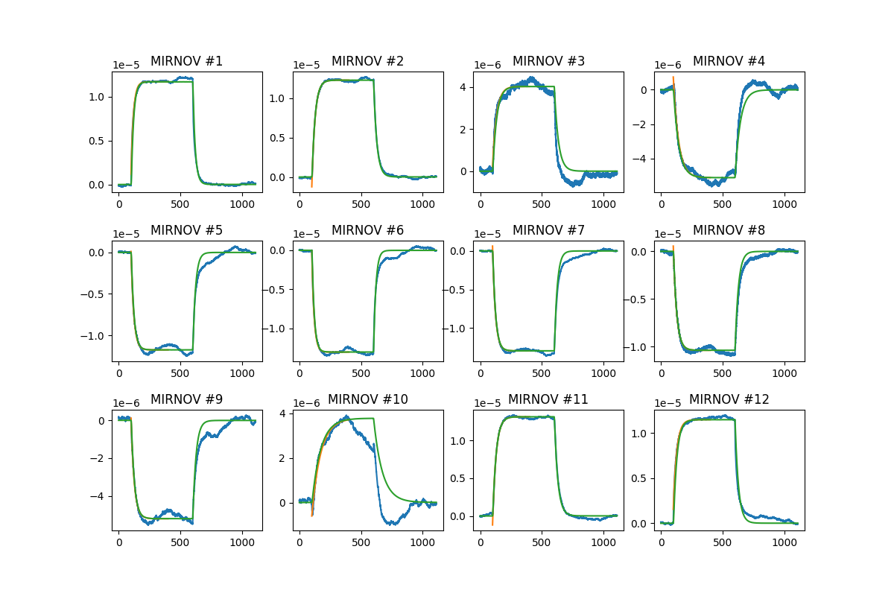
Primary

Slide 9
Primary
Fit from 100 to 400 ms
mirnov | angle | Tau (ms) | R² | Gain (Vs/A)
1 | 345 | 19,15 | 9,89E-01 | 7,44E-08
2 | 315 | 26,06 | 9,98E-01 | 7,81E-08
3 | 285 | 32,57 | 9,39E-01 | 2,56E-08
4 | 255 | 43,08 | 9,79E-01 | -3,25E-08
5 | 225 | 22,01 | 9,75E-01 | -7,46E-08
6 | 195 | 18,53 | 9,83E-01 | -8,26E-08
7 | 165 | 23,15 | 9,93E-01 | -8,22E-08
8 | 135 | 26,90 | 9,88E-01 | -6,61E-08
9 | 105 | 25,71 | 9,59E-01 | -3,31E-08
10 | 75 | 70,88 | 9,82E-01 | 2,40E-08
11 | 45 | 28,16 | 9,97E-01 | 8,36E-08
12 | 15 | 27,57 | 9,89E-01 | 7,28E-08

