Slide 1
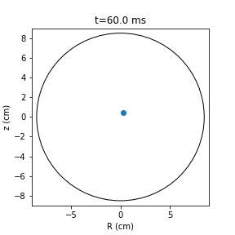
André Torres
APPLAuSE C5
MT2 – Plasma Diagnostics
Plasma shape reconstruction and position control using the magnetic diagnostic at ISTTOK
Notes:
I’ll talk about a particular part of the magnetics diagnostic, two of the most important usages: plasma shape reconstruction and position control
I will explain one dificult aspect of data analysis with this aparently simple diagnostic and I will do so focussed on the ISTTOK
This animation is very easy to make, one only needs to project the mirnov signals on its vertical and horizontal components and we suposedly have the curent centroid of the plasma
Unfortunatly this in not correct and I will explain why.
Without further adue, the magnetic diagnostic

Slide 2
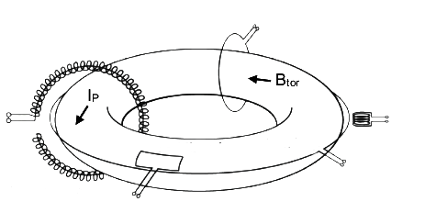
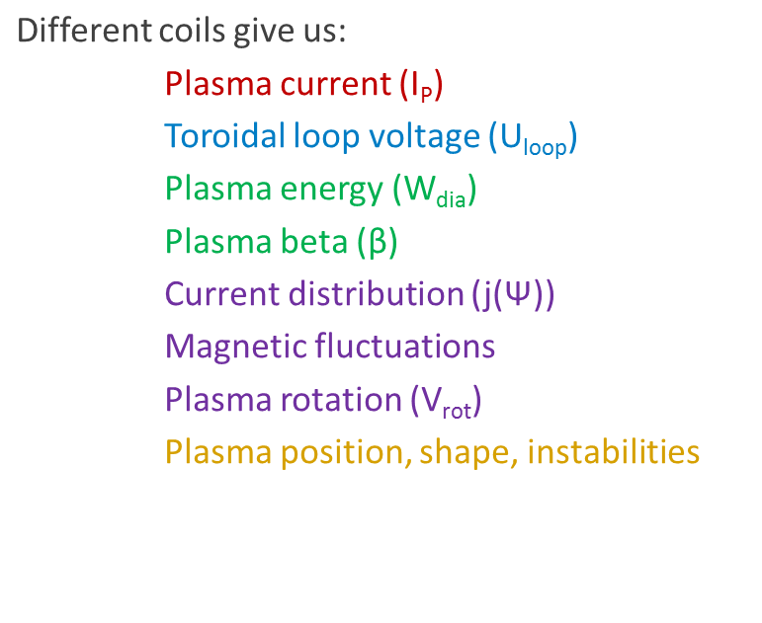
Magnetic Diagnostic
Diamagnetic loop
Rogowski coil
Probes
Saddle loop
Flux loop
G. Papp – Fusion Research Lecture notes (adapted)
Measure total flux through the enclosed
surface
Notes:
We’ve all seen simmilar slides to this, the basic physical fenomena behind the magnetic diagnostic is simple – there is induction on a probe coil and we get a setigal proportional to the total flux rate of change.
To recover the flux, and the magnetic fields, we integrate the signal, which is done in real time (electronically or digialy) in the data aquisition systems.
It is a robust and passive diagnostic that, depending on the type of coils used can recover several parameters. And is subject to constant diagnostic tecniques improvements even though it is used since the first tokamaks
Plasma rotation - homework

Slide 3
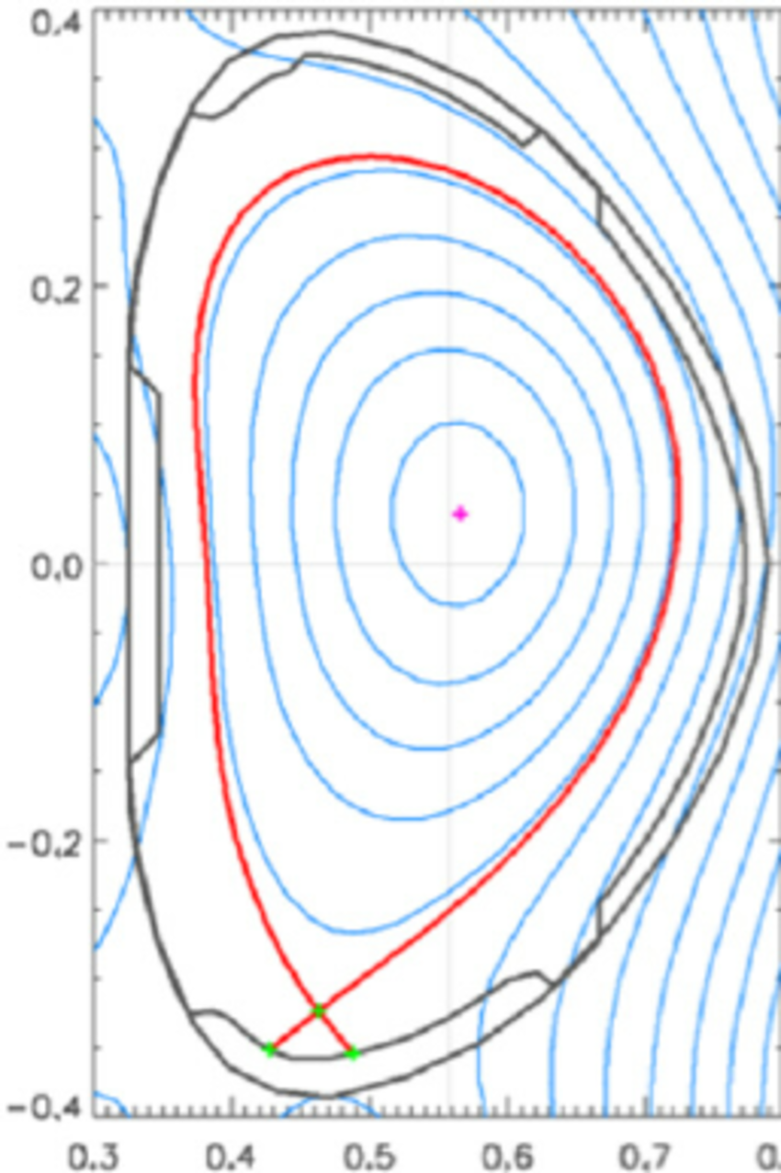
Plasma Shape Reconstruction
Grad-Shafranov Equation
MHD equilibrium code
EFIT (1985)
EFIT++
NICE
rtEFIT
XLOC
(others)
Magnetic coils
Flux loops
Motional Stark Efect sensor
Saddle loops
Active coil curents
EFIT++ reconstruction in COMPASS (R. Panek, 2016)
Notes:
On of the techiques that is most widely used is the employment of plasma shape reconstruction.
The plasma shape (magnetic flux surfaces) are given by the Grad-Shafranov equation and using different approximations or numerical techniques we optimize this equation for the magnetic diagnostic data or do the oposite and plan the device or the campain to produce plasmas of a certain shape
So we feed data from the magnetic diagnostic and the current on the actve coils (the ones that generate the confinement fields) to MHD equilibrium codes
EFIT is the most known and we obtain information about the plasma shape and other parameters.
These are post processing codes and these two are optimized for real-time applications

Slide 4
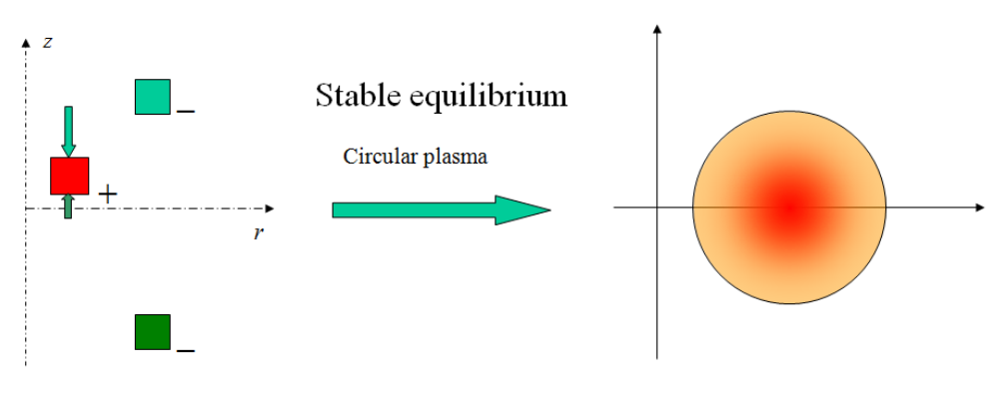
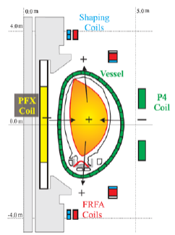
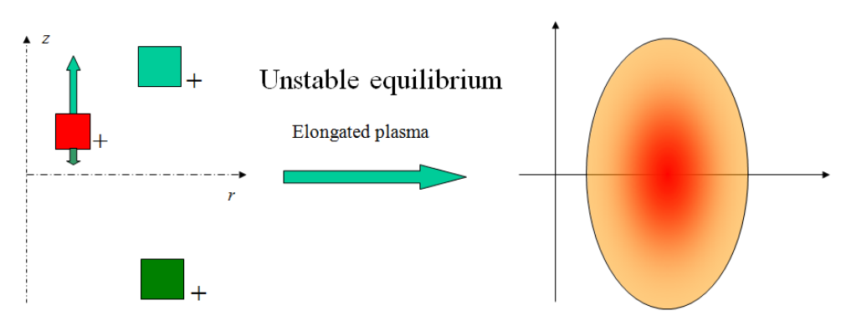
Plasma Position Control
Elongated plasmas in D shaped tokamaks are vertically unstable!
Vertical stabilization (VS) coils required, in addition to the shaping coils
T. Bellizio – PF coils in JET
G. De Tommasi - Plasma current, position and shape control in tokamaks - Part 1
Notes:
Elongation allows reaching higher beta (plasma pressure over magnetic pressure) and therefore are the strategy to all medium sized machines nowadays. There are even spherical tokamaks that create very elengated plasmas.
Magnetostatic analysis
In JET a coil system to create the ellongation and another to supress the instability with active control.

Slide 5
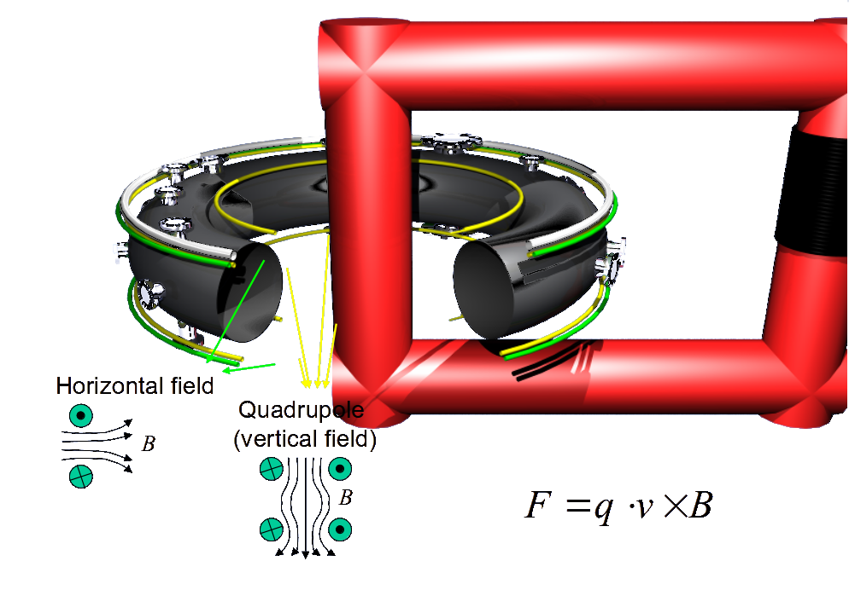
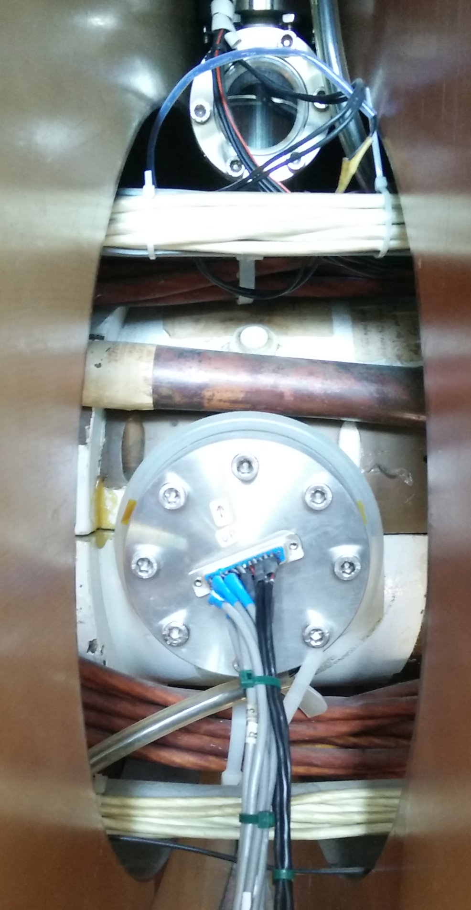
At ISTTOK
The copper shell provides passive instability control by increasing the growth rate of plasma instabilities to the millisecond scale.
H. Fernandes – ISTTOK Machine Description
Primary coils
Notes:
Another way of controling the plasma instabilities is with metalic structures surrounding the plasma.
There is always a trade-off, but by in therory if we solw the instability so much, we cont even need to control it.
ISTTOK has a copper shel that does exactly this, increasing the growth rate of the instabilities to the pulse (cycle) length scale.
This picture shows the 3 sets of Poloidal Field coils or PF
And here there is an image where we can se the copper shell the horizontal Field coils and the primary winding, which is in LFS in ISTTOK
Mirnov port

Slide 6
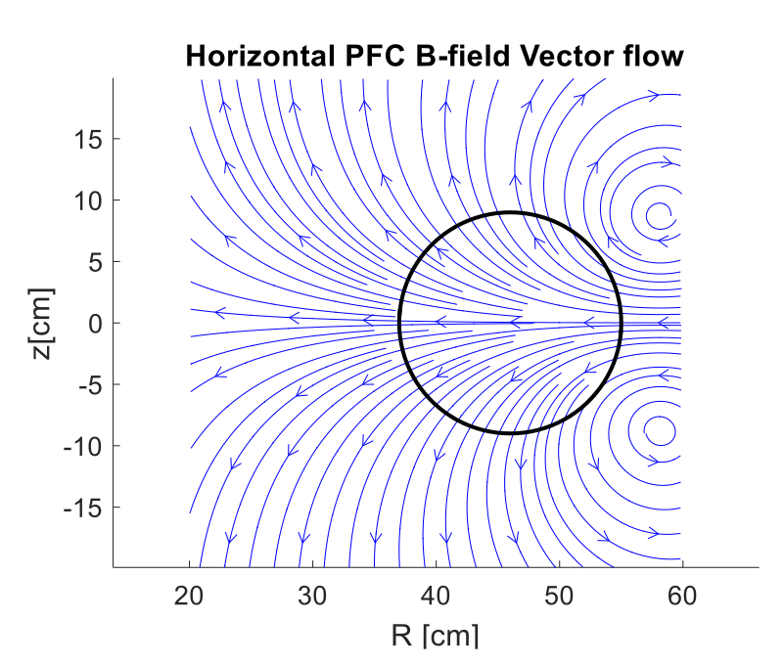
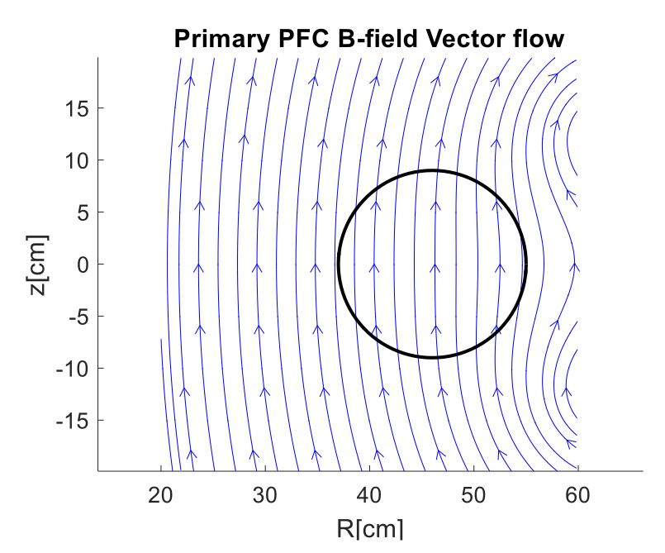
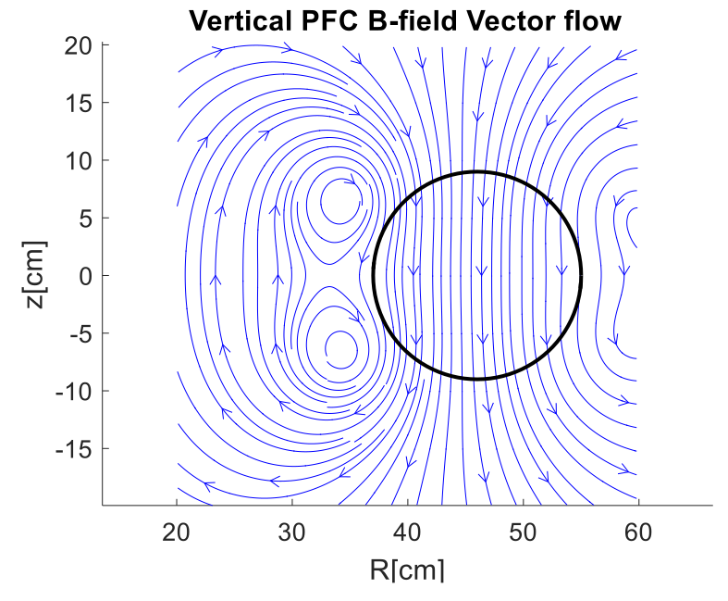
PF Coils Signal
We intend to measure the plasma but we also pick up signal from the PF coils that generate and position the plasma
D. Corona
Remove PF coils field in the magnetic signals
Notes:
These coils generate these field distribuitions.
Or at least they should, since these are simulations done with biot-savart law and not real measured date.
Any deviation of the coils from their theoretical positions will chage the field distribuition. This is usually treated considering an error field and is predictable.
During a plasma pulse, these currents are there, are changing and are picked up by the magneticc sensors

Slide 7
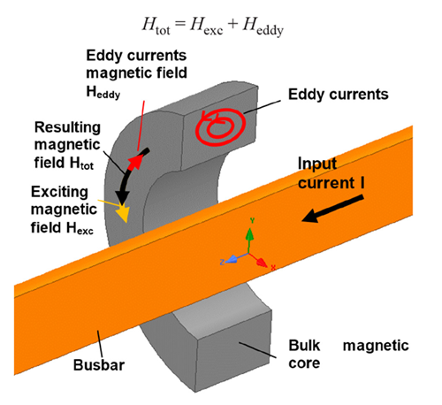
Eddie Currents
The magnetic field generated by the PF coils and the plasma will generate Eddy currents on the passive structures
This is specially relevant for small machines
Strong dependence on the passive structures geometry (i. e. access ports)
Generates error fields on the magnetic probes!
Allegro MicroSystems
Notes:
Now, combining the two previous slides, we have a spatial distribuition of the field generated by the active coils and plasma and a big metalic component surrounding the vessel.
This will generate eddy currents that in turn generate more magnetic fields.
These currents depend a lot on the material shape and imperfections (ports), making them expected but difficult to analyse with rigor.
These of corse are more relevant for small machines, where there is more metal to plasma.
For ITER - Ferromagnetic elements of the bioshield and tokamak complex (rebar in concrete)

Slide 8
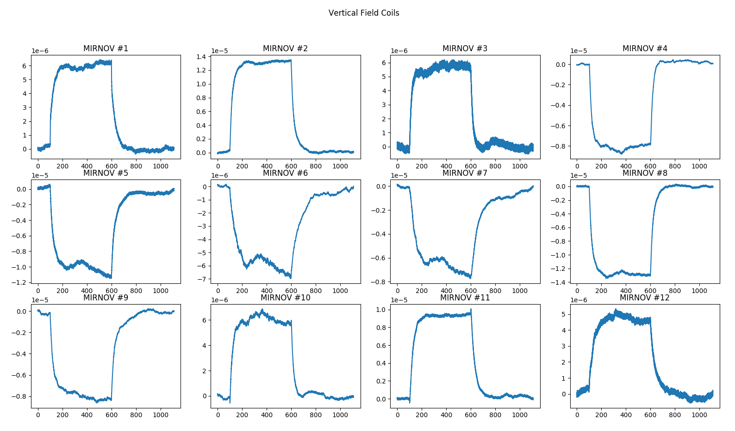
Plasmaless Pulse – Error Field
Notes:
What do the mirnov coils measure without plasma?
Vertical PF
Integrated data

Slide 9
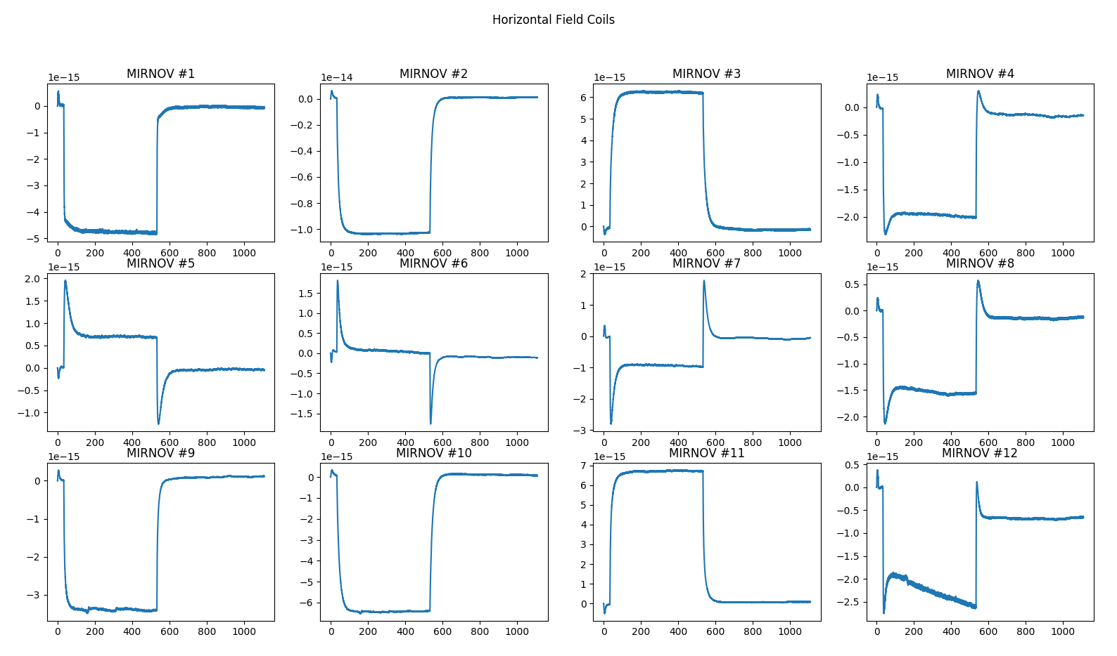
Plasmaless Pulse – Error Field
Mirnov 6
Notes:
Horizontal
Call attention to the mirnov 6

Slide 10
Possible Solutions - I
Modeling a low pass filter using the integrated Mirnov signal
1. Model a low pass filter for the current in the the effect of each PF coil on each probe
2. Apply the filter in state-space and remove the contribution of the error field in real-time
3a. Compute plasma centroid position
3b. Close the control feedback loop
New digital integrators
Improved signal conditioning
New Multiple Input Multiple Output (MIMO) controler
Notes:
What can we do about it.
Currently the ISTTOK has active control using the electric probes
New state of the art integrators
Domenica

Slide 11
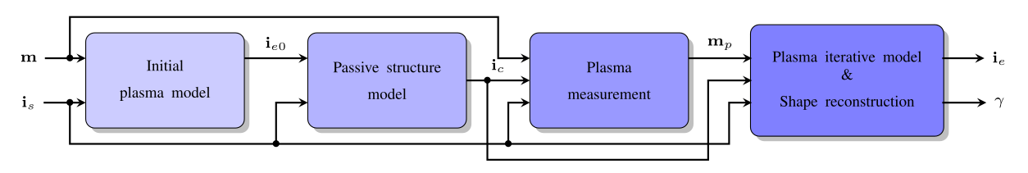
Possible Solutions - II
Modeling the eddy currents on the passive stuctures
Finding an optimized location of discrete current filaments that would fit the magnetic data
1. Filamentary model of the plasma
2. Computation of a filamentary model of the currents on the passive structures
3. Correction of the error field on the magnetic measurements
4. Reconstruction/contol algorithms
- magnetic measurements
- active coil currents
- eddy currents
- plasma model
- shape parameters
A. Cenedese, et al. - Model-Based Approach for Magnetic Reconstruction in Axisymmetric Nuclear Fusion Machines (2018)
Notes:
Another strategy is to employ a filamentary model for the plasma to get an optimazed discrete distribuiton of filaments of curent in the passive structures to correct the magnetic data

Slide 12
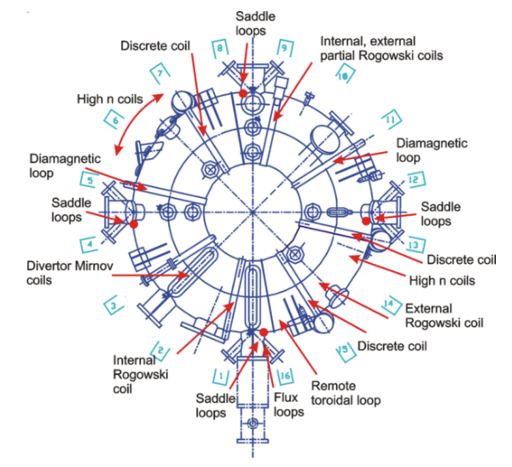
Possible Solutions - III
More coils, more data
Reconstruction codes used in medium and large machines rely on a large ammount of magnetic probes, flux and saddle loops.
ISTTOK has the increased difficulty of a large and highly asymmetrical passive conductive structure, yet only has one flux loop and an array of 12 Mirnov probes.
External vertical flux loop on HFS and LFS is under assessment In order to feed data to NICE for reconstruction of LCFS
16
22x4
www.ipp.cas.cz
8
Notes:
A third option is to get more data to feed the reconstruction codes. Larger machines deal with this problem by having more measusements
This is the a top view of the COMPASS showing the magnetic diagnostic.
The EFIT reconstruction previously shown for uses data from the coils highlited and in the saddle loops there are more coils dedicted to plasma position controll.

Slide 13
Thank you for the attention!

