Slide 1
André Torres
APPLAuSE C5
MT3&4 – LR1
Reconstruction of magnetic plasma boundary in tokamaks using low drift integrator measurements and steady state-space modelling on eddy currents in passive structures
Notes:
I’ll talk about a particular part of the magnetics diagnostic, two of the most important usages: plasma shape reconstruction and position control
I will explain one dificult aspect of data analysis with this aparently simple diagnostic and I will do so focussed on the ISTTOK
This animation is very easy to make, one only needs to project the mirnov signals on its vertical and horizontal components and we suposedly have the curent centroid of the plasma
Unfortunatly this in not correct and I will explain why.
Without further adue, the magnetic diagnostic

Slide 2
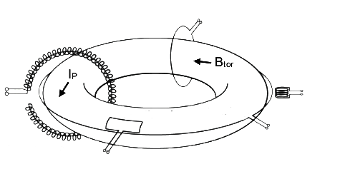
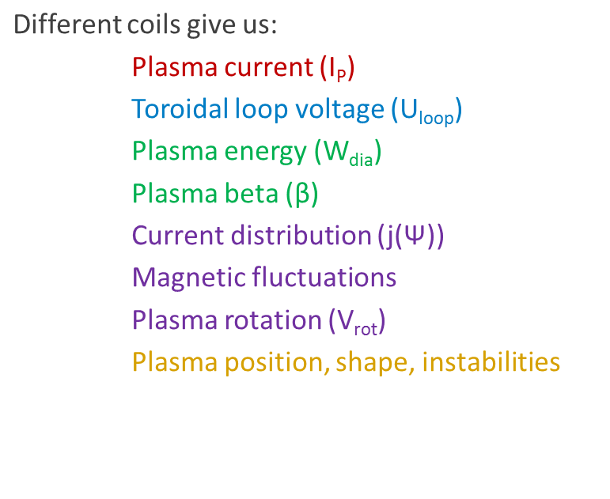
Magnetic diagnostic
Diamagnetic loop
Rogowski coil
Probes
Saddle loop
Flux loop
G. Papp – Fusion Research Lecture notes (adapted)
Measure total flux through the enclosed
surface
Notes:
We’ve all seen simmilar slides to this, the basic physical fenomena behind the magnetic diagnostic is simple – there is induction on a probe coil and we get a setigal proportional to the total flux rate of change.
To recover the flux, and the magnetic fields, we integrate the signal, which is done in real time (electronically or digialy) in the data aquisition systems.
It is a robust and passive diagnostic that, depending on the type of coils used can recover several parameters. And is subject to constant diagnostic tecniques improvements even though it is used since the first tokamaks
Plasma rotation - homework

Slide 3
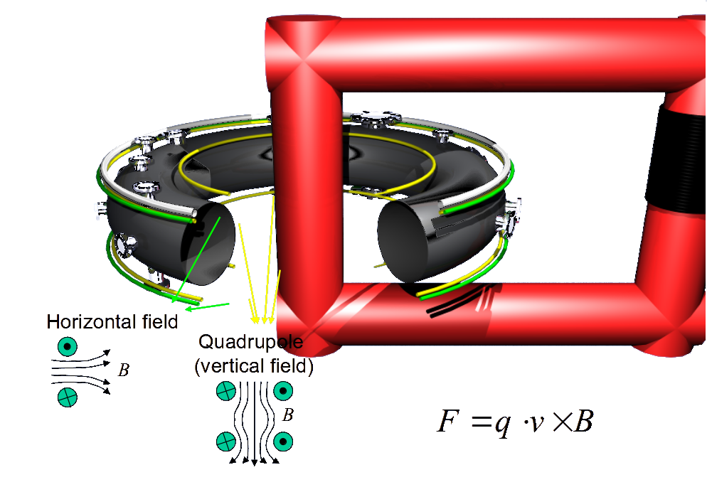
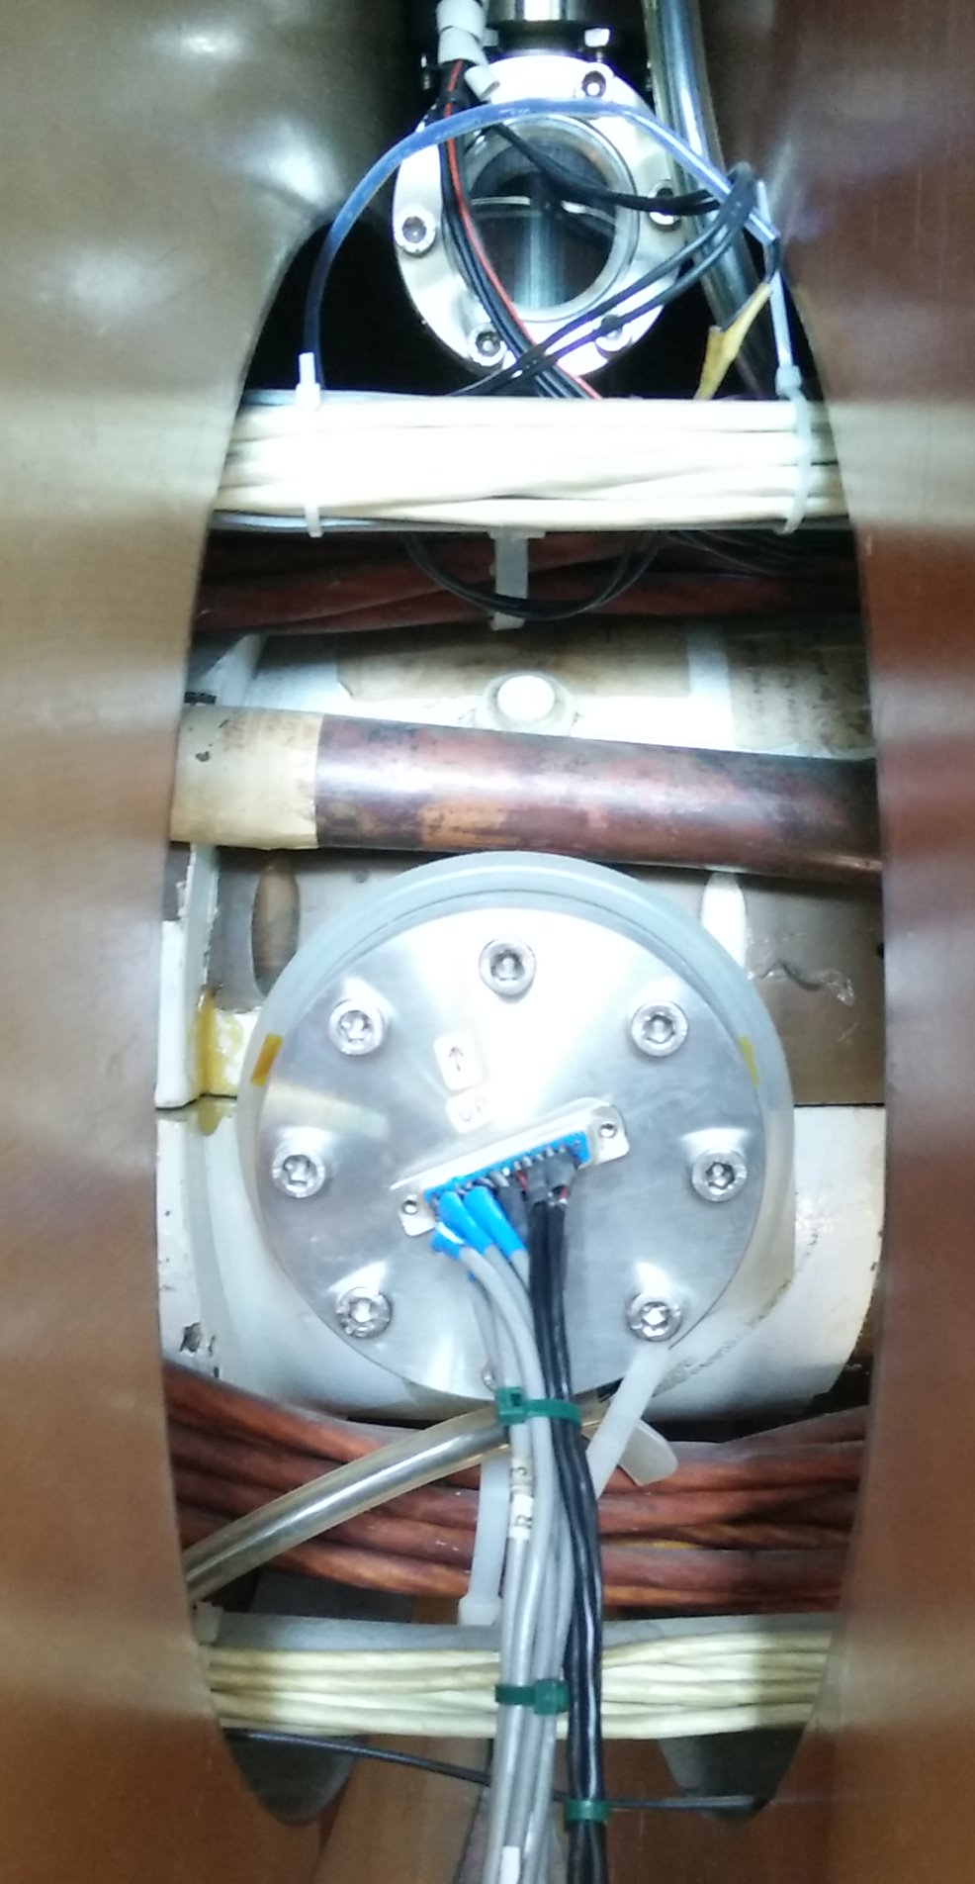
At ISTTOK
The copper shell provides passive instability control by increasing the growth rate of plasma instabilities to the millisecond scale.
H. Fernandes – ISTTOK Machine Description
Primary coils
Notes:
Another way of controling the plasma instabilities is with metalic structures surrounding the plasma.
There is always a trade-off, but by in therory if we solw the instability so much, we cont even need to control it.
ISTTOK has a copper shel that does exactly this, increasing the growth rate of the instabilities to the pulse (cycle) length scale.
This picture shows the 3 sets of Poloidal Field coils or PF
And here there is an image where we can se the copper shell the horizontal Field coils and the primary winding, which is in LFS in ISTTOK
Mirnov port

Slide 4
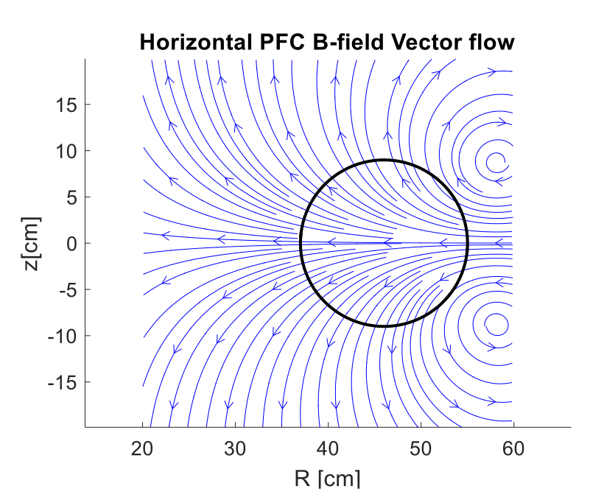
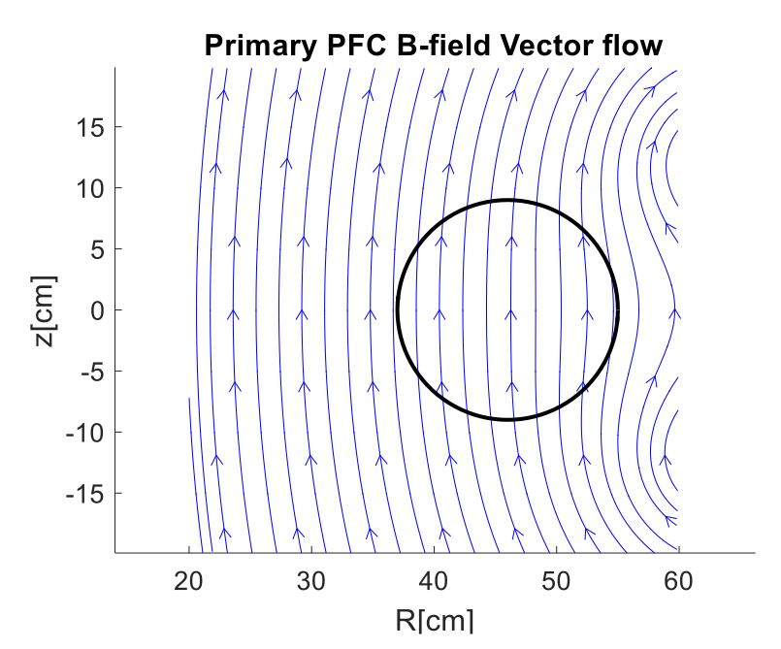
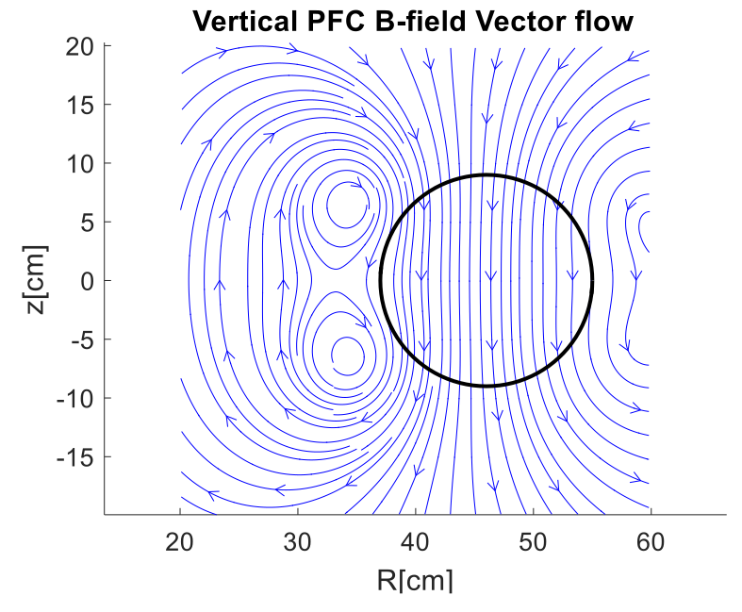
PF coils signals
We intend to measure the plasma but we also pick up signal from the PF coils that generate and position the plasma
D. Corona
Remove PF coils field in the magnetic signals
Notes:
These coils generate these field distribuitions.
Or at least they should, since these are simulations done with biot-savart law and not real measured date.
Any deviation of the coils from their theoretical positions will chage the field distribuition. This is usually treated considering an error field and is predictable.
During a plasma pulse, these currents are there, are changing and are picked up by the magneticc sensors

Slide 5
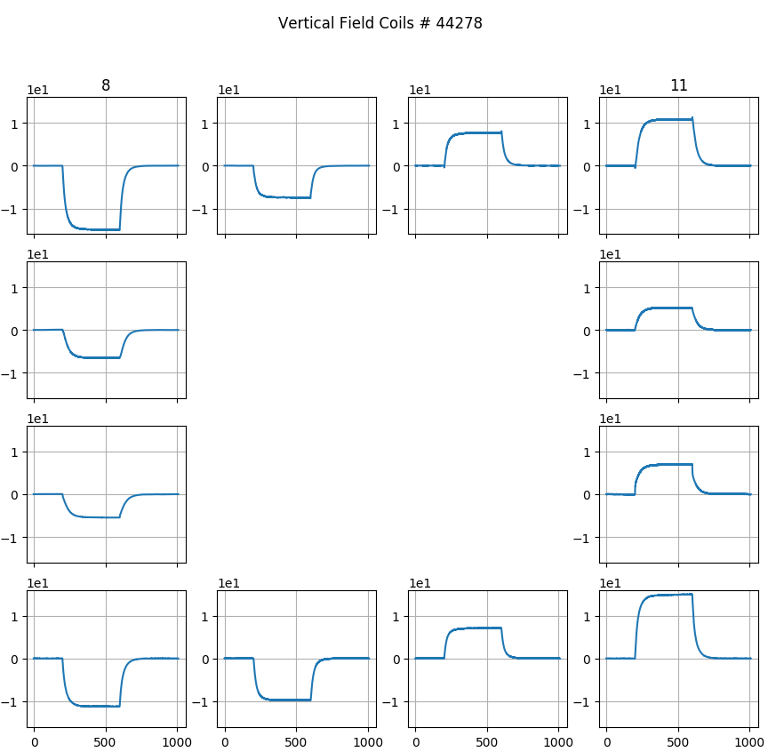
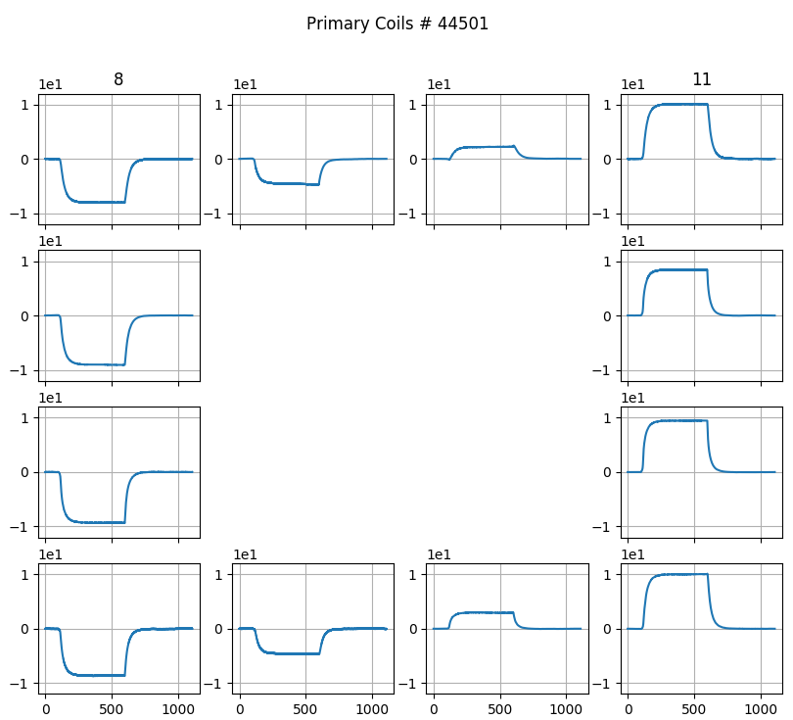
Plasmaless pulse –vertical field and primary
Notes:
What do the mirnov coils measure without plasma?
Vertical PF
Integrated data

Slide 6
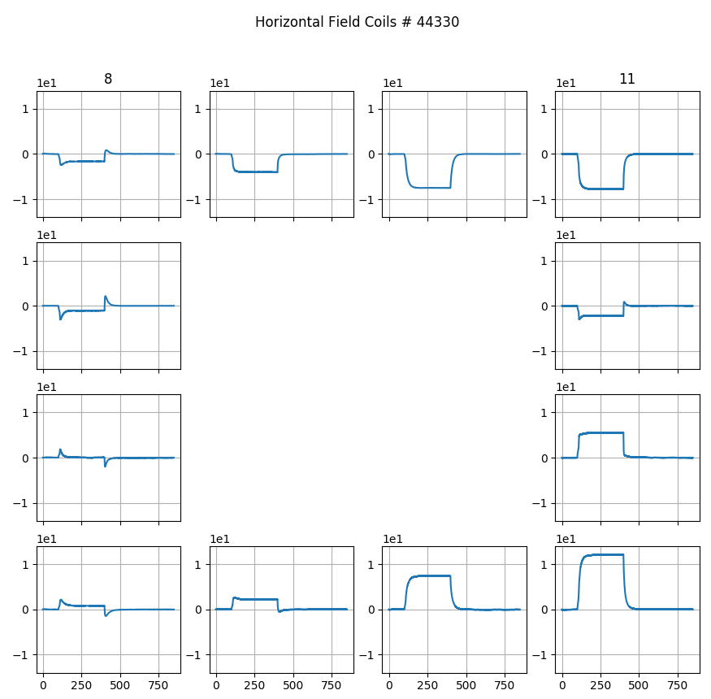
Plasmaless pulse – horizontal field coils
Mirnov 6
Notes:
What do the mirnov coils measure without plasma?
Vertical PF
Integrated data

Slide 7
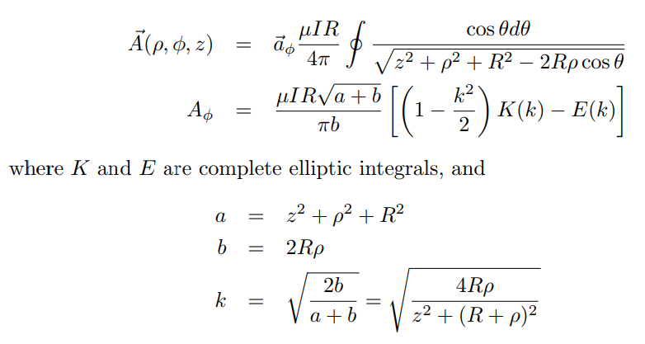
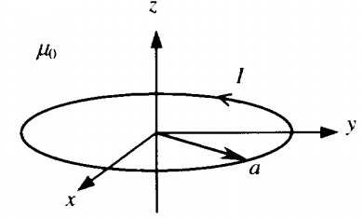
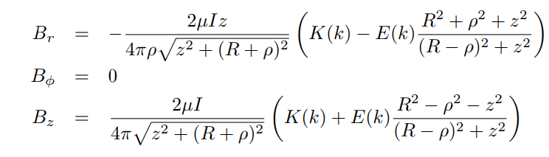
Accurate computation of the magnetic field flux
Simple Analytic Expressions for the Magnetic
Field of a Circular Current Loop, J. Simpson et al., 2012
https://ntrs.nasa.gov/archive/nasa/casi.ntrs.nasa.gov/20010038494.pdf
R
Accurate Formulas for A and B due to Circular
Current Loops with Code, K. Nalty, 2012
http://www.kurtnalty.com/ClosedLoopFormulasForAandBwithCode.pdf
Notes:
What do the mirnov coils measure without plasma?
Vertical PF
Integrated data

Slide 8
PFC position optimization
12 points, 4-8 (+) DoF
Several possible solutions
Manual ‘fitting’
Developed script allows changing:
R and Z coordinate of each coil independently
Current on the set of coils
Number of windings
Empiric gain factor on Bz and Br
Notes:
What do the mirnov coils measure without plasma?
Vertical PF
Integrated data

Slide 9
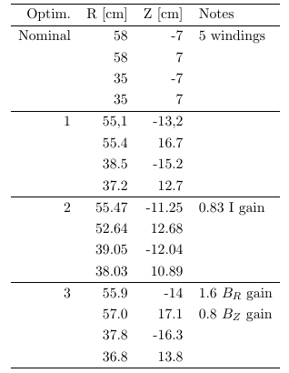
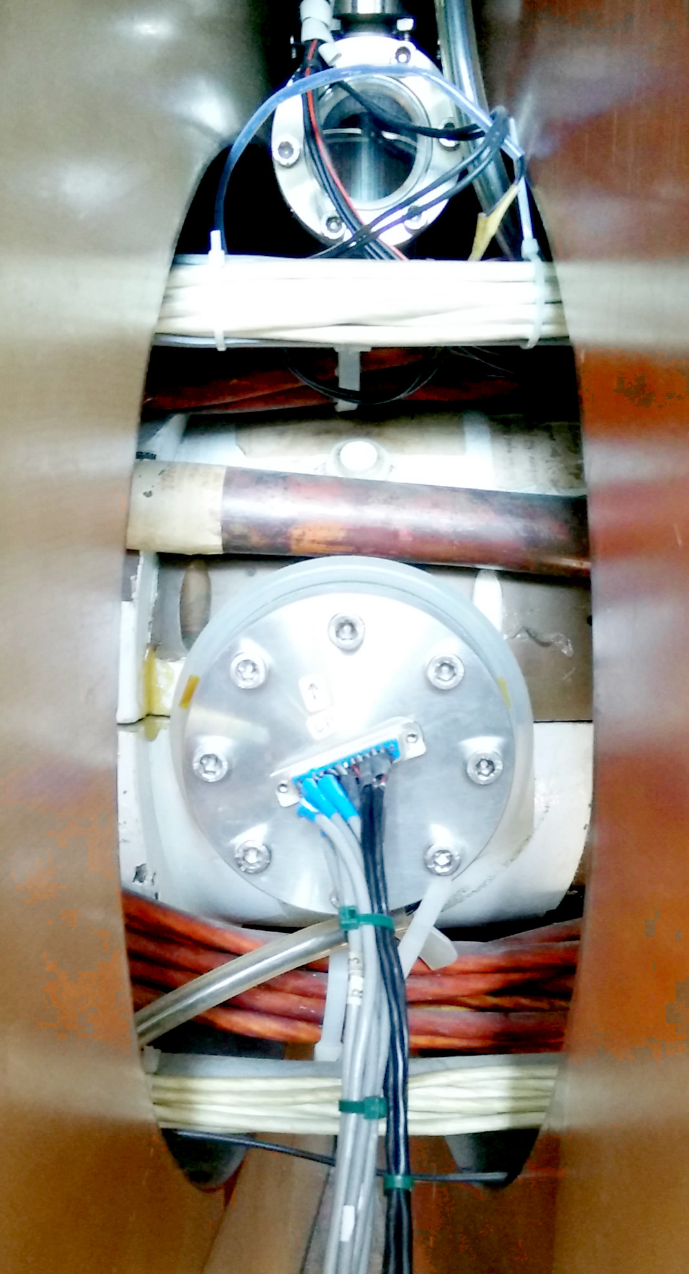
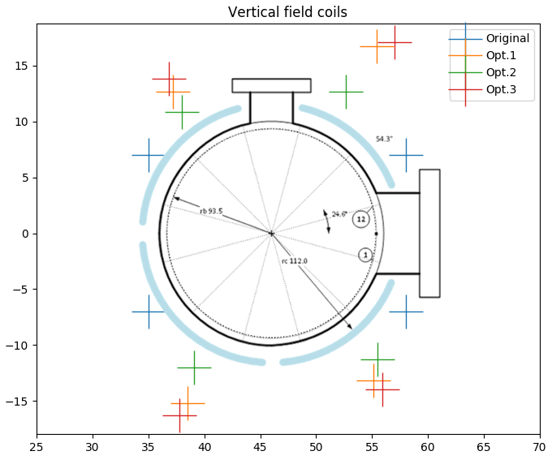
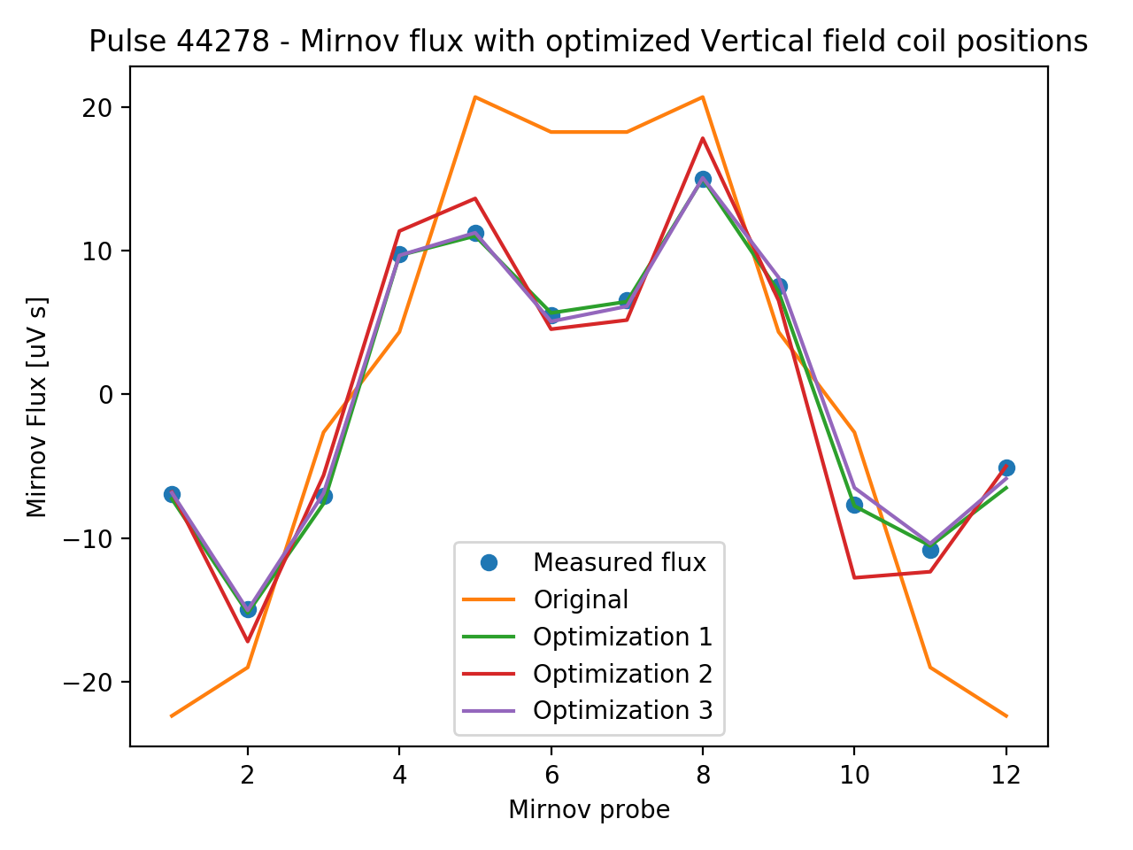
Vertical field coils optimization
Notes:
What do the mirnov coils measure without plasma?
Vertical PF
Integrated data

Slide 10
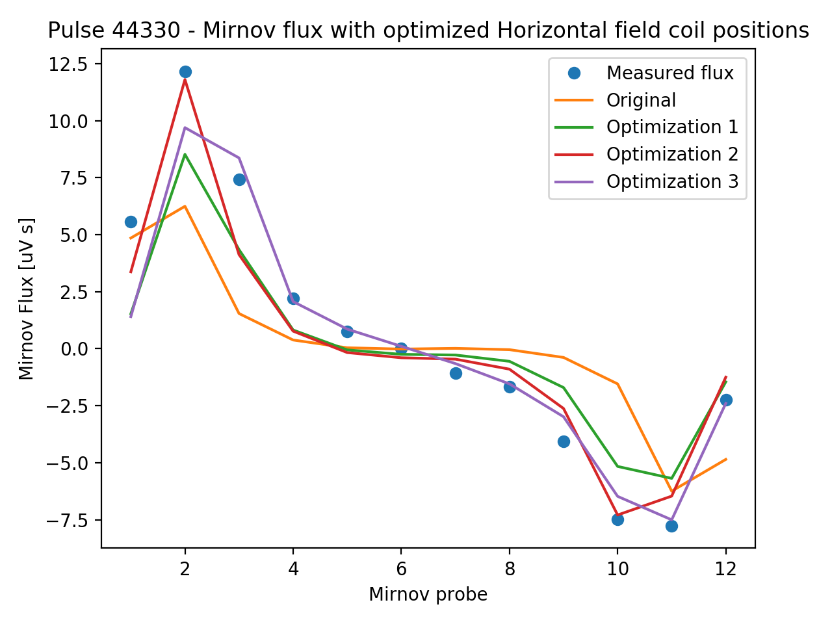
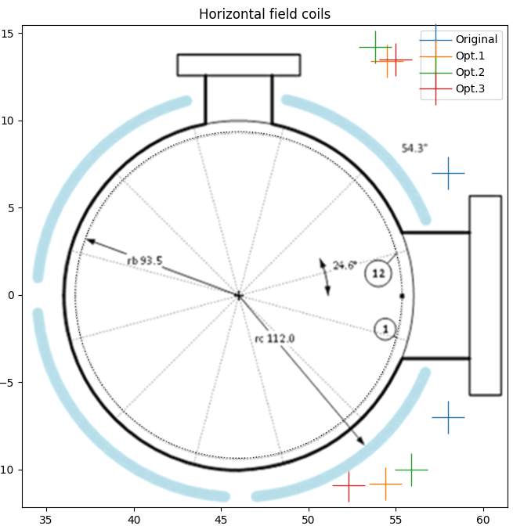
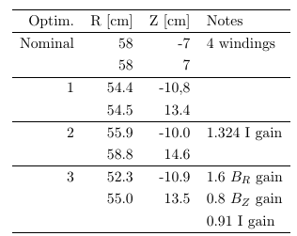
Horizontal field coils optimization
Notes:
What do the mirnov coils measure without plasma?
Vertical PF
Integrated data

Slide 11
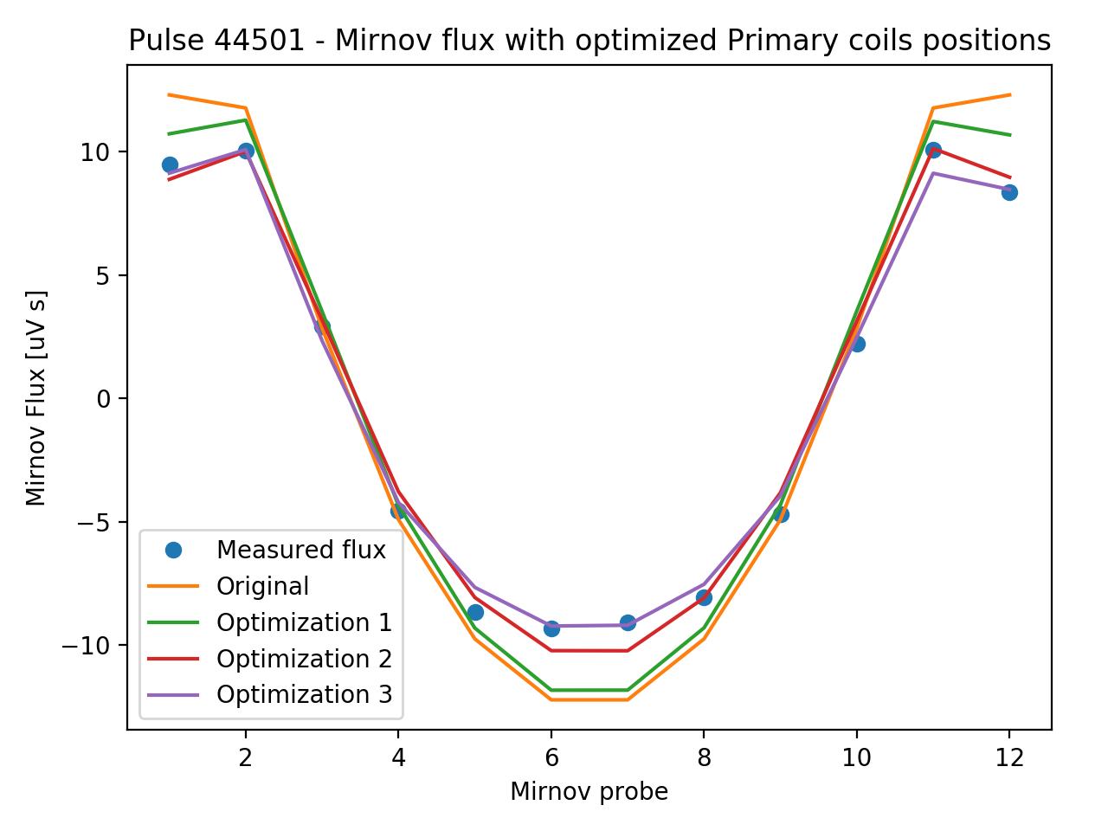
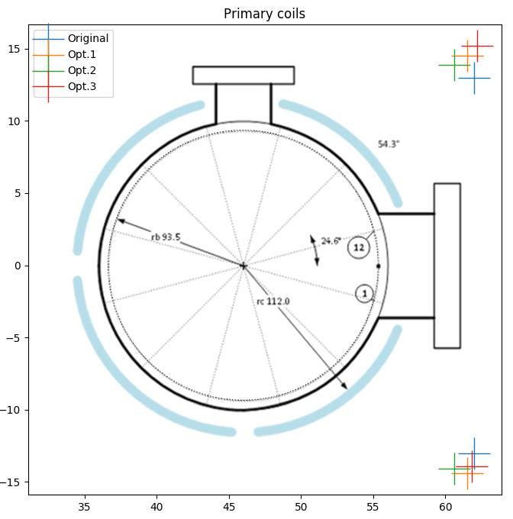
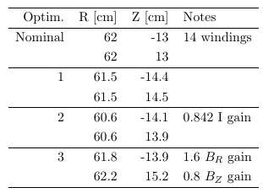
Primary coils optimization
Notes:
What do the mirnov coils measure without plasma?
Vertical PF
Integrated data

Slide 12
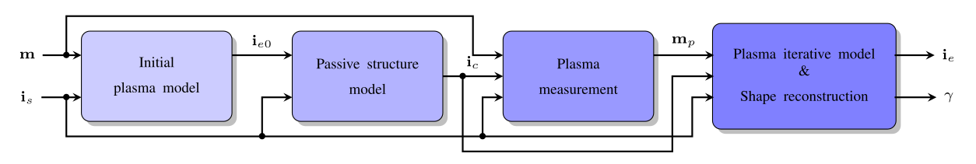
LTI model for axisymmetric structures
Modeling the eddy currents on the passive stuctures
Finding an optimized location of discrete current filaments that would fit the magnetic data
1. Filamentary model of the plasma
2. Computation of a filamentary model of the currents on the passive structures
3. Correction of the error field on the magnetic measurements
4. Reconstruction/contol algorithms
- magnetic measurements
- active coil currents
- eddy currents
- plasma model
- shape parameters
A. Cenedese, et al. - Model-Based Approach for Magnetic Reconstruction in Axisymmetric Nuclear Fusion Machines (2018)
Notes:
Another strategy is to employ a filamentary model for the plasma to get an optimazed discrete distribuiton of filaments of curent in the passive structures to correct the magnetic data

Slide 13
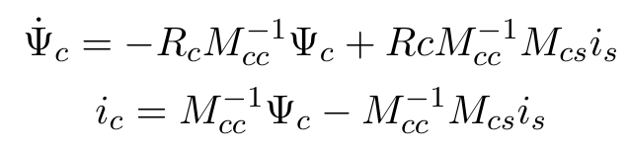


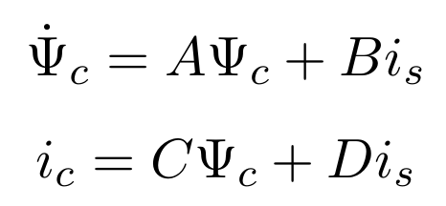


LTI model implemented
Notes:
Another strategy is to employ a filamentary model for the plasma to get an optimazed discrete distribuiton of filaments of curent in the passive structures to correct the magnetic data

Slide 14
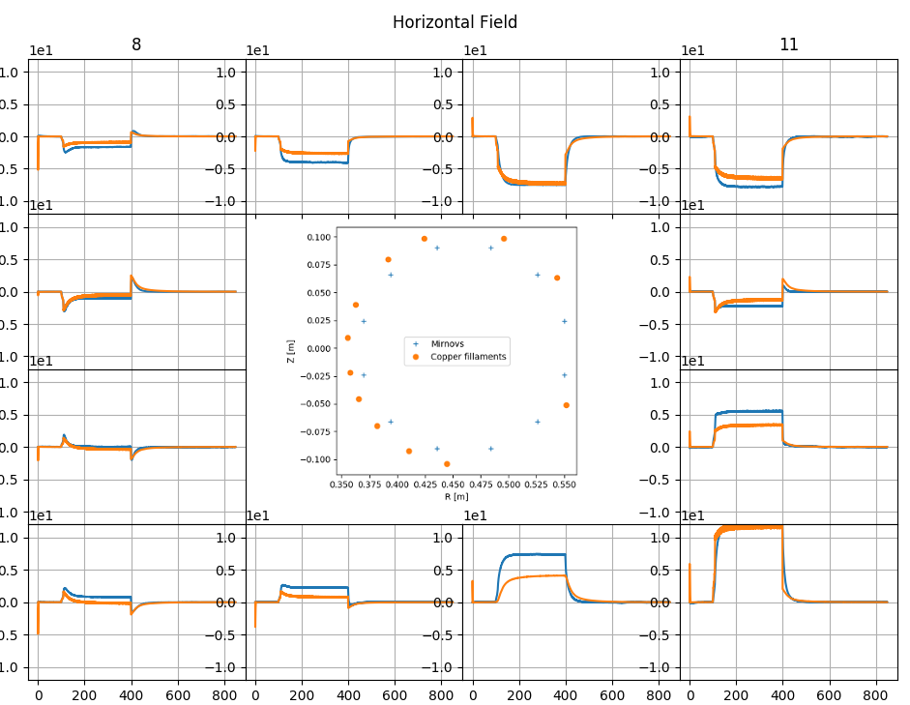
Interactive script for filament position optimization
Interative script
a=10 mm;
12 filaments
Interactively change the angle of the each filament, observing the efect on the 3 closest mirnovs
Allowed angles:
[20, 70], [110, 175], [180, 265], [275, 340]
Notes:
Another strategy is to employ a filamentary model for the plasma to get an optimazed discrete distribuiton of filaments of curent in the passive structures to correct the magnetic data

Slide 15
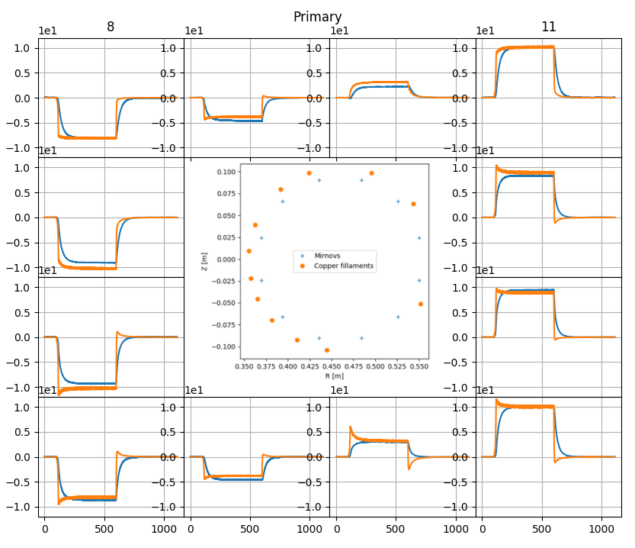
Interactive script for filament position optimization
Notes:
Another strategy is to employ a filamentary model for the plasma to get an optimazed discrete distribuiton of filaments of curent in the passive structures to correct the magnetic data

Slide 16
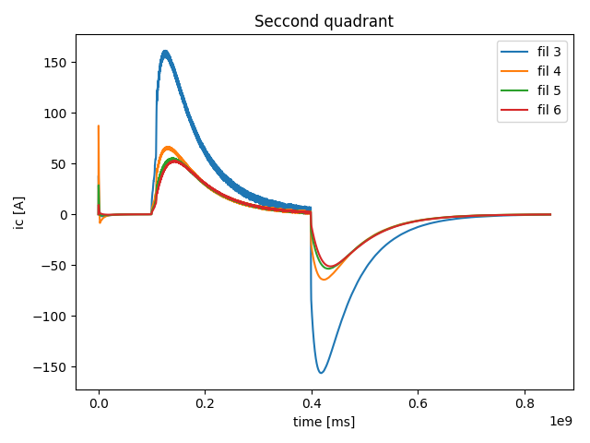
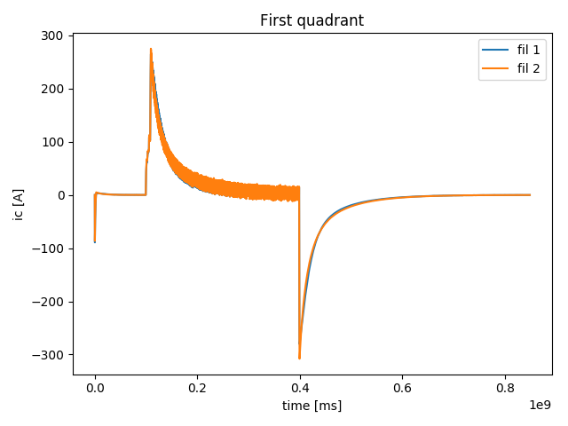
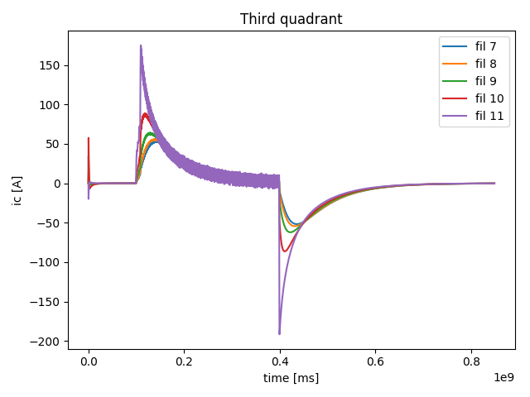
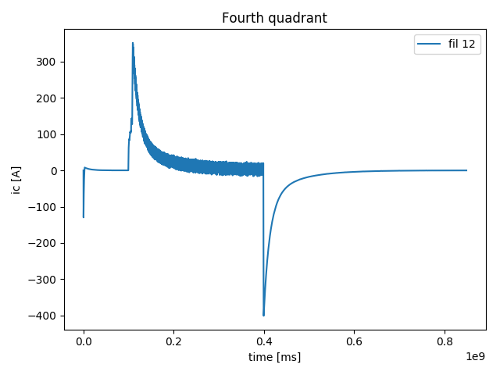
Interactive script for filament position optimization
Notes:
Another strategy is to employ a filamentary model for the plasma to get an optimazed discrete distribuiton of filaments of curent in the passive structures to correct the magnetic data

Slide 17
Conclusions and future work
Implemented model relies on the active coils positions for the mutal indutance between the filaments and PFCs and is therefore essential to have low uncertenty.
Measurements on the PFC actual positions in order to reduce the number of DoF.
Missalignments or misscalibration on the mirnov coils can not be rulled out, effective area.
Modeling of the iron core for correction of the field on HFS
Copper shell not axisymetric
Notes:
Another strategy is to employ a filamentary model for the plasma to get an optimazed discrete distribuiton of filaments of curent in the passive structures to correct the magnetic data

Slide 18



A precise computation of the external and error magnetic flux on the mirnov coils is needed in order to apply boudary reconstruction algorithms or to use the Mirnov coils for active control or plasma boundary reconstruction.

