Slide 1
University of Central Florida CIS 4004 Web Based Information Technology

Slide 2
HTML
HyperText Markup Language, or HTML, is the standard markup language for describing the structure of documents displayed on the web
HTML consists of a series of elements and attributes which are used to mark up all the components of a document to structure it in a meaningful way

Slide 3
HTML
HTML documents are basically a tree of nodes, including HTML elements and text nodes
HTML elements provide the semantics and formatting for documents, including creating paragraphs, lists and tables, and embedding images and form controls
Each element may have multiple attributes specified
Many elements can have content, including other elements and text
Other elements are empty, with the tag and attributes defining their function

Slide 4
HTML
There are several categories of elements
metadata
sectioning
text
inline semantic
form
interactive
media
component
scripting

Slide 5
HTML
HTML consists of a series of elements, which enclose, or wrap, different parts of the content to make it appear or act in a certain way
HTML elements are delineated by tags, written using angle brackets (< and >)
The closing tag is the same tag as the opening tag, preceded by a slash.

Slide 6
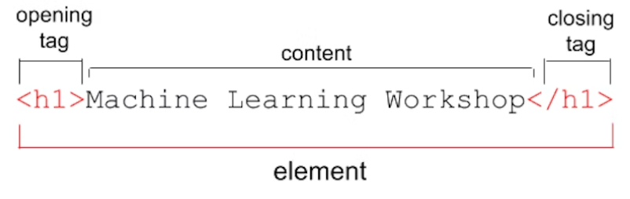
HTML
Elements comprise
Opening tag
Content ~ inner HTML
Closing tag

Slide 7
HTML
Elements and tags aren't the exact same thing
Many people use the terms interchangeably
The tag name is the content in the brackets
The tag includes the brackets
An element is the opening and closing tags, and all the content between those tags, including nested elements

Slide 8
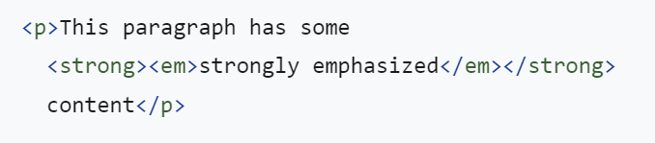
HTML
This paragraph element has other elements nested in it
When nesting elements, it's important that they are properly nested
HTML tags should be closed in the reverse order of which they were opened

Slide 9
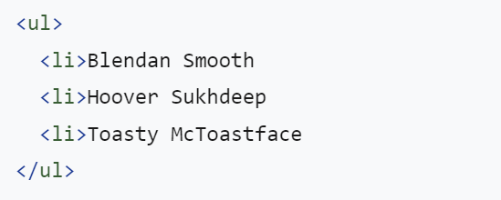
HTML
Browsers do not display the tags
The tags are used to interpret the content of the page
HTML is very, very forgiving
If omit the closing </li>tags, the closing tags are implied

Slide 10
HTML
Best practices state developers should always balance the open and close tags of an element to achieve desired output to the web browser
The specification for each element lists whether the closing tag is mandatory or not
"Neither tag is omissible" in the specification means both an opening tag and a closing tag are required
https://html.spec.whatwg.org/multipage/syntax.html#syntax-tag-omission

Slide 11
HTML
There are two types of elements
Replaced
Non-replaced
Non-replaced elements
Non-replaced elements have opening and (sometimes optional) closing tags that surround them and may include text and other tags as sub-elements
These enclosing tags can turn a phrase or image into a hyperlink, can make a sentence into a header, can give emphasis to words, and so on.
The paragraph, header, and lists marked up in the examples are all non-replaced

Slide 12
HTML
Replaced and void elements
Replaced elements are replaced by objects, be it a graphical user interface (UI) widget in the case of most form controls, or a raster or scalable image file in the case of most images
Being replaced by objects, each comes with a default appearance
Depending on the type of object and the browser, the applicable styles are limited

Slide 13
HTML
Replaced and void elements
Replaced elements and void elements are often confused
Void elements are all self-closing elements and are represented by one tag
This means there is no such thing as a closing tag for a void element
Optionally, can include a slash at the end of the tag, which many people find makes markup easier to read
Void elements cannot contain text content or nested elements
Most replaced elements are void elements, but not all

Slide 14
HTML
Case sensitivity
To make markup easier to read, it is recommended, but not required, to mark up the HTML using lowercase letters
Use lowercase letters for all element names and attribute names within the tags and quote all attribute values
The term "XHTML style markup", this methodology and self-closing empty elements with a slash at the end, is what that means

Slide 15
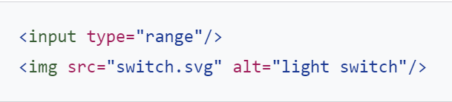
HTML
Attributes
The code example below contains more than just the element type in their opening tag
These extra bits of space-separated name/value pairs (though sometimes including a value is optional) are called attributes
Attributes are what make HTML so incredibly powerful

Slide 16
HTML
Attributes
Attributes provide information about the element
The attribute, like the rest of the opening tag, won't appear in the content, but they do help define how the content will appear to users
Attributes only appear in the opening tag
The opening tag always starts with the element type
The type can be followed by zero or more attributes, separated by one or more spaces

Slide 17
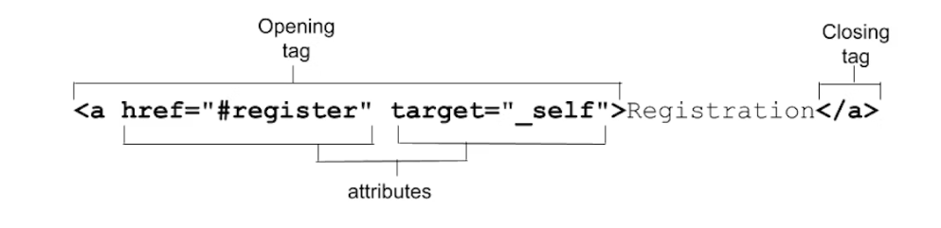
HTML
Attributes
Most attribute names are followed by an equal sign equating it with the attribute value, wrapped with opening and closing quotation marks

Slide 18
HTML
Attributes
Attributes define the behavior, linkages, and functionality of elements
Some attributes are global, meaning they can appear within any element's opening tag
Some attributes apply only to several elements but not all
Other attributes are element-specific, relevant only to a single element
Most attributes are name/value pairs
Boolean attributes, whose value is true, false, or the same as the name of the attribute, can be included as just the attribute: the value is not necessary

Slide 19
HTML
Attributes
While quoting attributes isn't always required, it sometimes is
If the value includes a space or special characters, quotes are needed
For this reason, quoting is always recommended
One or more spaces between attributes if the attribute value is quoted are not actually required
Best practices state quotes and spaces are recommended, and appreciated

Slide 20
HTML
Appearance of elements
The default appearance of semantic elements is set by user-agent stylesheets
Most browsers use actual stylesheets for this purpose, while others simulate them in code
Some constraints on user-agent stylesheets are set by the HTML specification
Browsers have a lot of latitude, which means some differences exist between browsers

Slide 21
HTML
Appearance of elements
The element chosen, and therefore the tags used, should be appropriate for the content being displayed, as tags have semantic meaning
The semantics, or role, of an element is important to assistive technologies and, in some cases, search engines
HTML should be used to structure content, not to define the content's appearance

Slide 22
HTML
Appearance of elements
Appearance of HTML elements is the realm of Cascading Style Sheets (CSS)
While many elements that alter the appearance of content have a semantic meaning, the appearance can and generally will be changed with author styles

Slide 23
HTML
Element, attributes, and JavaScript
The Document Object Model (DOM) is the data representation of the structure and content of the HTML document
As the browser parses HTML, it creates a JavaScript object for every element and section of text encountered
These objects are called nodes; element nodes and text nodes, respectively

Slide 24
HTML
Element, attributes, and JavaScript
There is an interface to define the functionality of every HTML element
The HTML DOM API provides access to and control of every HTML element via the DOM, providing interfaces for the HTML element and all the HTML classes that inherit from it
The HTMLElement interface represents the HTML element and all of its descendant nodes
Every other element implements it via an interface that inherits from it.

Slide 25
HTML
Element, attributes, and JavaScript
Each inheriting interface has a constructor, methods, and properties
Via the inherited HTMLElement properties, developers can access every global attribute

