Slide 1
Peruvian Time Matrix
Andrei Bartra

Slide 2
The Challenge
The Challenge
Path to a Solution
Path to a Solution
To Do
To Do
Data
Data
Results
Results

Slide 3






Travel Time Between Schools
Teacher Salary
New Schools
Research

Slide 4
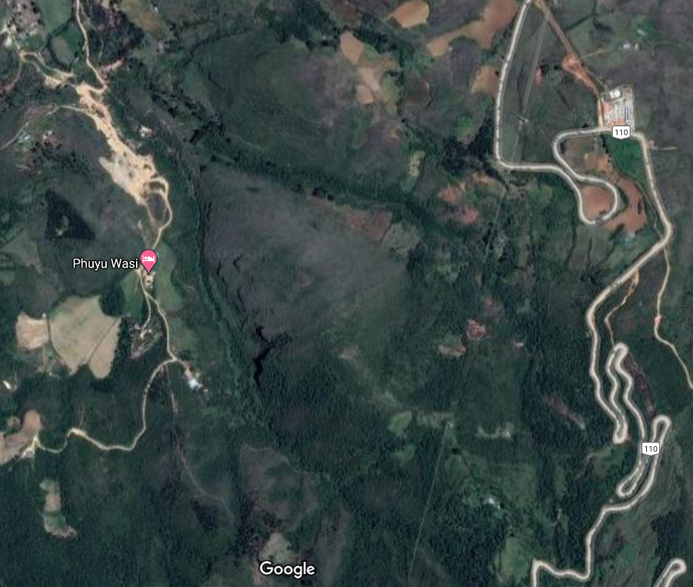
Peruvian Geography
Not mapped road
Mapped Road
School

Slide 5
The Challenge
The Challenge
Path to a Solution
Path to a Solution
To Do
To Do
Data
Data
Results
Results

Slide 6






Speed raster
1.3GB
90x90mts
Limitations:
The transportation is always available
It is the the same to go uphill or downhill
Type of way & slope
No way→ Walking speed
With way→ Walk or car
River → Bote from a port

Slide 7
The Challenge
The Challenge
Path to a Solution
Path to a Solution
To Do
To Do
Data
Data
Results
Results

Slide 8




Solution Design: User View
Coordinates pairs
Transport
Parallel Parameters
Coordinates pairs with travel times
Inputs
Process
Output

Slide 9

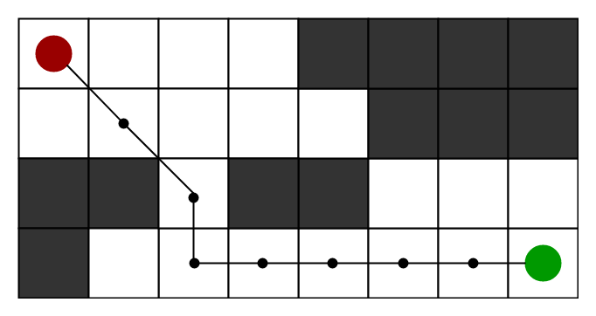
Solution Design: Under the Hood
Batches
Djkstra or A*
Gathering
Output

Slide 10







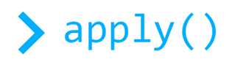




The plan and the failures
A*

Slide 11
The Challenge
The Challenge
Path to a Solution
Path to a Solution
To Do
To Do
Data
Data
Results
Results

Slide 12
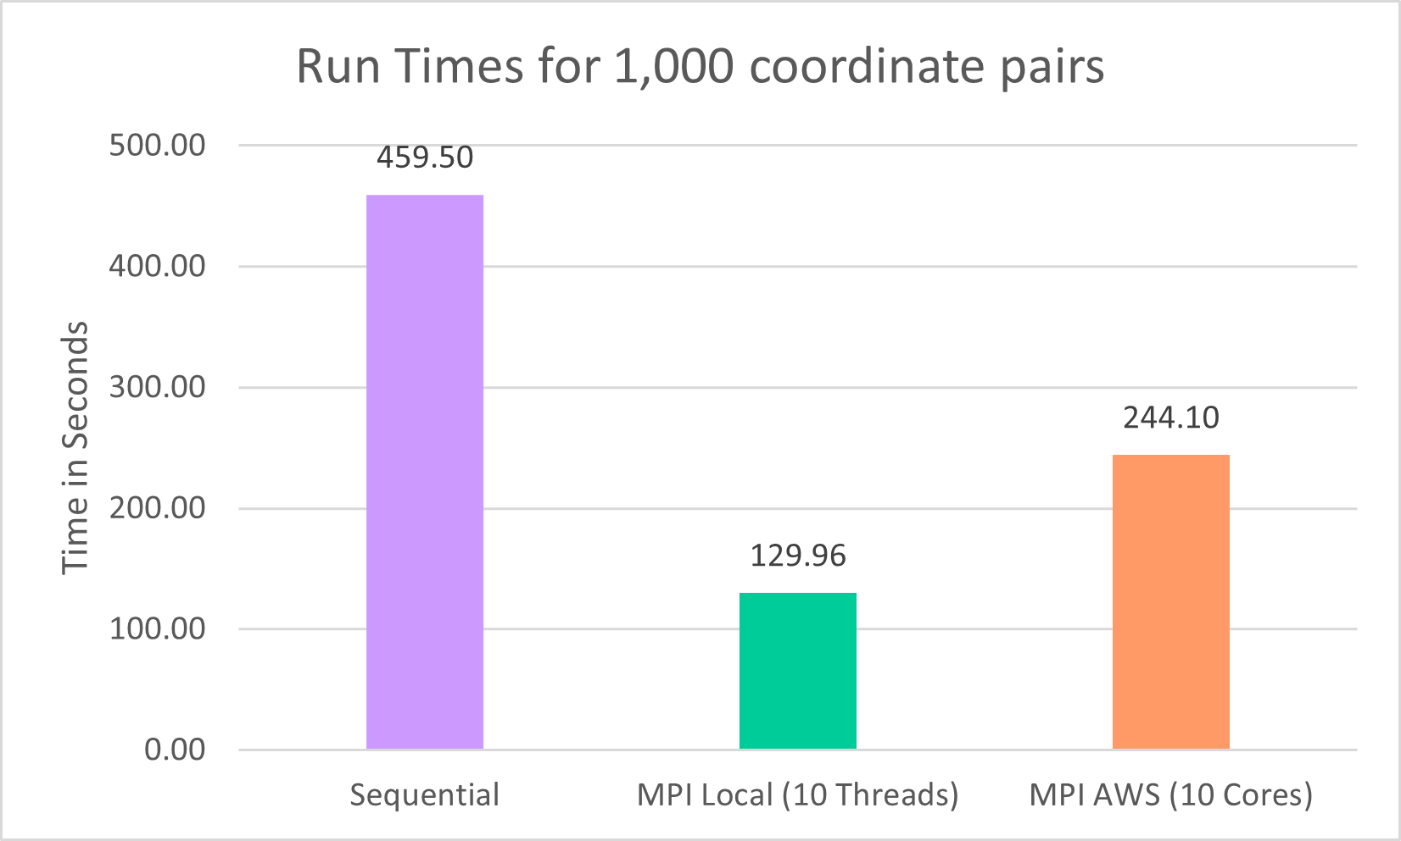

Slide 13
The Challenge
The Challenge
Path to a Solution
Path to a Solution
To Do
To Do
Data
Data
Results
Results

Slide 14
To Do
Solve custom function Issues
Design an API to run from AWS
New Features: Save results in DynamoDB

Slide 15

¡Gracias!

