Slide 1
.Net Aspire
.NET and Python Azure functions integration POC
2025

Slide 2
Agenda
.NET Aspire
About the POC
Get the code
Local configuration
Run the app
Conclusions

Slide 3
.NET Aspire
.NET Aspire improves the experience of building apps that have a variety of projects and resources. With dev-time productivity enhancements that emulate deployed scenarios, you can quickly develop interconnected apps. Designed for flexibility, .NET Aspire allows you to replace or extend parts with your preferred tools and workflows. Key features include:
Dev-Time Orchestration: .NET Aspire provides features for running and connecting multi-project applications, container resources, and other dependencies for local development environments.
Integrations: .NET Aspire integrations are NuGet packages for commonly used services, such as Redis or Postgres, with standardized interfaces ensuring they connect consistently and seamlessly with your app.
Tooling: .NET Aspire comes with project templates and tooling experiences for Visual Studio, Visual Studio Code, and the .NET CLI to help you create and interact with .NET Aspire projects.

Slide 4
About the POC
The scop of this POC is to check it we can integrate a .NET and Python Azure function into Aspire.

Slide 5
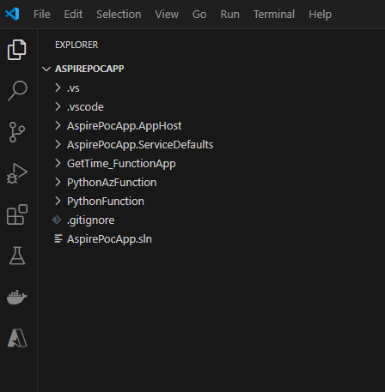
Get the code
The code for this POC can be found on GitLab:
https://github.com/andrei-bularca-cognizant/AspirePoc
The solution contains the Aspire project, one .NET Azure function, one Python Azure function and another simple Python function.

Slide 6
Local configuration
After the repo is cloned locally the Python functions should be configured to work locally.
Open the project using Visual Studio Code and open a terminal. Navigate into Python function folder (this should be done for each Python project) and execute:
python -m venv .venv (create Python virtual environment)
.venv\Scripts\activate (activate Python virtual environment)
python -m pip install --upgrade pip
python -m pip install -r requirements.txt

Slide 7
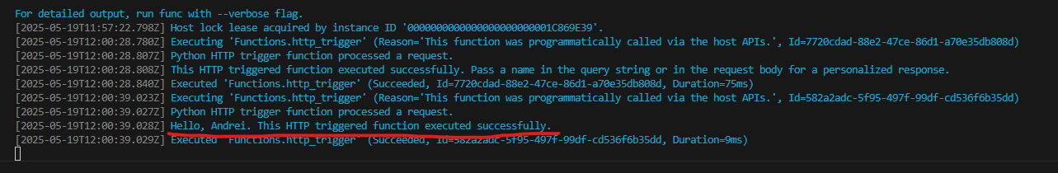
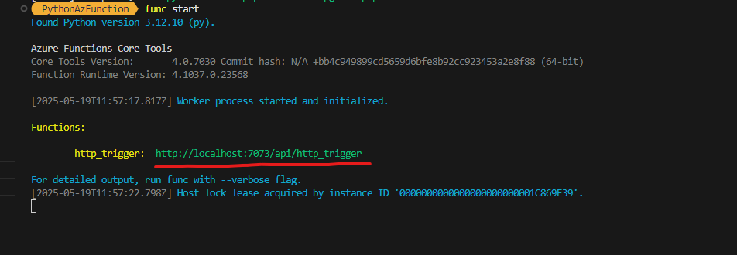
Run Python Azure function
Hello, Andrei. This HTTP triggered function executed successfully.
To run the Python function locally (not in .NET Aspire) open a terminal and execute ‘func start’. After the function is started open the url in a web browser to trigger the function (add ?name=your_name to display a Hello message):
When the function is triggered, a message will be displayed in the terminal:

Slide 8
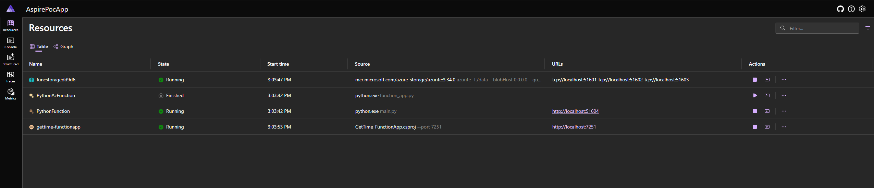
Run the app
In Visual Studio Code go to Solution explorer, right click on the Aspire project, go to Debug -> Start new instance
Here we can see all the functions added to Aspire project, open a console to see the logs. Structure, Metric and Traces are available only .NET Azure function.

Slide 9
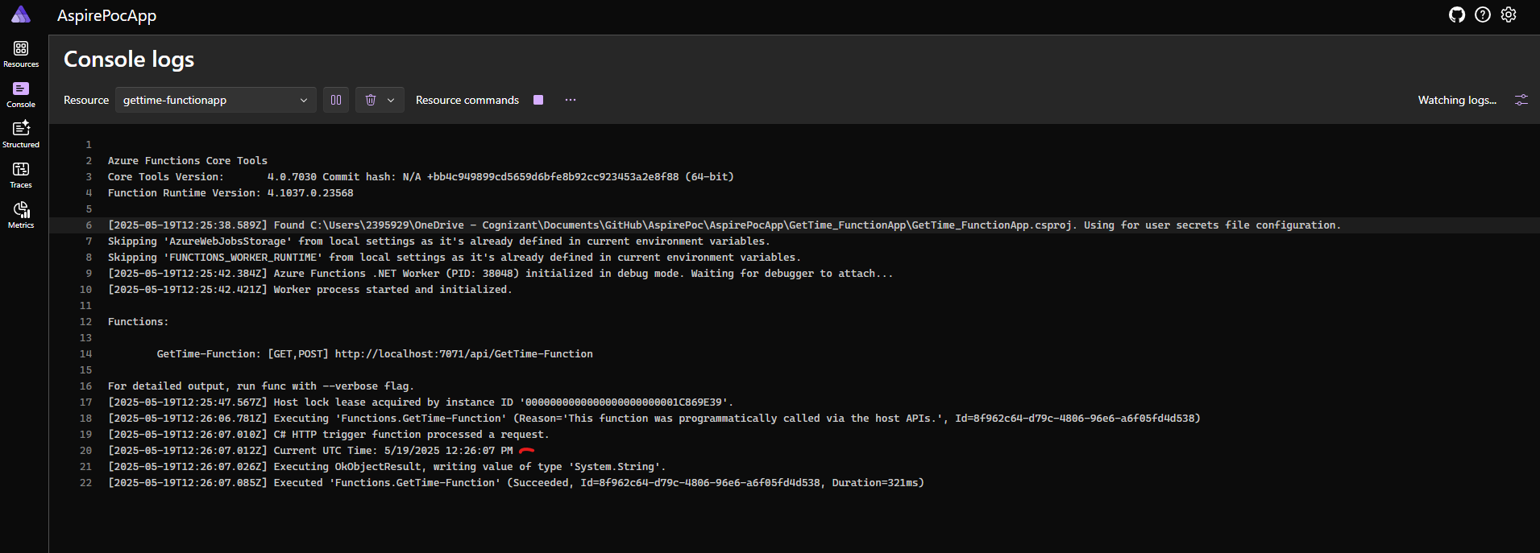
Run the app
.NET Azure function is started, and we can see logs in console. Open the Console from left menu (or from actions column) and select gettime-functionapp. Open function url in a new tab and check the log:

Slide 10
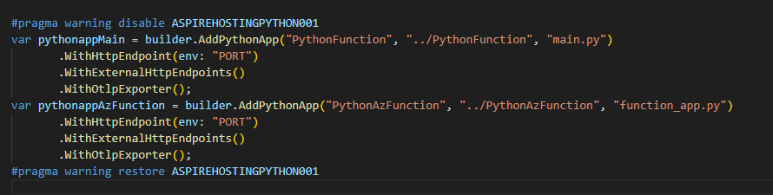
Run the app
As we can see the .NET Azure function and the simple Python app are running. The Python Azure function is not working as expected and cannot be started.
Unfortunately, at this moment the Python integration is experimental, and it looks like is not working for Python Azure function. Also, in the code we should add “#pragma warning disable ASPIREHOSTINGPYTHON001”.

Slide 11
Conclusions
For the moment .NET Aspire is not a solution to integrate both .NET and Python Azure functions as the Python is experimental, but when this will be stabile .NET Aspire can be a helpful tool for this scope.

Slide 12
Thank you
Bularca Andrei

