Slide 1
Проектирование мобильных приложений
Android: Lifecycle Components, ViewModel,
DataBinding
Кузнецов
Андрей Николаевич
Санкт-Петербургский Государственный
Политехнический Университет

Slide 2
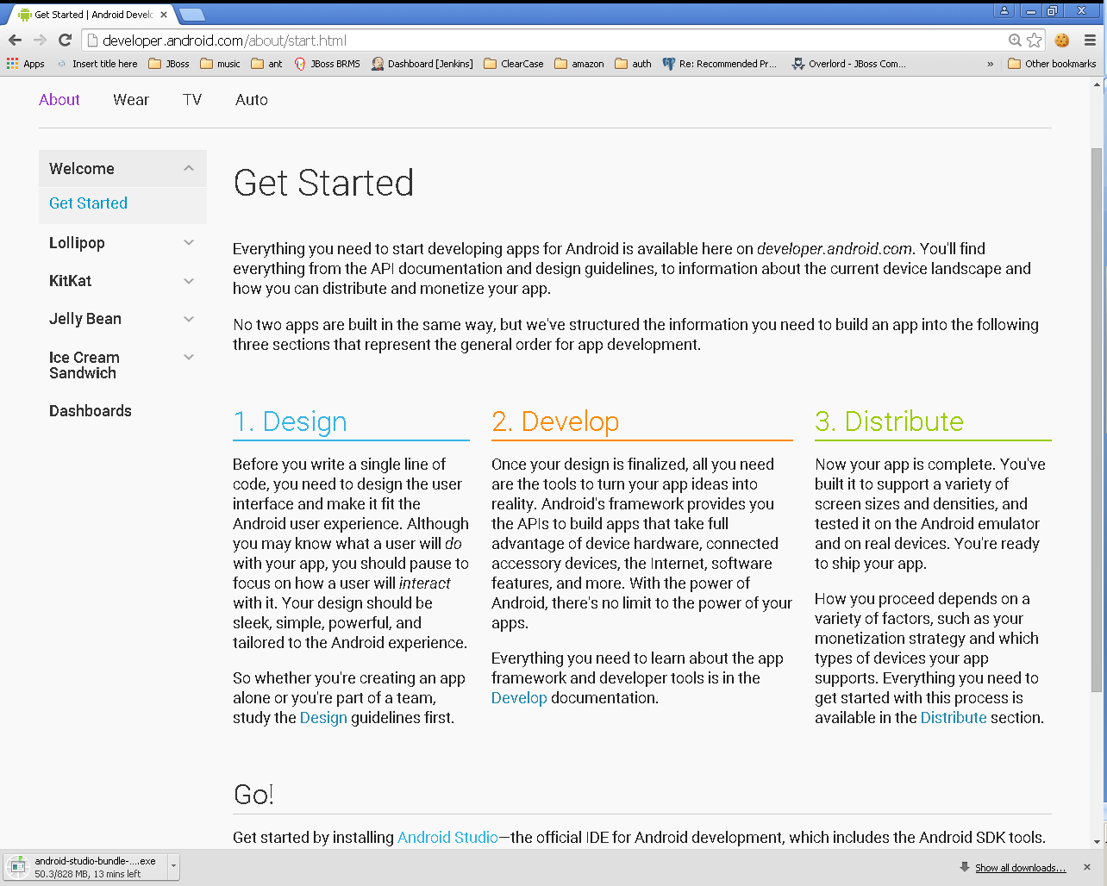

Slide 3
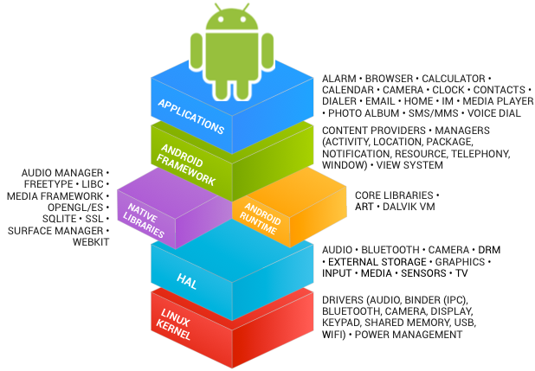
В предыдущих лекциях...
See https://source.android.com/source/index.html

Slide 4
В предыдущих лекциях...
Android Studio
http://developer.android.com/sdk/index.html
IntelliJ Idea (Bundled Android Plugin)
Android SDK
http://developer.android.com/sdk/index.html
Kotlin & Java

Slide 5
В предыдущих лекциях...
Activities
Services
Content Providers
Broadcast Receivers
As a developer we need only to call and extend these already defined classes to use in our application.

Slide 6
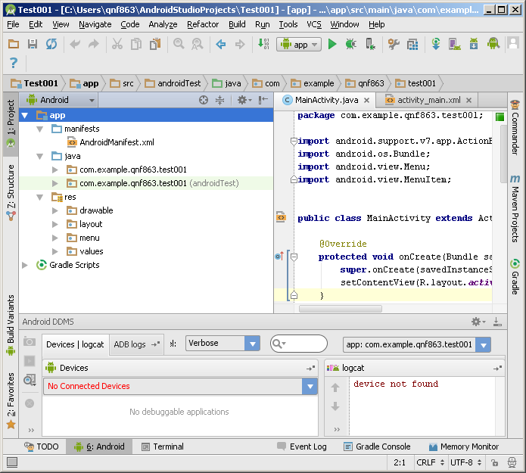
В предыдущих лекциях...

Slide 7
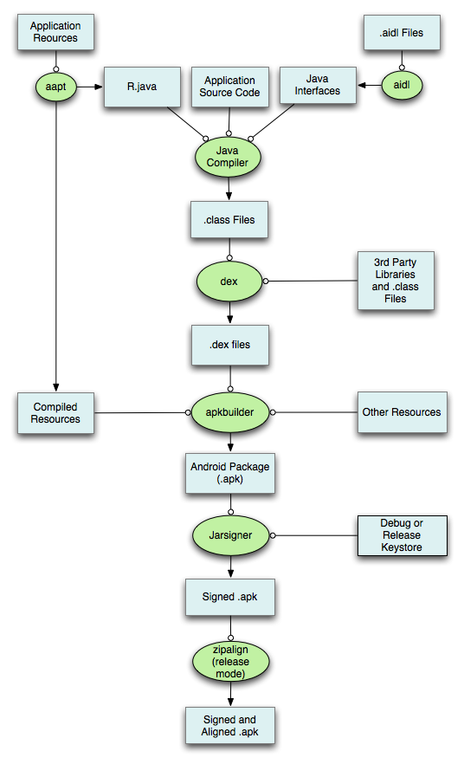

Slide 8
В предыдущих лекциях...
<?xml version="1.0" encoding="utf-8"?> <manifest> <uses-permission /> <permission /> <permission-tree /> <permission-group /> <instrumentation /> <uses-sdk /> <uses-configuration /> <uses-feature /> <supports-screens /> <compatible-screens /> <supports-gl-texture /> <application> <activity> <intent-filter> <action /> <category /> <data /> </intent-filter> <meta-data /> </activity>
<activity-alias> <intent-filter> . . . </intent-filter> <meta-data /> </activity-alias> <service> <intent-filter> . . . </intent-filter> <meta-data/> </service> <receiver> <intent-filter> . . . </intent-filter> <meta-data /> </receiver> <provider> <grant-uri-permission /> <meta-data /> <path-permission /> </provider> <uses-library /> </application> </manifest>

Slide 9
В предыдущих лекциях...
./animator/*
./anim/*
./xml/*
./drawable/*
Bitmap files (png, 9.png, jpg, gif)
State lists
Shapes
Other drawables

Slide 10
В предыдущих лекциях...
./layout/*
./menu/*
./raw/*
./values/*
arrays.xml
colors.xml
dimens.xml
strings.xml
styles.xml

Slide 11
В предыдущих лекциях...
<resources_name>-<config_qualifier>
resources_name := anim, drawable, layout, menu, raw, value, xml
config_qualifier := qualifier1[-qualifier2[…]]
Примеры:
drawable-ldpi
drawable-en-notouch-12key
values-land-mdpi-v11

Slide 12
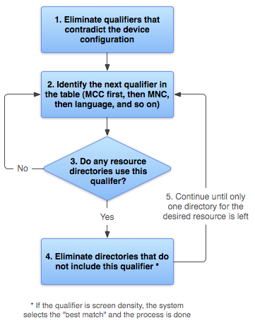
http://developer.android.com/guide/topics/resources/providing-resources.html

Slide 13
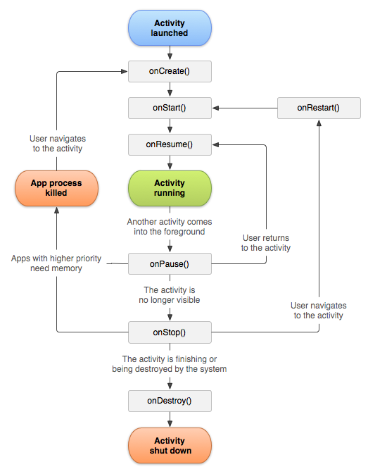
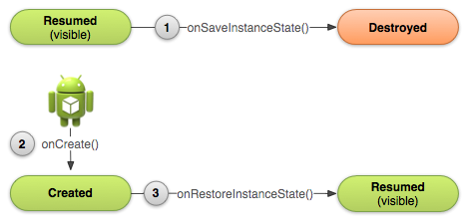
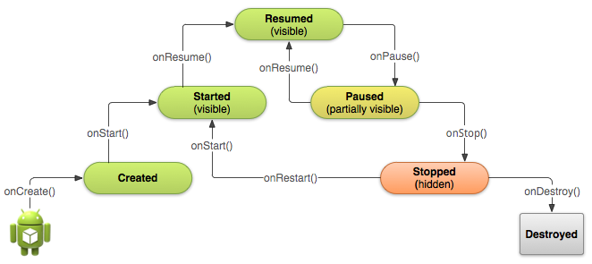

Slide 14
kotlin-android-extensions

Slide 15
kotlinx.android.synthetic
Demo
import kotlinx.android.synthetic.main.activity_main.*

Slide 16
DataBinding library
https://developer.android.com/topic/libraries/data-binding

Slide 17
Enable databinding (build.gradle)
build.gradle
==============
android { ... dataBinding { enabled = true } }

Slide 18
Layouts and binding expressions
<?xml version="1.0" encoding="utf-8"?> <layout xmlns:android="http://schemas.android.com/apk/res/android"> <data> <variable name="user" type="com.example.User"/> </data> <LinearLayout android:orientation="vertical" android:layout_width="match_parent" android:layout_height="match_parent"> <TextView android:layout_width="wrap_content" android:layout_height="wrap_content" android:text="@{user.firstName}"/> <TextView android:layout_width="wrap_content" android:layout_height="wrap_content" android:text="@{user.lastName}"/> </LinearLayout> </layout>

Slide 19
Layouts and binding expressions
data class User(val firstName: String, val lastName: String)

Slide 20
Expression language: common features
Mathematical + - / * %
String concatenation +
Logical && ||
Binary & | ^
Unary + - ! ~
Shift >> >>> <<
Comparison == > < >= <= (Note that < needs to be escaped as &lt;)
instanceof
Grouping ()
Literals - character, String, numeric, null
Cast
Method calls
Field access
Array access []
Ternary operator ?:
https://developer.android.com/topic/libraries/data-binding/expressions#common_features

Slide 21
Expression language: common features (пример)
android:text="@{String.valueOf(index + 1)}" android:visibility="@{age > 13 ? View.GONE : View.VISIBLE}" android:transitionName='@{"image_" + id}'
https://developer.android.com/topic/libraries/data-binding/expressions#common_features

Slide 22
Expression language: Missing operations
this
super
new
Explicit generic invocation

Slide 23
Expression language: некоторые примеры
android:text="@{user.lastName}"
android:text="@{user.displayName ?? user.lastName}"
android:padding="@{large? @dimen/largePadding : @dimen/smallPadding}"
android:text="@{@string/nameFormat(firstName, lastName)}" android:text="@{@plurals/banana(bananaCount)}"

Slide 24
Expression language: обработка событий
<Button android:layout_width="wrap_content" android:layout_height="wrap_content" android:onClick="@{() -> presenter.onSaveClick(task)}" />
<CheckBox android:layout_width="wrap_content" android:layout_height="wrap_content" android:onCheckedChanged=
"@{(cb, isChecked) -> presenter.completeChanged(task, isChecked)}" />
https://developer.android.com/topic/libraries/data-binding/expressions#event_handling

Slide 25
Create a binding object
override fun onCreate(savedInstanceState: Bundle?) { super.onCreate(savedInstanceState) val binding: MyLayoutBinding = MyLayoutBinding.inflate(layoutInflater) }
https://developer.android.com/topic/libraries/data-binding/generated-binding#create

Slide 26
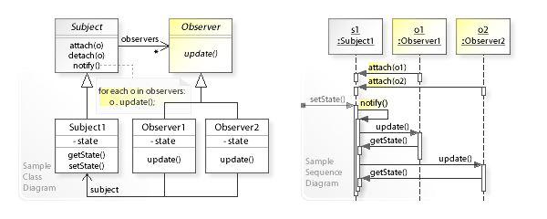
Observable pattern
https://upload.wikimedia.org/wikipedia/commons/0/01/W3sDesign_Observer_Design_Pattern_UML.jpg

Slide 27
androidx.lifecycle.LiveData
LiveData is an observable data holder class. Unlike a regular observable, LiveData is lifecycle-aware, meaning it respects the lifecycle of other app components, such as activities, fragments, or services. This awareness ensures LiveData only updates app component observers that are in an active lifecycle state.
As soon as an app component is in the STARTED state, the observer receives the most recent value from the LiveData objects it’s observing.
https://developer.android.com/topic/libraries/architecture/livedata

Slide 28
DEMO
Data binding library & LifeData

Slide 29
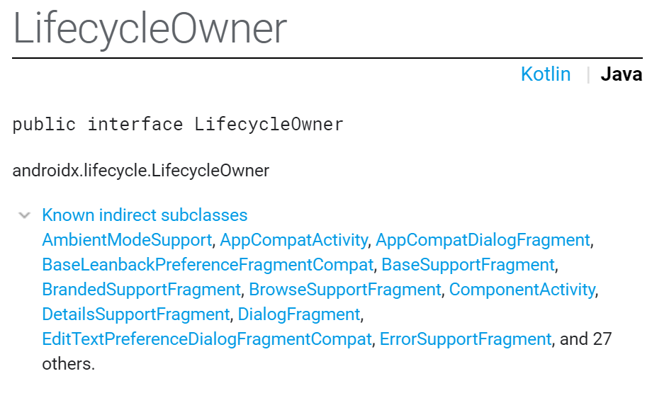
androidx.lifecycle.LifecycleOwner
https://developer.android.com/reference/androidx/lifecycle/LifecycleOwner.html

Slide 30
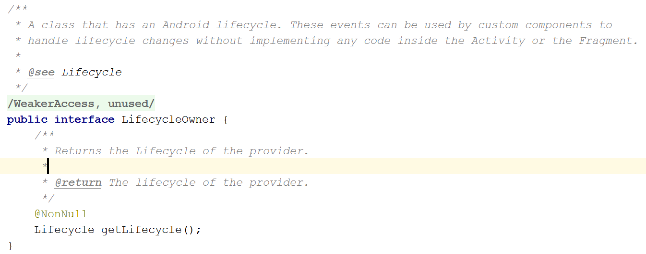
androidx.lifecycle.LifecycleOwner
https://developer.android.com/reference/androidx/lifecycle/LifecycleOwner.html

Slide 31
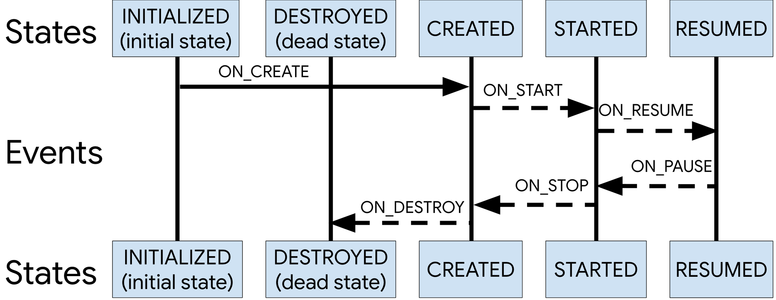
androidx.lifecycle.Lifecycle
https://developer.android.com/topic/libraries/architecture/lifecycle

Slide 32
androidx.lifecycle.LifecycleObserver
public interface LifecycleObserver
Marks a class as a LifecycleObserver. It does not have any methods, instead, relies on OnLifecycleEvent annotated methods.
class TestObserver implements LifecycleObserver {
@OnLifecycleEvent(ON_CREATE)
void onCreated(LifecycleOwner source) {}
@OnLifecycleEvent(ON_ANY)
void onAny(LifecycleOwner source, Event event) {}
}
https://developer.android.com/reference/androidx/lifecycle/LifecycleObserver.html

Slide 33
Типичное использование LifecycleObserver
https://developer.android.com/topic/libraries/architecture/lifecycle#use-cases
https://codelabs.developers.google.com/codelabs/android-lifecycles/index.html?index=..%2F..%2Findex#4

Slide 34
ViewModel
https://developer.android.com/topic/libraries/architecture/viewmodel

Slide 35
ViewModel Overview
The ViewModel class is designed to store and manage UI-related data in a lifecycle conscious way. The ViewModel class allows data to survive configuration changes such as screen rotations.
https://developer.android.com/topic/libraries/architecture/viewmodel

Slide 36
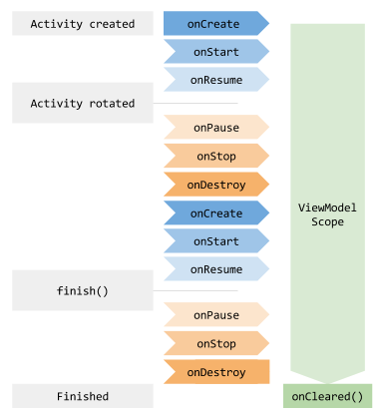
The lifecycle of a ViewModel
https://developer.android.com/topic/libraries/architecture/viewmodel#lifecycle

Slide 37
The lifecycle of a ViewModel
class MyActivity : AppCompatActivity() { override fun onCreate(savedInstanceState: Bundle?) { // Create a ViewModel the first time the system calls an activity's onCreate() method. // Re-created activities receive the same MyViewModel instance created by the first activity. val model = ViewModelProviders.of(this)[MyViewModel::class.java] … } }

Slide 38
Options for preserving UI state
 | ViewModel | Saved instance state | Persistent storage
Storage location | in memory | serialized to disk | on disk or network
Survives configuration change | Yes | Yes | Yes
Survives system-initiated process death | No | Yes | Yes
Survives user complete activity dismissal/onFinish() | No | No | Yes
Data limitations | complex objects are fine, but space is limited by available memory | only for primitive types and simple, small objects such as String | only limited by disk space or cost / time of retrieval from the network resource
Read/write time | quick (memory access only) | slow (requires serialization/deserialization and disk access) | slow (requires disk access or network transaction)
https://developer.android.com/topic/libraries/architecture/saving-states#options_for_preserving_ui_state

Slide 39
Preserving complex UI state
Local persistence: Stores all data you don’t want to lose if you open and close the activity.
Example: A collection of song objects, which could include audio files and metadata.
ViewModel: Stores in memory all the data needed to display the associated UI Controller.
Example: The song objects of the most recent search and the most recent search query.
onSaveInstanceState(): Stores a small amount of data needed to easily reload activity state if the system stops and then recreates the UI Controller. Instead of storing complex objects here, persist the complex objects in local storage and store a unique ID for these objects in onSaveInstanceState().
Example: Storing the most recent search query.
https://developer.android.com/topic/libraries/architecture/saving-states#managing_ui_state_divide_and_conquer

Slide 40
Restoring complex UI state
The activity is recreated after having been stopped by the system. The activity has the query saved in an onSaveInstanceState() bundle, and should pass the query to the ViewModel. The ViewModel sees that it has no search results cached, and delegates loading the search results, using the given search query.
The activity is created after a configuration change. The activity has the query saved in an onSaveInstanceState() bundle, and the ViewModel already has the search results cached. You pass the query from the onSaveInstanceState() bundle to the ViewModel, which determines that it already has loaded the necessary data and that it does not need to re-query the database.
https://developer.android.com/topic/libraries/architecture/saving-states#managing_ui_state_divide_and_conquer

Slide 41
Demo

