Slide 1
Проектирование мобильных приложений
Android: Ресурсы
Кузнецов
Андрей Николаевич
Санкт-Петербургский Государственный
Политехнический Университет
25.02.2016
Creative Commons Attribution-ShareAlike 3.0

Slide 2
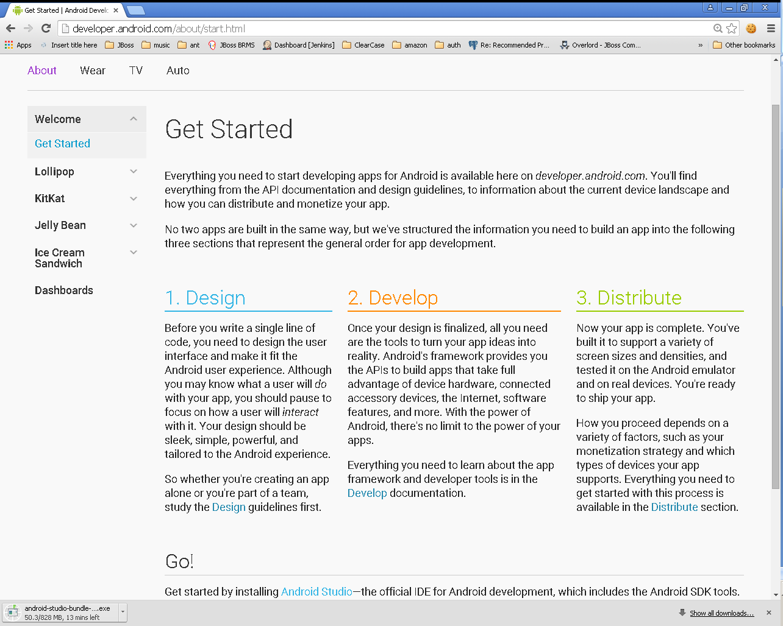
25.02.2016
Creative Commons Attribution-ShareAlike 3.0

Slide 3
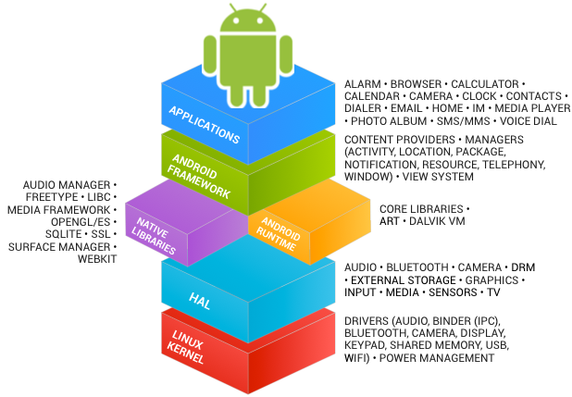
В предыдущих лекциях...
See https://source.android.com/source/index.html
25.02.2016
Creative Commons Attribution-ShareAlike 3.0

Slide 4
В предыдущих лекциях...
Android Studio
Android SDK
  http://developer.android.com/sdk/index.html
Eclipse IDE for Mobile Developers
  http://eclipse.org/mobile/
ADT Plugin для Eclipse
  https://dl-ssl.google.com/android/eclipse/
Java SE Development Kit 7
  http://www.oracle.com/technetwork/java/javase/downloads/jdk7-downloads-1880260.html
25.02.2016
Creative Commons Attribution-ShareAlike 3.0

Slide 5
В предыдущих лекциях...
Activities
Services
Content Providers
Broadcast Receivers
As a developer we need only to call and extend these already defined classes to use in our application.
25.02.2016
Creative Commons Attribution-ShareAlike 3.0

Slide 6
КОМПИЛЯЦИЯ ПРОЕКТА
25.02.2016
Creative Commons Attribution-ShareAlike 3.0

Slide 7
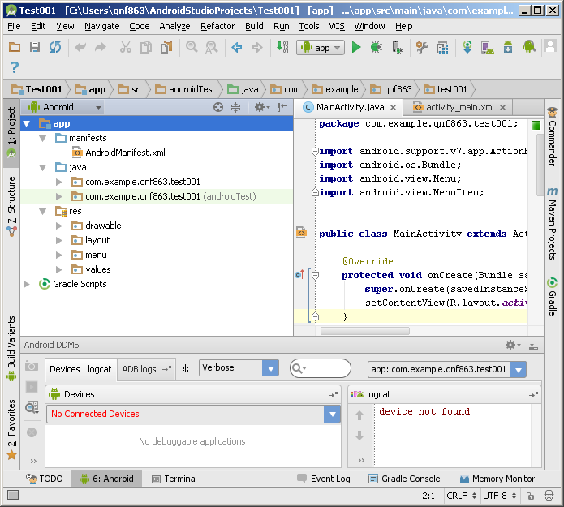
Пример проекта Android
25.02.2016
Creative Commons Attribution-ShareAlike 3.0

Slide 8
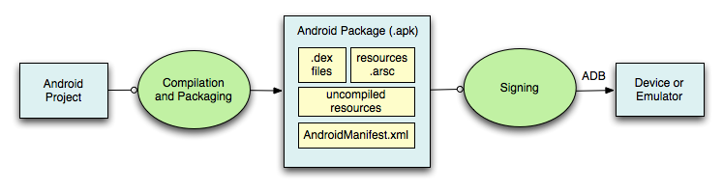
Компиляция Проекта (1)
25.02.2016
Creative Commons Attribution-ShareAlike 3.0

Slide 9
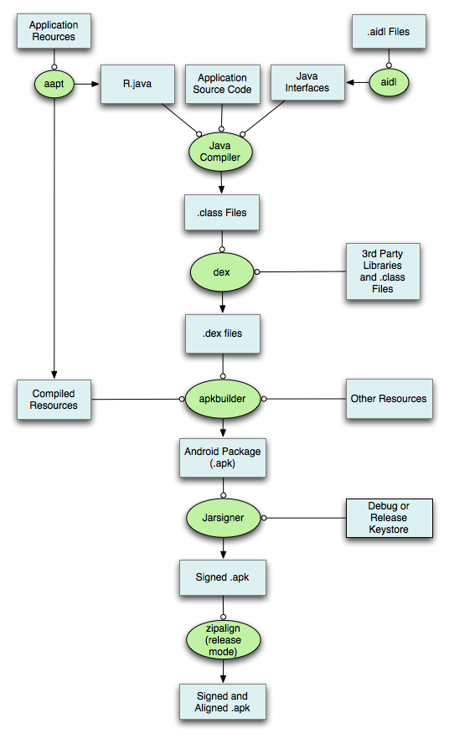
Компиляция Проекта (2)
25.02.2016
Creative Commons Attribution-ShareAlike 3.0

Slide 10
25.02.2016
Creative Commons Attribution-ShareAlike 3.0

Slide 11
РЕСУРСЫ: ОБЗОР
Ресурсы Android
25.02.2016
Creative Commons Attribution-ShareAlike 3.0

Slide 12
Важное замечание
В этой лекции мы узнаем только как определять различные ресурсы, но не использовать ☹
Альтернативные ресурсы будут рассмотрены в отдельной лекции
25.02.2016
Creative Commons Attribution-ShareAlike 3.0

Slide 13
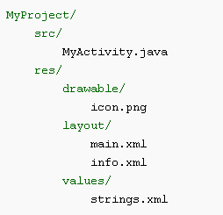
Типы ресурсов
Все ресурсы хранятся в каталоге “res”
Тип ресурса определяется именем подкаталога
25.02.2016
Creative Commons Attribution-ShareAlike 3.0

Slide 14
Типы ресурсов
Имя ресурса | Доступ к ресурсу | Описание
layout/filename.xml | Java: R.layout.filename XML: @[package:]layout/filename | Верстка UI
drawable/filename.??? | Java: R.drawable.filename XML: @[package:]drawable/filename | Графические ресурсы
values/filename.xml | Java: R.<restype>.resname XML: @[package:]<restype>/resname | Значения
<restype> := “array” | “color” | “dimen” | “string” | “style” |
“bool” | “id” | “integer”
Рекомендуется (для удобства) хранить ресурсы разных типов
в разных файлах (values/arrays.xml, values/strings.xml, и т.п.)
25.02.2016
Creative Commons Attribution-ShareAlike 3.0

Slide 15
Типы ресурсов
Имя ресурса | Доступ к ресурсу | Описание
animator/filename.xml | Java: R.animator.filename XML: @[package:]animator/filename | XML файлы для property анимации
anim/filename.xml | Java: R.anim.filename XML: @[package:]anim/filename | XML файлы для tween анимации
color/filename.xml | Java: R.color.filename XML: @[package:]color/filename | XML файлы для color state list
raw/filename.??? | Java: R.raw.filename XML: @[package:]raw/filename | Неинтерпретируемый ресурс
menu/filename.xml | Java: R.menu.filename XML: @[package:]menu/filename | Меню
xml/filename.xml | Java: R.xml.filename XML: @[package:]xml/filename | XML файл произвольной природы
25.02.2016
Creative Commons Attribution-ShareAlike 3.0

Slide 16
Демонстрация
25.02.2016
Creative Commons Attribution-ShareAlike 3.0

Slide 17
LAYOUTS & WIDGETS
Ресурсы Android
25.02.2016
Creative Commons Attribution-ShareAlike 3.0

Slide 18
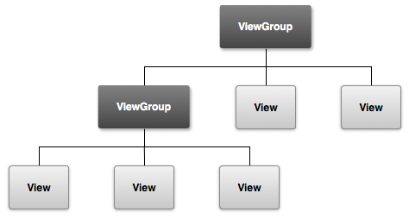
View Hierarchy
http://developer.android.com/guide/topics/ui/overview.html
25.02.2016
Creative Commons Attribution-ShareAlike 3.0

Slide 19
Layout resource (.xml)
<?xml version="1.0" encoding="utf-8"?>
<ViewGroup xmlns:android="http://schemas.android.com/apk/res/android"
android:id="@[+][package:]id/resource_name"
android:layout_height=["dimension" | "fill_parent" | "wrap_content"]
android:layout_width=["dimension" | "fill_parent" | "wrap_content"]
[ViewGroup-specific attributes] >
<View
android:id="@[+][package:]id/resource_name"
android:layout_height=["dimension" | "fill_parent" | "wrap_content"]
android:layout_width=["dimension" | "fill_parent" | "wrap_content"]
[View-specific attributes] >
<requestFocus/>
</View>
<ViewGroup >
<View />
</ViewGroup>
<include layout="@layout/layout_resource"/>
</ViewGroup>
25.02.2016
Creative Commons Attribution-ShareAlike 3.0

Slide 20
android.view.View & android.view.ViewGroup
java.lang.Object
  ↳android.view.View
    ↳android.view.ViewGroup
25.02.2016
Creative Commons Attribution-ShareAlike 3.0

Slide 21
android.view.ViewGroup
Known Direct Subclasses
  AbsoluteLayout, AdapterView<T extends Adapter>, FragmentBreadCrumbs, FrameLayout, GridLayout, LinearLayout, PagerTitleStrip, RelativeLayout, SlidingDrawer, ViewPager
Known Indirect Subclasses
  AbsListView, AbsSpinner, AdapterViewAnimator, AdapterViewFlipper, AppWidgetHostView, CalendarView, DatePicker, DialerFilter, ExpandableListView, FragmentTabHost, Gallery, GestureOverlayView, GridView, ListView and 21 others.
25.02.2016
Creative Commons Attribution-ShareAlike 3.0

Slide 22
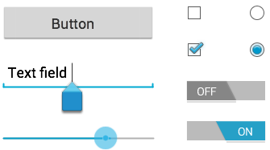
android.view.View
Known Direct Subclasses
  AnalogClock, ImageView, KeyboardView, MediaRouteButton, ProgressBar, Space, SurfaceView, TextView, TextureView, ViewGroup, ViewStub
Known Indirect Subclasses
  AbsListView, AbsSeekBar, AbsSpinner, AbsoluteLayout, AdapterView<T extends Adapter>, AdapterViewAnimator, AdapterViewFlipper, AppWidgetHostView, AutoCompleteTextView, Button, CalendarView, CheckBox, CheckedTextView, and 55 others.
25.02.2016
Creative Commons Attribution-ShareAlike 3.0

Slide 23
Layout resource (.xml)
<?xml version="1.0" encoding="utf-8"?>
<ViewGroup xmlns:android="http://schemas.android.com/apk/res/android"
android:id="@[+][package:]id/resource_name"
android:layout_height=["dimension" | "fill_parent" | "wrap_content"]
android:layout_width=["dimension" | "fill_parent" | "wrap_content"]
[ViewGroup-specific attributes] >
<View
android:id="@[+][package:]id/resource_name"
android:layout_height=["dimension" | "fill_parent" | "wrap_content"]
android:layout_width=["dimension" | "fill_parent" | "wrap_content"]
[View-specific attributes] >
<requestFocus/>
</View>
<ViewGroup >
<View />
</ViewGroup>
<include layout="@layout/layout_resource"/>
</ViewGroup>
25.02.2016
Creative Commons Attribution-ShareAlike 3.0

Slide 24
android:id
"@+id/<name>" – создать новый ресурс типа ID и сослаться на него
"@id/<name>" – ссылка на существующий ресурс типа ID
25.02.2016
Creative Commons Attribution-ShareAlike 3.0

Slide 25
android:layout_height
& android:layout_width
Value | Description
match_parent | Sets the dimension to match that of the parent element. Added in API Level 8 to deprecate fill_parent.
fill_parent | Sets the dimension to match that of the parent element.
wrap_content | Sets the dimension only to the size required to fit the content of this element.
25.02.2016
Creative Commons Attribution-ShareAlike 3.0

Slide 26
Common Controls
Control Type | Description | Related Classes
Button | A push-button that can be pressed, or clicked, by the user to perform an action. | Button
Text field | An editable text field. You can use theAutoCompleteTextView widget to create a text entry widget that provides auto-complete suggestions | EditText, AutoCompleteTextView
Checkbox | An on/off switch that can be toggled by the user. You should use checkboxes when presenting users with a group of selectable options that are not mutually exclusive. | CheckBox
Radio button | Similar to checkboxes, except that only one option can be selected in the group. | RadioGroup RadioButton
http://developer.android.com/guide/topics/ui/controls.html
25.02.2016
Creative Commons Attribution-ShareAlike 3.0

Slide 27
Common Controls
Control Type | Description | Related Classes
Toggle button | An on/off button with a light indicator. | ToggleButton
Spinner | A drop-down list that allows users to select one value from a set. | Spinner
Pickers | A dialog for users to select a single value for a set by using up/down buttons or via a swipe gesture. Use a DatePicker widget to enter the values for the date (month, day, year) or a TimePicker widget to enter the values for a time (hour, minute, AM/PM), which will be formatted automatically for the user's locale. | DatePicker, TimePicker
http://developer.android.com/guide/topics/ui/controls.html
25.02.2016
Creative Commons Attribution-ShareAlike 3.0

Slide 28
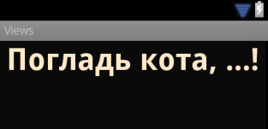
android.widget.TextView
<TextView
android:id="@+id/pat_a_cat"
android:layout_width="fill_parent"
android:layout_height="wrap_content"
android:text="@string/patacat" />
25.02.2016
Creative Commons Attribution-ShareAlike 3.0

Slide 29

android.widget.Button android.widget.ImageButton
<Button
android:layout_width="wrap_content"
android:layout_height="wrap_content"
android:text="@string/button_text” ... />
<ImageButton
android:layout_width="wrap_content"
android:layout_height="wrap_content"
android:src="@drawable/button_icon”... />
<Button
android:layout_width="wrap_content"
android:layout_height="wrap_content"
android:text="@string/button_text”
android:drawableLeft="@drawable/button_icon” ... />
25.02.2016
Creative Commons Attribution-ShareAlike 3.0

Slide 30
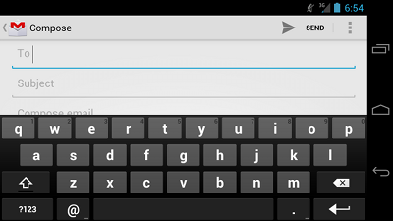
android.widget.EditText
<EditText
android:id="@+id/email_address"
android:layout_width="fill_parent"
android:layout_height="wrap_content"
android:hint="@string/email_hint"
android:inputType="textEmailAddress" />
java.lang.Object
↳ android.view.View
↳ android.widget.TextView
↳ android.widget.EditText
25.02.2016
Creative Commons Attribution-ShareAlike 3.0

Slide 31
android:inputType (1)
"text“
  Normal text keyboard.
"textEmailAddress“
  Normal text keyboard with the @ character.
"textUri“
  Normal text keyboard with the / character.
"number“
  Basic number keypad.
"phone“
  Phone-style keypad.
25.02.2016
Creative Commons Attribution-ShareAlike 3.0

Slide 32
android:inputType (2)
"textCapSentences“
  Normal text keyboard that capitalizes the first letter for each new sentence.
"textCapWords“
  Normal text keyboard that capitalizes every word. Good for titles or person names.
"textAutoCorrect“
  Normal text keyboard that corrects commonly misspelled words.
25.02.2016
Creative Commons Attribution-ShareAlike 3.0

Slide 33
android:inputType (3)
"textPassword“
  Normal text keyboard, but the characters entered turn into dots.
"textMultiLine“
  Normal text keyboard that allow users to input long strings of text that include line breaks (carriage returns).
25.02.2016
Creative Commons Attribution-ShareAlike 3.0

Slide 34
android:inputType (4)
<EditText
android:id="@+id/postal_address"
android:layout_width="fill_parent"
android:layout_height="wrap_content"
android:hint="@string/postal_address_hint"
android:inputType="textPostalAddress|
textCapWords|
textNoSuggestions" />
25.02.2016
Creative Commons Attribution-ShareAlike 3.0

Slide 35

Keyboard Actions
<EditText
android:id="@+id/search"
android:layout_width="fill_parent"
android:layout_height="wrap_content"
android:hint="@string/search_hint"
android:inputType="text"
android:imeOptions="actionSend" />
http://developer.android.com/reference/android/widget/TextView.html#attr_android:imeOptions
25.02.2016
Creative Commons Attribution-ShareAlike 3.0

Slide 36

android.widget.CheckBox
android.widget.Button
↳android.widget.CompoundButton
↳android.widget.CheckBox
<CheckBox android:id="@+id/checkbox_cheese"
android:layout_width="wrap_content"
android:layout_height="wrap_content"
android:text="@string/cheese"/>
25.02.2016
Creative Commons Attribution-ShareAlike 3.0

Slide 37

android.widget.RadioButton
android.widget.Button
↳android.widget.CompoundButton
↳android.widget.RadioButton
<RadioButton android:id="@+id/radio_ninjas"
android:layout_width="wrap_content"
android:layout_height="wrap_content"
android:text="@string/ninjas"/>
25.02.2016
Creative Commons Attribution-ShareAlike 3.0

Slide 38
android.widget.RadioGroup (1)
android.view.View
↳android.view.ViewGroup
↳android.widget.LinearLayout
↳android.widget.RadioGroup
25.02.2016
Creative Commons Attribution-ShareAlike 3.0

Slide 39
android.widget.RadioGroup (2)
<?xml version="1.0" encoding="utf-8"?>
<RadioGroup xmlns:android="http://schemas.android.com/apk/res/android"
android:layout_width="fill_parent"
android:layout_height="wrap_content"
android:orientation="vertical">
<RadioButton android:id="@+id/radio_pirates"
android:layout_width="wrap_content"
android:layout_height="wrap_content"
android:text="@string/pirates"
android:onClick="onRadioButtonClicked"/>
<RadioButton android:id="@+id/radio_ninjas"
android:layout_width="wrap_content"
android:layout_height="wrap_content"
android:text="@string/ninjas"
android:onClick="onRadioButtonClicked"/>
</RadioGroup>
25.02.2016
Creative Commons Attribution-ShareAlike 3.0

Slide 40

android.widget.ToggleButton
android.widget.Button
↳android.widget.CompoundButton
↳android.widget.ToggleButton
<ToggleButton
android:id="@+id/togglebutton"
android:layout_width="wrap_content"
android:layout_height="wrap_content"
android:textOn="On"
android:textOff="off”/>
25.02.2016
Creative Commons Attribution-ShareAlike 3.0

Slide 41
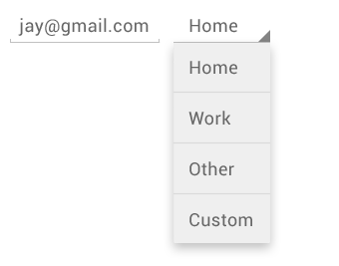
android.widget.Spinner
android.view.ViewGroup
↳android.widget.AdapterView<android.widget.SpinnerAdapter>
↳android.widget.AbsSpinner
↳android.widget.Spinner
<Spinner
android:id="@+id/planets_spinner"
android:layout_width="fill_parent"
android:layout_height="wrap_content" />
25.02.2016
Creative Commons Attribution-ShareAlike 3.0

Slide 42
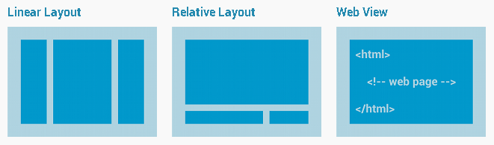
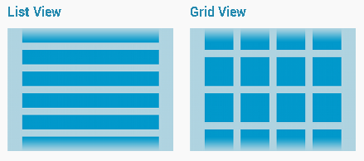
Layout Types
Common
Layouts
Building Layouts
with an Adapter
25.02.2016
Creative Commons Attribution-ShareAlike 3.0

Slide 43
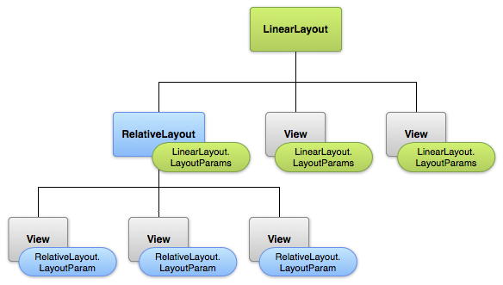
LayoutParams
25.02.2016
Creative Commons Attribution-ShareAlike 3.0

Slide 44
Linear Layout
android.view.View
↳android.view.ViewGroup
↳android.widget.LinearLayout
XML Attributes:
  android:orientation
  android:gravity
  android:layout_gravity
  android:layout_weight
  More: http://developer.android.com/reference/android/widget/LinearLayout.html
25.02.2016
Creative Commons Attribution-ShareAlike 3.0

Slide 45
Relative Layout
android.view.View
↳android.view.ViewGroup
↳android.widget.RelativeLayout
XML Attributes:
  android:gravity
  android:layout_alignParentTop
  android:layout_below
  android:layout_toRightOf
  More: http://developer.android.com/reference/android/widget/RelativeLayout.html
25.02.2016
Creative Commons Attribution-ShareAlike 3.0

Slide 46
RelativeLayout.LayoutParams
Attribute Name | Description
android:layout_above | Positions the bottom edge of this view above the given anchor view ID.
android:layout_alignBaseline | Positions the baseline of this view on the baseline of the given anchor view ID.
android:layout_alignBottom | Makes the bottom edge of this view match the bottom edge of the given anchor view ID.
android:layout_alignEnd | Makes the end edge of this view match the end edge of the given anchor view ID.
android:layout_alignLeft | Makes the left edge of this view match the left edge of the given anchor view ID.
android:layout_alignParentBottom | If true, makes the bottom edge of this view match the bottom edge of the parent.
android:layout_alignParentEnd | If true, makes the end edge of this view match the end edge of the parent.
android:layout_alignParentLeft | If true, makes the left edge of this view match the left edge of the parent.
android:layout_alignParentRight | If true, makes the right edge of this view match the right edge of the parent.
android:layout_alignParentStart | If true, makes the start edge of this view match the start edge of the parent.
android:layout_alignParentTop | If true, makes the top edge of this view match the top edge of the parent.
android:layout_alignRight | Makes the right edge of this view match the right edge of the given anchor view ID.
android:layout_alignStart | Makes the start edge of this view match the start edge of the given anchor view ID.
android:layout_alignTop | Makes the top edge of this view match the top edge of the given anchor view ID.
android:layout_alignWithParentIfMissing | If set to true, the parent will be used as the anchor when the anchor cannot be be found for layout_toLeftOf, layout_toRightOf, etc.
android:layout_below | Positions the top edge of this view below the given anchor view ID.
android:layout_centerHorizontal | If true, centers this child horizontally within its parent.
android:layout_centerInParent | If true, centers this child horizontally and vertically within its parent.
android:layout_centerVertical | If true, centers this child vertically within its parent.
android:layout_toEndOf | Positions the start edge of this view to the end of the given anchor view ID.
android:layout_toLeftOf | Positions the right edge of this view to the left of the given anchor view ID.
android:layout_toRightOf | Positions the left edge of this view to the right of the given anchor view ID.
android:layout_toStartOf | Positions the end edge of this view to the start of the given anchor view ID.
25.02.2016
Creative Commons Attribution-ShareAlike 3.0

Slide 47
Layout: Root Element
ViewGroup
  LinearLayout, RelativeLayout, FrameLayout, etc.
View
  TextView, Button, CheckBox, etc.
<merge>
  An alternative root element that is not drawn in the layout hierarchy
25.02.2016
Creative Commons Attribution-ShareAlike 3.0

Slide 48
<include>
<include layout="@layout/layout_resource“
android:id="@[+][package:]id/resource_name"
android:layout_height=["dimension" | "fill_parent" | "wrap_content"]
android:layout_width=["dimension" | "fill_parent" | "wrap_content"] />
25.02.2016
Creative Commons Attribution-ShareAlike 3.0

Slide 49
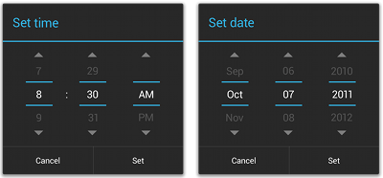
Pickers
android.app.Dialog
↳android.app.AlertDialog
↳android.app.TimePickerDialog
↳android.app.DatePickerDialog
See: http://developer.android.com/guide/topics/ui/controls/pickers.html
25.02.2016
Creative Commons Attribution-ShareAlike 3.0

Slide 50
DRAWABLES
Ресурсы Android
25.02.2016
Creative Commons Attribution-ShareAlike 3.0

Slide 51
Drawable
Bitmap files (png, 9.png, jpg, gif)
  See \Android\android-sdk\tools\draw9patch.bat
State lists
Shapes
25.02.2016
Creative Commons Attribution-ShareAlike 3.0

Slide 52
Drawable: State Lists
Layer List
  A Drawable that manages an array of other Drawables. These are drawn in array order, so the element with the largest index is be drawn on top.
State List
  An XML file that references different bitmap graphics for different states (for example, to use a different image when a button is pressed)
Level List
  An XML file that defines a drawable that manages a number of alternate Drawables, each assigned a maximum numerical value
25.02.2016
Creative Commons Attribution-ShareAlike 3.0

Slide 53

Drawable: Layer List
Определение
<?xml version="1.0" encoding="utf-8"?>
<layer-list
xmlns:android="http://schemas.android.com/apk/res/android" >
<item
android:drawable="@[package:]drawable/drawable_resource"
android:id="@[+][package:]id/resource_name"
android:top="dimension"
android:right="dimension"
android:bottom="dimension"
android:left="dimension" />
</layer-list>
25.02.2016
Creative Commons Attribution-ShareAlike 3.0

Slide 54



Drawable: State List
Определение
<?xml version="1.0" encoding="utf-8"?>
<selector xmlns:android="http://schemas.android.com/apk/res/android"
android:constantSize=["true" | "false"]
android:dither=["true" | "false"]
android:variablePadding=["true" | "false"] >
<item
android:drawable="@[package:]drawable/drawable_resource"
android:state_pressed=["true" | "false"]
android:state_focused=["true" | "false"]
android:state_hovered=["true" | "false"]
android:state_selected=["true" | "false"]
android:state_checkable=["true" | "false"]
android:state_checked=["true" | "false"]
android:state_enabled=["true" | "false"]
android:state_activated=["true" | "false"]
android:state_window_focused=["true" | "false"] />
</selector>
25.02.2016
Creative Commons Attribution-ShareAlike 3.0

Slide 55
Drawable: State List
Пример
<?xml version="1.0" encoding="utf-8"?>
<selector xmlns:android="http://schemas.android.com/apk/res/android">
<item android:state_pressed="true"
android:drawable="@drawable/button_pressed" /> <!-- pressed -->
<item android:state_focused="true"
android:drawable="@drawable/button_focused" /> <!-- focused -->
<item android:state_hovered="true"
android:drawable="@drawable/button_focused" /> <!-- hovered -->
<item android:drawable="@drawable/button_normal" /> <!-- default -->
</selector>
25.02.2016
Creative Commons Attribution-ShareAlike 3.0

Slide 56
Drawable: Level List
Определение
<?xml version="1.0" encoding="utf-8"?>
<level-list
xmlns:android="http://schemas.android.com/apk/res/android" >
<item
android:drawable="@drawable/drawable_resource"
android:maxLevel="integer"
android:minLevel="integer" />
</level-list>
25.02.2016
Creative Commons Attribution-ShareAlike 3.0

Slide 57
Drawable: Level List
Пример
<?xml version="1.0" encoding="utf-8"?>
<level-list xmlns:android="http://schemas.android.com/apk/res/android" >
<item
android:drawable="@drawable/status_off"
android:maxLevel="0" />
<item
android:drawable="@drawable/status_on"
android:maxLevel="1" />
</level-list>
25.02.2016
Creative Commons Attribution-ShareAlike 3.0

Slide 58
Drawable: Other (1)
Transition Drawable
  An XML file that defines a drawable that can cross-fade between two drawable resources
Inset Drawable
  An XML file that defines a drawable that insets another drawable by a specified distance. This is useful when a View needs a background drawble that is smaller than the View's actual bounds.
25.02.2016
Creative Commons Attribution-ShareAlike 3.0

Slide 59
Drawable: Other (2)
Clip Drawable
  An XML file that defines a drawable that clips another Drawable based on this Drawable's current level value
Scale Drawable
  An XML file that defines a drawable that changes the size of another Drawable based on its current level value
25.02.2016
Creative Commons Attribution-ShareAlike 3.0

Slide 60
Drawable: Shape (1)
<?xml version="1.0" encoding="utf-8"?>
<shape
xmlns:android="http://schemas.android.com/apk/res/android"
android:shape=["rectangle" | "oval" | "line" | "ring"] >
<corners
android:radius="integer"
android:topLeftRadius="integer"
android:topRightRadius="integer"
android:bottomLeftRadius="integer"
android:bottomRightRadius="integer" />
<gradient
android:angle="integer"
android:centerX="integer"
android:centerY="integer"
android:centerColor="integer"
android:endColor="color"
android:gradientRadius="integer"
android:startColor="color"
android:type=["linear" | "radial" | "sweep"]
android:useLevel=["true" | "false"] />
25.02.2016
Creative Commons Attribution-ShareAlike 3.0

Slide 61
Drawable: Shape (2)
<padding
android:left="integer"
android:top="integer"
android:right="integer"
android:bottom="integer" />
<size
android:width="integer"
android:height="integer" />
<solid
android:color="color" />
<stroke
android:width="integer"
android:color="color"
android:dashWidth="integer"
android:dashGap="integer" />
</shape>
25.02.2016
Creative Commons Attribution-ShareAlike 3.0

Slide 62
Drawable: Shape
Пример
<?xml version="1.0" encoding="utf-8"?>
<shape xmlns:android="http://schemas.android.com/apk/res/android"
android:shape="rectangle">
<gradient
android:startColor="#FFFF0000"
android:endColor="#80FF00FF"
android:angle="45"/>
<padding android:left="7dp"
android:top="7dp"
android:right="7dp"
android:bottom="7dp" />
<corners android:radius="8dp" />
</shape>
25.02.2016
Creative Commons Attribution-ShareAlike 3.0

Slide 63
VALUES
Ресурсы Android
25.02.2016
Creative Commons Attribution-ShareAlike 3.0

Slide 64
Values
String, String Array, Quantity Strings (Plurals)
Style
Bool
Color
Dimesion
ID
Integer
Integer Array
Typed Array
25.02.2016
Creative Commons Attribution-ShareAlike 3.0

Slide 65
Values: String (1)
String
  XML resource that provides a single string
String Array
  XML resource that provides an array of strings
Quantity Strings (Plurals)
  XML resource that carries different strings for pluralization
25.02.2016
Creative Commons Attribution-ShareAlike 3.0

Slide 66
Values: String (2)
<?xml version="1.0" encoding="utf-8"?>
<resources>
<string
name="string_name"
>text_string</string>
</resources>
<?xml version="1.0" encoding="utf-8"?>
<resources>
<string name="hello">Hello!</string>
</resources>
25.02.2016
Creative Commons Attribution-ShareAlike 3.0

Slide 67
Values: String Array
Определение
<?xml version="1.0" encoding="utf-8"?>
<resources>
<string-array
name="string_array_name">
<item
>text_string</item>
</string-array>
</resources>
25.02.2016
Creative Commons Attribution-ShareAlike 3.0

Slide 68
Values: String Array
Пример
<?xml version="1.0" encoding="utf-8"?>
<resources>
<string-array name="planets_array">
<item>Mercury</item>
<item>Venus</item>
<item>Earth</item>
<item>Mars</item>
</string-array>
</resources>
25.02.2016
Creative Commons Attribution-ShareAlike 3.0

Slide 69
Values: Quantity Strings (Plurals)
Определение
<?xml version="1.0" encoding="utf-8"?>
<resources>
<plurals
name="plural_name">
<item
quantity=["zero" | "one" | "two" | "few" | "many" | "other"]
>text_string</item>
</plurals>
</resources>
25.02.2016
Creative Commons Attribution-ShareAlike 3.0

Slide 70
Values: Quantity Strings (Plurals)
Пример
<?xml version="1.0" encoding="utf-8"?>
<resources>
<plurals name="numberOfSongsAvailable">
<item quantity="one">One song found.</item>
<item quantity="other">%d songs found.</item>
</plurals>
</resources>
<?xml version="1.0" encoding="utf-8"?>
<resources>
<plurals name="numberOfSongsAvailable">
<item quantity="one">Znaleziono jedną piosenkę.</item>
<item quantity="few">Znaleziono %d piosenki.</item>
<item quantity="other">Znaleziono %d piosenek.</item>
</plurals>
</resources>
25.02.2016
Creative Commons Attribution-ShareAlike 3.0

Slide 71
Values (other)
<?xml version="1.0" encoding="utf-8"?>
<resources>
<bool name="screen_small">true</bool>
<color name="translucent_red">#80ff0000</color>
<item type="id" name="button_ok" />
<integer name="max_speed">75</integer>
<integer-array name="bits">
<item>4</item>
<item>8</item>
</integer-array>
<array name="icons">
<item>@drawable/home</item>
<item>@drawable/settings</item>
</array>
<array name="colors">
<item>#FFFF0000</item>
<item>#FF00FF00</item>
</array>
</resources>
25.02.2016
Creative Commons Attribution-ShareAlike 3.0

Slide 72
Values: Dimension (1)
<?xml version="1.0" encoding="utf-8"?>
<resources>
<dimen name="textview_height">25dp</dimen>
<dimen name="textview_width">150dp</dimen>
<dimen name="ball_radius">30dp</dimen>
<dimen name="font_size">16sp</dimen>
</resources>
25.02.2016
Creative Commons Attribution-ShareAlike 3.0

Slide 73
Values: Dimension (2)
“px”
  Pixels
“mm”
  Millimeters
“in”
  Inches
25.02.2016
Creative Commons Attribution-ShareAlike 3.0

Slide 74
Values: Dimension (3)
“dp”
  Density-independent Pixels - An abstract unit that is based on the physical density of the screen.
“sp”
  Scale-independent Pixels - This is like the dp unit, but it is also scaled by the user's font size preference.
“pt”
  Points - 1/72 of an inch.
25.02.2016
Creative Commons Attribution-ShareAlike 3.0

