Slide 1
Проектирование мобильных приложений
Android: Ресурсы
Кузнецов
Андрей Николаевич
Санкт-Петербургский Государственный
Политехнический Университет

Slide 2
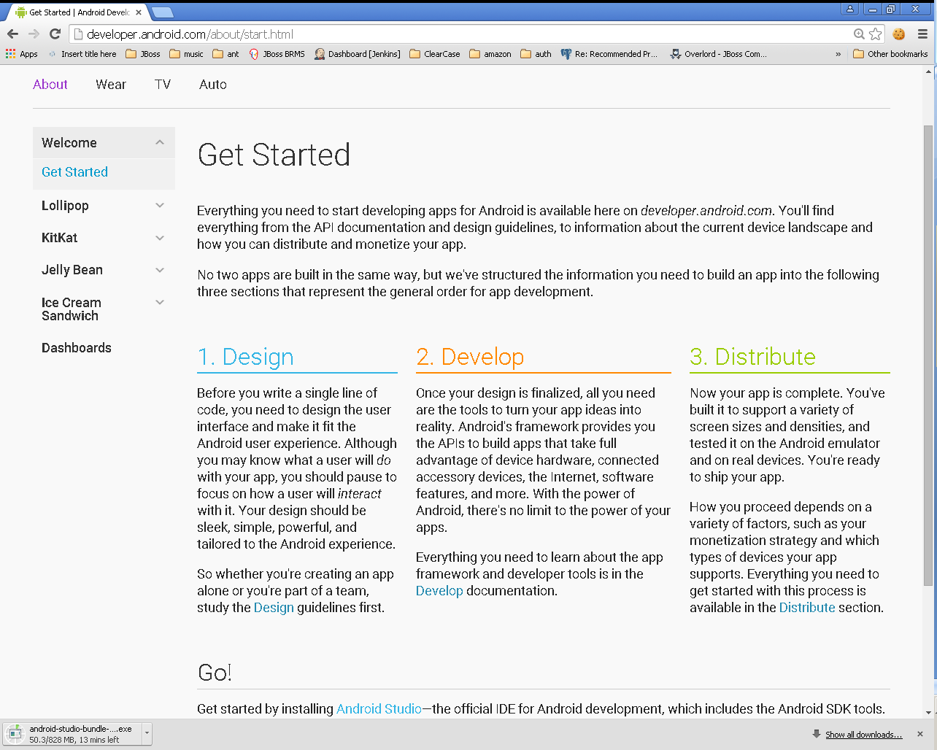

Slide 3
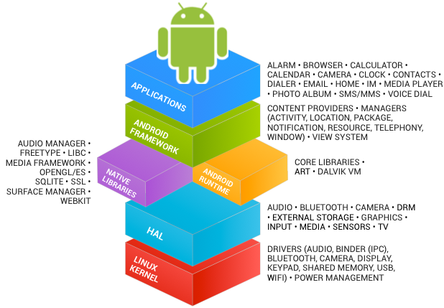
Архитектура ОС Android
See https://source.android.com/source/index.html

Slide 4
В предыдущих лекциях...
Android Studio
  http://developer.android.com/sdk/index.html
IntelliJ Idea (Bundled Android Plugin)
Android SDK
  http://developer.android.com/sdk/index.html
Kotlin & Java

Slide 5
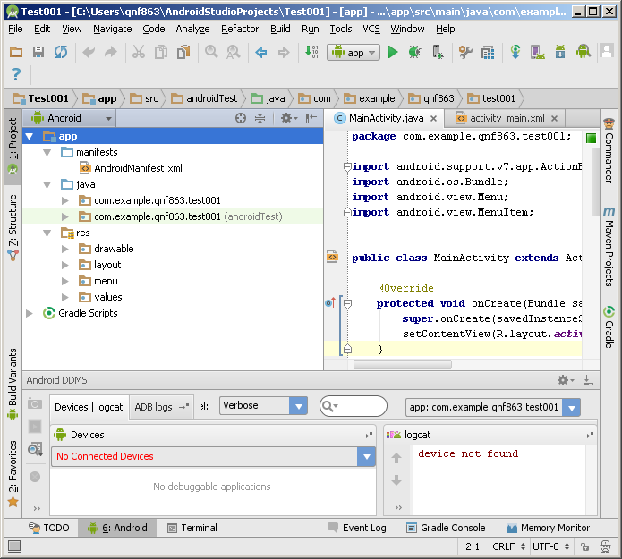
В предыдущих лекциях...

Slide 6
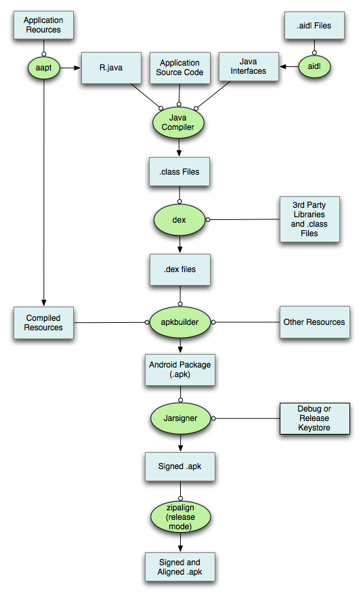

Slide 7
В предыдущих лекциях...
Activities
Services
Content Providers
Broadcast Receivers
As a developer we need only to call and extend these already defined classes to use in our application.

Slide 8
Ресурсы: Обзор
Ресурсы Android

Slide 9
Важное замечание
В этой лекции мы узнаем только как определять различные ресурсы, но не использовать

Slide 10
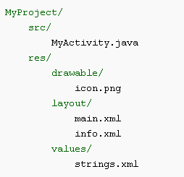
Типы ресурсов
Все ресурсы хранятся в каталоге “res”
Тип ресурса определяется именем подкаталога

Slide 11
Типы ресурсов
Имя ресурса | Доступ к ресурсу | Описание
layout/filename.xml | Java: R.layout.filename XML: @[package:]layout/filename | Верстка UI
drawable/filename.??? | Java: R.drawable.filename XML: @[package:]drawable/filename | Графические ресурсы
values/filename.xml | Java: R.<restype>.resname XML: @[package:]<restype>/resname | Значения
<restype> := “array” | “color” | “dimen” | “string” | “style” |
“bool” | “id” | “integer”
Рекомендуется (для удобства) хранить ресурсы разных типов
в разных файлах (values/arrays.xml, values/strings.xml, и т.п.)

Slide 12
Типы ресурсов
Имя ресурса | Доступ к ресурсу | Описание
animator/filename.xml | Java: R.animator.filename XML: @[package:]animator/filename | XML файлы для property анимации
anim/filename.xml | Java: R.anim.filename XML: @[package:]anim/filename | XML файлы для tween анимации
color/filename.xml | Java: R.color.filename XML: @[package:]color/filename | XML файлы для color state list
raw/filename.??? | Java: R.raw.filename XML: @[package:]raw/filename | Неинтерпретируемый ресурс
menu/filename.xml | Java: R.menu.filename XML: @[package:]menu/filename | Меню
xml/filename.xml | Java: R.xml.filename XML: @[package:]xml/filename | XML файл произвольной природы

Slide 13
Layouts & Widgets
Ресурсы Android

Slide 14
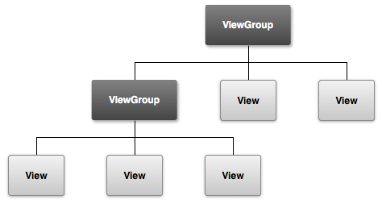
View Hierarchy
http://developer.android.com/guide/topics/ui/overview.html

Slide 15
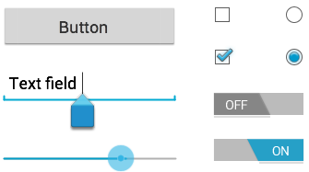
android.view.View
Known Direct Subclasses
  AnalogClock, ImageView, KeyboardView, MediaRouteButton, ProgressBar, Space, SurfaceView, TextView, TextureView, ViewGroup, ViewStub
Known Indirect Subclasses
  AbsListView, AbsSeekBar, AbsSpinner, AbsoluteLayout, AdapterView<T extends Adapter>, AdapterViewAnimator, AdapterViewFlipper, AppWidgetHostView, AutoCompleteTextView, Button, CalendarView, CheckBox, CheckedTextView, and 55 others.

Slide 16
android.view.ViewGroup
Known Direct Subclasses
  AbsoluteLayout, AdapterView<T extends Adapter>, FragmentBreadCrumbs, FrameLayout, GridLayout, LinearLayout, PagerTitleStrip, RelativeLayout, SlidingDrawer, ViewPager
Known Indirect Subclasses
  AbsListView, AbsSpinner, AdapterViewAnimator, AdapterViewFlipper, AppWidgetHostView, CalendarView, DatePicker, DialerFilter, ExpandableListView, FragmentTabHost, Gallery, GestureOverlayView, GridView, ListView and 21 others.

Slide 17
android.view.View & android.view.ViewGroup
java.lang.Object
↳android.view.View
↳android.view.ViewGroup

Slide 18
Layout resource (.xml)
<?xml version="1.0" encoding="utf-8"?>
<ViewGroup xmlns:android="http://schemas.android.com/apk/res/android"
android:id="@[+][package:]id/resource_name"
android:layout_height=["dimension" | "match_parent" | "wrap_content"]
android:layout_width=["dimension" | "match_parent" | "wrap_content"]
[ViewGroup-specific attributes] >
<View
android:id="@[+][package:]id/resource_name"
android:layout_height=["dimension" | "match_parent" | "wrap_content"]
android:layout_width=["dimension" | "match_parent" | "wrap_content"]
[View-specific attributes] >
<requestFocus/>
</View>
<ViewGroup >
<View />
</ViewGroup>
<include layout="@layout/layout_resource"/>
</ViewGroup>

Slide 19
android:id
"@+id/<name>" – создать новый ресурс типа ID и сослаться на него
"@id/<name>" – ссылка на существующий ресурс типа ID

Slide 20
android:layout_height
& android:layout_width
Value | Description
match_parent | Sets the dimension to match that of the parent element. Added in API Level 8 to deprecate fill_parent.
fill_parent | Sets the dimension to match that of the parent element.
wrap_content | Sets the dimension only to the size required to fit the content of this element.

Slide 21
Common Controls
Control Type | Description | Related Classes
Button | A push-button that can be pressed, or clicked, by the user to perform an action. | Button
Text field | An editable text field. You can use theAutoCompleteTextView widget to create a text entry widget that provides auto-complete suggestions | EditText, AutoCompleteTextView
Checkbox | An on/off switch that can be toggled by the user. You should use checkboxes when presenting users with a group of selectable options that are not mutually exclusive. | CheckBox
Radio button | Similar to checkboxes, except that only one option can be selected in the group. | RadioGroup RadioButton
http://developer.android.com/guide/topics/ui/controls.html

Slide 22
Common Controls
Control Type | Description | Related Classes
Toggle button | An on/off button with a light indicator. | ToggleButton
Spinner | A drop-down list that allows users to select one value from a set. | Spinner
Pickers | A dialog for users to select a single value for a set by using up/down buttons or via a swipe gesture. Use a DatePicker widget to enter the values for the date (month, day, year) or a TimePicker widget to enter the values for a time (hour, minute, AM/PM), which will be formatted automatically for the user's locale. | DatePicker, TimePicker
http://developer.android.com/guide/topics/ui/controls.html

Slide 23
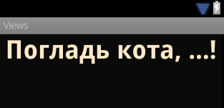
android.widget.TextView
<TextView
android:id="@+id/pat_a_cat"
android:layout_width="fill_parent"
android:layout_height="wrap_content"
android:text="@string/patacat" />

Slide 24

android.widget.Button android.widget.ImageButton
<Button
android:layout_width="wrap_content"
android:layout_height="wrap_content"
android:text="@string/button_text” ... />
<ImageButton
android:layout_width="wrap_content"
android:layout_height="wrap_content"
android:src="@drawable/button_icon”... />
<Button
android:layout_width="wrap_content"
android:layout_height="wrap_content"
android:text="@string/button_text”
android:drawableLeft="@drawable/button_icon” ... />

Slide 25
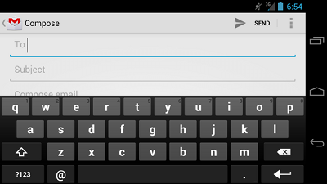
android.widget.EditText
<EditText
android:id="@+id/email_address"
android:layout_width="fill_parent"
android:layout_height="wrap_content"
android:hint="@string/email_hint"
android:inputType="textEmailAddress" />
java.lang.Object
↳ android.view.View
↳ android.widget.TextView
↳ android.widget.EditText

Slide 26
android:inputType (1)
"text“
  Normal text keyboard.
"textEmailAddress“
  Normal text keyboard with the @ character.
"textUri“
  Normal text keyboard with the / character.
"number“
  Basic number keypad.
"phone“
  Phone-style keypad.

Slide 27
android:inputType (2)
"textCapSentences“
  Normal text keyboard that capitalizes the first letter for each new sentence.
"textCapWords“
  Normal text keyboard that capitalizes every word. Good for titles or person names.
"textAutoCorrect“
  Normal text keyboard that corrects commonly misspelled words.

Slide 28
android:inputType (3)
"textPassword“
  Normal text keyboard, but the characters entered turn into dots.
"textMultiLine“
  Normal text keyboard that allow users to input long strings of text that include line breaks (carriage returns).

Slide 29
android:inputType (4)
<EditText
android:id="@+id/postal_address"
android:layout_width="fill_parent"
android:layout_height="wrap_content"
android:hint="@string/postal_address_hint"
android:inputType="textPostalAddress|
textCapWords|
textNoSuggestions" />

Slide 30

Keyboard Actions
<EditText
android:id="@+id/search"
android:layout_width="fill_parent"
android:layout_height="wrap_content"
android:hint="@string/search_hint"
android:inputType="text"
android:imeOptions="actionSend" />
http://developer.android.com/reference/android/widget/TextView.html#attr_android:imeOptions

Slide 31

android.widget.CheckBox
android.widget.Button
↳android.widget.CompoundButton
↳android.widget.CheckBox
<CheckBox android:id="@+id/checkbox_cheese"
android:layout_width="wrap_content"
android:layout_height="wrap_content"
android:text="@string/cheese"/>

Slide 32

android.widget.RadioButton
android.widget.Button
↳android.widget.CompoundButton
↳android.widget.RadioButton
<RadioButton android:id="@+id/radio_ninjas"
android:layout_width="wrap_content"
android:layout_height="wrap_content"
android:text="@string/ninjas"/>

Slide 33
android.widget.RadioGroup (1)
android.view.View
↳android.view.ViewGroup
↳android.widget.LinearLayout
↳android.widget.RadioGroup

Slide 34
android.widget.RadioGroup (2)
<?xml version="1.0" encoding="utf-8"?>
<RadioGroup xmlns:android="http://schemas.android.com/apk/res/android"
android:layout_width="fill_parent"
android:layout_height="wrap_content"
android:orientation="vertical">
<RadioButton android:id="@+id/radio_pirates"
android:layout_width="wrap_content"
android:layout_height="wrap_content"
android:text="@string/pirates"
android:onClick="onRadioButtonClicked"/>
<RadioButton android:id="@+id/radio_ninjas"
android:layout_width="wrap_content"
android:layout_height="wrap_content"
android:text="@string/ninjas"
android:onClick="onRadioButtonClicked"/>
</RadioGroup>

Slide 35

android.widget.ToggleButton
android.widget.Button
↳android.widget.CompoundButton
↳android.widget.ToggleButton
<ToggleButton
android:id="@+id/togglebutton"
android:layout_width="wrap_content"
android:layout_height="wrap_content"
android:textOn="On"
android:textOff="off”/>

Slide 36
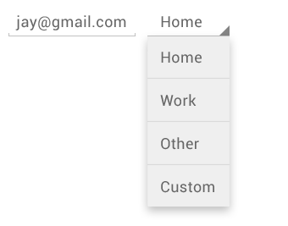
android.widget.Spinner
android.view.ViewGroup
↳android.widget.AdapterView<android.widget.SpinnerAdapter>
↳android.widget.AbsSpinner
↳android.widget.Spinner
<Spinner
android:id="@+id/planets_spinner"
android:layout_width="fill_parent"
android:layout_height="wrap_content" />

Slide 37
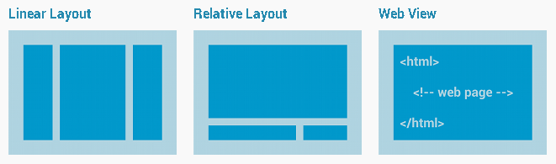
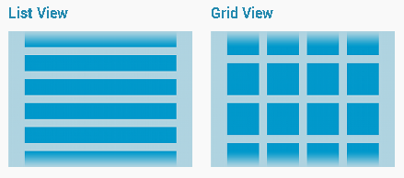
Layout Types
Common
Layouts
Building Layouts
with an Adapter

Slide 38
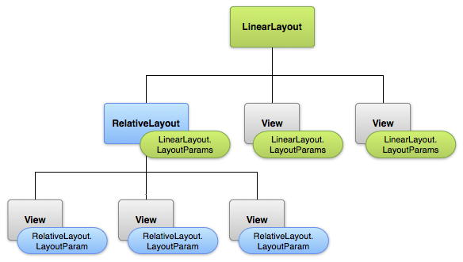
LayoutParams

Slide 39
Linear Layout
android.view.View
↳android.view.ViewGroup
↳android.widget.LinearLayout
XML Attributes:
  android:orientation
  android:gravity
  android:layout_gravity
  android:layout_weight
  More: http://developer.android.com/reference/android/widget/LinearLayout.html

Slide 40
Constraint Layout
android.view.View
↳android.view.ViewGroup
↳androidx.constraintlayout.widget.ConstraintLayout
XML Attributes:
  android:gravity
  app:layout_constraintBottom_toTopOf
  app:layout_constraintHorizontal_bias
  app:layout_constraintStart_toStartOf
  More: https://developer.android.com/reference/androidx/constraintlayout/widget/ConstraintLayout

Slide 41
Layout: Root Element
ViewGroup
  LinearLayout, RelativeLayout, FrameLayout, etc.
View
  TextView, Button, CheckBox, etc.
<merge>
  An alternative root element that is not drawn in the layout hierarchy

Slide 42
<include>
<include layout="@layout/layout_resource“
android:id="@[+][package:]id/resource_name"
android:layout_height=["dimension" | "fill_parent" | "wrap_content"]
android:layout_width=["dimension" | "fill_parent" | "wrap_content"] />

Slide 43
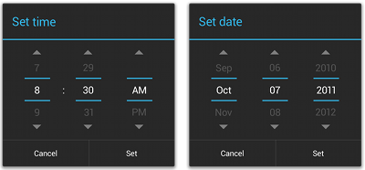
Pickers
android.app.Dialog
↳android.app.AlertDialog
↳android.app.TimePickerDialog
↳android.app.DatePickerDialog
See: http://developer.android.com/guide/topics/ui/controls/pickers.html

Slide 44
Drawables
Ресурсы Android

Slide 45
Drawable
Bitmap files (png, 9.png, jpg, gif)
State lists
Shapes

Slide 46
Drawable: State Lists
Layer List
  A Drawable that manages an array of other Drawables. These are drawn in array order, so the element with the largest index is be drawn on top.
State List
  An XML file that references different bitmap graphics for different states (for example, to use a different image when a button is pressed)
Level List
  An XML file that defines a drawable that manages a number of alternate Drawables, each assigned a maximum numerical value

Slide 47

Drawable: Layer List
Определение
<?xml version="1.0" encoding="utf-8"?>
<layer-list
xmlns:android="http://schemas.android.com/apk/res/android" >
<item
android:drawable="@[package:]drawable/drawable_resource"
android:id="@[+][package:]id/resource_name"
android:top="dimension"
android:right="dimension"
android:bottom="dimension"
android:left="dimension" />
</layer-list>

Slide 48



Drawable: State List
Определение
<?xml version="1.0" encoding="utf-8"?>
<selector xmlns:android="http://schemas.android.com/apk/res/android"
android:constantSize=["true" | "false"]
android:dither=["true" | "false"]
android:variablePadding=["true" | "false"] >
<item
android:drawable="@[package:]drawable/drawable_resource"
android:state_pressed=["true" | "false"]
android:state_focused=["true" | "false"]
android:state_hovered=["true" | "false"]
android:state_selected=["true" | "false"]
android:state_checkable=["true" | "false"]
android:state_checked=["true" | "false"]
android:state_enabled=["true" | "false"]
android:state_activated=["true" | "false"]
android:state_window_focused=["true" | "false"] />
</selector>

Slide 49
Drawable: State List
Пример
<?xml version="1.0" encoding="utf-8"?>
<selector xmlns:android="http://schemas.android.com/apk/res/android">
<item android:state_pressed="true"
android:drawable="@drawable/button_pressed" /> <!-- pressed -->
<item android:state_focused="true"
android:drawable="@drawable/button_focused" /> <!-- focused -->
<item android:state_hovered="true"
android:drawable="@drawable/button_focused" /> <!-- hovered -->
<item android:drawable="@drawable/button_normal" /> <!-- default -->
</selector>

Slide 50
Drawable: Level List
Определение
<?xml version="1.0" encoding="utf-8"?>
<level-list
xmlns:android="http://schemas.android.com/apk/res/android" >
<item
android:drawable="@drawable/drawable_resource"
android:maxLevel="integer"
android:minLevel="integer" />
</level-list>

Slide 51
Drawable: Level List
Пример
<?xml version="1.0" encoding="utf-8"?>
<level-list xmlns:android="http://schemas.android.com/apk/res/android" >
<item
android:drawable="@drawable/status_off"
android:maxLevel="0" />
<item
android:drawable="@drawable/status_on"
android:maxLevel="1" />
</level-list>

Slide 52
Drawable: Other (1)
Transition Drawable
  An XML file that defines a drawable that can cross-fade between two drawable resources
Inset Drawable
  An XML file that defines a drawable that insets another drawable by a specified distance. This is useful when a View needs a background drawble that is smaller than the View's actual bounds.

Slide 53
Drawable: Other (2)
Clip Drawable
  An XML file that defines a drawable that clips another Drawable based on this Drawable's current level value
Scale Drawable
  An XML file that defines a drawable that changes the size of another Drawable based on its current level value

Slide 54
Drawable: Shape (1)
<?xml version="1.0" encoding="utf-8"?>
<shape
xmlns:android="http://schemas.android.com/apk/res/android"
android:shape=["rectangle" | "oval" | "line" | "ring"] >
<corners
android:radius="integer"
android:topLeftRadius="integer"
android:topRightRadius="integer"
android:bottomLeftRadius="integer"
android:bottomRightRadius="integer" />
<gradient
android:angle="integer"
android:centerX="integer"
android:centerY="integer"
android:centerColor="integer"
android:endColor="color"
android:gradientRadius="integer"
android:startColor="color"
android:type=["linear" | "radial" | "sweep"]
android:useLevel=["true" | "false"] />

Slide 55
Drawable: Shape (2)
<padding
android:left="integer"
android:top="integer"
android:right="integer"
android:bottom="integer" />
<size
android:width="integer"
android:height="integer" />
<solid
android:color="color" />
<stroke
android:width="integer"
android:color="color"
android:dashWidth="integer"
android:dashGap="integer" />
</shape>

Slide 56
Drawable: Shape
Пример
<?xml version="1.0" encoding="utf-8"?>
<shape xmlns:android="http://schemas.android.com/apk/res/android"
android:shape="rectangle">
<gradient
android:angle="45"
android:endColor="#80FF00FF"
android:startColor="#FFFF0000" />
<padding
android:bottom="7dp"
android:left="7dp"
android:right="7dp"
android:top="7dp" />
<corners android:radius="8dp" />
</shape>

Slide 57
Values
Ресурсы Android

Slide 58
Values
String, String Array, Quantity Strings (Plurals)
Style
Bool
Color
Dimesion
ID
Integer
Integer Array
Typed Array

Slide 59
Values: String (1)
String
  XML resource that provides a single string
String Array
  XML resource that provides an array of strings
Quantity Strings (Plurals)
  XML resource that carries different strings for pluralization

Slide 60
Values: String (2)
<?xml version="1.0" encoding="utf-8"?>
<resources>
<string
name="string_name"
>text_string</string>
</resources>
<?xml version="1.0" encoding="utf-8"?>
<resources>
<string name="hello">Hello!</string>
</resources>

Slide 61
Values: String Array
Определение
<?xml version="1.0" encoding="utf-8"?>
<resources>
<string-array
name="string_array_name">
<item
>text_string</item>
</string-array>
</resources>

Slide 62
Values: String Array
Пример
<?xml version="1.0" encoding="utf-8"?>
<resources>
<string-array name="planets_array">
<item>Mercury</item>
<item>Venus</item>
<item>Earth</item>
<item>Mars</item>
</string-array>
</resources>

Slide 63
Values: Quantity Strings (Plurals)
Определение
<?xml version="1.0" encoding="utf-8"?>
<resources>
<plurals
name="plural_name">
<item
quantity=["zero" | "one" | "two" | "few" | "many" | "other"]
>text_string</item>
</plurals>
</resources>

Slide 64
Values: Quantity Strings (Plurals)
Пример
<?xml version="1.0" encoding="utf-8"?>
<resources>
<plurals name="numberOfSongsAvailable">
<item quantity="one">One song found.</item>
<item quantity="other">%d songs found.</item>
</plurals>
</resources>
<?xml version="1.0" encoding="utf-8"?>
<resources>
<plurals name="numberOfSongsAvailable">
<item quantity="one">Znaleziono jedną piosenkę.</item>
<item quantity="few">Znaleziono %d piosenki.</item>
<item quantity="other">Znaleziono %d piosenek.</item>
</plurals>
</resources>

Slide 65
Values (other)
<?xml version="1.0" encoding="utf-8"?>
<resources>
<bool name="screen_small">true</bool>
<color name="translucent_red">#80ff0000</color>
<item type="id" name="button_ok" />
<integer name="max_speed">75</integer>
<integer-array name="bits">
<item>4</item>
<item>8</item>
</integer-array>
<array name="icons">
<item>@drawable/home</item>
<item>@drawable/settings</item>
</array>
<array name="colors">
<item>#FFFF0000</item>
<item>#FF00FF00</item>
</array>
</resources>

Slide 66
Values: Dimension (1)
<?xml version="1.0" encoding="utf-8"?>
<resources>
<dimen name="textview_height">25dp</dimen>
<dimen name="textview_width">150dp</dimen>
<dimen name="ball_radius">30dp</dimen>
<dimen name="font_size">16sp</dimen>
</resources>

Slide 67
Values: Dimension (2)
“px”
  Pixels
“mm”
  Millimeters
“in”
  Inches

Slide 68
Values: Dimension (3)
“dp”
  Density-independent Pixels - An abstract unit that is based on the physical density of the screen.
“sp”
  Scale-independent Pixels - This is like the dp unit, but it is also scaled by the user's font size preference.
“pt”
  Points - 1/72 of an inch.

Slide 69
Классное чтение
https://developer.android.com/training/constraint-layout

Slide 70
Демонстрация

