Slide 1

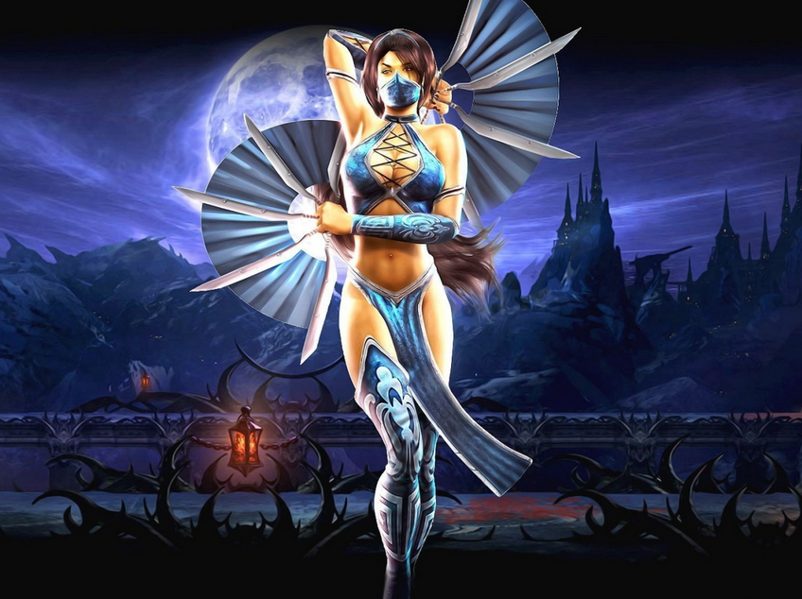
Team “Kitana”
Гергана Георгиева
Симеон Чолаков
Мирослав Димитров
Андрей Трайков
Иван Димитров
Никола Стефанов
Александър Дамянов
Галимир Ганчев
Радослав Георгиев
Иво Александров

Slide 2



Game concept
Vision:
original
interesting
education
Goals:
All General Requirements
All Optional Requirements
All members of team involved
Description:
Single player
English test
Puzzle idea
Time limit
Raising score

Slide 3
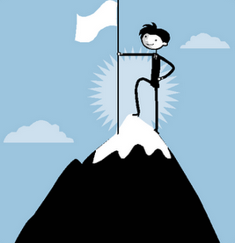
Content
Classes: 6 pcs
Sounds: 3 pcs
Serialization
dimensional arrays: 6 pcs
multi-dimensional array: 6 pcs
existing .NET classes: 3 pcs
exception handlings: 4 pcs
Methods: 20 pcs
uses of external text file: 3 pcs

Slide 4
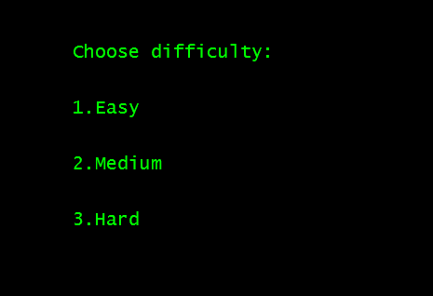

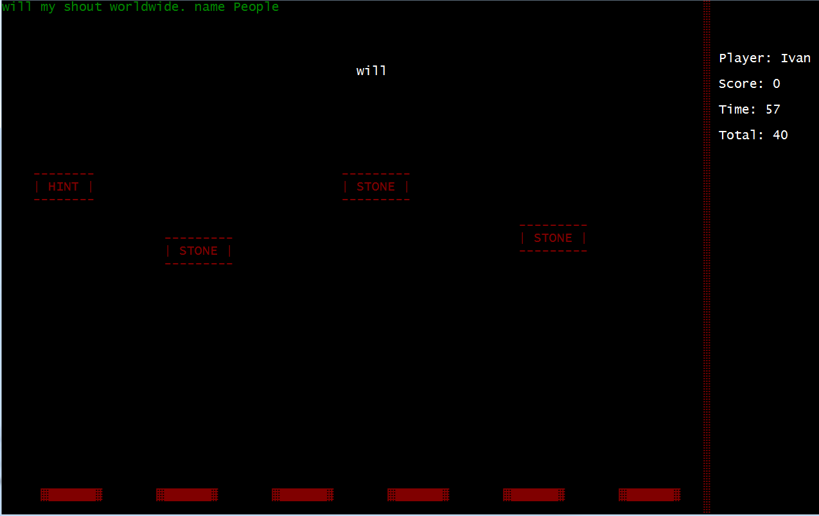
Presentation

Slide 5

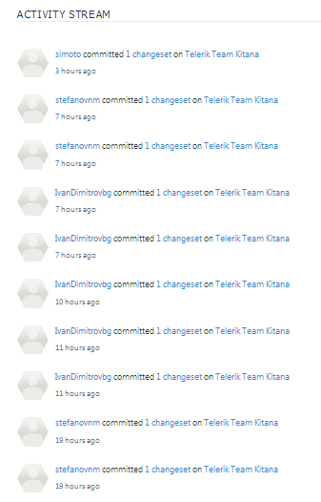
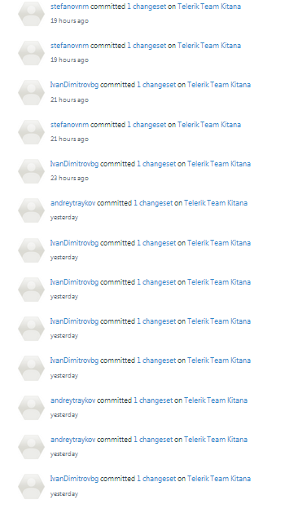
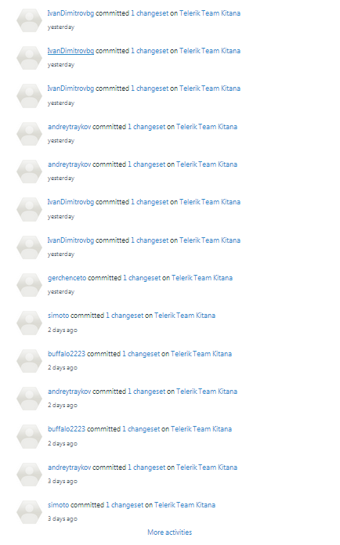
CodePlex

