Slide 1
Soft Body Dynamics
Rope Simulation
331CB
Săceleanu Andrei Iulian
Toader Petru Cătălin

Slide 2
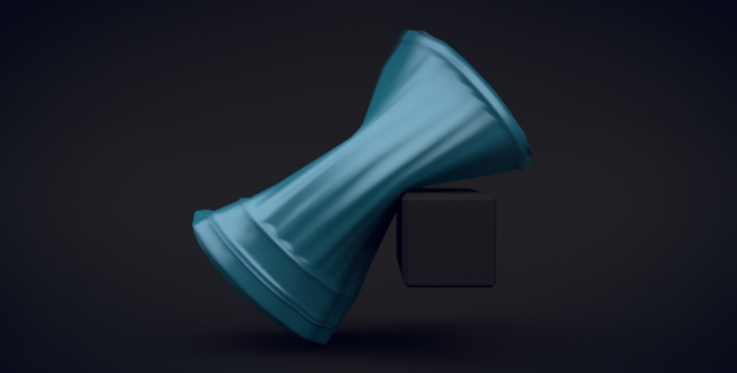
Rigid Bodies vs Soft Bodies
In physics, a rigid body (also known as a rigid object) is a solid body in which deformation is zero or so small it can be neglected. The distance between any two given points on a rigid body remains constant in time regardless of external forces or moments exerted on it.
In contrast, a soft body (or a deformable object) is a body in which deformation can happen and the relative distance of two points on the object is not fixed. While the distances of points are not fixed, the body is expected to retain its shape to some degree (unlike a fluid).
A soft body bending around a rigid body

Slide 3
Soft Body Simulation Approaches
There are multiple ways to simulate a soft body:
Spring/mass models
Finite element simulation
Energy minimization
Shape matching
Rigid body based deformation
The last method is used in Havok Destruction (which can be found in the Unity engine) for deformable objects and the second method is used in Digital Molecular Matter (which has plugins for Autodesk Maya and Autodesk 3ds Max).
Let’s discuss the spring/mass model.

Slide 4
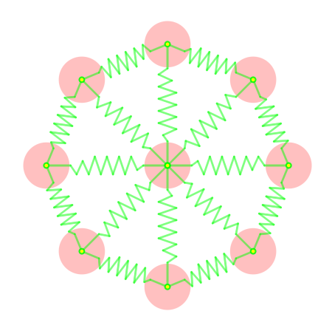
Spring/Mass models
In this approach, the body is modeled as a set of point masses (nodes) connected by ideal weightless elastic springs obeying some variant of Hooke's law.
Applying Newton's second law to the point masses including the forces applied by the springs and any external forces (due to contact, gravity, air resistance, wind, and so on) gives a system of differential equations for the motion of the nodes, which is solved by standard numerical schemes for solving ODEs.
A soft body circle using a spring/mass model

Slide 5
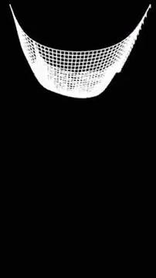
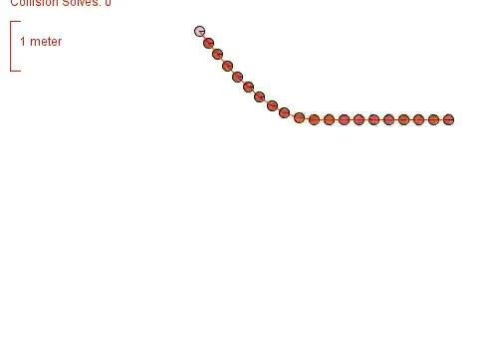
Cloth simulation
Cloth simulators are generally based on mass-spring models. By creating a grid of 2D points connected with springs, you can create fairly realistic simulation of cloth behavior.
This approach can be used with a single line of points to create a rope.

Slide 6
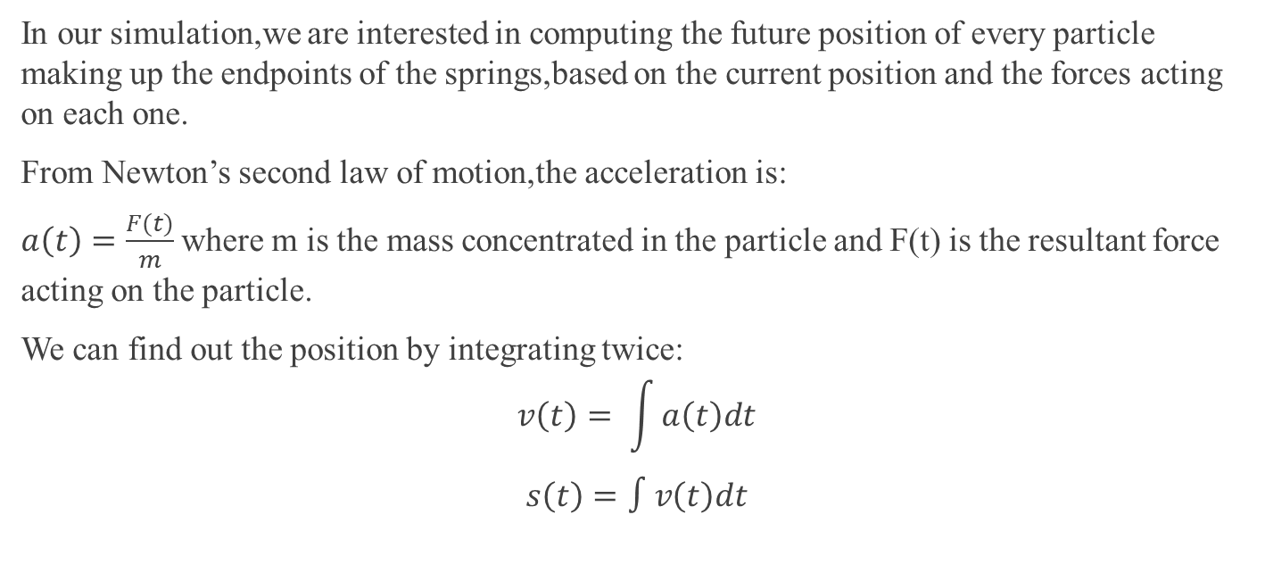
Equations of motion

Slide 7
Equations of motion
If we know the acceleration to be constant(ie. a(t) = a0,where a0 is a constant),our previous
integration steps would yield:
s(t)=s0+v0∗t+a0 ∗t^2/2
where s0 is an initial offset and v0 is the initial speed.
However,in our situation,we cannot assert that ,at every timestep,the acceleration will be constant and,because of this,we won’t be able to obtain an analytic solution(ie position s = f(t),for some function f).
So,the equations need to be solved numerically,by using numerical solvers/integrators.Unlike the analytical solution,the result produced by these solvers will involve a certain error.

Slide 8
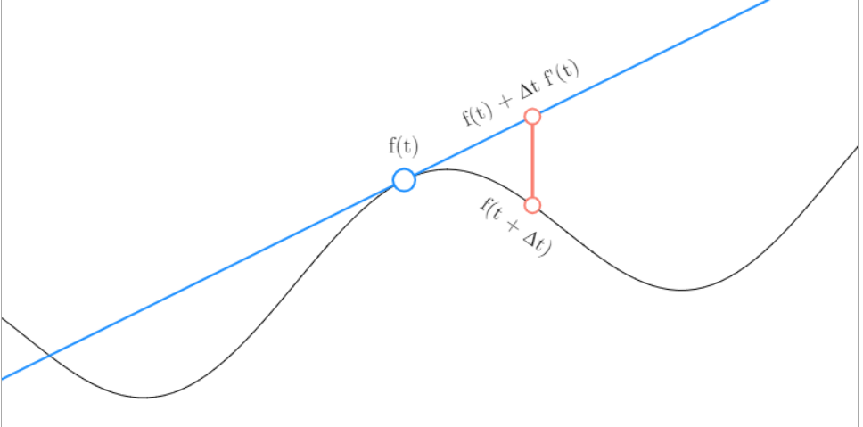



Euler Method

Slide 9





Verlet Integration
The next position of the particle can be computed from the current and previous positions +
the acceleration at the current timestep t (f’’(t) = a(t) = F(t)/m).
Unlike Euler Method,where our global error was O(𝛥t),Verlet Method has O(𝛥t^2).
Higher order of the error means that this second approach yields better accuracy.Moreover,Verlet is more stable at steep changes in velocity.

Slide 10


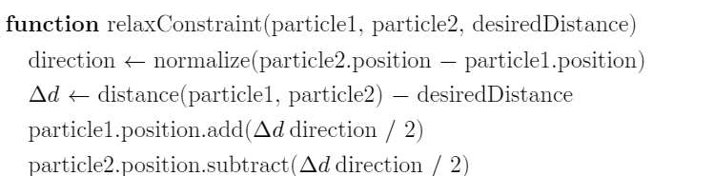
Verlet + Jakobsen Constraints
In order to maintain the general shape of the rope and to prevent unstable behavior due to inaccuracies,the endpoint particles need to be constrained to stay close to one another.
After applying all the forces on the particles and updating positions and velocities using Verlet,we can do several relaxation passes in order to make as many pairwise consecutive distances as possible closer to the desired distance.

Slide 11
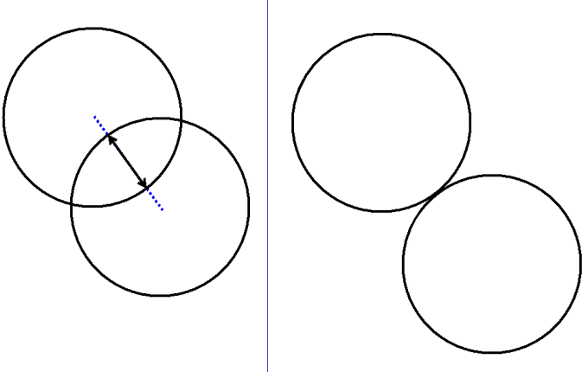
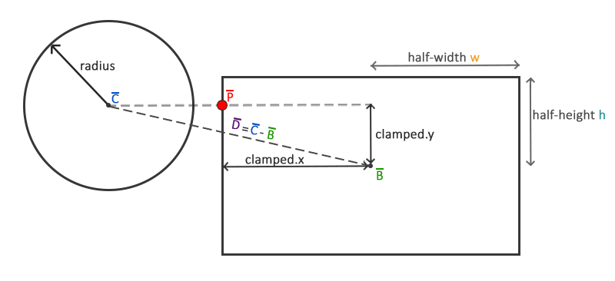
Collision Detection
For our simulated rope,we detect collisions with different obstacles/rigid bodies by checking every endpoint particle(assumed as a circle with a certain small radius).
Collisions with other soft bodies can be approached differently,depending on the type of the other object:
A soft body with a convex hull could be dealt with in a similar way as the rigid variants.
Otherwise, all pairwise combinations with particles and springs could be checked for collision

Slide 12
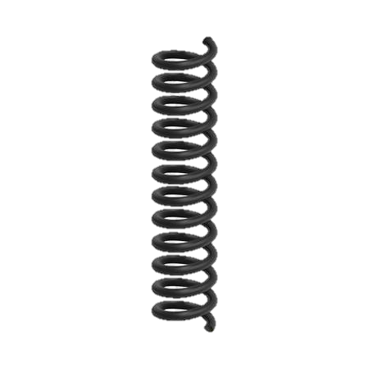
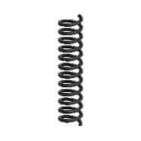
Collision Resolution
Projection-based
For a particle colliding with an obstacle,project its new position at the surface of the obstacle(move it in the direction of the vector V,pointing from the center of the obstacle to the one of the particle) and assign a new velocity(direction given by V,variable magnitude depending on the „bounciness” of the obstacle)
Penalty-based
The boundary of an obstacle could be assumed to be filled with several elastic strings which would thrust outwards any particle which collides(it compresses some string and the elastic will accelerate it outwards)

Slide 13
Collision Resolution
Momentum-based
A force given by the change in momentum is applied to the colliding particle in order to resolve the intersection.In this approach,the obstacle should have a bounding strip where the change in momentum is checked and applied as a force.This should avoid the situation in which the particle has a high speed and ,because of a timestep not small enough,it avoids the surface of the obstacle.

