Slide 1
Remote car monitoring
Coordinator:Mihaela CRISAN-VIDA
Students: Andrei STEFANESCU
Serban MEMA

Slide 2
Description of the project
The objective of the project is to monitorize the interaction of a car with the surrounding environment.
Moreover, the registration status of the vehicle is also recorded.

Slide 3
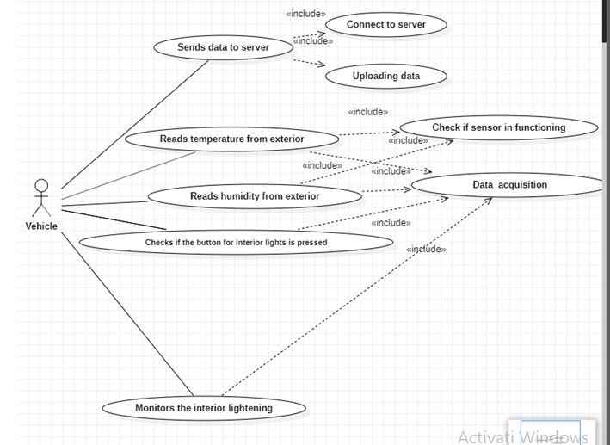
Use case diagrams Vehicle use case diagram

Slide 4
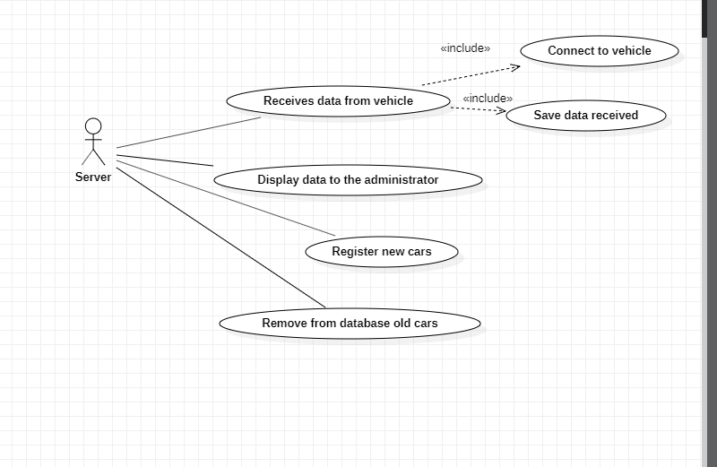
Server use case diagram

Slide 5
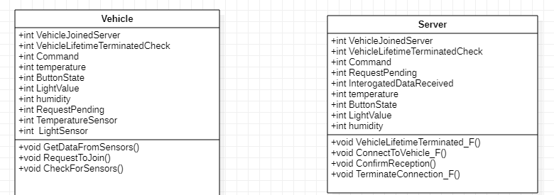
Class diagram

Slide 6
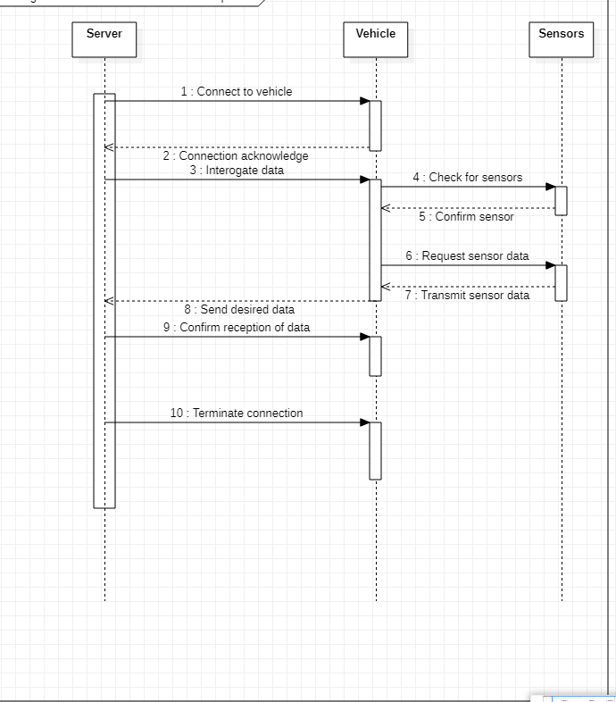
Sequence diagrams Sequence diagram for the communication between the server, the vehicle and the sensors

Slide 7
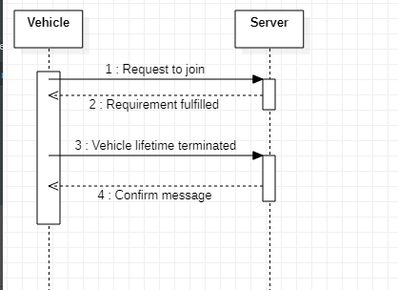
Vehicle management sequence diagram

Slide 8
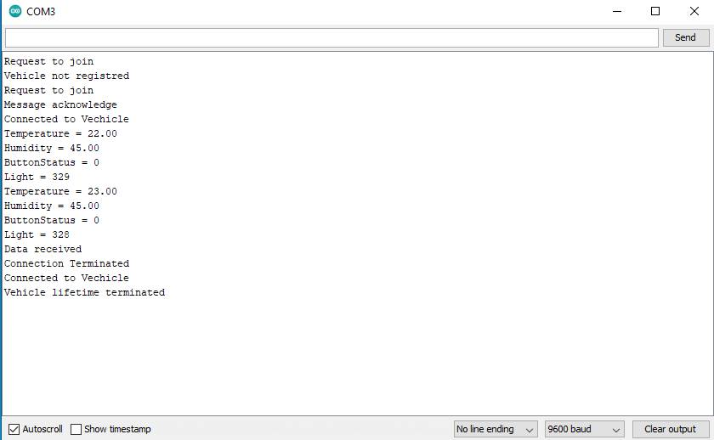
Pictures from the developed project

Slide 9
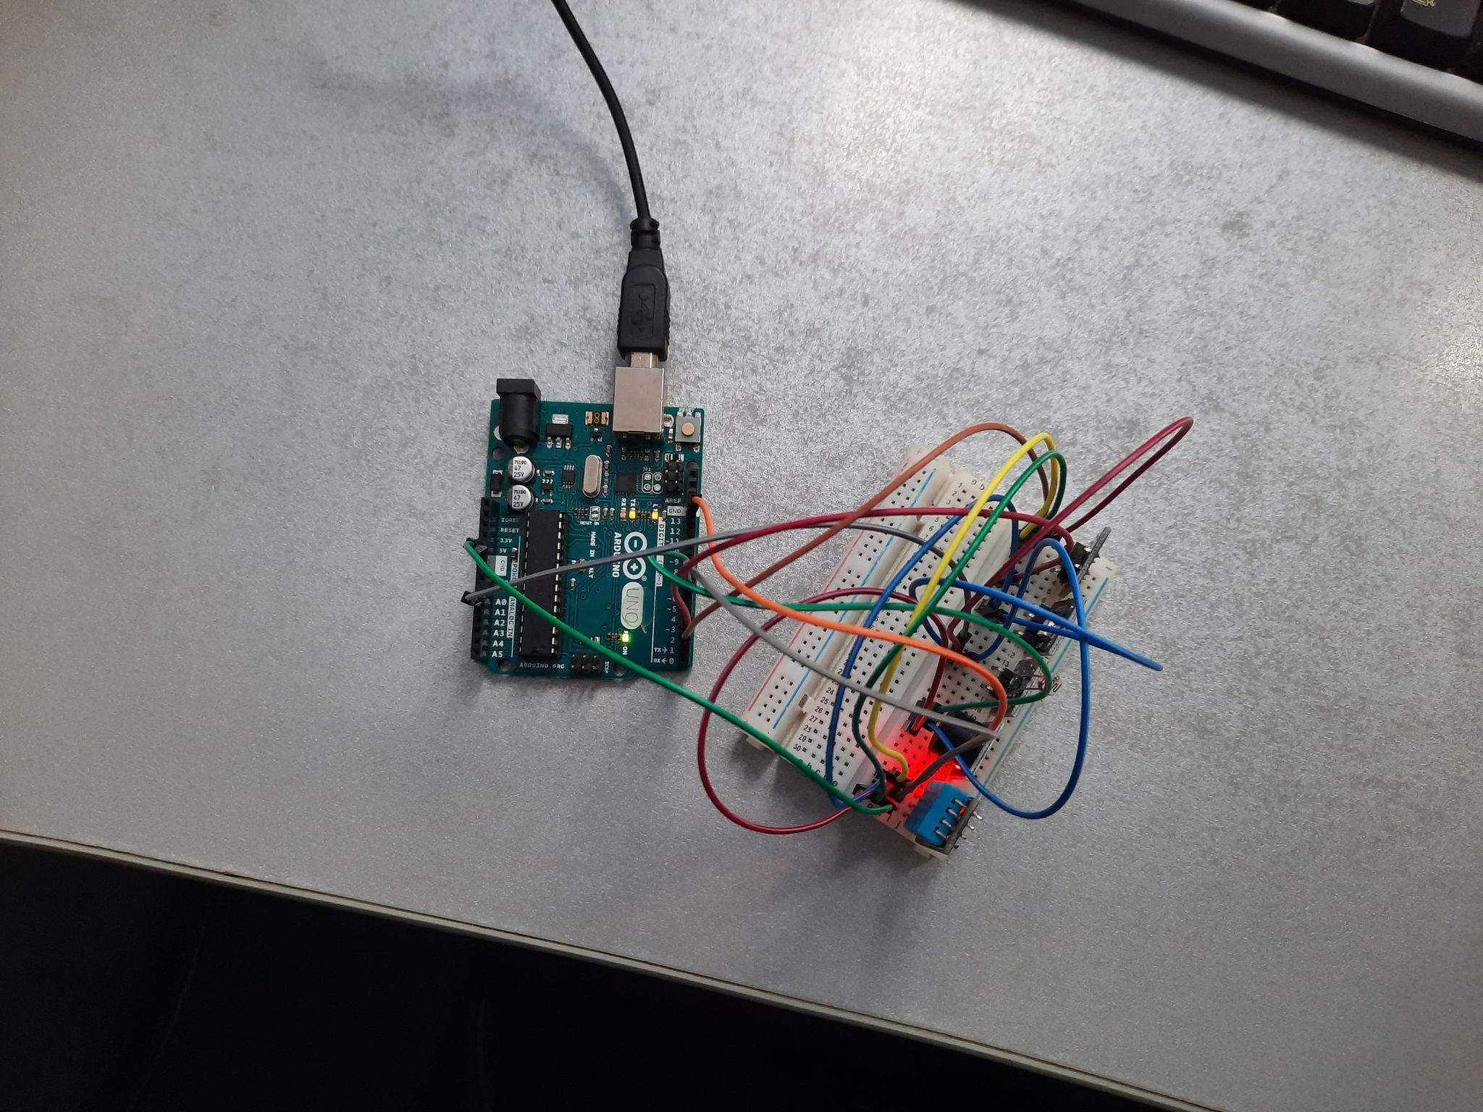

Slide 10
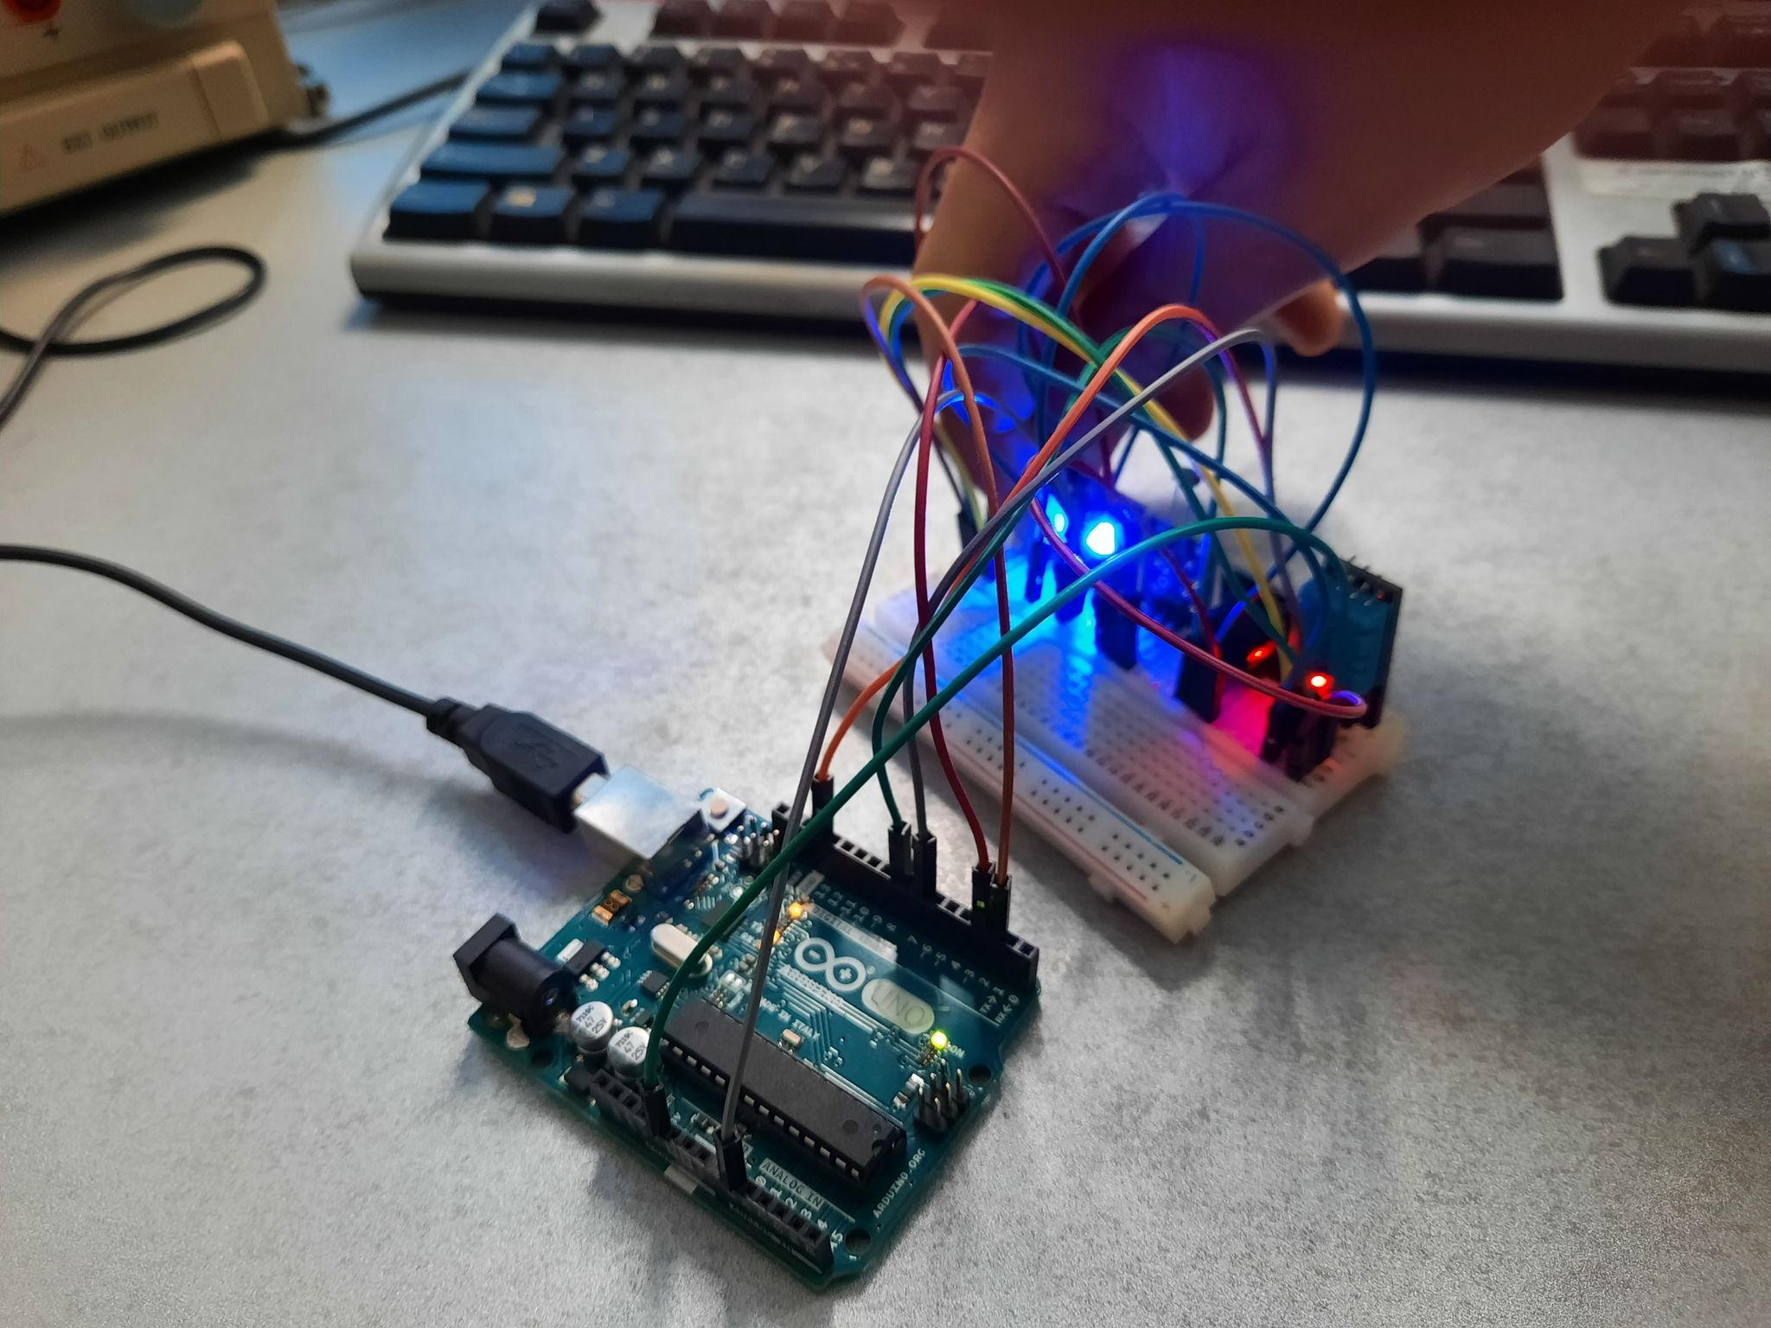

Slide 11
Conclusion
The UML diagrams were very useful in order to have a clear software design before the writing of the source code.

Slide 12
Thank you for you attention! We are open to questions

