Slide 1
AWS IOT COre
ESP8266MOD version

Slide 2
What is AWS IOT?
AWS IoT provides secure, bi-directional communication between Internet-connected devices such as sensors, actuators, embedded micro-controllers, or smart appliances and the AWS Cloud.
You can:
Collect telemetry data to store and analyze
Create mobile applications to control these devices from phones or tablets.

Slide 3
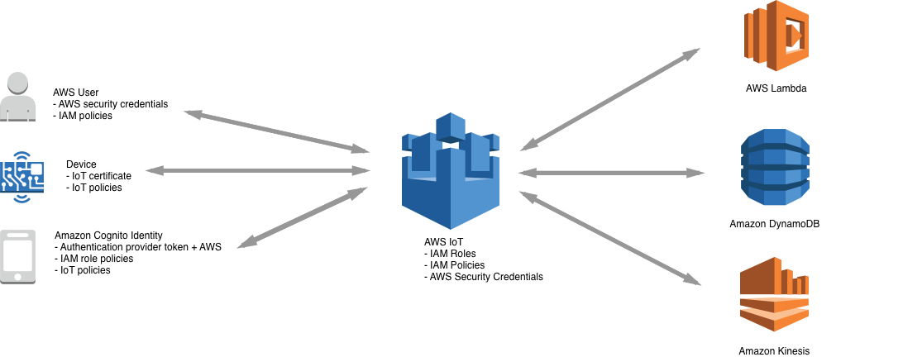
MQTT IN AWS
MQ Telemetry Transport - It is a publish/subscribe messaging protocol

Slide 4

Demo
GITHUB

Slide 5
It IS connected… now what?
AWS IoT rule actions are used to specify what to do when a rule is triggered.

Slide 6
cloudwatchAlarm to change a CloudWatch alarm.
cloudwatchLogs to send data to CloudWatch Logs.
cloudwatchMetric to capture a CloudWatch metric.
dynamoDB to write data to a DynamoDB database.
dynamoDBv2 to write data to a DynamoDB database.
elasticsearch to write data to an Amazon Elasticsearch Service domain.
firehose to write data to an Amazon Kinesis Data Firehose stream.
http to post data to an HTTPS endpoint.
iotAnalytics to send data to an AWS IoT Analytics channel.
iotEvents to send data to an AWS IoT Events input.
iotSiteWise to send data to asset properties in AWS IoT SiteWise.
kinesis to write data to a Kinesis stream.
lambda to invoke a Lambda function.
republish to republish the message on another MQTT topic.
s3 to write data to an Amazon S3 bucket.
salesforce to write a message to a Salesforce IoT input stream.
sns to write data as a push notification.
sqs to write data to an SQS queue.
stepFunctions to start execution of a Step Functions state machine.

Slide 7
Cost
AWS Free Tier with AWS IoT Core
2,250,000 minutes of connection
500,000 messages
225,000 Registry or Device Shadow operations
250,000 rules triggered and 250,000 actions executed
For example, the Free Tier would allow you to run a 50-device workload, where each device:
Connects for 24 hours a day
Exchanges 300 messages per day (message size 5 KB or smaller)
Makes 130 Registry or Device Shadow operations per day (Registry or Device Shadow record size 1 KB or smaller)
Triggers 150 rule executions per day that invoke one action (processed message size 5 KB or smaller)

Slide 8


Thank you!
Questions?

