Slide 1
Title (0:30)
MSA Detector: Automated Detection of Architectural Anti-Patterns in Java Microservices
Author name
Supervisor name
University / Department
Date
Notes:
- Good [morning/afternoon], my name is [Name], and today I present my dissertation on MSA Detector.
- This work focuses on automatically detecting architectural anti-patterns in Java microservice systems.

Slide 2
Agenda (0:20)
Motivation and problem
Objectives and anti-pattern scope
Detection methodology
System architecture and implementation
Evaluation results
Conclusions and future work
Live demo
Notes:
- I will first explain why this problem matters, then show methodology and implementation.
- I will then present evaluation results and finish with a short live demo.

Slide 3
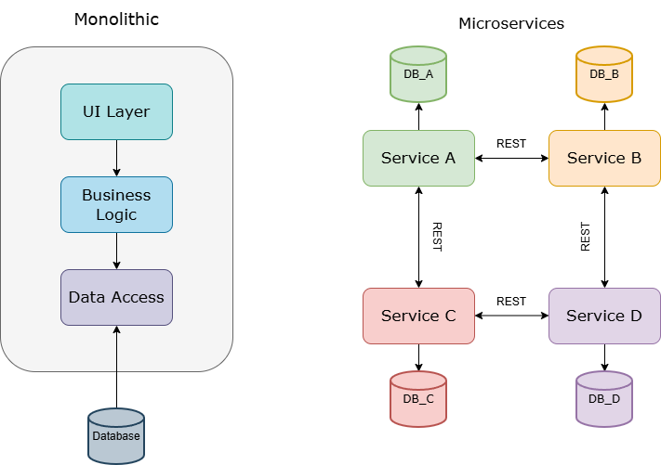
Context and Motivation (1:30)
Microservices improve scalability and deployment independence.
Architectural anti-patterns still emerge in practice.
Manual architecture review is hard to scale.
Need: automated, early, evidence-based detection.
Notes:
- Microservices promise independent deployability, fault isolation, and team autonomy.
- In real projects, anti-patterns such as shared databases and cyclic dependencies silently accumulate as architectural debt.
- The cost of fixing these issues increases over time, which motivates automated detection early in development.

Slide 4
Problem and Objectives (1:30)
Problem:
Existing detection support is fragmented across abstraction levels.
Outputs are often hard to act on.
Objectives:
Detect 8 anti-patterns across 4 dimensions.
Combine code-level and architecture-level analysis.
Provide a composite health score.
Deliver as web app + REST API.
Evaluate on open-source microservice datasets.
Notes:
- The key gap is that many approaches focus either on code smells or on architecture dependencies, but rarely both.
- This dissertation addresses that by combining both levels into one analysis pipeline and presenting actionable evidence.

Slide 5
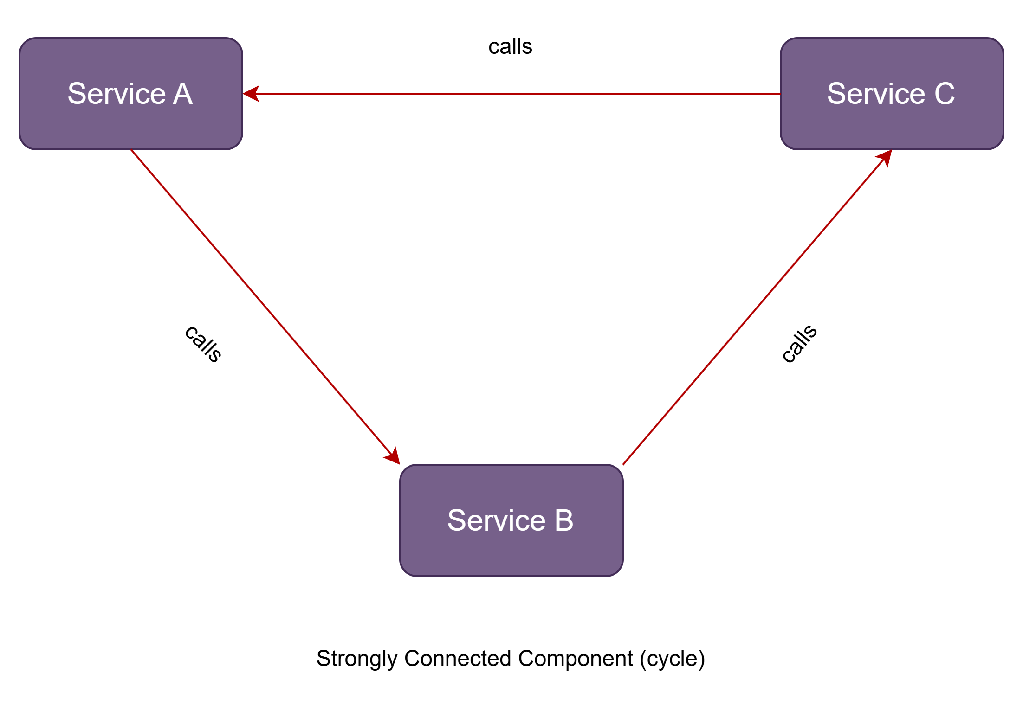
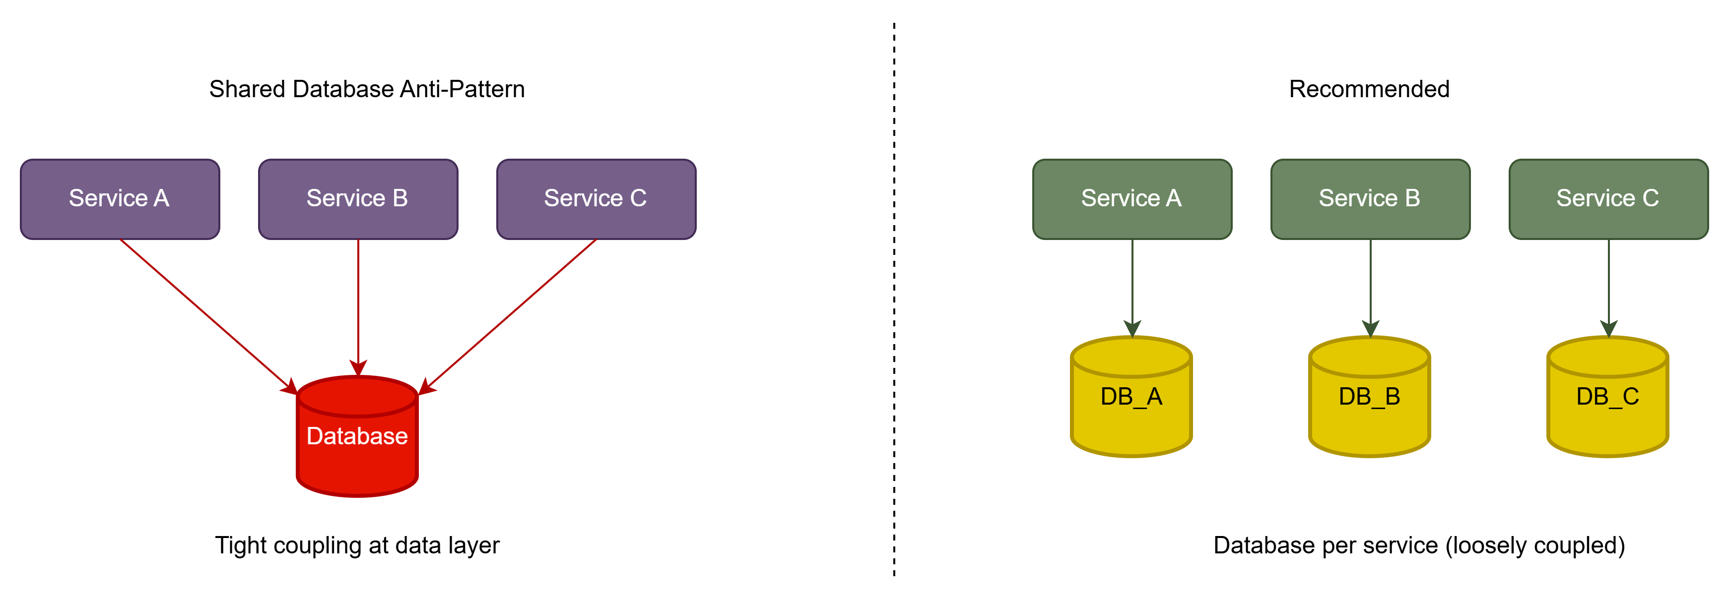
Anti-Patterns in Scope (1:30)
**Service design**: Nano Service, God Service
**Communication**: Chatty Service, Cyclic Dependency, Hardcoded Endpoints
**Data management**: Shared Database
**Deployment and coupling**: Distributed Monolith, API Versioning Absence
Notes:
- I target anti-patterns that are both common and impactful in microservice systems.
- Each detector has configurable thresholds and generates source code evidence for remediation.

Slide 6
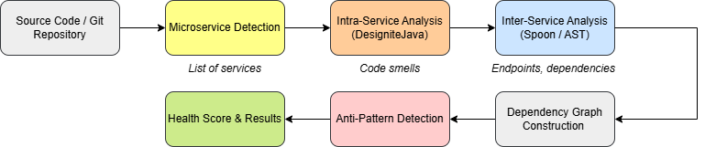
Detection Pipeline (2:00)
Project ingestion (ZIP or Git)
Automatic microservice boundary detection
Intra-service analysis (DesigniteJava)
Inter-service AST analysis (Spoon)
Dependency graph construction
Anti-pattern detection + evidence extraction
Composite health score and report
Notes:
- The pipeline starts by identifying microservices from build files.
- DesigniteJava contributes code-smell signals (for example, God Class frequency).
- Spoon extracts dependencies from annotations and client calls.
- Results are merged into a dependency graph used for graph-based detection and final reporting.

Slide 7
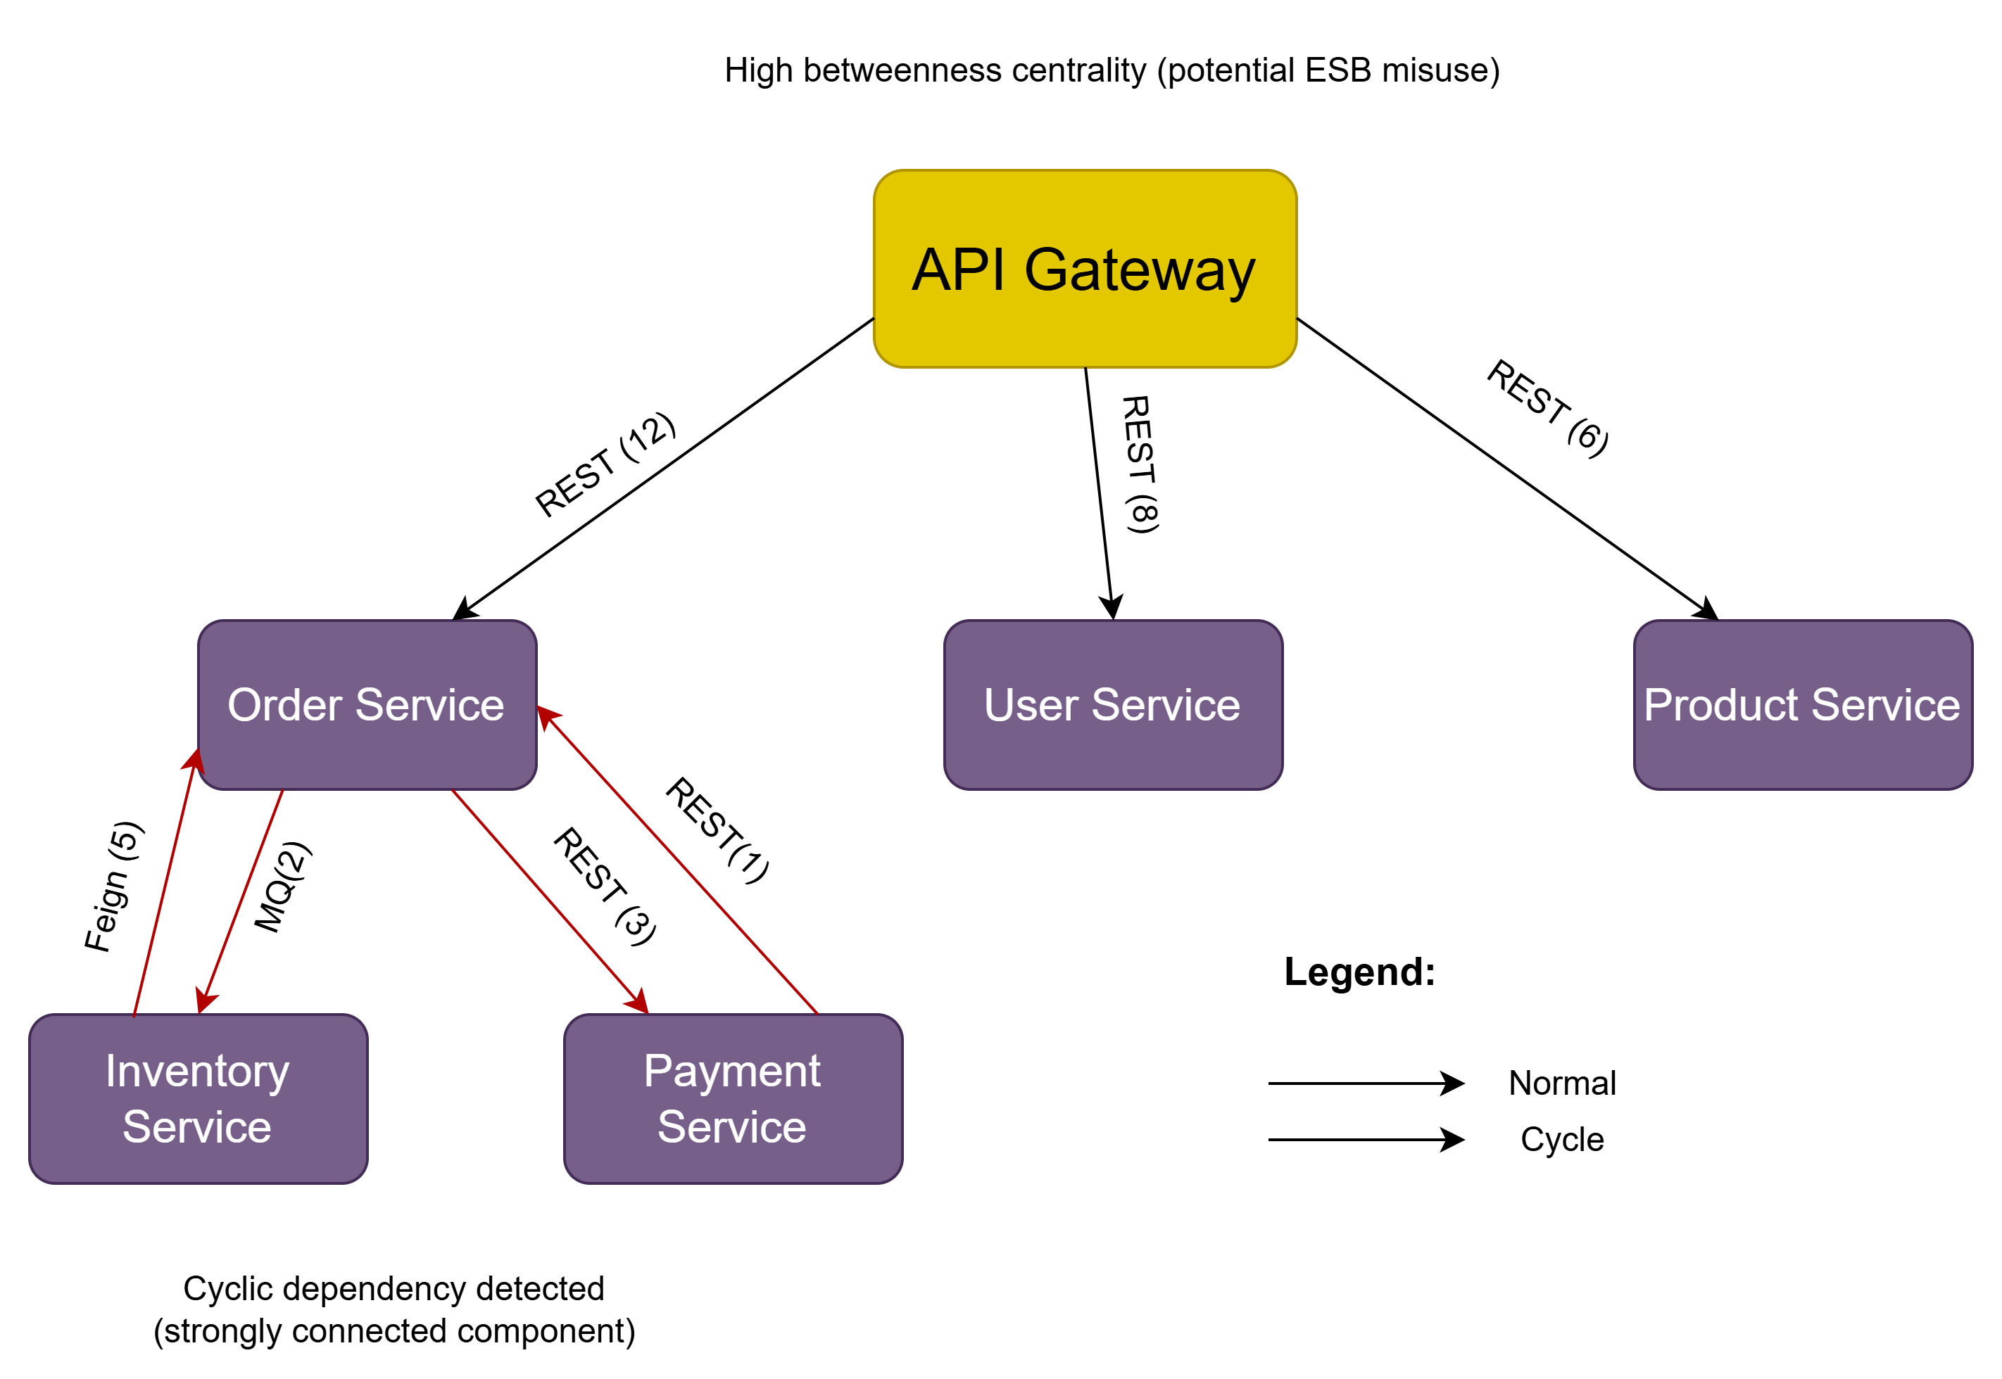
Graph Analysis and Health Score (1:30)
Dependency graph: nodes = services, edges = inter-service dependencies
Cycle detection via Tarjan SCC
Coupling metrics for distributed monolith signals
Health score formula:
`H = max(0, 100 - 15*n_crit - 10*n_high - 5*n_med - 2*n_low)`
Notes:
- The graph is central to detecting structural anti-patterns such as cycles and high coupling.
- The health score gives one trackable indicator while still preserving detailed findings by severity and category.

Slide 8
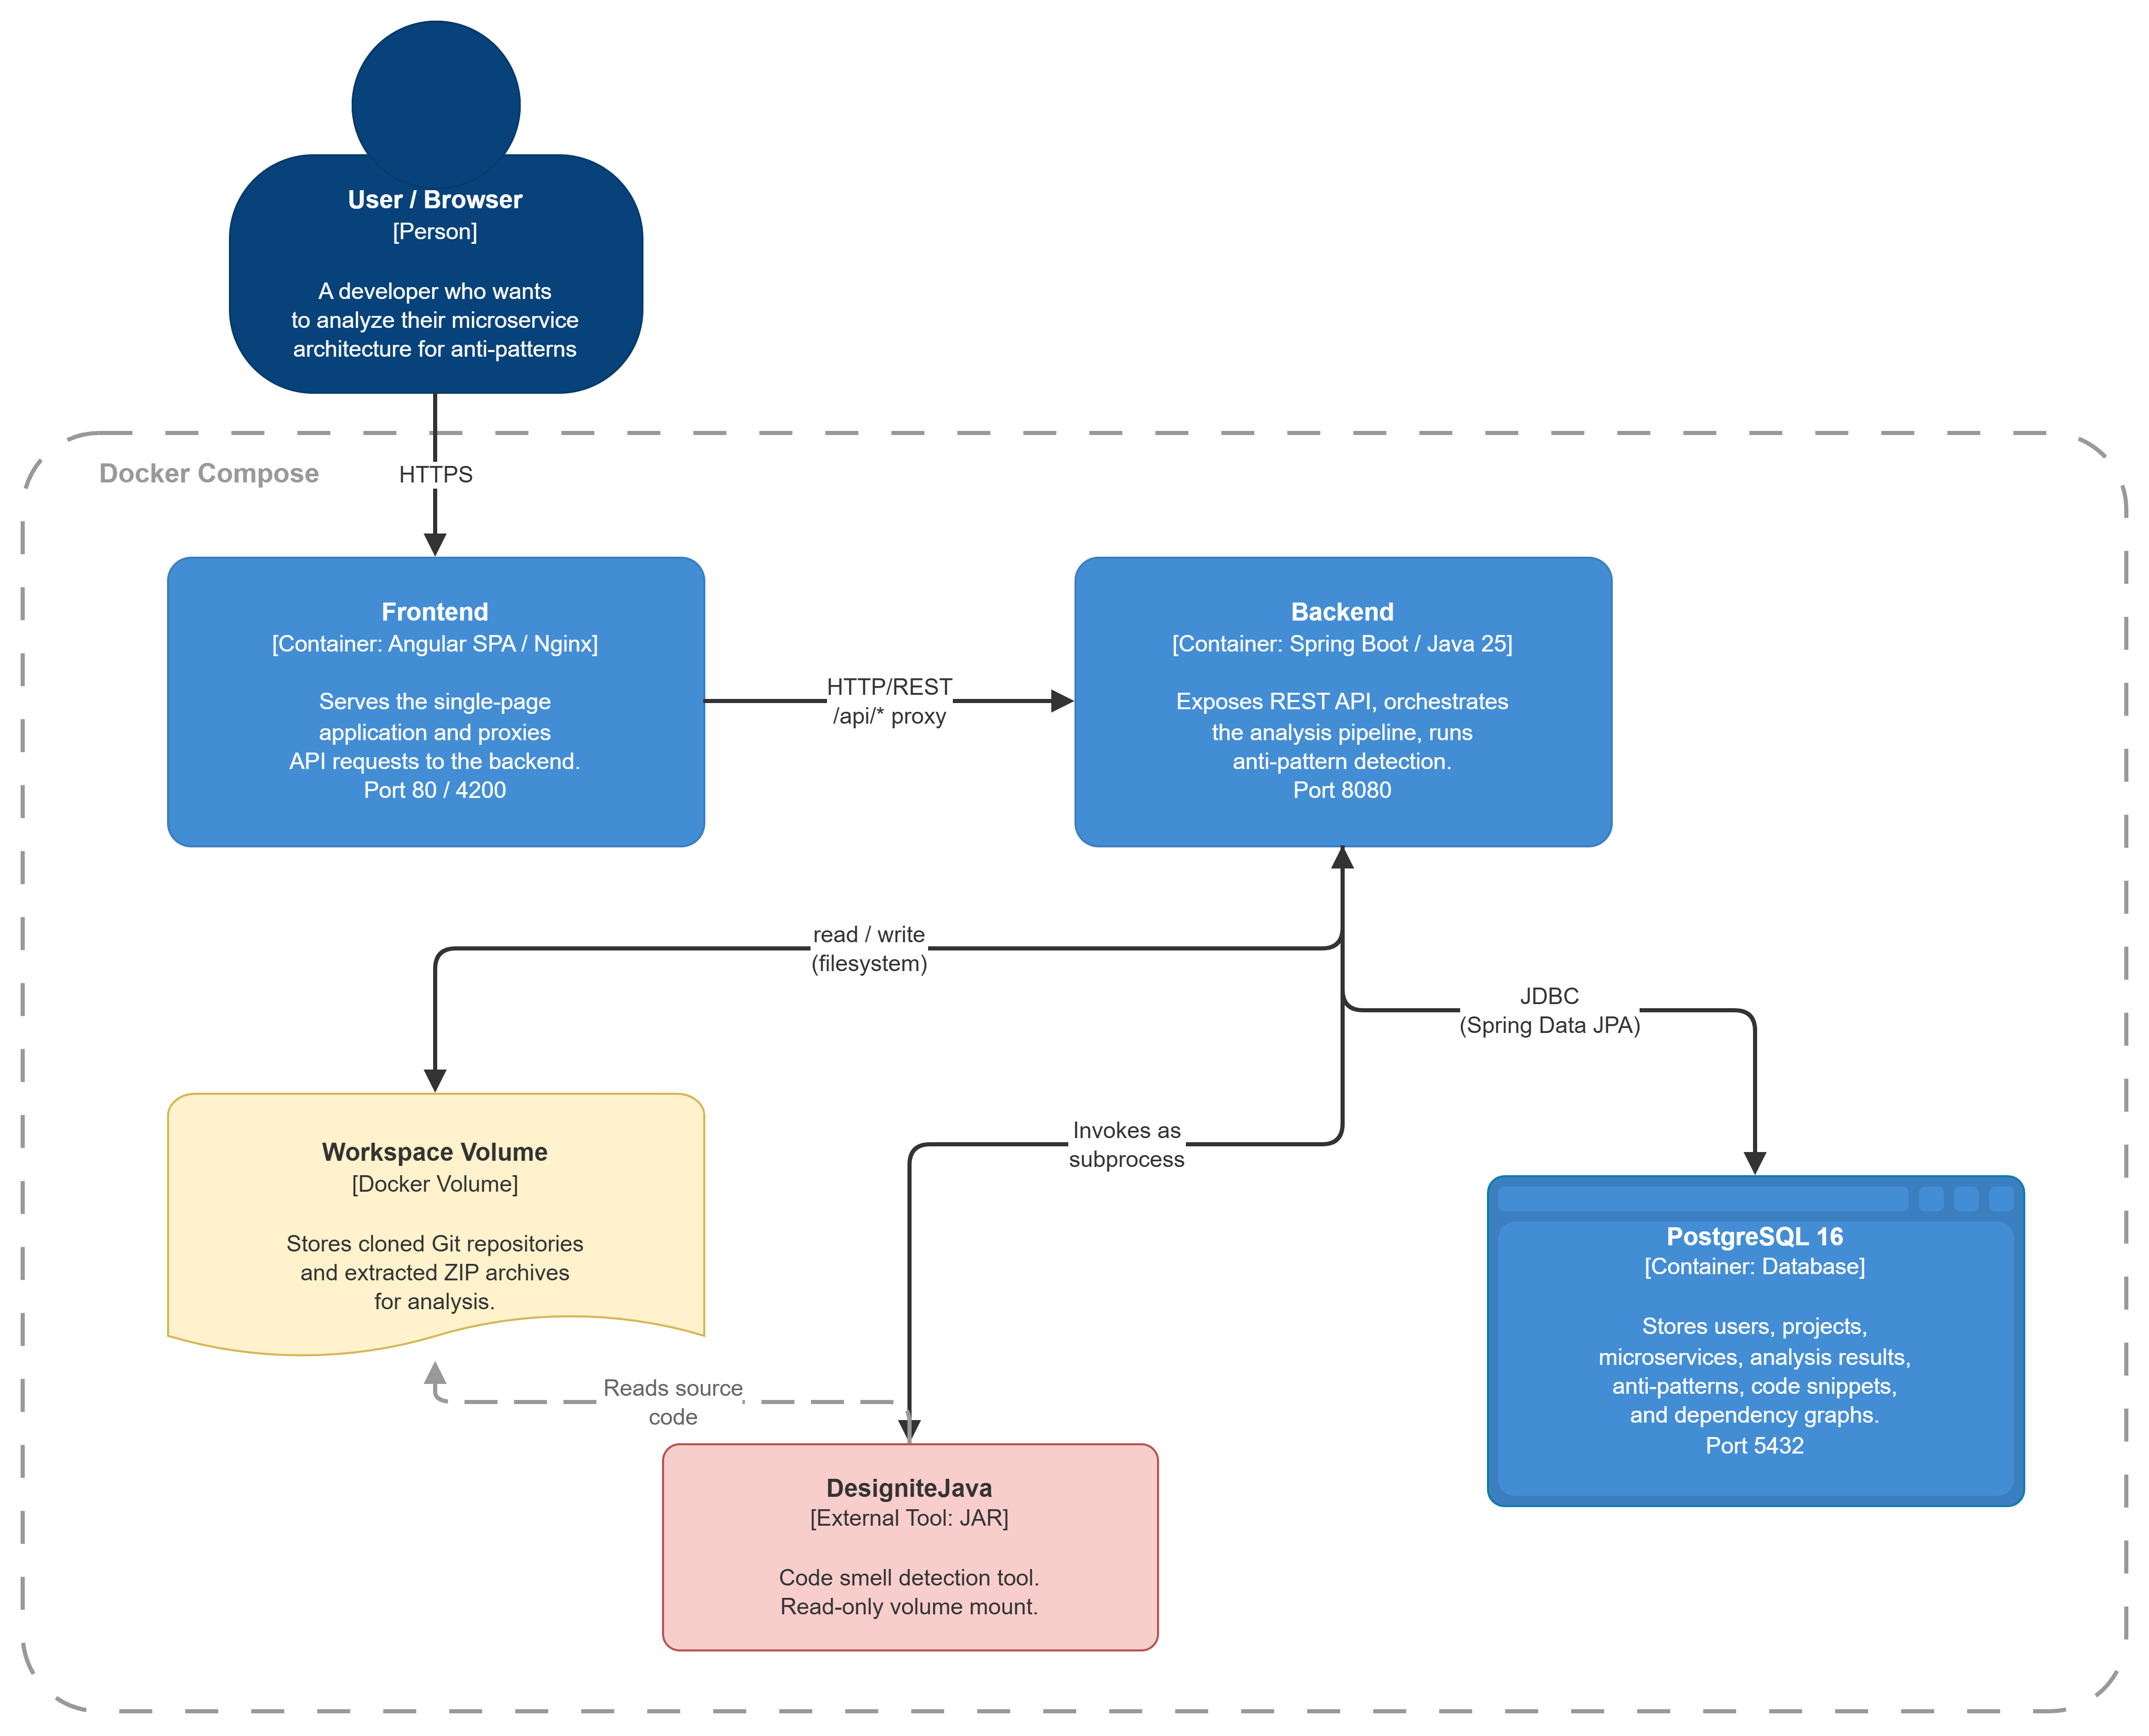
Implementation Architecture (1:00)
Backend: Spring Boot
Frontend: Angular
Data store: PostgreSQL
Deployment: Docker
Detector design: pluggable Strategy components
Interfaces: browser dashboard + REST API
Notes:
- The implementation is designed for practical use in both manual analysis and CI/CD integration.
- Pluggable detector components make future anti-pattern extensions straightforward.

Slide 9
Evaluation Results (2:00)
Dataset: 4 open-source projects, 60 microservices, ~465k LOC
Health scores:
MicroservicesSocial: 77 (C)
microservices-design-patterns: 60 (D)
Activiti: 45 (F)
Karate: 87 (B)
Frequent detections: Nano Service, God Service, Hardcoded Endpoints
Notes:
- The scoring differentiated projects with lower and higher architectural issue concentration.
- The largest project, Activiti, scored lowest, while Karate scored highest.
- Shared Database appears in MicroservicesSocial, consistent with its architecture.

Slide 10
Conclusions and Future Work (1:00)
Contributions:
Multi-level static analysis approach
8 anti-pattern detectors with evidence
Composite health score and trend tracking
Automated microservice boundary detection
Limitations:
Java + Spring Boot scope
Static-analysis-only constraints
Future work:
Multi-language support
Additional anti-patterns
Deeper CI/CD and IDE integration
Notes:
- The core contribution is actionable architectural quality feedback without requiring a running system.
- The methodology is extensible even though the current implementation is Java/Spring-focused.

Slide 11
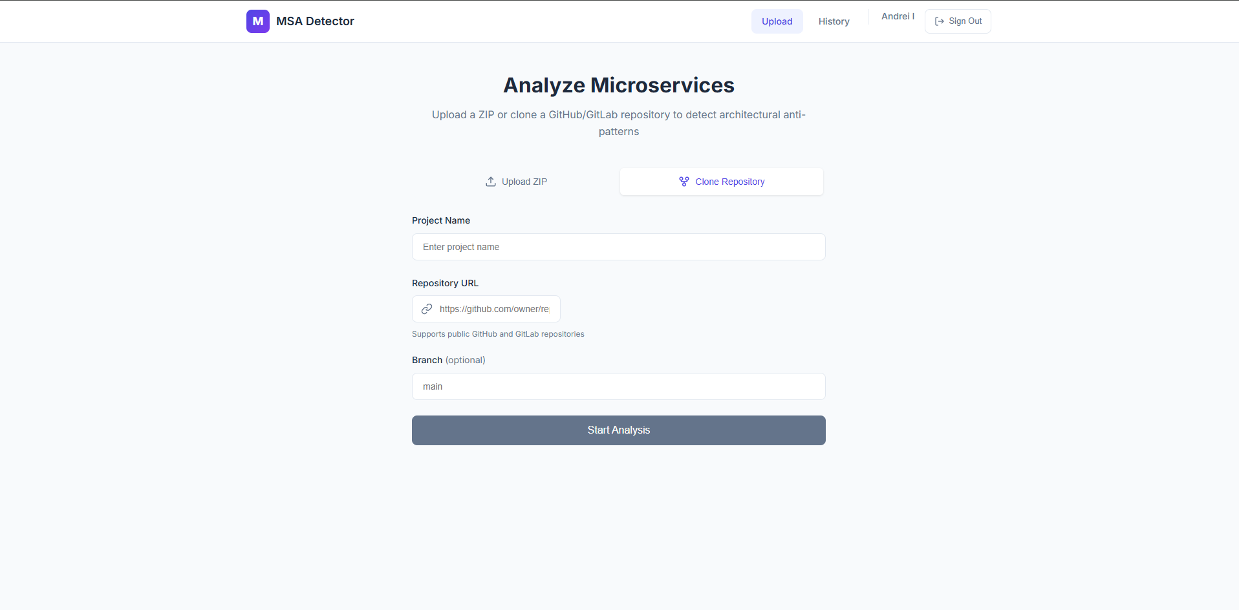
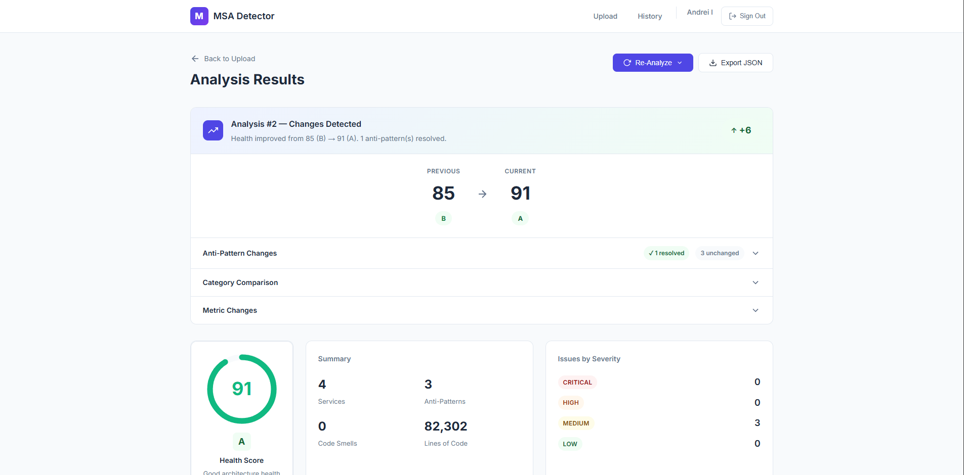
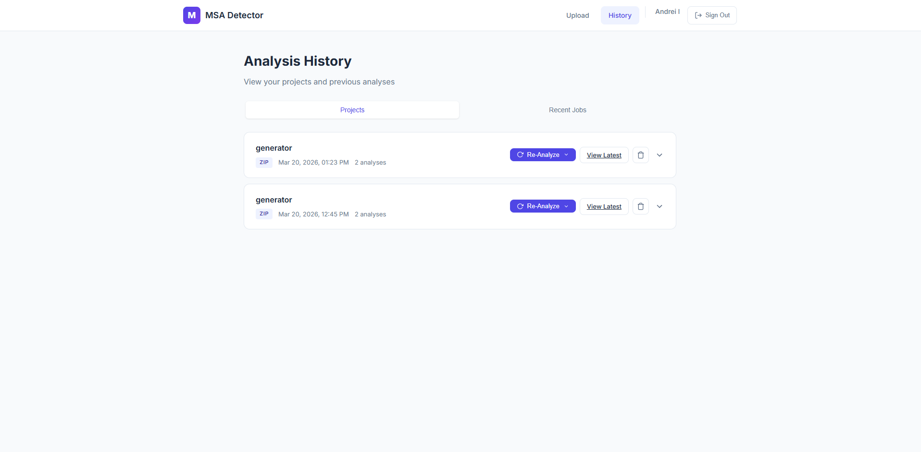
Live Demo (2:00)
Live demo:
Ingest project (Git clone)
Run analysis
Inspect anti-pattern findings + snippets
Show health score and history/diff
Notes:
- I will run one full analysis flow live and show the final findings.
- If runtime is tight, I will use a pre-analyzed project and focus on findings, score, and analysis history.
- Transition to Q&A after the demo.

