Slide 1
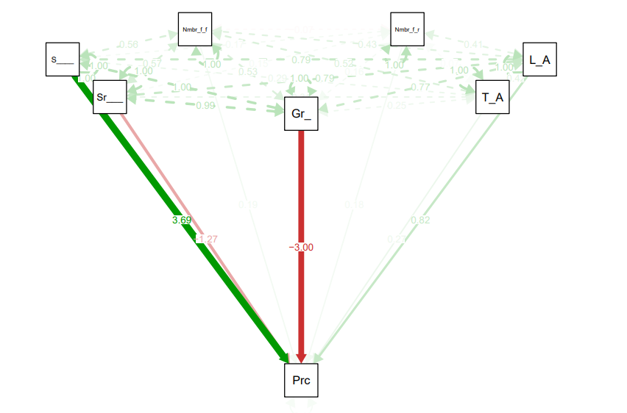
Path analysis

Slide 2
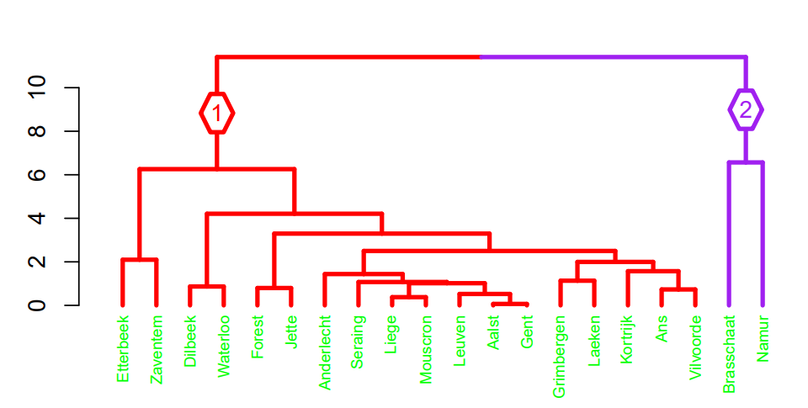
Cluster analysis

Slide 3
