Slide 1
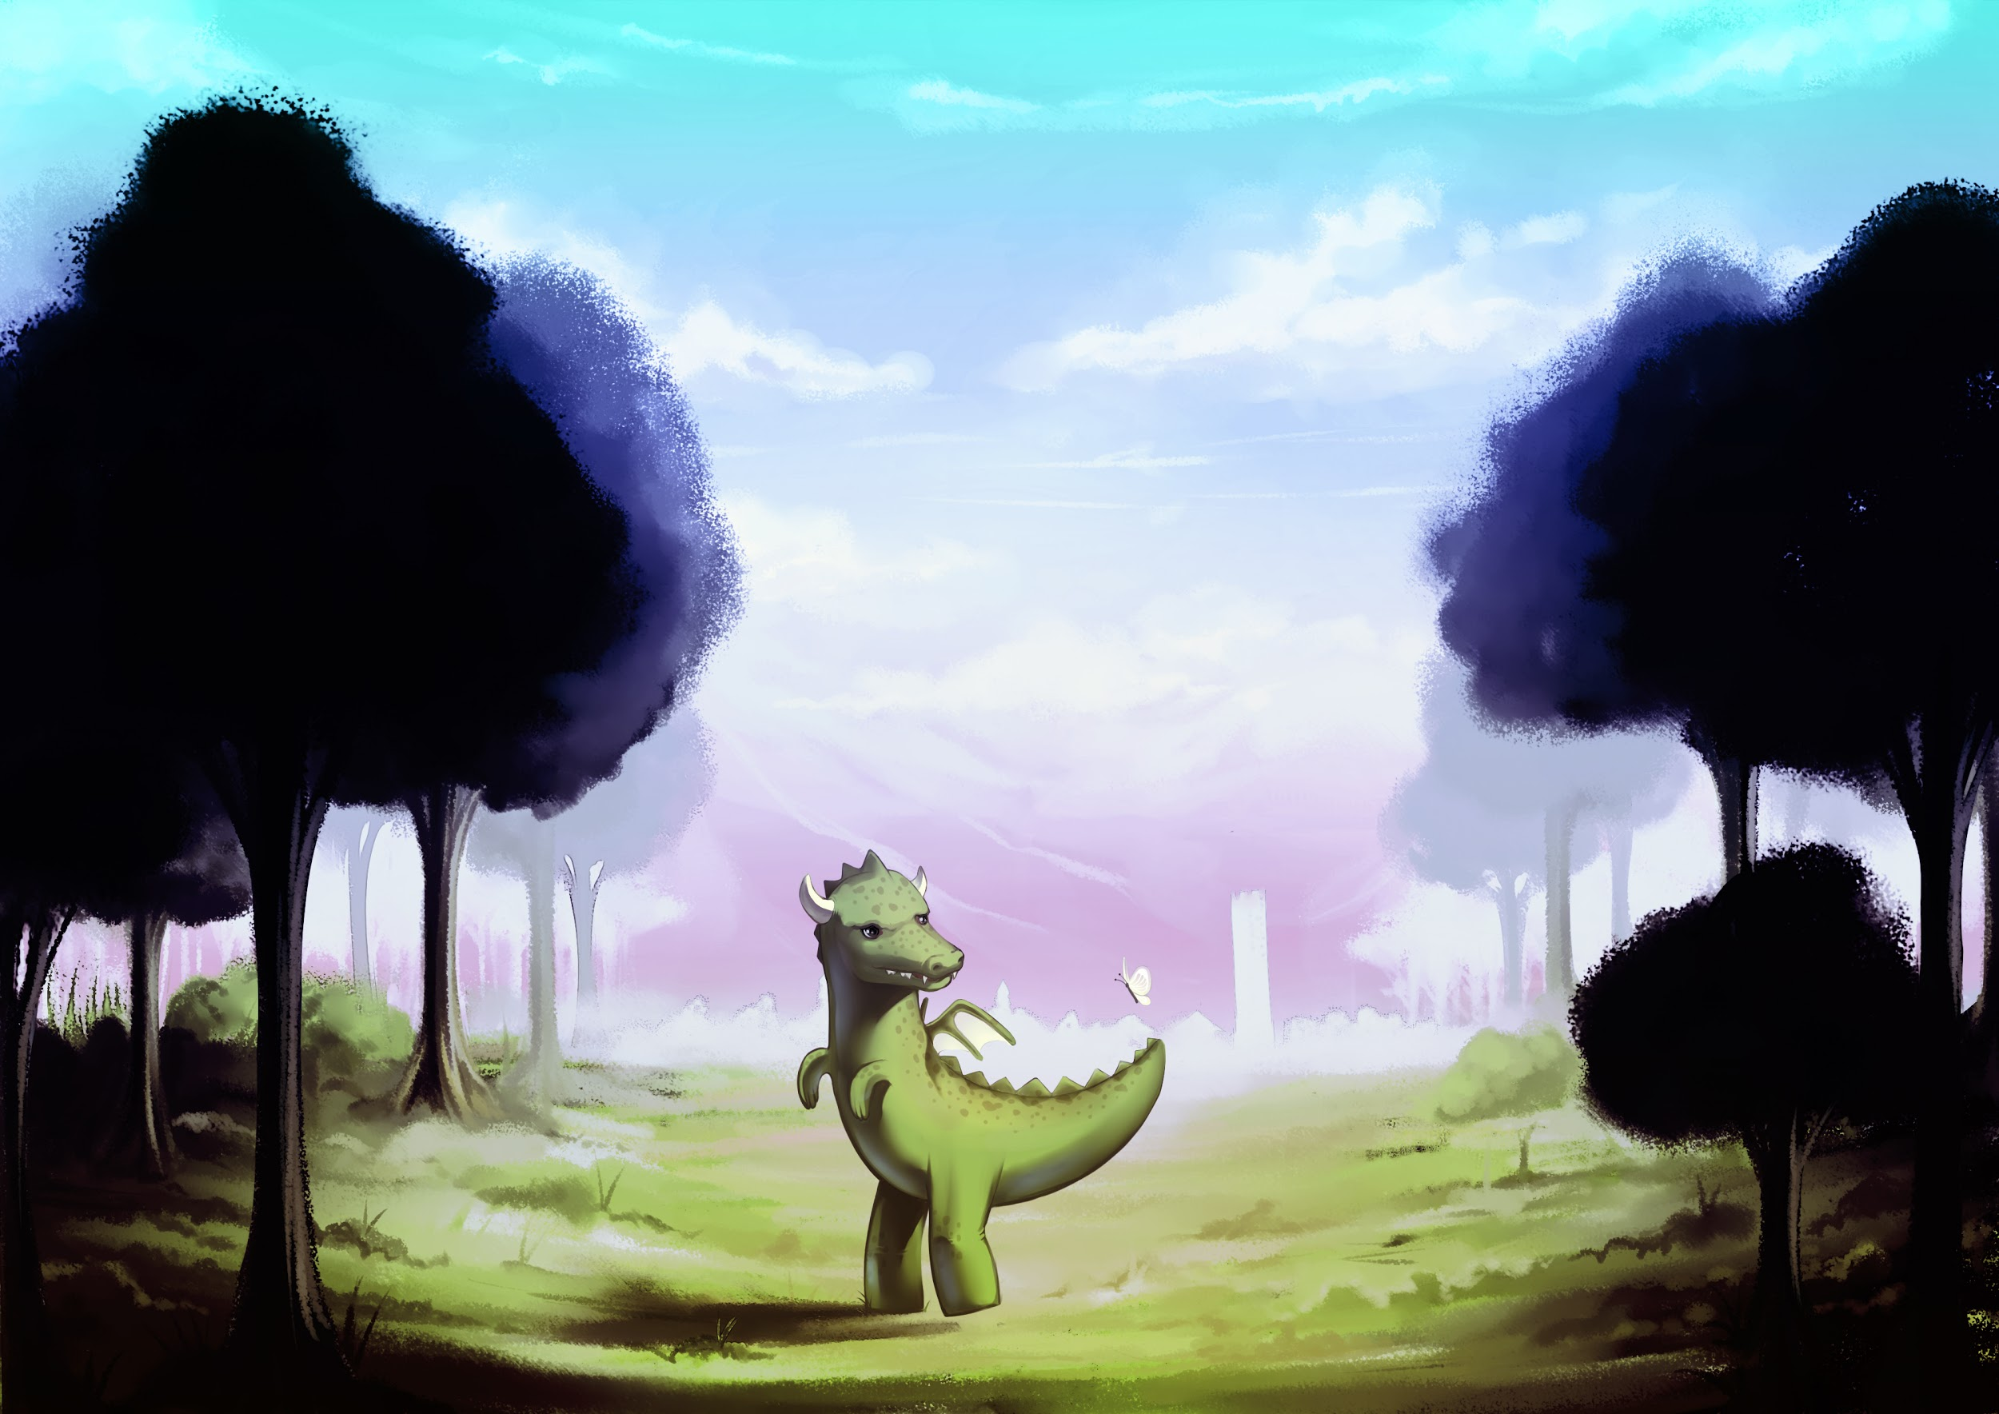
DragonTale

Slide 2


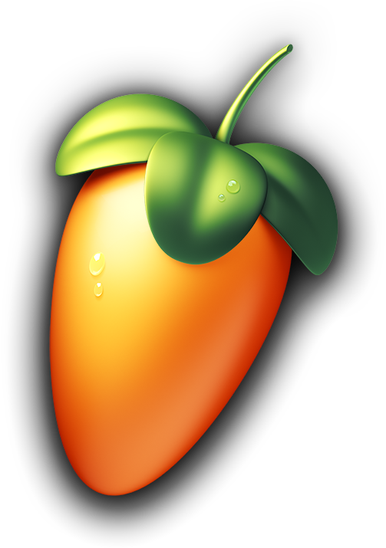

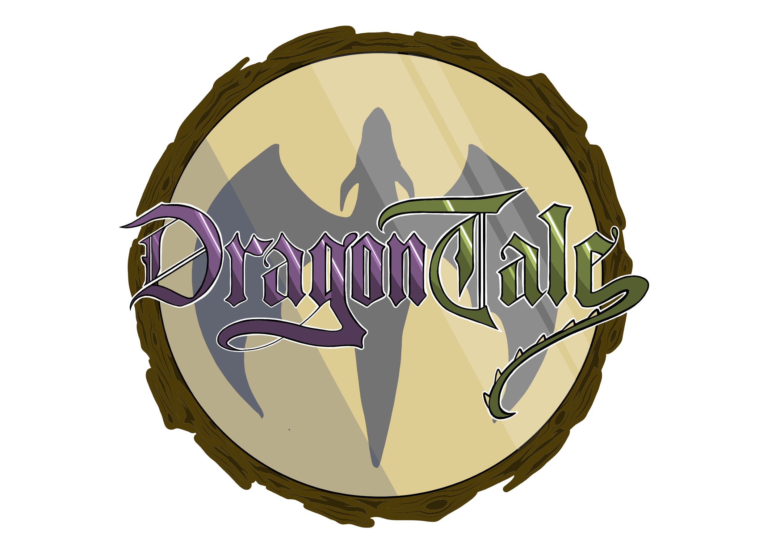
The tools we used

Slide 3
Sound events
Soundscapes
Forest & Tower
UI effects
Character animations
Motion & Combat
Using two parameters

Slide 4
Music & Snapshots
Orchestral/Fantasy themed soundtrack
Main theme
Exploration themes
Combat themes
Snapshots
Combat, Reverb & Main Menu

