Slide 1
Student Dorm Accommodation Application
Graduate: Andrei Zoltan BONYHAI
Supervisor: As. Eng. Iulia STEFAN, PhD

Slide 2
Contents
Introduction
Objectives and Specifications
Bibliographical study
Analysis and Projecting
Implementation
Testing
Conclusions

Slide 3
Introduction
Queues take up a lot more time in people’s lives than we think
Saving precious time for the students

Slide 4
Objectives and specifications
Speed up the accommodation process for each student
Create a scalable application fit for further development

Slide 5
Bibliographical study
MVC Design Pattern
WEB API
MV framework for the User Interface
Dependency Injection

Slide 6
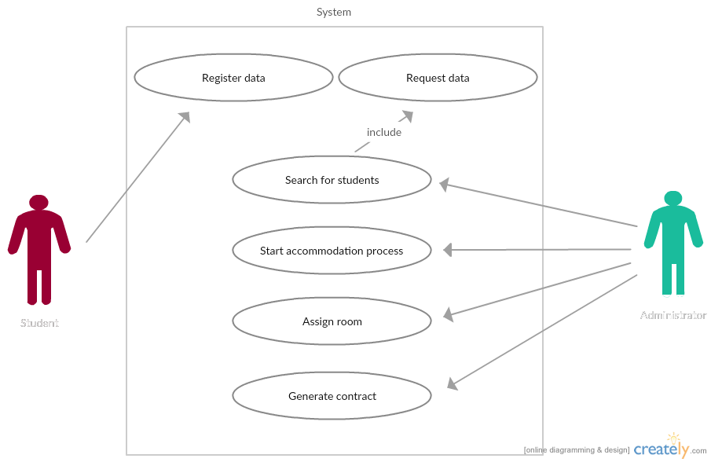
Analysis and Projecting

Slide 7
Implementation
The application consists in the following main components:
Database
WEB API
Encryption for passwords
User interface

Slide 8
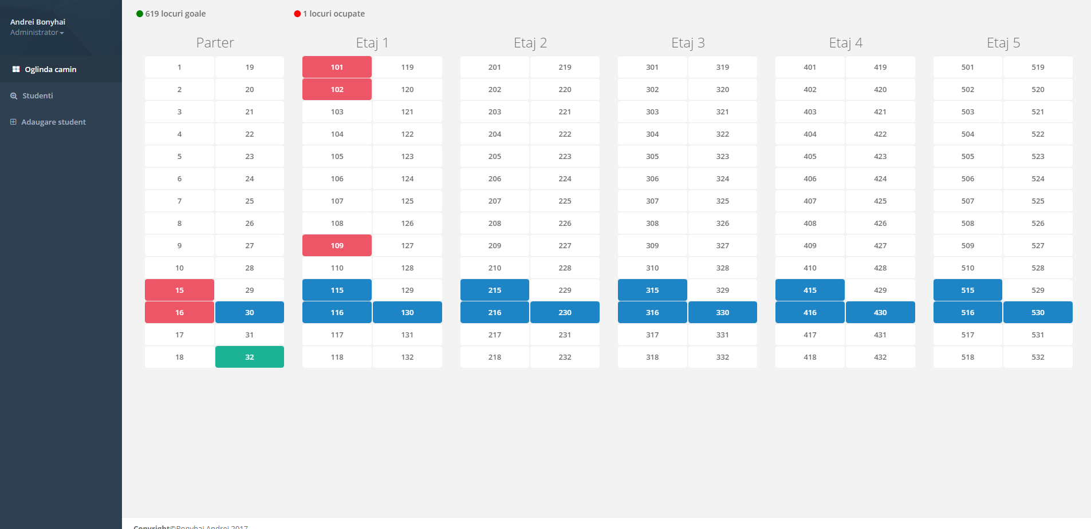
Testing

Slide 9
Conclusions
Obtained results
Create a new interface for the accommodation application
Implementing a system allowing students to take part in their accommodation process
Future development
Implementing a student type account for the application
Extend the application to manage the campus football field, washing machines and medical cabinet
Extending the application to manage the dorm rent payment

Slide 10
Thank you for your attention!

