Slide 1


Week 4
How Do We Know Whether a Biometric System is “Good”?
COSC 594-003 Special Topics in Computer Science
Biometrics
Benjamin S. Riggan
Associate Professor

Slide 2
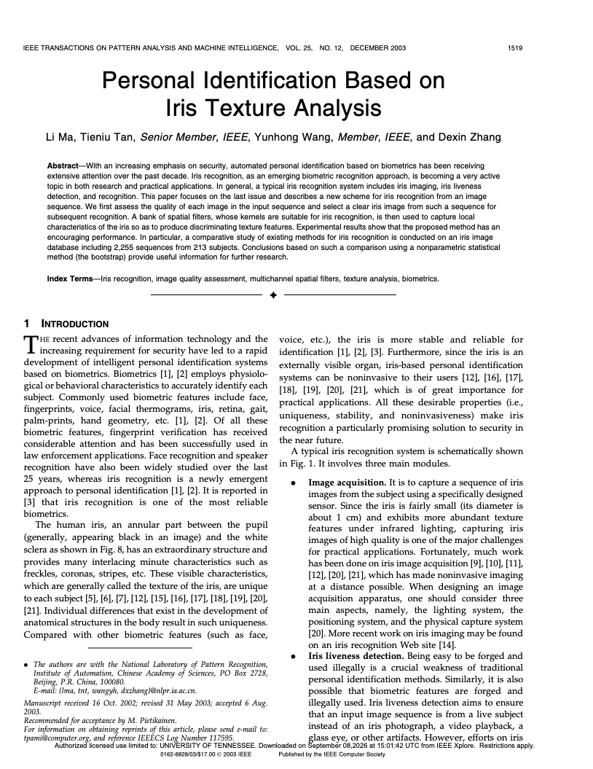
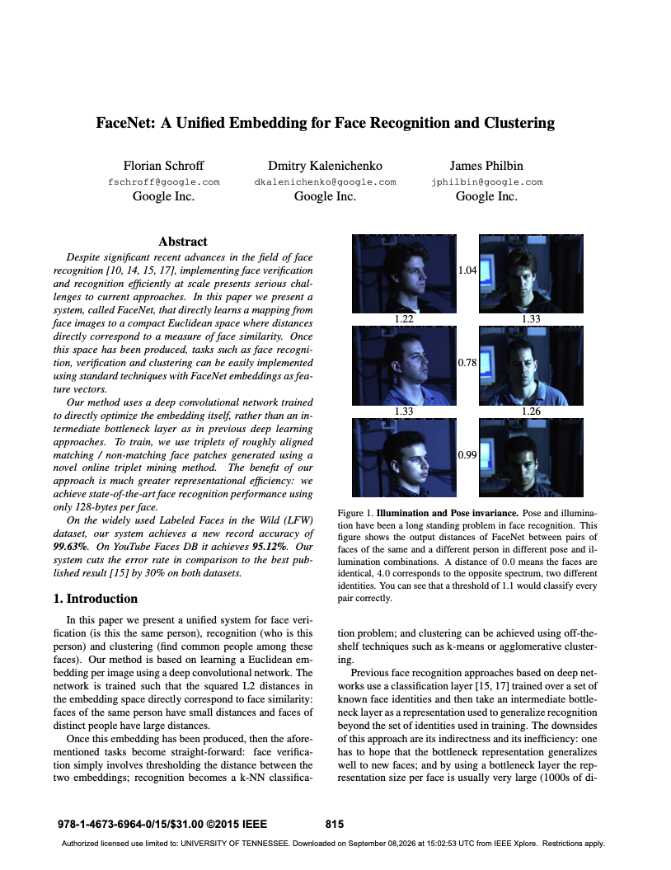
Recap Weeks 2-3
Notes:
AI = Artificial Intelligence
ML = Machine Learning
CV = Computer Vision
DL = Deep learning

Slide 3
LAST WEEK — How should we learn identity?
THIS WEEK — How do we know whether a biometric system is “good”?
person
face
fingerprint
iris
…

Slide 4
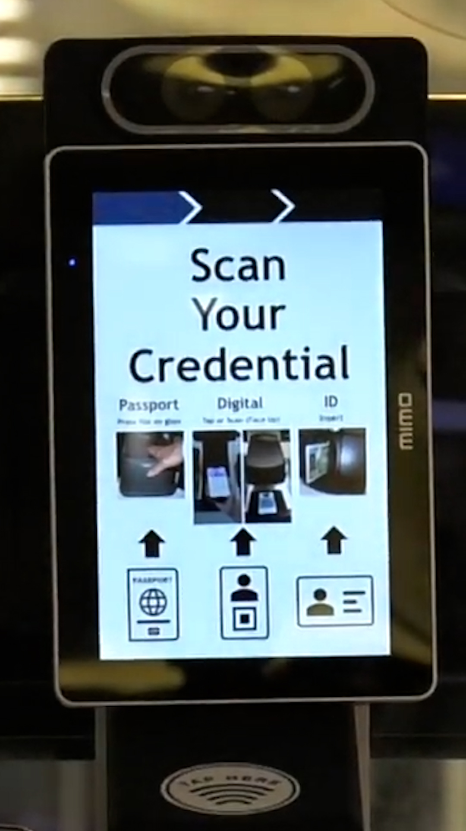
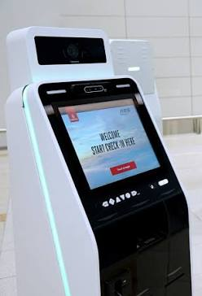

Which system is better?
System A
System B
🚫
$$>$$
99.9% Accuracy
99.5% Accuracy

Slide 5

❌ High Accuracy $⇒$ “Good” system
Characteristic of a “Good” biometric systems:
Discriminative
Reliable
Designed according to requirements and specification (Application)
Clearly defined conditions
Measurable Performance
Reproducible
Notes:
A biometric system is not “good” because it produces a high accuracy number.
A good biometric system produces reliable decisions for its intended application, under clearly defined conditions, and its performance can be measured and reproduced.

Slide 6
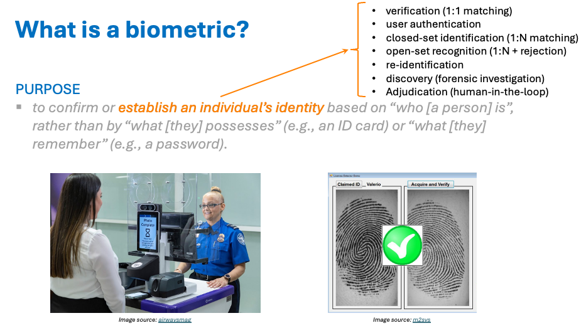
Good for what???
Consider:
Applications have specific metrics
Must evaluate risk
Degree of control
Notes:
Different applications require different metrics!
Need to determine the amount of risk (and the consequences)
How much control is there?

Slide 7
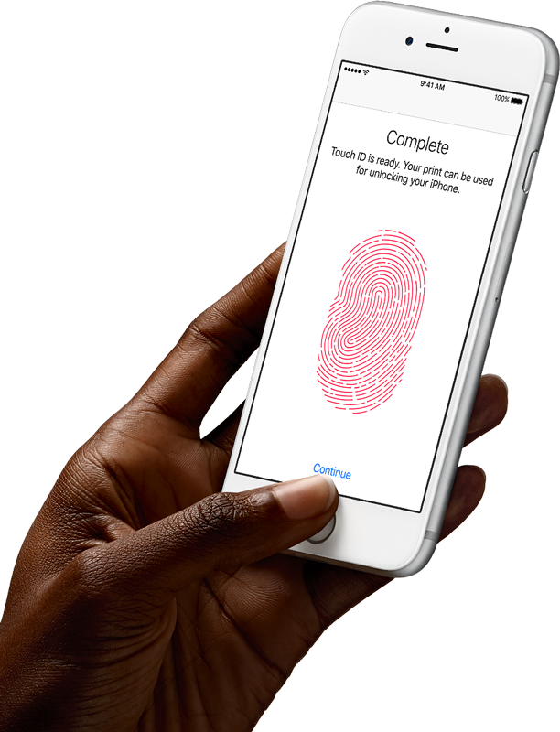
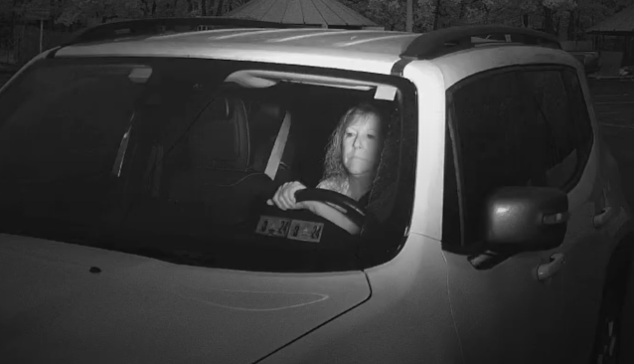
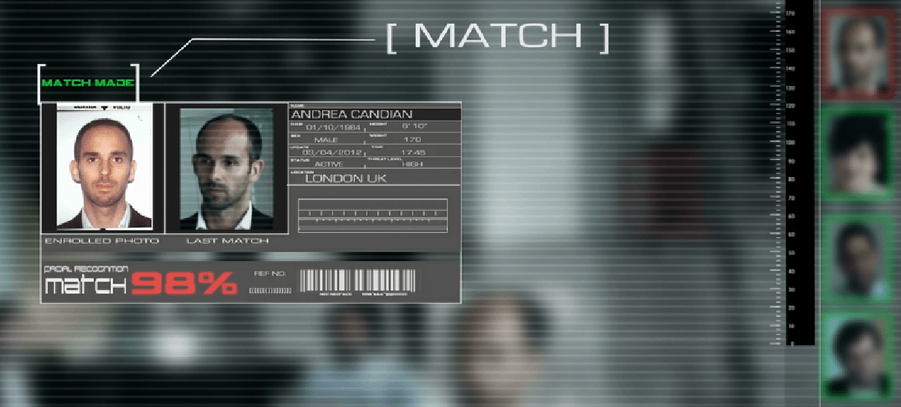
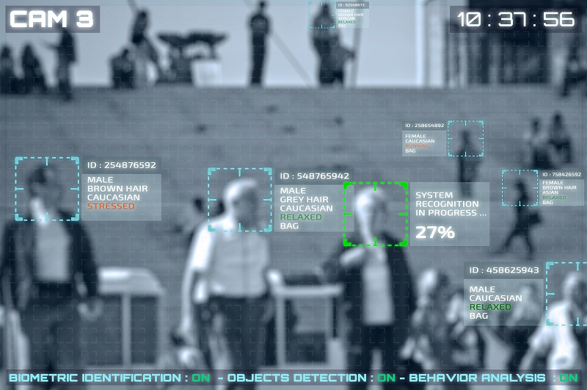
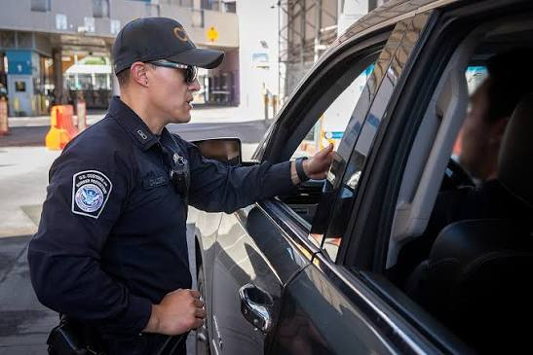
Example Applications
Unlocking Smart Phone
Boder Patrol Identification
Watchlist Search
Notes:
Different applications require different metrics!
Need to determine the amount of risk (and the consequences)
How much control is there?

Slide 8

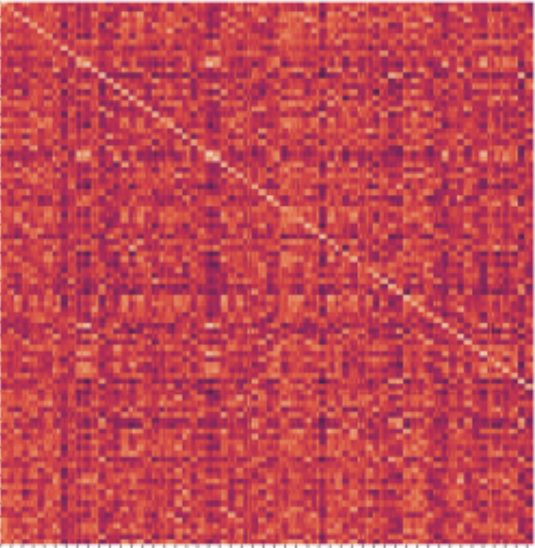
Accuracy can be misleading
Example
- 1,000,000 biometric transactions
- 999,000 are genuine
- 1,000 are impostors
- System gets 998,000 genuine decisions correct and 990 impostors correct.
Overall accuracy looks fantastic (99.8%)
FMR — 1%
(1 out of 100 imposter granted)
FNMR — 0.2%
(2 out of 1000 genuine denied)
Gallery
Distractors
Probes
Notes:
Different applications require different metrics!
Need to determine the amount of risk (and the consequences)
How much control is there?

Slide 9
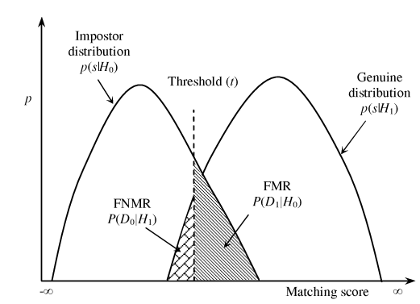
Accuracy can be misleading
Rank-1 Accuracy (1:N identification)
only concerned with comparison between query/probe with all gallery template
No threshold
FNMR vs. FMR (1:1 verification)
Separability analysis
Threshold
What is the relationship between rank and ROC analysis?
Gallery
Distractors
Probes
Notes:
Better genuine/impostor score separation generally provides a stronger foundation for good identification performance, whereas good rank accuracy can occur even when the genuine and impostor distributions substantially overlap.
ROC measures the quality of the underlying score space. Rank accuracy measures how that score space behaves when forced to make an identification decision among a particular number of candidates.

Slide 10
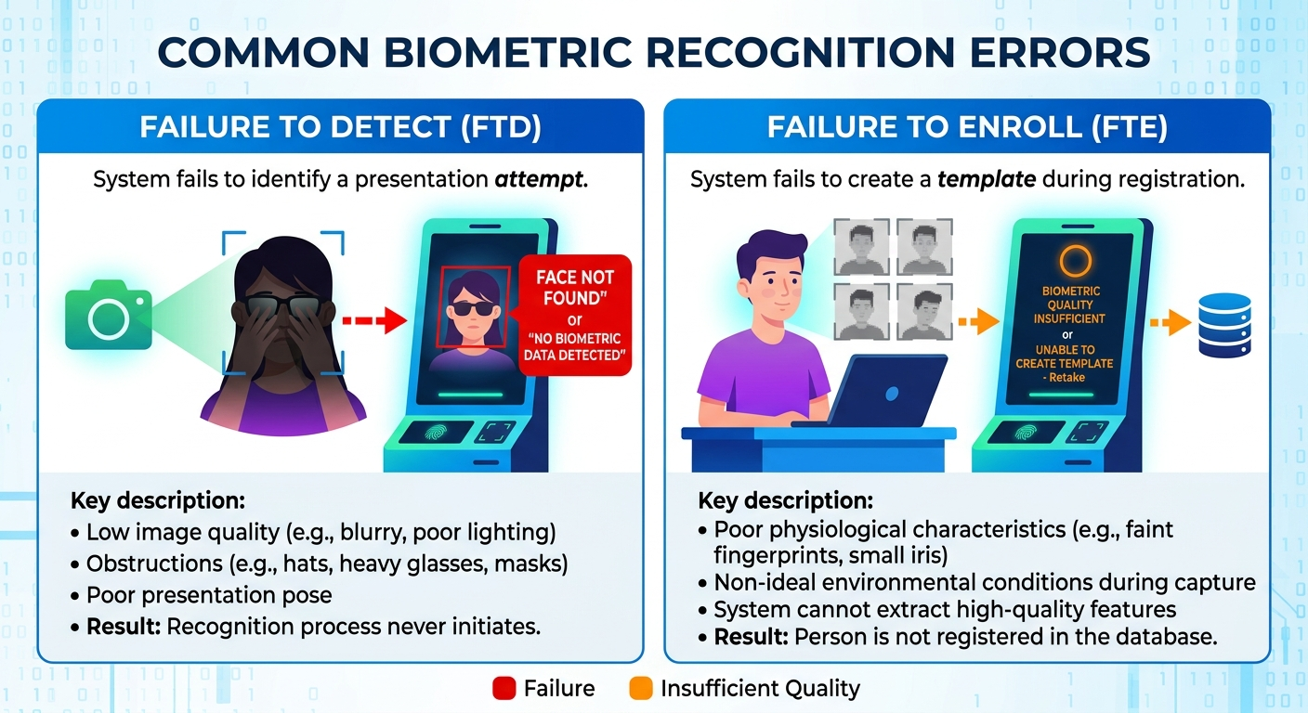
Matching errors are NOT the only errors

Slide 11
Matching errors are NOT the only errors
Gallery: Acquisition → Detection → Enrollment → Representation
→ Matching → Decision
Probe: Acquisition → Detection → Representation
Stage | Failure | What happened
Detection | Failure to Detect (FTD) | Cannot detect/localize the biometric
Enrollment | Failure to Enroll (FTE) | Cannot obtain a useable template
Matching | False Non-Match (FNM) | Genuine person incorrectly rejected
Matching | False Match (FM) | Imposter is incorrectly accepted
Notes:
Better genuine/impostor score separation generally provides a stronger foundation for good identification performance, whereas good rank accuracy can occur even when the genuine and impostor distributions substantially overlap.

Slide 12
Why this matters for system-level performance?
Consider a system with:
FTD = 5%
FTE = 2%
FNMR = 1%
FMR = 0.1%
Reporting only FNMR = 1% and FMR = 0.1% may suggest system viability
But 5% of presentations never produce a useable face in the first place
Notes:
For example, in an unattended surveillance application, failing to detect someone may be much more consequential than a small increase in matcher error.

Slide 13
Which system is better?
System A
System B
🚫
$$>$$
99.9% Accuracy
99.5% Accuracy

Slide 14
Under what operating conditions?
What dataset?
How many subjects?
How many images per subject?
Same camera or different cameras?
Same session or different sessions?
Same lighting?
How much time between enrollment and recognition?
How were subjects selected?
Was the test data independent?
Were identities present in training?
How was the threshold selected?
Verification or identification?
Closed-set or open-set?
What is the impostor/genuine comparison protocol?

Slide 15
Project 1 (Baseline) Activity
Draft a biometric problem statement for your project?
Search for and list some potential datasets
What part(s) of the pipeline does your potential project consider?
What biometric modalities does your potential problem utilize?
Why is this problem relevant?

Slide 16
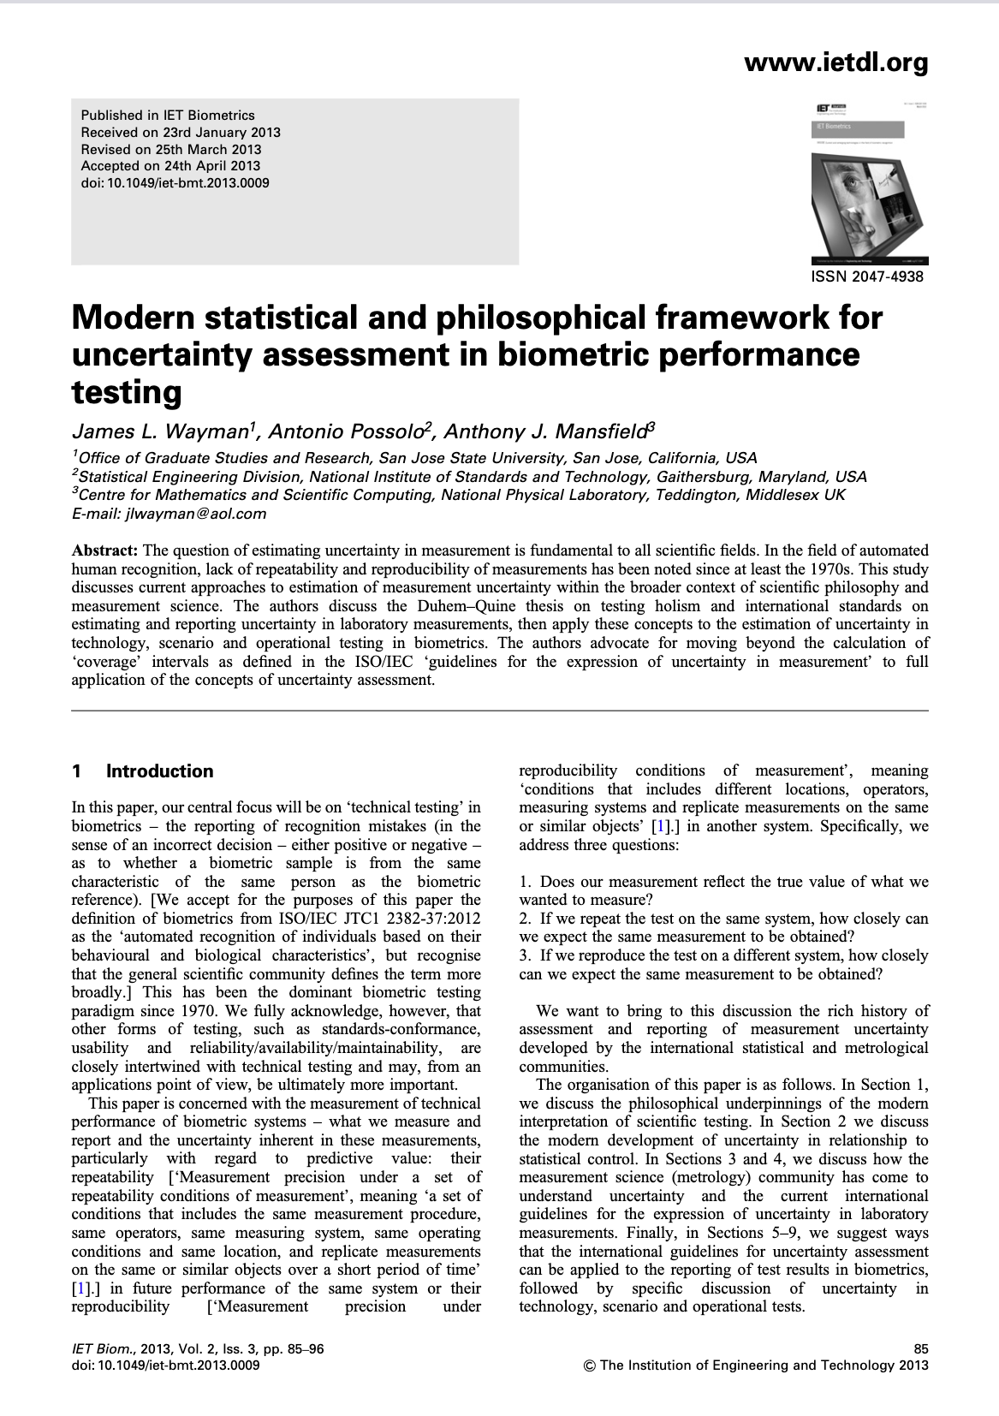
Paper Discussion

Slide 17
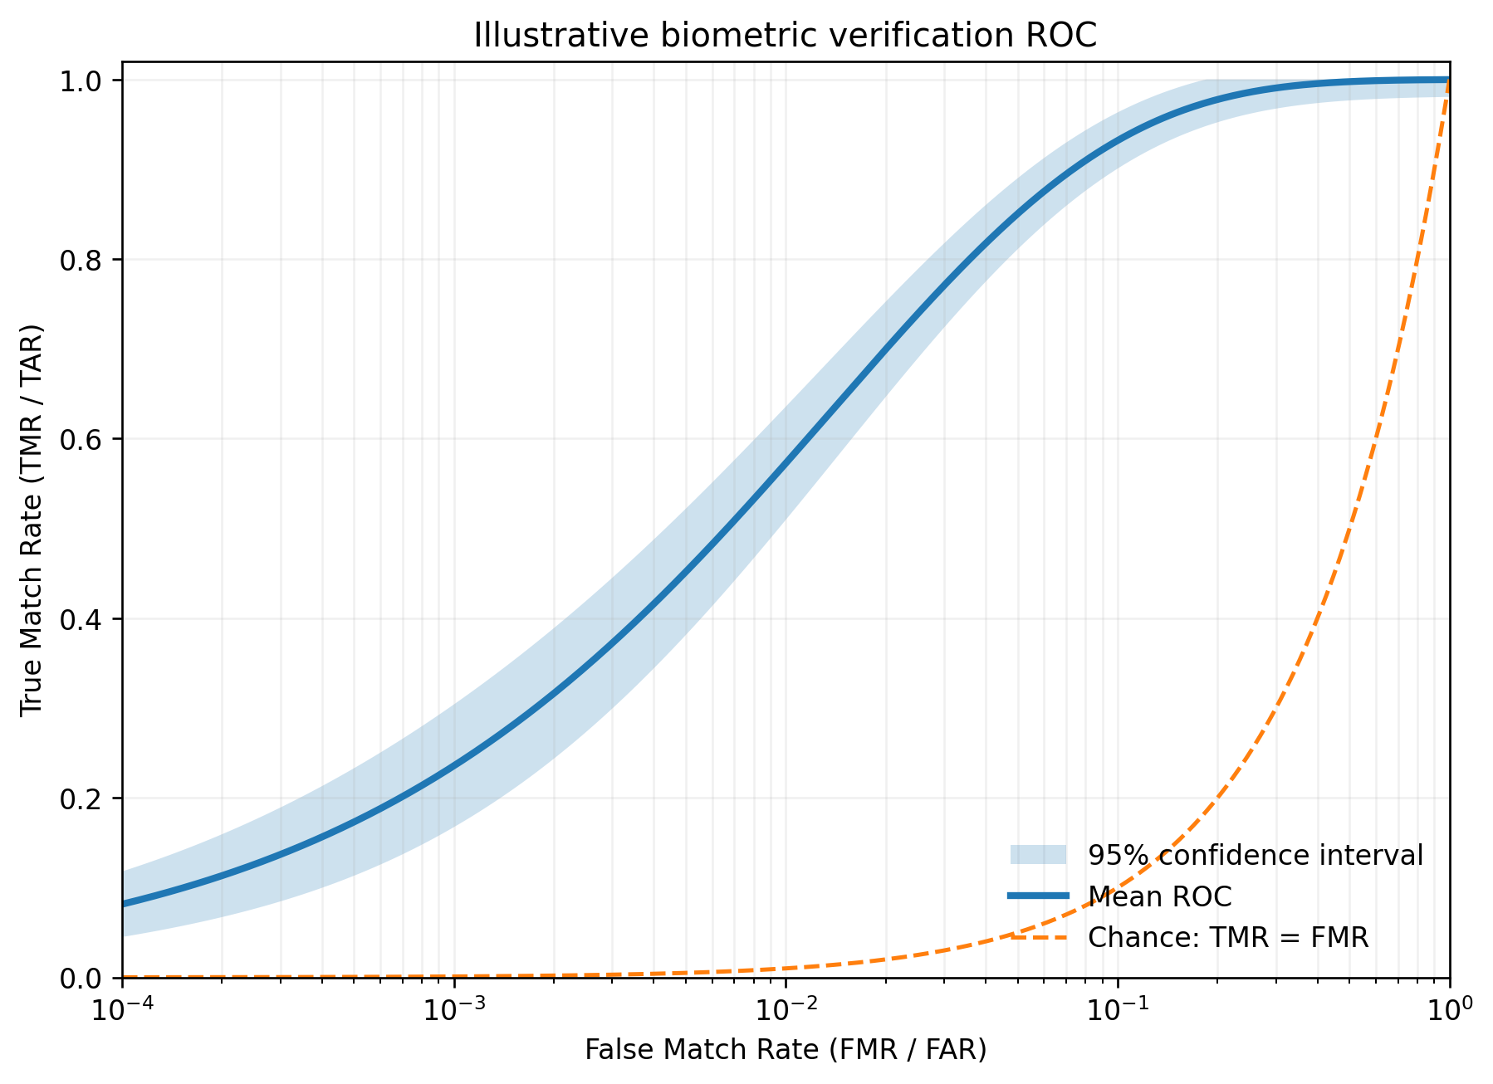
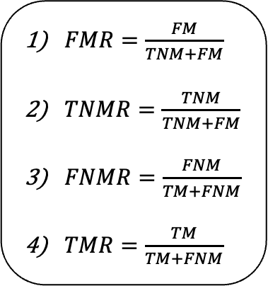




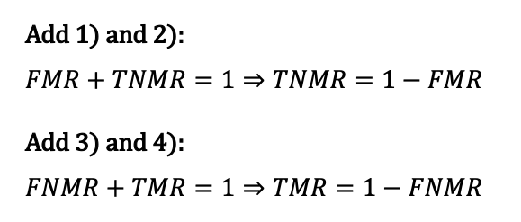
Paper Discussion
What problem is addressed?
Why?
$FMR=\frac{FM}{TNM+FM}$
$TNMR=\frac{TNM}{TNM+FM}$
$FNMR=\frac{FNM}{TM+FNM}$
$TMR=\frac{TM}{TM+FNM}$
Uncertainty and Confidence Intervals
Prediction
same ID ($+$)
different ID ($−$)
True Match (TM)
False Non-Match
(FNM)
same ID ($+$)
Actual
False Match
(FM)
True Non-Match
(TNM)
Add 1) and 2):
$$FMR+TNMR=1⇒TNMR=1−FMR$$
Add 3) and 4):
$$FNMR+TMR=1⇒TMR=1−FNMR$$
different ID ($−$)
Notes:
Core prompt: What do the authors believe is wrong or incomplete about conventional reporting of biometric performance, and why does it matter?
Follow-up probes
The paper argues that uncertainty is broader than “error.” What is missing if a paper only reports a point estimate such as TAR at a specified FAR, EER, rank-1, or FNMR?
Why do the authors resist treating a test result as a property of an algorithm alone?
What is at stake when a result from one test setting is generalized to another setting or to real deployment?
Which parts of a biometric experiment can make two apparently identical metrics mean different things?
Target synthesis: A performance number is a measurement made under particular conditions. Without a sufficiently complete definition of what was measured and control/reporting of influential conditions, its repeatability, reproducibility, and applicability beyond the test are unknown.

Slide 18
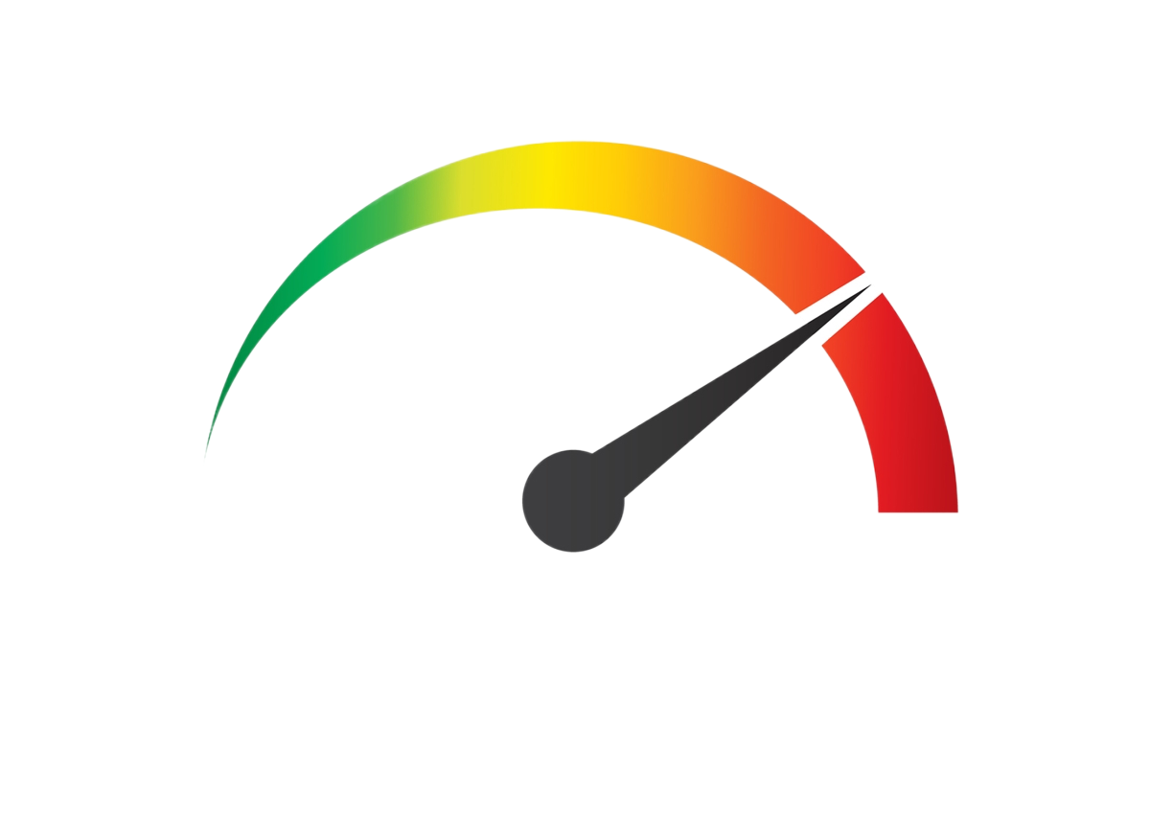
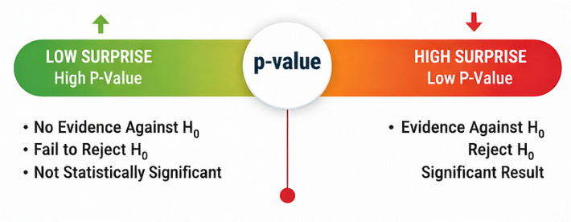
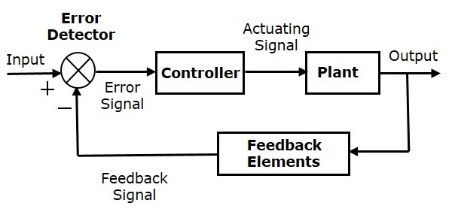
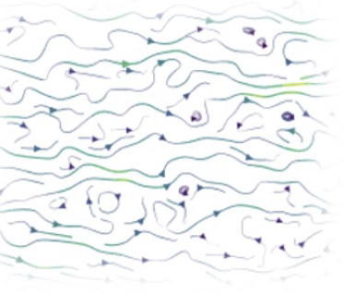
Paper Discussion
What are some key ideas from the paper?
A. Performance Testing
B. Significance
C. Statistical Control
D. Uncertainty

Slide 19
Paper Discussion
Major points
Biometric performance testing is measurement, not merely metric calculation
The measured quantity is not inherently “the system’s accuracy.”
It must be defined in context.
The authors use measurand for the quantity intended to be measured.
In biometrics, an observed error rate or comparison-error rate is often only a proxy for the intended quantity.
A metric can be computed correctly while the underlying claim remains poorly specified.
Notes:
Prompt: In a verification study, what exactly might the measurand be? Is it “FMR,” “FMR for this software/database/threshold,” or something still broader?
The best answer is something broader—and it depends on the purpose of the study.
“FMR” alone is too vague. It names a metric, but not the population, system, decision rule, or conditions to which it applies.
“FMR for this software/database/threshold” is closer, particularly for a controlled technology test, but it still leaves critical details implicit: the matching key/ground truth, sample-selection and pairing procedure, sensor/acquisition and preprocessing pipeline, software version and parameters, and the target population or application.
The measurand should instead be stated as the intended quantity

Slide 20
Paper Discussion
“The probability that a non-mated verification attempt is incorrectly accepted for adults enrolled in the university’s access-control system, using frontal face images captured by security cameras located at building entrances (exits) during typical indoor lighting condition between the hours of 7am–7pm, processed by software version 3.2 with the stated quality checks and a threshold of 0.42, during the Fall 2026 deployment period.”
Event — non-mated verification attempt
Population — adults enrolled in the university access control system
Complete system — camera, software version, quality checks, and threshold
Conditions — frontal indoor capture under typical lighting
When — Fall 2026 deployment period
This is NOT only a metric
This is NOT an algorithm in isolation
Notes:
This makes the resulting estimate interpretable, repeatable, and appropriately limited in scope. An observed FMR can be evaluated as an estimate of this specific probability; it should not automatically be generalized to other populations, cameras, lighting conditions, thresholds, software versions, or time periods.

Slide 21
Paper Discussion
Major points
The unit of empirical significance is the whole test context
Drawing on Duhem–Quine, the paper argues that an experiment is not an isolated test of one hypothesis or component.
The relevant unit includes the database, labels, acquisition, preprocessing, software, hardware, parameter choices, comparison process, threshold, and assumptions used to interpret results.
Consequently, “algorithm A has a better TAR than algorithm B” leaves out much of what could have produced the observed difference.
Notes:
Prompt: Choose one reported biometric result you have seen. What would belong in its unit of empirical significance beyond model architecture and metric?

Slide 22
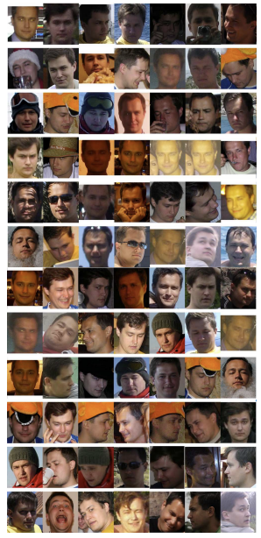
Paper Discussion
Example
“FaceNet achieves 99.63% verification accuracy on LFW”
Notes:
Beyond the architecture and accuracy metric, what does the unit of empirical significance include?
LFW dataset: identities and images, demongraphics, image quality, pose, and collection era
ID labels and pair definitions: How mated and non-mated pairs are determined and whether any labels are incorrect
Protocol: 6,000 selected pairs, ten folds, and the procedure for estimating decision threshold
Exact data splits: which identities and images were used to train the embedding, whether they overlap with LFW, and the preprocessing/alignment applied
Image processing pipeline: face detection, cropping, alignment, resizing, normalization, and handling of failed detections;
the embedding and comparison procedure: model weights/checkpoint, embedding dimension, distance or similarity function, and score normalization
the software and hardware environment: library versions, implementation choices, numerical settings, and model inference configuration; and
the intended interpretation: performance on the LFW benchmark protocol, not automatically performance for a real access-control, surveillance, or identity-verification deployment.

Slide 23
Paper Discussion
Major points
Statistical control is a prerequisite for useful interpretation
The authors use statistical control in the quality/measurement sense: relevant conditions and sources of variation must be known, controlled, measured, or reported well enough to interpret a result.
Repeatability and reproducibility are not automatic properties of code release or a fixed dataset. They depend on conditions remaining sufficiently stable and documented.
The paper separates uncertainty that can be statistically characterized from uncertainty that must be assessed through other evidence or may remain unknown.
Notes:
Prompt: What would it mean to put a modern deep-learning biometric experiment “under statistical control”? Which factors can be measured, and which are difficult to control?

Slide 24
Paper Discussion
Classical Understanding and Assumption
Change one variable at a time, while holding others constant
Control is expected
Modern Understanding and Assumption
There are dependencies—number of model parameters and template (embedding) size
There are factors that are difficult to control
Notes:
For a face-verification experiment, factors that can usually be controlled or measured include:
train/validation/test identity splits and any identity overlap;
dataset version, labels, pair-generation protocol, and sampling procedure;
model architecture, pretrained weights, loss function, optimizer, hyperparameters, number of epochs, and random seeds;
preprocessing: detector, alignment, crop, resolution, normalization, and treatment of detection or quality-control failures;
comparison rule: similarity metric, score normalization, threshold-selection procedure, and reporting metric;
software versions, hardware, mixed-precision settings, and inference configuration;
observed dataset attributes, such as sensor/camera, pose, illumination, capture session, image quality, demographic labels where available, and time between enrollment and probe images.
Factors that are often difficult to control, and sometimes difficult even to measure fully, include:
whether the sampled subjects and images represent the intended deployment population;
latent or incompletely documented dataset biases;
label or matching-key errors;
real user behavior, such as cooperation, retries, presentation angle, or deliberate attempts to defeat the system;
changing environmental conditions, sensor aging, camera placement, and software updates;
correlations among samples from the same subject, session, location, or collection process;
temporal change: aging, appearance changes, evolving population composition, and changing attack behavior; and
unknown interactions among these factors—for example, a preprocessing choice that affects one camera, demographic group, or quality regime differently than another.
If two research groups release the same code and report different results, which uncontrolled or undocumented parts of the experimental system would you investigate before concluding that one implementation is wrong?
*** IMPORTANT ***
Releasing code is helpful, but it does not automatically make a result reproducible.
Reproduction also requires enough information and access to recreate the relevant experimental conditions, including:
exact data version, identity splits, labels/matching keys, and evaluation protocol;
preprocessing, quality-control, pair-generation, and threshold-selection procedures;
model weights, training configuration, random seeds, dependencies, and hardware/runtime settings;
treatment of failures such as undetected faces or failed enrollment; and
a clear definition of what result is expected to be reproduced and under what conditions.

Slide 25
Paper Discussion
Major points
Uncertainty has multiple sources, and confidence intervals are not enough
ISO/IEC “Guide to Expression of Uncertainty” (GUM)
incomplete deﬁnition of the measurand;
imperfect realization of the deﬁnition of the measurand;
non-representative sampling – the sample measured may not represent the deﬁned measurand;
inadequate knowledge of the effects of environmental conditions on the measurement or imperfect measurement of environmental conditions;
personal bias in reading analogue instruments;
ﬁnite instrument resolution or discrimination threshold;
inexact values of measurement standards and reference materials;
inexact values of constants and other parameters obtained from external sources and used in the data reduction algorithm;
approximations and assumptions incorporated in themeasurement method and procedure;
variations in repeated observations of the measurandunder apparently identical conditions
Notes:
Prompt: What would it mean to put a modern deep-learning biometric experiment “under statistical control”? Which factors can be measured, and which are difficult to control?

Slide 26
Paper Discussion
Major points
Test type determines the meaning and scope of a claim
Test Type | Primary Setting | What it can support | Main Caution
Technology Test | Controlled use of a pre-collected database | Characterization of a specific software/database/test configuration | It should not be treated as general real-world performance or as a result for the algorithm independent of the database and matching key.
Scenario Test | Data collected from human subjects under a defined prototype application scenario | Performance of a complete system under the stated scenario conditions | Uncontrolled human, environmental, and threshold-feedback effects limit repeatability/reproducibility and generalization.
Operational Test | A real application environment | Evidence about the deployed process in that operation | Ground truth, user behavior, policy, non-biometric rejection reasons, and changing conditions complicate interpretation.

Slide 27
Paper Discussion
Major points
The scope of a result must be limited explicitly
The paper’s final recommendations emphasize documenting the test conditions, defining the measurand and proxies, discussing sources of systematic uncertainty, and limiting conclusions to the specific system, conditions, and purpose of the test.
This is not a call to abandon evaluation. It is a call to align the strength of the conclusion with the evidence collected.

Slide 28
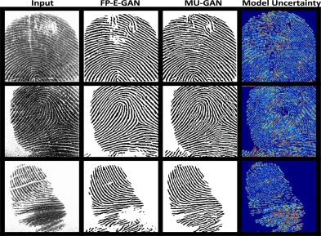
Paper Discussion
Where does the paper fall short?
Limited ML Workflow
Strong framework, but limited practical guidance for modern ML evaluation.
Pre-AI Era
Does not address today’s data scale, pretraining, model selection, and benchmark leakage.
Fairness Uncertainty
Limited treatment of subgroup, intersectional, and small-sample uncertainty.
Label Uncertainty
Identifies label and matching-key errors without modern methods for quantifying them.
Hybrid Deployment Stages
Technology, scenario, and operational tests often overlap in evolving systems.
Decision-Ready Uncertainty
Does not specify what uncertainty is acceptable for a given application.
Notes:
Ma et al. represent the iris primarily through hand-designed local texture statistics. Although this provides a compact and discriminative representation, the relatively coarse spatial pooling and fixed filter bank can discard fine-grained spatial/structural information and do not exploit potentially complementary biometric information across spectra or acquisition conditions.

Slide 29
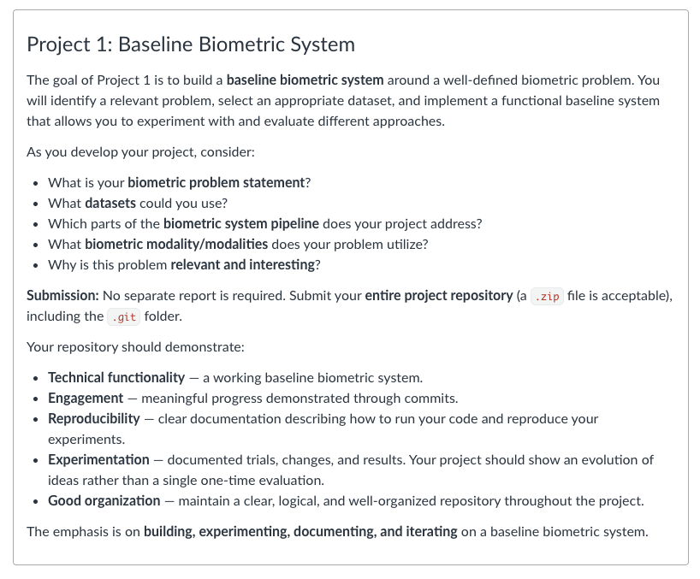
Project 1 (Baseline) due Sept. 11

