Slide 1


Week 5
How Should Biometric Experiments Be Designed?
COSC 594-003 Special Topics in Computer Science
Biometrics
Benjamin S. Riggan
Associate Professor

Slide 2
Key Learning Objectives
How can biometric experiments be designed so that conclusions are supported by the evidence—not by accidental properties of the dataset or protocol?
Key Outcomes:
Translate a biometric research question into a testable claim, population, protocol, and metric.
Identify dependence and leakage caused by repeated captures, identities, sessions, sensors, and acquisition conditions.
Design an evaluation that distinguishes an algorithmic gain from a data-collection or protocol artifact.
Notes:
AI = Artificial Intelligence
ML = Machine Learning
CV = Computer Vision
DL = Deep learning

Slide 3
LAST WEEK — How do we know whether a biometric system is “good”?
THIS WEEK — How Should Biometric Experiments Be Designed?
person
face
fingerprint
iris
…
Notes:
Testing & Evaluation
Explainability
Insanity (?)

Slide 4
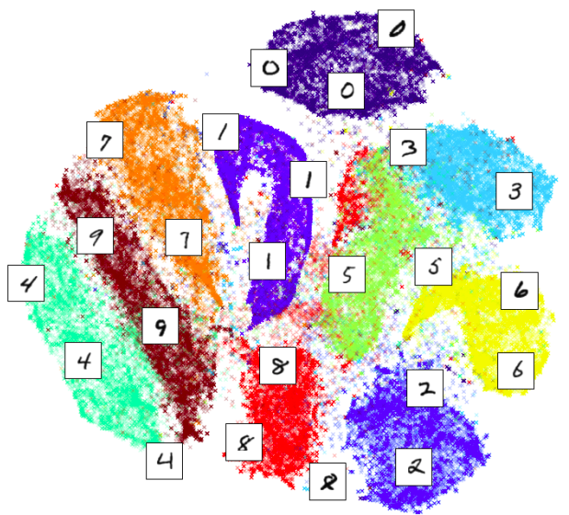
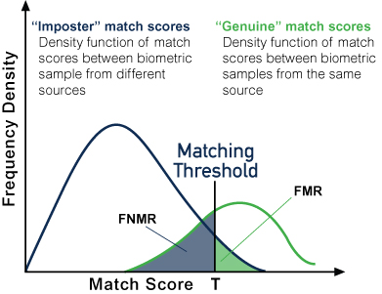
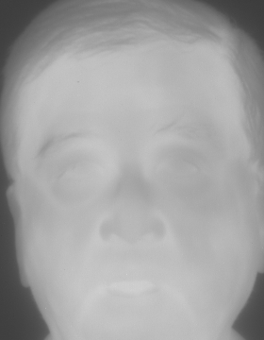
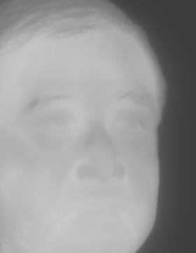
Which choice most threatens the validity of a face-verification result?
A. A test set with too few images
B. The same subject appearing in training and evaluation splits
C. A threshold selected after inspecting the test ROC curve
Train
Eval
Notes:
Is not a problem, unless pair with with an overparameterized model
Is not bad from a general ML perspective.
Generally, not acceptable but is often violated in less subtle ways.
Example. PCA mean statistics or normalization captured using complete dataset (train & test).

Slide 5
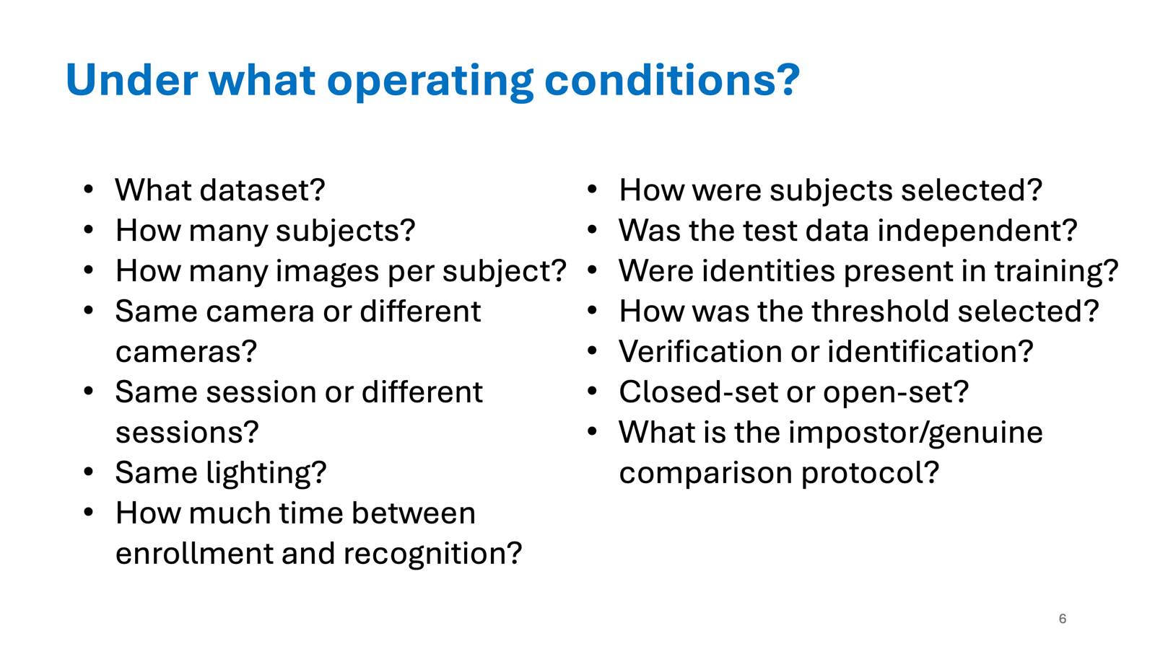
Review Week 4
What must be specified before the statement “The system is state-of-the-art” has technical meaning?
Event (or Task)
Population and Protocols
Complete system
Conditions
When
Decision Rule
Operating Points
Notes:
Last week asked whether a system is “good.” This week asks whether an experiment can justify that answer.

Slide 6
Why collection and design are part of the method?
Claim
A biometric benchmark is not merely a container of samples.
Collecting biometric data at scale turns operational choices:
Subject recruitment,
Repeated acquisition,
Metadata,
Quality control,
Data management
Into scientific design decisions.
Scenario: You collect 1,000,000 face images.
Question: Which quantity is more informative for judging experimental breadth: sample count, subject count, number of sessions, or number of capture conditions?
Notes:
Core claim
A biometric benchmark is not merely a container of samples. Its population, capture process, labels, metadata, partitioning, and comparison protocol define what performance means.
Answer:
none is sufficient alone. The answer depends on the claim being tested; report the structure, not only the headline count.

Slide 7
Concept Overview
From research question to protocol
  state the claim
  protocol is the experimental instrument
Dependence, leakage, and effective sample size
  samples are not always independent
  where can information cross boundaries?
Valid Inference: uncertainty, comparison, and reproducibility
  a point estimate is not a conclusion
  fair comparisons require control
  reproducibility is an experimental result

Slide 8
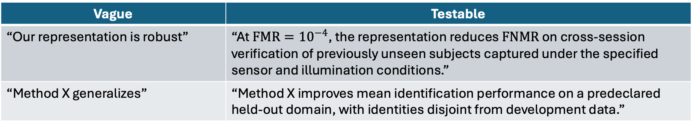
Concept I: state the claim
Experiment Chain:
$$\text{claim}→\text{target population}→\text{sampling unit}→\text{protocol}→\text{metric}→\text{uncertainty}$$
Vague vs. Testable:
Vague | Testable
“Our representation is robust” | “At $FMR={10}^{−4}$, the representation reduces $FNMR$ on cross-session verification of previously unseen subjects captured under the specified sensor and illumination conditions.”
“Method X generalizes” | “Method X improves mean identification performance on a predeclared held-out domain, with identities disjoint from development data.”
Notes:
Key distinction: target versus observed population
Target population: the people, sensors, environments, and time period to which you want to generalize.
Study population: the cases that could actually be sampled.
Evaluation sample: the data actually included in the test protocol.
Question: If a claim says “works across demographics,” what information must a protocol define before that claim is capable of being assessed, analyzed, or evaluated?
Answer: attributes, sampling frame, inclusion criteria, label provenance, sample size, task, metric, and uncertainty

Slide 9
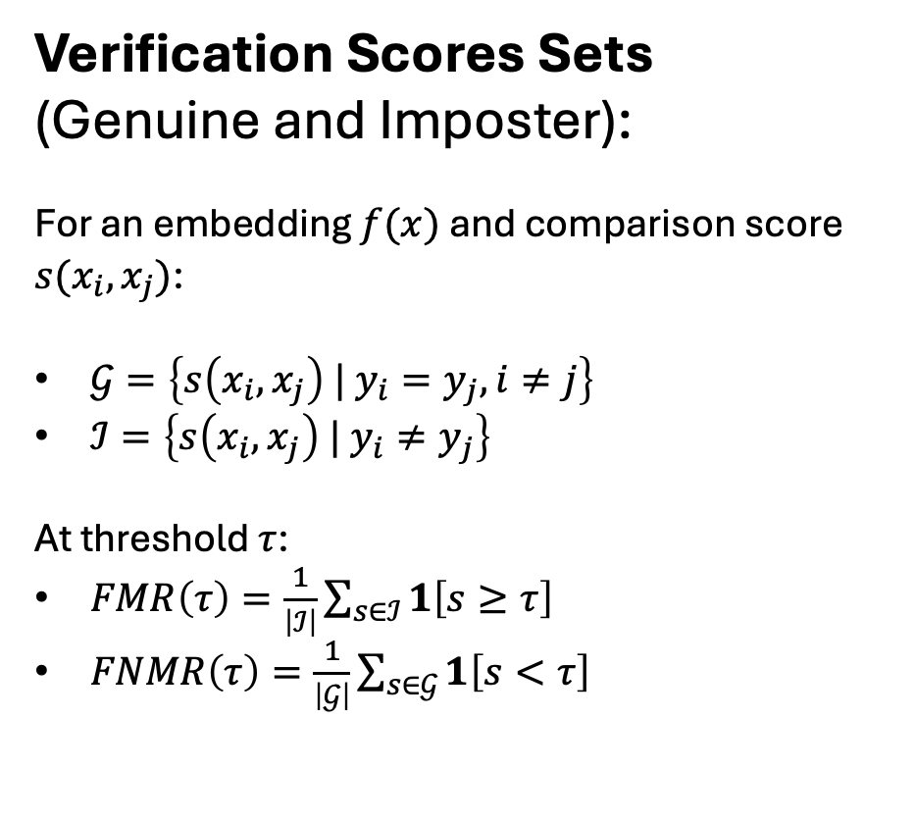
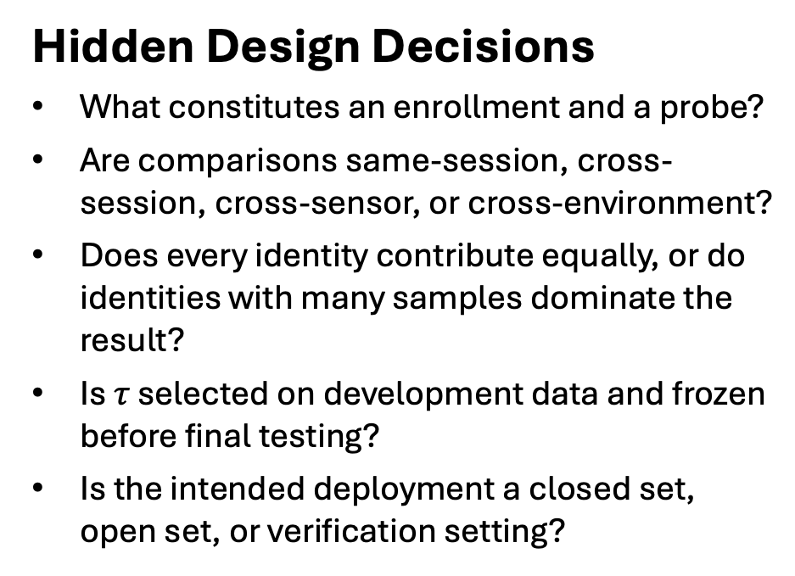
Concept I: protocol is the experimental instrument
Verification Scores Sets
(Genuine and Imposter):
For an embedding $f(x)$ and comparison score $s(x_{i}, x_{j})$:
$𝒢=\left\{s\left(x_{i}, x_{j}\right) | y_{i}=y_{j}, i≠j\right\}$
$ℐ=\left\{s\left(x_{i}, x_{j}\right) | y_{i}≠y_{j}\right\}$
At threshold $τ$:
$FMR\left(τ\right)=\frac{1}{\left|ℐ\right|}\sum_{s∈ℐ}{1\left[s≥τ\right]}$
$FNMR\left(τ\right)=\frac{1}{\left|𝒢\right|}\sum_{s∈𝒢}{1\left[s<τ\right]}$
Hidden Design Decisions
What constitutes an enrollment and a probe?
Are comparisons same-session, cross-session, cross-sensor, or cross-environment?
Does every identity contribute equally, or do identities with many samples dominate the result?
Is $τ$ selected on development data and frozen before final testing?
Is the intended deployment a closed set, open set, or verification setting?
Notes:
Example: A dataset has 500 identities, each with 20 images from one 10-minute session. Is a random image-level split suitable evidence for “robust recognition over time”?
Answer: No. It may be suitable for a narrowly defined within-session test, but it does not test time variation.

Slide 10
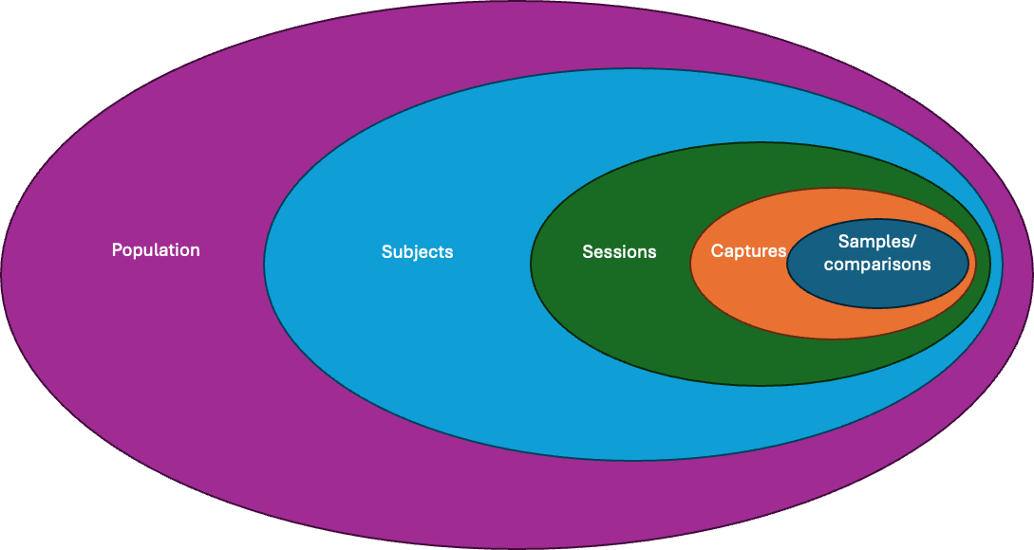
Concept II: samples are not always independent
Hierarchical structure of biometric data
Notes:
Hierarchical structure of biometric data
$$\text{population}⊃\text{subjects}⊃\text{sessions}⊃\text{captures}⊃\text{derived samples / comparisons}$$
Images of one person, frames from one video, or captures from one session commonly share nuisance factors: identity, pose, illumination, sensor behavior, operator, background, and time.
Consequence
Treating correlated samples as independent can yield overly optimistic performance estimates and overly narrow uncertainty intervals.
The central split rule
Partition at the highest level that could transmit information from development to evaluation for the claim you are making.
Examples:
Identity-disjoint split for generalization to new people.
Session-disjoint split for new acquisition episodes.
Sensor- or site-disjoint split for deployment at new devices or locations.
Time-disjoint split for future deployment.

Slide 11
Concept II: where can information cross boundaries?
Common leakage pathways
Identity overlap: the same person appears in training and test data.
Near-duplicate overlap: adjacent video frames, bursts, crops, or augmentations appear across partitions.
Session overlap: environment or capture setup is shared between development and test.
Preprocessing leakage: normalization, PCA, imputation, quality thresholds, or hyperparameters use all data.
Threshold leakage: the final test set determines the operating threshold.
Benchmark feedback: repeated tuning against a public test set turns it into development data.
Notes:
Example: A team splits individual images randomly, trains a face embedding, tunes the threshold on the validation set, and reports test performance. Each subject was photographed in several bursts during one visit. Identify every issue you would investigate before accepting the result.
Instructor debrief
Start with the unit of independence: subject and burst/session. Then ask whether the claimed use case requires new subjects, new sessions, or both.

Slide 12
Think-Pair-Share: Design a defensible split
Scenario
You are building an iris-verification system.
The collection contains:
300 subjects;
left and right eye images;
3 visits per subject, one month apart;
2 sensors used at every visit; and
5 captures per eye–sensor pair.
Your claim is: “The system verifies previously unseen users under a later acquisition session and either sensor.”
Questions to consider:
What is the primary unit of partitioning?
What data may be used for threshold selection?
Which comparisons belong in the final test protocol?
What limitation remains even after a careful split?
Notes:
Solicit two protocol designs. On the board, label each boundary: identity, time/session, sensor, and development/test.
Target synthesis
Hold out identities for unseen-user claims.
Use only development identities/sessions to select the threshold and all design choices.
Test cross-session comparisons; stratify same-sensor and cross-sensor conditions if sensor robustness is a question.
Limitation: 300 subjects and two sensors still bound the population to which results can generalize.

Slide 13
Concept III: a point estimate is not a conclusion
Questions an experimental result must answer:
What quantity was estimated?
How variable would that estimate be under another plausible sample of subjects, sessions, or captures?
Is the apparent difference between systems larger than the uncertainty introduced by the protocol?

Slide 14
Concept III: a point estimate is not a conclusion
Why subject-aware uncertainty matters
A biometric test may contain many pairwise comparisons but far fewer independent identities. Resampling comparisons alone can overstate precision when comparisons share subjects.
Practical recommendation
Use subject-level resampling (or a hierarchy-aware resampling scheme) for interval estimates when the scientific unit is the person. Preserve the protocol structure during resampling.
Notes:
Example: System A has $FNMR=2.1\%$ and System B has $FNMR=1.9\%$ at the same stated $FMR$. What additional evidence do you need before claiming B is better?
Expected ideas: paired protocol, threshold procedure, confidence interval or resampling distribution for the difference, subject/session composition, and an effect-size/operational relevance argument.

Slide 15
Concept III: fair comparisons require control
Keep constant
(justify differences):
training identities and samples;
preprocessing and quality filtering;
image resolution and alignment;
augmentation and external pretraining data;
hyperparameter search budget;
score normalization, fusion, and calibration;
threshold-selection data;
test comparisons and metric implementation.
Analysis Plan
Before examing results, record:
primary claim and primary metric;
partitions and inclusion/exclusion criteria;
threshold/calibration procedure;
subgroup or condition analyses;
uncertainty method; and
stopping or model-selection rule.
Notes:
Question
A method is evaluated on 12 conditions and reported only on the 3 conditions where it wins. Is this an algorithmic result, an analysis-plan problem, or both?
Debrief: Both. The model may have useful strengths, but selective reporting invalidates a general superiority claim.

Slide 16
Concept III: reproducibility is an experimental result
Reproducible Biometric Experiment Enable Reconstruction of:
data version and provenance;
subject/session/sensor metadata and split manifest;
code revision and dependency environment;
random seeds and nondeterminism controls;
training configuration and checkpoint selection rule;
exact comparison lists and metric code;
all exclusions, failures, and deviations from plan.
Practice & Reproducibility Expectations
A repository should let another researcher distinguish what was planned, what was run, and what was reported.
Notes:
Exit prompt
Name one artifact you would require from a paper before trusting a reported biometric result enough to build on it.

Slide 17
Summary
Three Concept to Recall:
Claim–protocol alignment: define the target population, task, operating condition, and metric before evaluating.
Dependence-aware partitioning: split at the level required to prevent the information transfer that would invalidate the claim.
Valid inference and reproducibility: quantify uncertainty, control experimental degrees of freedom, and preserve the artifacts needed to audit the result.
Notes:
Exit prompt
Name one artifact you would require from a paper before trusting a reported biometric result enough to build on it.
Bridge
Last class treated the protocol as the instrument for measuring a system.
The assigned reading asks what it takes to construct the corpus and metadata on which that instrument depends.

Slide 18
Summary
Five Questions to Ask of Every Biometric Experiment:
Who and what conditions does this result claim to represent?
What is the unit of independence, and where is the split boundary?
What is fixed before final testing?
Which metric and operating point correspond to the real decision problem?
Can another researcher reconstruct the data protocol and analysis?
Notes:
Exit prompt
Name one artifact you would require from a paper before trusting a reported biometric result enough to build on it.

Slide 19
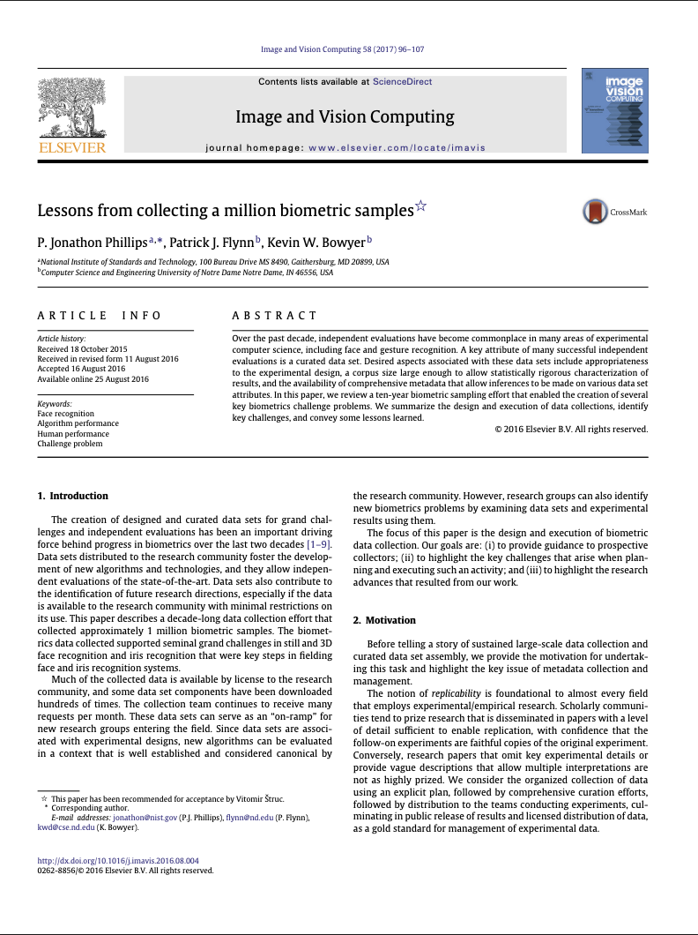

Paper Discussion
Impact Factor 5.0
CiteScore 7.7
https://www.sciencedirect.com/journal/image-and-vision-computing

Slide 20
Paper Discussion
What problem is addressed?
Why?
Consider and complete the following claim:
“A dataset of one million biometric samples is valuable only if …”

Slide 21
Paper Discussion
What problem is addressed?
Why?
Biometric recognition research requires data collections that are
fit for an experimental purpose, rather than merely large
large/structured enough to support meaningful error estimates at relevant operating points
accompanied by metadata that make variation, failures, and confounds observable
documented sufficiently for external researcher(s) to understand the protocol and reproduce the evaluation
Notes:
Why the problem matters
A biometric result is inseparable from its collection and evaluation conditions. A benchmark can make a method look strong because it measures a narrow condition well, or because its unmeasured structure leaks information into an evaluation.
Whole-class discussion
What scientific question becomes answerable only after moving from a small convenience collection to a large, structured collection?
What scientific question remains unanswerable even with one million samples?
Which is the scarcer resource: samples, subjects, independent sessions, difficult conditions, accurate labels, or metadata? Defend one choice.
synthesis: scale is a means to estimate defined quantities with useful precision. It is not itself a definition of representativeness, independence, or generalization.

Slide 22
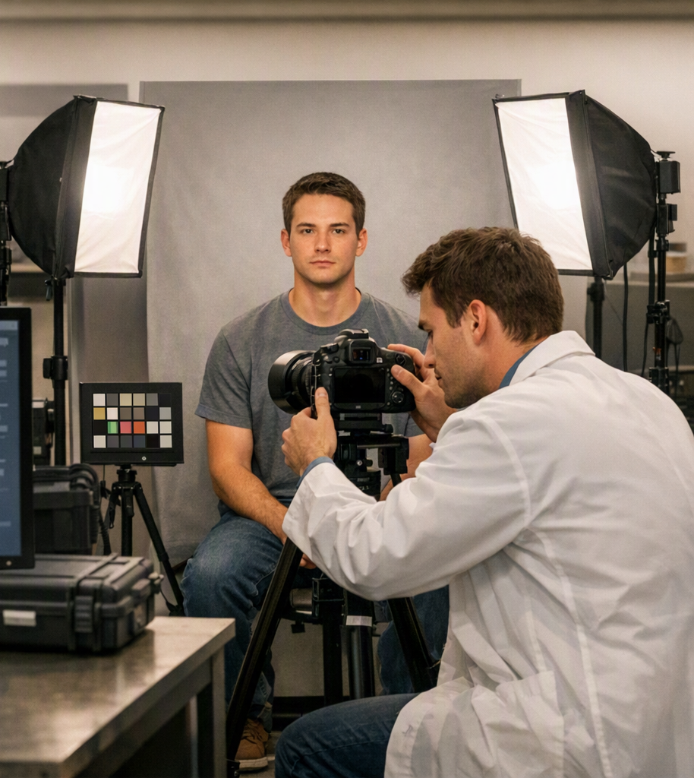
Design Case Study (Groups)
In groups, open the paper and find at least one observation in the paper that aligns under the following topics…
Group 1 Topics/Questions
Scientific Validity
Operations
Group 2 Topics/Questions
Statistics
Reusability
Scientific Validity
What claim does the collection permit, and what claim does it not permit?
Operations
What human, hardware, workflow, and quality-control decisions determine what can be collected?
Statistics
What are the independent units; where does dependence enter?
Reusability
Which metadata and documentation enable a future researcher to pose a different valid question?
Notes:
Scientific validity The authors frame curated collections as the infrastructure for independent evaluation, but emphasize that the collection must be designed for the intended experiment—not simply made large. A collection can therefore support a claim about performance under its specified population, sensors, and acquisition protocol, but not automatically a broader claim about all people, cameras, or operational settings.
Require a benchmark card that explicitly states the target population, sensing environment, time span, task, and evaluation protocol. “One million samples” is not evidence of generalization unless those dimensions were sampled for the intended claim.
Scientific validity The paper comes from a decade-long collection effort tied to face and gesture recognition evaluation, where the value of the corpus is its ability to support controlled challenge problems and comparative testing rather than to establish a universal property of recognition algorithms.
Ask: What is held fixed, what varies, and what deployment claim does that variation permit? A constrained lab collection may be excellent for isolating pose or sensor effects while remaining insufficient for claims about real-world demographic, geographic, or temporal robustness.
Operations A large collection is not just a camera and a recruitment list: it requires repeatable acquisition procedures, staff workflow, subject management, hardware operation, quality control, storage, and data release processes. The paper explicitly treats collection as a design-and-execution problem over a long time horizon.
Document operator instructions, capture scripts, sensor configuration, calibration or maintenance changes, quality-control rules, re-capture policy, enrollment/identity-resolution workflow, and exclusions. Otherwise, researchers cannot distinguish a model failure from an acquisition-process artifact.
Operations The authors’ retrospective perspective over ten years highlights that collection decisions made early become constraints on later analyses. If the protocol does not record a factor—or does not deliberately vary it—it may be impossible to study its effect afterward.
Before collection, create a “future-analysis” table: for each anticipated question—cross-sensor robustness, aging, quality sensitivity, demographic performance, or failure analysis—identify the needed repeated captures and metadata fields.
Statistics The paper argues for corpus scale sufficient for statistically rigorous characterization, but its collection perspective should lead students to separate the number of files or comparisons from the number of independent experimental units. Many images or pairwise scores can come from the same people, sessions, or acquisition events.
Report the hierarchy: $N_{\text{subjects}},N_{\text{sessions}},N_{\text{captures}},N_{\text{comparisons}}$. Use identity-disjoint splits for unseen-subject claims; use session-, site-, sensor-, or time-disjoint protocols when those are the deployment shifts being claimed.
Statistics In a face-verification corpus, every extra image can generate many genuine and impostor comparisons, but the resulting scores share identities and often share session conditions. Thus, a smooth ROC curve does not by itself establish equally precise population-level performance. This is the key statistical consequence of the paper’s emphasis on experimental design and corpus structure.
Require identity-aware uncertainty analysis, such as subject-level bootstrap resampling or confidence intervals stratified by subject/session. Ask students whether an apparent algorithmic improvement survives when the resampling unit is the subject rather than the image pair.
Reusability The authors identify comprehensive metadata as necessary for making inferences about collection attributes. Metadata turns a corpus from a fixed benchmark into an object that can be stratified, audited, and repurposed for future questions.
Preserve capture timestamp or session ID, sensor and software version, site, capture protocol, image-quality indicators, failure-to-acquire/enroll flags, identity linkage, and label provenance. For human-subject data, document permitted uses and restrictions as well.
Reusability The paper’s connection to independent evaluations implies that reuse requires more than released images: outside researchers need the experimental definition that explains how samples, identities, and comparisons were organized.
Release or precisely specify subject-disjoint partitions, enrollment/probe roles, allowed comparison lists, score direction, threshold-selection procedure, metric implementation, and any preprocessing that was fit using development data. Without these, two groups can use the same images yet evaluate different tasks.

Slide 23
Paper Discussion
What are some key ideas from the paper?
Core Ideas
Collections Enable Independent Evaluation
Design Determines What Can Be Claimed
Population, Protocol, and Metadata Are Experimental Variables
Scale Requires Scientific and Operational Infrastructure
Structure and Metadata Enable Diagnosis
Lesson: Experimental Capability Matters More Than File Count

Slide 24
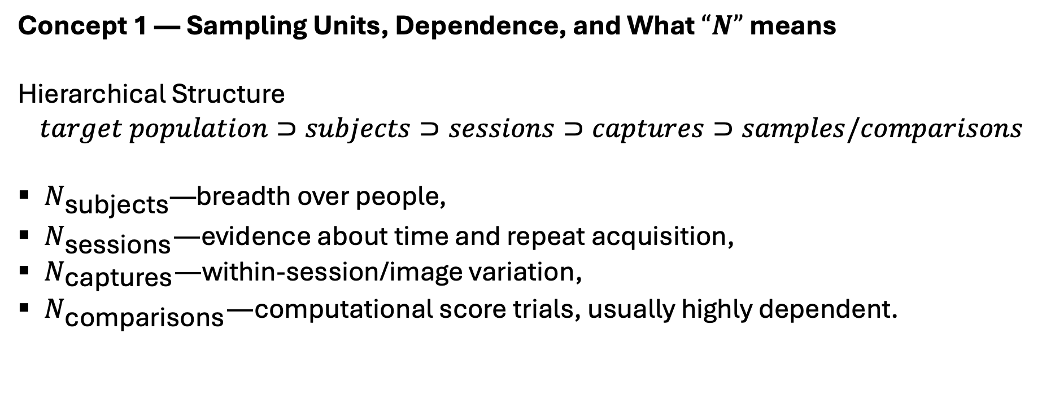
Paper Discussion
Major points
Concept 1 — Sampling Units, Dependence, and What $“N”$ means
Hierarchical Structure
$$target population⊃subjects⊃sessions⊃captures⊃samples/comparisons$$
$N_{\text{subjects}}$—breadth over people,
$N_{\text{sessions}}—$evidence about time and repeat acquisition,
$N_{\text{captures}}—$within-session/image variation,
$N_{\text{comparisons}}—$computational score trials, usually highly dependent.
Notes:
Headline: A million samples are not a million independent observations
Recall the hierarchial structure:
Each level may carry shared factors: identity, physiology, camera/sensor, operator, lighting, background, time, or acquisition workflow.
For a recognition claim, distinguish: num subjects, seesions, captures, comparisons
main point: A vast number of pairwise comparisons may be generated from a modest number of identities and sessions. It improves score-curve resolution but does not automatically provide an equivalent amount of independent evidence about population-level performance.

Slide 25
Paper Discussion
Example
Two collections each contain 100,000 face images.
Collection A contains 10 images each from 10,000 subjects in one session. Collection B contains 1,000 images each from 100 subjects over ten sessions.
Which collection better supports:
recognition of unseen people,
longitudinal robustness,
precision at a stringent false-match operating point?
What additional protocol details do you need before deciding?
Notes:
1. When do samples from the same identity become a source of leakage rather than valuable repeated measurements?
2. If a metric is computed over all genuine and impostor pairs, which identities contribute the most influence? Is that desired?
3. What resampling unit would you use for a confidence interval: comparison, image, session, or subject? Why?
4. How would your answer change for video-frame-based gait or face recognition?
Synthesis: Report the collection hierarchy—not merely a single $N$. Match the split and the uncertainty procedure to the unit over which the conclusion is intended to generalize.

Slide 26
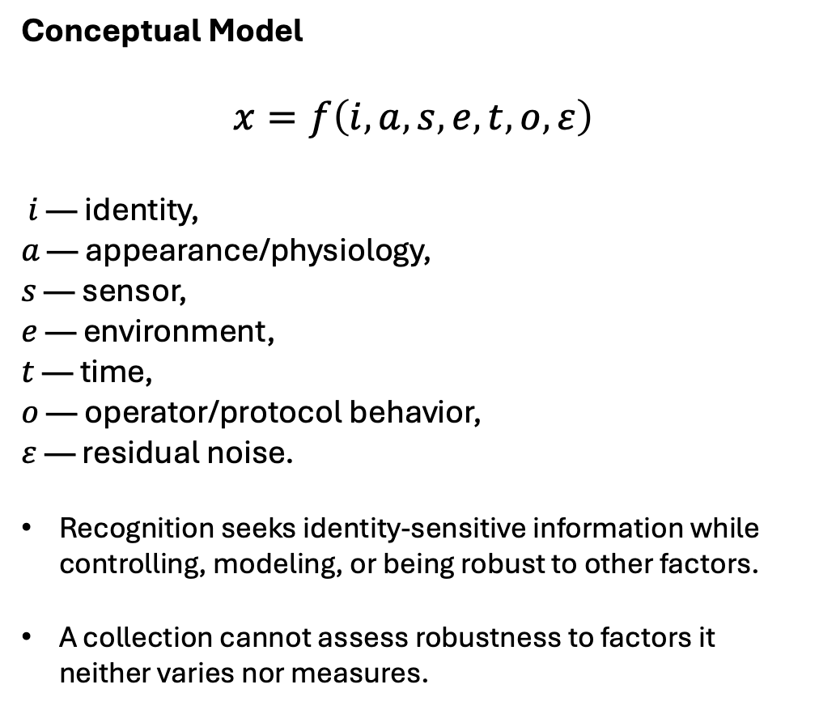
Paper Discussion
Conceptual Model
$$x=f\left(i , a , s , e , t , o , ε\right)$$
$i$ — identity,
$a$ — appearance/physiology,
$s$ — sensor,
$e$ — environment,
$t$ — time,
$o$ — operator/protocol behavior,
$ε$ — residual noise.
Recognition seeks identity-sensitive information while controlling, modeling, or being robust to other factors.
A collection cannot assess robustness to factors it neither varies nor measures.
Major points
Concept 2 — Acquisition protocol turns nuisance variation into measurable variables
Core Distinction
A collection protocol can either:
control a factor to isolate a causal/algorithmic question, or
vary and record a factor to measure robustness under realistic conditions.
Neither is universally better. The decision must follow the research question.
Notes:
Headline: Controlled variation, operational realism, and confounding
A lab wants to claim that Method B is more robust to illumination than Method A. Which design provides the strongest evidence?
A. Capture each identity only once under whatever lighting occurs naturally.
B. Capture the same identities under pre-specified lighting conditions, randomize or balance their order, and record illumination metadata.
C. Train with synthetic brightness augmentation and test on the same images.
D. Report performance on a larger dataset without illumination labels.
Expected answer: B, with discussion of external validity and whether the specified conditions represent the target environment.
Discussion Questions:
Identify a plausible confound if one sensor is used only at one site or for one demographic stratum.
Is a highly controlled collection less useful than a “in the wild” collection? State the estimand each supports.
Which acquisition variables should be mandatory metadata for face, iris, fingerprint, gait, or person re-identification? Select a modality and justify five fields.
When is a nuisance factor a protected/ethical attribute rather than simply an experimental variable?
main point: Protocol design is experimental design. Balance, randomization, repeated measures, and metadata determine whether a performance difference can be attributed to the intended factor.

Slide 27
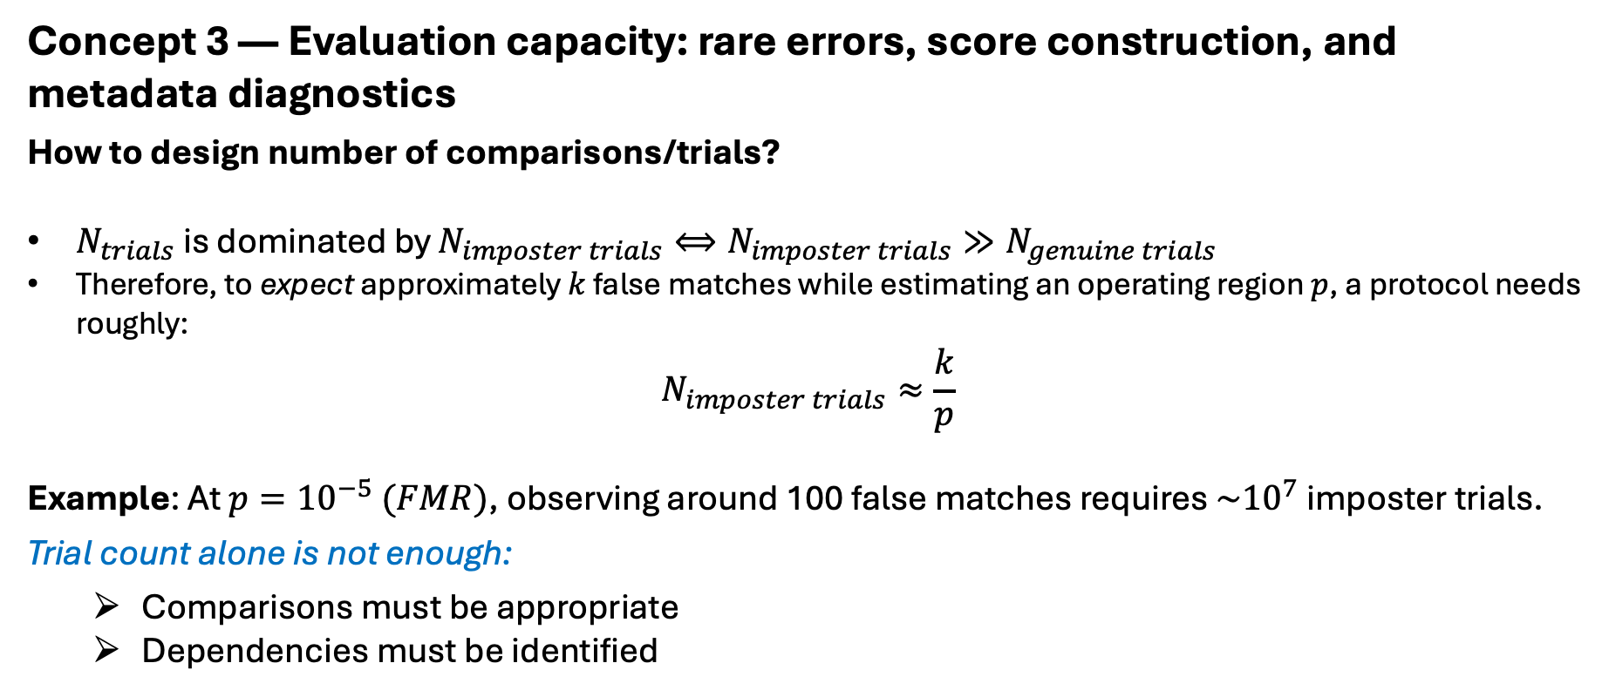
Paper Discussion
Major points
Concept 3 — Evaluation capacity: rare errors, score construction, and metadata diagnostics
How to design number of comparisons/trials?
$N_{trials}$ is dominated by $N_{imposter trials}⟺N_{imposter trials}≫N_{genuine trials}$
Therefore, to expect approximately $k$ false matches while estimating an operating region $p$, a protocol needs roughly:
$$N_{imposter trials}≈\frac{k}{p}$$
Example: At $p={10}^{−5} (FMR)$, observing around 100 false matches requires $\sim {10}^{7}$ imposter trials.
Trial count alone is not enough:
  Comparisons must be appropriate
  Dependencies must be identified
Notes:
Headline: Does the collection permit the operating point you report?
Queestion: Your proposed access-control evaluation reports $FNMR$ at $FMR={10}^{−6}$. You have 500,000 impostor comparisons. How many false matches do you expect at that operating point? Is reporting that point defensible without qualification? What would you add to the design?
Answer—0.5 !!!
The point is too sparsely observed for a stable empirical characterization; add substantially more appropriate impostor trials, report uncertainty/bounds, and reconsider whether the evaluation construction matches deployment.
main point: A strong collection supports more than a headline ROC or CMC curve. Its structure and metadata let researchers define valid score sets, assess uncertainty, and diagnose failure modes.

Slide 28
Paper Discussion
Where does the paper fall short?
Area | Why this is a limitation?
Demographic / Fairness | The paper values metadata that enable inferences about dataset attributes, but it does not provide a modern fairness framework for defining demographic coverage, assessing subgroup error disparities, handling uncertain demographic labels, or reporting uncertainty for small subgroups
Privacy, consent, or data-governance | The discussion focuses on the scientific and operational value of curated collections, while contemporary biometric collection also requires explicit attention to informed consent, purpose limitation, retention, access controls, secondary use, withdrawal, and re-identification risk.

Slide 29
Paper Discussion
Where does the paper fall short?
Metadata advocated more than specified | Comprehensive metadata is identified as important, but the paper does not prescribe a standardized schema, label-provenance procedure, versioning policy, or audit trail that would make metadata consistently interoperable and independently auditable.
Dependence and Uncertainy need statistical treatment | The paper calls for datasets large enough for statistically rigorous characterization, but a modern treatment should explicitly distinguish subjects, sessions, captures, and derived comparisons, then align confidence intervals and resampling with the deployment claim.

Slide 30
Paper Discussion
Where does the paper fall short?
Representativeness is not fully formalized | Fitness for an experimental design is central to the paper, but the work does not offer a detailed method for defining a target population, sampling frame, selection mechanism, coverage gaps, or the limits of transportability from the collected sample to deployment.
Distribution Shifts are limited | The retrospective collection lessons predate many current deployment concerns involving rapid sensor evolution, foundation-model pretraining, synthetic or manipulated imagery, changing social-media image distributions, and cross-domain transfer at scale. The paper was published in 2017.

Slide 31
Paper Discussion
Where does the paper fall short?
Test set overfitting underdeveloped | Independent evaluation is a core motivation, but the paper does not deeply address how a public benchmark’s repeated use can turn its nominal test set into an implicit development set through leaderboard optimization and model-selection feedback.
Failure-to-Acquire and Operations Exclusions need more emphasis | Large-scale collection requires quality control, yet an evaluation can become biased if it reports recognition only for successfully captured or enrolled samples without separately measuring who was excluded and why. This distinction is not foregrounded in the paper’s high-level account.

Slide 32
Paper Discussion
Where does the paper fall short?
Retrospective / Position Paper (Reproducible?) | Stated purpose is to summarize the design, execution, challenges, and lessons from a ten-year sampling effort; it is therefore not intended to function as a full, prescriptive protocol for reproducing every collection decision in a new corpus.

Slide 33
Project 2 (Reproduce + Investigate) due Oct. 23
Objective: to reproduce a method from a modern biometric journal or conference paper and investigate
Same problem as Project 1
Consider sources like:
  IEEE Transactions on Biometrics, Behavior, and Identity Science (T-BIOM)
  IEEE/IAPR Internation Joint Conference on Biometrics
  IEEE/CVF Winter Conference on Application of Computer Vision
  IEEE/CVF Conference on Computer Vision and Pattern Recognition
  Not limited to these venues

