Slide 1


Week 8
Can We Make Representations Generalize?
COSC 594-003 Special Topics in Computer Science
Biometrics
Benjamin S. Riggan
Associate Professor
Notes:
Question to ask ourselves: Generalize to what?

Slide 2
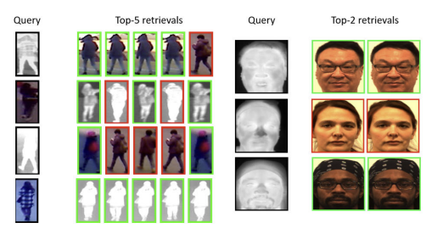
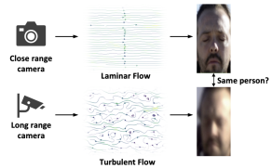
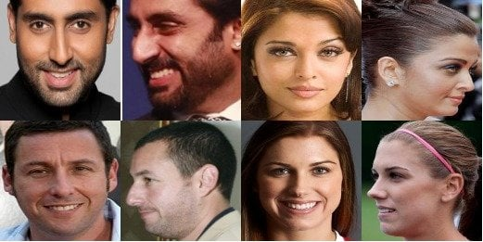
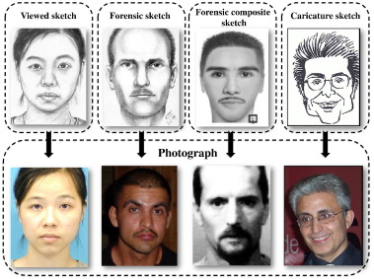
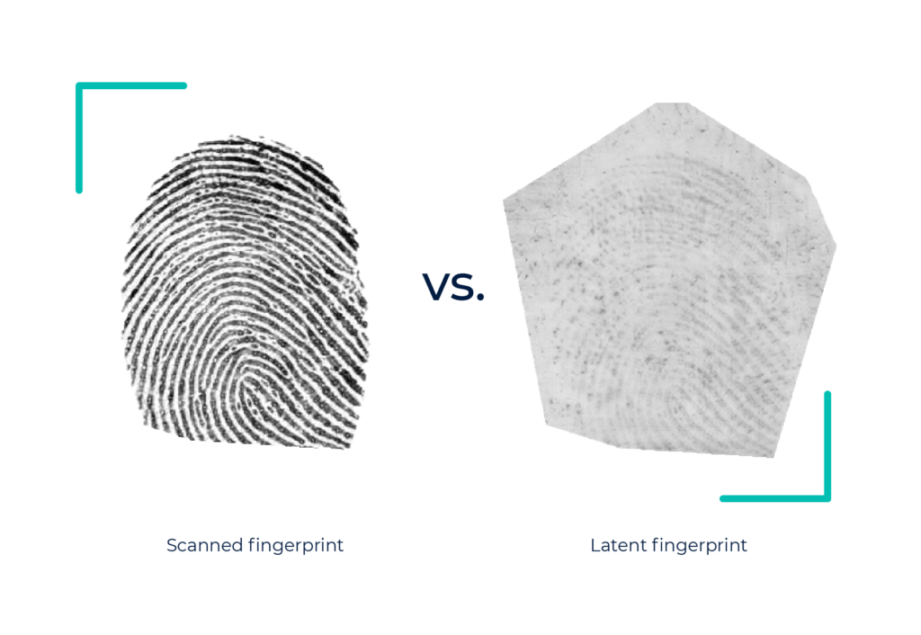
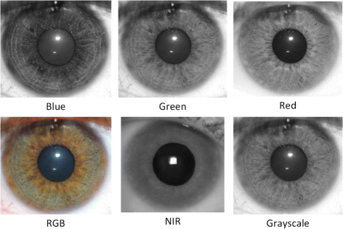
Domain Gaps
Thermal vs. Visible
Pristine vs. Turbulent
Frontal vs. Profile
Sketch vs. Photo
Patent vs. Latent
Visible vs. Near Infrared (NIR)
Notes:
Questions: A model trained only on clean, canonical faces, fingerprints, and iris produces a very low similarity scores for these domain shifts. Is that a data problem, a feature problem, or a loss problem?”

Slide 3
LAST WEEK — How do we know whether a biometric system is “good”?
THIS WEEK — Can We Make Representations Generalize?
person
face
fingerprint
iris
…
Notes:
Testing & Evaluation
Explainability
Insanity (?)

Slide 4
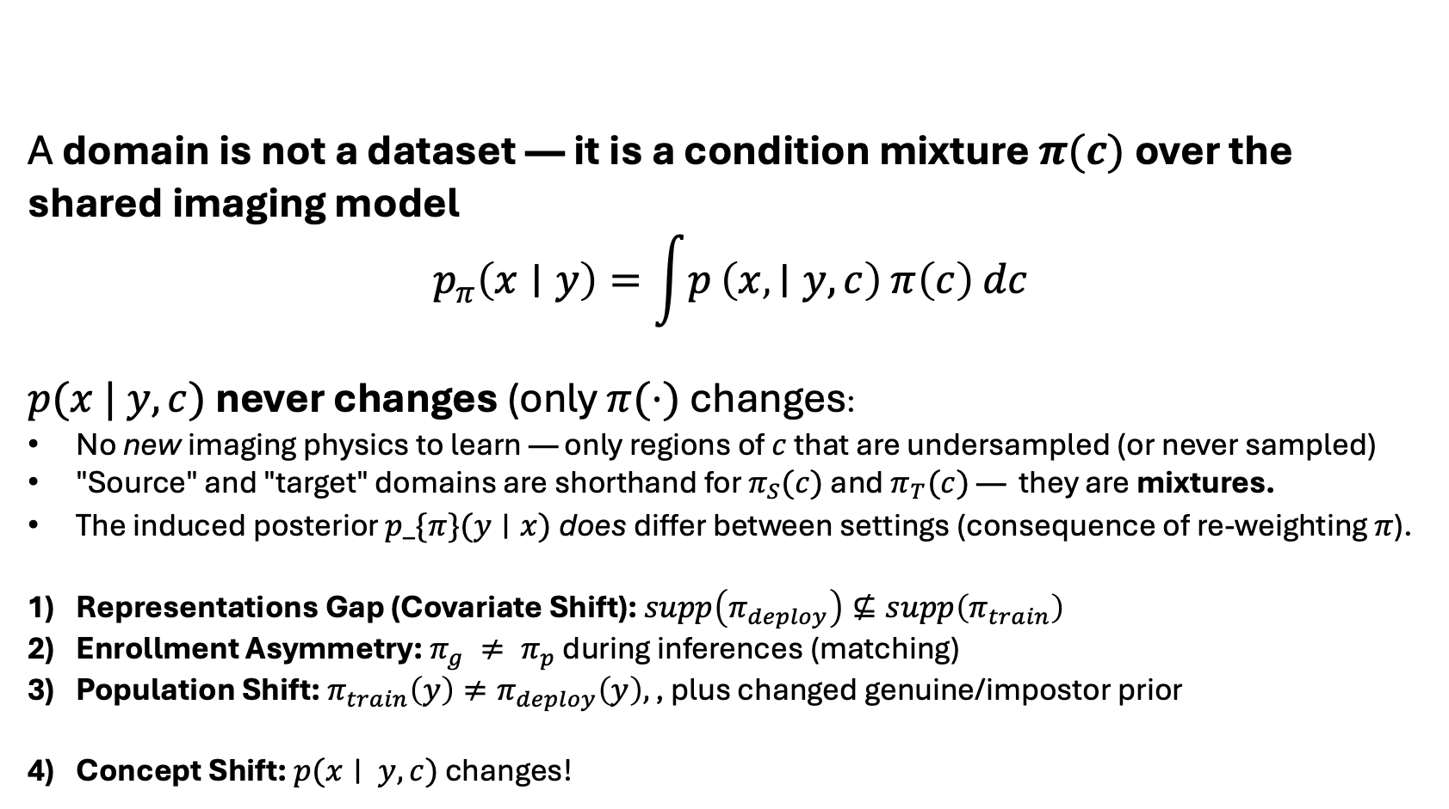
Bridge: Domain $⇒$ Condition Mixture
A domain is not a dataset — it is a condition mixture $π(c)$over the shared imaging model
$$p_{π}\left(x∣y\right)=\int{p}\left(x , ∣y,c\right) π\left(c\right) dc$$
$p(x | y,c)$ never changes (only $π(⋅)$ changes:
No new imaging physics to learn — only regions of $c$ that are undersampled (or never sampled)
"Source" and "target" domains are shorthand for $π_{S}(c)$ and $π_{T}(c)$ — they are mixtures.
The induced posterior $p_\{π\}(y∣x)$does differ between settings (consequence of re-weighting $π$).
Representations Gap (Covariate Shift): $supp\left(π_{deploy}\right)⊈supp\left(π_{train}\right)$
Enrollment Asymmetry: $π_{g} ≠ π_{p}$ during inferences (matching)
Population Shift: $π_{train}\left(y\right)≠π_{deploy}\left(y\right),\text{, plus changed genuine/impostor prior}$
Concept Shift: $p(x∣ y,c)$ changes!
Notes:
Covariate shift is a statement about training;
Shift 2 is a statement about every single score at test time. Recall $s(x_g,x_p) = f_{θ\left(x_{g}\right)}^{T} f_{θ}(x_{p})$ with $x_{g}∼\int{ }p\left(x ∣ y,c\right)π_{g}(c)dc$and $x_{p}∼\int{ }p\left(x ∣ y,c\right)π_{p}(c)dc$. A model can be perfectly adapted to the deploy distribution in aggregate and still fail, because matching is asymmetric across two mixtures.
Concept shift is defined as a change in the relationship between representation and labels with the input space fixed
Why the open-set structure bites (2 min)
Test identities are disjoint from training identities → you cannot adapt a classifier head; you must adapt the embedding $f_{θ}$.
Decisions are threshold-based on $s(x_{g},x_{p})$ → the gap surfaces as score-distribution shift, which moves the operating point, not merely accuracy.
Key consequence: a domain gap is dangerous not because mated scores drop, but because mated and non-mated distributions move by different amounts under $π_{g}≠π_{p}$. One global threshold then becomes wrong for one subpopulation. This is precisely the quantity Wu et al. measure.

Slide 5
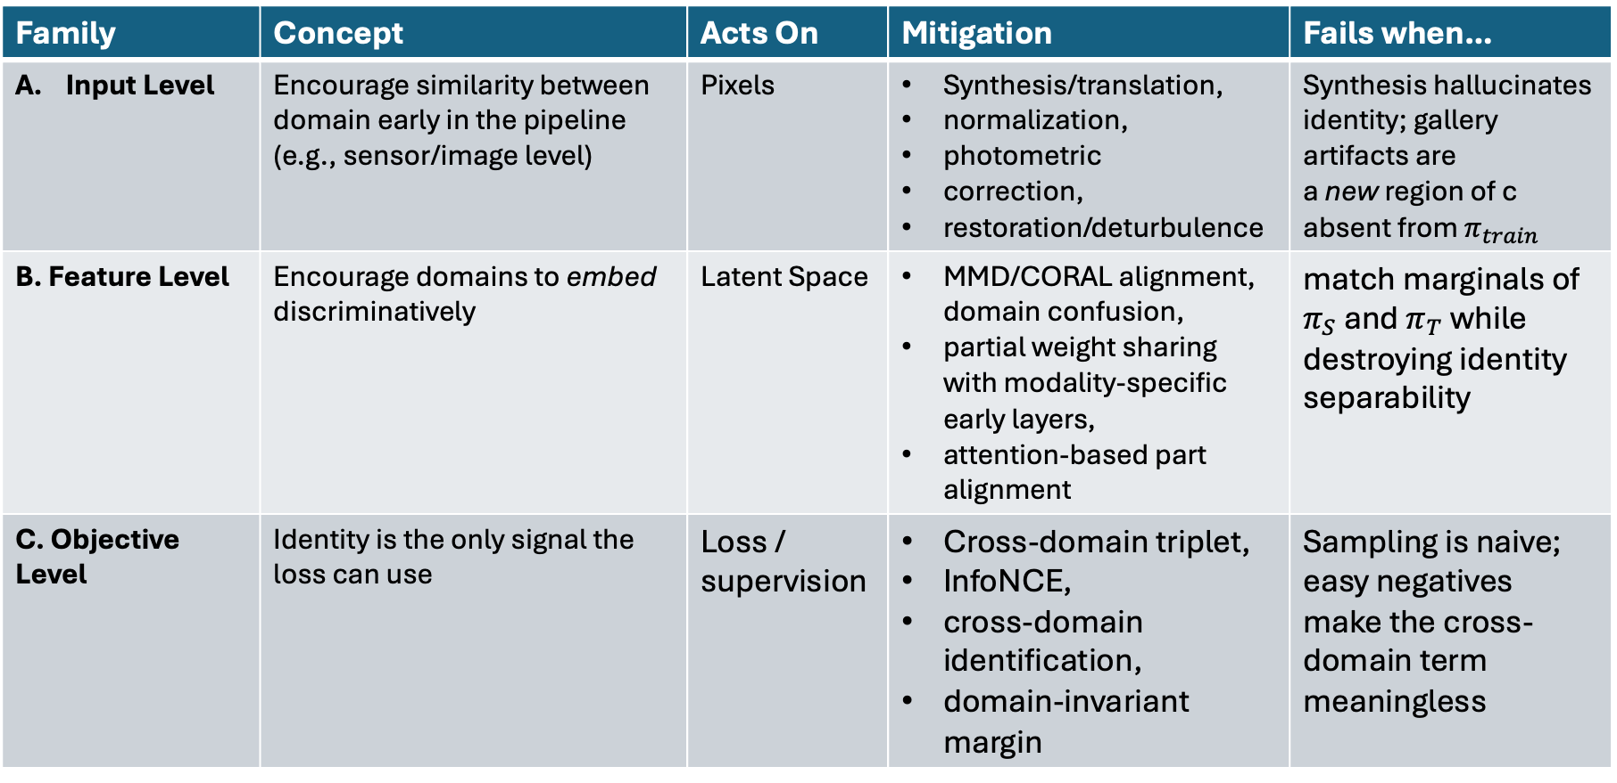
Domain Gap Mitigation
Family | Concept | Acts On | Mitigation | Fails when…
Input Level | Encourage similarity between domain early in the pipeline (e.g., sensor/image level) | Pixels | Synthesis/translation, normalization, photometric correction, restoration/deturbulence | Synthesis hallucinates identity; gallery artifacts are a new region of c absent from $π_{train}$
B. Feature Level | Encourage domains to embed discriminatively | Latent Space | MMD/CORAL alignment, domain confusion, partial weight sharing with modality-specific early layers, attention-based part alignment | match marginals of $π_{S}$ and $π_{T}$ while destroying identity separability
C. Objective Level | Identity is the only signal the loss can use | Loss / supervision | Cross-domain triplet, InfoNCE, cross-domain identification, domain-invariant margin | Sampling is naive; easy negatives make the cross-domain term meaningless
Notes:
Three points:
These are not mutually exclusive; most strong systems do two of three. The research question is always which part of the pipeline is the gap actually living in?
A. inverts the nuisance, B. ignores it, C. supervises through it. A. needs you to know $c$; B. needs you to have sampled $c$; C. needs you to have paired identities across $c$. Your available supervision usually picks the family for you.
Only Family C. addresses Shift 2 directly. A. and B. both operate on a single marginal at a time, so they can reduce a train→deploy gap while leaving the gallery↔probe asymmetry untouched. Flag this now; it is the reason §3 spends most of its time on pairwise losses.

Slide 6
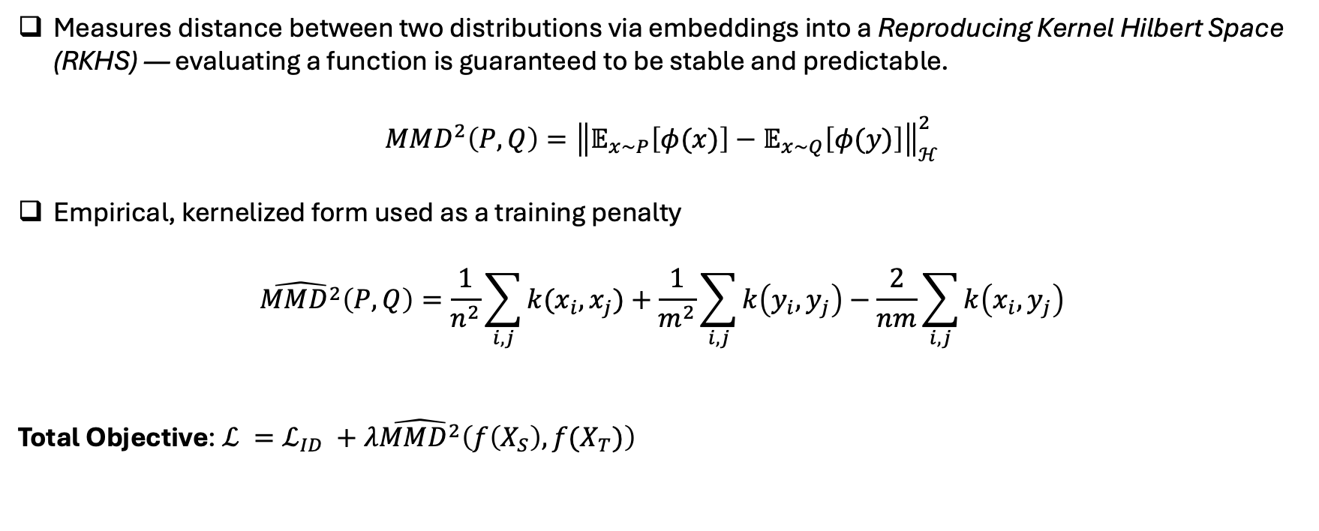
Maximum Mean Discrepancy
Measures distance between two distributions via embeddings into a Reproducing Kernel Hilbert Space (RKHS) — evaluating a function is guaranteed to be stable and predictable.
$$MMD^{2}\left(P,Q\right)={\left\|𝔼_{x\sim P}\left[φ(x)\right]−𝔼_{x\sim Q}\left[φ(y)\right]\right\|}_{ℋ}^{2}$$
Empirical, kernelized form used as a training penalty
$$\hat{MMD^{2}}\left(P,Q\right)=\frac{1}{n^{2}}\sum_{i,j}{k(x_{i}, x_{j})}+\frac{1}{m^{2}}\sum_{i,j}{k\left(y_{i},y_{j}\right)}−\frac{2}{nm}\sum_{i,j}{k\left(x_{i},y_{j}\right)}$$
Total Objective: $ℒ =ℒ_{ID} +λ\hat{MMD^{2}}\left(f\left(X_{S}\right),f(X_{T})\right)$
Notes:
Discuss the catch: MMD aligns marginals only. A degenerate encoder that maps everything to a constant achieves $\mathrm{MMD}=0$. The identity loss is what prevents collapse — alignment terms are never used alone. Mention class-conditional / joint variants as the fix when labels are available.
Connect to Week 7 (say this explicitly): MMD matches $\int p_\theta(z\mid y,c)\pi_S(c),dc$ to the same integral under $\pi_T$ — it operates on the mixture, so it is blind to which $c$ a sample came from. Two consequences:
(i) it can equalize the two mixtures while leaving individual conditions badly mismatched, and
(ii) it does nothing for Shift 2, because gallery↔probe asymmetry is a property of pairs, not of either marginal.
MMD is a Shift 1 tool.

Slide 7
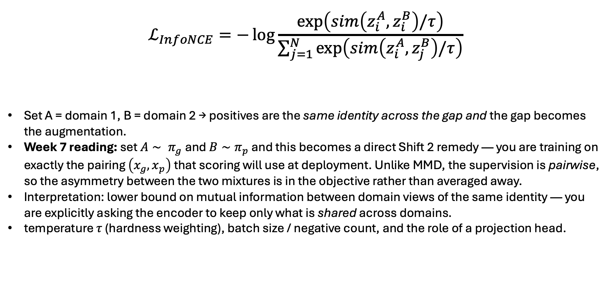
InfoNCE — Cross-Domain Contrastive
$$ℒ_{InfoNCE}=−\log{\frac{\exp\left(sim\left(z_{i}^{A},z_{i}^{B}\right)/τ\right)}{\sum_{j=1}^{N}{\exp\left(sim\left(z_{i}^{A},z_{j}^{B}\right)/τ\right)}}}$$
Set A = domain 1, B = domain 2 → positives are the same identity across the gap and the gap becomes the augmentation.
Week 7 reading: set $A∼ π_{g}$and $B∼π_{p}$ and this becomes a direct Shift 2 remedy — you are training on exactly the pairing $\left(x_{g}, x_{p}\right)$ that scoring will use at deployment. Unlike MMD, the supervision is pairwise, so the asymmetry between the two mixtures is in the objective rather than averaged away.
Interpretation: lower bound on mutual information between domain views of the same identity — you are explicitly asking the encoder to keep only what is shared across domains.
temperature $τ$ (hardness weighting), batch size / negative count, and the role of a projection head.

Slide 8
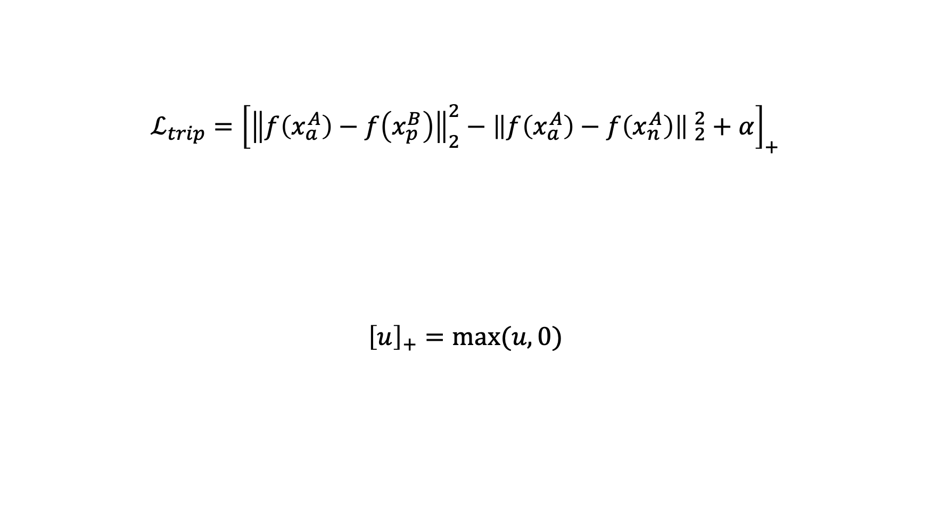
Cross-Domain Triplet Loss
$$ℒ_{trip}={\left[{\left\|f\left(x_{a}^{A}\right)−f\left(x_{p}^{B}\right)\right\|}_{2}^{2}−{\left\|f\left(x_{a}^{A}\right)−f\left(x_{n}^{A}\right)\right\| }_{2}^{2}+α\right]}_{+}$$
$${\left[u\right]}_{+}=max⁡(u, 0)$$
Anchor to negative distance (same domains)
Separability margin
Anchor to positive distance (differnt domain)
Notes:
The configuration the instructor wants interrogated: anchor and positive from one domain, negative from the other domain.
Board exercise (do this live, it's the pedagogical centerpiece of the section): ask students what this loss actually optimizes.
The model can satisfy it trivially by pushing all of domain B away from all of domain A — i.e., it can learn domain discrimination instead of identity discrimination, and the loss will look great.
Contrast with the intended configuration: anchor from A, positive from B (same ID), negative from B (different ID) → now identity must beat domain.

Slide 9
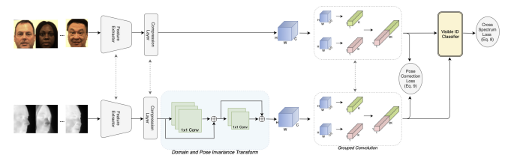
Case Studies—Three Gaps and Mitigations
Thermal-to-Visible Gap
2015 Coupled Auto-Associative Neural Networks for Heterogeneous Face Recognition — Riggan, Reale, Nasrabadi
2016: Optimal Feature Learning and Discriminative Framework for Polarimetric Thermal to Visible Face Recognition — Riggan, Short, Hu
2016: Estimation of Visible Spectrum Faces from Polarimetric Thermal Faces — Riggan, Short, Hu, Kwon
2016: A Polarimetric Thermal Database for Face Recognition Research — Hu, Short, Riggan et al.
2017: Generative Adversarial Network-Based Synthesis of Visible Faces from Polarimetric Thermal Faces — Zhang, Patel, Riggan, Hu
2018: Thermal to Visible Synthesis of Face Images Using Multiple Regions — Riggan, Short, Hu
2019: Synthesis of High-Quality Visible Faces from Polarimetric Thermal Faces Using Generative Adversarial Networks — Zhang, Riggan, Hu, Short, Patel
2019: Polarimetric Thermal to Visible Face Verification via Self-Attention Guided Synthesis — Di, Riggan, Hu, Short, Patel
2020: Cross-Domain Identification for Thermal-to-Visible Face Recognition — Fondje, Hu, Short, Riggan
2021: Multi-Scale Thermal to Visible Face Verification via Attribute Guided Synthesis — Di, Riggan, Hu, Short, Patel
2023: Learning Domain and Pose Invariance for Thermal-to-Visible Face Recognition — Fondje, Hu, Riggan

Slide 10
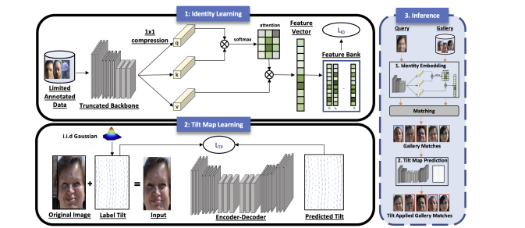
Case Studies—Three Gaps and Mitigations
Turbulence Gap
K. Nikhal and B. S. Riggan, “Weakly Supervised Face and Whole Body Recognition in Turbulent Environments,” IEEE International Joint Conference on Biometrics (IJCB), 2023.
C. N. Fondje, K. Nikhal, J. B. Peace, R. Karl, M. Lee, P. Berkowitz, K. Gramzinski, B. Kennedy, N. Uzuegbunam, T. Barrett, O. Arend, W. Liane, S. Semenova, and B. S. Riggan, “HBRC-500: A Long Range Recognition Benchmark Dataset using Face and Whole-body Imagery,” IEEE IJCB, 2023.

Slide 11
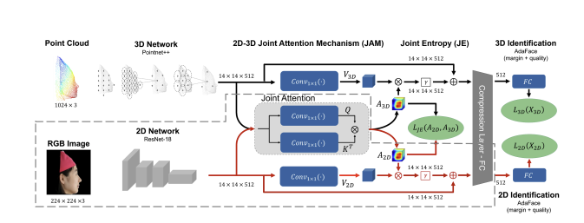
Case Studies—Three Gaps and Mitigations
Structural Gap
J. B. Peace, S. Hu, and B. S. Riggan, "2D-3D attention and entropy for pose robust facial recognition," IEEE Int'l Conf. on Automatic Face and Gesture Recognition, May 2025.

Slide 12
Wu et al. CVPRW 2023
Core Claims :
Differential face recognition accuracy across demographic groups is partly attributable to differences in face-region illumination/brightness, not an irreducible property of the groups
In controlled-acquisition scenarios there is a large face-region brightness difference between African-American and Caucasian subjects, and a smaller male/female difference
Impostor pairs where both faces are under-exposed, or both over-exposed, show increased FMR; pairs with strongly different brightness show decreased similarity
They propose a brightness information metric; too-low or too-high brightness reduces usable information in the face region, giving a mechanism for the accuracy drop
Operational recommendation: adjust illumination per individual during controlled acquisition rather than applying one fixed setting
Notes:
Discussion questions (pick 3, ~3 min each):
Reframe it in our notation: Is this a fairness paper or a domain-gap paper? Argue that face-region brightness is a component of $c$ whose distribution is correlated with $y$'s demographic attribute — so it looks like Shift 3 (population shift) but the mechanism is Shift 1/2 acting through $c$. Which family (A/B/C) is their fix? (Answer: Family A, and uniquely at acquisition time — they change $\pi$ itself rather than compensating for it, which is the only move that adds information instead of redistributing it.)
Mechanism vs. correlation: The paper moves from "accuracy differs by group" to "brightness is a cause." What evidence makes that a causal claim rather than a correlational one, and what would you add to strengthen it?
The both-dark/both-bright FMR result is the most interesting finding. Why would two under-exposed impostors look more similar? What does that tell us about what the embedding is actually encoding at low information content?
Limits of the fix: Their recommendation requires controlled acquisition. What is the analogue for uncontrolled imagery — and does photometric normalization in software recover the same benefit, or does it fail because information was already lost at capture? (Link to information-theoretic framing: you cannot normalize back information the sensor never recorded.)
Transfer the idea to our three gaps: Is there a "brightness" analogue in thermal (temperature/ambient conditions), turbulence (severity/range), or 3D (reconstruction quality)? Should those be measured and reported per-condition in Project 2?

Slide 13
Activity: Design the Fix
Scenario.
Your lab's whole-body recognition system was trained and validated on ground-level imagery: fixed tripod cameras, 1–10 m standoff, roughly horizontal optical axis, continuous 30 fps video of subjects walking toward the camera. It performs well.
A sponsor now wants the same system fielded on a small UAV operating at 50–400 m altitude with oblique-to-near-nadir viewing angles.
The gallery cannot be re-collected — enrollment imagery is ground-level and will stay ground-level.
Pilot results: rank-1 falls from 0.91 (ground) to 0.22 (aerial, 100 m) to near-chance at 300 m. Face is unusable beyond ~50 m. Gait-based matching degrades more gracefully but is unstable: scores for consecutive frames of the same track vary more than scores between different subjects.
Notes:
The four induced gaps (do not print this part — this is the instructor key):
Sub-gap
Physical cause
Class in our notation
Information-destroying?
Illumination / atmosphericOutdoor sun angle, haze, long path length, auto-exposure chasing bright groundShift 1 in $c$; also the Wu et al. mechanism at altitude — exposure is now set by the scene, not the subjectPartly — clipped highlights/shadows are unrecoverable
MotionPlatform ego-motion + vibration + subject motion ⟹ blur and roll/yaw jitterShift 1; stochastic and time-varying, like turbulence in §4.2Yes, where blur exceeds the sampling limit
Perspective / elevation angleOblique-to-nadir pitch; foreshortening of the body's vertical extent; self-occlusion (head occludes torso at nadir)Shift 2 — permanent $\pi_g \neq \pi_p$ over viewing angle; and a structural gap in the §4.3 sense (projection geometry changed, not photometry)No — geometry is transformed, not erased, up to occlusion
TemporalVariable/lower effective frame rate, dropped frames, short dwell over target, no guaranteed full gait cycleShift 1 over temporal support; breaks the implicit assumption that a track contains ≥1 gait periodYes, if dwell < one gait cycle
What makes this card pedagogically strong:
The gallery constraint makes Shift 2 non-negotiable. Groups who propose "just collect aerial enrollment data" have dissolved the problem rather than solved it — a good thing to name explicitly, since in research that is often the right answer and it's worth saying why it's off the table here.
The resolution/altitude axis is continuous, so "train one model vs. route by altitude" (the §4.2 prompt) recurs with a measurable control variable.
Face-vs-body degrade at different rates, which forces a quality-weighted fusion discussion and previews Week 11 (multi-modal) and Week 9 (uncertainty/rejection).
The within-track score instability is a gift: it points at frame-level aggregation as a fix that costs nothing in training.
Expected strong answers (any two of these constitute a good deliverable):
Family A, geometric only: estimate pitch/altitude from platform telemetry and warp or re-render probes toward the gallery's viewing geometry. Strength: attacks the one gap that is not information-destroying. Limit: cannot undo self-occlusion at nadir; and inverse-warping amplifies blur.
Family C, cross-domain InfoNCE with the deployment pairing: positives $= $ (ground gallery view, aerial view) of the same identity, $A \sim \pi_g$, $B \sim \pi_p$ — i.e., train on exactly the pairing deployment will score. Requires paired ground+aerial collection on training identities only, not on gallery identities. This is the move the card is built to reward.
Family B with conditioning, not marginal alignment: align features conditioned on altitude/pitch bins rather than globally; plain MMD on pooled marginals will try to erase a factor that varies within the probe set.
Set-based / temporal aggregation: replace per-frame scoring with a quality-weighted track-level embedding; let predicted uncertainty (the §4.3 entropy-as-selector idea) down-weight blurred or occluded frames rather than averaging uniformly.
Acquisition-side fix (the Wu et al. move): constrain the flight profile — altitude ceiling, pitch limits, sun-angle-aware approach, exposure locked on the subject region rather than scene-average. This changes $\pi_p$ itself, which is the only intervention that adds information instead of redistributing it.

Slide 14
Project 2 (Reproduce + Investigate) due Oct. 23
Objective: to reproduce a method from a modern biometric journal or conference paper and investigate
Same problem as Project 1
Consider sources like:
  IEEE Transactions on Biometrics, Behavior, and Identity Science (T-BIOM)
  IEEE/IAPR Internation Joint Conference on Biometrics
  IEEE/CVF Winter Conference on Application of Computer Vision
  IEEE/CVF Conference on Computer Vision and Pattern Recognition
  Not limited to these venues

