Slide 1


Week 9
What Should A Model Do When It Encounters Something It Has Never Seen?
COSC 594-003 Special Topics in Computer Science
Biometrics
Benjamin S. Riggan
Associate Professor
Notes:
Question to ask ourselves: Generalize to what?

Slide 2
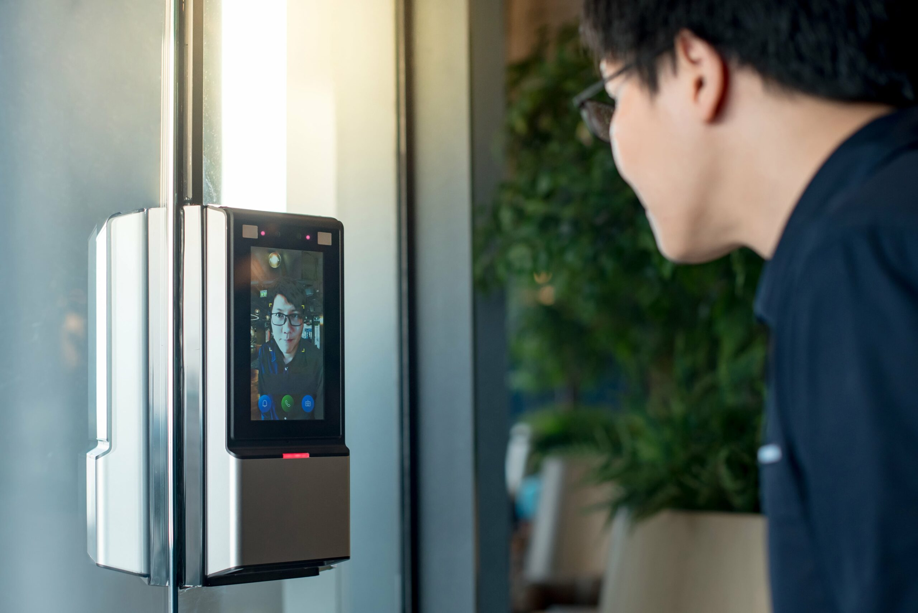
Scenario
Deployed face identification systems at a secure facility enrolls 1,200 employees
Unenrolled visitor walk up to the camera
The system return a rank-1 (top) match with cosine similarity of 0.61
Is a 0.61 match score considered “high”?
What should the system output?
Who decides whether the system was allowed to refuse?
Notes:
Many ID systems that we have discussed so far answers a closed-set question: which of the N identities does the probe/query correspond to the most.
Today, we will remove that assumption in two directions:
- Open-set Recognition: model must recognize that the probe/query does not belong to an enrolled subject—presumably with access privileges.
- Zero-shot Learning: model must recognize a class that it was never trained on, using side information instead of training examples—a challenging generalization problem (a biometric problem)
These are two aspects of our topic question for the week: reject it vs. recognize it

Slide 3
LAST WEEK — Can We Make Representations Generalize?
THIS WEEK — What Should a Model Do When It Encounters Something It Has
Never Seen?
person
face
fingerprint
iris
…
Notes:
Testing & Evaluation
Explainability
Insanity (?)

Slide 4
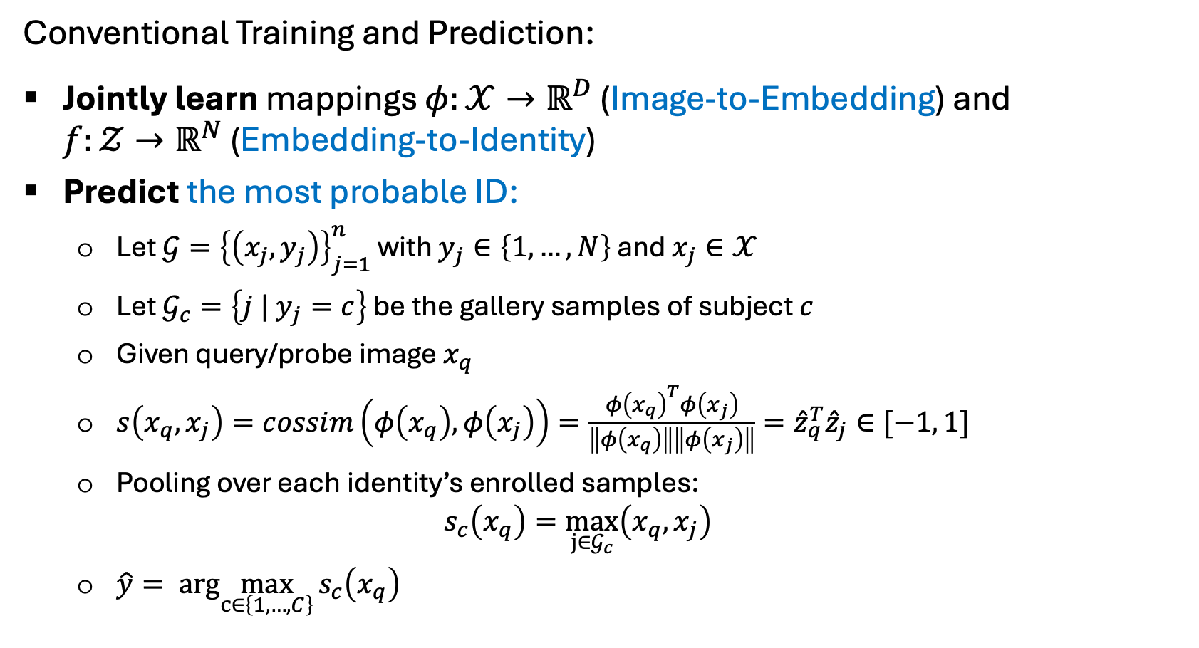
Closed-Set Model
Conventional Training and Prediction:
Jointly learn mappings $φ:𝒳→ℝ^{D}$ (Image-to-Embedding) and
$f:𝒵→ℝ^{N}$ (Embedding-to-Identity)
Predict the most probable ID:
  Let $𝒢={\left\{\left(x_{j}, y_{j}\right)\right\}}_{j=1}^{n}$ with $y_{j}∈\left\{1, …, N\right\}$ and $x_{j}∈𝒳$
  Let $𝒢_{c}=\left\{j | y_{j}=c\right\}$ be the gallery samples of subject $c$
  Given query/probe image $x_{q}$
  $s\left(x_{q}, x_{j}\right)=cossim\left(φ\left(x_{q}\right),φ\left(x_{j}\right)\right)=\frac{φ{\left(x_{q}\right)}^{T}φ\left(x_{j}\right)}{\left\|φ\left(x_{q}\right)\right\|\left\|φ\left(x_{j}\right)\right\|}={\hat{z}}_{q}^{T}{\hat{z}}_{j}∈[−1, 1]$
  Pooling over each identity’s enrolled samples:
  $s_{c}\left(x_{q}\right)=\max_{j∈𝒢_{c}}\left(x_{q}, x_{j}\right)$
  $\hat{y}=arg\max_{c∈\left\{1, …, C\right\}}{s_{c}\left(x_{q}\right)}$
Notes:
The pedagogical hook for Week 9
The $\arg{max}$ in the prediction has no "none of the above" branch. It partitions $𝕊^{D−1}$ into $N$ cells that cover the entire sphere, so every probe — impostor, off-pose, wrong modality, photograph of a tree — is assigned to some enrolled identity with some measure of confidence.
The minimal open-set repair is to make the decision conditional on the score itself:
$$\hat{y} = \left\{\begin{matrix}\arg{\max_{c}}s_{c}\left(x_{q}\right), & \text{if }\max_{c}s_{c}\left(x_{q}\right) ≥ T \\ \text{"unknown"}, & \text{otherwise}\end{matrix}\right.$$
But this introduce errors, and if we really want our system to operate then we must make sure that we are tracking the correct metrics

Slide 5
Problem Terminology & Definitions
Setting | Question | Biometric Instance
Closed-set Identification | Which of the N enrolled identities is the sample? | 1:N matching
Open-set Recognition | Does the sample have mate in the gallery above threshold? If so, what is the mated identity? | Watch list retrieval (hits)
Zero-shot Learning | Can the system recognize an identity or class that was unseen during training, using learned representations and potentially semantic side information? | A biometric model trained on other identities receives a probe of a newly encountered person; Soft-biometrics and attribute retrieval (stricter)
Open Vocabulary | Can the system recognize or retrieve biometric instances using flexible identity descriptions, labels, or concepts not restricted to a fixed, predefined vocabulary? | A person-search system receives a text query such as “the person wearing a red jacket and carrying a backpack” and retrieves matching person images from a gallery.
Notes:
Open space risk — the geometric argument
Introduce the central intuition from Walter Scheirer-lineage Open-Set Recognition formulation:
a discriminative decision rule partitions all of feature space, including regions arbitrarily far from any training data.
Labeling unbounded "open space" as a known class incurs risk that no amount of closed-set empirical risk minimization penalizes.
Objective sketch): $\arg{\min_{f}} \underset{\text{open space risk}}{\underbrace{R_{𝒪}\left(f\right)}} + λ \underset{\text{empirical risk}}{\underbrace{R_{ε}\left(f , 𝒟_{\text{train}}\right)}}$
Board exercise:
Draw the unit circle with three enrolled templates $\hat{w}_1, \hat{w}_2, \hat{w}_3$ on it; the cosine $\arg\max$ cuts the circle into three arcs.
Question: where a probe from a 4th, non-enrolled subject lands?
Answer: it lands in an arc, and is named.
Follow-up: can any purely discriminative boundary fix this?
Lead to the conclusion that open-set behavior requires either bounded decision regions or a score plus a threshold layered on top of the classifier.

Slide 6
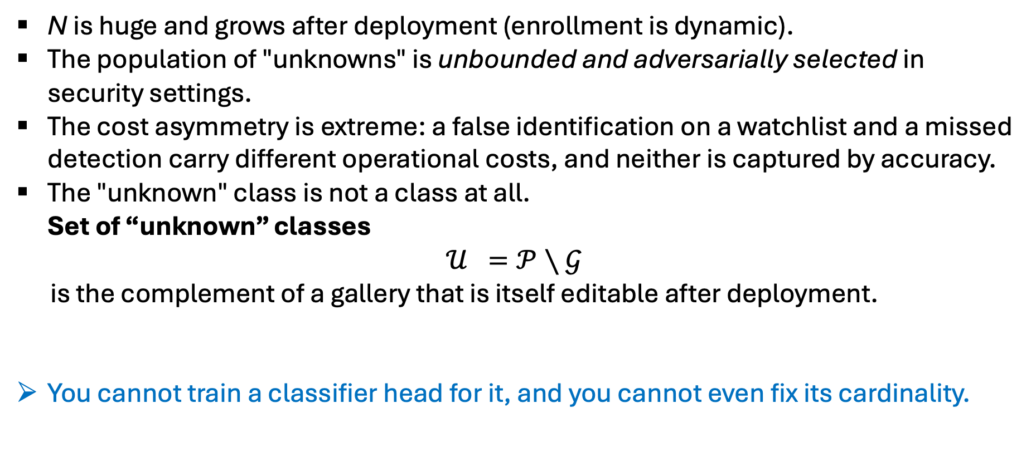
Problem Terminology & Definitions
N is huge and grows after deployment (enrollment is dynamic).
The population of "unknowns" is unbounded and adversarially selected in security settings.
The cost asymmetry is extreme: a false identification on a watchlist and a missed detection carry different operational costs, and neither is captured by accuracy.
The "unknown" class is not a class at all.
Set of “unknown” classes
$$𝒰 =𝒫∖𝒢$$
is the complement of a gallery that is itself editable after deployment.
You cannot train a classifier head for it, and you cannot even fix its cardinality.
Notes:
Open space risk — the geometric argument
Introduce the central intuition from Walter Scheirer-lineage Open-Set Recognition formulation:
a discriminative decision rule partitions all of feature space, including regions arbitrarily far from any training data.
Labeling unbounded "open space" as a known class incurs risk that no amount of closed-set empirical risk minimization penalizes.
Objective sketch): $\arg{\min_{f}} \underset{\text{open space risk}}{\underbrace{R_{𝒪}\left(f\right)}} + λ \underset{\text{empirical risk}}{\underbrace{R_{ε}\left(f , 𝒟_{\text{train}}\right)}}$
Board exercise:
Draw the unit circle with three enrolled templates $\hat{w}_1, \hat{w}_2, \hat{w}_3$ on it; the cosine $\arg\max$ cuts the circle into three arcs.
Question: where a probe from a 4th, non-enrolled subject lands?
Answer: it lands in an arc, and is named.
Follow-up: can any purely discriminative boundary fix this?
Lead to the conclusion that open-set behavior requires either bounded decision regions or a score plus a threshold layered on top of the classifier.

Slide 7
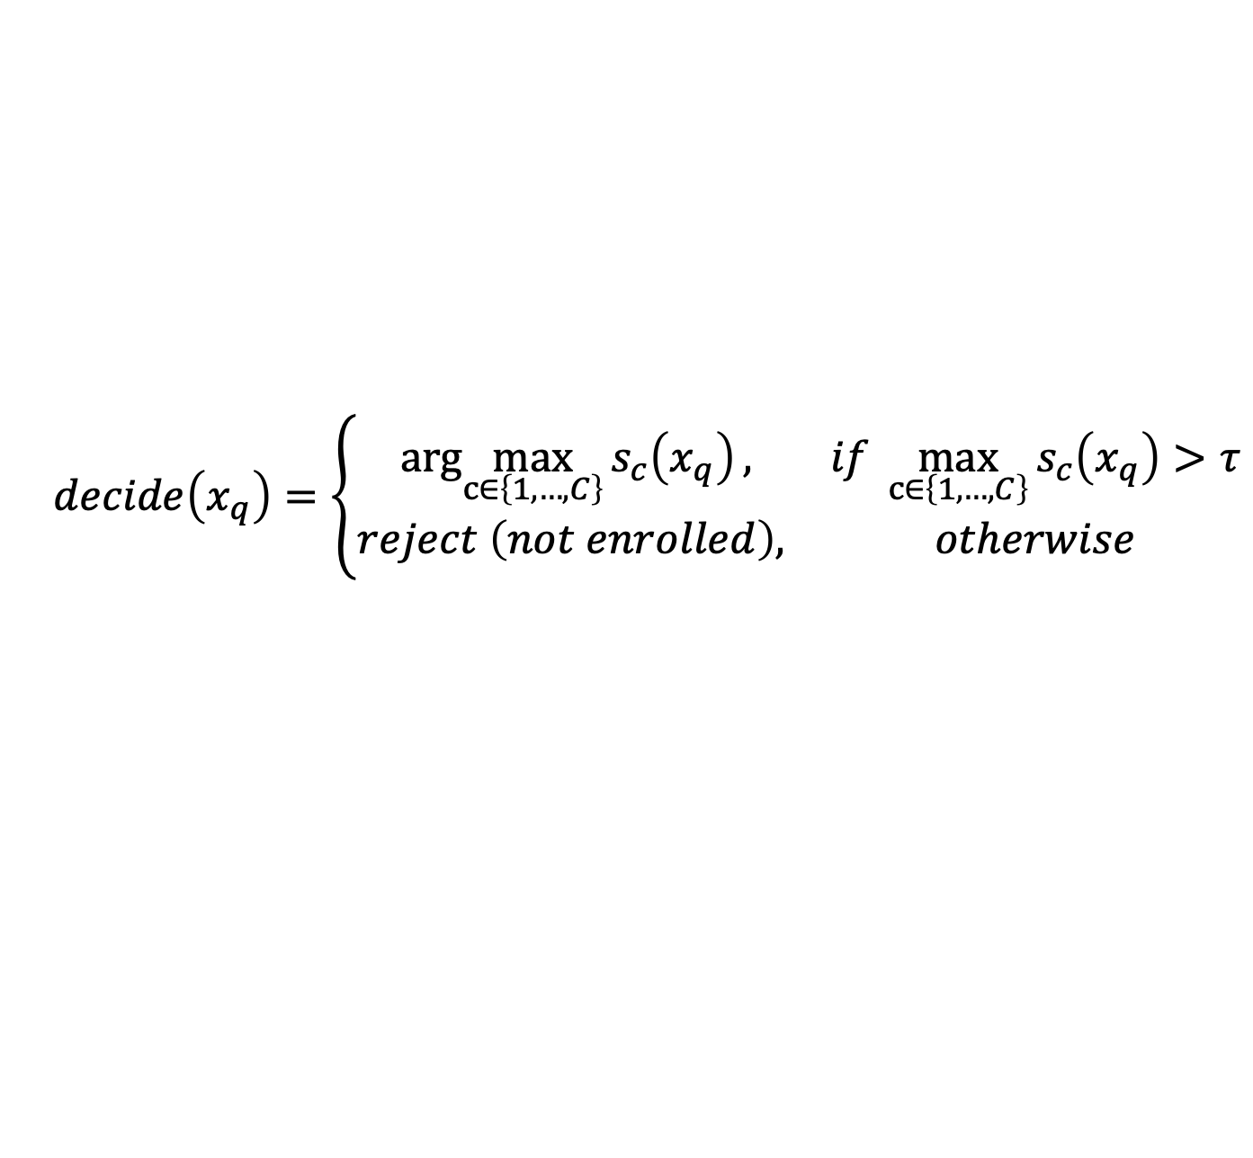
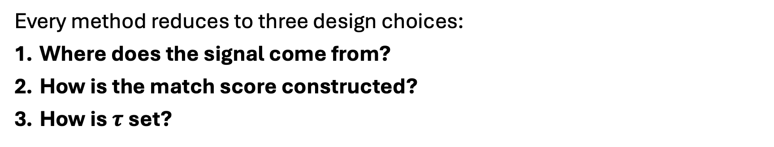
Open-Set Recognition
$$decide\left(x_{q}\right)=\left\{\begin{matrix}arg\max_{c∈\left\{1, …, C\right\}}{s_{c}\left(x_{q}\right)}, & if\max_{c∈\left\{1, …, C\right\}}{s_{c}\left(x_{q}\right)}>τ \\ reject \left(not enrolled\right), & otherwise\end{matrix}\right.$$
Every method reduces to three design choices:
Where does the signal come from?
How is the match score constructed?
How is $τ$set?
Notes:
Q1 options: logits, features, gradients, reconstruction error, density
Q2 options: max, margin, distance, likelihood ratio, learned metric
Q3 options: validation data, held-out outliers, etc.
*** #3 If we are not careful, this is where our OSR results can quietly cheat. Cannot tune on evaluation data

Slide 8
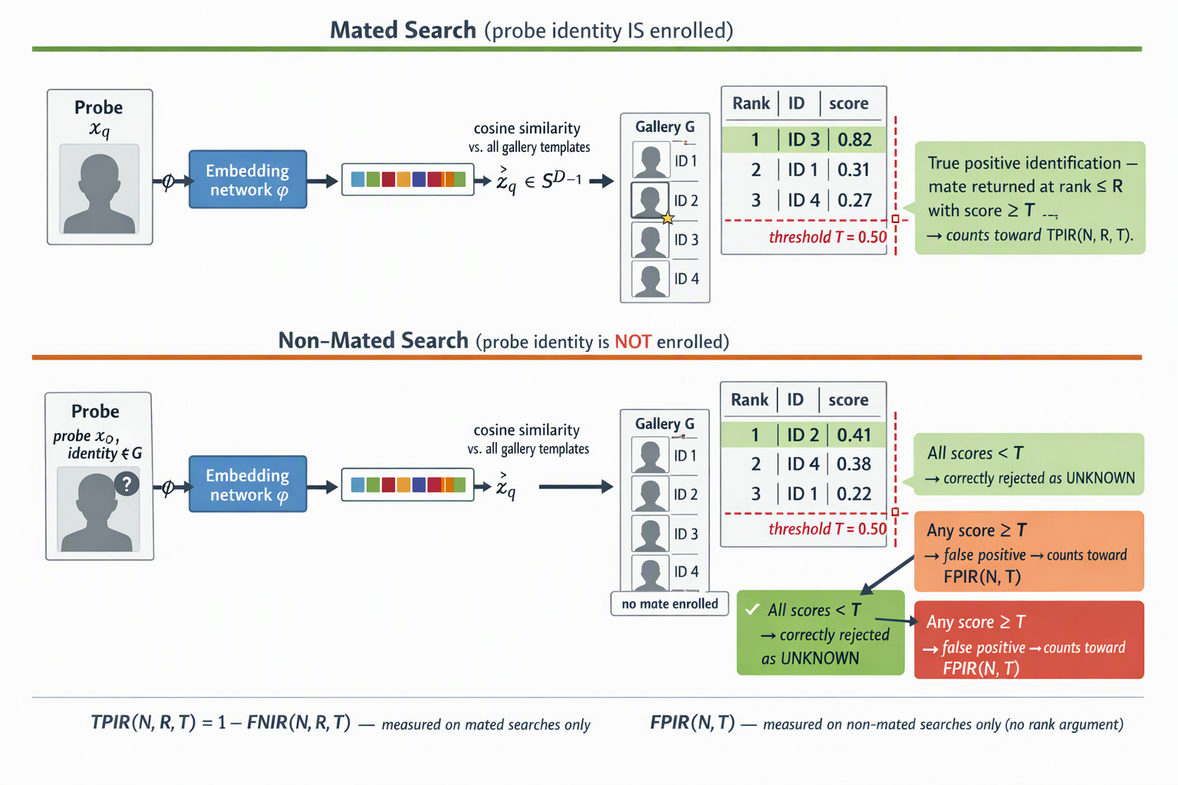
Evaluating Open-Set Recognition
An identification search submits a probe against a gallery of N enrolled identities and returns a candidate list.
Searches are of exactly two kinds:
Mated search: the probe's true identity is enrolled. The correct enrolled entry is called the mate.
Non-mated search: the probe's true identity is not enrolled. There is no mate to find.
Three parameters govern every reported number — insist that all three are always stated:
N — gallery size
R — the rank cutoff of the candidate list examined
T — the score threshold

Slide 9
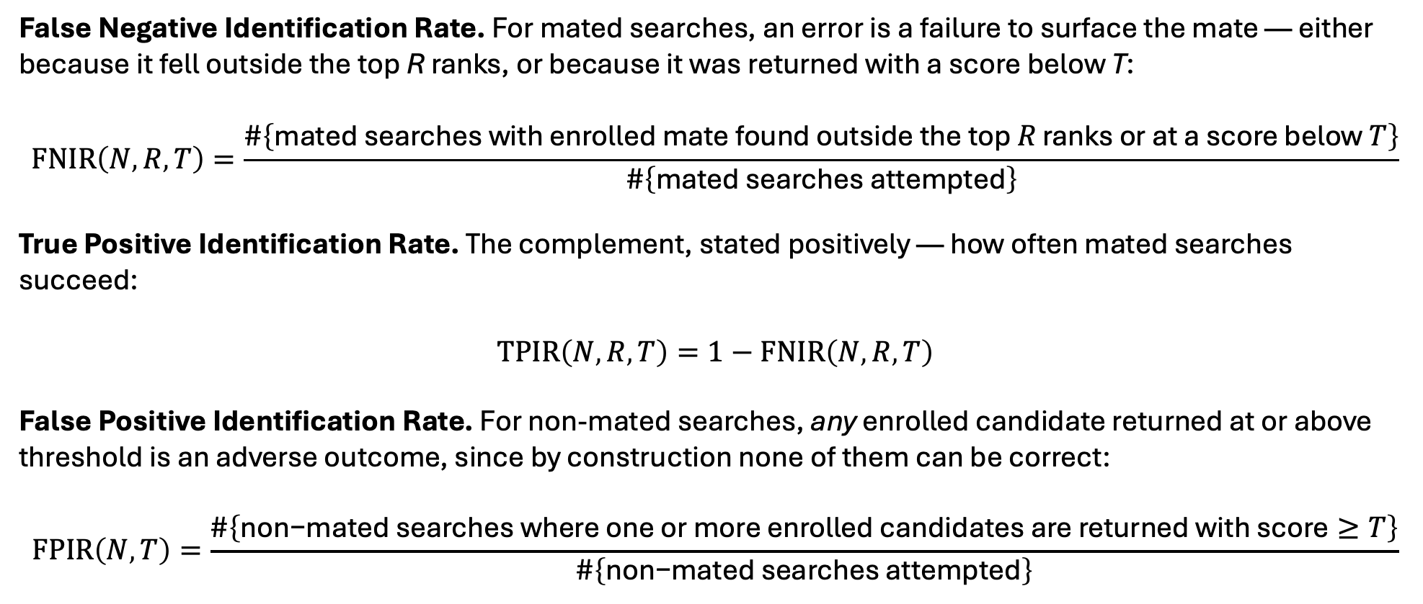
NIST Metrics: FNIR, TPIR, and FPIR
False Negative Identification Rate. For mated searches, an error is a failure to surface the mate — either because it fell outside the top R ranks, or because it was returned with a score below T:
$$FNIR\left(N , R , T\right)=\frac{\#\left\{\text{mated searches with enrolled mate found outside the top }R\text{ ranks or at a score below }T\right\}}{\#\left\{\text{mated searches attempted}\right\}}$$
True Positive Identification Rate. The complement, stated positively — how often mated searches succeed:
$$TPIR\left(N , R , T\right)=1−FNIR\left(N , R , T\right)$$
False Positive Identification Rate. For non-mated searches, any enrolled candidate returned at or above threshold is an adverse outcome, since by construction none of them can be correct:
$$FPIR\left(N , T\right)=\frac{\#\left\{\text{non−mated searches where one or more enrolled candidates are returned with score}≥T\right\}}{\#\left\{\text{non−mated searches attempted}\right\}}$$
Notes:
Four points to draw out explicitly:
FPIR has no R argument. A non-mated search is a false positive if anything clears threshold; which rank it landed at is irrelevant to whether an analyst's time was wasted. TPIR carries R because finding the mate at rank 1 and at rank 50 are different operational outcomes. Ask the class why the asymmetry is correct before telling them.
The two rates are computed over disjoint probe sets. TPIR is measured only on mated searches, FPIR only on non-mated searches. This is why the mix of mated to non-mated probes does not change either rate — unlike accuracy, precision, or AUPR, which are all contaminated by the openness ratio you happened to choose. TPIR/FPIR is the pair that refuses to collapse the two errors.
Only reportable as a pair at a stated operating point. "TPIR = 0.94" is not a result. TPIR(N = 1.6M, R = 1, T) = 0.94 at FPIR = 0.001 is a result. The curve of TPIR versus FPIR, swept over T, is the open-set DET/ROC analogue — this is exactly the quantity DIR@FPIR names in the older biometrics literature (detection and identification rate at rank R).
TPIR degrades with N. Gallery size enters the definition as an explicit argument because a larger gallery supplies more opportunities for a non-mate to outrank the mate. A TPIR reported at N = 1,000 tells you very little about N = ${10}^{7}$. This is the single most common misreading of vendor claims.

Slide 10
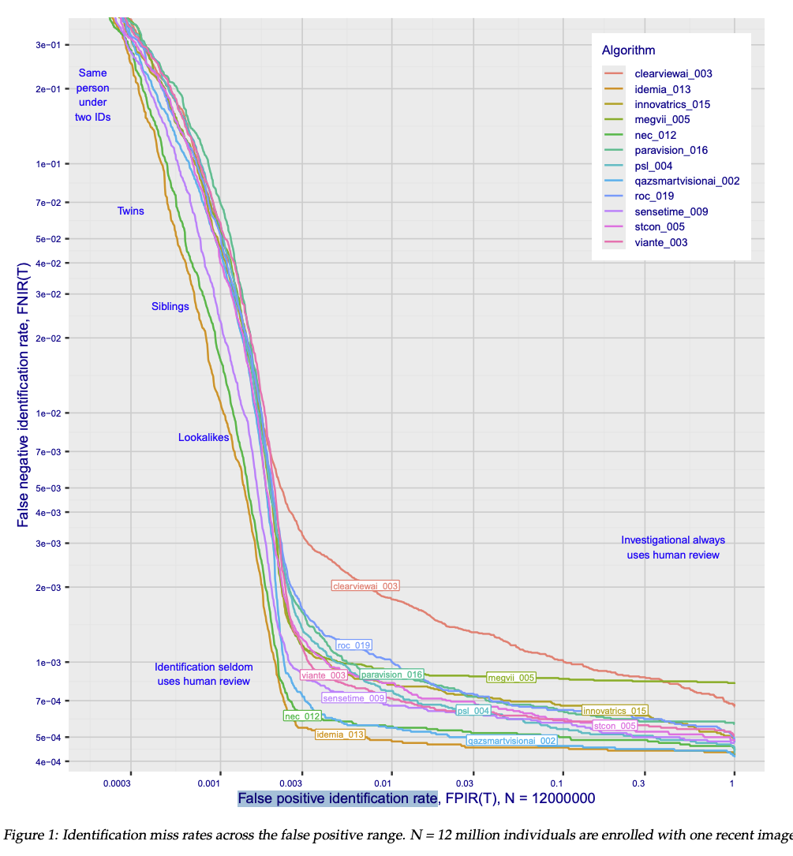
Figure extracted from the latest Face Recognition Technology Evaluation (FRTE) Part 2: Identification Report (dated 2026/10/06)
https://pages.nist.gov/frvt/reports/1N/frvt_1N_report.pdf
Patrick Grother
Mei Ngan
Kayee Hanaoka

Slide 11
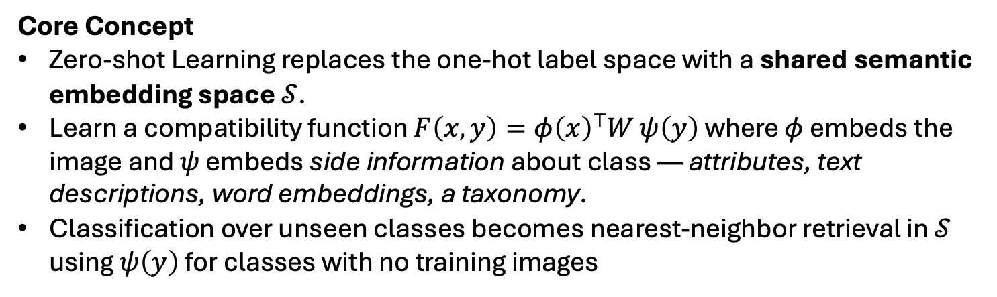
Zero-Shot Learning: Recognizing Without Examples
Core Concept
Zero-shot Learning replaces the one-hot label space with a shared semantic embedding space $𝒮$.
Learn a compatibility function $F\left(x , y\right)=φ{\left(x\right)}^{⊤}W ψ\left(y\right)$ where $φ$ embeds the image and $ψ$ embeds side information about class — attributes, text descriptions, word embeddings, a taxonomy.
Classification over unseen classes becomes nearest-neighbor retrieval in $𝒮$ using $ψ\left(y\right)$ for classes with no training images
Key Assumptions: the semantic space must be both
rich enough to separate unseen classes
aligned with what the visual encoder actually represents.
Notes:
Classic failure modes
Hubness: in high dimensions, a few semantic prototypes become nearest neighbors to disproportionately many image embeddings.
Domain shift / projection shift: the mapping W is fit to seen classes and is systematically biased when applied to unseen ones.
Seen-class bias in generalized ZSL: the model overwhelmingly predicts seen classes; this is why GZSL reports harmonic mean of seen and unseen accuracy rather than overall accuracy.
The modern form: vision–language pretraining
Large-scale image–text contrastive pretraining (CLIP-style) is ZSL with the semantic encoder learned at web scale rather than hand-specified. Discussion prompts:
Is CLIP "zero-shot" in any meaningful sense when the test concept almost certainly appeared in 400M training pairs? What is the right word for this?
Foreshadow Week 10 (foundation models) without stealing it.
Where ZSL and biometrics collide — and where it breaks
This is the biometrics-specific payoff. Make the argument carefully:
Identity is not a semantic category. There is no attribute vector that uniquely specifies "Alice" the way "has stripes, four legs, hooved" partially specifies "zebra." Soft biometrics (age, hair color, build, gait descriptors) are not identity-discriminative at population scale.
Therefore face/iris/fingerprint recognition is natively a zero-shot-ish problem of a different kind: we never train on the deployment identities. The transfer is achieved by learning a metric that generalizes to unseen identities, not by learning a semantic prototype for each identity. Connect to Week 3: angular-margin losses are trained with a closed identity set but deployed open.
Legitimate ZSL in biometrics therefore shows up as: text-to-image person retrieval, attribute-based search, cross-spectral / cross-modal matching with no paired training identities, and novel-sensor generalization.

Slide 12
Take-Home Point
Both Open-set Recognition and Zero-shot Learning are tests of whether a representation encodes more than what was needed to minimize training loss.
Notes:
A representation optimized to the point of sufficiency for the training task is exactly the representation most likely to fail on both.

Slide 13
Activity: Design the Rejection
Consider the different deployment scenarios:
Airport watchlist: gallery of 500 persons of interest; millions of travelers
Phone face unlock: gallery of 1; attacker might be a family member
Person re-identification: gallery of 80 know individuals; new individuals enter population continuously
Forensic latent fingerprint search: gallery of 10 million; examiner reviews top-50 candidate list manually; true mate may be absent from the database

Slide 14
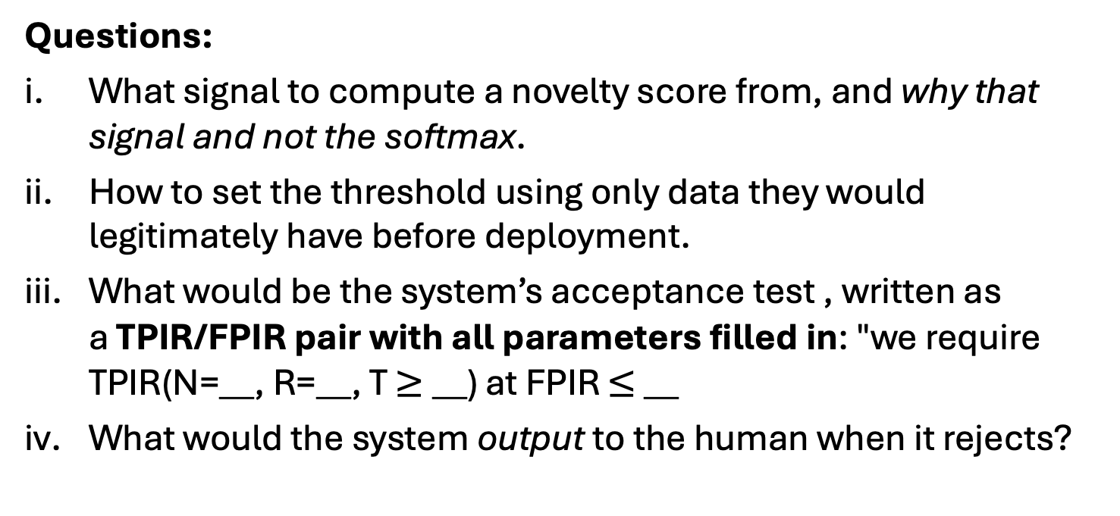
Activity: Design the Rejection
Questions:
What signal to compute a novelty score from, and why that signal and not the softmax.
How to set the threshold using only data they would legitimately have before deployment.
What would be the system’s acceptance test , written as a TPIR/FPIR pair with all parameters filled in: "we require TPIR(N=__, R=__, T $≥$__) at FPIR $≤$ __
What would the system output to the human when it rejects?

Slide 15
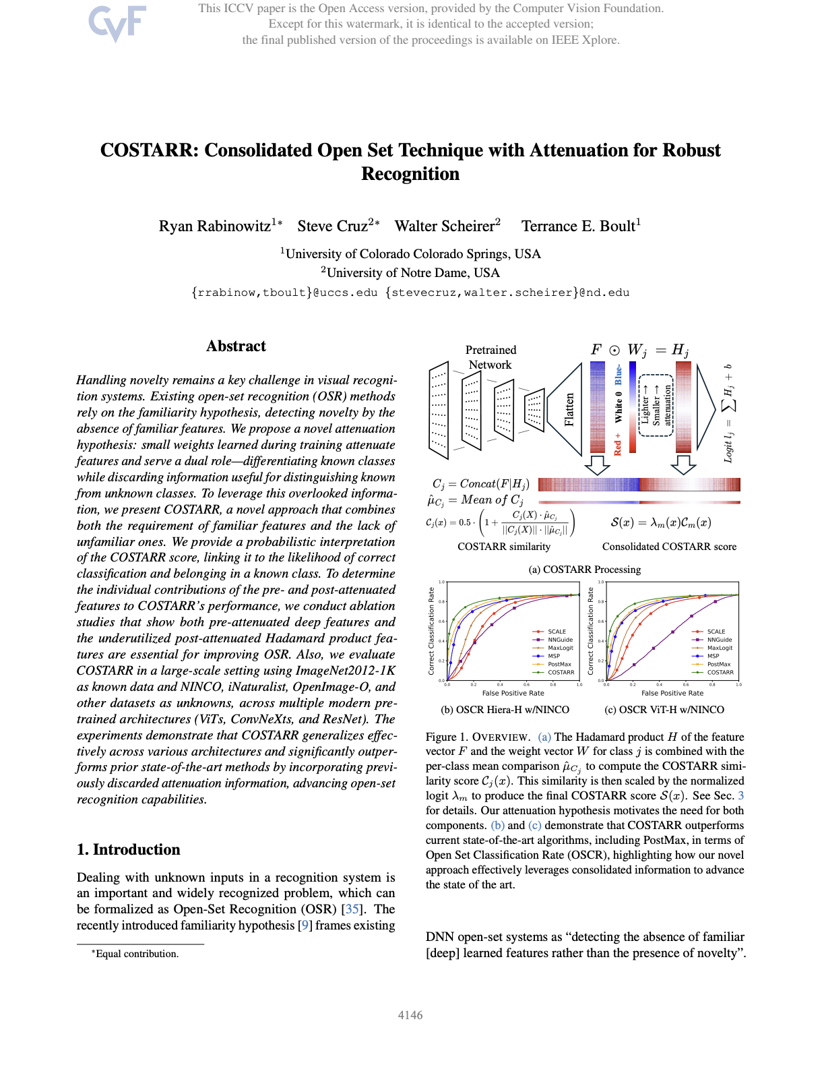


Paper Discussion
International Conference on Computer Vision (ICCV) 2025 paper — a top Computer Vision Conference
Walter Scheirer
Terrance Boult
Even though this is computer vision paper, both are biometrics scholars!

Slide 16
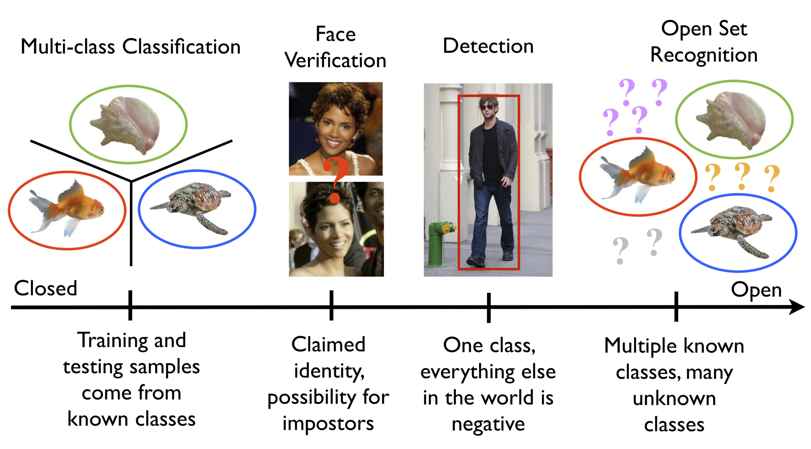
Paper Discussion
What problem is addressed?
Why?
Problem — Open-set Recognition
Deep networks must handle novelty (unknown inputs)
Source: https://www.wjscheirer.com/projects/openset-recognition/
What is the definition of Open-set Recogntion?
Notes:
Definition: Open-set recognition (OSR) is a machine learning and computer vision framework where a recognition system must correctly classify known training classes while simultaneously detecting and rejecting unknown or novel classes that were never seen during training.
Why can’t we use the latest Yolo detector to ”detect” our known identities?
In general surveillance: multiple people in the same area at the same time could all be identified as the same person (3 “Johns” or 3 “Janes’); false positive IDs
still closed set: each proposed bbox above confidence thresholds is forces into a closed-set classification
Would require ”many” observations of each enrolled person

Slide 17
Paper Discussion
The deeper problem…
Existing open-set recognition methods rely familiarity hypothesis (Dietterich and Guyer, Pattern Recognition 2022) — novelty is defined by the absence of familiar learned representations
The COSTARR paper asks why networks behave the way they do and offers an alternative hypothesis: attenuation hypothesis
The attenuation hypothesis view is that small weights learned during model training attenuate (weaken) certain features. While this helps separate known classes, it discards useful information needed to distinguish known data from unknown data.
Biometric framing. Does the problem the paper addresses even exist in a cosine-similarity gallery system with no learned classifier layer? Don’t Answer Yet…Just Think About It

Slide 18
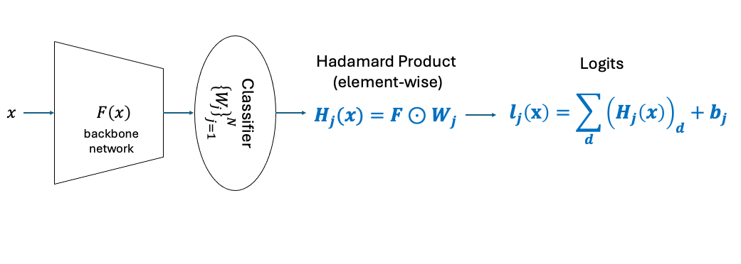
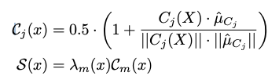
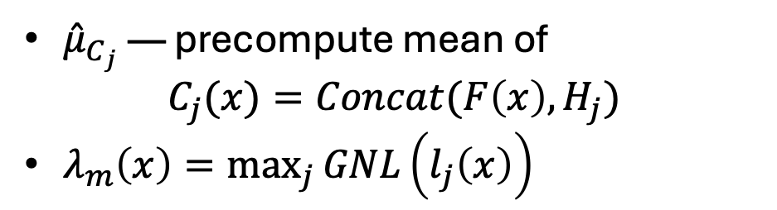
Paper Discussion
What are some key ideas from the paper?
${\hat{μ}}_{C_{j}}$ — precompute mean of
$C_{j}(x)=Concat(F\left(x\right), H_{j})$
$λ_{m}\left(x\right)=\max_{j}{GNL\left(l_{j}\left(x\right)\right)}$
Notes:
globalized normalized logit (GNL) function to normalize our logits using a global min-max normalization
Attenuation hypothesis. The small weights in $W_{j}$ serve a dual role:
they are necessary for known-class discrimination (features useful for class k must be ignored by class j), and
they simultaneously discard information useful for known/unknown discrimination
Robust OSR must therefore use both the pre-attenuation features F and the post-attenuation features H
Per-class consolidated model. Concatenate $C_{j}(x) = Concat(F(x), H_{j})$ and compare it by cosine similarity to a precomputed per-class mean ${\hat{μ}}_{C_{j}}$. This is a per-class normalization, versus PostMax's class-agnostic feature-norm division
Logit scaling with a probabilistic reading. Multiply the similarity by a globally min–max normalized max logit, which makes the product interpretable as the probability that the input is both known and correctly classified
Framing: COSTARR is a score function, not a model

Slide 19
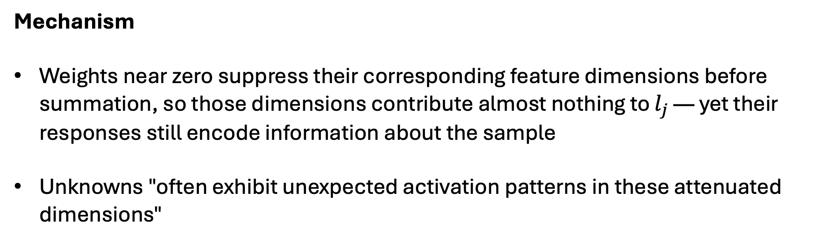
What exactly is thrown away?
Mechanism
Weights near zero suppress their corresponding feature dimensions before summation, so those dimensions contribute almost nothing to $l_{j}$ — yet their responses still encode information about the sample
Unknowns "often exhibit unexpected activation patterns in these attenuated dimensions"
Notes:
Fig. 2 (Hiera-H, ImageNet class 389): mean logit for knowns $= 8.959$ vs. unknowns $= 8.143$ — nearly inseparable.
Mean COSTARR score: $0.647$ vs. $0.369$

Slide 20
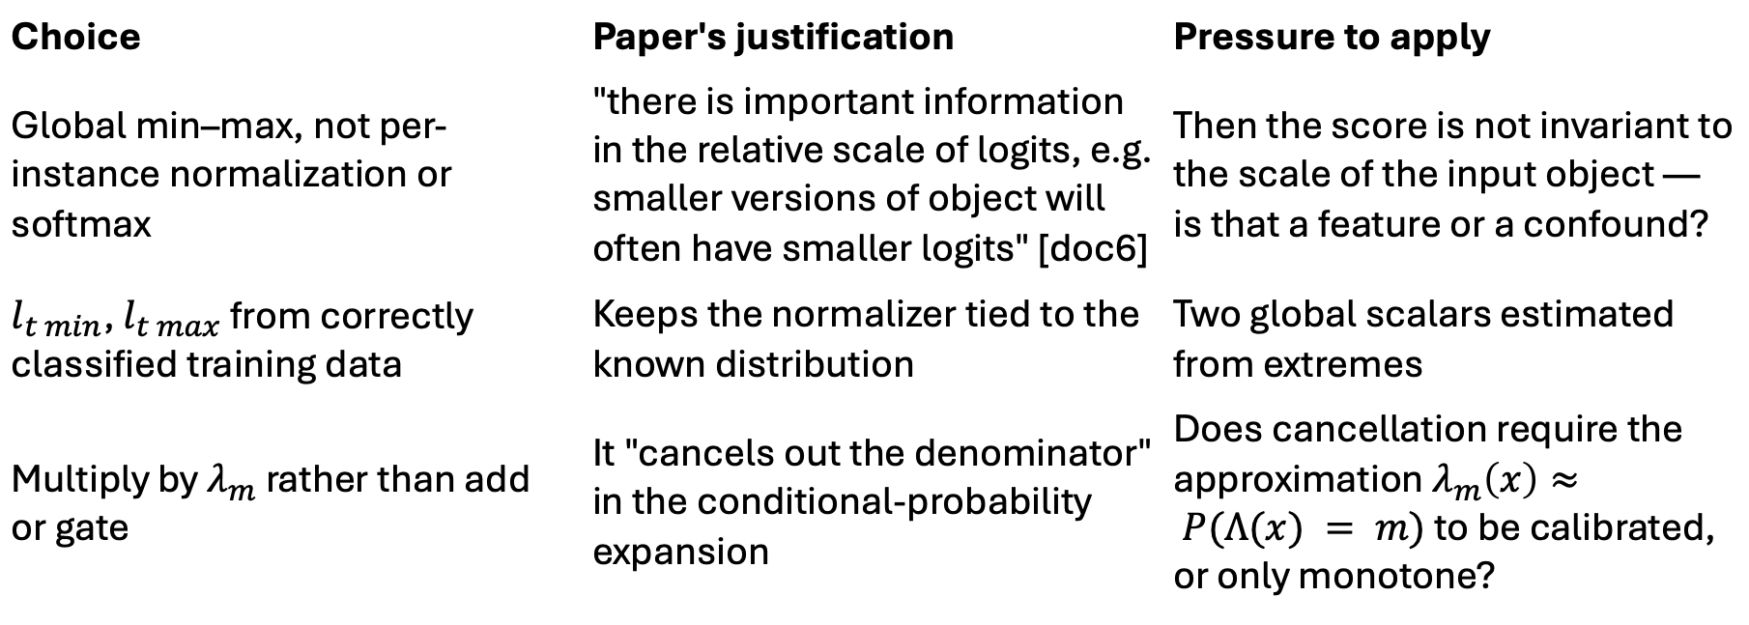
What exactly is thrown away?
Choice | Paper's justification | Pressure to apply
Global min–max, not per-instance normalization or softmax | "there is important information in the relative scale of logits, e.g. smaller versions of object will often have smaller logits" [doc6] | Then the score is not invariant to the scale of the input object — is that a feature or a confound?
$l_{t min}$, $l_{t max}$ from correctly classified training data | Keeps the normalizer tied to the known distribution | Two global scalars estimated from extremes
Multiply by $λ_{m}$ rather than add or gate | It "cancels out the denominator" in the conditional-probability expansion | Does cancellation require the approximation $λ_{m}\left(x\right)≈ P(Λ(x) = m)$ to be calibrated, or only monotone?
Notes:
The authors concede the interpretation fails when a known input is misclassified, since the wrong class mean is used — this is operationally desirable because such inputs would cause downstream errors anyway. Is that a principled argument or a post-hoc rescue?
Biometric version: in a watchlist, is rejecting a correctly-enrolled subject who would have been matched to the wrong identity a success or a miss? Note this changes the numerator of FNIR.

Slide 21
Evaluation Design
Experimental Protocol
OOSA (Operational Open-Set Accuracy) predicts the threshold from a validation set (ImageNetV2 knowns + an unknowns surrogate) and then deploys that fixed threshold on test splits — so there are, in the authors' words, "NO free/tuned parameters".
Contamination audit. Commonly used unknown splits (21K-P) overlap ImageNet-1K by >40%; Places 59.5%, Textures 20.0%. The authors swap in OpenImage-O as the surrogate, caution against over-interpreting contaminated sets, and show in the supplement that every image driving their apparent loss to PostMax on Places is actually a known mislabeled as unknown.
Statistics. Wilcoxon signed-rank with Bonferroni correction, deliberately replacing the paired t-tests used in prior work because reusing splits across architectures violates independence.
AUROC caution. They report it only in the supplement and warn it "is generally incoherent for comparisons of algorithms”
Notes:
The unknowns surrogate used to set the threshold (OpenImage-O) is a different distribution from the unknowns at test (iNaturalist, NINCO, Textures) [doc6]. That is realistic — but what is the biometric analogue of a "surrogate unknown population," and how would you choose one for a watchlist?

Slide 22
Paper Discussion
Where does the paper fall short?
Scope and transferability:
  Knowns are ImageNet-1K object categories, unknowns are other object datasets (no face, iris, fingerprint, gait, or re-identification experiment)
  The method structurally requires a linear classification layer with per-class weights W_j. Modern biometric systems deploy an embedding and a gallery, often discarding the training-time head entirely. If there is no $W_j$ for an enrolled identity, there is no $H_j$, and the central quantity is undefined.
  Per-class means are computed from training data, the subset correctly classified as class j — tens to thousands of images per class. Biometric enrollment is often one image per subject.
  The paper itself defers non-pretrained networks to future work
Metrices and operating points:
  Everything is reported as OOSA, AUOSCR, and AUROC [doc6] — threshold-averaged or single-operating-point measures. There is no reporting at a low false-alarm operating point.
  Known-class counts are fixed at N = 1000. TPIR is a function of gallery size; nothing here tells us how the method degrades as N grows by orders of magnitude.
Notes:
Tubulence Null:
Has Turbulence = True: +0.06, p = 0.104. A clean null for the phenomenon the program considers central.
The authors offer three explanations:
Algorithms genuinely mitigate it — temporal integration, "lucky" frames
It's already absorbed by distance and solar loading
It couldn't be measured: "we could only measure turbulence ($C_{n}^{2}$) for a small number of cameras which were placed near collection scintillometers. Consequently, estimating turbulence for the majority of the cameras is infeasible.”
Additivity by Assertion:
“Although interactions may indeed play a significant role in this research, we have opted for a simpler model.”
Ask: "Name an interaction you'd expect to be strong. Which way would including it move the Eq. (4) estimate?"
Candidates: head height × turbulence (turbulence should matter far more when you have few pixels to lose); solar load × modality; range × sensor. Most plausible interactions are super-additive, meaning Eq. (4) likely understates combined degradation.
Binning and UAV:
All continuous covariates were categorized (§5, p. 6) — within-bin information discarded. Worse, the UAV category:
"'UAV' mounted cameras exhibit significant variability. This likely results from the difference between small, modern HD and 4k quadcopters that typically fly at low altitude and within 100m of the subjects and larger systems that fly at longer distances and up to 1200 ft altitude, often with older or lower resolution payloads. In this model, all of these are grouped into the same category." — §6, p. 7
Result: +1.00 with CI (−0.12, 2.12), p = 0.081 — not significant, and operationally the most interesting category in the paper.
More Details on the Tubulence Null
The short version: the paper didn't find that turbulence doesn't matter. It found that a binary flag called "Has Turbulence" doesn't predict much — and those are very different claims. Almost everything interesting is in the gap between them.
What the number actually says
Has Turb. True: +0.06, CI (−0.01, 0.13), p = 0.104
Taken at face value, ${10}^{0.06}≈1.15$ — a 15% increase in FAR. Against head height < 30 px at ${10}^{1.88}≈76×$, it's nothing.
Note the CI is narrow — width 0.14, versus UAV's (−0.12, 2.12). So this isn't a low-power null where the effect could be anywhere. It's a precisely estimated near-zero. That matters, because it rules out the easy dismissal ("not enough data") and forces you to argue about construct validity instead: is the flag measuring turbulence?
Four reasons it probably isn’t
1. Exposure misclassification, and it's one-directional. $C_{n}^{2}$ was measured only for cameras near scintillometers. Every other camera gets "False" by default — so the False group is a mixture of genuinely calm and turbulent but uninstrumented. This is non-differential misclassification of the exposure variable, and its effect is textbook: it attenuates the estimate toward zero. If a fraction $α$ of truly-turbulent probes are labeled False, the observed contrast shrinks roughly by $\left(1−α\right)$ relative to the truth. The direction of the bias is known even when its size isn’t.
2. Binarizing a quantity with orders-of-magnitude dynamic range. $C_{n}^{2}$ spans roughly ${10}^{−17}$ to ${10}^{−13} m^{−2/3}$ near the ground. And it enters the optics nonlinearly — recall Tuesday's $r_{0}∝{\left[\int{C_{n}^{2}}dz\right]}^{−3/5}$, with degradation severity scaling as $D/r_{0}$. Collapsing that onto yes/no discards nearly all of it. "True" pools weak turbulence with seeing-destroying turbulence.
3. Collinearity — and this is the sharp one. Daytime near-ground turbulence is driven by solar heating of the surface: insolation → surface heat flux → convective thermal plumes → refractive index fluctuations. Solar load is a turbulence generator.
Solar Load > 900 W/m² comes in at +0.87, p < 0.001 — one of the largest weather effects in the paper.
So a live hypothesis is that the paper did detect turbulence and filed it under "solar loading." The authors half-say this themselves (§6, p. 8): "It is also possible that turbulence is already accounted for in the model by other covariates, such as distance or solar loading." Path length is the other absorber, since turbulence integrates along the optical path, so range partially encodes cumulative $C_{n}^{2}$. Plus the 63 sensor×collection groups soak up site- and season-level atmospheric character. Turbulence is competing with three better-measured proxies for the same variance.
4. Restricted support. Turbulence only degrades medium- and long-range imagery, so most of the 8,295 modeled probes are structurally incapable of showing an effect. The contrast that matters is being estimated on a subset, then reported as a global coefficient.

Slide 23
Summary
The attenuation hypothesis is a claim about discriminatively trained classifier heads.
Biometric deployment usually throws that head away.
So either:
(i) the hypothesis is irrelevant to deployed biometrics, or
(ii) the information loss has simply moved upstream — the embedding was trained to be invariant to everything that does not separate training identities, and that discarded variation is exactly what would separate enrolled identities from unenrolled ones

Slide 24
Summary
COSTARR argues that open-set failure is not a scoring accident but an architectural consequence of discriminative training, and shows that recovering the discarded signal helps — but shows it only where an explicit classifier layer exists to do the discarding.
Week 10 — Do Foundation Models Change Biometric Recognition? unknowns are detected using the structure of a supervised classification head. Foundation models are often trained with no such head and an open vocabulary. Does that eliminate the attenuation problem, relocate it, or make it worse?

Slide 25
Project 2 (Reproduce + Investigate) due Oct. 23
Objective: to reproduce a method from a modern biometric journal or conference paper and investigate
Same problem as Project 1
Consider sources like:
  IEEE Transactions on Biometrics, Behavior, and Identity Science (T-BIOM)
  IEEE/IAPR Internation Joint Conference on Biometrics
  IEEE/CVF Winter Conference on Application of Computer Vision
  IEEE/CVF Conference on Computer Vision and Pattern Recognition
  Not limited to these venues

