Slide 1


Secure IoT solution for office building monitoring

Slide 2

Purpose of the thesis
Designing a low-powered IoT solution which enforces entity attestation and securely transmits data into the cloud, performing edge Machine Learning and issuing blockchain transactions.

Slide 3
Contents
Introduction
Architecture Overview
Design of the IoT Node
Cloud-Hosted Microservices
Securing the Solution – Attestation Service
Securing the Solution – Protecting Secrets
Conclusion

Slide 4
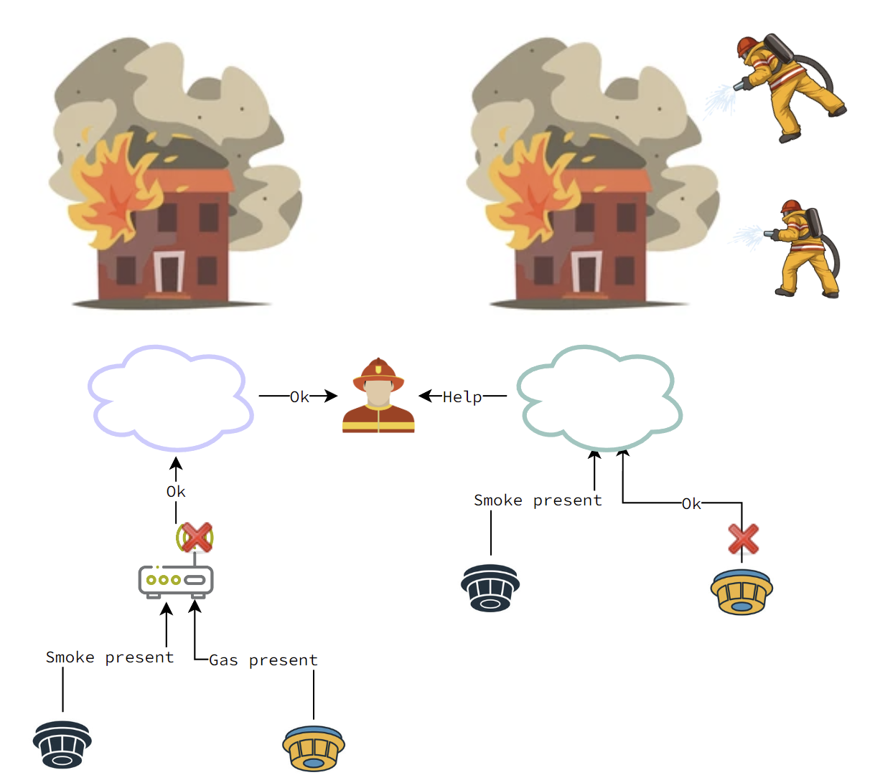
INTRODUCTION
Current IoT fog computing solutions pose a severe security risk by introducing single points of failure
Creating an architecture that is more resilient is imperative in mission-critical applications

Slide 5
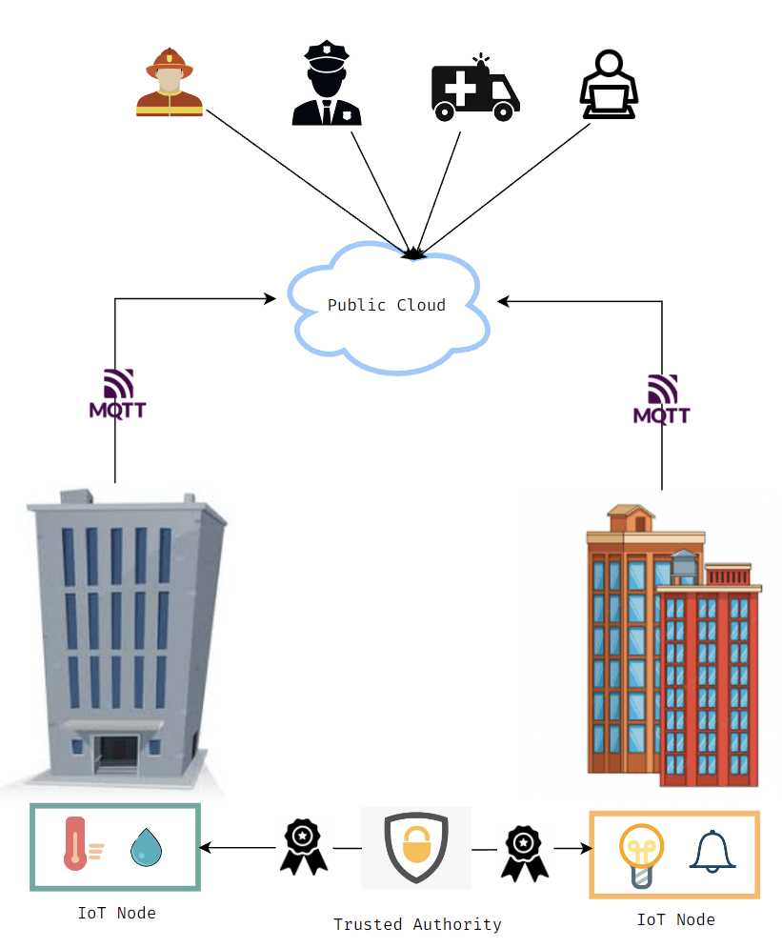
Architecture overview
Wi-Fi enabled IoT nodes are pushing sensitive data into the cloud
Fast dispatch and reaction is achieved through encoding of the payload to reduce size
Complete confidentiality is achieved through End-to-End encryption
Each entity is attested

Slide 6
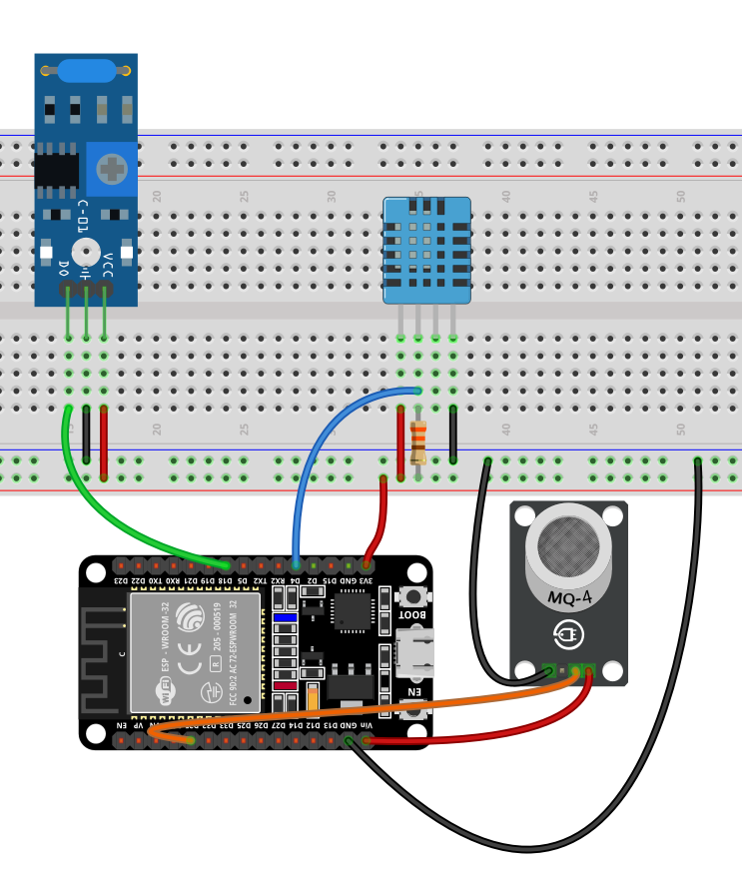
Design of the IoT node
Built using off the shelf components:
Espressif ESP32
DHT11 Temperature and Humidity Sensor
SW-420 Vibration Sensor
MQ-2 Gas Sensor
Performs Edge Machine Learning
Issues blockchain transactions
Runs ESP-IDF and uses a CMake derived build system
Has two Xtensa LX6 CPU cores and supports FreeRTOS
Baked-in support for mbedTLS, which offers a plethora of cryptographic operations
Sensor data is sent CBOR encoded and formatted according to the IPSO guidelines

Slide 7
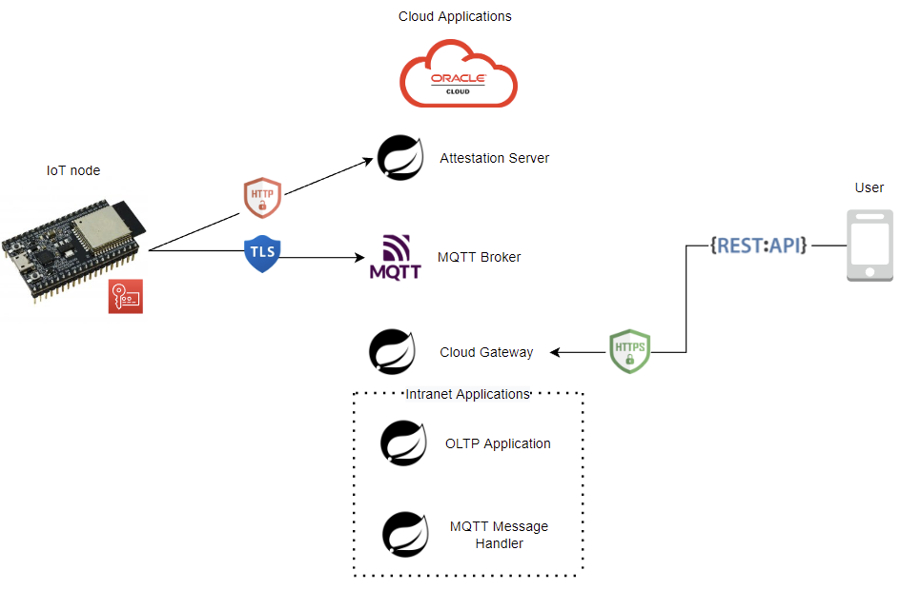
Cloud-Hosted Microservices
Hosted on an Oracle Cloud Instance with 4 ARM cores and 24 GB of RAM
Developed in Spring Boot
Conforms to the microservice architecture: exposes all available endpoints through a web-facing gateway
Runtime serving of configuration files using Spring Cloud Configuration Server
Service Discovery through Netflix Eureka Server
Transport layer security through HTTPS
All requests are authenticated using JWT
Deployed using Docker Compose

Slide 8
Securing the solution Attestation Service
01
Mutual Authentication
02
Session Key Establishment
03
Instance ID allocation
04
MQTT Connection
Through signed X.509 certificates
Through EC Ephemeral Diffie-Hellman
By calling the DB microservice
Using the established key for TLS-PSK

Slide 9
Securing the Solution Protecting Secrets
Credentials and other sensitive information are served to the microservices using HashiCorp Vault over HTTPS
The chosen strategy to prevent the secret zero problem is cubbyhole response wrapping
The flash storage of the IoT node is encrypted, saving the key in eFUSE

Slide 10

Conclusion
Securing the Solution Protecting Secrets
Resilient and secure solution
End-to-End encryption
Resiliency is improved by removing gateways
Entity attestation is enforced

Slide 11
Conclusion
Securing the Solution Protecting Secrets
Feature rich and easily expandable
Handles sensor data transparently which allows facile extensions
Performs edge Machine Learning supporting a large number of models
Able to issue blockchain transaction
Persisting records into Ethereum Smart Contracts

Slide 12
Conclusion
Securing the Solution Protecting Secrets
Interoperable
Industry standards such as IPSO formatting guide and CBOR have been used
Transport over IP

Slide 13
THANK YOU!

