Slide 1
Secure Iot solution for office building monitoring

Slide 2
Contents
Purpose of the thesis
Architecture overview
Design of the node
Securing the solution
Neural Network Used
Conclusion

Slide 3
Purpose of the thesis
Build an IoT node that securely transmits data into the Cloud
Design an Attestation Process in order to verify the origin of the node
Limit the power consumption of the node
Devise a machine learning solution for edge anomaly detection
Safely expose the collected data via REST
Ability to issue blockchain transactions from the Node

Slide 4
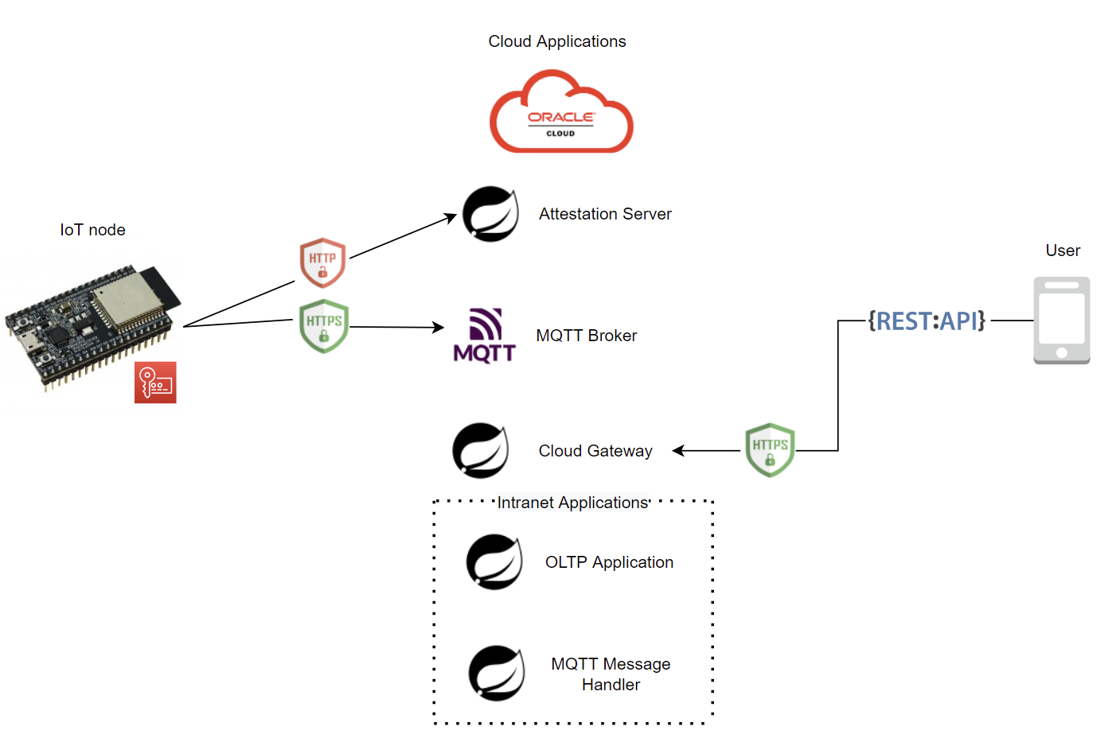
Architecture overview
IoT node consisting of ESP32 with sensors attached
Provisioned with own key pair signed by CA
Cloud hosted Spring Boot microservices and MQTT Broker
Attestation Server over unsecured transport
Cloud Gateway over secured transport
MQTT Broker that allows TLS over PSK or certificates
Payload size is reduced using CBOR, and standardized according to IPSO Smart Object Guide

Slide 5
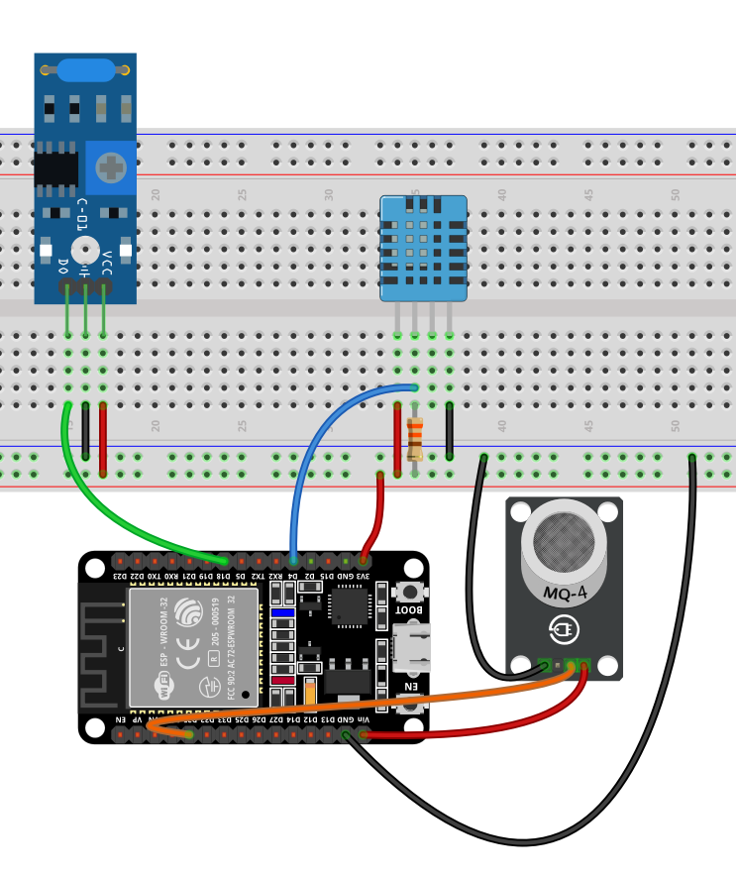
Design of the node
The IoT node is built using off the shelf components:
Espressif ESP32
DTH11 Temperature and Humidity Sensor
SW-420 Vibration Sensor
MQ-2 Gas Sensor
Battery Pack

Slide 6
Securing the solution
The origin of the Node is attested
Device is provisioned with key pair signed by CA
Elliptic Curve Ephemeral Diffie Hellman is used for generating a session key to be used in TLS-PSK
The device identifier is sent encrypted with the session key as a last step of the attestation
Sensor data is sent secured using MQTT in TLS PSK mode which offers transport layer security
The flash storage is encrypted, saving the key in eFUSE
Mutual verification is performed at attestation time

Slide 7
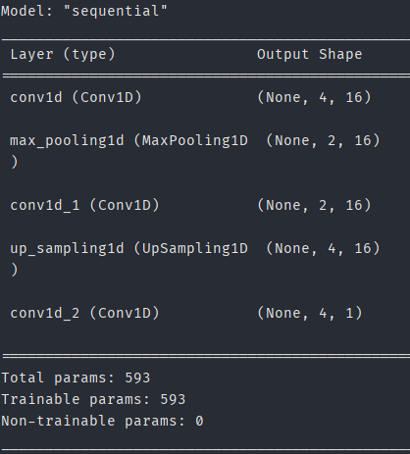
Neural network used
A neural network was used to perform anomaly detection
Inference is performed on the edge device, training on development machine
It follows the AutoEncoder architecture
Implemented using convolutional layers

Slide 8
CONCLUSION
In order to fulfil the security needs of connecting an IoT node directly to the internet, enough computational power must be ensured in order to perform complex cryptographic operations, which the ESP32 provided
Confidentiality had to be ensured for the secrets store on device, placing the key in a tamper resistant medium
Attestation of the node prevents injection of malicious data
Outliers are filtered out using a Convolutional Neural Network before publishing sensor data
Retrieval of the records is done securely over HTTPS
The cloud hosted applications follow a microservice architecture
Authorization is verified before returning any sensor data, using an IDP and JWT

Slide 9
THANKS

Slide 10
SECURITY SOLUTION OVERVIEW

