Slide 1


Secure Iot solution for office building monitoring

Slide 2
Contents
Purpose of the thesis
Architecture Overview
Design of the IoT Node
Cloud-Hosted Microservices
Securing the Solution – Attestation Service
Securing the Solution – Protecting Secrets
Conclusion

Slide 3
Purpose of the thesis
Build an IoT node with off the shelf components that securely transmits data into the Cloud
Design an Attestation Process in order to verify the origin of the node
Limit the power consumption of the node
Implement a machine learning solution for edge anomaly detection
Ability to issue blockchain transactions from the Node
Securely expose the collected data via REST

Slide 4
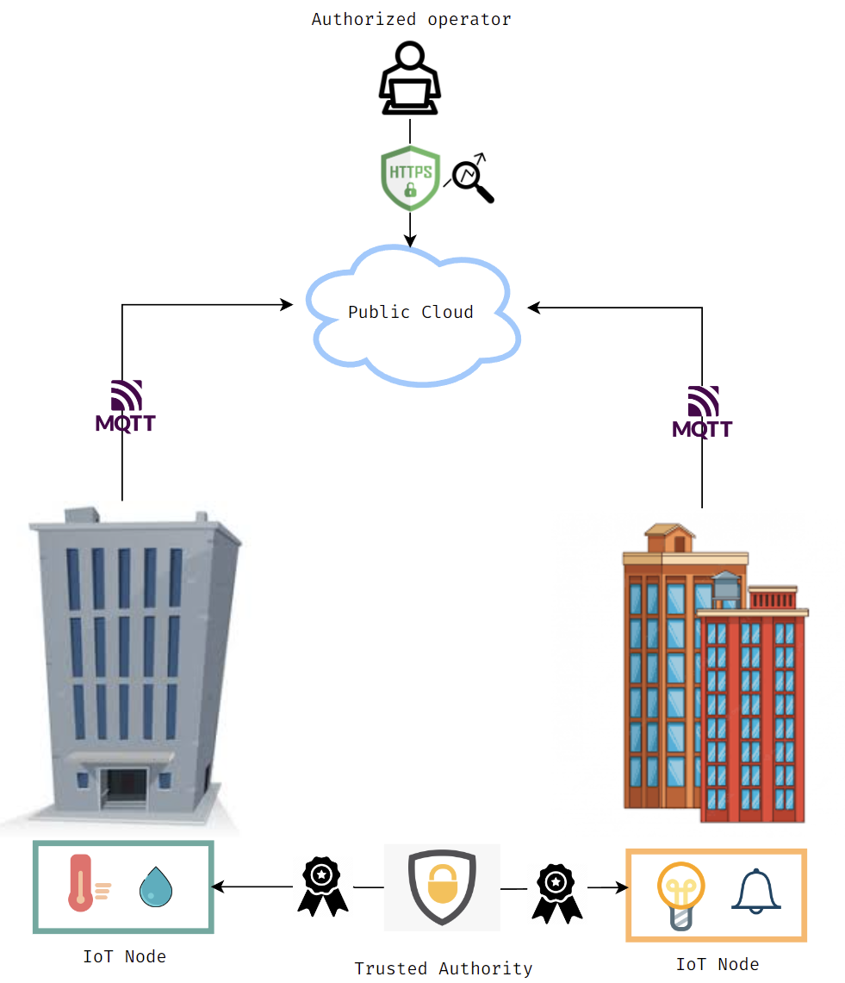
Architecture overview

Slide 5
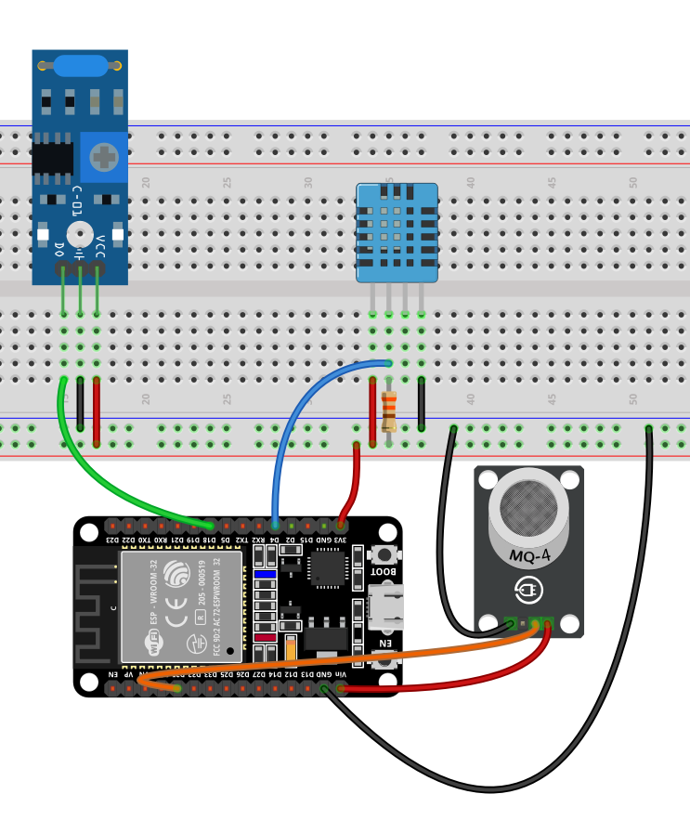
Design of the IoT node
Built using off the shelf components:
Espressif ESP32
DHT11 Temperature and Humidity Sensor
SW-420 Vibration Sensor
MQ-2 Gas Sensor
Performs Edge Machine Learning
Issues blockchain transactions
Runs ESP-IDF and uses a CMake derived build system
Has two Xtensa LX6 CPU cores and supports FreeRTOS
Baked-in support for mbedTLS, which offers a plethora of cryptographic operations
Sensor data is sent CBOR encoded and formatted according to the IPSO guidelines

Slide 6
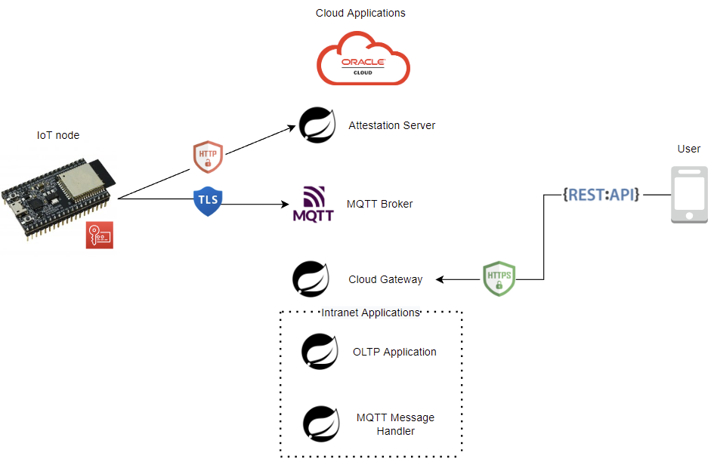
Cloud-Hosted Microservices
Hosted on an Oracle Cloud Instance with 4 ARM cores and 24 GB of RAM
Developed in Spring Boot
Conforms to the microservice architecture: exposes all available endpoints through a web-facing gateway
Runtime serving of configuration files using Spring Cloud Configuration Server
Service Discovery through Netflix Eureka Server
Transport layer security through HTTPS
All requests are authenticated using JWT
Deployed using Docker Compose

Slide 7
Securing the solution Attestation Service
The origin of each IoT node is attested by the Attestation Service
Mutual authentication is performed using signed X.509 certificates
Elliptic Curve Ephemeral Diffie Hellman is used for session-key establishment
The key is tested by encrypting a sequence of 16 bytes using AES in CBC mode
Attestation is finished when the IoT node sends the encrypted sequence alongside the unique identifier of the device
Besides attesting the origin of the node, this step is used to upsert information about the IoT node
Each node is assigned an Instance ID based on the sent unique identifier
The established session key is used to connect to the MQTT broker in TLS-PSK mode to limit power consumption

Slide 8
Securing the Solution Protecting Secrets
Credentials and other sensitive information are served to the microservices using HashiCorp Vault over HTTPS
The chosen strategy to prevent the secret zero problem is cubbyhole response wrapping
The flash storage of the IoT node is encrypted, saving the key in eFUSE

Slide 9
CONCLUSION
In order to fulfil the security needs of connecting an IoT node directly to the internet, enough computational power must be ensured in order to perform complex cryptographic operations, which the ESP32 provided
Confidentiality had to be ensured for the secrets store on device, placing the key in a tamper resistant medium
Attestation of the node prevents injection of malicious data
Outliers are filtered out using a Convolutional Neural Network before publishing sensor data
Retrieval of the records is done securely over HTTPS
The cloud hosted applications follow a microservice architecture
Authorization is verified before returning any sensor data, using an IDP and JWT

Slide 10
THANKS

