Slide 1














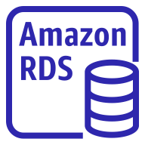
AWS Cloud
Availability Zone 1
Availability Zone 2
VPC
Public subnet
Public subnet
Bastion security group
Bastion host
Amazon EFS
Private subnet
Private subnet
Worker nodes security group
ACM
Application Load Balancer
Auto Scaling group
Agent instances
Agent instances
Amazon Route 53
Control plane security group
Network Load Balancer
AWS Secrets Manager
Auto Scaling group
Server instances
Server instances
Database security group
IAM

