Slide 1














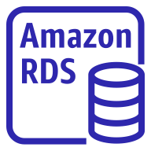
AWS Cloud
Availability Zone 1
Availability Zone 2
VPC
Public subnet
Public subnet
Bastion Security group
AWS Elastic File System
Bastion Host
Private subnet
Private subnet
Worker nodes Security group
AWS Certificate Manager
Application load balancer
Auto Scaling group
Amazon Route 53
Agent instances
Agent instances
Control Plane Security group
AWS Secrets Manager
Network load balancer
Auto Scaling group
Server instances
Server instances
AWS Identity and Access Management
Database Security group

