Slide 1
Effective Unit-Testing
…in iOS native applications
Andrei Fecioru

Slide 2

What do we need?
Basic unit-test patterns
Support for async. unit-tests
Powerful assertions
Object mocking
Continuous integration
Notes:
* type of attendees : corporate developers

Slide 3
What do we have?
Basic UT patterns: GHUnitIOS [GHTestCase]
Support for async. UT: GHUnitIOS [GHAsyncTestCase]
Powerful assertions: OCHamcrestIOS
Objet mocking: OCMock
Continuous integration: Jenkins
Notes:
* type of attendees : corporate developers

Slide 4
Basic UT patterns
GHUintIOS
Notes:
* type of attendees : corporate developers

Slide 5
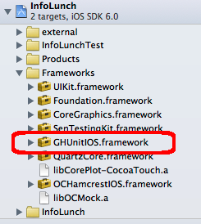
Project configuration – GHUintIOS (1)
Get the latest version from: https://github.com/gabriel/gh-unit/downloads
Ad the framework to you project:
Notes:
550K new devices registered every day…

Slide 6
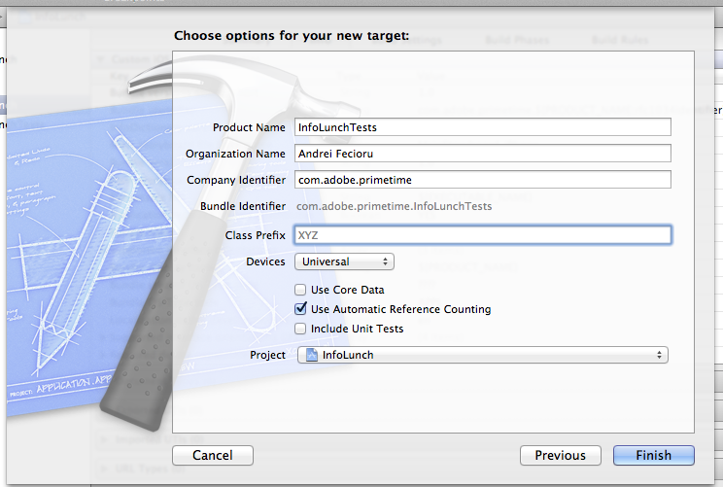
Project configuration – GHUintIOS (2)
Create a new Empty Application:
Notes:
550K new devices registered every day…

Slide 7
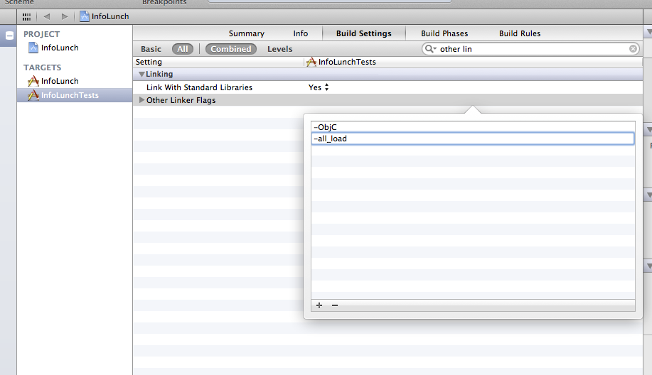
Project configuration – GHUintIOS (3)
Set the application linker flags:
Notes:
550K new devices registered every day…

Slide 8
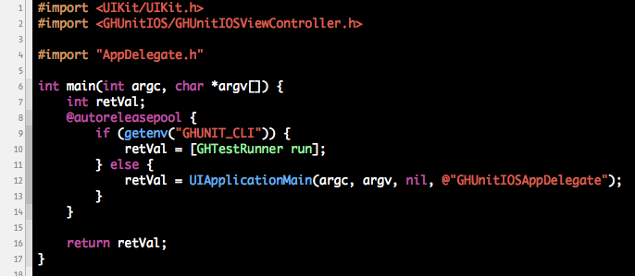
Project configuration – GHUintIOS (4)
Change the main.m file:
Notes:
550K new devices registered every day…

Slide 9
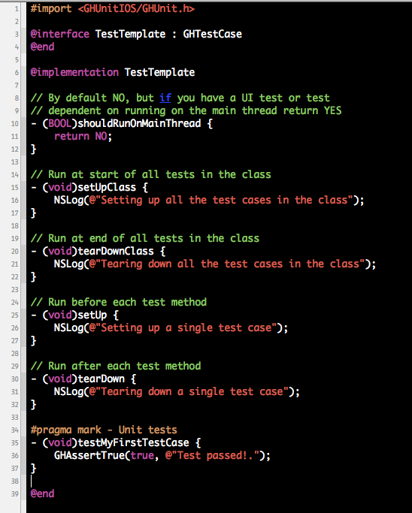
Basic unit-test patterns (1) Template for synchronous test case
Notes:
550K new devices registered every day…

Slide 10
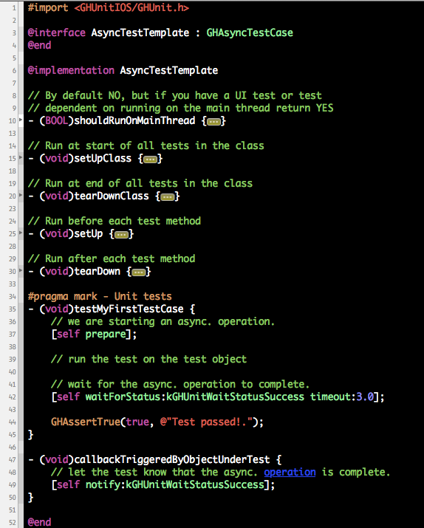
Basic unit-test patterns (2) Template for asynchronous test case
Notes:
550K new devices registered every day…

Slide 11
Powerful assertions
OCHamcrest
Notes:
* type of attendees : corporate developers

Slide 12
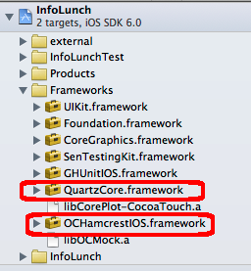
Project configuration – OCHamcrest
Get the latest version from: https://github.com/hamcrest/OCHamcrest
Ad the framework to you project:
* Also add the QuartzCore framework
Notes:
550K new devices registered every day…

Slide 13
Assertions based on matcher objects
Object matcher example:
assertThat(objectOne, equalTo(objectTwo));
Number matcher example:
assertThat(numberOne, greaterThan(objectTwo));
String matcher example:
assertThat(stringOne, endsWith(stringTwo));
Collection matchers example:
assertThat(collectionOne, containsInAnyOrder([list-of-matchers]));
Write your own!!
Notes:
550K new devices registered every day…

Slide 14
Mocking objects
OCMock
Notes:
* type of attendees : corporate developers

Slide 15
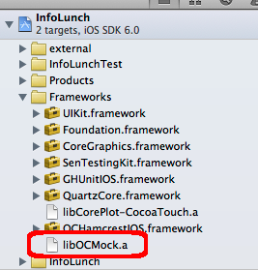
Project configuration – OCMock (1)
Get the latest version from: http://ocmock.org/
Link the library to you project:
Notes:
550K new devices registered every day…

Slide 16
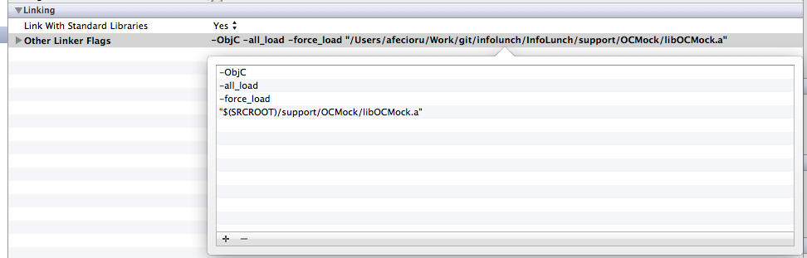
Project configuration – OCMock (2)
Set the application linker flags:
Notes:
550K new devices registered every day…

Slide 17
Mocking in action (1)
Create the mock object
mockedUrlConnection = [OCMockObject mockForClass: [NSURLConnection class]];
Specify the expected invocations and return values
[[[[mockedUrlConnection stub]
andDo:^(NSInvocation *invocation) {…}]
andReturn:OCMOCK_ANY]
initWithRequest:OCMOCK_ANY
delegate:OCMOCK_ANY
startImmediately:YES];
Notes:
550K new devices registered every day…

Slide 18
Mocking in action (2)
Associate the mock object with the code under test
testSignal.urlConnection = mockedUrlConnection;
Execute the code under test
[testSignal loadSineWaveFromURL:URL];
Validate that your assertions are correct
assertThat([NSNumber numberWithUnsignedInteger:testSignal.sampleCount], equalToInt(LENGTH));
Notes:
550K new devices registered every day…

Slide 19
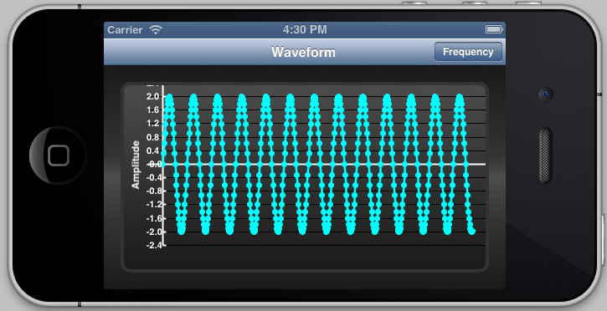
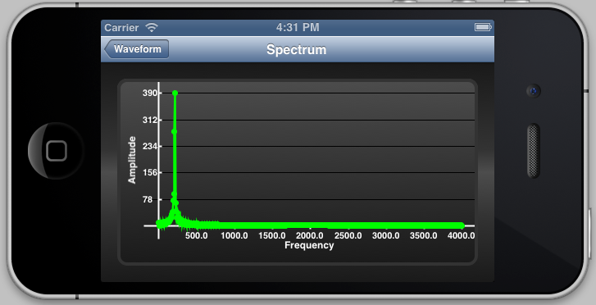
Putting it all together Testing our own application
Generating sine-waves
Computing the spectrum
Notes:
550K new devices registered every day…

Slide 20
What are we testing?
Object under test - the Signal class
Generate silence
Generate sine-waves
Parameters are provided directly via API
Parameters are taken from URL
Compute the spectrum
Synchronously
Asynchronously
Notes:
550K new devices registered every day…

Slide 21

Enough! Let’s test already!
Notes:
550K new devices registered every day…

Slide 22
Continuous Integration - Jenkins
Run the tests from the command line:
GHUNIT_CLI=1 xcodebuild -target InfoLunchTest -configuration Debug -sdk iphonesimulator build
Configure your Jenkins job
Notes:
550K new devices registered every day…

Slide 23
Q&A
Source code available on GitHub:
https://github.com/andreifecioru/infolunch/tree/master/InfoLunch
Notes:
550K new devices registered every day…

