Slide 1
Go Presentation
Gabor Petru-Andrei

Slide 2
What is Go?
Go is a statically typed, compiled programming language designed at Google. Go is syntactically similar to C, but with memory safety, garbage collection and structural typing. The language is often referred to as Golang because of its domain name, golang.org, but the proper name is Go.

Slide 3
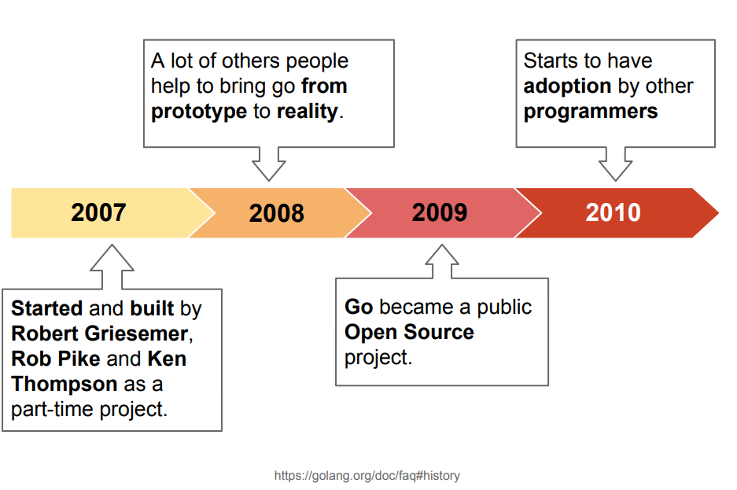
History

Slide 4
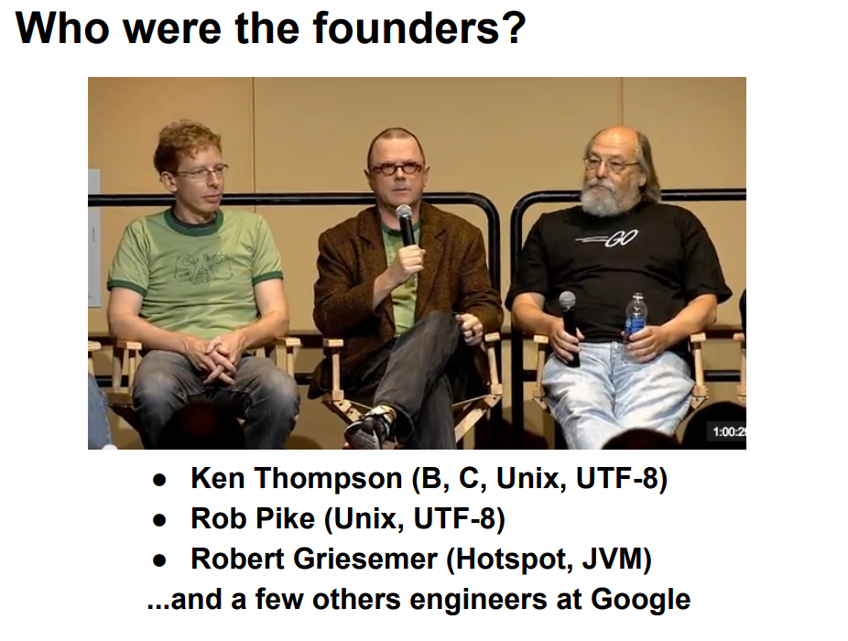

Slide 5
Why Go?
Eliminate slowness
Eliminate clumsiness
Improve productivity
Simple syntax, easy to catch, fully utf-8, and different
go get, go install, go build, go run

Slide 6
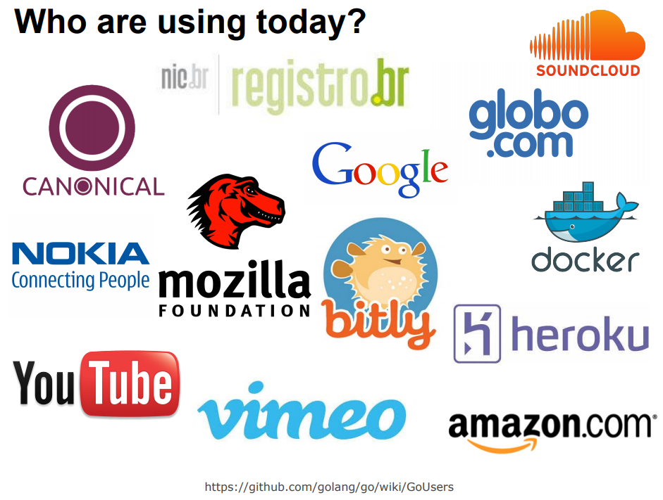

Slide 7
What will you see in Go?
Compiled
Garbage-collected
Simple syntax
Great standard library
Object Oriented (without inheritance)
Statically and stronger typed
Concurrent (goroutines)
Closures
Explicity dependencies
Multiple return values
Pointers
and so on...

Slide 8
What will you not see in Go?
Exception handling
Inheritance
Generics
Assert
Method overload
Have not been implemented in favor of efficiency

Slide 9
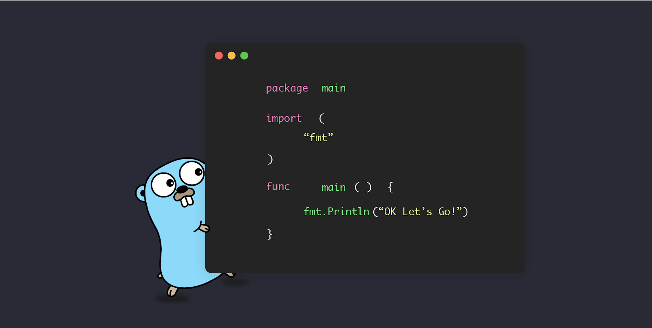
Let's see a bit of code

Slide 10
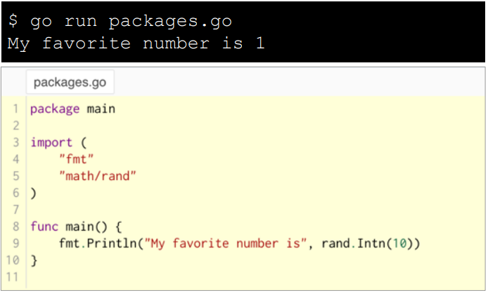
First Program
Programs start from main package
This example is using the fmt and math packages

Slide 11
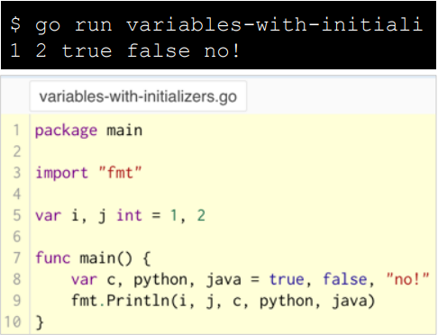
Variables
The var instruction declares a list of variables
The type is informed at the end

Slide 12
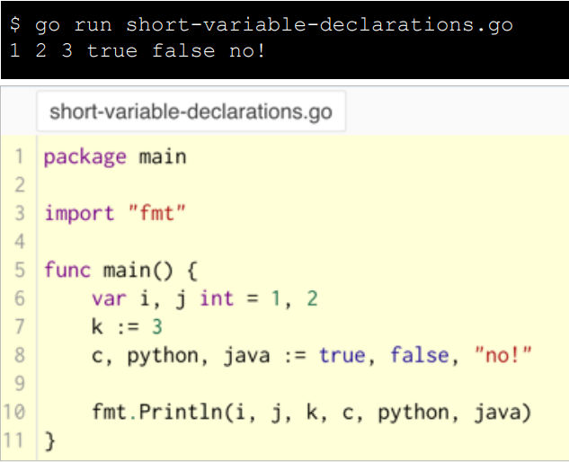
Short variables declarations
Inside a function, the short attribution instruction := can be used instead of a var declaration

Slide 13
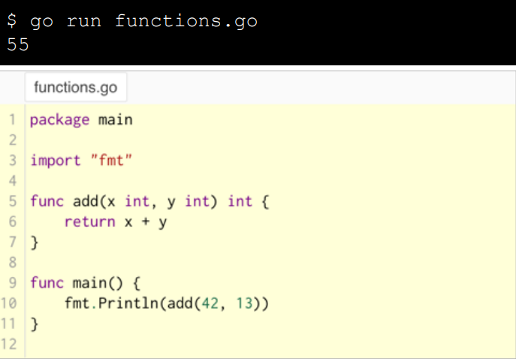
Functions
Functions may have zero or more arguments
Notice that the type comes after the parameter name, like variables

Slide 14
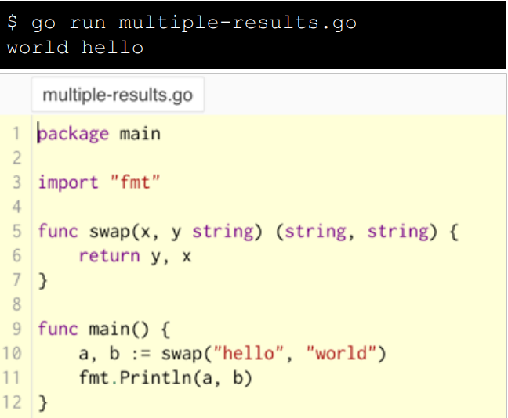
Multiple return values
A function can have multiple return values

Slide 15
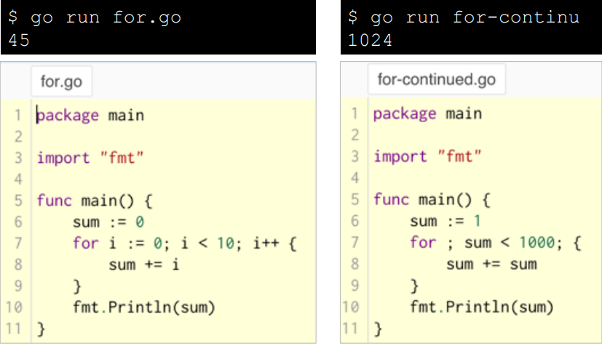
For loop
It is very similar with C or Java code, except for ( )
Start and end declarations can be empty

Slide 16
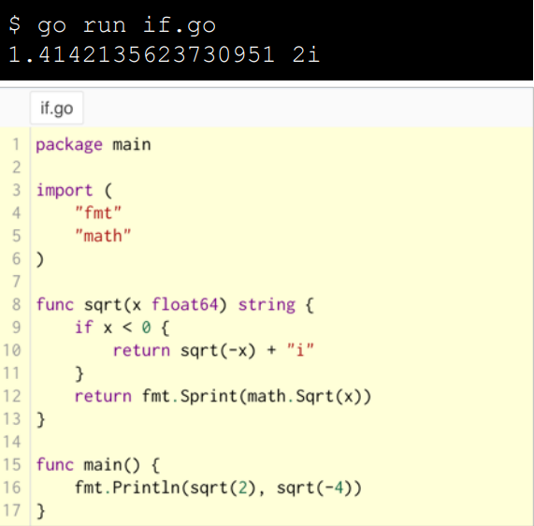
If condition
It is very similar with C or Java code, except for ( )

Slide 17
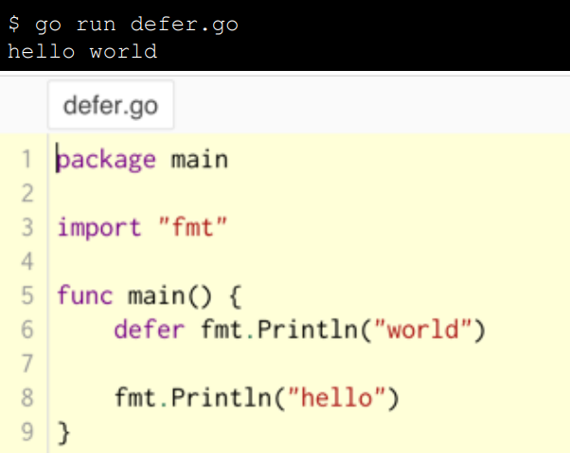
Defer
A defer statement defers the execution of a function until the surrounding function returns
The deferred call's arguments are evaluated immediately, but the function call is not executed until the surrounding function returns.

Slide 18
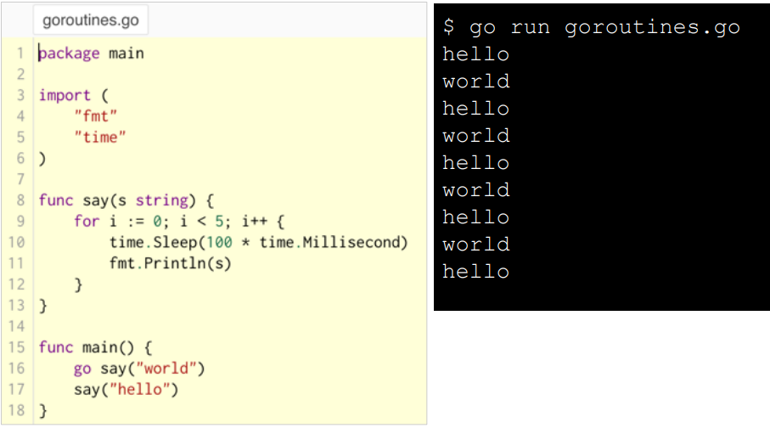
Goroutines
A goroutine is a lightweight thread managed by the Go runtime.

Slide 19
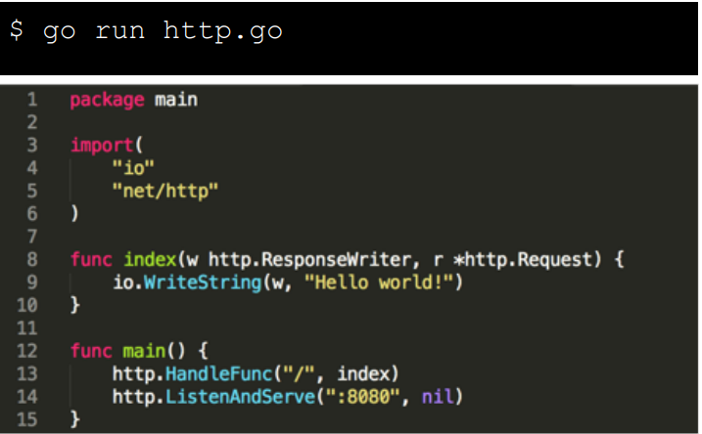
Go on the web

Slide 20
Bibliography
http://golang.org
https://en.wikipedia.org/wiki/Go_(programming_language)
https://tour.golang.org
https://gobyexample.com
https://github.com/golang/go
https://golang.org/doc/

