Slide 1
Arm imbalances in the TW-MZM model
Where they come from, what they do to EO bandwidth and eye, and how INTERCONNECT represents them

Slide 2
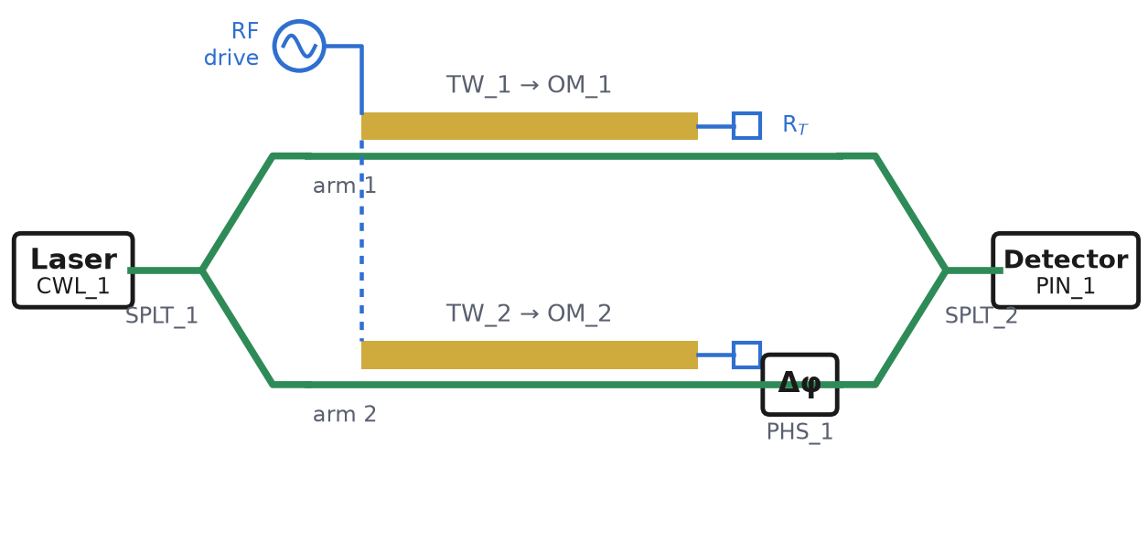
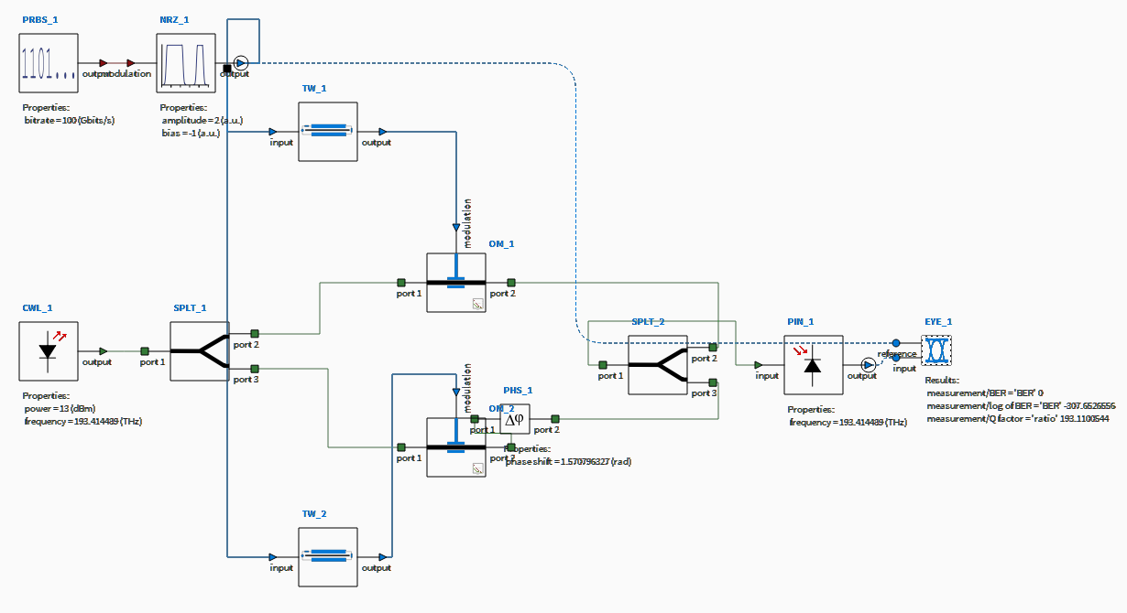
The model: a familiar MZM, block by block
Same blocks, same names: the simple picture (left) is what INTERCONNECT simulates (right)
CWL_1 laser
SPLT_1 / SPLT_2 Y splitter / combiner
TW_1, TW_2 travelling-wave electrode, one per arm
OM_1, OM_2 phase modulator, one per arm
PHS_1 bias phase (quadrature)
PIN_1 photodetector
Reference device for every number: measured line 6NK0020 scaled to 16.5 mm · n_{g} = 2.27 · V_{π} = 4 V per arm · 100 Gb/s NRZ, 2 Vpp · balanced EO BW = 58.8 GHz

Slide 3
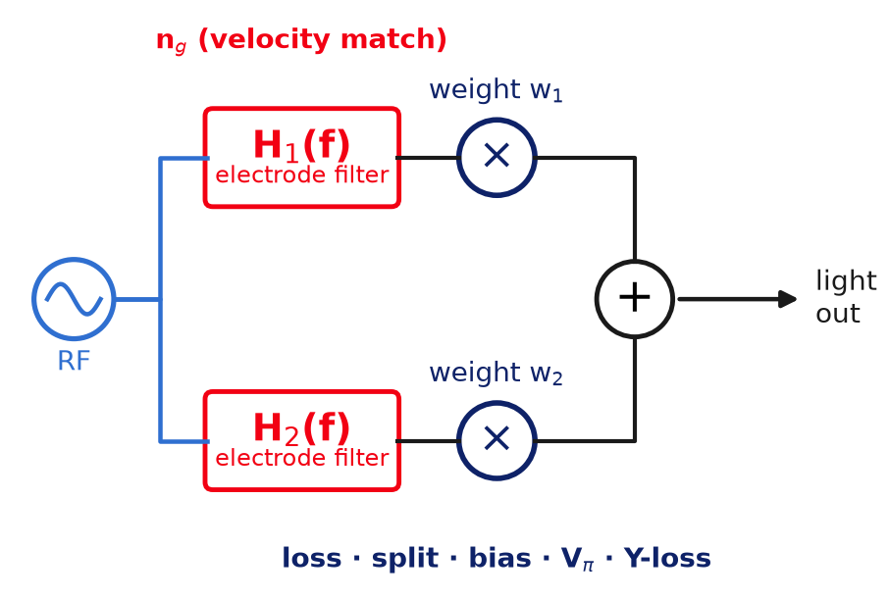
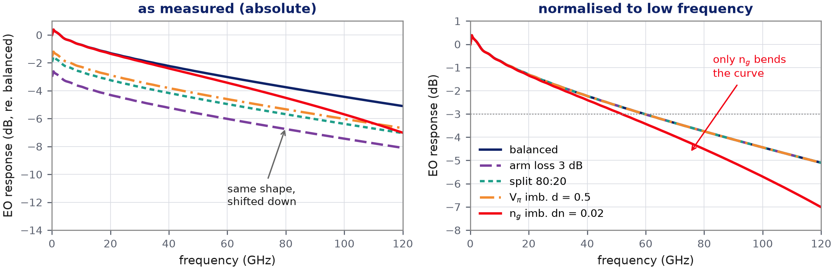
Why only one imbalance can move the EO bandwidth
Each arm = an electrode filter H(f) × a constant weight. Weights change the volume, not the tone
Weights: loss, split, bias, V_{π}, Y-loss
Act the same way on a slow bit and a fast bit → the whole curve shifts down, the normalised shape is identical → BW unchanged
Filter: group index n_{g}
Sets how long light and RF stay in step. Different n_{g} per arm → the two filters differ → the sum changes shape → BW moves

Slide 4
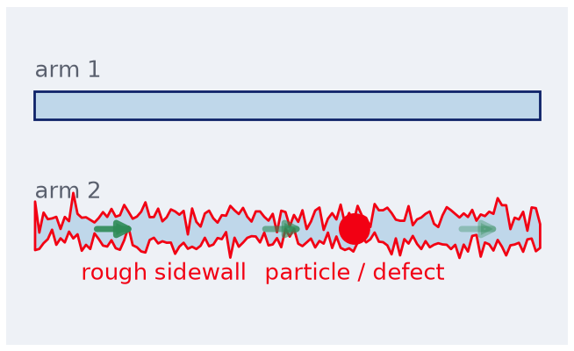
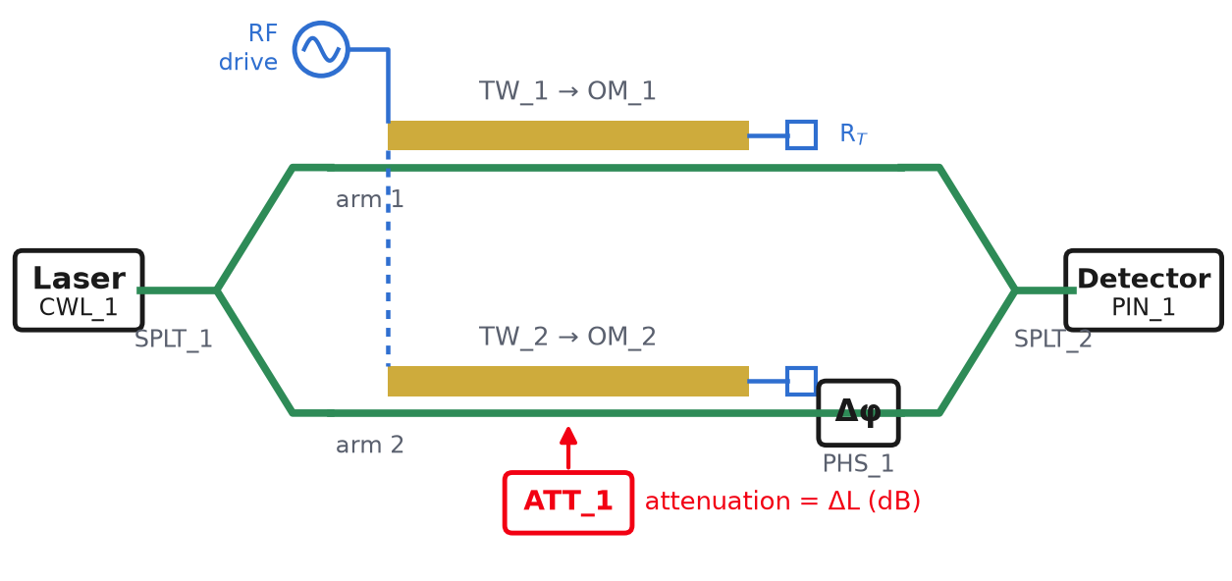
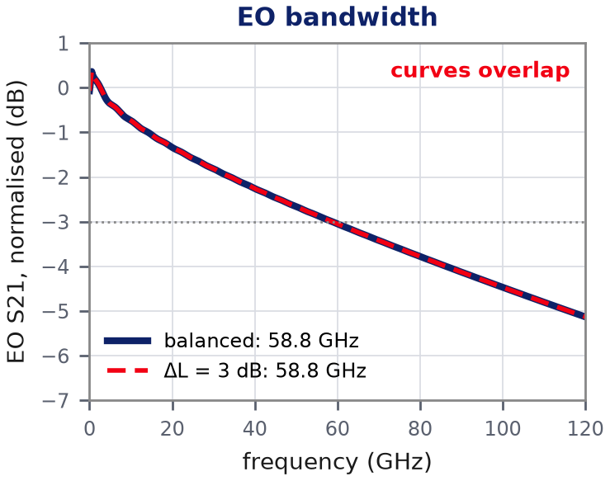
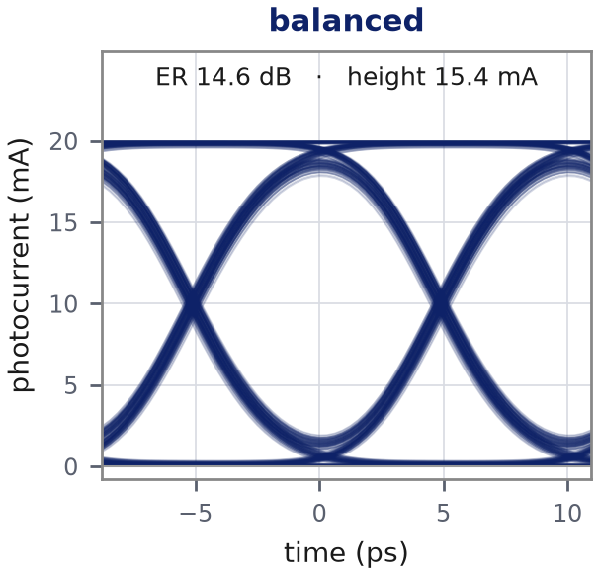
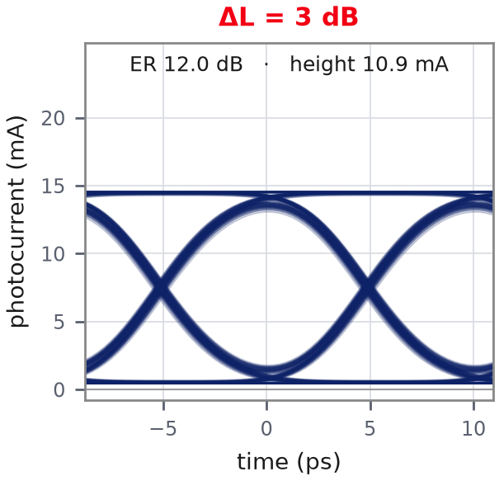
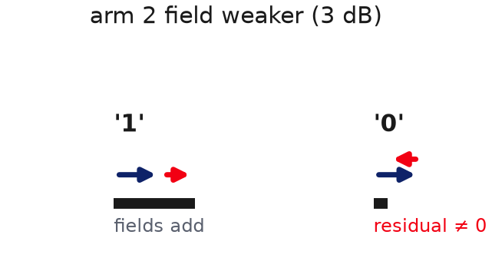
1 Arm loss imbalance
One arm loses more light: the '0' no longer goes dark
Where it comes from
Where it enters the model
In INTERCONNECT
ATT_1
Optical Attenuator, arm 2
attenuation = ΔL (dB)
realistic: 0 – 0.3 dB
rough sidewall, particle or local defect in one arm
Why
EO BW: unchanged — light is dimmed by the same fraction at every frequency
Eye: fields no longer cancel at '0' → floor lifts, ER 14.6 → 12.0 dB at 3 dB

Slide 5
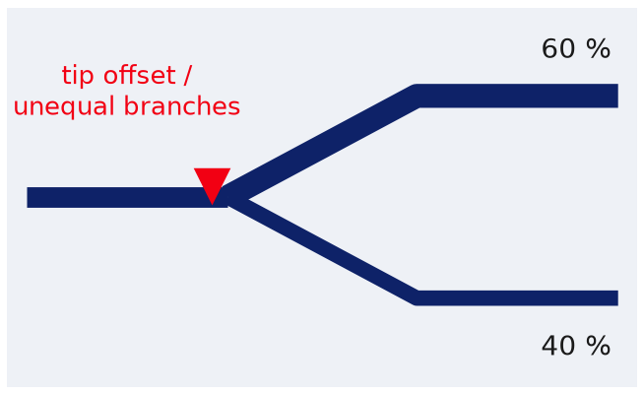
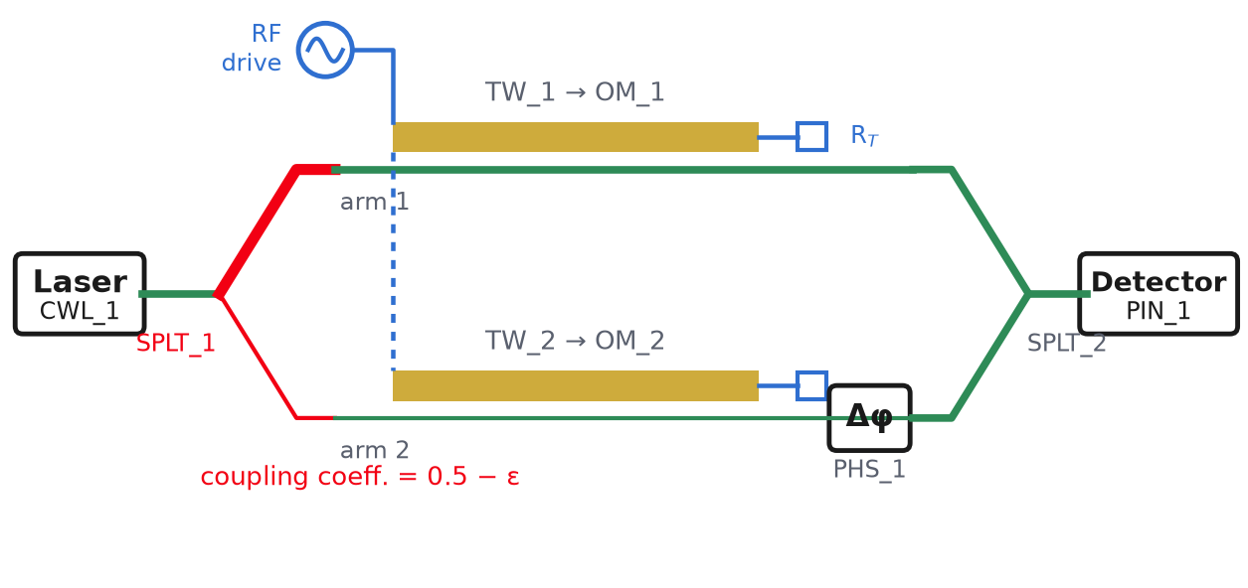
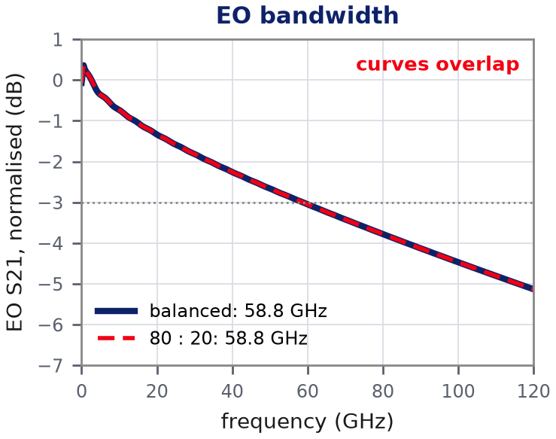
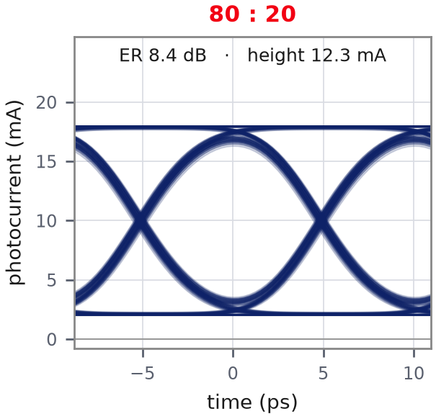
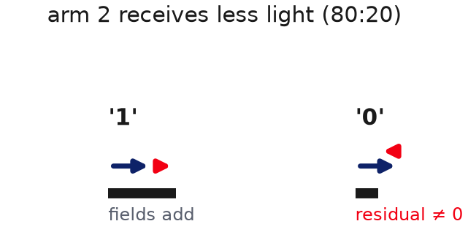
2 Splitter imbalance
Light shared unequally between the arms: same signature as loss, but no light is lost
Where it comes from
Where it enters the model
In INTERCONNECT
SPLT_1
Waveguide Y Branch, input
coupling coefficient = 0.5 − ε
realistic: 50.5:49.5 – 52:48
Y-junction asymmetry: tip offset, unequal branches
Why
EO BW: unchanged — a constant amplitude ratio, frequency-flat
Eye: residual field at '0' → ER 14.6 → 8.4 dB at 80:20; mean power unchanged

Slide 6
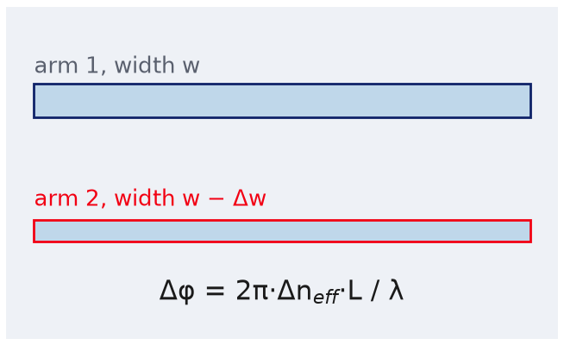
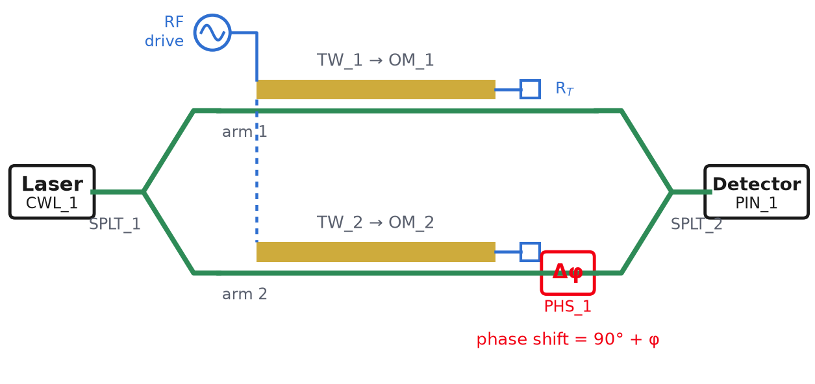
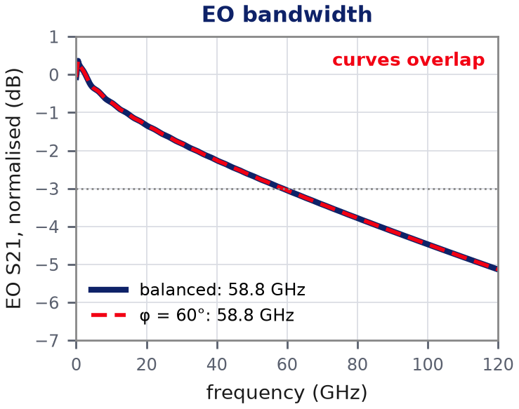
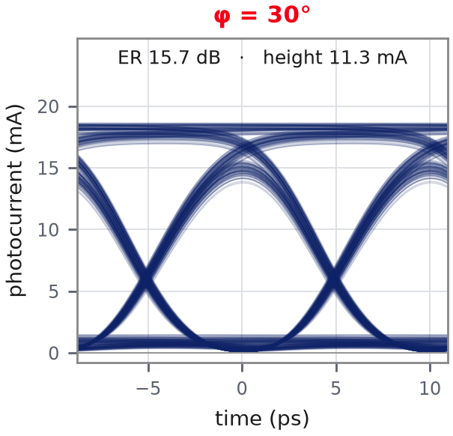
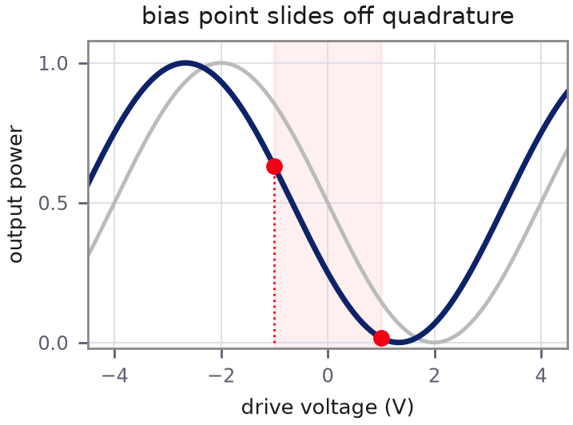
3 Static phase error
The interferometer is biased away from quadrature
Where it comes from
Where it enters the model
In INTERCONNECT
PHS_1
Optical Phase Shift (bias)
phase shift = 90° + φ
any value: nulled by the bias loop
optical path difference between the arms
Why
EO BW: unchanged — the bias only scales the slope (a weight)
Eye: levels sit asymmetrically on the cosine → crossing 50 → 24 % at 30°, eye closes near 60°

Slide 7
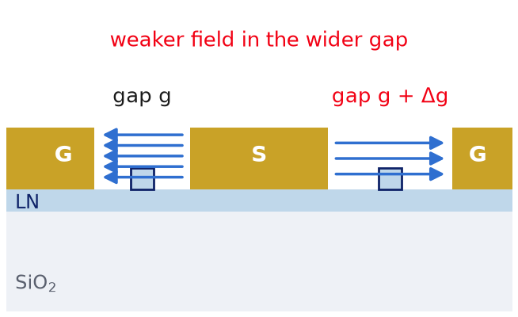
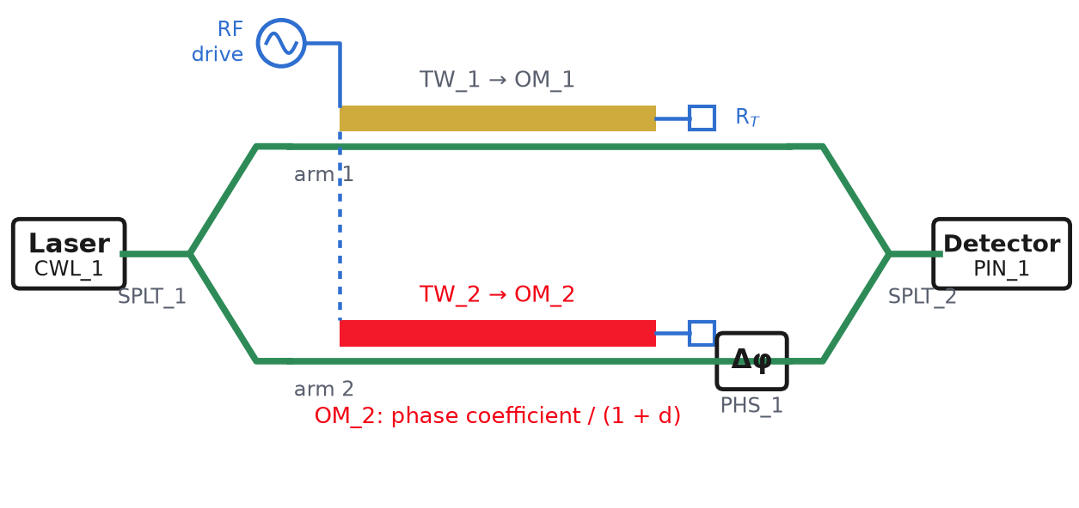
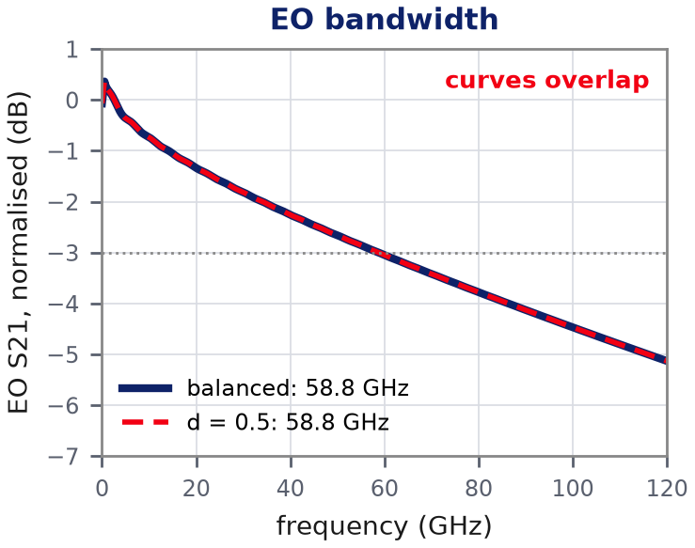
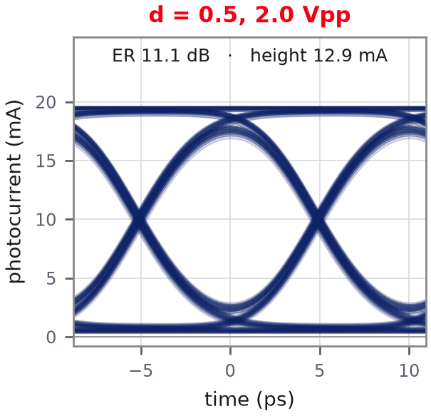
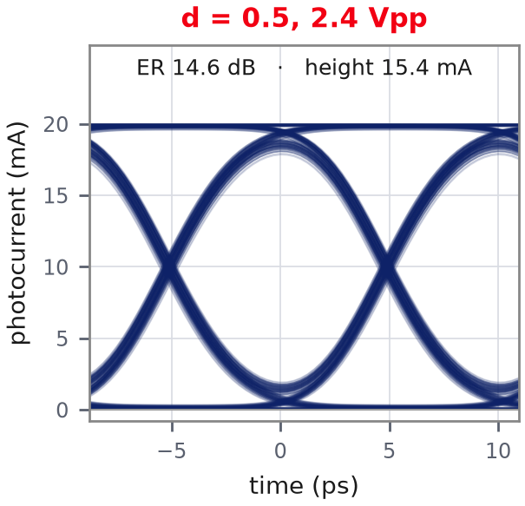
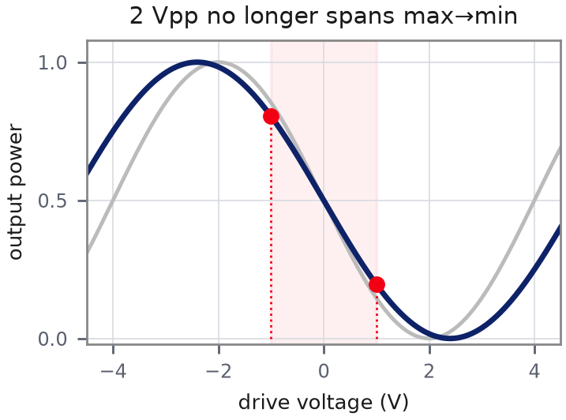
4 V_{π} imbalance
One arm is modulated less efficiently: fixable by re-setting the drive
Where it comes from
Where it enters the model
In INTERCONNECT
OM_2
Optical Modulator, arm 2
phase coefficient × 1/(1+d)
realistic: d = 0.5 – 3 %
different gap or overlap per arm
Why
EO BW: unchanged — both arms keep the same filter, only the weights differ
Eye: 2 Vpp falls short of max→min: ER 11.1 dB; drive re-set to 2.4 Vpp → 14.6 dB (= balanced)

Slide 8
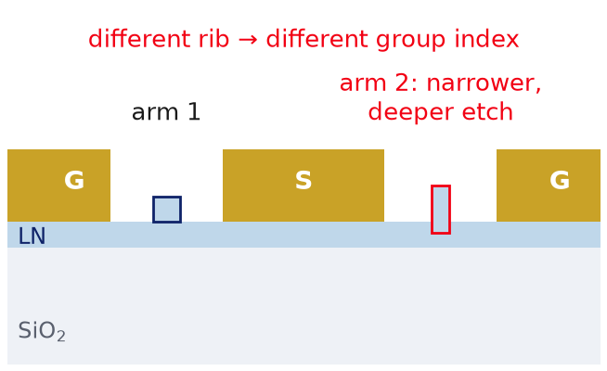
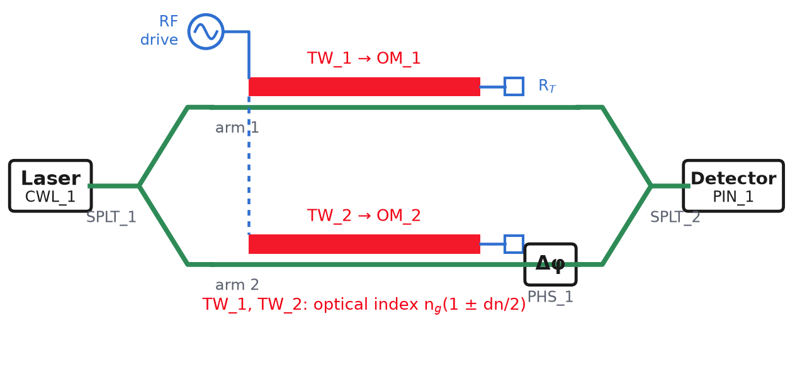
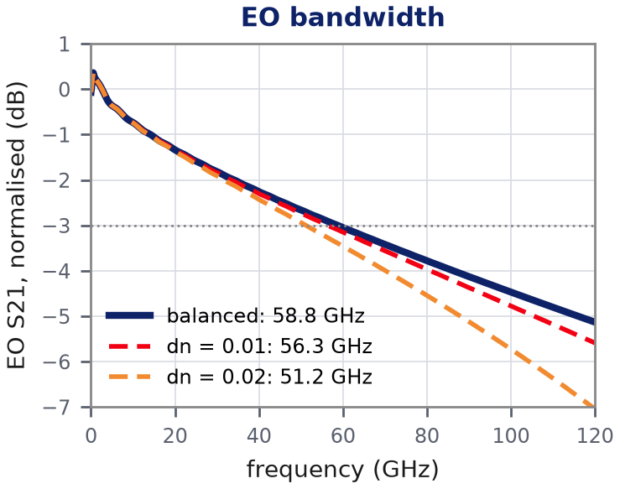
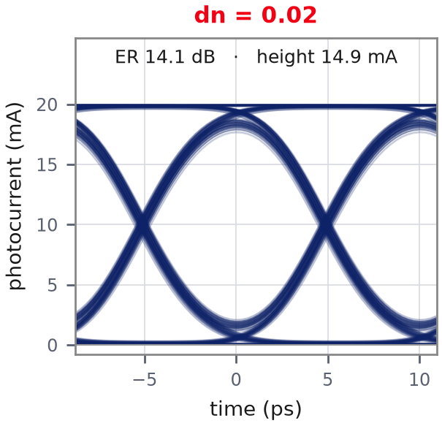
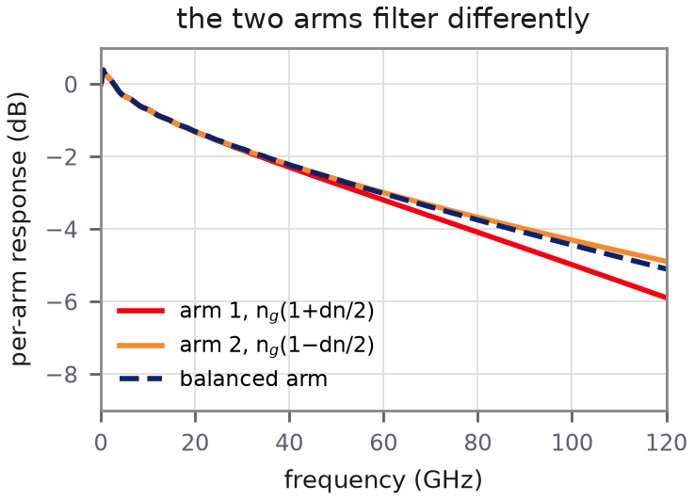
5 Group-index imbalance
The only imbalance that reshapes the frequency response
Where it comes from
Where it enters the model
In INTERCONNECT
TW_1, TW_2
Traveling Wave Electrode × 2
optical index = n_{g}(1 ± dn/2)
realistic: dn < 0.001
different rib cross-section per arm
Why
EO BW: −0.03 GHz at dn = 0.001, −2.4 GHz at 0.01: grows as dn²
Eye: slightly more ISI: ER 14.6 → 14.1 dB even at dn = 0.02

Slide 9
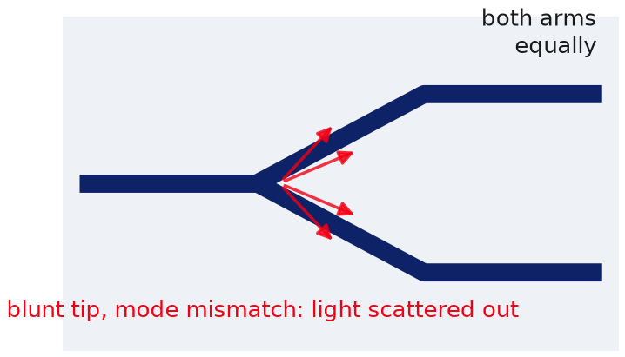
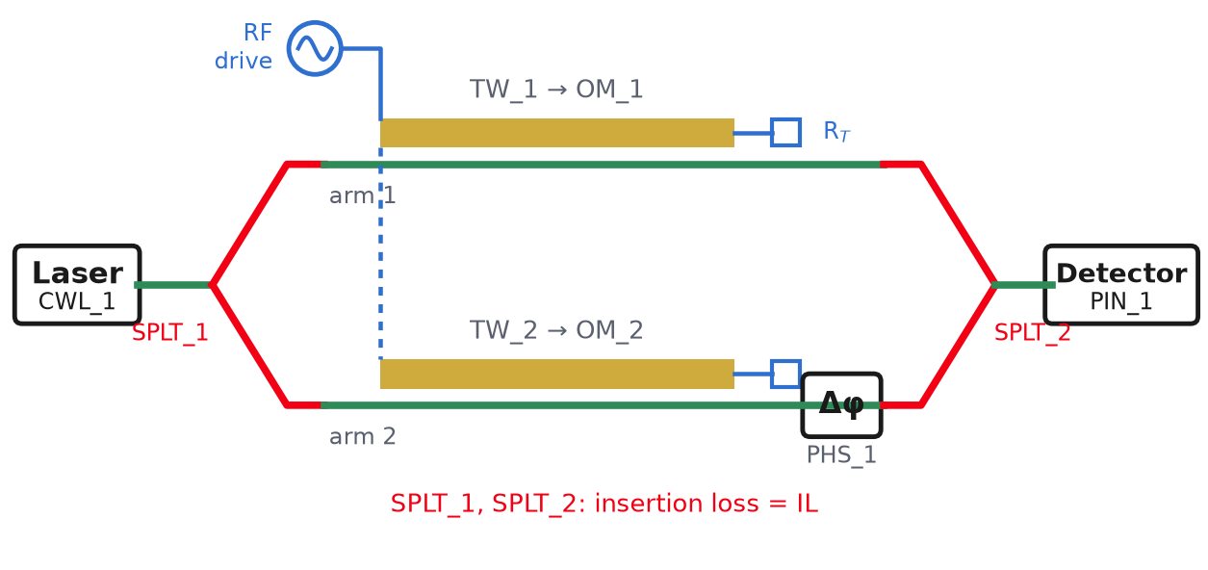

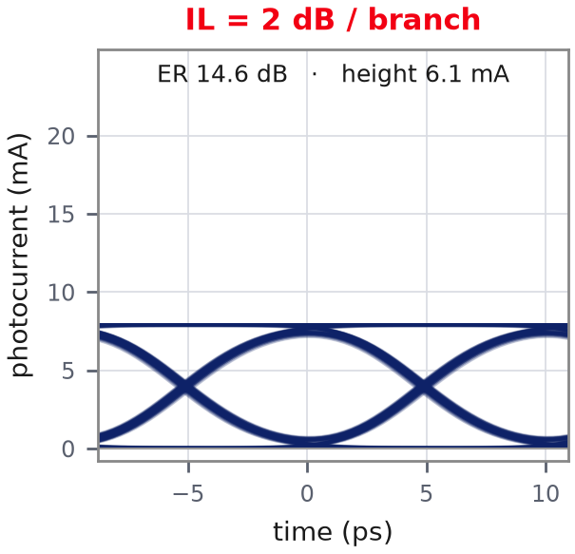
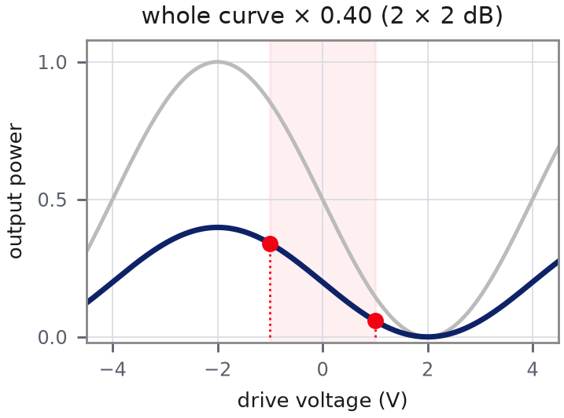
6 Y-branch excess loss
Common-mode: both arms lose the same fraction (not an imbalance)
Where it comes from
Where it enters the model
In INTERCONNECT
SPLT_1, SPLT_2
Waveguide Y Branch × 2
insertion loss = IL (dB)
realistic: 0.1 – 0.3 dB / branch
light scattered at the junctions
Why
EO BW: unchanged — same fraction lost at every frequency
Eye: whole eye scaled × 10^{−2IL/10}: ER stays 14.6 dB; only the received power (and the noise-limited Q) drops

Slide 10
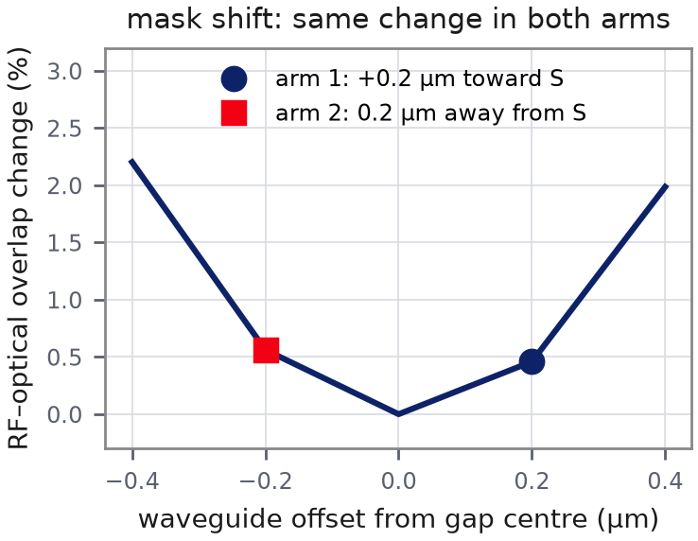
From process errors to imbalances
Each process error is one row: compute its components once, enter each in its own block → no double counting
Process error | Arm loss | Split | Static phase | V_{π} | n_{g} | Y-loss
Waveguide ↔ electrode mask shift | — | — | — | ≈ 0 (symmetric) | — | —
Electrode gap error, one side | — | — | — | ● main | — | —
Rib width / etch depth error, one arm | ○ small | — | ● main | ○ small | ○ tiny | —
Y-junction asymmetry | — | ● main | ○ small | — | — | ○ small
Sidewall roughness / defect, one arm | ● main | — | ○ small | — | — | —
Temperature / stress gradient | — | — | ● main | — | — | —
Blunt junction tips (both) | — | — | — | — | — | ● main
Why a mask shift gives no V_{π} imbalance
The field in each gap is symmetric about its centre. Both waveguides move off-centre by the same distance, one toward S and one away from it, so both see the same field.
No redundancy:
the six columns are six different physical quantities (amplitude, split, phase, efficiency, delay, common loss). One error can feed several columns, but each column receives each error only once.

Slide 11
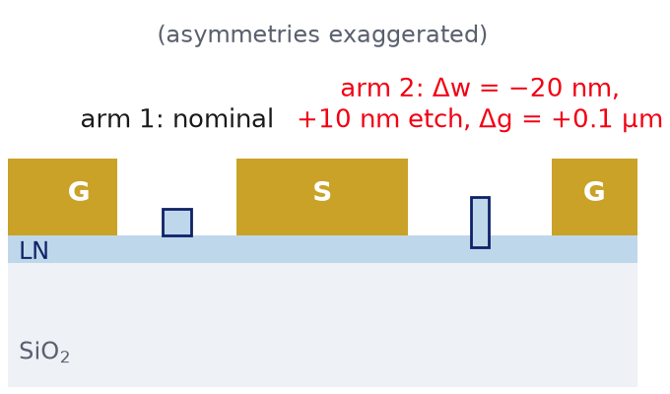
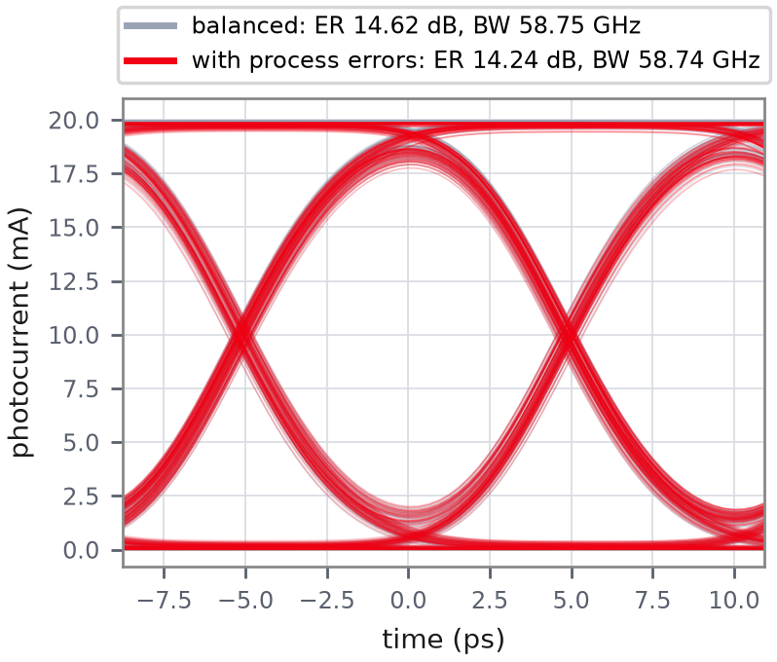
Real example: asymmetric over-etch + gap error + splitter
Realistic process errors: a large static phase (handled by the bias loop), everything else is small
Process error (arm 2) | Static phase | V_{π} d | n_{g} dn | Arm loss | Split
Rib 20 nm narrower, 10 nm deeper | 270 rad | 0.57 % | 5.2·10⁻⁴ | 0.036 dB | —
Electrode gap +0.1 µm (of 4.15) | — | 2.46 % | — | — | —
Y-junction 52 : 48 (typical) | — | — | — | — | ε = 0.02
Total entered in the model | bias loop → 0° | 3.03 % | 5.2·10⁻⁴ | 0.036 dB | ε = 0.02
270 rad = 43 × 2π: the arms' optical paths differ by tens of wavelengths, so the bias point is arbitrary from die to die → a bias loop is mandatory
-0.38 dB
-0.01 GHz
-1.9 %
eye ER
EO bandwidth
eye height
Mode solver: semi-vectorial FD, 550 nm film, 275 nm etch, 1 µm rib (n_{g} = 2.26 vs 2.27 measured). RF field: thin-electrode conformal map. Arm loss assumes 0.3 dB/cm, all from sidewall scattering.

Slide 12
Summary
Imbalance | EO bandwidth | Eye | Physical reason | INTERCONNECT
1 Arm loss | — | ER ↓ | '0' not dark: unequal fields | ATT_1 attenuation
2 Splitter | — | ER ↓, power kept | '0' not dark: unequal fields | SPLT_1 coupling coeff.
3 Static phase | — | leans, closes ~60° | off quadrature | PHS_1 phase shift
4 V_{π} | — | ER ↓ at fixed drive | swing < max→min; re-set drive | OM_2 phase coefficient
5 Group index | ● ↓ ∝ dn² | slight ISI | arms filter differently | TW_1 / TW_2 optical index
6 Y-branch loss | — | scaled, ER kept | common-mode | SPLT_1, SPLT_2 insertion loss
Take-away
Only the group index can move the EO bandwidth, and realistic values do not. Process asymmetries show up mainly as a static phase (bias loop) and as small ER penalties (splitter, V_{π}). All six are single, independent knobs in the GUI and in INTERCONNECT.

