Slide 1
Danube (O band)
Standing wave, tee cross-sections and over-etch
Slab-width sweep at 1310 nm, wavelength sweep 1270–1330 nm, comparison with measured trends

Slide 2
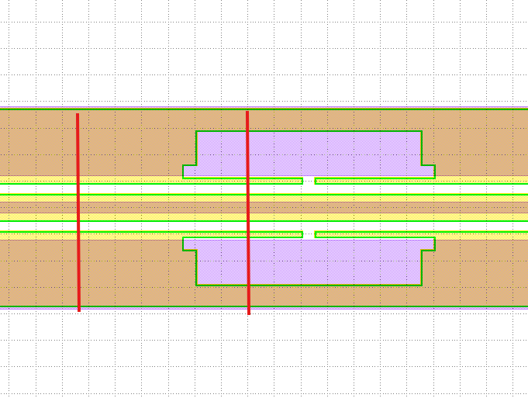
Where the four cross-sections come from
Top view of the push-pull modulator (KLayout): red lines = the two simulated cuts
Two cuts along the line
Outside of tee: full ground electrode, 28 µm wide, 2 µm thick
Inside of tee: the slow-wave tee leaves only a 2.0 × 0.5 µm ground stub next to the gap; the signal is unchanged
Two process versions
Standard: BOX intact
Over-etched (process reality): BOX recessed 700 nm wherever the LN slab is removed; gold fills the recess under the electrodes
→ 2 cuts × 2 processes = 4 cross-sections

Slide 3
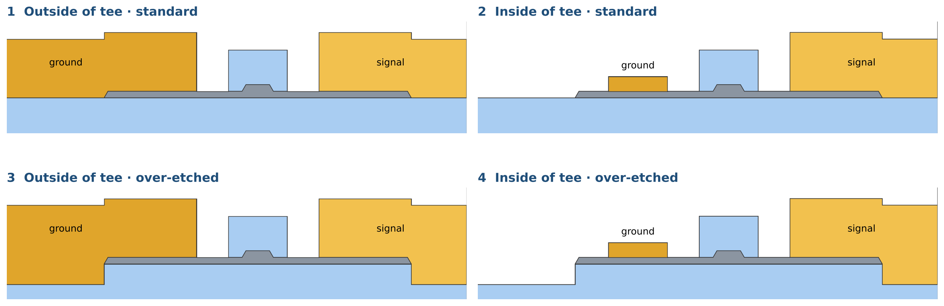
The four simulated cross-sections
Nominal geometry, one arm: the right edge is the signal centre (mirror plane)
λ = 1310 nm · LN film 450 nm, etch 225 nm · rib top 0.8 µm · gap 4.15 µm · signal 10 µm (5 µm per arm) · slab top width 10.15 µm · slab ends etched at 60° · SiO₂ cap 2.0 × 1.4 µm
Mesh converged at 1310 nm: 6 nm gold skin (skin depth ≈ 12 nm); IL within ≈ 3 %, Vπ·L within 0.1 %

Slide 4
Slab-width sweep: the IL ripple survives in all four cases
1310 nm, slab top width 5.15 → 12.15 µm, 100 nm step
≈ 1.3 µm
ripple period in slab width
0.003 → 0.21
IL range over the sweep (dB/cm)
0.027–0.029
nominal IL, all four (dB/cm),
on the falling edge of a peak
Same peak positions in all four cases; the tee and the over-etch only change peak heights.

Slide 5
Why the ripple is the same in all four
The cavity is the LN slab covered by gold, between the gap edge and the slab end
Cavity unchanged
The slab wave guided under the gold is reflected at the slab end
That stretch is identical in all four cases: same gap, slab, 60° end
Electrode size irrelevant
Light enters gold only ≈ 12 nm (skin depth)
2 µm or 0.5 µm thick, 28 µm or 2 µm wide: same to the light
Over-etch is out of the way
The recess is below the slab plane and beyond the slab end
Only the evanescent tail reaches it: small change in peak heights
Optical loss depends only on the gold geometry seen by the light, not on which electrode is signal or ground: with a symmetric cross-section each side gives half of the loss.

Slide 6
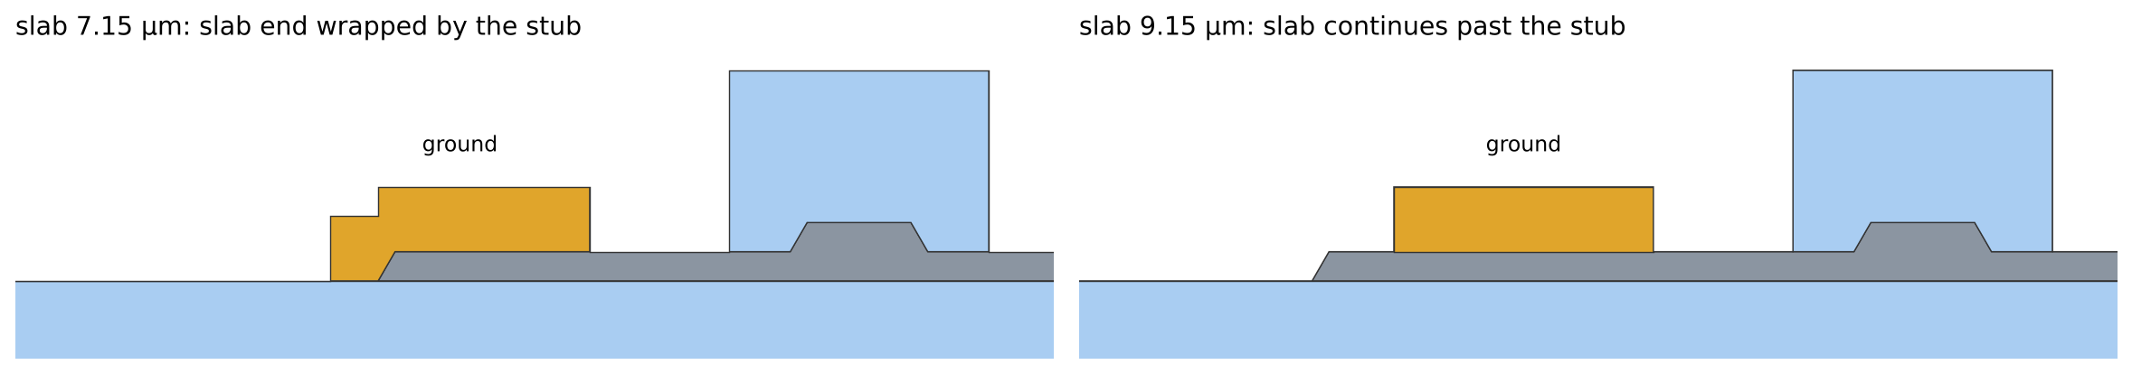
Inside of tee: a second ripple from 8.15 µm
The stub is fixed (2 µm); the slab end moves with the slab width
Below 8.15 µm
Stub wraps the slab end: both sides alike, curves 1 and 2 coincide
From 8.15 µm
Ground cavity frozen at the stub width: constant ≈ 0.01–0.015 dB/cm
Only the signal side still ripples: peaks ≈ halved, troughs raised

Slide 7
Vπ·L: flat with slab width, two small offsets
Per arm, 1310 nm
Inside vs outside of tee: +1.8 %
1.937 vs 1.903 V·cm. The small 0.5 µm stub collects fewer field lines than the full 2 µm ground, so less field crosses the LN
Over-etch: lower Vπ·L at narrow slabs
Gold filling the recess sits beside the slab end; with a narrow slab it is close to the gap and pulls more field into the LN
−1.9 % at 5.15 µm, −0.1 % at nominal

Slide 8
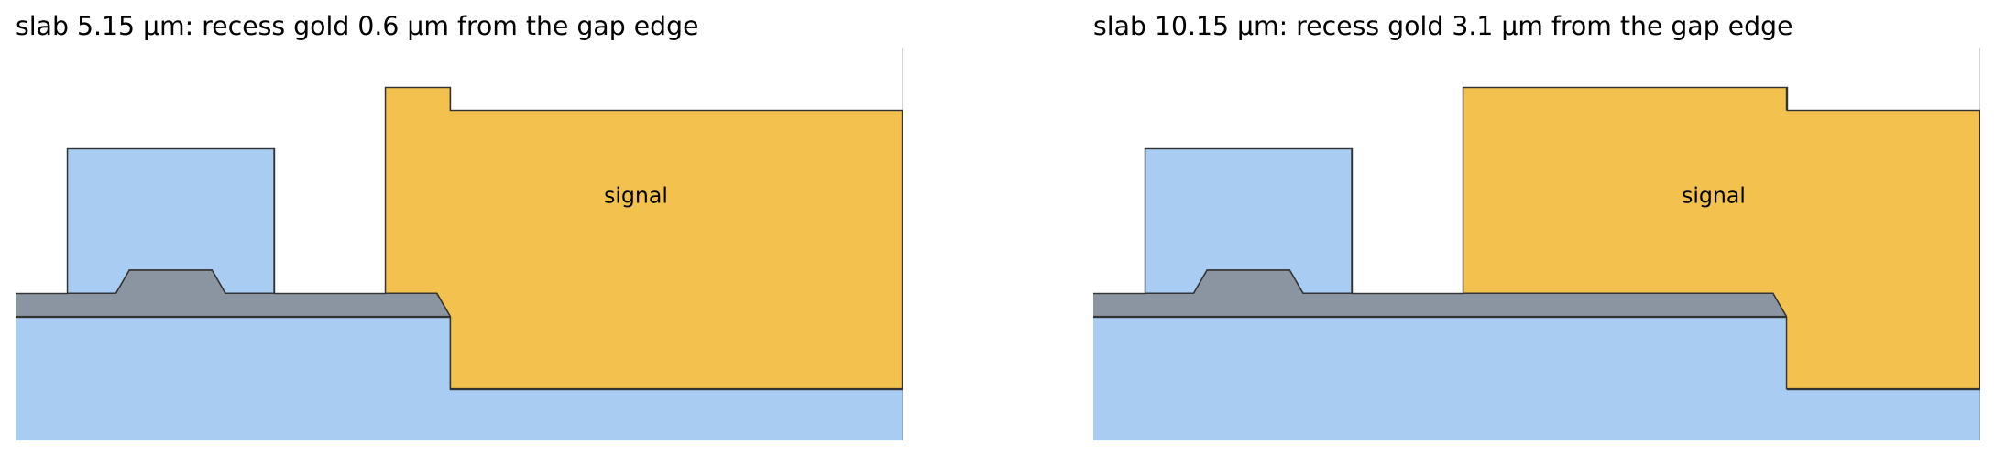
Effect of the 700 nm over-etch
Outside of tee, standard vs over-etched (inside of tee behaves the same)
Quantity | Standard | Over-etched | Change
Vπ·L at 5.15 µm (V·cm) | 1.902 | 1.866 | −1.9 %
Vπ·L at 10.15 µm (V·cm) | 1.903 | 1.900 | −0.1 %
IL at 10.15 µm (dB/cm) | 0.0274 | 0.0290 | +6 %
1st IL peak, ≈ 5.9 µm (dB/cm) | 0.206 | 0.160 | lower, broader
Peaks above 8.3 µm | – | – | within 5 %
Ripple period / peak positions | – | – | unchanged
The over-etch matters only where the slab is narrow and the recessed gold comes close to the gap.

Slide 9
Wavelength sweep 1270–1330 nm
Over-etched cross-sections (the process reality), slab 10.15 µm, 5 nm step
λ (nm) | Outside | Inside
1270 | 0.009 | 0.008
1290 | 0.014 | 0.014
1310 | 0.029 | 0.029
1330 | 0.083 | 0.077
Reading
Monotonic rise, no ripple peak inside the band
Lower flank of the peak just above 1330 nm
Inside and outside of tee coincide: the tee fill factor does not matter
IL in dB/cm; Vπ·L rises linearly, ≈ +2 % per 20 nm, in both cases.

Slide 10
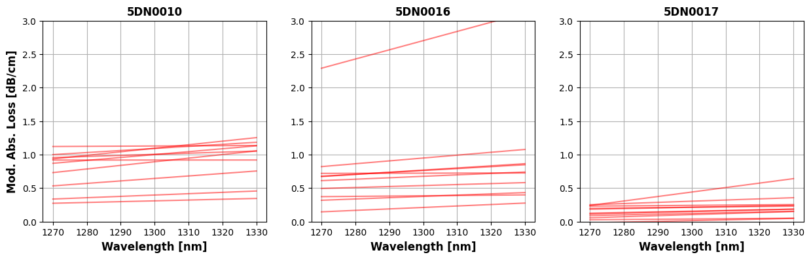
Comparison with measured data: trends
Three Danube wafers (ASML, over-etched), modulation-section absorption loss
Simulation, same 0–3 dB/cm scale
Trends agree
Smooth, slowly rising loss across 1270–1330 nm, no visible ripple peak, as in every measured chip
Absolute values are not compared: wafer-to-wafer spread (up to ×10) is set by process variations

Slide 11
Conclusions
1
The standing wave is present in all four Danube cross-sections: period ≈ 1.3 µm of slab width at 1310 nm
2
Tee and over-etch do not move the ripple; they only change peak heights
3
Inside of tee, from 8.15 µm the slab passes the stub: fixed ground cavity + signal ripple
4
Vπ·L ≈ 1.90 V·cm (outside) and 1.94 V·cm (inside of tee); the over-etch lowers it only at narrow slabs
5
Nominal slab: 0.03 dB/cm at 1310 nm, rising smoothly to 0.08 dB/cm at 1330 nm
6
The wavelength trend agrees with the measured wafers

