Slide 1
ALD alumina protection layer:
Cordoba vs buffered Lisbon lifted
Effect on Vπ·L and insertion loss, gap relaxation and robustness at λ = 1575 nm

Slide 2
What we studied
A thin alumina film covers every exposed surface after the electrodes are made
The layer
ALD Al₂O₃, conformal on all surfaces
Nominal 40 nm, swept 0 → 100 nm
Optical index 1.74
RF permittivity 9.8
Cordoba
Gold directly on the LN slab
Electrode gap 4.2 µm
Reference: 0.43 dB/cm, 2.17 V·cm
Lisbon lifted, buffered
Gold on a 200 nm SiO₂ buffer
Bottom gap 3.4 µm
Reference: 0.03 dB/cm, 2.17 V·cm
Common settings: 1575 nm, 550 nm LN film with 275 nm etch, rib top width 1.4 µm, SiO₂ cap 2.0 × 1.4 µm, full LN slab (no slab etch).
Questions: how much does the layer lower Vπ·L, how much loss does it add, and can it let us widen the Lisbon gap?

Slide 3
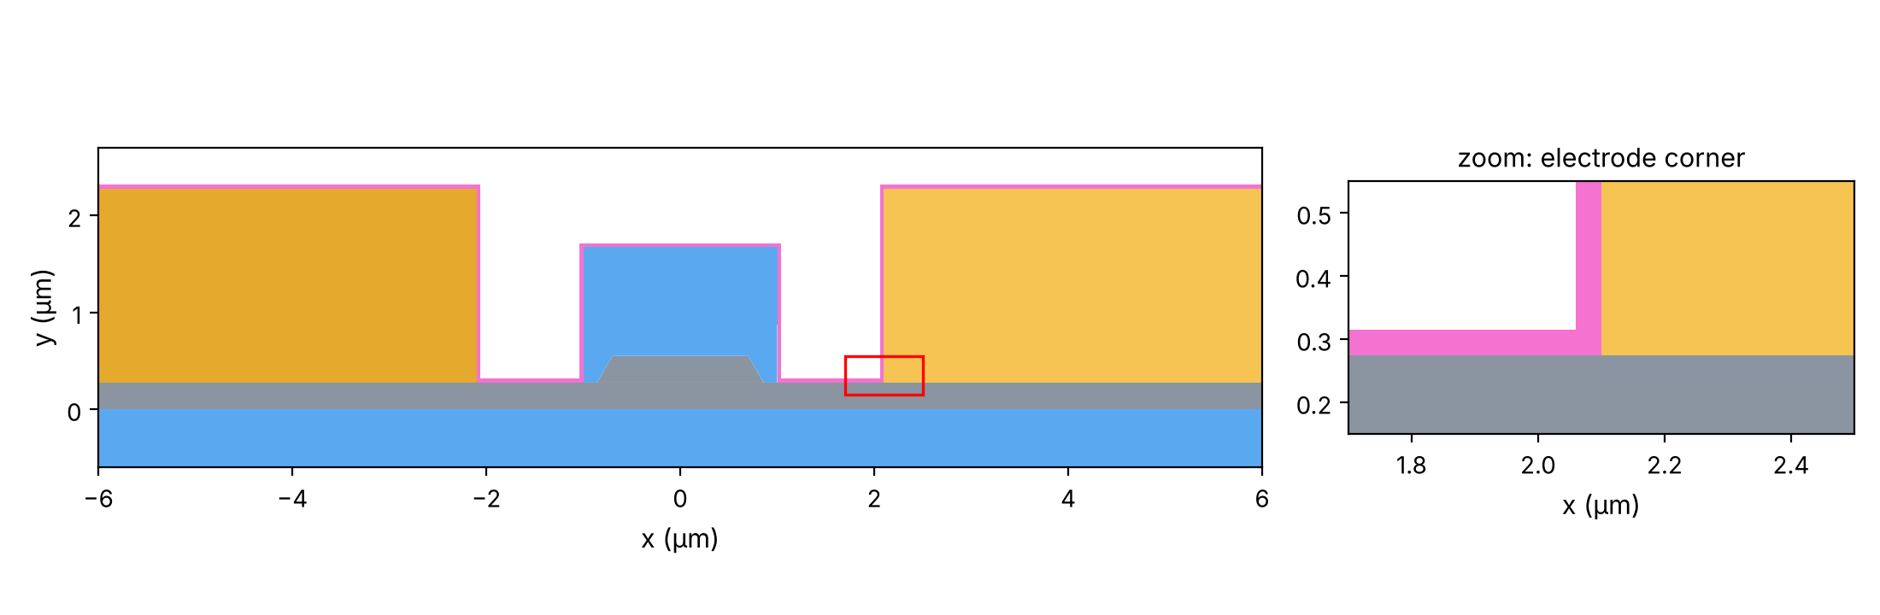
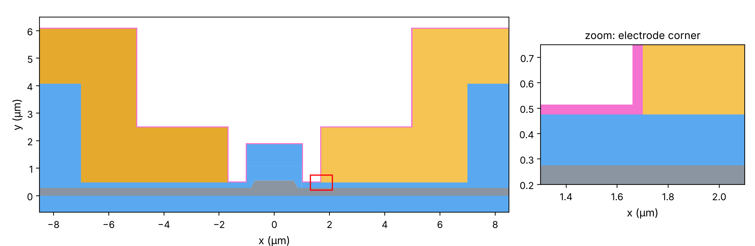
The two cross-sections with 40 nm of alumina
Alumina in pink; the red box marks the zoomed electrode corner
Cordoba
Legend
Gold: electrodes
Grey: lithium niobate
Blue: SiO₂ (box, cap, buffer, lift)
Pink: ALD alumina
Lisbon lifted with 200 nm SiO₂ buffer

Slide 4
Cordoba: lower Vπ·L, but twice the loss at 40 nm
Gap 4.2 µm
−3 %
×2.2
Vπ·L at 40 nm: 2.174 → 2.109 V·cm
loss at 40 nm: 0.43 → 0.93 dB/cm
Notes:
Validated against COMSOL: the Vpi*L change matches point by point; the IL increase factor matches within about 3 %. Absolute IL differs by a nearly constant ~25 % ratio (gold model or metal mesh in COMSOL).

Slide 5
Lisbon buffered: larger Vπ·L gain, very low loss
Bottom gap 3.4 µm
−5.4 %
0.055 dB/cm
Vπ·L at 40 nm: 2.175 → 2.058 V·cm
loss at 40 nm: still 8× below bare Cordoba

Slide 6
Side by side: same trend, different strength
Each curve is measured from its own design without alumina
Same starting Vπ·L (2.17 V·cm), but Lisbon gains almost twice as much.
Loss grows by a similar factor in both, yet Lisbon stays about 15 times lower.

Slide 7
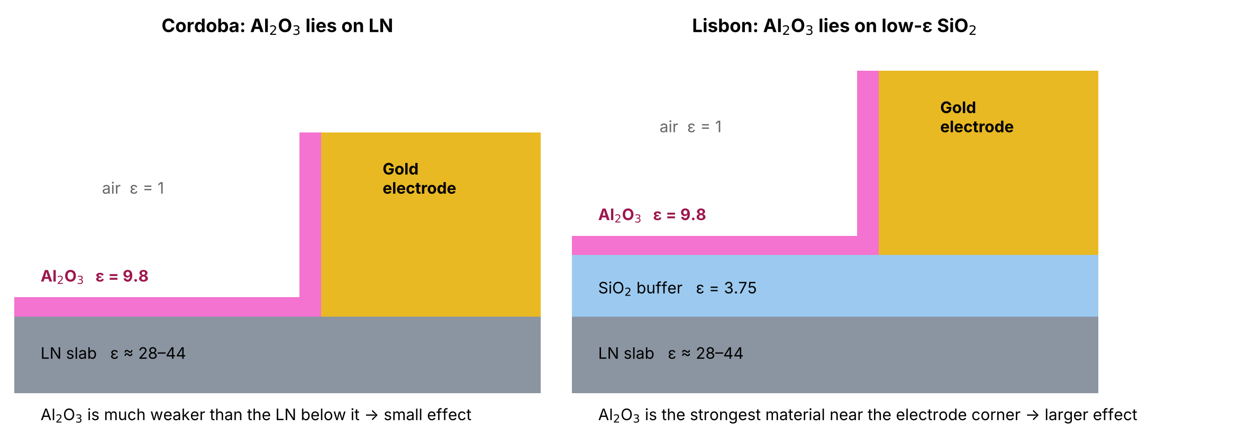
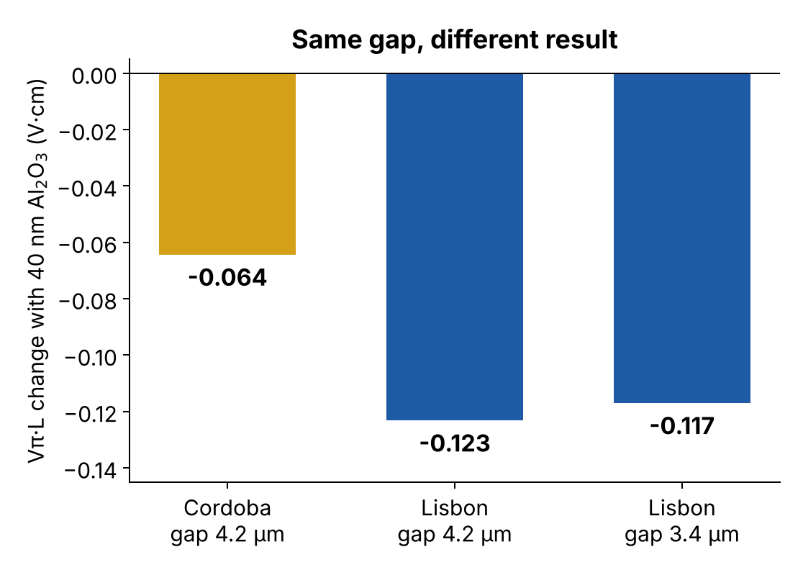
Why Lisbon gains more: what the alumina sits on
Simplified drawing, not to scale
In Cordoba, the electric field already prefers the LN, which is far more polarisable than alumina.
In Lisbon, alumina is the most polarisable material at the electrode level: it acts like a small extension of the electrode toward the waveguide.
Test at the same 4.2 µm gap: Lisbon still gains twice as much. The buffer, not the narrower gap, causes the difference.

Slide 8
Is it the mesh? No
The 40 nm cases were repeated with a much finer mesh
Case (40 nm alumina) | Mesh refinement | Vπ·L change | Loss change
Lisbon, gap 3.4 µm | 30 % finer everywhere | +0.01 % | −0.8 %
Lisbon, gap 3.4 µm | 5 elements across the alumina (instead of 3) | < 0.01 % | −0.2 %
Lisbon, gap 4.2 µm | 30 % finer everywhere | +0.01 % | −0.8 %
Cordoba, gap 4.2 µm | 30 % finer everywhere | +0.02 % | −0.6 %
Cordoba, gap 4.2 µm | 5 elements across the alumina (instead of 3) | 0.00 % | +0.03 %
0.05 V·cm
Lisbon–Cordoba difference at 40 nm: about 100× larger than any mesh effect

Slide 9
Gap relaxation: from 3.4 µm to 3.6 µm
Target: Vπ·L of Lisbon without alumina at 3.4 µm (2.175 V·cm, the same as Cordoba)
3.60 µm
0.029 dB/cm
+0.58 V·cm/µm
relaxed gap with 40 nm alumina
loss at 3.60 µm: 15× below Cordoba
Vπ·L cost of widening the gap
Notes:
The 0.12 V*cm gained from the alumina buys only about 0.2 um of gap, because Vpi*L rises steeply with the gap. Loss is never the limit: it falls with the gap and is below 0.001 dB/cm at 4.8 um.

Slide 10
Robustness: alumina thickness ±10 nm
Gap fixed at 3.60 µm, designed for 40 nm
Alumina thickness | Vπ·L (V·cm) | Change | Insertion loss (dB/cm)
30 nm (-10 nm) | 2.200 | +1.1 % | 0.025
40 nm (nominal) | 2.175 | +0.0 % | 0.029
50 nm (+10 nm) | 2.152 | -1.1 % | 0.033
A ±10 nm error moves Vπ·L by only about ±1 %.
This equals a gap error of about 40 nm: gap lithography matters more than alumina control.
Loss stays between 0.025 and 0.033 dB/cm, far below Cordoba's 0.43 dB/cm.

Slide 11
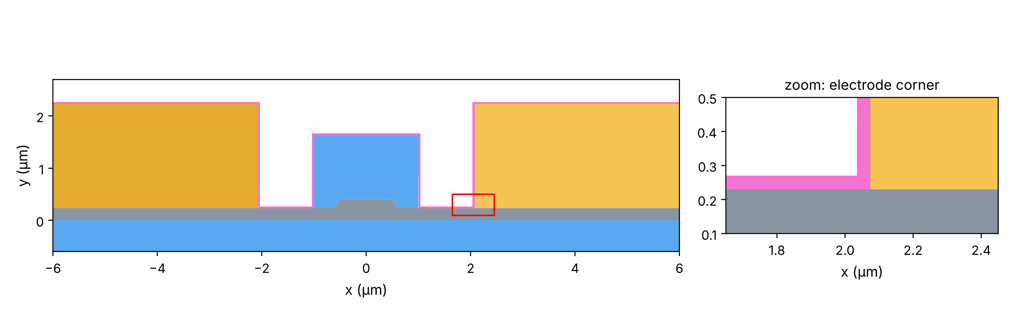
Jerez V0 in the O band: same alumina, new design
Non-lifted Cordoba-type electrodes, unetched slab, λ = 1310 nm
Jerez V0
LN film 400 nm, rib etch 170 nm
Rib top 1.0 µm (single mode)
Gap 4.15 µm, gold 2 µm on the slab
No buffer, no slab etch, no over-etch
SiO₂ cap 2.0 × 1.4 µm
Alumina placed as for Cordoba
n 1.74, RF permittivity 9.8, swept 0 → 100 nm
Mesh converged at 1310 nm: IL within 0.6 %, Vπ·L within 0.01 %

Slide 12
Jerez V0: lower Vπ·L, almost 3× the loss at 40 nm
Gap 4.15 µm, 1310 nm
−2.9 %
×2.7
Vπ·L at 40 nm: 1.788 → 1.736 V·cm
loss at 40 nm: 0.10 → 0.27 dB/cm

Slide 13
Jerez V0 vs Cordoba
Each curve is measured from its own design without alumina
At 40 nm | Jerez V0 | Cordoba
Loss without alumina | 0.10 dB/cm | 0.43 dB/cm
Loss with 40 nm | 0.27 dB/cm | 0.93 dB/cm
Vπ·L change | −2.9 % | −3.0 %

Slide 14
Optical group index: how it is computed
Same 2D FEM mode solver, three wavelengths on one fixed mesh
Method
n_g = n_eff − λ · dn_eff/dλ, central difference
Solves at λ₀ and λ₀ ± 1 nm (and ± 2 nm as a check)
One mesh for all wavelengths: discretisation errors cancel
All materials dispersive: LN (Zelmon), SiO₂ (Malitson), Au (Johnson & Christy), ALD Al₂O₃ (Sellmeier)
Checks
± 1 nm and ± 2 nm agree to all 5 decimals
Light and fine meshes give the same n_g
ALD Al₂O₃ optical index
No published ALD Sellmeier: fitted to ellipsometry of 20 nm ALD films (Zhukovsky et al., PRL 115, 177402, 2015)
n² = 1 + 1.5977 λ² / (λ² − 0.010751), λ in µm
Error < 4·10⁻⁴ over 0.35–1.69 µm
n = 1.614 at 1575 nm, 1.615 at 1310 nm
The earlier value n = 1.74 is closer to crystalline alumina; the Sellmeier fit is used for the conclusions

Slide 15
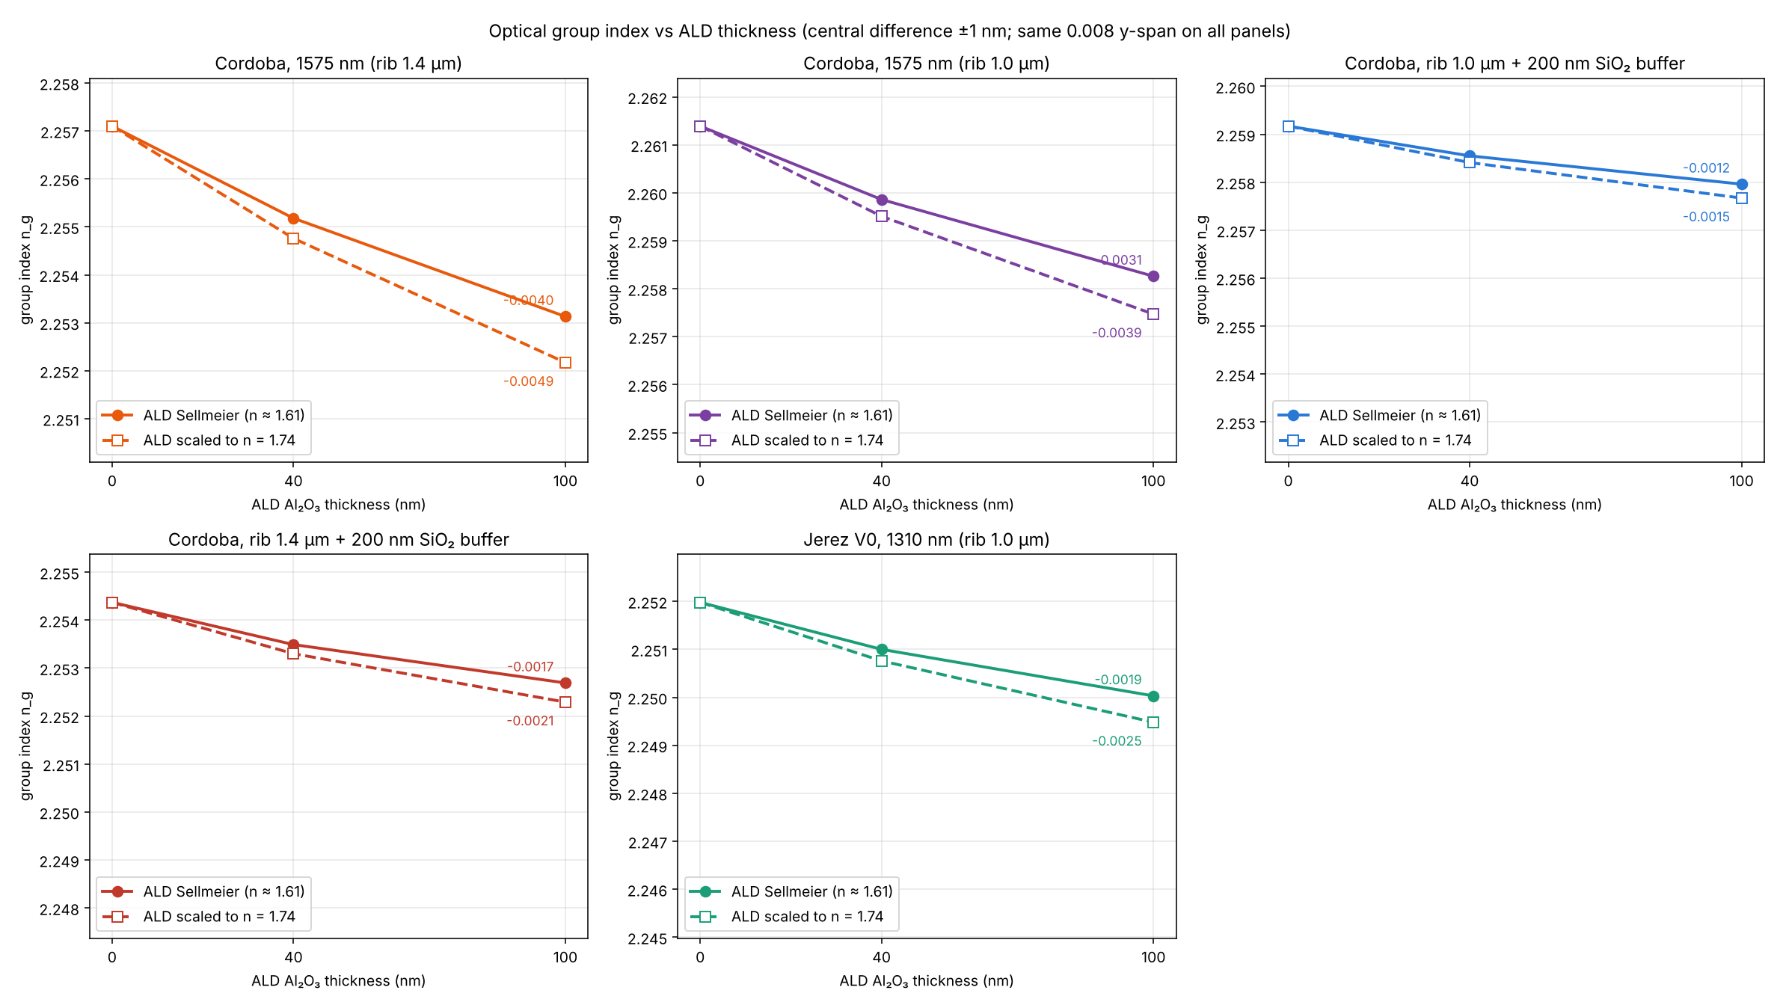
Group index vs ALD thickness
Five cross-sections; solid: ALD Sellmeier, dashed: ALD scaled to n = 1.74
ALD lowers n_g by at most 0.005 (0.2 %) at 100 nm; with the buffer the drop is 2–3× smaller.

Slide 16
Cordoba at 1575 nm: rib width, buffer and ALD
ALD Sellmeier; gap 4.15 µm, 540/270 nm, unetched slab
Rib top (µm) | SiO₂ buffer (nm) | ALD (nm) | n_eff | n_g
1.0 | 0 | 0 | 1.879241 | 2.26139
1.0 | 0 | 40 | 1.879575 | 2.25986
1.0 | 200 | 0 | 1.879685 | 2.25917
1.0 | 200 | 40 | 1.879783 | 2.25855
1.4 | 0 | 0 | 1.899858 | 2.25710
1.4 | 0 | 40 | 1.900467 | 2.25518
1.4 | 200 | 0 | 1.900633 | 2.25437
1.4 | 200 | 40 | 1.900814 | 2.25349
Reading
Rib width matters most: 1.0 → 1.4 µm lowers n_g by ≈ 0.004–0.005
Buffer alone: −0.002 to −0.003
40 nm ALD: −0.0006 to −0.0019
Higher n_eff, lower n_g?
The wider rib confines the mode more: n_eff falls less steeply with λ (−0.227 vs −0.243 µm⁻¹), so its −λ·dn/dλ term is 0.025 smaller
All Cordoba cases lie within 2.252–2.261: < 0.5 %. ALD and buffer do not affect the optical side of velocity matching.

Slide 17
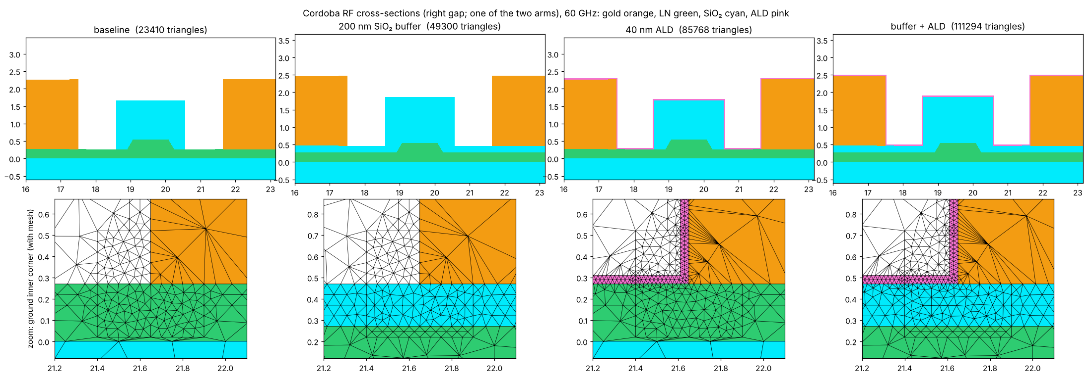
RF study at 60 GHz: Cordoba push-pull
Full GSG cross-section, both arms, rib 1.0 µm, cap 2.0 × 1.4 µm
Model
Signal 35 µm, gap 4.15 µm, grounds 49.85 µm, gold 2 µm, Si 550 µm
n_m, Z0 from the full-wave mode; R′ and L_int from the current inside the gold (volumetric, no IBC)
Layers, drawn as in the optical models
Buffer: 200 nm SiO₂ (ε 3.9) under the gold and across the gaps
ALD: 40 nm conformal Al₂O₃, ε 9.8

Slide 18
RF figures of merit: buffer and ALD
60 GHz, lateral padding 200 µm; changes vs baseline
Case | n_m | Z0 (Ω) | α (dB/cm) | Δn_m | ΔZ0 | Δα
Baseline | 2.0121 | 35.97 | 5.364 | – | – | –
SiO₂ buffer | 1.9366 | 37.37 | 5.164 | -3.75 % | +3.87 % | -3.73 %
ALD 40 nm | 2.0257 | 35.74 | 5.398 | +0.68 % | -0.64 % | +0.64 %
Buffer + ALD | 1.9557 | 37.02 | 5.213 | -2.80 % | +2.90 % | -2.82 %
Why
Buffer: low-ε SiO₂ between gold and LN (ε 28–44) where the RF field is strongest → C drops: n_m ↓, Z0 ↑; R′ unchanged, so α = R′/2Z0 ↓
ALD: ε 9.8 replaces air in the gaps → C slightly up, opposite and ≈ 5× smaller
Same changes at 800 µm padding (within 0.1 %)
Buffer + ALD: n_m −2.8 %, Z0 +2.9 %, α −2.8 %

Slide 19
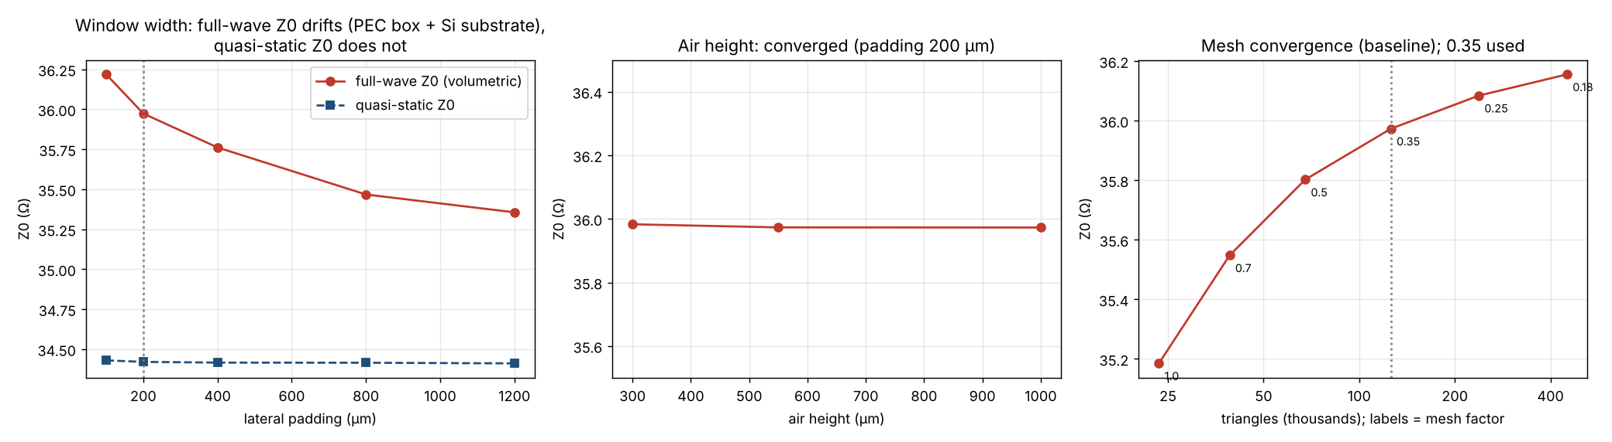
RF study: window, mesh and ALD loss
Absolute values depend on the closed simulation box; the buffer / ALD changes do not
−2.4 %
≤ 0.5 %
+0.074 dB/cm
full-wave Z0 from 100 to 1200 µm padding
(quasi-static: ±0.03 %)
mesh error at the chosen setting
(factor 0.35, 126k triangles)
ALD loss at a pessimistic tan δ = 0.05
(1.4 % of α): lossless is a fair assumption

Slide 20
Conclusions
Alumina lowers Vπ·L in both designs: by 3 % in Cordoba and 5.4 % in Lisbon at 40 nm
The difference is physical: the buffer makes the alumina more effective; the mesh is not the cause
Loss is not a concern for Lisbon: below 0.06 dB/cm at 3.4 µm, below 0.03 dB/cm at 3.6 µm
The gap gain is modest: 3.4 → 3.6 µm: a wider gap is possible only by accepting a higher Vπ·L
Process tolerance is comfortable: ±10 nm of alumina changes Vπ·L by about ±1 %

Slide 21
Conclusions: group index and RF
Group index:
40 nm ALD ≤ 0.1 %, buffer ≈ 0.1 %, rib 1.0 → 1.4 µm 0.2 %: all negligible
Velocity matching:
Optical side unaffected by ALD and buffer; RF n_m moves from 2.01 to 1.96 with buffer + ALD
RF impedance and loss:
Buffer: Z0 +3.9 %, α −3.7 %; ALD: Z0 −0.6 %, α +0.6 %; together Z0 +2.9 %, α −2.8 %
ALD at RF:
Thin film: even tan δ = 0.05 adds only 1.4 % to α
Numerics:
Use the % changes; absolute RF values need absorbing boundaries to be window-independent

