Slide 1
Lifted-electrode TFLN modulator:
optical loss, Vπ·L and the lift-position resonance
femwell / scikit-fem eigenmode study at λ = 1575 nm
Notes:
Summary deck of the femwell simulations of the lifted-electrode geometry: set-up, mesh convergence, comparison with the legacy flat-electrode design, the discovery that IL oscillates with the lift position, the physical mechanism behind it, and design implications.

Slide 2
Summary
Vπ·L of the lifted design is 2.265 V·cm, identical to the legacy flat design at the same 4.2 µm gap (2.260 V·cm): lifting does not affect the electro-optic efficiency.
Optical IL is NOT a single number: it oscillates with the position where the gold leaves the LN slab (x_lift), with a period of 0.90 µm, between 0.18 and 0.88 dB/cm around the nominal design.
Mechanism: with bare gold on the slab the rib mode is leaky. It feeds a surface wave under the gold; the lift step reflects it, turning the gold-on-slab strip into a lossy resonator side-coupled to the rib.
Proven three independent ways: standing wave in the field (period 0.89 µm), strip eigenmode crossing the rib index at every IL peak, and 1.7× mesh refinement changing peak and dip by < 1 %.
The nominal design (x_lift = 7.0 µm) sits 0.1 µm from a dip and 0.3 µm from a peak: ±0.2 µm of lithography error spans 0.18–0.60 dB/cm. Averaged over one period IL = 0.41 dB/cm, i.e. the legacy value.
Far from the rib (x_lift ≥ 24 µm) IL converges to 0.41–0.42 dB/cm, the legacy no-lift result.
Key numbers (gap 4.2 µm)
Vπ·L 2.265 V·cm
IL, nominal x_lift = 7.0 0.22 dB/cm
IL range 6.5–11 µm 0.18 – 0.88
IL, legacy (no lift) 0.42 dB/cm
Ripple / IL period 0.90 µm
Bottom line
The lift does not reduce the loss on average; it makes the loss resonant and extremely sensitive to the lift position. A 0.22 dB/cm design value is not a robust prediction.
Notes:
All values from femwell N1xP1 vector FEM, 8-10 modes around n=1.8755, mesh converged to about +/-3 % on IL and 0.1 % on Vpi*L.

Slide 3
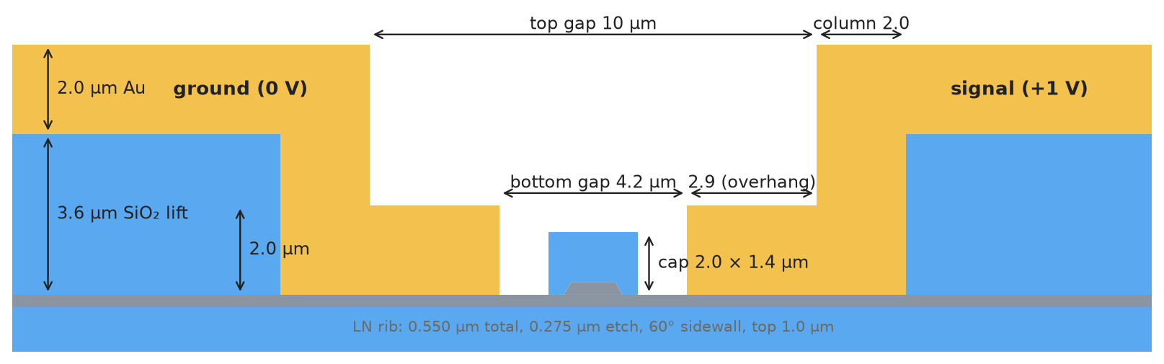
Lifted-electrode geometry
Each electrode is one fused gold body: lower block on the slab, 2 µm column, pad lifted on 3.6 µm SiO₂
Parameters
λ = 1575 nm, TE fundamental mode
LN: 550 nm total, 275 nm etch, 60° sidewall, rib top 1.0 µm
SiO₂ cap 2.0 × 1.4 µm on the rib
Bottom gap 4.2 µm (lower blocks directly on the LN slab)
Top gap 10 µm, column 2.0 µm → overhang 2.9 µm
Au 2.0 µm thick; pad on 3.6 µm SiO₂ buffer
Electrode width 30 µm (gap edge to pad end); BOX 4.7 µm
x_lift = GAP_TOP/2 + COL_W: where the gold leaves the slab (7.0 µm nominal)
How to move the lift in cell 0: GAP_TOP = 2·(x_lift − COL_W). Everything else (lower block, column, pad, buffer, skins, corners) follows automatically. Maximum x_lift ≈ 30 µm (the 30 µm electrode needs some pad).
Notes:
Geometry built with shapely, meshed with gmsh through femwell mesh_from_OrderedDict. All regions tile the domain exactly (assertions on validity, overlap, tiling, resolution/polygon parity).

Slide 4
Simulation method and figures of merit
Optical eigenproblem
Full-vector FEM, Nédélec N1 × Lagrange P1 elements (femwell / scikit-fem), anisotropic LN (nₑ, nₒ) and lossy gold
ARPACK shift-invert around n = 1.8755; fundamental TE mode picked by TE fraction, core power and unipolarity
Gold: ε = −120.7 − 11.9 j; nₑ = 2.1368, nₒ = 2.2103, n(SiO₂) = 1.4387
Electrostatics
Anisotropic Laplace (ε_DC LN = 28 / 44), whole electrode body pinned (volumetric Dirichlet), 1 V bias
Figures of merit
Γ = (g/V) ∫ E_x,DC |E_x,opt|² dA / ∫ |E_x,opt|² dA (over LN)
Vπ·L = g λ₀ / (2 nₑ³ r₃₃ Γ), r₃₃ = 30.8 pm/V
IL [dB/cm] = 20 log₁₀(e) · k₀ · |Im(n_eff)| / 100
Loss bookkeeping check
The ohmic absorption ∫ Im(ε)|E|² dA over the gold, divided by |Im(n_eff)|, is the same constant (7.54–7.55 × 10⁸) in every run: IL is entirely gold absorption, and the absorbed-power maps shown later are quantitatively consistent with IL.
Runtime
Production mesh: 74 k triangles, ≈ 80 s for a 10-mode search on the full notebook (cells 0–5).
Timing on the cloud machine reproduces the reference notebook to within 2 % (46 s vs 47 s), so timings transfer to the workstation.
Notes:
IL uses exp(+j w t) convention, Im(eps_Au) < 0 is the physical loss. Quadrature for the P0 permittivity basis set to intorder=4 so the N1xP1 forms are fully integrated.

Slide 5
Meshing: a femwell bug and its fix
The resolution dictionary did not describe the mesh that was actually built
mesh_from_OrderedDict() intends to switch off gmsh's “extend mesh size from boundary”, but writes
gmsh.model.mesh.MeshSizeExtendFromBoundary = 0
which only sets a Python attribute: the gmsh option is never changed.
Consequence: every fine region leaks its size deep into its neighbours.
Past notebooks were still converged, but on a much finer mesh than the dictionary says.
Fix (now at the top of cell 0): wrap setAsBackgroundMesh and apply gmsh.option.setNumber("Mesh.MeshSizeExtendFromBoundary", 0) (plus FromPoints / FromCurvature).
All resolutions re-converged with the fix in place. Do not paste the fix into older notebooks without re-converging them.
Region | Nominal | Actual (bug) | Actual (fixed)
LN slab near gap | 50 nm | 17 nm | 43 nm
Air in the gap | 80 nm | 20 nm | 67 nm
Electrode bulk | 800 nm | 18 nm | 59 nm
12 nm gold skin: total mesh | — | 122 k tri | 62 k tri
Why it matters here
With the gold directly on LN, the surface wave decays into the gold over ≈ 22 nm and the gold skin needs 12 nm elements along the whole lower block. Without the fix this alone doubles the mesh; with it the full model fits the 90 s budget.
Notes:
Median element sizes measured per region from the actual gmsh output, femwell as-is vs patched.

Slide 6
Mesh convergence
Every refinement test against a 265 k-triangle reference; production mesh 74 k triangles
Test (production mesh unless stated) | IL [dB/cm] | Change | Vπ·L [V·cm]
Reference: all regions near the mode ×1.5–2 finer (265 k) | 0.2218 | — | 2.2659
Production mesh (74 k, ≈ 80 s / 10 modes) | 0.2216 | −0.1 % | 2.2647
Gold skin 12 → 10 nm | 0.2270 | +2.4 % | 2.2647
Corner patches 50 → 100 nm | 0.2205 | −0.5 % | 2.2650
Fine slab extended 8 → 10 µm | 0.2206 | −0.5 % | 2.2647
Slab beyond it 110 → 50 nm | 0.2217 | +0.05 % | 2.2647
Dip (x_lift 6.9), 1.7× finer mesh | 0.1807 → 0.1801 | −0.3 % | —
Peak (x_lift 7.3), 1.7× finer mesh | 0.8827 → 0.8892 | +0.7 % | —
Old settings, femwell bug, 25 nm skin (66 k) | 0.1984 | −10.6 % | 2.2598
Converged settings
Gold skin 12 nm, uniform along the whole lower block (70 nm shell)
6 nm patches at the two slab-contact corners of each block (field singularity)
LN slab 25 nm up to 1 µm past the lift; BOX 40 nm in the top 0.5 µm
Accuracy
Vπ·L: ≈ 0.1 %
IL: ≈ ±3 %; the gold skin is the last parameter still moving
The resonance shape (peak/dip values) is mesh-independent to < 1 %
Notes:
The residual skin sensitivity is consistent with the resonance: the skin mesh sets the surface-wave phase, i.e. slides the resonance slightly.

Slide 7
First result: lifted vs legacy flat electrodes
Same cross-section near the rib; the only difference is where the gold leaves the slab
Configuration | Gap | IL [dB/cm] | Vπ·L [V·cm]
Legacy flat, cap 2.0 µm (reference notebook) | 4.15 µm | 0.4945 | 2.2296
Legacy flat, same notebook, gap changed | 4.20 µm | 0.4202 | 2.2604
Legacy flat, gold skin 25 → 12 nm | 4.15 µm | 0.4911 | 2.2316
Lifted, x_lift = 7.0 µm (nominal) | 4.20 µm | 0.2216 | 2.2647
Where does the legacy loss go?
Absorbed power in the gold, binned by distance from the gap edge (legacy, gap 4.15):
0 – 5 µm 61.6 %
5 – 10 µm 23.8 %
10 – 20 µm 12.6 %
> 20 µm, bulk 2.3 %
38 % of the loss is deposited more than 5 µm out. An evanescent tail cannot do that: the mode is leaky and the loss is carried outward by a wave under the gold.
50 nm of gap is worth 15 % of IL: the rib couples to the gold by tunnelling, exponentially in distance. The fair comparison is 0.42 vs 0.22 dB/cm, both at 4.2 µm.
Vπ·L agrees to 0.2 %: the lift is electrically irrelevant.
The legacy result is itself mesh-converged (−0.7 % at 12 nm skin).
The lifted IL is about half of the legacy value. Physical, or a mesh artefact? The next slides answer.
Notes:
The gold/LN surface wave has an index (about 2.26 on bulk LN, about 2.08 on the 275 nm slab) above the rib index 1.883, so the rib mode can leak into it laterally.

Slide 8
IL vs lift position
0.1 µm steps from 6.5 to 11.0 µm plus far points; legacy no-lift value for reference
What the sweep shows
Regular oscillation, period 0.90 µm
Peaks: 0.883 → 0.782 → 0.708 → 0.650 → 0.607 (7.3, 8.2, 9.1, 10.0, 10.9 µm)
Dips: 0.181 → 0.207 → 0.231 → 0.253 → 0.272 (6.9, 7.8, 8.6, 9.5, 10.4 µm)
Damped: the swing shrinks as the strip gets longer; from 24 µm on IL is 0.41–0.42
Vπ·L 2.2647–2.2649 V·cm at every point
Nominal 7.0 µm sits on the rising edge just past the first dip
Notes:
Data: results/lift_sweep.csv on branch VPI-CODE. Points 12.1-30.1 are sparse and do not resolve the oscillation; they show the convergence of the mean value.

Slide 9
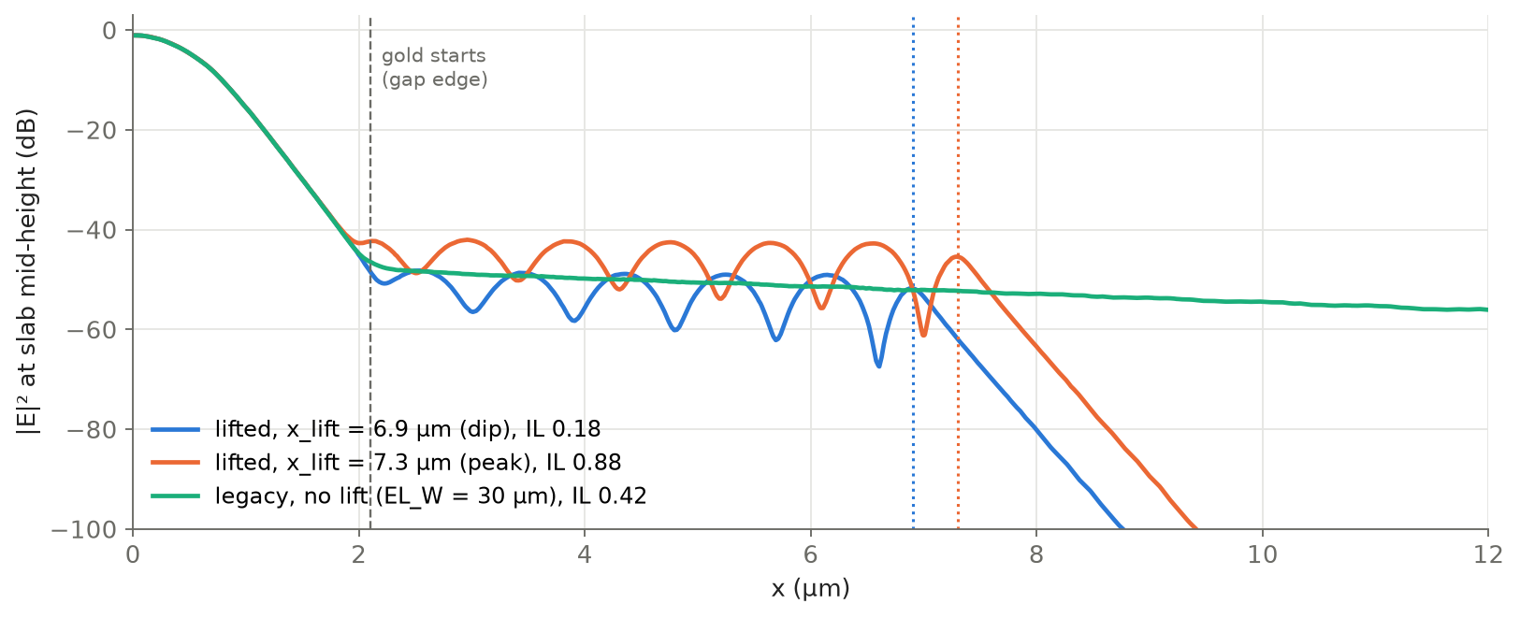
Evidence 1: a standing wave under the gold
|E|² along the LN slab at mid-height, same dB reference for all three cases
Reading the plot
0–2 µm: evanescent tail of the rib mode, identical in all cases
Legacy (green): smooth, slowly decaying curve: a pure travelling wave carried outward and absorbed
Lifted (blue, orange): regular ripples all along the gold, then clean decay under the oxide past the lift
Ripple period 0.888–0.901 µm at every x_lift (6.9–9.1 µm) and on the finer mesh: equal to the IL period
Peak case plateau ≈ 7 dB above the dip case: ≈ 5× intensity ⇔ 0.88 / 0.18 = 4.9× IL
Notes:
Ripples in |E|^2 come from the superposition of the outgoing surface wave and the wave reflected at the lift step. Their spacing is pi/k_x.

Slide 10
Evidence 2: strip modes cross the rib index at every peak
x_lift [µm] | IL [dB/cm] | Nearest strip-mode index | Distance from rib (1.8834)
6.9 (dip) | 0.181 | 1.8502 / 1.9200 | −0.033 / +0.037
7.3 (peak) | 0.883 | 1.8831 | −0.0003
7.7 (dip) | 0.208 | 1.8475 / 1.9094 | −0.036 / +0.026
8.1 | 0.596 | 1.8768 | −0.0066
9.0 | 0.585 | 1.8780 | −0.0054
9.1 (peak) | 0.708 | 1.8836 | +0.0002
Mesh artefact excluded
Dip and peak recomputed with a 1.7× finer mesh (skin 8 nm, corners 4 nm, slab 18 nm, core 30 nm):
6.9 µm: 0.1807 → 0.1801
7.3 µm: 0.8827 → 0.8892
Ripple period unchanged (0.888 / 0.891 µm). An artefact would move with the mesh; the resonance does not.
Rib mode itself unchanged everywhere: Re(n_eff) = 1.88339, core power 36.7 %.
The solver also returns the lossy eigenmodes of the gold-on-slab strip itself (TE fraction ≈ 10 %, core power ≈ 0, Im(n) ≈ −0.01).
IL peaks exactly where one strip mode lands on the rib index: the two hybridise and the rib borrows the strip's loss. At the dips the strip modes sit on either side.
100 nm of lift moves the strip mode by ≈ 0.006 in index; this is why 9.0 µm (0.585) and 9.1 µm (0.708) differ.
Notes:
Strip modes are listed from the 10-mode search at each x_lift; the two quasi-degenerate entries are the signal and ground electrode strips.

Slide 11
Mechanism: a leaky resonator beside the rib
Why a short strip can absorb more than a long one
No lift: leaked power travels outward once and is absorbed on the way. No reflection, no build-up: a single-pass loss (0.42 dB/cm).
In phase (peak): each round trip adds to the field already in the strip. The strip fills up and pulls power out of the rib much faster than a single pass.
Out of phase (dip): the returning wave opposes the newly leaking light; the strip resists being filled and less power leaves the rib than with no lift at all.
Same physics as a ring resonator on a bus waveguide: on resonance a short lossy ring extracts far more than a straight lossy section of the same length.
lift step (x_lift)
rib + cap
① leak: rib → surface wave under the gold (tunnelling across the gap) ② wave travels out, absorbed in the gold ③ partial reflection at the lift step
Phase condition
Along z the surface wave must match the rib: β = k₀·1.8834. Its lateral wavenumber is k_x = k₀·√(n_strip² − 1.8834²).
Outgoing + reflected waves give |E|² ripples with period π/k_x; each extra π/k_x of strip adds one ripple and restores the round-trip phase: IL period = ripple period.
0.90 µm ⇒ n_strip ≈ 2.08 (below 2.26 for gold on bulk LN, as expected for a 275 nm slab). Set by materials and thicknesses, independent of x_lift.
Notes:
The ripple amplitude is not fixed: it is set by the resonant build-up. What the lift changes is the round-trip phase (strip length), not the ripple period.

Slide 12
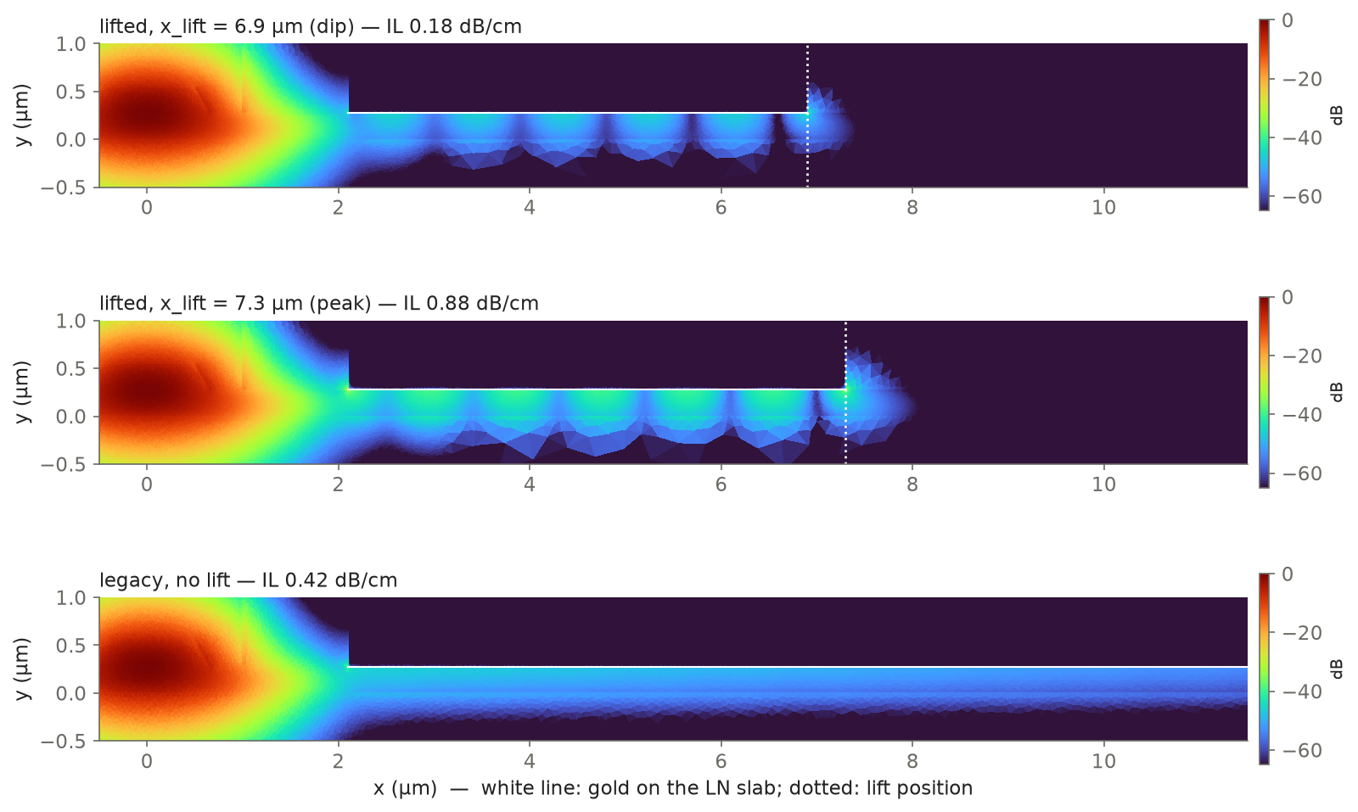
Field maps: dip, peak and legacy (no lift)
|E|², common dB reference for the three cases
Observations
Rib mode identical in all three (same colour scale near x = 0)
Peak: band under the gold visibly brighter along the whole strip, brightest near the lift step
Dip: same ripple pattern, markedly dimmer
Legacy: uniform band slowly fading with x, no ripples: travelling wave
Past the lift the field decays quickly under the SiO₂: no power escapes laterally in the slab
Notes:
Legacy case is the reference notebook geometry (flat 2 um electrodes, EL_W = 30 um) at gap 4.2 um.

Slide 13
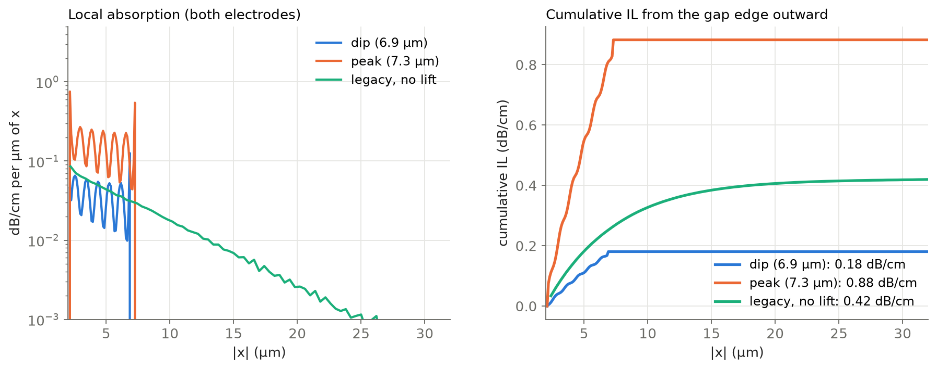
Where the loss is deposited
Absorbed power Im(ε)|E|² in the gold, binned along x and scaled to dB/cm (both electrodes)
Case | IL | within 7 µm of rib
Dip 6.9 µm | 0.181 | 0.181 (100 %)
Peak 7.3 µm | 0.883 | 0.815 (92 %)
Legacy no lift | 0.420 | 0.255 (61 %)
Over the same 2–7 µm of gold the peak case absorbs 3.2× more than the legacy line, and the dip case 30 % less: the difference is the intensity of the resonant field, not the length of gold.
Legacy: exponential decay of the local absorption (straight line on the log scale), 0.85 dB/µm: a travelling wave absorbed as it goes; 39 % of the loss beyond 7 µm.
The absorbed-power integral matches IL through the same constant in every case, so this map is a quantitative picture of the insertion loss.
Notes:
Bins: 0.1 um for the lifted cases, 0.4 um for the legacy case (coarser gold mesh far from the gap).

Slide 14
Far lift vs no lift: the discontinuity never fully disappears
Lifted design | IL [dB/cm]
x_lift = 24.1 µm | 0.4180
x_lift = 28.1 µm | 0.4157
x_lift = 29.65 µm | 0.4179
x_lift = 30.1 µm | 0.4086
Legacy flat (gap 4.2) | IL [dB/cm]
EL_W = 15 µm | 0.4063
EL_W = 15.45 µm | 0.4245
EL_W = 30 µm | 0.4201
EL_W = 35 µm | 0.4203
EL_W = 35.45 µm | 0.4214
Why ripples only at the far end of a long strip
With the lift at 30.1 µm, the forward wave has decayed by the time it reaches the step. The reflected wave is a fixed fraction of that weak wave and decays again on the way back.
Near the step, forward and reflected waves are comparable: visible ripples. Closer to the rib the forward wave dominates: no visible ripples.
The legacy line (no lift) shows no ripples anywhere, so it is the correct travelling-wave reference used in the plots of this deck.
Any end of the gold-on-slab contact is a discontinuity that reflects the surface wave: the lift step, and also the outer end of a flat electrode.
The reflected wave must travel back to the rib, and it is absorbed on the way: the interference term decays as exp(−2·α·L).
Legacy: ±2 % swing at 15 µm (half a period apart), < ±0.2 % at 30–35 µm. Electrode length no longer matters there.
Lifted design: 29.65 vs 30.1 µm (half a period apart) still gives 0.418 vs 0.409 dB/cm, a ±1.1 % swing, ≈ 7× the legacy residual. The lift step is a stronger reflector than the end of a flat electrode: a lifted line is not equivalent to a no-lift line, even at 30 µm.
Notes:
Half-period pairs isolate the interference term: lifted 29.65/30.1 um differ by 2.3 % (peak-to-peak), legacy 35/35.45 um by 0.26 %. The 30.1 um vs legacy gap (0.409 vs 0.420) is mostly this residual interference; the rest is within the +/-3 % IL uncertainty (different mesh set-up, column/buffer at the end of the lifted electrode).

Slide 15
Design implications
Tolerance
Around the nominal 7.0 µm, ±0.2 µm of lift position spans 0.18–0.60 dB/cm; ±0.3 µm reaches the 0.88 dB/cm peak.
Anything that shifts the surface-wave phase moves the resonance: gold permittivity, slab thickness, sidewall angles, corner rounding, overhang.
Averages
Mean IL over one period around the design (6.8–7.6 µm): 0.41 dB/cm ≈ legacy 0.42 dB/cm. Lifting does not reduce the loss on average; it redistributes it.
A real lift edge with a few hundred nm of roughness or drift along the device would tend to average toward this value (reasoning, not simulated: the model is 2D and z-invariant).
Options
Keep the lift and target a dip deliberately, only if the lift position can be controlled to ≪ 0.2 µm and the material data are trusted.
Decouple the gold from the slab (SiO₂ buffer under the whole lower block): removes the leaky channel at its origin.
Or place the lift far out (≥ 20 µm), where the interference swing is small.
Robust numbers
Vπ·L = 2.265 V·cm
IL oscillation period 0.90 µm
Period-average IL ≈ 0.41 dB/cm
Not robust
The exact position of peaks and dips (depends on material data and fabrication details at the 100 nm level).
Any single-x_lift IL value near the rib, including the nominal 0.22 dB/cm.
Notes:
Period average: mean of the nine points 6.8-7.6 um = 0.407 dB/cm.

Slide 16
Conclusions and next steps
Conclusions
The lifted-electrode geometry has the same Vπ·L as the legacy design (2.265 V·cm).
Its optical loss oscillates with the lift position (period 0.90 µm, 0.18–0.88 dB/cm near the design) and converges to the legacy 0.42 dB/cm far out.
Cause: leaky coupling of the rib mode into a surface wave under the gold, resonantly enhanced or suppressed by the reflection at the lift step. Confirmed by the field, the eigenmode spectrum and mesh refinement.
The mesh set-up was re-converged after fixing a femwell size-field bug; IL ±3 %, Vπ·L 0.1 %.
Next steps
Independent check: COMSOL at x_lift = 6.9 and 7.3 µm (expected ≈ 0.18 and ≈ 0.88 dB/cm).
Sensitivity of the resonance position to gold permittivity and slab thickness.
Buffered lower block (SiO₂ under the whole electrode) as a robust low-loss alternative.
Measurement: devices with lifts stepped by ≈ 0.2 µm around 7 µm would test the prediction directly.
Files (branch VPI-CODE)
cells/cell0_lifted.py: geometry, mesh (with femwell fix)
cells/cell1_lifted.py, cell5_lifted.py: electrostatics plots, dB mode map
results/lift_sweep.csv: full IL / n_eff / Vπ·L sweep
results/*.png: field cuts, maps, absorption plots
Notes:
All simulations are 2D cross-sections; the lift is assumed perfectly straight and uniform along the propagation direction.

