Slide 1
RF impact of the Al₂O₃ (ALD) layer:
CORDOBA, JEREZ and HELSINKI comparison
4 wafers · 52 chips measured before and after ALD · median per-chip change of n_{m}, Z₀, α, S₂₁

Slide 2
Samples and values before ALD
Same extraction and figures of merit for all wafers; medians over chips, no ALD
Design | Wafer | Line | Chips | n_{m} @ 60 GHz | Z₀ (Ω) | α @ 30 GHz (dB/cm) | α @ 60 GHz (dB/cm)
CORDOBA | 4CA0162 | 8 mm | 15 | 2.251 | 42.13 | 4.27 | 5.94
CORDOBA | 4CA0163 | 8 mm | 14 | 2.263 | 41.70 | 4.08 | 5.81
JEREZ | 6JZ0011 | 8 mm | 15 | 2.243 | 42.83 | 3.72 | 5.40
HELSINKI | 5HK0005 | 13 mm | 8 | 2.274 | 42.64 | 3.41 | 4.70
Notes
Z₀: Re Z_{c} averaged over whole pad-ripple periods (10–42.8 GHz for 8 mm, 10–41.5 GHz for 13 mm).
4CA0163 chip 04 excluded (bad ALD measurement). ALD thickness and process of JEREZ and HELSINKI not documented here.

Slide 3
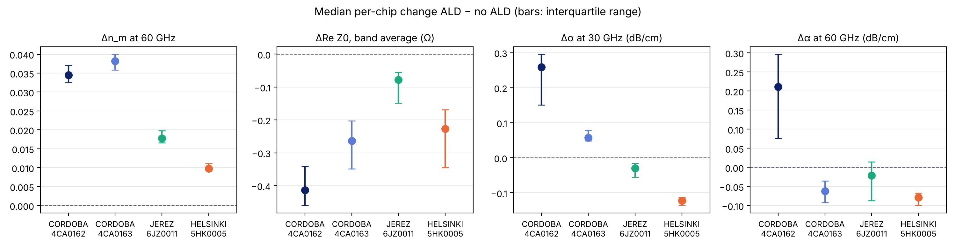
Change after ALD
Median per-chip change; chips up = chips with a higher value after ALD
Wafer | Δn_{m} @ 60 GHz | ΔZ₀ (Ω) | Δα @ 30 GHz | Δα @ 60 GHz | Δ|S₂₁| @ 30 GHz
CORDOBA 4CA0162 | +0.034 (15/15) | -0.41 (0/15) | +0.259 (15/15) | +0.211 (14/15) | -0.201 dB (0/15)
CORDOBA 4CA0163 | +0.038 (14/14) | -0.26 (0/14) | +0.058 (14/14) | -0.062 (1/14) | -0.039 dB (1/14)
JEREZ 6JZ0011 | +0.018 (15/15) | -0.08 (2/15) | -0.030 (0/15) | -0.021 (5/15) | +0.029 dB (15/15)
HELSINKI 5HK0005 | +0.010 (8/8) | -0.23 (0/8) | -0.122 (0/8) | -0.079 (0/8) | +0.160 dB (8/8)

Slide 4
Conclusions
n_{m} ↑
Z₀ ↓
α: open
+0.4 to +1.7 % at 60 GHz, every chip of every wafer
−0.2 to −1.0 % (median), every wafer
Direction differs between designs and between fit and measured S₂₁
Established
ALD adds capacitance: n_{m} increases and Z₀ decreases on all four wafers.
Size of the n_{m} increase depends on the design: CORDOBA +0.035 / +0.038, JEREZ +0.018, HELSINKI +0.010.
Open: attenuation
Fitted α at 60 GHz is sensitive to fit and data noise; the change is of the order of its uncertainty.
Band-averaged measured S₂₁ does not confirm the fitted direction on every wafer (JEREZ).

