Slide 1
ALD alumina protection layer:
Cordoba vs buffered Lisbon lifted
Effect on Vπ·L and insertion loss, gap relaxation and robustness at λ = 1575 nm

Slide 2
What we studied
A thin alumina film covers every exposed surface after the electrodes are made
The layer
ALD Al₂O₃, conformal on all surfaces
Nominal 40 nm, swept 0 → 100 nm
Optical index 1.74
RF permittivity 9.8
Cordoba
Gold directly on the LN slab
Electrode gap 4.2 µm
Reference: 0.43 dB/cm, 2.17 V·cm
Lisbon lifted, buffered
Gold on a 200 nm SiO₂ buffer
Bottom gap 3.4 µm
Reference: 0.03 dB/cm, 2.17 V·cm
Common settings: 1575 nm, 550 nm LN film with 275 nm etch, rib top width 1.4 µm, SiO₂ cap 2.0 × 1.4 µm, full LN slab (no slab etch).
Questions: how much does the layer lower Vπ·L, how much loss does it add, and can it let us widen the Lisbon gap?

Slide 3
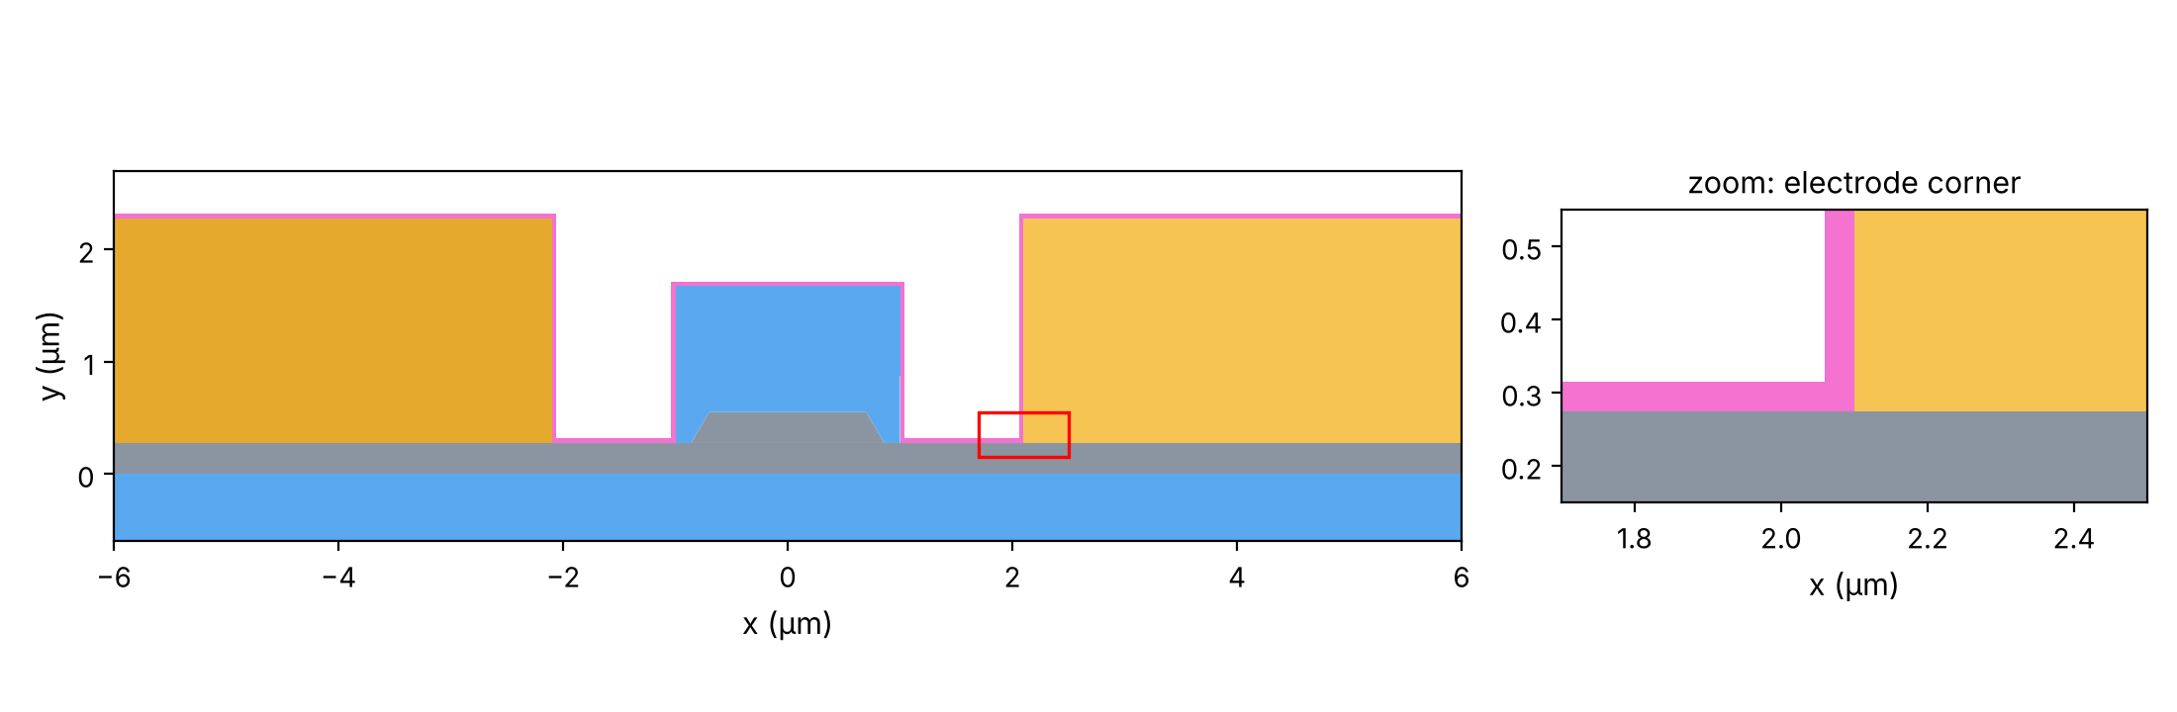
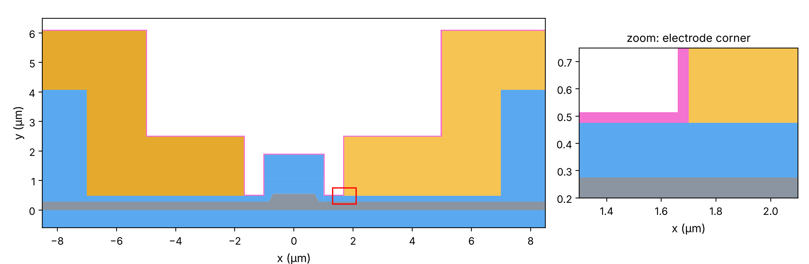
The two cross-sections with 40 nm of alumina
Alumina in pink; the red box marks the zoomed electrode corner
Cordoba
Legend
Gold: electrodes
Grey: lithium niobate
Blue: SiO₂ (box, cap, buffer, lift)
Pink: ALD alumina
Lisbon lifted with 200 nm SiO₂ buffer

Slide 4
Cordoba: lower Vπ·L, but twice the loss at 40 nm
Gap 4.2 µm
−3 %
×2.2
Vπ·L at 40 nm: 2.174 → 2.109 V·cm
loss at 40 nm: 0.43 → 0.93 dB/cm
Notes:
Validated against COMSOL: the Vpi*L change matches point by point; the IL increase factor matches within about 3 %. Absolute IL differs by a nearly constant ~25 % ratio (gold model or metal mesh in COMSOL).

Slide 5
Lisbon buffered: larger Vπ·L gain, very low loss
Bottom gap 3.4 µm
−5.4 %
0.055 dB/cm
Vπ·L at 40 nm: 2.175 → 2.058 V·cm
loss at 40 nm: still 8× below bare Cordoba

Slide 6
Side by side: same trend, different strength
Each curve is measured from its own design without alumina
Same starting Vπ·L (2.17 V·cm), but Lisbon gains almost twice as much.
Loss grows by a similar factor in both, yet Lisbon stays about 15 times lower.

Slide 7
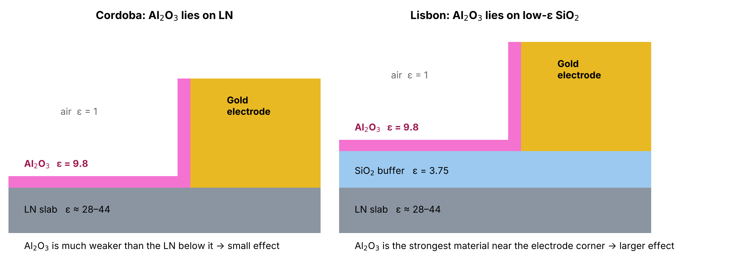
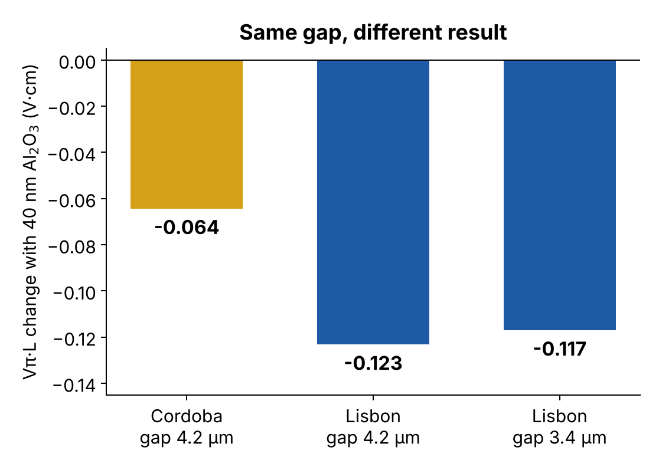
Why Lisbon gains more: what the alumina sits on
Simplified drawing, not to scale
In Cordoba, the electric field already prefers the LN, which is far more polarisable than alumina.
In Lisbon, alumina is the most polarisable material at the electrode level: it acts like a small extension of the electrode toward the waveguide.
Test at the same 4.2 µm gap: Lisbon still gains twice as much. The buffer, not the narrower gap, causes the difference.

Slide 8
Is it the mesh? No
The 40 nm cases were repeated with a much finer mesh
Case (40 nm alumina) | Mesh refinement | Vπ·L change | Loss change
Lisbon, gap 3.4 µm | 30 % finer everywhere | +0.01 % | −0.8 %
Lisbon, gap 3.4 µm | 5 elements across the alumina (instead of 3) | < 0.01 % | −0.2 %
Lisbon, gap 4.2 µm | 30 % finer everywhere | +0.01 % | −0.8 %
Cordoba, gap 4.2 µm | 30 % finer everywhere | +0.02 % | −0.6 %
Cordoba, gap 4.2 µm | 5 elements across the alumina (instead of 3) | 0.00 % | +0.03 %
0.05 V·cm
Lisbon–Cordoba difference at 40 nm: about 100× larger than any mesh effect

Slide 9
Gap relaxation: from 3.4 µm to 3.6 µm
Target: Vπ·L of Lisbon without alumina at 3.4 µm (2.175 V·cm, the same as Cordoba)
3.60 µm
0.029 dB/cm
+0.58 V·cm/µm
relaxed gap with 40 nm alumina
loss at 3.60 µm: 15× below Cordoba
Vπ·L cost of widening the gap
Notes:
The 0.12 V*cm gained from the alumina buys only about 0.2 um of gap, because Vpi*L rises steeply with the gap. Loss is never the limit: it falls with the gap and is below 0.001 dB/cm at 4.8 um.

Slide 10
Robustness: alumina thickness ±10 nm
Gap fixed at 3.60 µm, designed for 40 nm
Alumina thickness | Vπ·L (V·cm) | Change | Insertion loss (dB/cm)
30 nm (-10 nm) | 2.200 | +1.1 % | 0.025
40 nm (nominal) | 2.175 | +0.0 % | 0.029
50 nm (+10 nm) | 2.152 | -1.1 % | 0.033
A ±10 nm error moves Vπ·L by only about ±1 %.
This equals a gap error of about 40 nm: gap lithography matters more than alumina control.
Loss stays between 0.025 and 0.033 dB/cm, far below Cordoba's 0.43 dB/cm.

Slide 11
Conclusions
Alumina lowers Vπ·L in both designs: by 3 % in Cordoba and 5.4 % in Lisbon at 40 nm
The difference is physical: the buffer makes the alumina more effective; the mesh is not the cause
Loss is not a concern for Lisbon: below 0.06 dB/cm at 3.4 µm, below 0.03 dB/cm at 3.6 µm
The gap gain is modest: 3.4 → 3.6 µm: a wider gap is possible only by accepting a higher Vπ·L
Process tolerance is comfortable: ±10 nm of alumina changes Vπ·L by about ±1 %

