Slide 1
Electrode bends: a designed bend line
Validated 2D reference, analytical line model, inverse design, and what the bends do to EO bandwidth and eye
TW-MZM modelling toolkit · 5NK0050 line, 16.5 mm modulating length, push-pull
Notes:
Follow-up to the bends-in-INTERCONNECT talk. There, a bend was a line with a fixed impedance, a fixed index and a fitted loss. Here the bend becomes a cross-section that we compute, validate and design: the loss, index and impedance come from its geometry at every frequency, the geometry is chosen by an inverse design, and the result goes straight into the device response and the eye.

Slide 2
Roadmap
0
1
2
3
Modulating section vs bend
2D FEM reference
Analytical line model
Inverse design
4
5
6
Bends in the device
Sensitivities
What is left
Notes:
Seven steps. 0: why the bend is a different line from the modulating section. 1: the 2D FEM reference, why the impedance boundary condition was replaced and how the reference was checked. 2: the analytical model and its agreement with the reference. 3: the inverse design (red), the core of the work: impedance matching, loss, and the delay the bend must provide. 4: the bends in the device, EO bandwidth and eye, and the GUI. 5: how the figures of merit move with each parameter. 6: what the 2D model cannot see, and what to do next.

Slide 3
Key results
≤ 0.8 %
+8 % / -13 %
42.31 Ω
analytical model vs 2D FEM reference
IBC: converged limit / practical mesh
designed bend, matched to the line
α; n_m ≤ 0.25 %, |Zc| ≤ 0.18 %; 33 geometries, 1–200 GHz
loss from the current inside the gold instead
S 40 · W 4.92 · Wg 60 µm, Au 2 µm
61.2 GHz
+1.5 GHz
−3.4 GHz
EO bandwidth, 2 bends
walk-off compensated bend length
worst-case 3D effect, 4 bends
previous bend values: 41.7 GHz; straight: 67.6 GHz
vs plain 5 ps delay; within 0.15 GHz of the best length
slotline conversion in the 180° turn, no ground bridges
Notes:
The six numbers of the talk. Top left: the analytical model agrees with the validated 2D FEM reference to better than 1 % on the loss and 0.25 % on index and impedance, everywhere in the design space and at every frequency. Top middle: why the reference does not use the impedance boundary condition: its converged limit is 8 % high on the bend, and at practical corner meshes it is 6-13 % low. Top right: the designed bend, impedance-matched to the 5NK0050 line at 60 GHz. Bottom: what that buys in the device (2 bends, 16.5 mm), what the right bend length buys, and an upper bound on what the 3D turn can still take away.

Slide 4
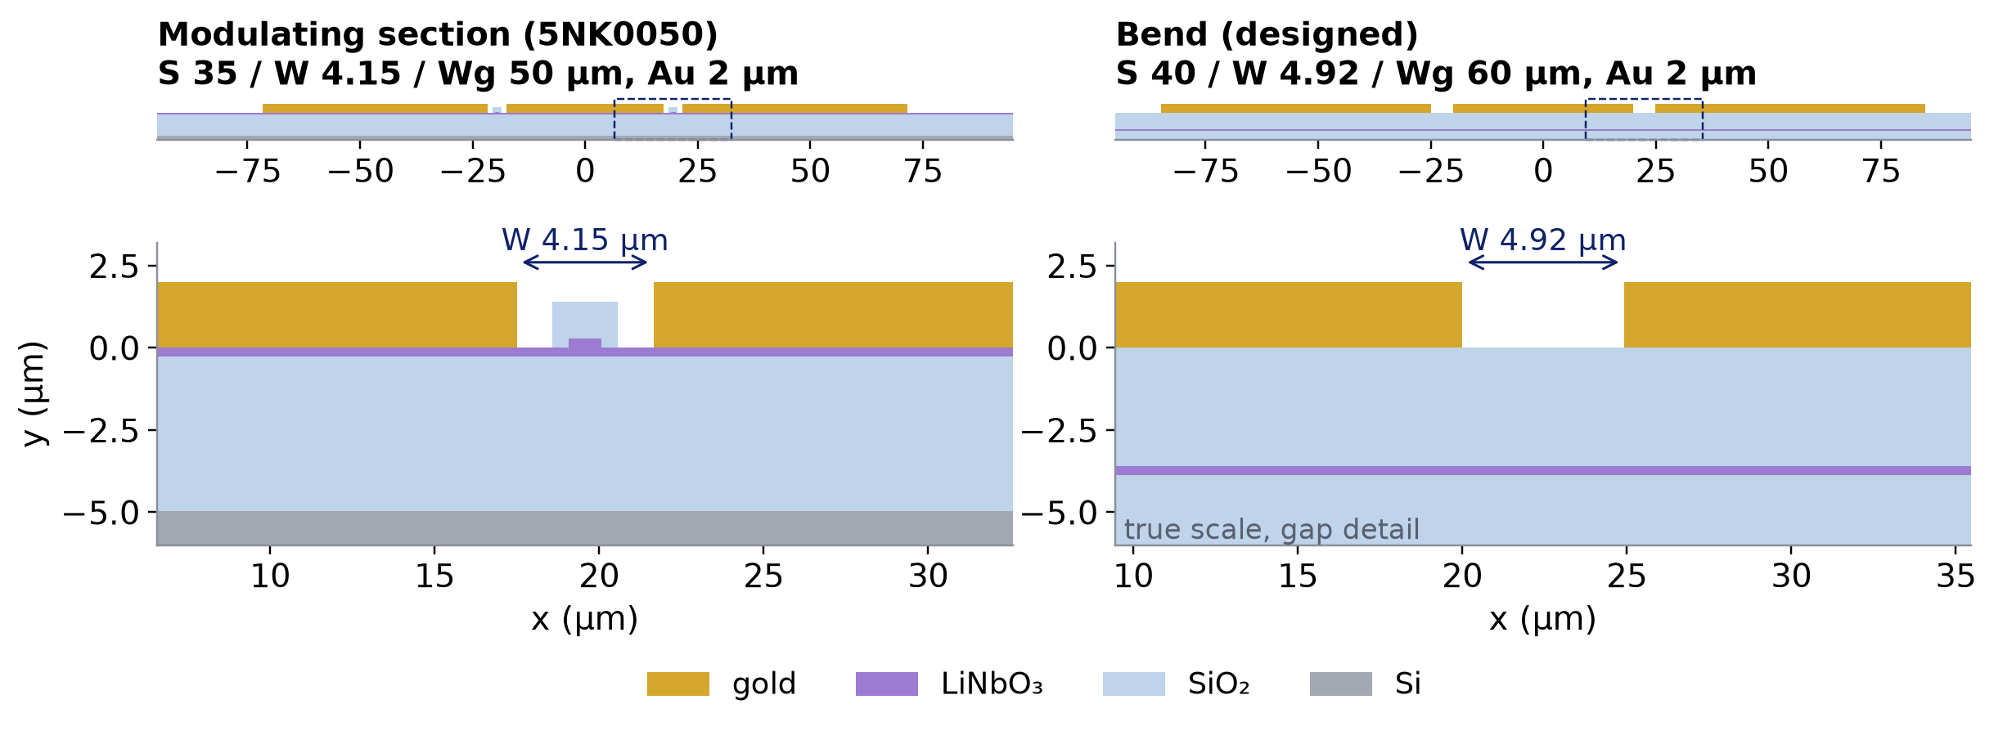
0
Modulating section vs bend
Same 2 µm gold; no ribs, electrodes on 3.6 µm SiO₂ instead of the LN slab: a different line
at 60 GHz | modulating line (5NK0050, measured) | bend (designed, model)
|Zc| | 42.31 Ω | 42.31 Ω
n_m | 2.288 | 1.728
α | 5.31 dB/cm | 4.02 dB/cm
n_m drops from 2.29 to 1.73
the RF crosses the bend faster than the light → the bend length is set by the delay it must give
same |Zc| as the line → no reflection at the bend ends
Notes:
Left: the modulating section of the 5NK0050 device, C-band 550 nm TFLN etched by 275 nm (275 nm slab): S 35 um, gap 4.15 um, Wg 50 um, 2 um gold sitting on the LN slab, with the waveguide ribs in the gaps. The table gives the measured 5NK0050 line. Right: the bend. Where the electrode turns, the waveguides are routed elsewhere: no LN ribs under the bend, the gold is still 2 um thick (same metal layer, no new mask) but sits on 3.6 um of SiO2 above the 275 nm LN slab. The zooms show the right-hand gap at true scale. With almost no LN in the field, the microwave index drops from about 2.29 to 1.73: the RF is faster than the light (n_g 2.27). So the bend is a line of its own: its length decides how long the RF takes to reach the next section, and its impedance decides whether there are reflections at both ends. The inverse design later chooses S, W, Wg so that |Zc| equals the line's.

Slide 5
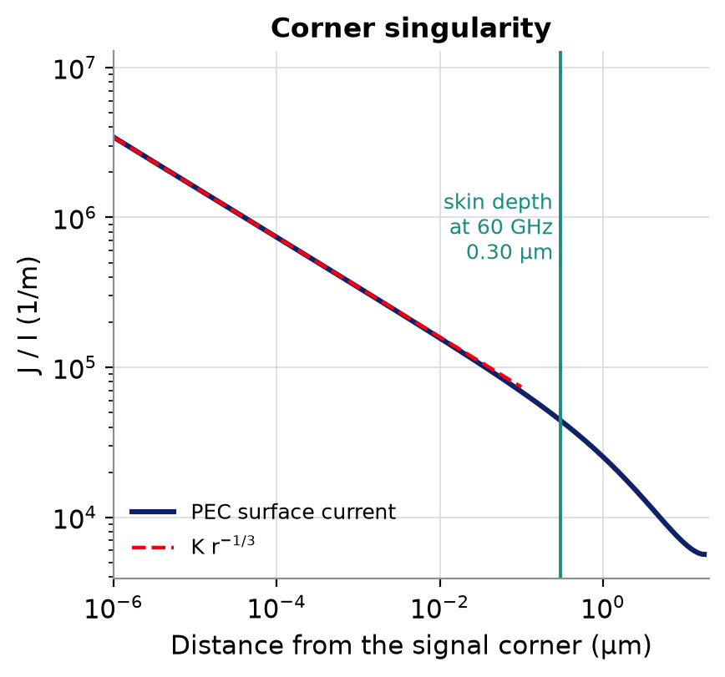
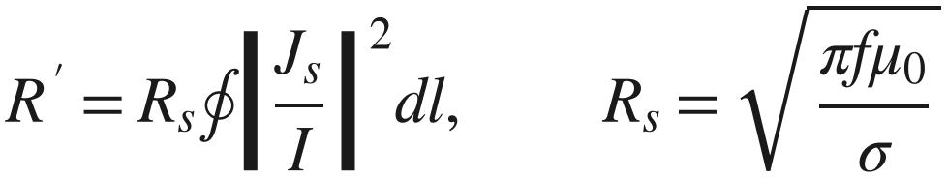
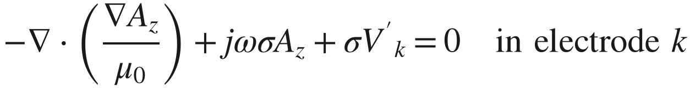
1
Conductor loss: IBC or current inside the gold
IBC (FEM notebook, COMSOL): perturbation of a perfect conductor
$$R^{′}=R_{s}∮{\left|\frac{J_{s}}{I}\right|}^{2}dl, R_{s}=\sqrt{\frac{πfμ_{0}}{σ}}$$
needs the PEC surface current: singular at every corner, J ∝ r^{−1/3}
valid only if the skin depth ≪ every dimension, corners included
Reference: the current solved inside the gold (2D, quasi-TEM)
$$−∇⋅\left(\frac{∇A_{z}}{μ_{0}}\right)+jωσA_{z}+σV_{k}^{′}=0 in electrode k$$
𝑘​𝜎 (−𝑗𝜔𝐴𝑧−𝑉𝑘′) 𝑑𝑆=𝐼𝑘, 𝑅′+𝑗𝜔𝐿′=𝑉𝑔𝑛𝑑′−𝑉𝑠𝑖𝑔′
At the corner the PEC current diverges; the real current spreads over a skin depth (0.30 µm at 60 GHz, 15 % of the gold thickness)
skin and proximity effect, DC to 200 GHz, any corner
+ FEM quasi-static C → γ = √((R'+jωL')(G+jωC)), Z_{c} = √((R'+jωL')/(G+jωC))
Notes:
Two ways to get the conductor loss. The impedance boundary condition (IBC), used in the FEM notebook and in COMSOL, solves the line with perfect conductors and then integrates the square of the surface current times the surface resistance. It is a perturbation: right when the skin depth is small compared with every feature of the conductor. At a right-angle corner the perfect-conductor current goes as r to the -1/3 (right): the integral is finite but very sensitive to the corner, and the real metal does not do that, its current spreads over a skin depth, which at 60 GHz is 15 % of the 2 um gold. The reference instead solves the longitudinal current inside the gold (magneto-quasi-static, skin and proximity effect, prescribed currents in signal and grounds): nothing is assumed about the skin depth or the corners. Displacement current in the gold and propagation along z inside the metal are dropped; both are below 1e-6. With the FEM capacitance this gives the exact line constants.

Slide 6
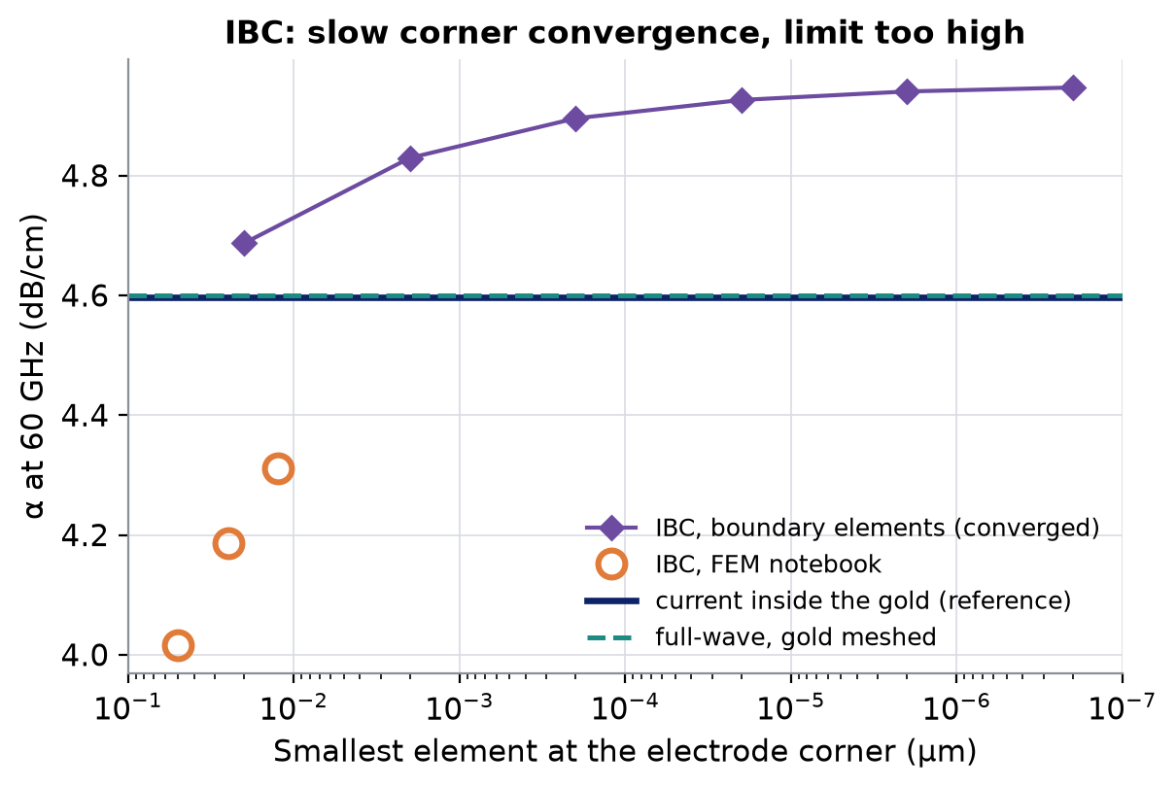
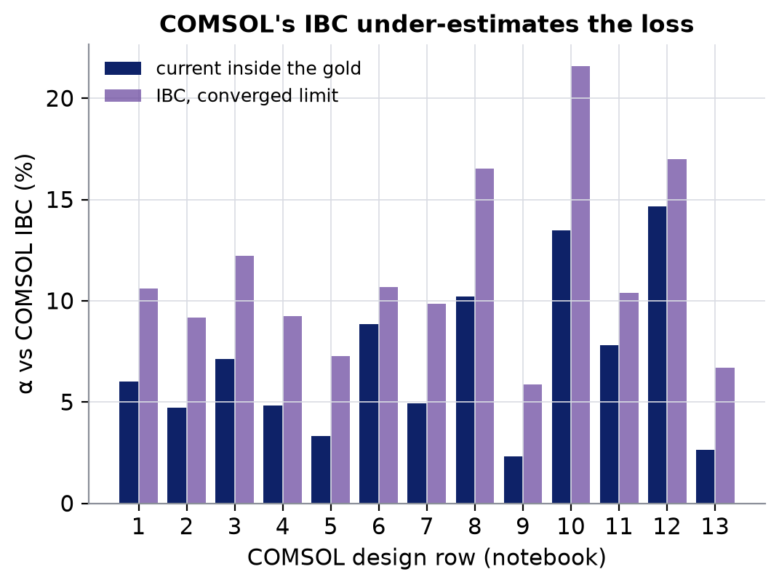
1
IBC: slow convergence, limit too high
-13 … -6 %
+7.6 %
+2 … +15 %
FEM notebook IBC, corner mesh 50 → 12.5 nm (converges as h^{1/3})
IBC converged limit (boundary elements, 1e−7 t at the corners)
13 COMSOL rows: current inside the gold vs COMSOL IBC
Notes:
Left: the attenuation of the bend at 60 GHz. Orange circles: the FEM notebook with the IBC, corner element 50, 25, 12.5 nm: each halving adds about 3 %, because the corner integral converges only as h^(1/3). At the default mesh it is 13 % low. Purple: the same IBC integral by boundary elements graded down to 1e-7 of the thickness, i.e. converged: it ends 7.6 % HIGH. Blue line: the current inside the gold; green dashed: the notebook's own full-wave mode solver with the gold meshed as a lossy dielectric (no IBC at all), which sits on the reference. So the IBC fails twice: its numerical convergence is too slow to reach, and what it converges to over-counts the corner current. At practical meshes the two errors partly cancel, which is why the notebook looked plausible. Right: the 13 COMSOL rows of the notebook: the current inside the gold gives 2-15 % more loss than COMSOL's IBC, 7 % on average. Conclusion: the reference solves the full domain, metal included.

Slide 7
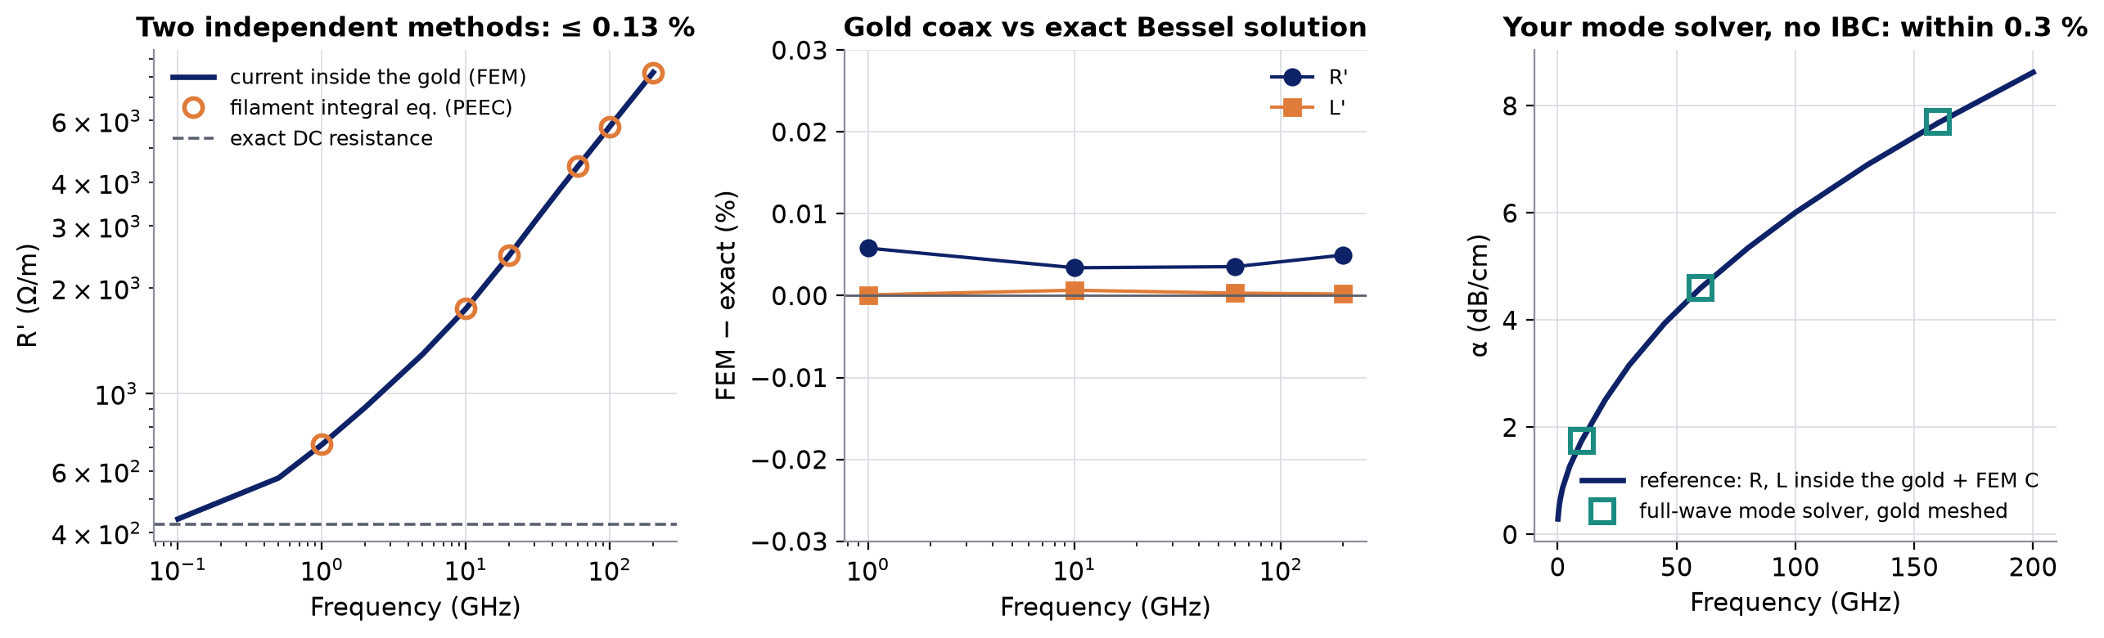
1
The reference, checked three independent ways
PEEC integral equation
Exact solution
Full-wave, gold meshed
filaments + exact mutual inductances, no mesh outside the metal: ≤ 0.13 %
gold coax vs Bessel functions: R' 0.006 %, L' 0.002 %
the notebook's vector mode solver, no IBC: -0.1 … +0.3 % on α (10/60/160 GHz)
Notes:
Why the reference can be trusted. Left: the bend's series resistance from the FEM current solve and from a completely different method, a partial-element integral equation (the method of FastHenry), which shares only the geometry and the conductivity: 0.13 % at worst from 1 to 200 GHz, and both tend to the exact DC resistance. Middle: the same solver on a gold coax, where the impedance is known exactly from Bessel functions: errors of a few thousandths of a percent, equal to the polygon area error. Right: the notebook's own full-wave vector mode solver with the gold meshed as a conductor: no quasi-static step and no IBC; it lands on the reference within 0.3 %. Capacitance: the same quasi-static FEM on a graded mesh, converged to 0.01 %.

Slide 8
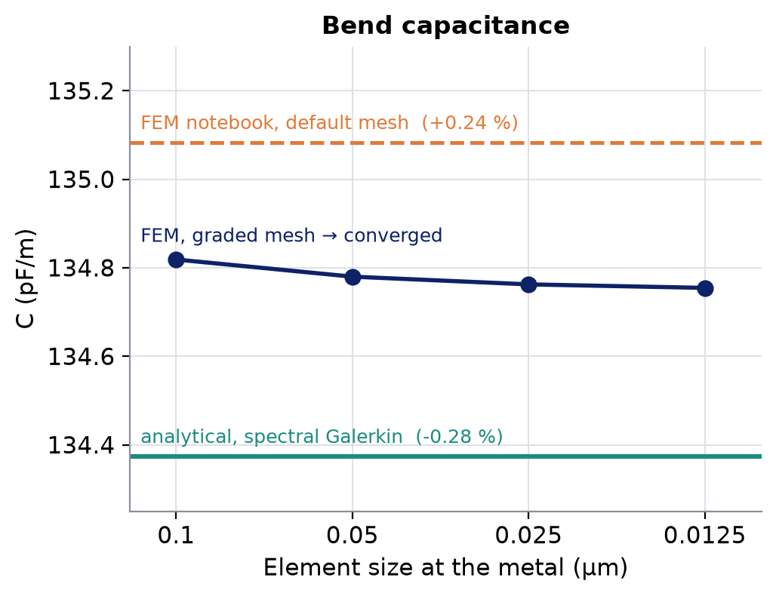
1
Your FEM notebook, updated
Modulating cross-section of the notebook, 60 GHz: new cell [6]
 | IBC (cell [4]) | current inside the gold (cell [6]) | Δ
R' (Ω/m) | 3157.9 | 3590.1 | +13.7 %
L_int (nH/m) | 8.38 | 10.76 | +28 %
n_m | 1.7089 | 1.7147 | +0.34 %
Z₀ (Ω) | 62.565 | 62.774 | +0.33 %
α (dB/cm) | 2.192 | 2.484 | +13.3 %
12 s for the conductor solve (eigen-solve: 224 s)
IBC kept only to show the difference: n_m and Z₀ hardly change, the loss does
C: the default mesh is +0.24 % high (FEM energy bound); converged on a graded mesh
Notes:
The notebook now has a cell that replaces the IBC loss with the current solved inside the gold, on the notebook's own modulating cross-section: the conductor loss goes up by 13.7 %, the attenuation from 2.19 to 2.48 dB/cm; the internal inductance changes more in relative terms, but it is a small part of L, so n_m and Z0 move by only 0.3 %. It costs 12 s. Right: the capacitance of the bend. The notebook's default mesh overestimates C by 0.24 %, as any conforming FEM energy solution does (it is an upper bound); a graded tensor mesh converges to 0.01 %. The analytical model (next section) is 0.28 % low.

Slide 9

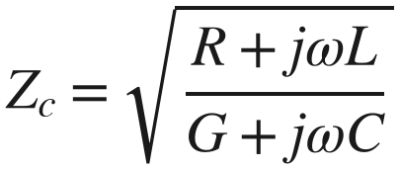
2
Analytical line model: what goes in
No mesh: one geometry in ~1 s, any frequency in µs
Capacitance
spectral-domain Galerkin: finite grounds, layered Green's function, LN anisotropy; + gold thickness from boundary elements
cross-section
S, W, Wg, t, σ, stack
R, L above 60 GHz
exact PEC surface current (top, bottom, sidewalls) on the gold receded by δ/2, minus c K² δ^{1/3} per corner (c = 0.70 from a square bar)
exact line constants
R, L below 60 GHz
$$γ=\sqrt{(R+jωL)(G+jωC)}$$
current solved inside the gold: filament integral equation (~700 filaments, one eigendecomposition)
$$Z_{c}=\sqrt{\frac{R+jωL}{G+jωC}}$$
~1 s
per new cross-section
µs
per frequency after that
1–2 min
2D FEM reference, 5 frequencies
Notes:
The analytical model replaces the mesh with three semi-analytical pieces. Capacitance: the strips are solved in the spectral domain on the layered substrate (Chebyshev charge basis with the edge singularity, finite grounds, layered Green's function by transmission-line recursion, LN anisotropy exact); exact in air to 1e-8 against the conformal map. The gold thickness is added from a boundary element solution in air. Conductor, above 60 GHz: the exact perfect-conductor surface current of the thick electrodes from boundary elements, sidewalls included, on the electrodes receded by half a skin depth, with a corner correction whose constant comes from an isolated square bar, not from fitting the CPW. Below 60 GHz the skin depth is not small against 2 um, so the current is solved inside the gold by a coarse filament integral equation; the two are blended in between. Then the exact line constants. One geometry costs about a second, every frequency after that microseconds.

Slide 10
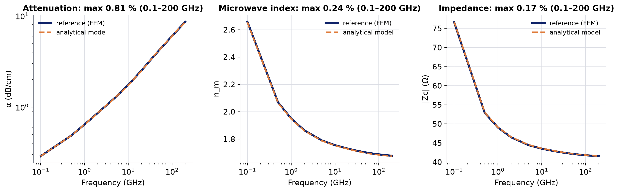
2
Agreement on the bend, 0.1–200 GHz
S 35 / W 4.15 / Wg 50 µm, Au 2 µm; reference with the mesh-converged C
≤ 0.81 %
≤ 0.24 %
≤ 0.17 %
α, model vs reference, every frequency
n_m, model vs reference, every frequency
|Zc|, model vs reference, every frequency
Notes:
The bend cross-section that was used for the reference work (signal 35, gaps 4.15, grounds 50 um), from 100 MHz to 200 GHz. The dashed model curves sit on the reference everywhere, including below 1 GHz where the line is RC-like and n_m and |Zc| rise steeply: this matters because the cascade and the INTERCONNECT tables use the bend line at every frequency, not only at 60 GHz.

Slide 11
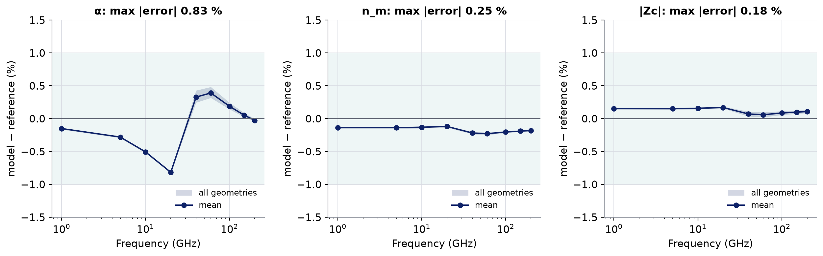
2
Agreement over the whole design space
33 geometries: S 30–40, W 4–5, Wg 50–60 µm, Au 2 µm; 1–200 GHz
≤ 0.83 %
≤ 0.25 %
≤ 0.18 %
α, worst geometry and frequency (60 GHz: ≤ 0.48 %)
n_m, worst geometry and frequency (60 GHz: ≤ 0.25 %)
|Zc|, worst geometry and frequency (60 GHz: ≤ 0.10 %)
Notes:
The 3 x 3 x 3 corners and centres of the design ranges plus 6 interior points, each solved with the reference at 9 frequencies (about 2 minutes each). The band is the spread over all geometries, the line the mean. The model is never off by more than 0.83 % on the loss (around 20 GHz, where the two conductor descriptions are blended), 0.25 % on n_m and 0.18 % on |Zc|. At 60 GHz, where the inverse design works: 0.48, 0.25 and 0.10 %. The small constant offsets in n_m and |Zc| are the capacitance, 0.29 % low, from the coupling between gold thickness and dielectric that the thin-strip + thickness split leaves out. This is the agreement the two-step process relies on: design with the model, verify the chosen geometry with the FEM.

Slide 12
2
How the model got there
rms error vs the reference, 23 geometries: t 0.5–4, S 8–70, W 2–16, buffer 1–6 µm
Sidewall currents
α at 60 GHz: 10.3 → 3.0 % rms
Galerkin capacitance
n_m: 0.98 → 0.42 % rms
|Zc|: 1.04 → 0.37 % rms
Current inside the gold
α at 20 GHz: 6.6 → 1.1 % rms
Notes:
Four versions of the model on the broad 23-geometry set (thick and thin gold, narrow and wide lines), against the reference with the notebook's FEM capacitance (which itself is about 0.24 % high, so the last 0.3-0.4 % on n_m and |Zc| is partly the reference). Ghione's thin-strip closed form, the textbook CPW loss, is 10 % off: it ignores the sidewalls of 2 um gold. Adding the exact thick-conductor surface current takes the 60 GHz loss to 3 %. The Galerkin capacitance with finite grounds halves the index and impedance errors. Solving the current inside the gold where the skin depth is comparable to the thickness fixes the low-frequency loss: 6.6 to 1 % at 20 GHz.

Slide 13
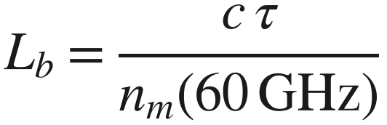
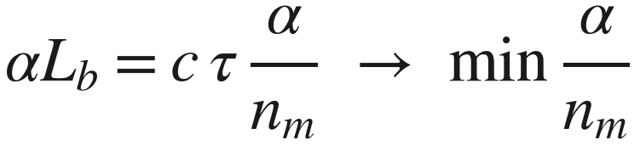
3
Three requirements on the bend
1
Impedance matching
2
RF delay through the bend
3
Minimum loss per bend
$$|Z_{c}(60 GHz)|=|Z_{c,line}(60 GHz)|$$
$$L_{b}=\frac{c τ}{n_{m}(60 GHz)}$$
$$αL_{b}=c τ \frac{α}{n_{m}} → min\frac{α}{n_{m}}$$
= 42.31 Ω from the 5NK0050 Touchstone: no reflection at either end of the bend
τ: the delay the bend must provide (the light's, or walk-off compensated: slides 16–17)
τ does not depend on the geometry: a slower line needs a shorter bend
Free: S, W, Wg inside the allowed ranges. Fixed: gold 2 µm, σ, layer stack. Reference frequency: 60 GHz.
Notes:
What the bend has to do. One: carry the RF without reflections, so its characteristic impedance must equal the modulating line's; we match the magnitude at 60 GHz, taken from the measured Touchstone. Two: deliver the RF to the next section at the right time: given a delay tau, the bend length follows from its own microwave index. Three: lose as little as possible on the way. Loss per bend is alpha times L_b, and since L_b is c tau over n_m, the objective is alpha over n_m. Tau depends on the device (section lengths, line index) but not on the bend geometry, so the geometry choice and the length choice separate cleanly.

Slide 14
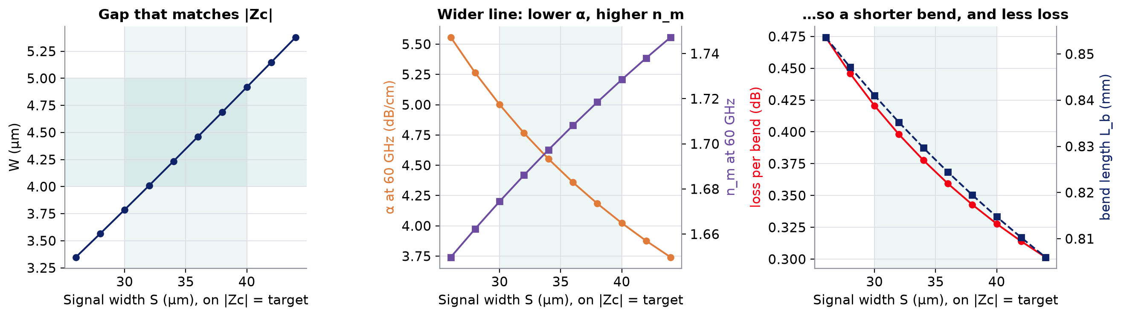
3
The index–length trade-off
Along |Zc| = 42.31 Ω, Wg = 60 µm, RF delay 4.70 ps (2 bends)
5.00 → 4.02
1.674 → 1.728
0.421 → 0.328 dB
α (dB/cm), S 30 → 40 µm
n_m: the bend gets shorter
loss per bend, −22 %
Notes:
Keep |Zc| at the target and move along the constraint. Left: a wider signal needs a wider gap to keep the impedance (W grows from 3.8 to 4.9 um as S goes from 30 to 40). Middle: the wider line has a lower current density, so less loss per cm, and more of its field in the SiO2 and LN below, so a higher index. Right: both help: lower alpha, and a higher index means a shorter bend for the same delay, so the loss per bend falls by 22 % across the allowed range. Inside the ranges the optimum therefore sits at the widest signal the gap range still allows to match.

Slide 15
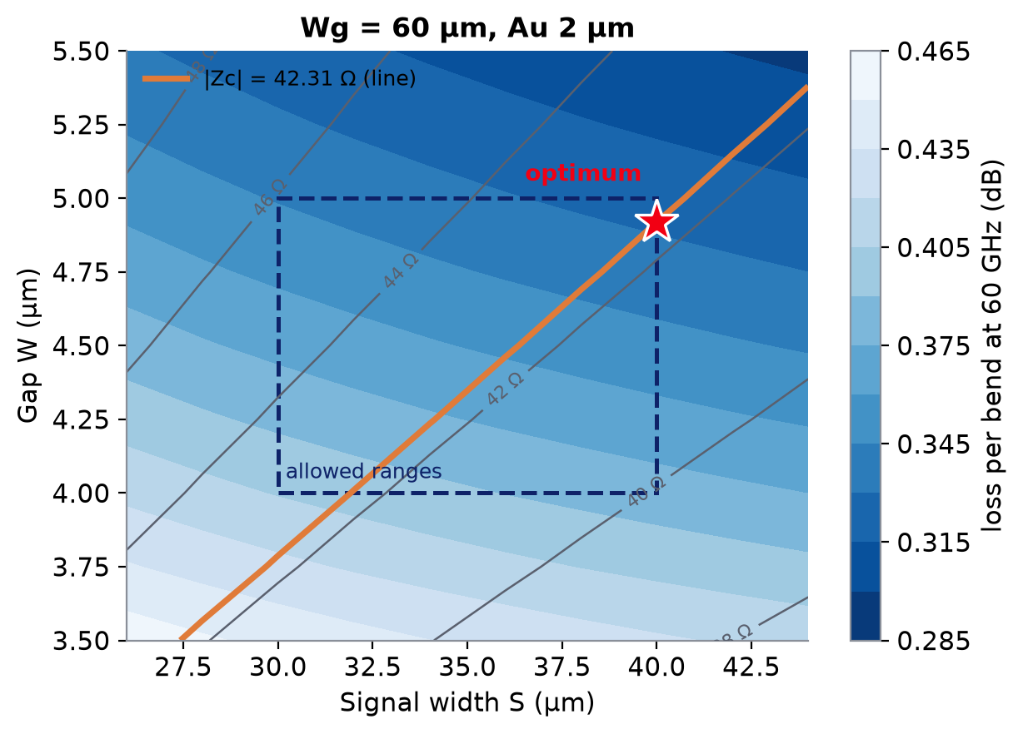
3
Design map and the optimiser
1
line model on a 3 × 3 × 3 grid of the ranges (60 GHz)
2
quadratic response surfaces for |Zc|, n_m, α (node residual < 0.02 %)
3
dense search on |Zc| = target, minimum α / n_m
4
polish with the line model itself: reported numbers are the model's
proposal
S / W / Wg | 40.00 / 4.919 / 60.0 µm
|Zc| (60 GHz) | 42.31 Ω (target 42.31)
n_m (60 GHz) | 1.7285
α (60 GHz) | 4.023 dB/cm
bend length, 2 bends | 0.815 mm
loss per bend | 0.328 dB
Notes:
Left: loss per bend (colour) over signal width and gap at Wg = 60 um, with the impedance contours. The orange line is the target impedance; the dashed box the allowed ranges. Along the orange line the loss falls towards wider lines, so the optimum (star) is where the line leaves the box: S at its maximum, 40 um, with the gap that matches, 4.92 um. Wider grounds help a little (Wg at its maximum). The optimiser does this in about 8 s: 27 model evaluations, quadratic response surfaces, a constrained search and a final polish with the model itself. If the target cannot be reached inside the ranges it says so and returns the closest geometry: with these ranges |Zc| spans 39.9-46.2 ohm, so the Jerez line (62.6 ohm) could not be matched without a wider gap.

Slide 16

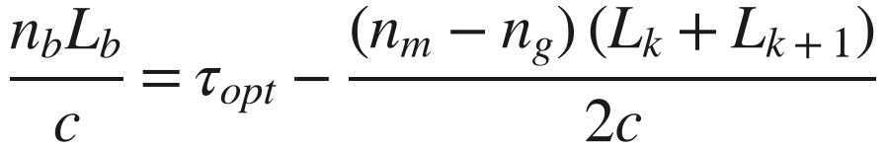
3
Delay compensation: two targets
section k
bend
section k+1
inside each section the RF drifts from the light by (n_m − n_g) L / c
1 Optical-delay matched
2 Walk-off compensated
the RF crosses the bend in the light's time: the bend itself is skew-free, the drift of the sections stays
the bend also cancels the drift between the centres of consecutive sections
$$\frac{n_{b}L_{b}}{c}=τ_{opt}$$
$$\frac{n_{b}L_{b}}{c}=τ_{opt}−\frac{(n_{m}−n_{g}) (L_{k}+L_{k+1})}{2c}$$
bends N | 1 | 2 | 3 | 4
walk-off skew (ps) | -0.45 | -0.30 | -0.23 | -0.18
L_b, 5 ps (mm) | 0.867 | 0.867 | 0.867 | 0.867
L_b, walk-off (mm) | 0.789 | 0.815 | 0.828 | 0.836
n_m − n_g = +0.018
line slower than the light → the RF arrives late → the bend is made shorter
same geometry for every N; only L_b changes
Notes:
The bend must deliver the RF to the next section at the right moment. Option 1: make the RF take exactly as long as the light through the bend (5 ps here). That makes the bend skew-free, but inside each modulating section the RF already drifts from the light, because the line's n_m (2.29 at 60 GHz) differs from n_g (2.27); the bend then simply carries that drift on, as if the electrode were straight. Option 2: use the bend to cancel the drift accumulated between the centres of the two sections it joins. Here the line is slightly slower than the light, so the RF must take less time through the bend: -0.45 ps for one bend (two 8.25 mm sections), -0.18 ps with four bends. The two options coincide when n_m = n_g. The geometry does not change with N, only the bend length. Note the walk-off skew uses n_m at the device's -3 dB frequency.

Slide 17
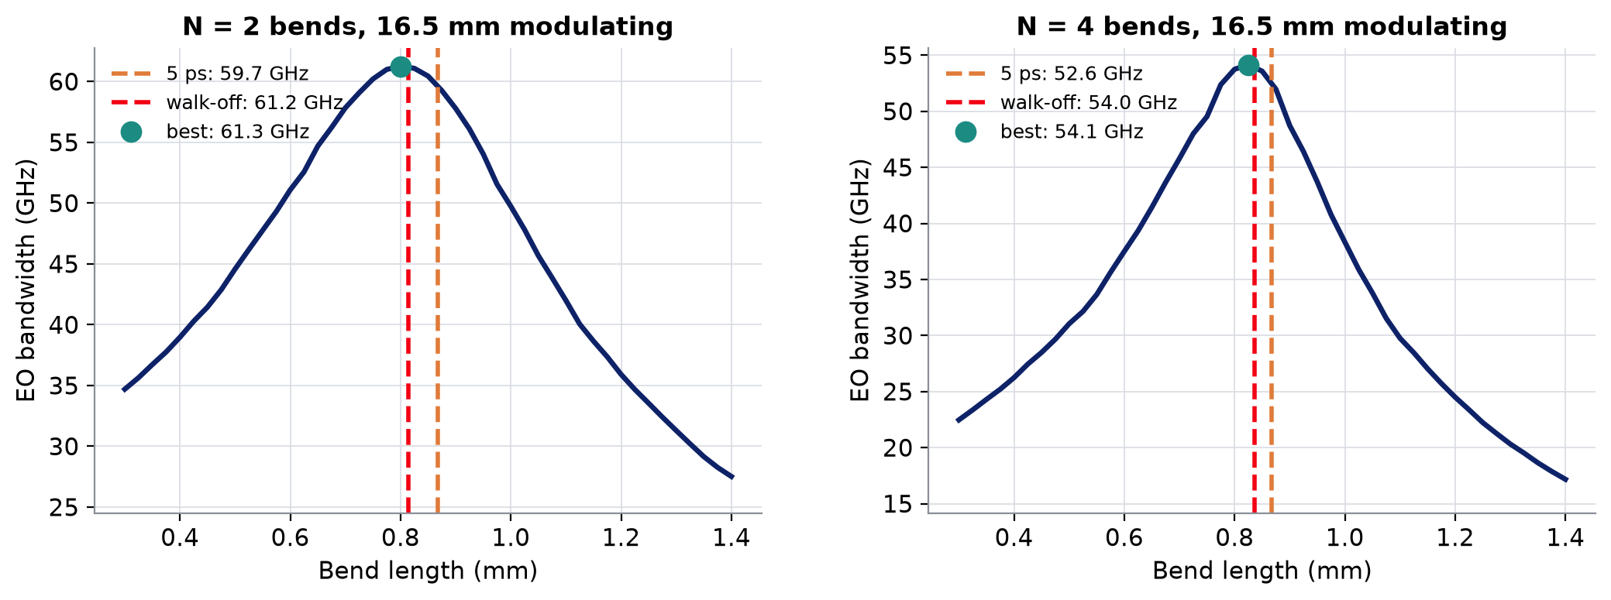
3
Walk-off compensated: the one to target
EO bandwidth vs bend length, designed cross-section, full cascade
+1.2 … +1.7 GHz
0.05 / 0.12 GHz
±0.1 mm
walk-off vs 5 ps length, N = 1–4
below the sweep's best, N = 2 / 4
of bend length costs ~2–5 GHz
Notes:
The full cascade (reflections at the bend ends, the bend's loss and dispersion, all sections) swept over the bend length, for 2 and 4 bends. The walk-off compensated length (red) lands within 0.05-0.12 GHz of the best bandwidth of the sweep; the plain 5 ps length (orange) is 1.2-1.7 GHz below. The peak is sharp: a 0.1 mm error in the bend length costs a few GHz, which is why the delay target matters as much as the impedance. The GUI uses the walk-off compensated delay by default.

Slide 18
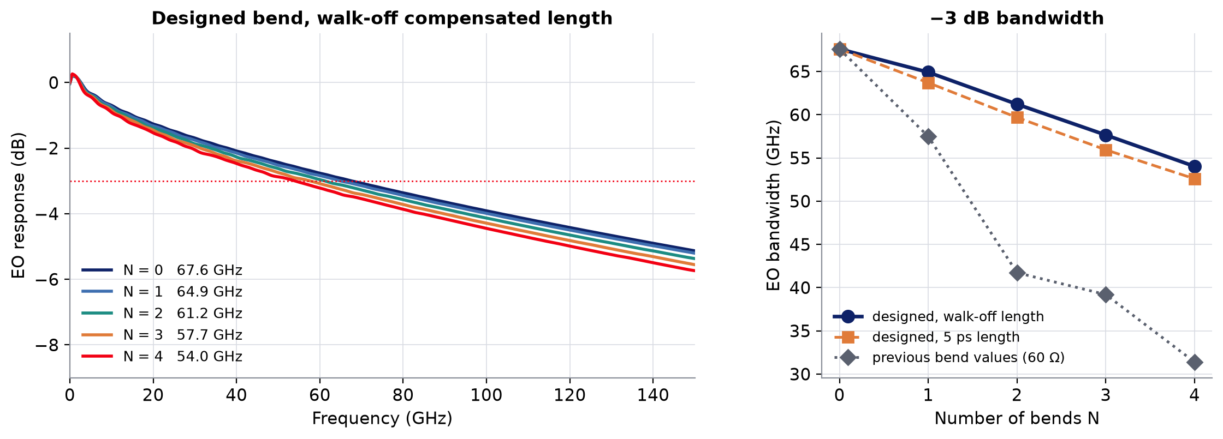
4
EO bandwidth with the designed bend
5NK0050 line, 16.5 mm modulating length split into N + 1 equal sections
67.6 GHz
54.0 GHz
31.4 GHz
straight, 16.5 mm
4 designed bends
4 bends, previous values (60 Ω)
Notes:
Left: the EO response with 0 to 4 designed bends at the walk-off compensated length; the modulating length stays 16.5 mm. Each bend costs about 3.5 GHz: its loss (about 0.33 dB at 60 GHz) and the extra RF path. Right: the designed bend at both lengths, and the previous bend values (60 ohm, fitted loss, 0.8 mm) for comparison: on a 42 ohm line a 60 ohm bend reflects at both ends, and with several bends these reflections pile up: 31 GHz with 4 bends instead of 54.

Slide 19
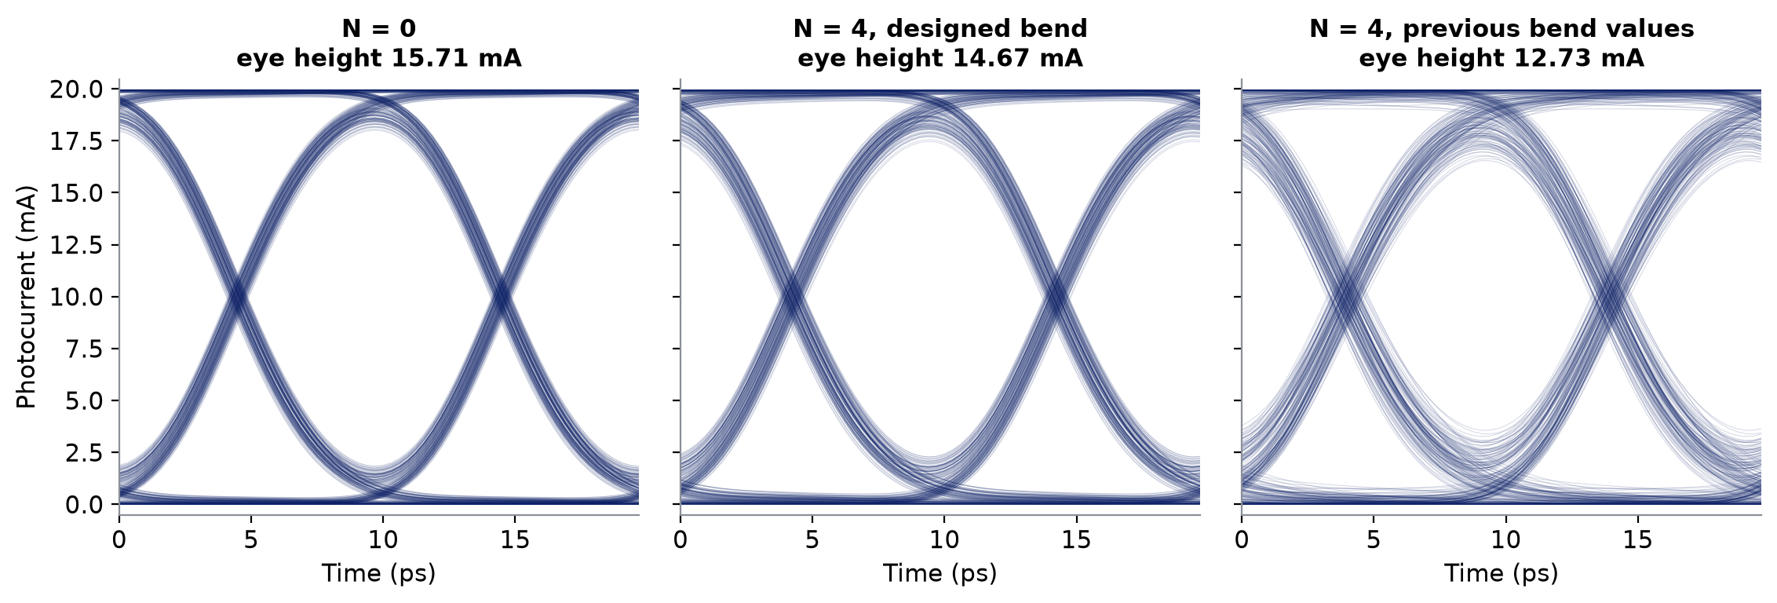
4
Eye diagram, 100 Gb/s NRZ
Same device; no noise, PRBS-9
15.71 mA
14.67 mA
12.73 mA
eye height, straight
4 designed bends (-6.6 %)
4 bends, previous values (-19.0 %)
Notes:
The eye at 100 Gb/s NRZ, 2 Vpp drive, no noise. The designed bends cost 6.6 % of eye height with 4 bends; the previous bend values cost 19 %, mostly through the reflections, which show up as the spread of the traces (inter-symbol interference), not as a lower average level.

Slide 20
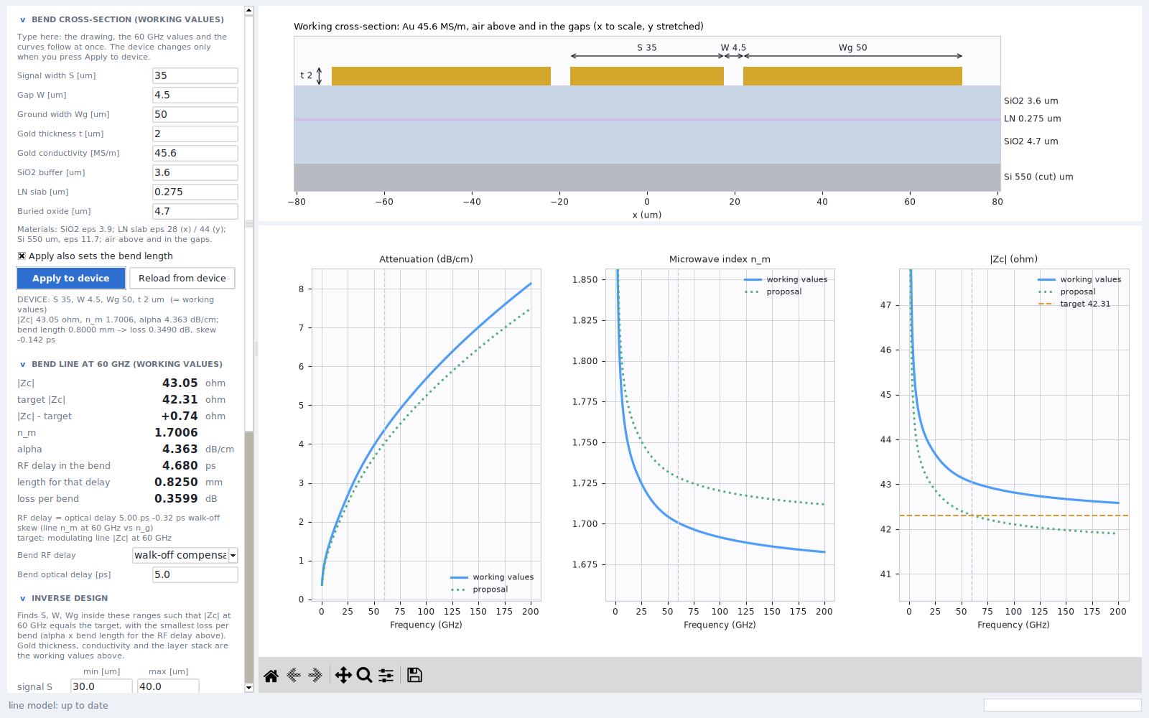
4
In the GUI: the Bend window
Working values
type S, W, Wg, gold, stack: drawing, 60 GHz figures and curves follow at once
Device
dashed outline and grey curves: the bend the device uses now
Optimise
ranges and target editable; proposal in green dotted
Apply
Apply to device (your values) or Apply proposal; optionally the bend length too
Notes:
The Bend window, opened from the header or from the sidebar. Left column: the working cross-section (typing updates everything in the window but not the device), the bend line at 60 GHz with the target impedance and the bend length for the chosen delay, the inverse design with its ranges, and the FEM check. Right: the cross-section to scale in x, and alpha, n_m and |Zc| versus frequency for the working values, the device's bend and the proposal. Nothing reaches the device until Apply.

Slide 21
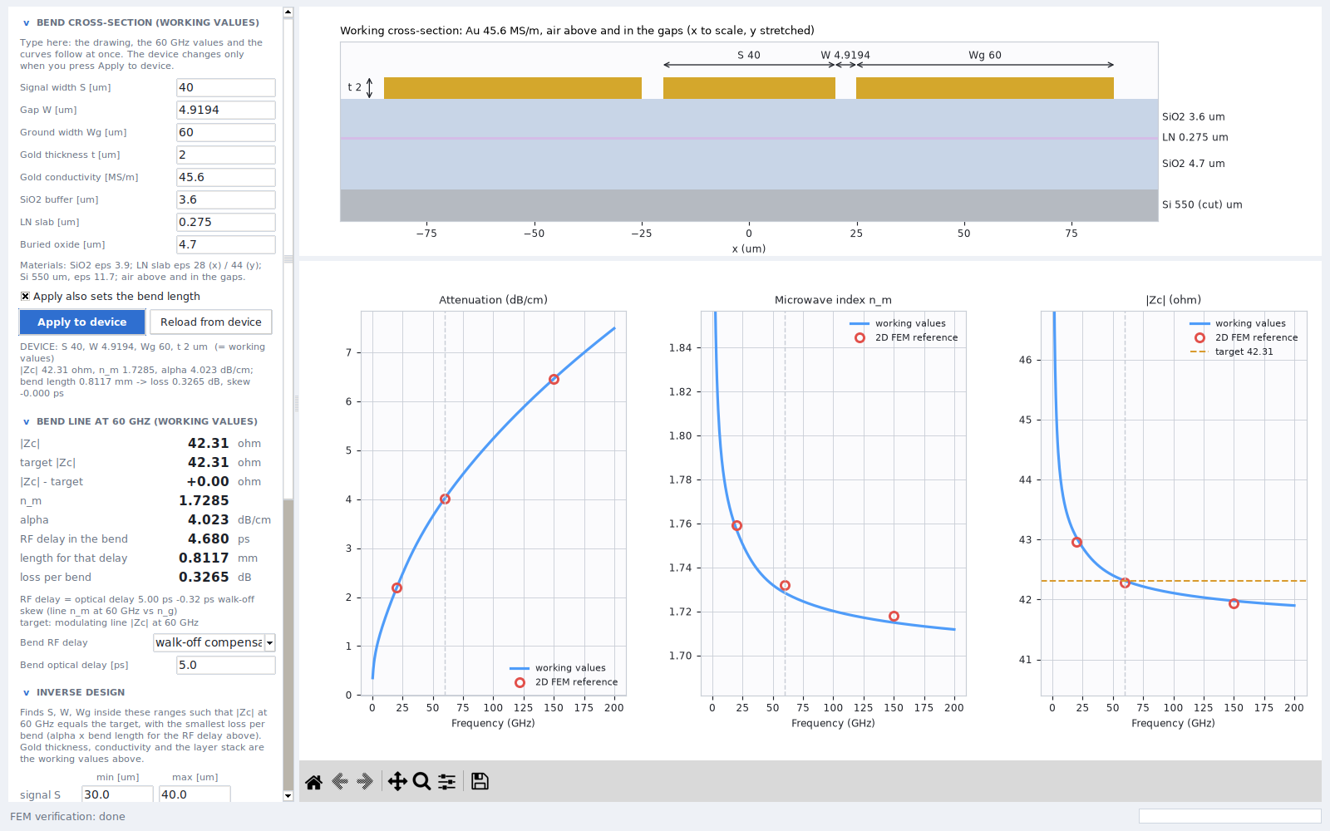
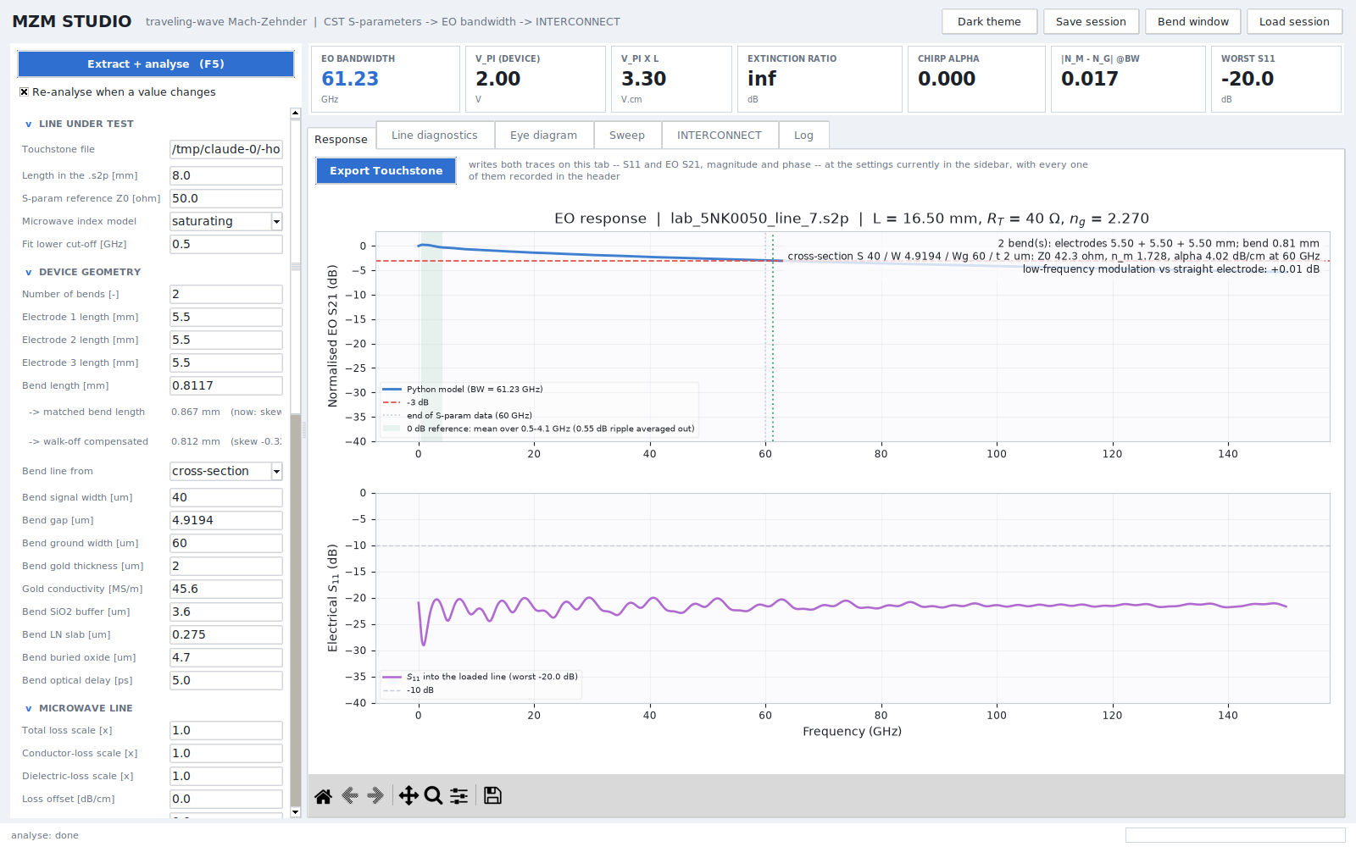
4
In the GUI: FEM check and the device response
Verify: the proposal solved with the 2D FEM reference in 36 s (20 / 60 / 150 GHz)
model vs FEM: α −0.8 / +0.3 / +0.0 %, n_m ≤ 0.21 %, |Zc| ≤ 0.16 %
Device: the bend line's α(f), n_m(f) and complex Z_{c}(f) go into the cascade and into the INTERCONNECT tables (40/40 TL checks pass)
Notes:
Left: the FEM verification of the proposed geometry inside the GUI, about 10 s per frequency: the red circles land on the model curves. Right: the main window with two bends: the bend is now a frequency-dependent line (loss, index and complex impedance from the cross-section) in the cascade, and the same tables feed the INTERCONNECT TL electrode block; the TL validation suite, including a cross-section bend case, passes 40 of 40 checks.

Slide 22
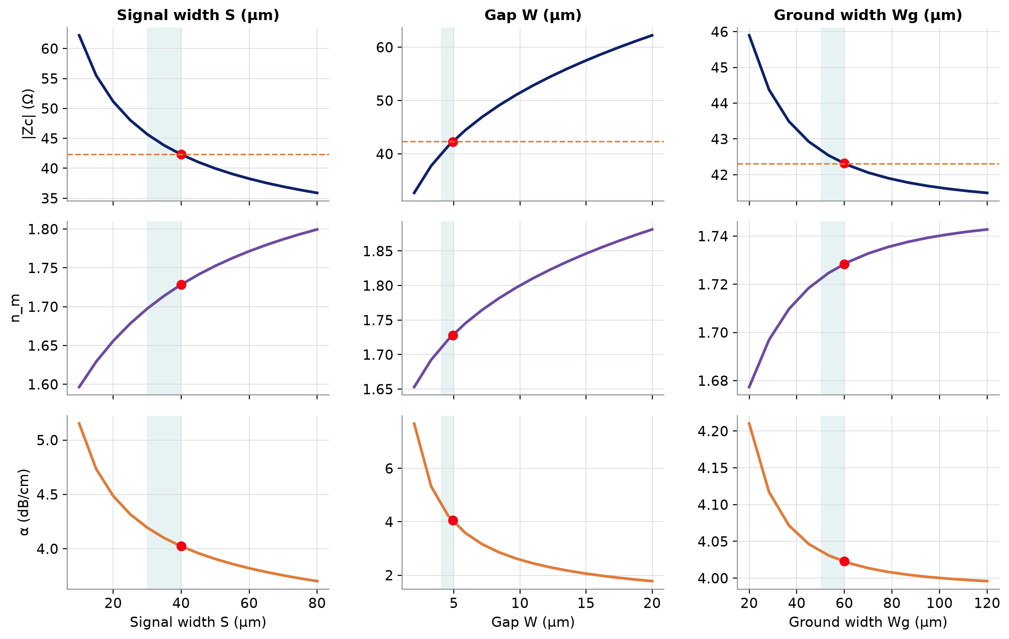
5
How the geometry moves the figures of merit
At 60 GHz, one parameter at a time around the design (red dot); green: allowed range
at the design | Δ|Zc| (Ω) | Δn_m | Δα
S +1 µm | -0.27 | +0.0027 | -0.3 %
W +0.1 µm | +0.24 | +0.0019 | -1.3 %
Wg +1 µm | -0.03 | +0.0005 | -0.0 %
Gap: the impedance lever
±0.1 µm of lithography ≈ ±0.24 Ω
Signal: index and loss
wider → slower, less lossy, lower |Zc|
Grounds: saturate beyond ~60 µm
Notes:
One parameter at a time around the designed bend, from the analytical model (each curve is a few seconds). The gap is the strongest handle on the impedance: a 0.1 um lithography error moves |Zc| by about 0.24 ohm. The signal width moves index and loss most. The grounds matter below about 50 um and saturate above 60-80 um. The orange dashed line in the top row is the target impedance.

Slide 23
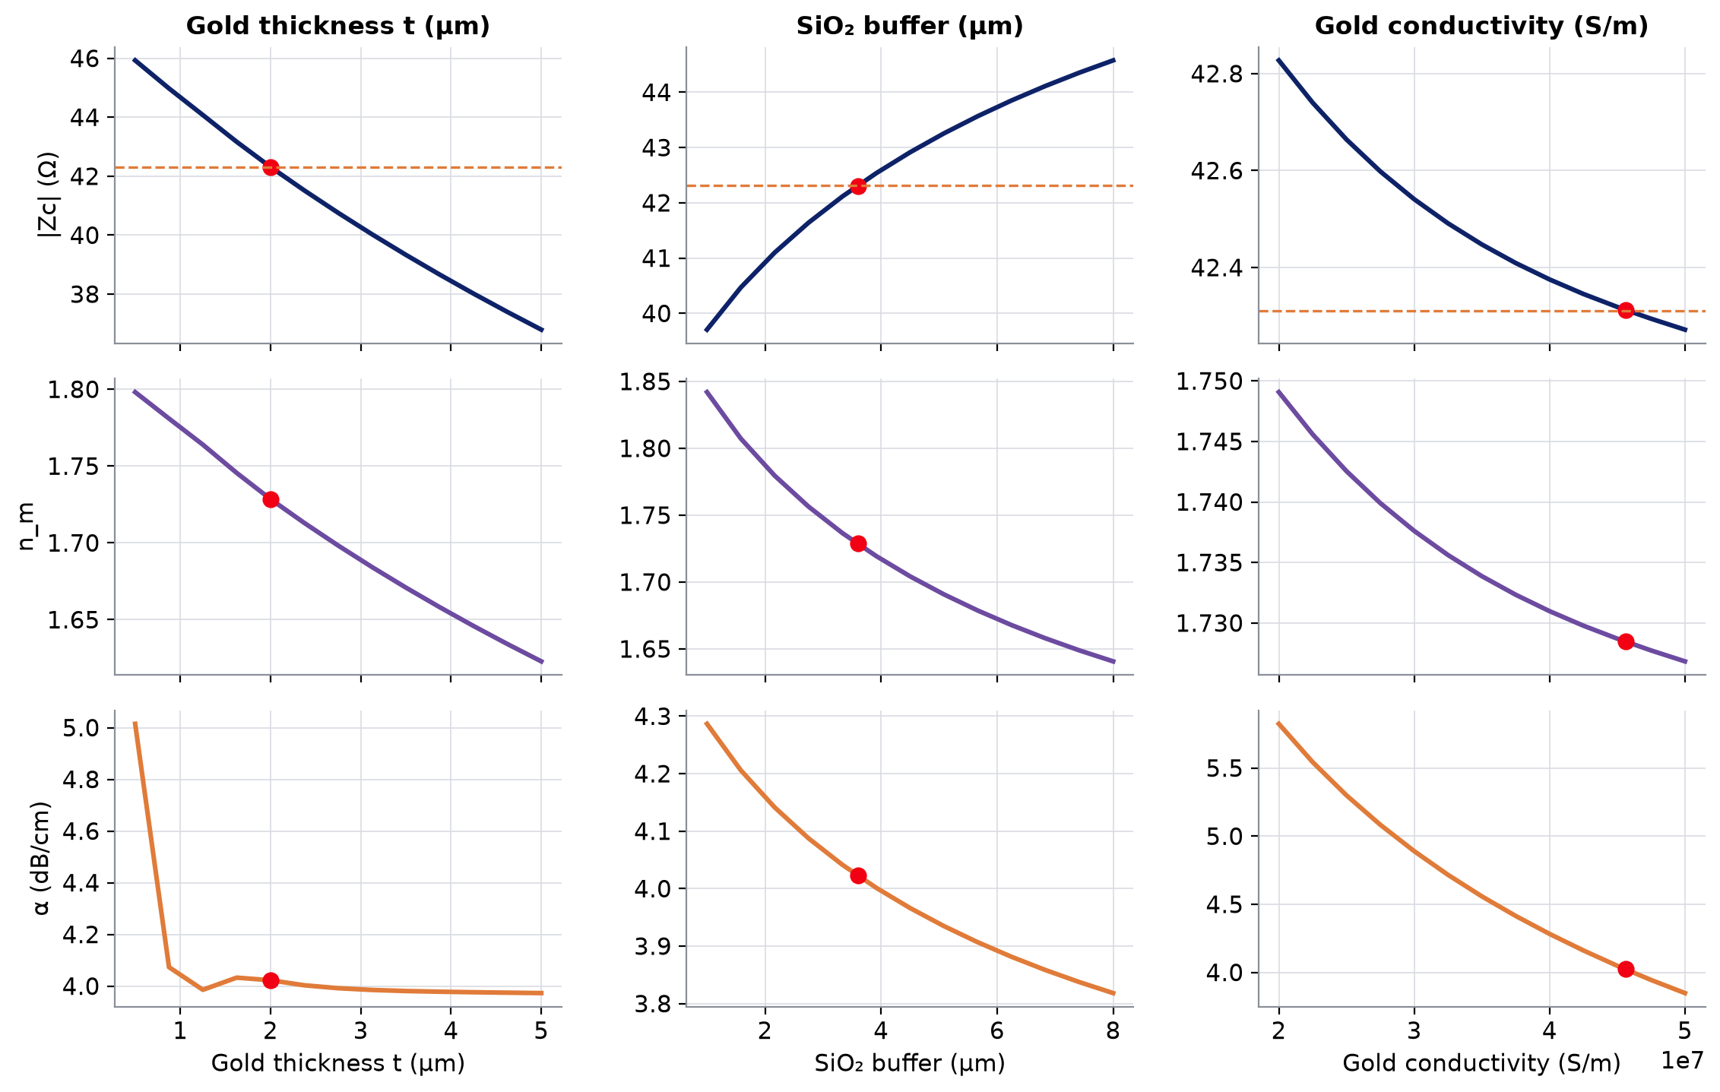
5
How the process moves the figures of merit
Gold thickness, SiO₂ buffer, gold conductivity; at 60 GHz
at the design | Δ|Zc| (Ω) | Δn_m | Δα
t +0.1 µm | -0.22 | -0.0042 | -0.2 %
buffer +0.1 µm | +0.07 | -0.0029 | -0.2 %
σ +10 % | -0.04 | -0.0017 | -4.5 %
Thicker gold
lower |Zc| and n_m (sidewall capacitance); α nearly flat above ~1 µm: R and |Zc| both fall
Thicker buffer
less LN in the field: higher |Zc|, lower n_m and α
Conductivity
α ∝ 1/√σ; |Zc| and n_m almost unchanged
Notes:
The same for the process. Gold thickness: thicker gold adds sidewall capacitance, so |Zc| and n_m drop; the loss is nearly flat above about 1 um, because R falls but |Zc| falls too (the 2D FEM reference shows the same: 4.03, 4.01, 4.02, 4.01, 3.99 dB/cm at 1, 1.25, 1.6, 2, 2.4 um). Buffer: thicker SiO2 under the gold puts less of the field in the LN slab: higher impedance, lower index and loss. Conductivity: the loss scales as one over the square root of sigma (CST library gold 45.6 MS/m; evaporated gold can be lower), the index and impedance barely move.

Slide 24
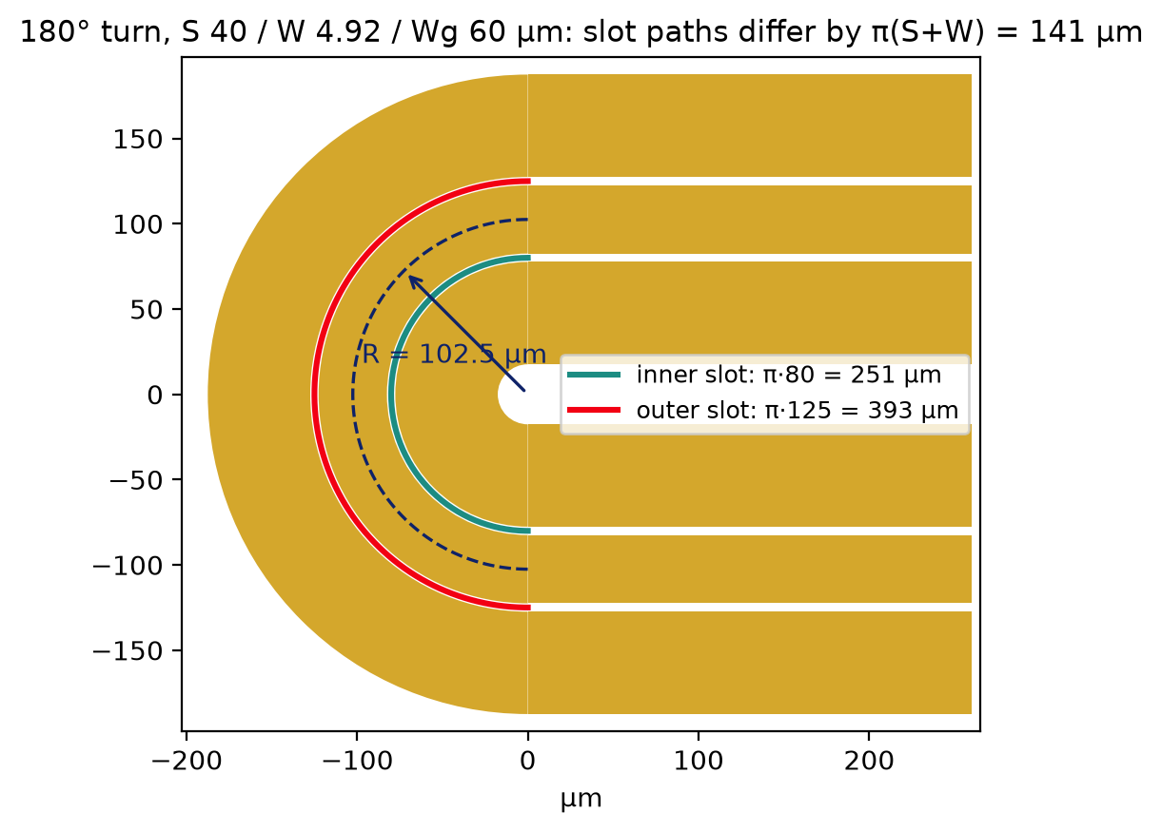
6
What the 2D bend line does not see
The bend is modelled as a straight line with the bend's cross-section
Slot-path difference
outer slot longer by π(S+W) = 141 µm → phase difference between the two slots → slotline (odd) mode
Curvature and radiation
R = 102.5 µm, a few times the line width: field asymmetry, radiation and substrate modes at high frequency
Discontinuities
start and end of the turn, transition from the modulating cross-section: local reflections
Notes:
The 2D model treats the bend as a straight piece of line with the bend's cross-section. Three things it cannot see. First, in a 180 degree turn the outer slot is longer than the inner one by pi times (S + W), 141 um for the designed geometry: the fields in the two slots arrive with a phase difference, and part of the CPW mode is converted into the slotline mode, unless the grounds are tied together by bridges. Second, the curvature itself: the radius (102.5 um at the signal centre) is only a few line widths, so the field is asymmetric, and at high frequency the line can radiate and couple to substrate modes. Third, the discontinuities at both ends of the turn and the transition from the modulating cross-section to the bend cross-section. None of these is in the bend tables yet.

Slide 25
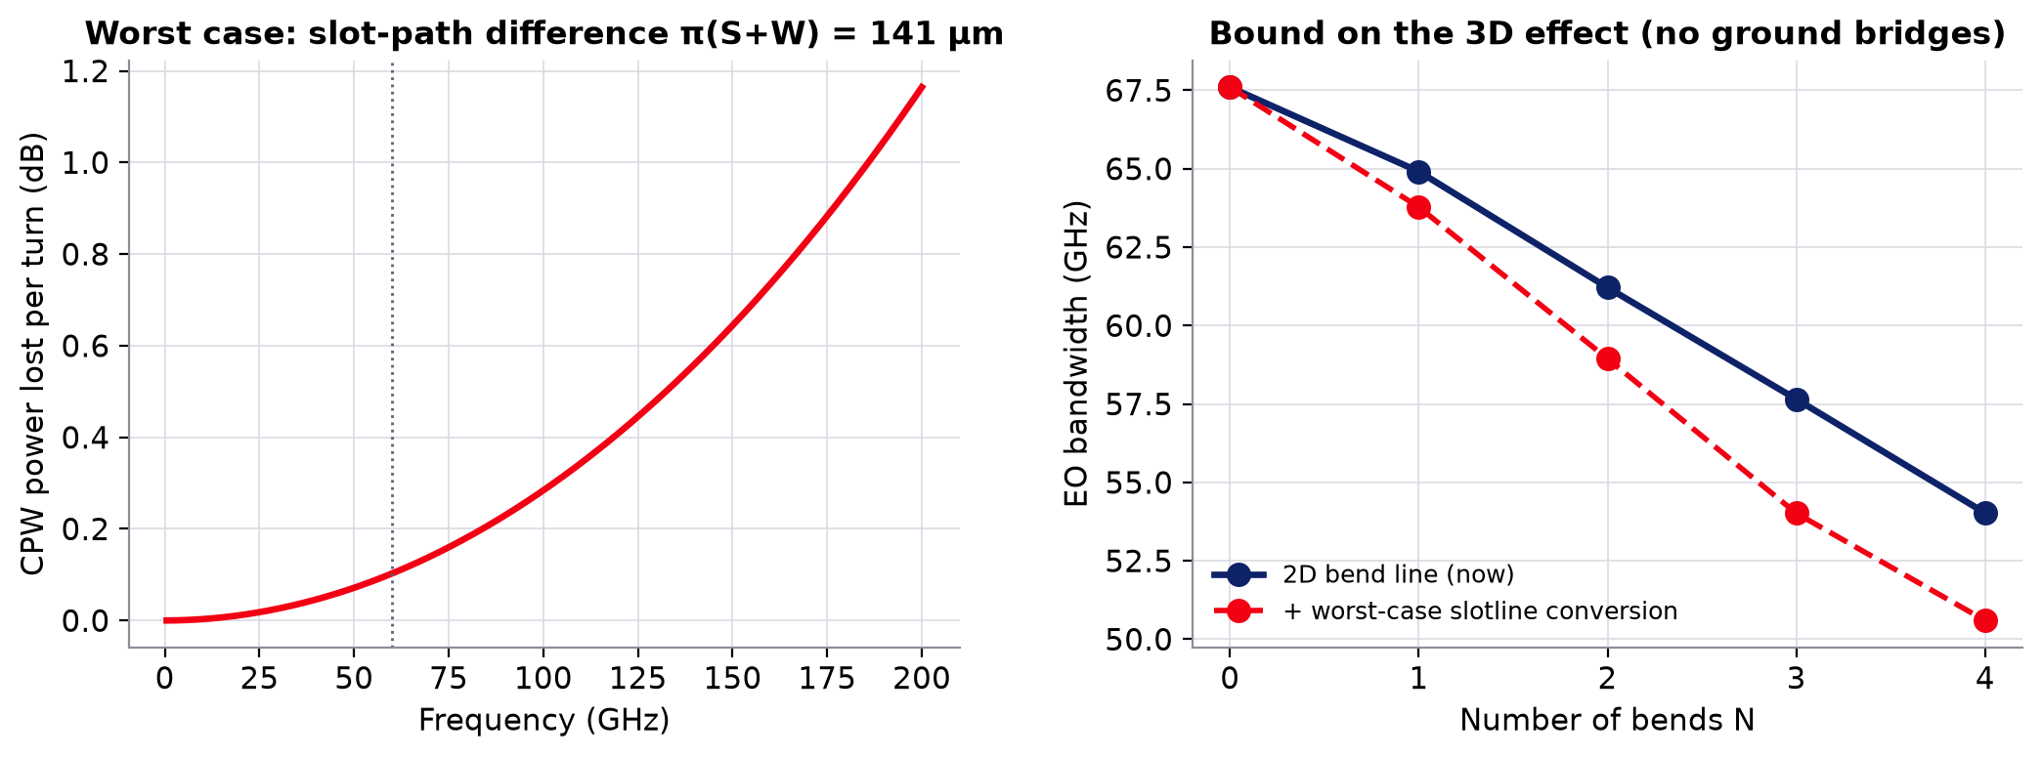
6
Prognosis: a bound on the 3D effect
Worst case: all converted power lost, no ground bridges
0.10 / 1.2 dB
54.0 → 50.6 GHz
14.67 → 14.47 mA
lost per turn at 60 / 200 GHz
EO bandwidth, 4 bends
eye height, 4 bends, 100 Gb/s
Notes:
An upper bound on the first effect. The power converted to the slotline mode per turn is sin^2 of half the phase difference between the slots; counting all of it as lost (no ground bridges, no re-conversion) gives 0.10 dB per turn at 60 GHz and 1.2 dB at 200 GHz. Added to each bend in the cascade, it lowers the 4-bend bandwidth from 54.0 to 50.6 GHz and the eye height by 1.4 %. With ground bridges in the turn the slotline mode is shorted and this bound collapses; radiation and the discontinuities are not in it and need the 3D simulation.

Slide 26
6
What is left
3D simulation of the designed turn
1
CST, 180°, R = 102.5 µm, S 40 / W 4.92 / Wg 60 µm, with and without ground bridges; de-embedded α, n_m, |Zc| vs the line model; mode conversion and radiation
Validate against a real bend
2
test structures: straight line + 1, 2, 4 turns of the same length, VNA to 110 GHz; per-turn loss and delay
Bring the 3D bend into the model
3
per-turn correction (excess loss, phase) on top of the 2D bend line, or the measured / simulated bend S21 through 'fitted values'
Transitions
4
taper between the modulating and the bend cross-section: length and reflection
Notes:
Next steps. One: simulate the designed turn in 3D and compare its de-embedded loss, index and impedance with the 2D line model; that also measures the slotline conversion and the radiation, with and without ground bridges. Two: validate on silicon with bend test structures of equal total length and 1 to 4 turns, so that the per-turn loss and delay come out of the difference. Three: feed what the 2D line misses back into the model, either as a per-turn correction or by loading the 3D or measured bend through the existing 'fitted values' path. Four: the transition between the two cross-sections. Prognosis from slide 25: at most a few GHz of bandwidth with 4 turns and no bridges; with bridges, expected to be small.

Slide 27

A1 Corner constants from a square bar
f (GHz) | δ / a | c_R | c_X
20 | 0.0527 | 0.7338 | 1.0815
50 | 0.0333 | 0.7180 | 0.8977
100 | 0.0236 | 0.7096 | 0.7891
200 | 0.0167 | 0.7029 | 0.6996
400 | 0.0118 | 0.6969 | 0.6239
800 | 0.0083 | 0.6911 | 0.5568
$$R_{int}=R_{s}\left(G(a−δ)−c_{R} K_{s} δ^{1/3}\right)$$
$$ωL_{int}=R_{s}\left(G(a−δ)−c_{X} K_{s} δ^{1/3}\right)$$
isolated gold bar, side 10 µm; current inside the gold (FEM) vs PEC surface current (boundary elements) on the bar receded by δ/2
c_R = 0.70: constant over 20–800 GHz → used in the model
c_X drifts: an O(δ) term, not a corner constant → L_{int} = R_{hf} / ω kept (−0.2 % on L, −0.1 % on n_m)
Notes:
Where the corner constant of the analytical model comes from: a canonical problem that is not part of the CPW validation set. For an isolated square bar, the resistance from the current inside the gold is compared with the perfect-conductor surface current on the bar receded by half a skin depth; the deficit scales as K^2 delta^(1/3) with a constant c_R = 0.70 over 20 to 800 GHz. The same for the reactance gives no constant, so the internal inductance is left at R/omega.

Slide 28
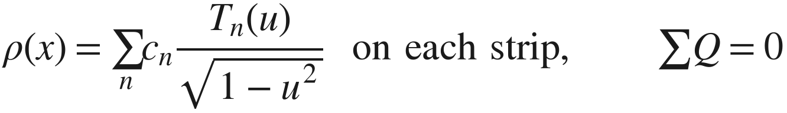
A2 Capacitance: spectral-domain Galerkin
$$\tilde{ϕ}(β)=\frac{\tilde{ρ}(β)}{ε_{0}\left(|β|+Y(β)\right)}, Y: layers by transmission\text{-}line recursion$$
𝜌(𝑥)=𝑛​𝑐𝑛𝑇𝑛(𝑢)1−𝑢2 on each strip, ∑𝑄=0
$$C=C_{thin}(layers)+C_{air,thick}^{BEM}−C_{air,thin}$$
zero-thickness strips, finite grounds; Chebyshev charge basis with the 1/√ edge singularity (6 + 8 functions, converged); exact in air: 1e−8 vs the conformal map
uniform-medium part in space (closed form), remainder in β (decays as e^{−2βh})
bend: C -0.28 % vs mesh-converged FEM; C_air −0.002 %; the previous conformal + single-trial version was up to +5 %
Notes:
The capacitance model in one slide. The charge on the strips is expanded in Chebyshev polynomials with the square-root edge singularity; the potential of a charge sheet over the layered substrate is a one-line expression in the spectral domain. The uniform-medium part of the kernel is integrated in space in closed form, the rest decays exponentially in beta and is integrated numerically. The gold thickness is added as the difference between the thick and thin air capacitances. The remaining -0.28 % is the coupling between thickness and dielectric that this split ignores.

Slide 29
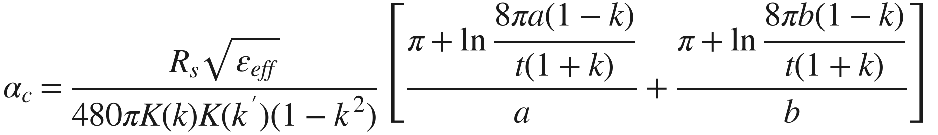
A3 Ghione's thin-strip loss: what was checked
$$α_{c}=\frac{R_{s}\sqrt{ε_{eff}}}{480πK(k)K(k^{′})(1−k^{2})}\left[\frac{π+ln\frac{8πa(1−k)}{t(1+k)}}{a}+\frac{π+ln\frac{8πb(1−k)}{t(1+k)}}{b}\right]$$
the 1993 paper is behind a paywall; the formula was checked term by term against two independent implementations: scikit-rf 0.23 (cpw.analyse_loss) and Qucs (cpwline.cpp, "equations by Ghione")
a = S/2, b = S/2 + W, k = a/b, infinite grounds, thin strip with a stopping distance set by t
on the 23 geometries: α error 10.3 % rms at 60 GHz: it has no sidewall current, which for 2 µm gold carries a large share of the edge current
Notes:
For completeness: Ghione's closed form, the usual CPW conductor-loss formula. The original paper could not be accessed; scikit-rf and Qucs implement the same expression term by term. It is a thin-strip result and misses the sidewall currents of thick gold, hence the 10 % error.

