Slide 1
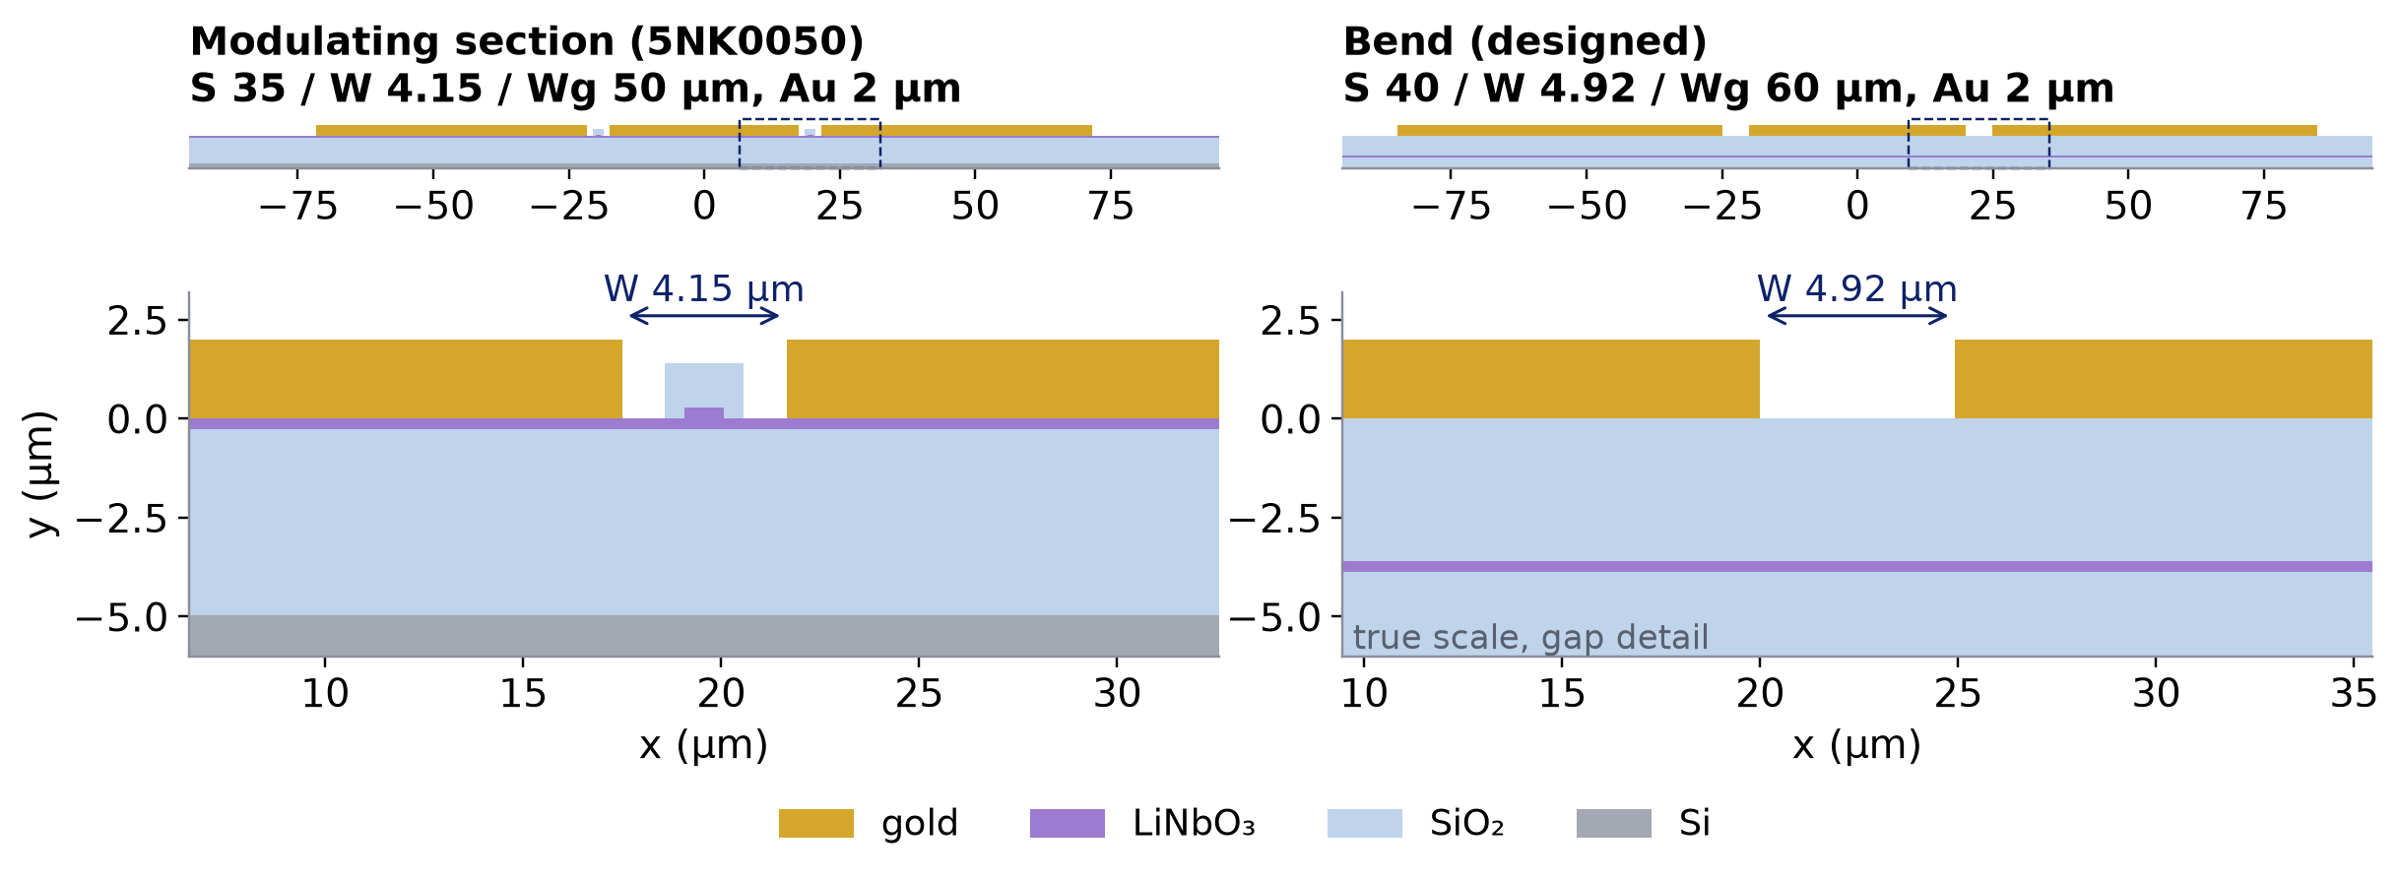
0
Modulating section vs bend
Same 2 µm gold; no ribs, electrodes on 3.6 µm SiO₂ instead of the LN slab: a different line
at 60 GHz | modulating line (5NK0050, measured) | bend (designed, model)
|Zc| | 42.31 Ω | 42.31 Ω
n_m | 2.288 | 1.728
α | 5.31 dB/cm | 4.02 dB/cm
n_m drops from 2.29 to 1.73
the RF crosses the bend faster than the light → the bend length is set by the delay it must give
same |Zc| as the line → no reflection at the bend ends
Notes:
Left: the modulating section of the 5NK0050 device, C-band 550 nm TFLN etched by 275 nm (275 nm slab): S 35 um, gap 4.15 um, Wg 50 um, 2 um gold sitting on the LN slab, with the waveguide ribs in the gaps. The table gives the measured 5NK0050 line. Right: the bend. Where the electrode turns, the waveguides are routed elsewhere: no LN ribs under the bend, the gold is still 2 um thick (same metal layer, no new mask) but sits on 3.6 um of SiO2 above the 275 nm LN slab. The zooms show the right-hand gap at true scale. With almost no LN in the field, the microwave index drops from about 2.29 to 1.73: the RF is faster than the light (n_g 2.27). So the bend is a line of its own: its length decides how long the RF takes to reach the next section, and its impedance decides whether there are reflections at both ends. The inverse design later chooses S, W, Wg so that |Zc| equals the line's.

