Slide 1
RF impact of the Al₂O₃ (ALD) layer
on JEREZ 8 mm lines
Wafer 6JZ0011 · 15 chips measured before and after ALD · n_{m}, Z₀, α, S₂₁

Slide 2
Samples and method
Same extraction and figures of merit as the CORDOBA ALD study
Samples
Wafer 6JZ0011, 15 chips, one 8 mm line each.
Same chip measured before and after ALD: paired comparison.
FOM | Value per chip
n_{m} | saturating dispersion fit, at 60 GHz
Z₀ | Re Z_{c}, mean over 10.0–42.8 GHz (4 pad-ripple periods)
α | fit a√f + b f + c (a, b ≥ 0), at 30 and 60 GHz
S₂₁ | fitted line between 50 Ω ends, at 30 and 60 GHz
Measurement
2-port VNA, 40 MHz–60 GHz, 1601 points, 50 Ω.
All 30 files pass the checks: reciprocity 0.8–1.1 % (median), passivity ≤ 0.92. No chip excluded.
Extraction
ABCD de-embedding of each 2-port as one uniform line, L = 8 mm (pads included, same bias before and after ALD).
Reported change: median of the per-chip difference ALD − no ALD.

Slide 3
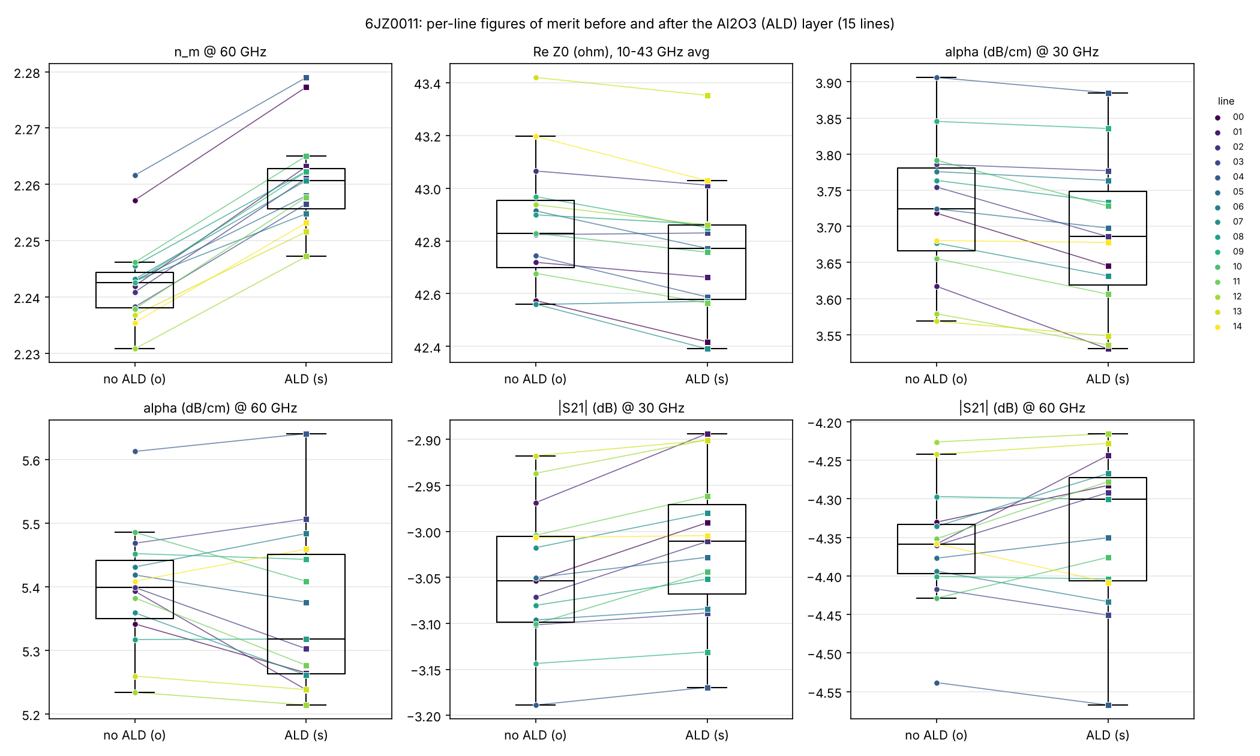
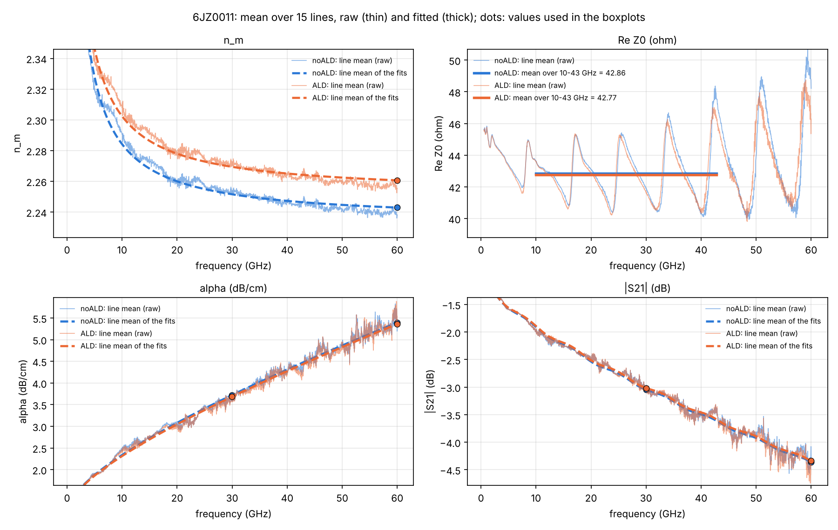
Wafer 6JZ0011: results
Chip means with fits (left) · per-chip values, before (o) and after (s) (right)

Slide 4
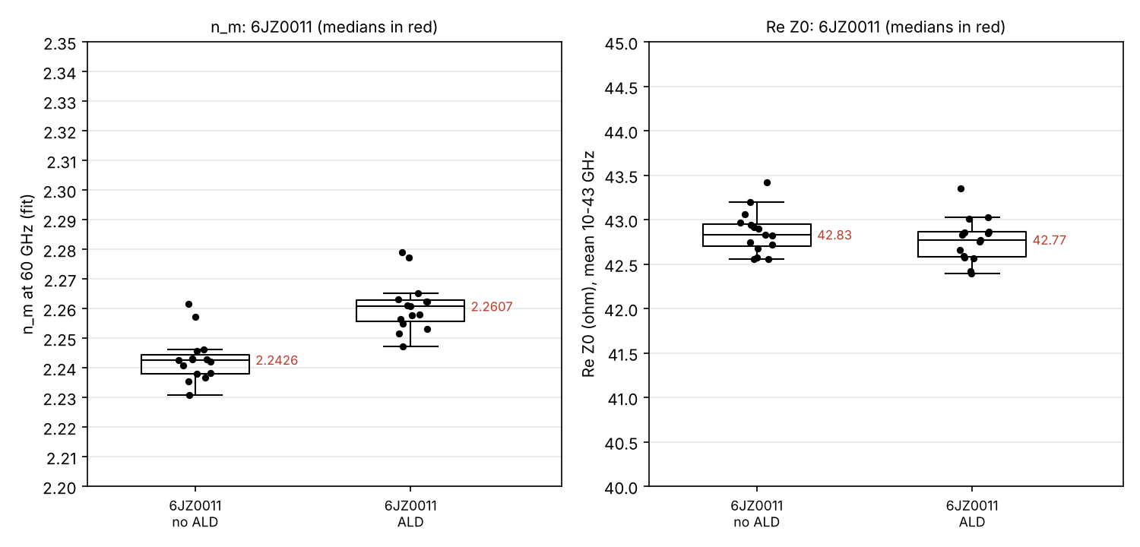
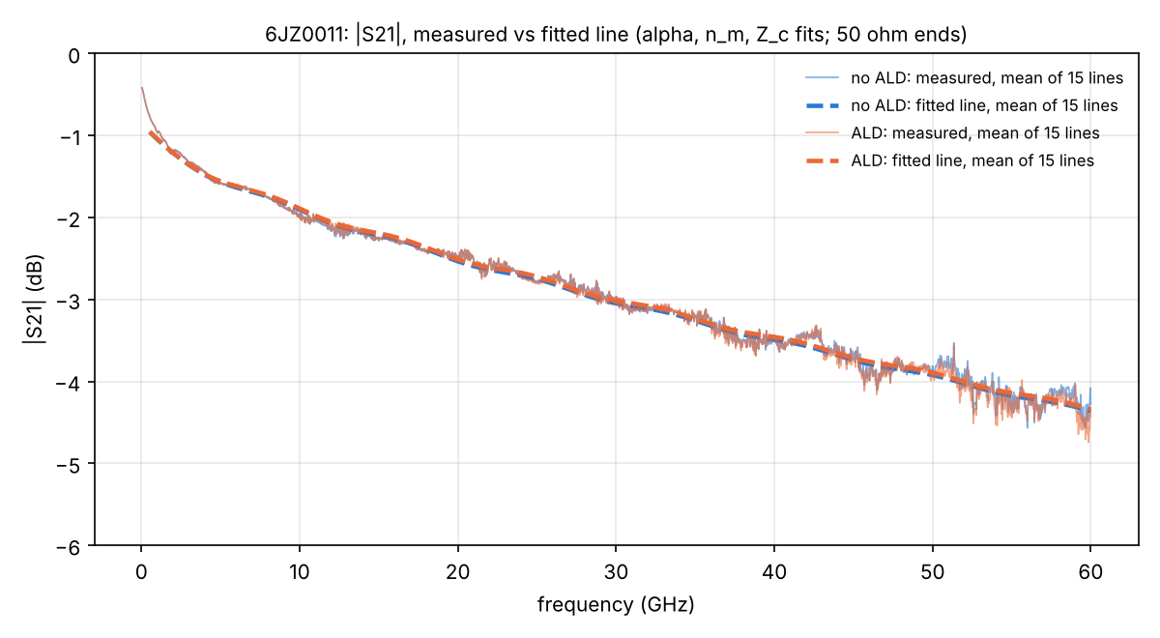
Median change after ALD
15 chips; Up = chips with a higher value after ALD
FOM | No ALD | ALD | Change | Up
n_{m} @ 60 GHz | 2.243 | 2.261 | +0.018 | 15/15
Z₀ (Ω), 10–43 GHz avg | 42.83 | 42.77 | -0.08 | 2/15
α (dB/cm) @ 30 GHz | 3.724 | 3.686 | -0.030 | 0/15
α (dB/cm) @ 60 GHz | 5.399 | 5.318 | -0.021 | 5/15
|S₂₁| (dB) @ 30 GHz | -3.054 | -3.011 | +0.029 | 15/15
|S₂₁| (dB) @ 60 GHz | -4.359 | -4.301 | +0.014 | 9/15
Z₀ changes below about 0.5 Ω are not resolved (pad ripple); α at 60 GHz carries about ±0.07 dB/cm (CORDOBA fit check).

Slide 5
Conclusions
n_{m} ↑
Z₀ ↓
α: open
+0.8 % at 60 GHz (+0.018), every chip
Median per-chip decrease after ALD
Change of the order of the fit uncertainty
Established
ALD adds capacitance: n_{m} increases and Z₀ decreases.
Open: attenuation
Fitted α depends on the fit and on the data noise.
To be checked against the band-averaged measured S₂₁ (no fit).

