Slide 1
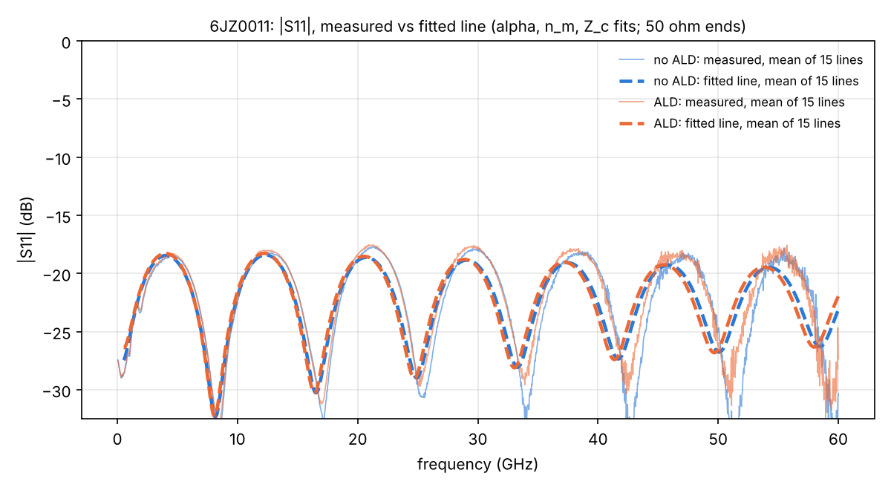
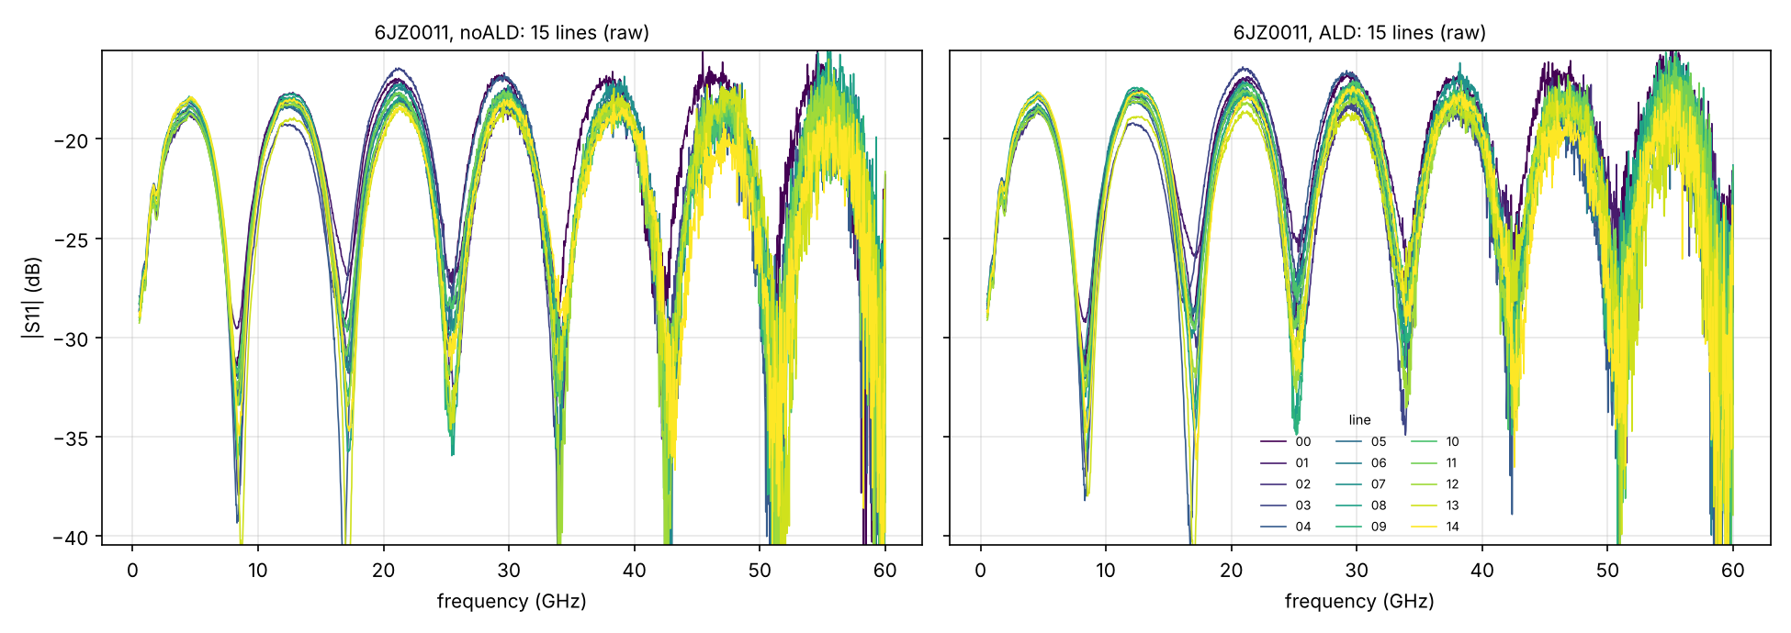
Wafer 6JZ0011: return loss |S₁₁|
15 chips · measured, before and after ALD
Chip mean (left)
Measured mean and fitted-line mean, no ALD vs ALD; 50 Ω ends.
No ALD → ALD, 1–60 GHz
Median |S₁₁|: −21.1 → −20.5 dB · maximum: −16.6 → −16.3 dB (medians over chips).

