Slide 1
Why each field component looks the way it does
Analytical and physical justification of the Ex, Ey, Ez maps, with the lateral gold cavity in focus
Lisbon lifted electrodes, etched LN slab | 1575 nm | 550 nm film, 275 nm etch | gap 4.2 µm | slab_w 8.2 µm | parameters unchanged
Sources: Okamoto (2006), Maier (2007), Peng & Oliner (1981, I & II), Webster et al. (2007), Liu et al. (2021)

Slide 2
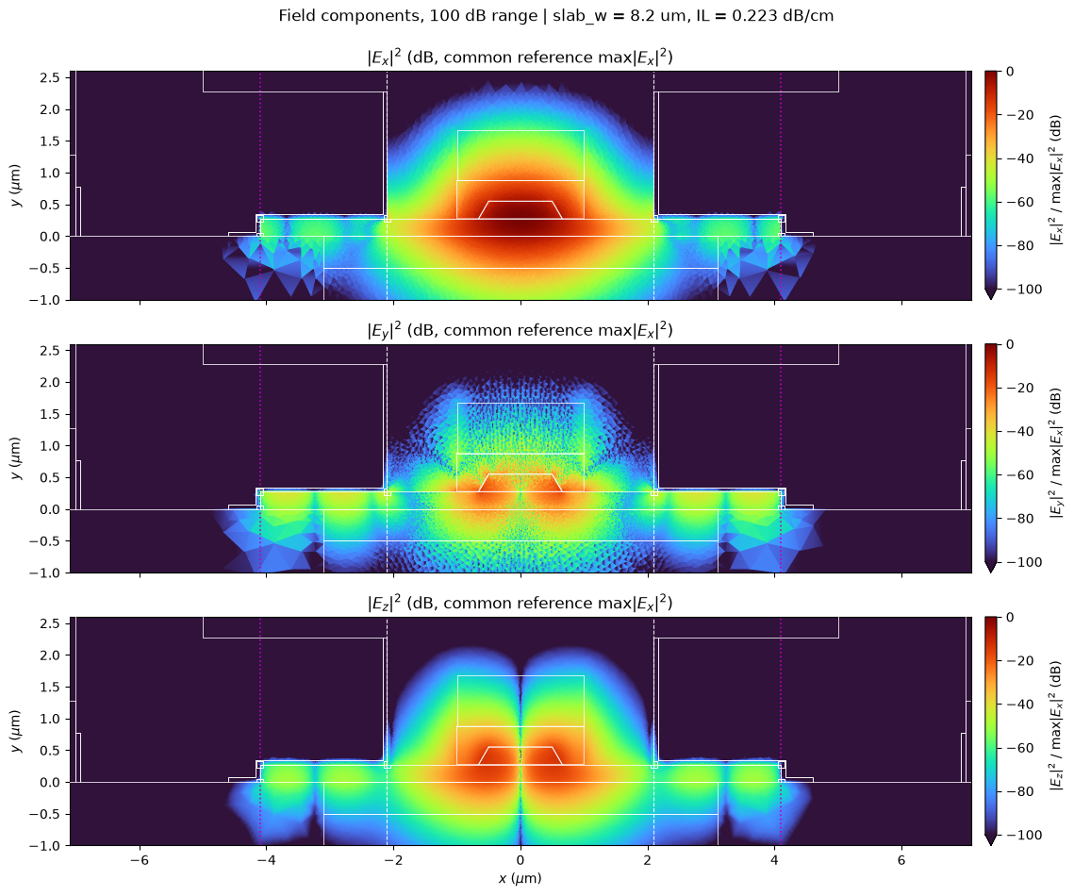
What we have to explain
Same mode, three components, 100 dB range (common reference max|Ex|²)
Rib
Ex one lobe; Ez two lobes, null on axis, 90° out of phase; Ey four weak lobes
Free slab (0.7–2.1 µm)
every component falls as a straight line in dB
Under the gold (2.1–4.1 µm)
Ex collapses, Ey/Ez dominate, standing wave with ~0.9 µm nulls; Ex nulls shifted by ¼ period
Device level
IL ripples with slab end / gold position; a buffer kills the ripple
Notes:
Four observations to justify, in order of position in the cross-section: rib, free slab, gold-clad slab (the cavity), and the device-level consequence (IL). Every following slide puts a simulation result next to an analytical prediction from the literature.

Slide 3
Five sources, one job each
Each observation is tied to a specific equation or figure
Okamoto, Fundamentals of Optical Waveguides, Ch. 1–2
Boundary conditions (1.32–1.33); Marcatili E^x_pq fields (2.41): Ez ∝ ∂Hy/∂x, Ey ∝ ∂²Hy/∂x∂y
1
Maier, Plasmonics, Ch. 2
SPP at metal/dielectric (2.10–2.14); no TE surface wave (2.17); decay into metal (2.13)
2
Peng & Oliner, IEEE MTT 29 (1981) Part I & II
TE–TM conversion at a lateral step; a TE-like mode leaks a TM wave; exit angle cos θ = n_eff / n_TM (3); resonance condition (2)
3
Webster et al., IEEE PTL 19 (2007)
Phase-matching picture (Fig. 2); measured periodic loss vs width with sharp minima (Fig. 4)
4
Liu et al., Chin. Opt. Lett. 19 (2021)
SiO₂ buffer suppresses the LN/metal leaky mode; > 100× lower loss (Fig. 1c)
5

Slide 4
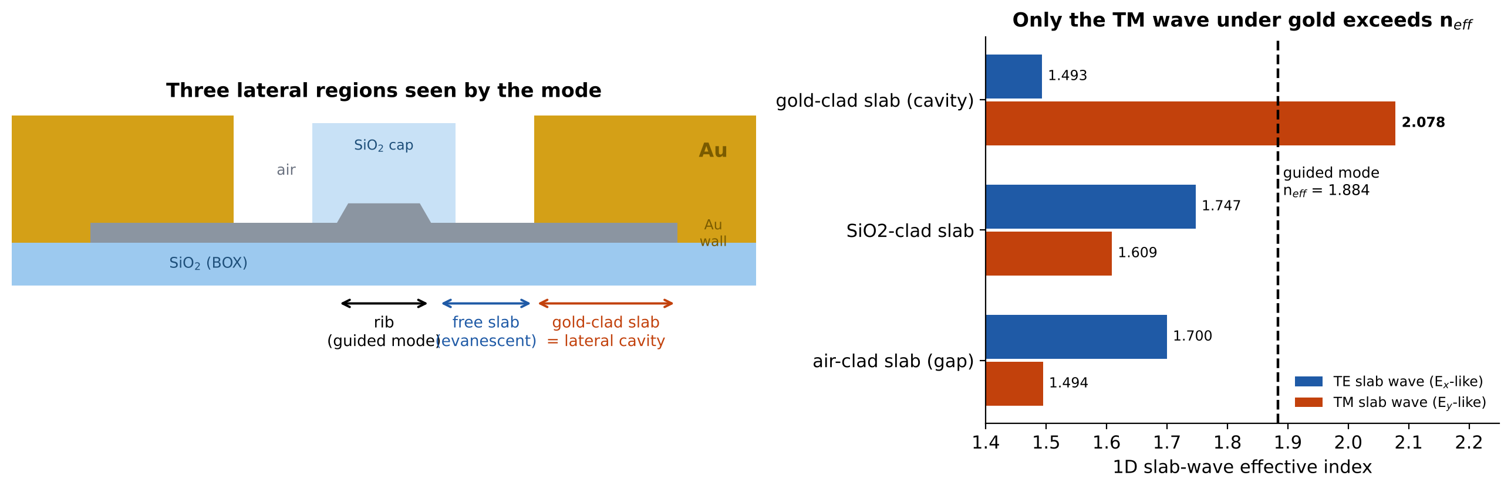
The cross-section is three 1D slab waveguides side by side
Oliner's criterion: a lateral region leaks only if one of its slab waves is faster than the mode (n_wave > n_eff)
1.884
2.078
1.700
n_eff of the guided TE-like mode
TM wave of the gold-clad slab: the only one above n_eff
TE wave of the free slab: below n_eff → evanescent
1D transfer-matrix solver, same Sellmeier/J&C materials as the notebook. Oliner Part II §III-D; Webster Fig. 1.
Notes:
Gold raises the TM index of the slab above n_eff because the TM wave is a hybrid with the gold surface plasmon: the single-interface SPP Au/LN has n = 2.256 (Maier eq. 2.14), and the thin LN slab on SiO2 brings it down to 2.078 — still above 1.884. The TE wave under the gold is pushed DOWN (1.49) because gold forces tangential Ex to zero. So under the gold the mode can only feed a TM (Ey-dominant) wave. This is exactly Oliner's 'new class of leaky modes': the leaking wave has the opposite polarisation to the bound mode.

Slide 5
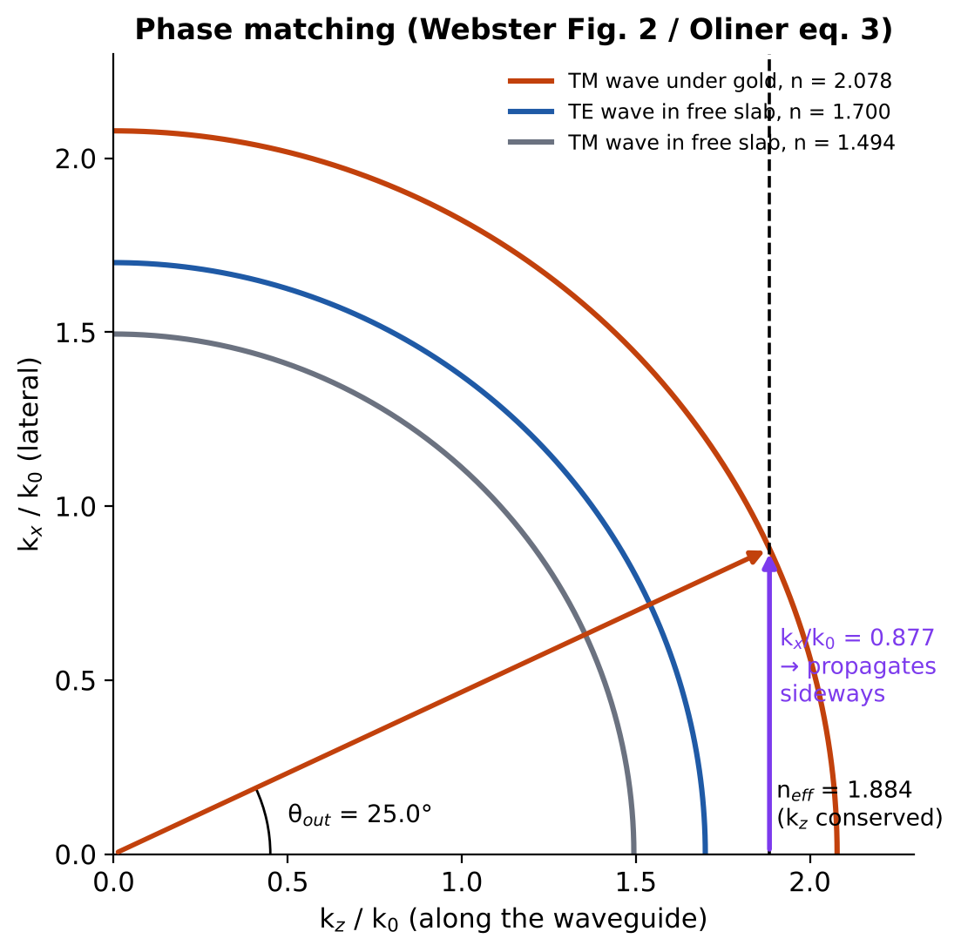
Why the light goes sideways under the gold
Along z the phase is locked to the mode; the leftover wavevector points laterally
kz is conserved: every wave has kz = β = k₀·1.884
Under gold the TM wave has |k| = k₀·2.078 > β, so kx is real: kx = k₀√(2.078² − 1.884²) = 0.877 k₀
It leaves the rib at θ = arccos(1.884/2.078) = 25° (Oliner eq. 3)
In the free slab |k| < β for both polarisations → kx imaginary → pure decay
Same picture as Webster Fig. 2 for SOI TM ridges, with gold playing the role of the thick slab
Result: the lateral wave period is fixed by two indices only, π/kx = 0.897 µm
Webster et al. 2007, Fig. 2; Oliner et al. 1981 Part II, eq. (3) and Fig. 8.

Slide 6
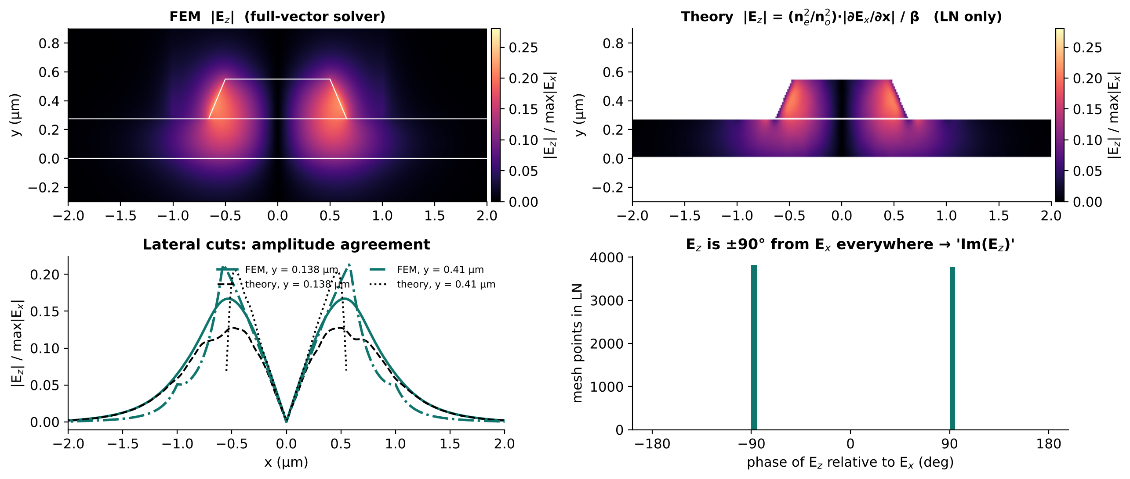
Rib: Ez is the x-derivative of Ex, shifted by 90°
Gauss's law ∇·D = 0 with e^(−jβz): Ez = −j (ε_x/ε_z) ∂Ex/∂x / β (Okamoto eq. 2.41, E^x_pq mode)
90.000°
median |phase(Ez/Ex)| over all LN points: Ez is purely imaginary
null at x = 0
Ex even → ∂Ex/∂x odd → Ez antisymmetric, two lobes
≈ −14 dB
|Ez|²/|Ex|² peak ≈ (1/βw)²: wide guide → small Ez
Lobes sit where Ex is steepest (the rib sidewalls). The '−j' is why we plot Im(Ez): it is not a typo but the physics of a forward wave.
Theory computed from the FEM Ex alone (no fit). Ripple in the theory curve = numerical derivative of a piecewise N1 field.

Slide 7
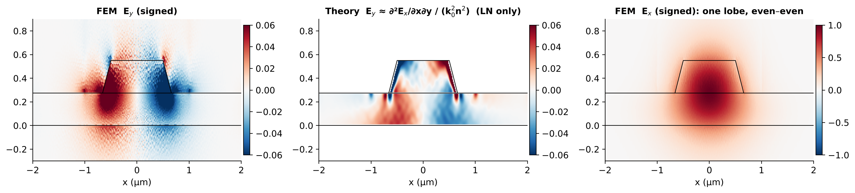
Rib: Ey is the weak quadrupole that makes the mode 'hybrid'
Marcatili: Ey ≈ ∂²Ex/∂x∂y / (k₀²n²) — odd in x, changes sign across the field centre (Okamoto eq. 2.41)
Ex (right) is one even lobe; its mixed derivative gives four lobes of alternating sign: same sign pattern as the FEM Ey (left)
Ey peaks at the slanted sidewalls and corners, where Ex bends fastest in both x and y; the 60° walls add a direct polarisation tilt
Ey is ~25 dB below Ex: the mode is TE-like but never pure — Oliner: 'all these waveguides support hybrid modes with all six components'
This small Ey is the seed of everything that follows: at the gold edge it is the TM part that can phase-match
Theory from FEM Ex (LN only). Speckle in the FEM Ey = N1 elements (normal component discontinuous between triangles), not physics.

Slide 8
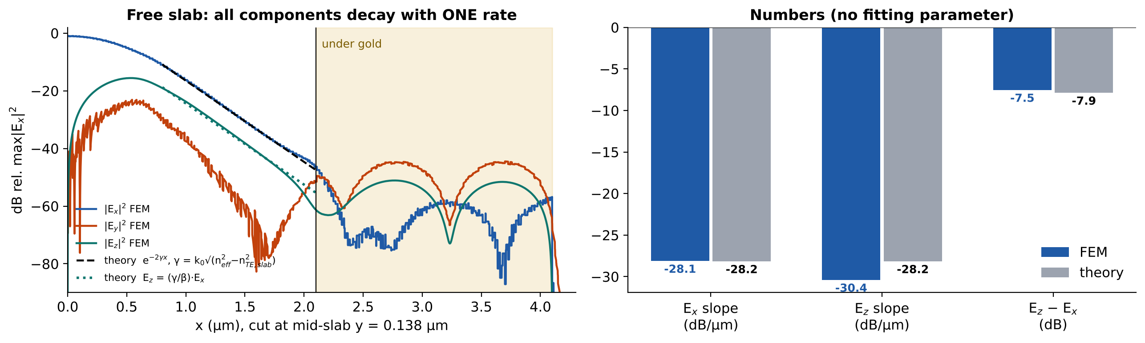
Free slab: a single evanescent tail, no fitting
Outside the rib the mode is a TE slab wave below cut-off: e^(−γx), γ = k₀√(n_eff² − n_TE,slab²) = 3.24 µm⁻¹
−28.1 / −28.2
−7.5 / −7.9 dB
straight line
Ex slope dB/µm: FEM / theory
Ez below Ex: FEM / theory (γ/β)
in dB = bound field (Peng–Oliner EDC picture)
Notes:
Ez follows Ex with the same exponent because Ez ∝ ∂Ex/∂x = −γ Ex, so the ratio is a constant γ/β (times ne²/no²). At x = 2.1 µm the straight line hits the gold: there the curves change character abruptly — that is the start of the cavity.

Slide 9
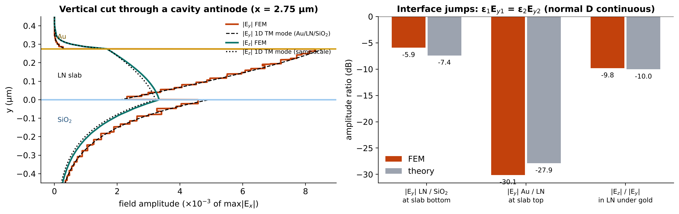
Under the gold the field becomes a plasmon-photonic TM wave
Gold kills tangential E (Ex, Ez → 0 at the surface) and keeps normal E (Ey) — Okamoto (1.32), Maier (2.10–2.12)
1D TM mode of Au / LN 275 nm / SiO₂ reproduces the FEM vertical profile of both Ey and Ez with one common scale
Normal D continuous: Ey jumps ×2.3 into SiO₂ and drops ×(|ε_Au|/ε_LN) ≈ 25 into gold; Ez/Ey = −9.8 dB FEM vs −10.0 dB theory
Maier (2.17): metal supports no TE surface wave → the Ex-polarised mode cannot follow under the gold; it can only feed TM
Jump at the LN/SiO₂ face −5.9 vs −7.4 dB: lowest-order N1 elements only approximate the normal-component jump.

Slide 10
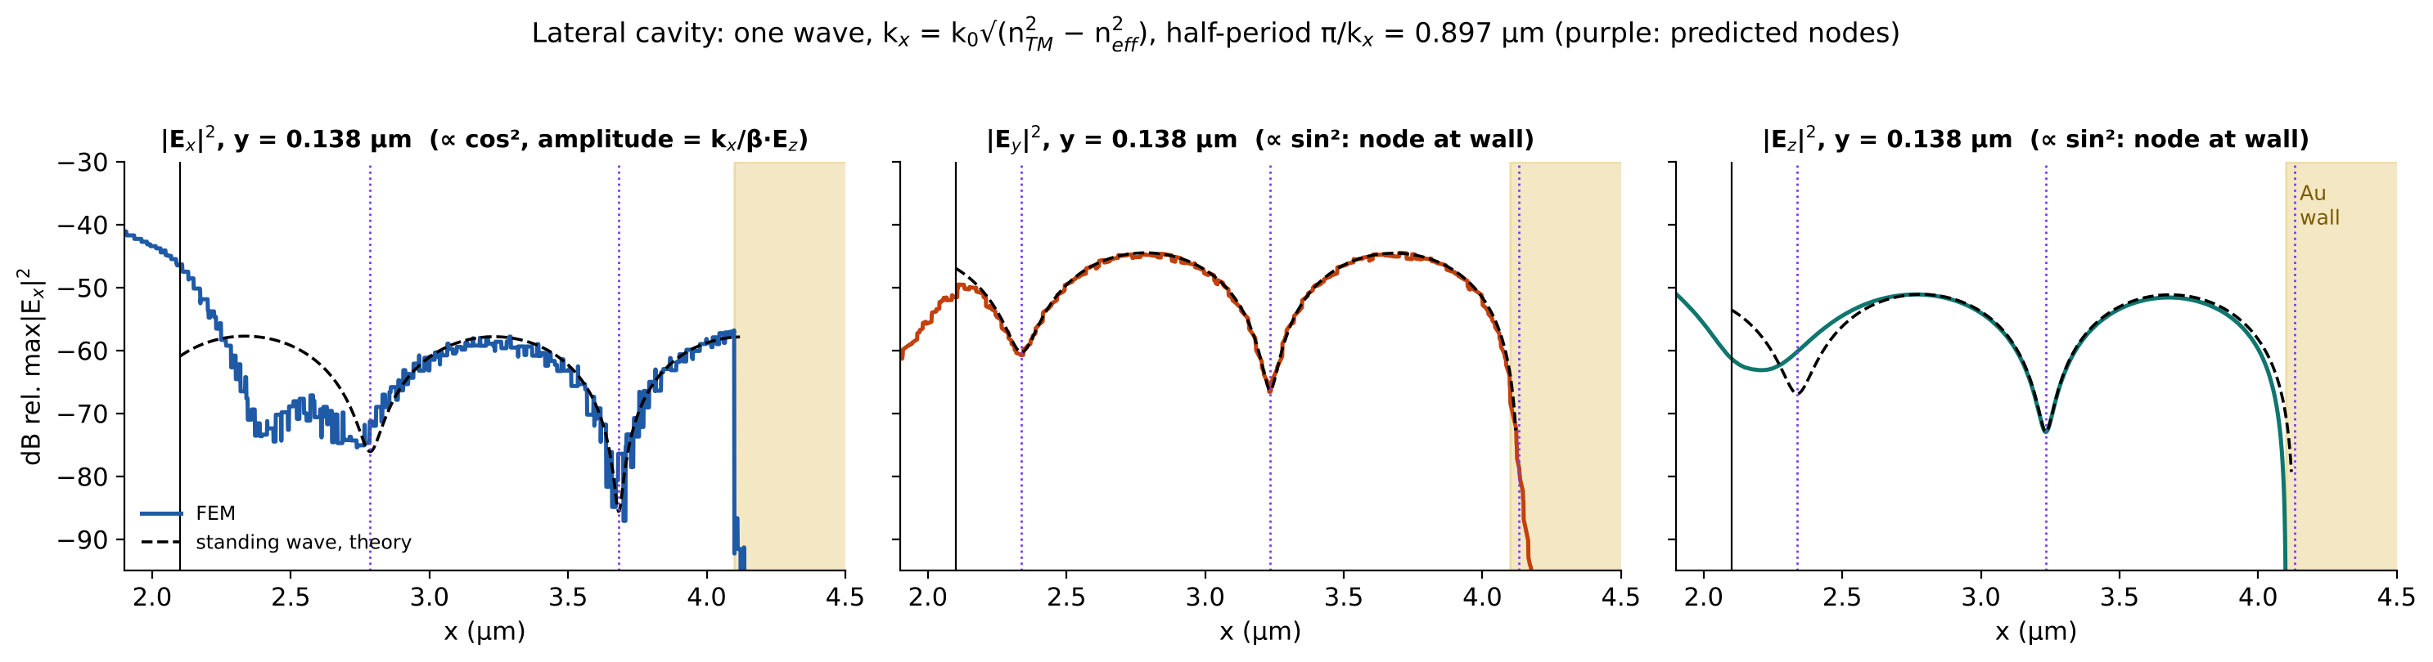
The cavity: one standing wave explains all three components
Gold wall at the slab end = mirror. Tangential Ey, Ez → node (sin); normal Ex → antinode (cos)
0.897 µm
¼ period
kx/β = 0.47
31 nm
predicted half-period π/kx; FEM nulls 3.234 and 2.33 µm
Ex nulls (2.79, 3.71) sit halfway between Ey/Ez nulls
sets Ex amplitude from Ez: no free parameter
effective mirror behind the wall ≈ skin depth (22 nm)
Notes:
Model: TM-to-y wave with potential f(y)·sin(kx(xw−x))·e^{−jβz}. Derivation: Ey ∝ β_lat² f sin, Ez ∝ −jβ f' sin, Ex ∝ −kx f' cos. So Ey and Ez share nodes; Ex has nodes where they peak — the quarter-period shift. The only adjusted quantity is the mirror plane xw, fixed by one FEM null: 4.131 µm, i.e. 31 nm inside the gold, consistent with the field penetrating ~ one skin depth. The left end (x≈2.1-2.3) deviates because there the evanescent bound tail and the corner fields add to the cavity wave — that is the coupling region (Oliner's TE→TM conversion at the step).

Slide 11
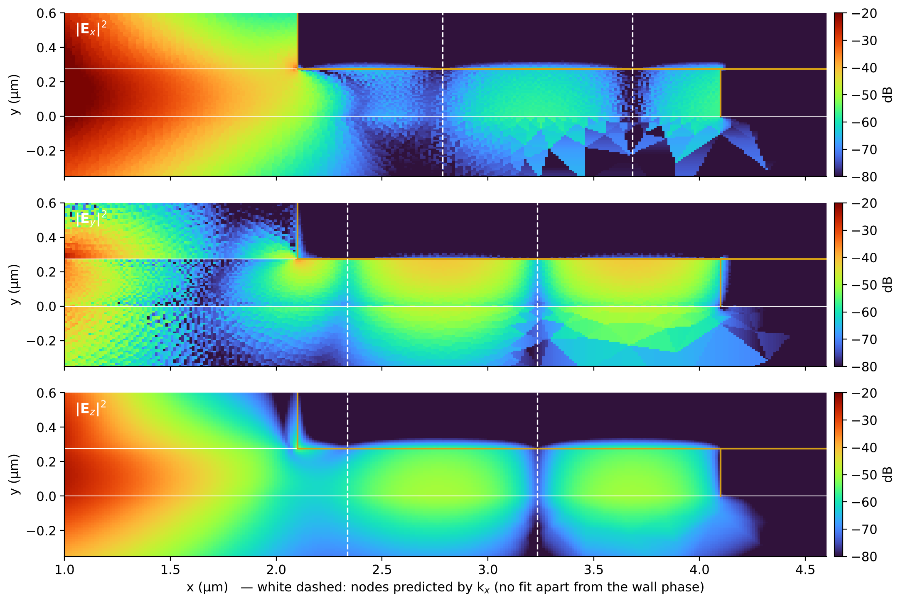
Same story in 2D: nodal lines are vertical and land where predicted
White dashed lines = nodes from kx; Ex lines offset by a quarter period
Nodes are straight vertical lines: the slab wave has one vertical profile and only the lateral factor sin/cos changes
Ey and Ez fill the LN slab and leak downward into SiO₂ (TM tail), never upward into gold
Ex survives only as the small in-plane projection (kx/β) of the TM wave → ~ −60 dB
Tiled triangles in the BOX are N1 discretisation of a −70 dB field, not physics
The left edge (x = 2.1 µm) is the launcher: the evanescent tail hits the gold step and converts TE → TM (Peng–Oliner mode matching)

Slide 12
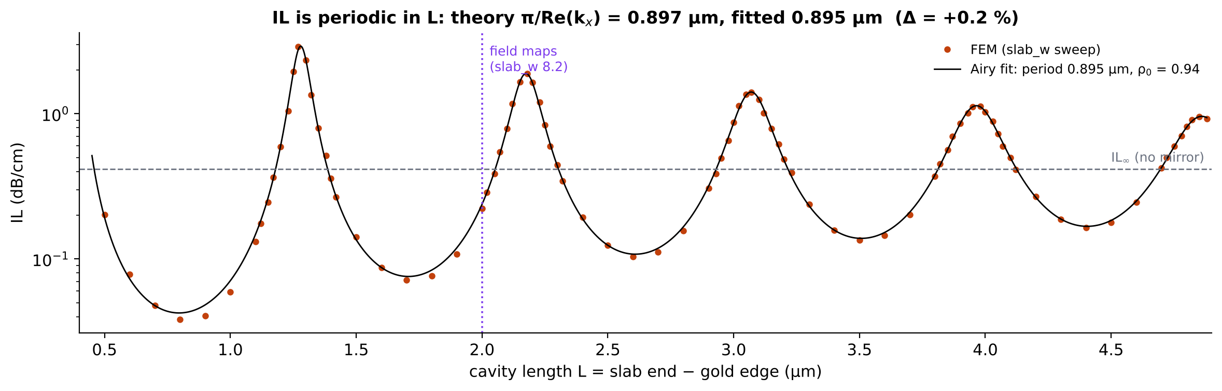
Device consequence: IL is a Fabry–Pérot of the lateral wave
Oliner/Webster: loss vs width shows sharp periodic features set by the transverse wavenumber of the converted wave
0.897 vs 0.895 µm
0.182 vs 0.180 µm⁻¹
×70 swing
period: theory π/kx vs FEM fit (+0.2 %)
round-trip decay 2|Im kx|: theory vs fit
between 0.04 and 2.9 dB/cm for 0.5 µm change of L
Notes:
Webster's condition (1)/Oliner's (2): k_x W = 2mπ for cancellation inside a ridge. Here the bouncing wave lives OUTSIDE the rib, between the gold step and the gold wall, so the condition becomes 2 kx L + φ = 2mπ — an Airy/FP law. The same two-index kx predicts both the period and the decay. The present design (L = 2.0 µm) sits on the rising flank of a peak: a ±50 nm slab-etch error changes IL by ~±40 %. Honesty note: the literature analogue (Webster, Oliner) is for dielectric ridges; no published measurement of this exact metal-clad lateral cavity was found.

Slide 13
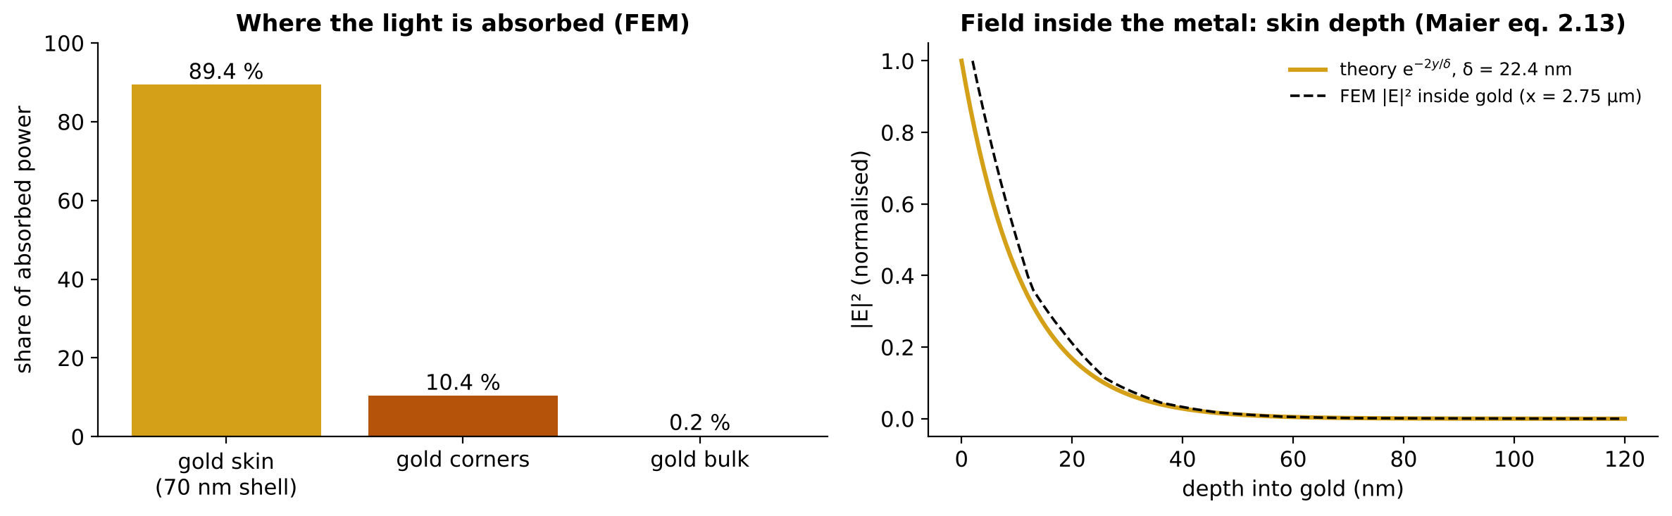
Where the power is lost: the first 20 nm of gold
Loss = Ey,Ez of the lateral wave penetrating the metal by one skin depth (Maier eq. 2.13)
δ = 1/Re√(β_lat² − ε_Au k₀²) = 22.4 nm; FEM decay inside gold follows it
90 % of absorption in the 70 nm shell under the slab, 10 % at the gold/LN corners (field singularities), bulk negligible
So IL scales with how much lateral wave is stored in the cavity → the Fabry–Pérot law of the previous slide

Slide 14
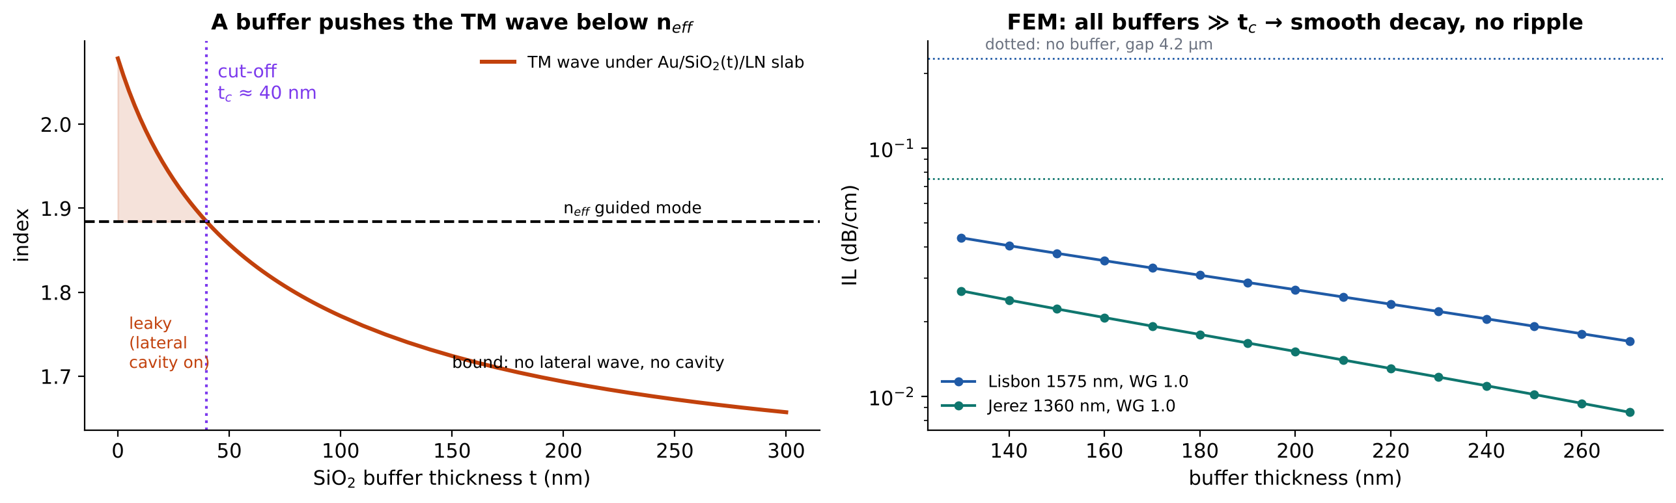
Why a SiO₂ buffer removes the cavity
Liu et al. 2021: the silica layer 'suppresses the leaky modes at the LN/metal interface' (>100× loss reduction)
Lifting gold by t lowers the TM index; below n_eff the lateral wave becomes evanescent: cut-off t_c ≈ 40 nm (1D)
All measured wafers (194–248 nm) are far beyond t_c → no lateral wave, no standing wave, IL smooth and exponential in t
This is the same physics read backwards: no phase-matched TM wave ⇒ no cavity

Slide 15
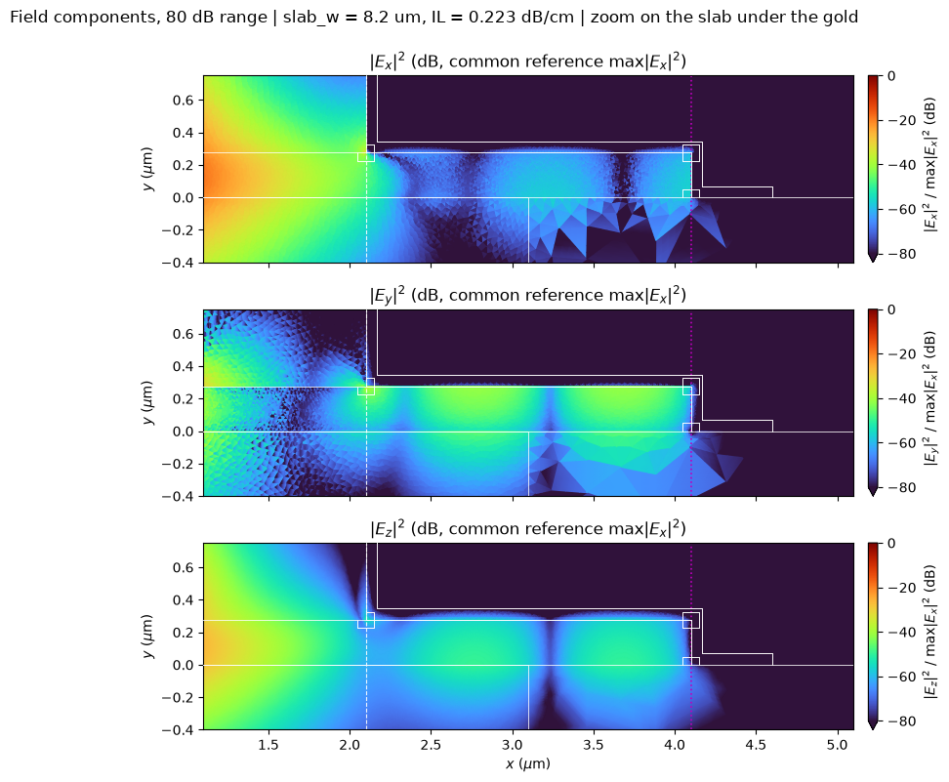
What is physics and what is the mesh
Answering the 'are these artefacts?' question up front
Feature | Verdict
Standing-wave nulls, period 0.9 µm | Physics: predicted to 0.2 %
Ex nulls shifted by ¼ period | Physics: sin/cos of TM wave
Ey/Ez ≫ Ex under the gold | Physics: metal boundary condition
Ex discontinuous at slab end | Physics: normal E jumps (ε ratio)
Straight-line decay in gap | Physics: γ to 0.2 %
Triangles in the BOX at −70 dB | Numerics: N1 normal comp.
Speckle in rib Ey | Numerics: same, field 25 dB down

Slide 16
One-to-one map: simulation ↔ theory ↔ literature
Observation | Mechanism | Check (FEM / theory) | Source
Ez two lobes, null on axis, Im | Gauss law, Ez ∝ −j∂Ex/∂x | phase 90.000° | Okamoto 2.41
Ey four lobes, weak | hybrid mode, ∂²Ex/∂x∂y | same sign pattern | Okamoto 2.41; Oliner II
Linear dB decay in gap | TE slab below cut-off | −28.1 / −28.2 dB/µm | Peng–Oliner EDC
Ez/Ex constant in gap | Ez = (γ/β)Ex | −7.5 / −7.9 dB | Okamoto 2.41
Wave appears under gold | TM index 2.078 > 1.884 | θ = 25° | Oliner II eq. 3; Webster Fig. 2
Ex dies under gold | tangential E → 0; no TE SPP | Ez/Ey −9.8 / −10.0 dB | Maier 2.10–2.17
Nulls every 0.9 µm | standing wave, π/kx | 0.895 / 0.897 µm | Oliner II eq. 2; Webster eq. 1
Ex nulls ¼-period shifted | sin (tangential) vs cos (normal) | 3.71 vs 3.68 µm | Okamoto 1.32
IL periodic in slab end | lateral Fabry–Pérot | 2α 0.180 / 0.182 µm⁻¹ | Webster Fig. 4
Loss in 20 nm of gold | skin depth | δ = 22.4 nm | Maier 2.13
Buffer kills ripple | TM wave cut-off | t_c ≈ 40 nm | Liu 2021 Fig. 1c

Slide 17
Take-aways
1
Every feature is predicted
with textbook formulas and two indices (1.884, 2.078); no free fit except the mirror plane
2
The cavity is a TM wave
born at the gold step by TE→TM conversion, bouncing between gold step and gold-wrapped slab end
3
It is physical and robust in kind
it needs only n_TM > n_eff, true for any unbuffered gold on this LN slab; tilt/roughness are expected to change ρ, not its existence
4
Fabrication sensitivity is real
IL period 0.9 µm in L: control slab-end position to ≲ 50 nm, or add ≥ 40 nm SiO₂ buffer to remove the cavity

