Slide 1
Etching the LN slab vs a SiO₂ buffer
Can we remove the lateral standing wave of the lifted electrodes?
λ = 1575 nm · 550 nm film, 275 nm etch · gap 4.2 µm · x_lift 7 µm · 2D FEM (femwell)
Notes:
Follow-up of the lifted-electrode study: does a full etch of the LN slab remove the standing wave, how does it compare with the standard lifted and the buffered designs, and why the ripple behaves the way it does.

Slide 2
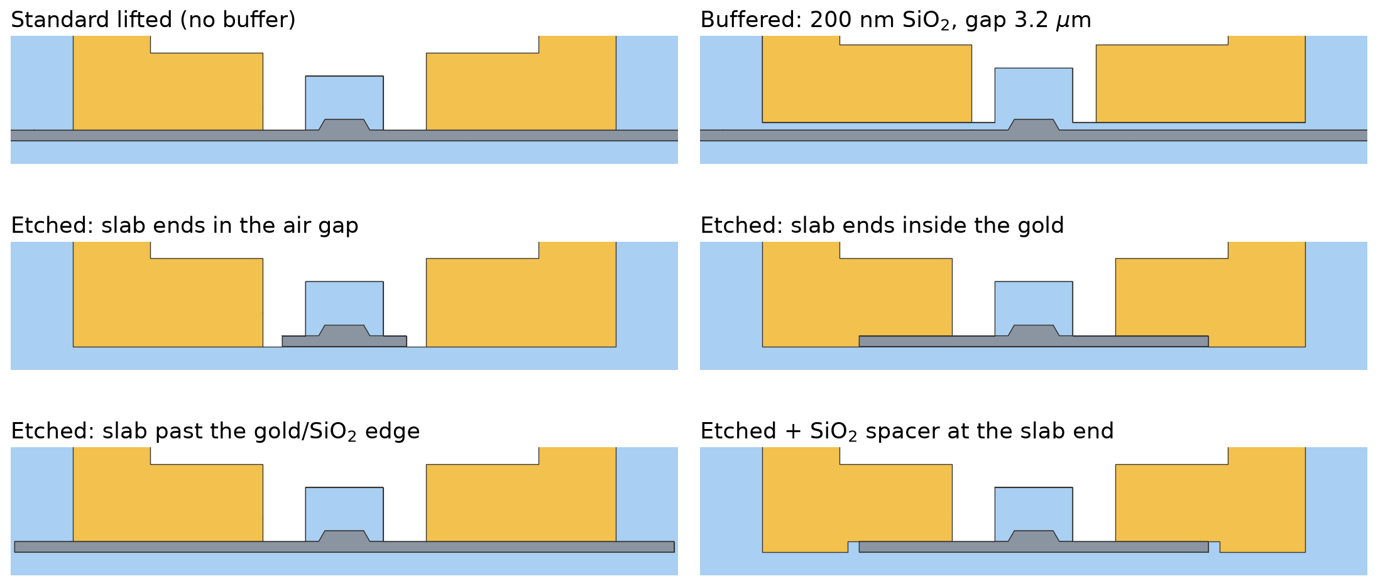
Geometries compared
Same rib, cap and lifted electrodes; only what sits under the gold changes
LN slab SiO₂ buffer / lift / BOX Au electrodes
Notes:
Etched slab: the slab is removed outside slab_w; gold fills the etched zone under the lower blocks, SiO2 under the pads, air in the gap. The spacer variant puts a SiO2 block between the slab end and the gold.

Slide 3
Etched slab: IL and Vπ·L vs slab width
λ = 1575 nm, gap 4.2 µm. slab_w = gap + 2d (d: slab edge beyond the gold inner edge)
≤ 0.003 dB/cm
slab ends in the gap
but Vπ·L 3.1 – 5.4 V·cm
0.04 – 7.4
dB/cm, slab ends in the gold
ripple period 1.79 µm in slab_w
= standard
slab past the gold/SiO₂ edge
IL 0.228 dB/cm at x_lift 7
Notes:
Three regimes. (1) slab_w < gap: no slab under the gold, no leak, IL ~0, but Vpi*L rises because the DC field crosses the air pocket. (2) slab ends in the gold: the gold-wrapped slab end is a mirror, ripples up to 7 dB/cm, first resonance at slab_w 4.95 um. (3) slab past the gold/SiO2 edge: identical to the standard lifted design; the cavity is clamped by x_lift. The orange curve uses a longer gold lower block (x_lift = 11 um) so the slab still ends in the gold up to slab_w 20: the ripple keeps decaying toward IL_inf. Check: at slab_w 8.6 / 10.4 / 12.2 the x_lift = 11 model gives the same IL as the nominal one within 0.2 %.

Slide 4
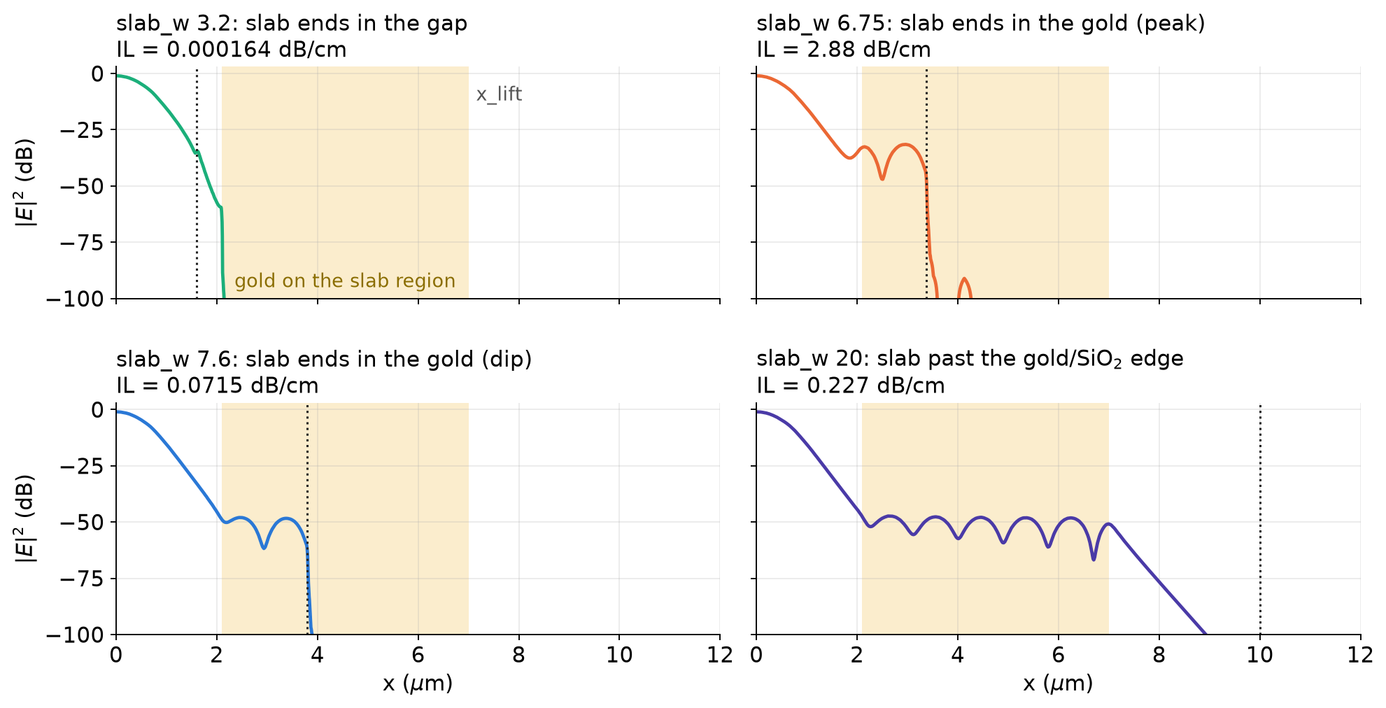
Where the light goes
|E|² along the slab mid-height; shaded = gold on the slab region, dotted = slab end
Notes:
Slab in the gap: the field never reaches the gold. Slab in the gold: a standing wave between the gold inner edge and the slab end. Slab past the edge: the standing wave stops at x_lift; beyond it the slab is under SiO2 and the field decays evanescently, so the slab end is invisible.

Slide 5
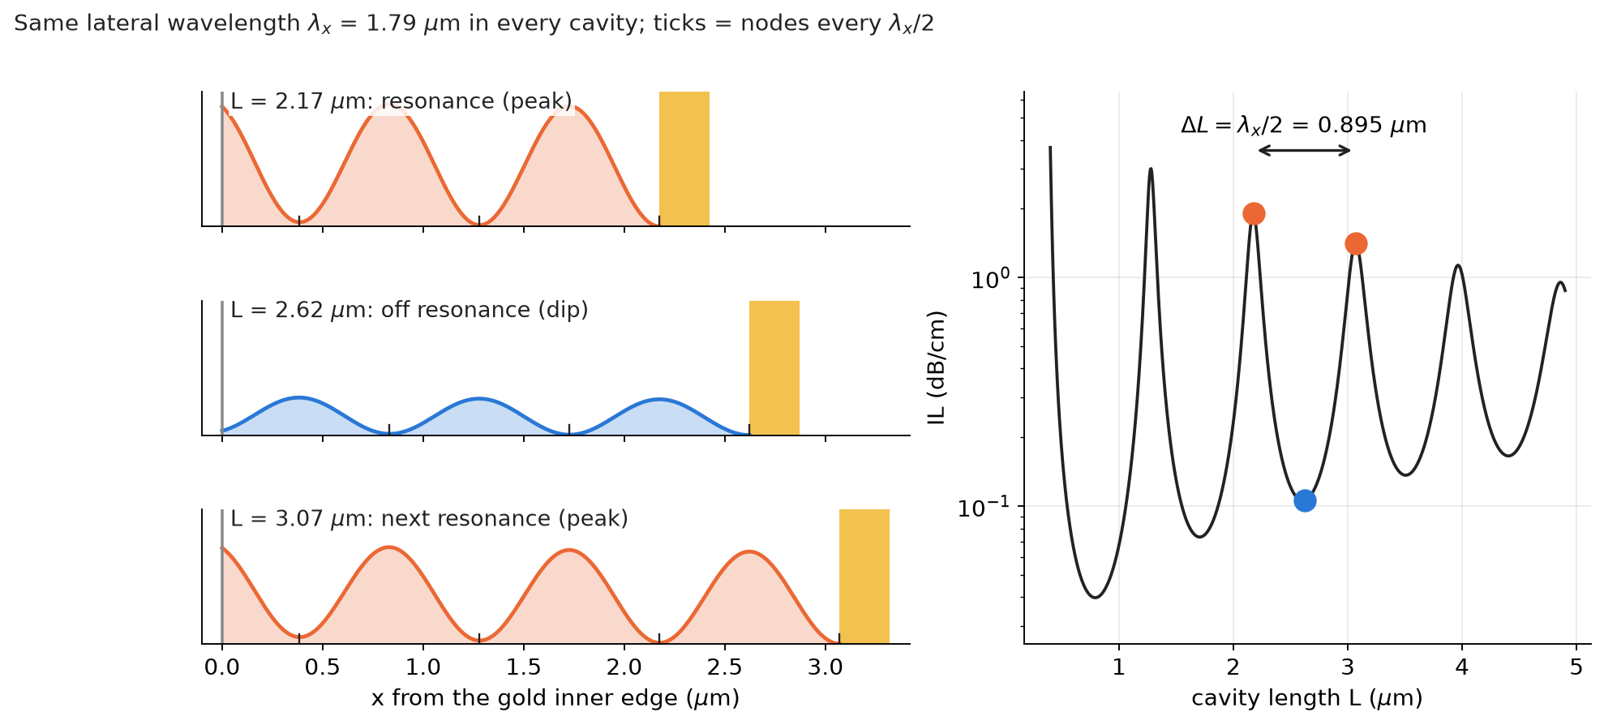
Why the ripple period does not depend on the cavity length
We sweep the mirror position at fixed λ, not λ at fixed mirror position
λ and β are fixed
→ the lateral wavelength λx = 1.79 µm is fixed by the source, not by the cavity
Resonance: 2kx·L + φ = 2πm
→ a new resonance every ΔL = λx/2 = 0.895 µm, whatever L is (like scanning a Fabry–Pérot mirror)
Off resonance
the rib keeps feeding the cavity; the echo returns out of phase → weaker field → dip, not zero
Notes:
A cavity scanned in frequency has resonances spaced by the free spectral range c/2nL, which depends on L. Here the frequency and the propagation constant beta of the rib mode are fixed, so the lateral wavenumber kx is fixed. Changing L by lambda_x/2 adds one half-wavelength and brings the same resonance back: the ripple period in L is lambda_x/2, independent of L. Off resonance the wave still exists because the cavity is continuously driven by the rib mode; the reflected wave returns with the wrong phase and partially cancels the incoming one, so the field under the gold is weaker and the absorption (IL) is lower.

Slide 6
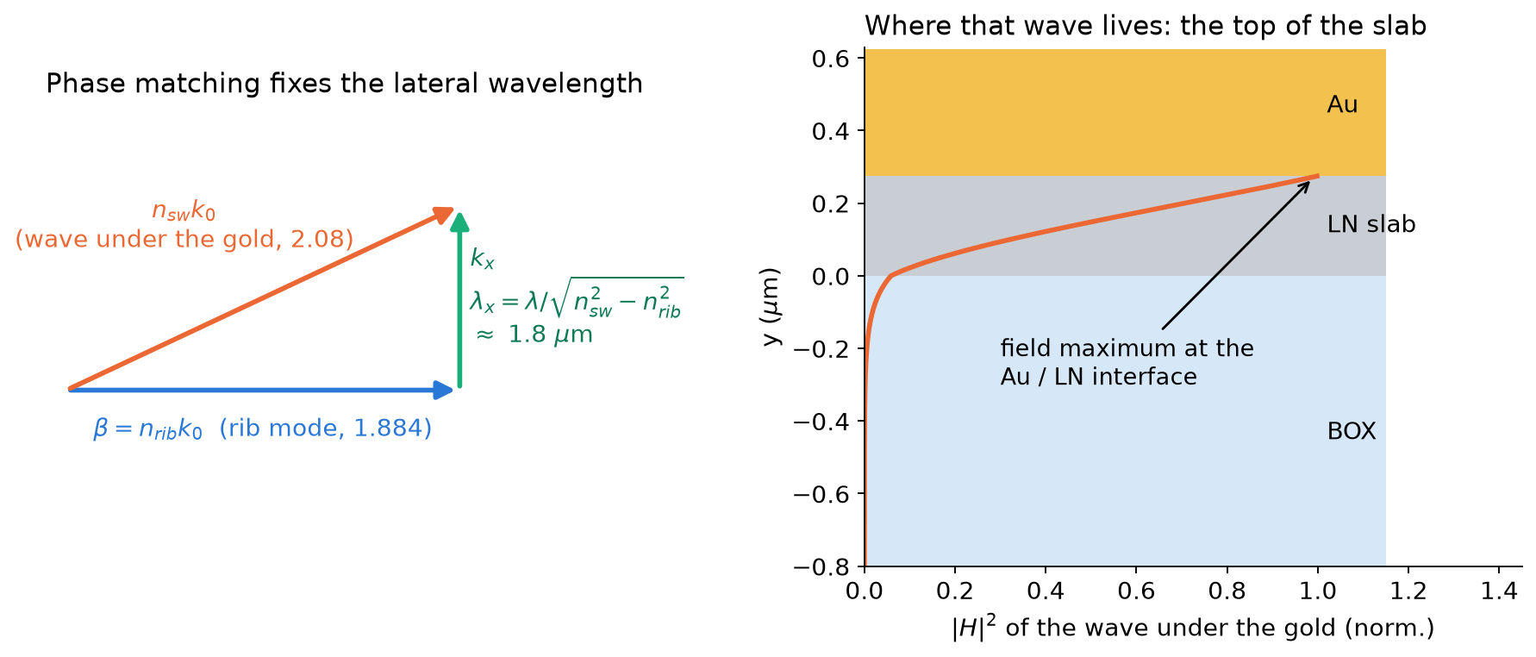
What sets the period: the wave under the gold
The stack Au / LN slab / BOX and the rib mode, not the mirror
Period
1D stack: n_sw = 2.08, rib: 1.884
→ λx/2 = 0.89 – 0.93 µm
2D fit: 0.895 µm for both mirrors
Both mirrors end the same guide
slab end: the slab stops
gold/SiO₂ edge: the gold cover stops
both at the top of the slab, where the field peaks
Buffer ≥ 38 nm: n_sw < n_rib
→ kx imaginary: no wave, no cavity
Notes:
The light under the gold is a gold-bound TM wave of the Au/LN/BOX stack with n_sw ~ 2.07-2.08. Its lateral wavenumber is kx = k0*sqrt(n_sw^2 - n_rib^2). The mirror material does not appear: it only terminates this guide. The guide exists only where gold covers LN, so it ends either where the slab ends or where the gold leaves the slab. The wave is strongest exactly at the gold/LN interface, at the top of the slab, so the gold edge is not 'away' from the field. With a SiO2 buffer above the cutoff the same stack gives n_sw below n_rib: kx becomes imaginary and no lateral wave can exist.

Slide 7
Same cavity, two mirrors
IL vs cavity length L = mirror position − gold inner edge
fit | slab end | gold/SiO₂ edge
period (µm) | 0.895 | 0.894
IL∞ (dB/cm) | 0.414 | 0.415
decay 2α (1/µm) | 0.182 | 0.179
mirror ρ₀ | 0.957 | 0.922
Same period, IL∞ and decay
→ they belong to the cavity (the wave under the gold)
Different ρ₀ and phase
→ they belong to the mirror: curves shifted by 0.34 µm (next slide)
Notes:
Period, asymptote and decay coincide: they belong to the cavity medium. The mirrors differ in strength and in reflection phase. At the gold-wrapped slab end the field must vanish at the metal wall: a node sits at the wall. At the gold/SiO2 edge the guide ends into a slab where the wave is evanescent: the field has an antinode at the edge and leaks ~0.3 um into the SiO2-covered slab. This moves the effective mirror plane by ~0.30 um (field cuts) and shifts the curves by 0.34 um (fits).

Slide 8
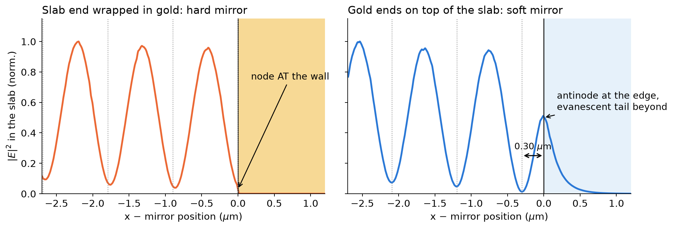
Why the two curves are offset
The two mirrors reflect with a different phase
Hard mirror: the field must vanish at the gold wall → node at the mirror
Soft mirror: the wave turns evanescent past the edge → antinode at the edge, tail into the SiO₂-covered slab
→ effective mirror planes 0.30 µm apart (field) ≈ 0.34 µm shift of the IL curves (fit)
Notes:
Field cuts aligned on the mirror position. Left: slab_w 12 um, the slab end wrapped in gold; the last node coincides with the wall. Right: slab past the edge, x_lift 7; the field has a local maximum at the edge and decays evanescently beyond it; the last node is 0.30 um inside. A shift of the effective mirror plane shifts every resonance by the same length, which is the offset seen between the two IL curves.

Slide 9
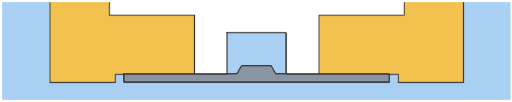
Countermeasure 1: SiO₂ spacer at the slab end
Slab ending in the gold, SiO₂ spacer of width w between slab end and gold (fabrication: not viable)
spacer w | peak IL | at slab_w
none | 2.88 | 6.75
100 nm | 2.88 | 6.60
300 nm | 2.93 | 6.50
600 nm | 3.04 | 6.50
The ripple survives at every width
Gold over SiO₂ cannot carry the wave (n < n_rib): the spacer is just another mirror, it only shifts the peaks
Notes:
Under the gold the wave can only be absorbed or reflected: beta of the rib mode exceeds k0*n of every cladding, so nothing can radiate away. A SiO2 spacer replaces the hard metal wall with a soft (evanescent) mirror: the peaks move by ~0.25 um in slab_w, their height does not drop (100, 300, 600 nm simulated). Wider spacers were not simulated: the spacer was judged not viable for fabrication, and from 300 to 600 nm the curve no longer changes.

Slide 10
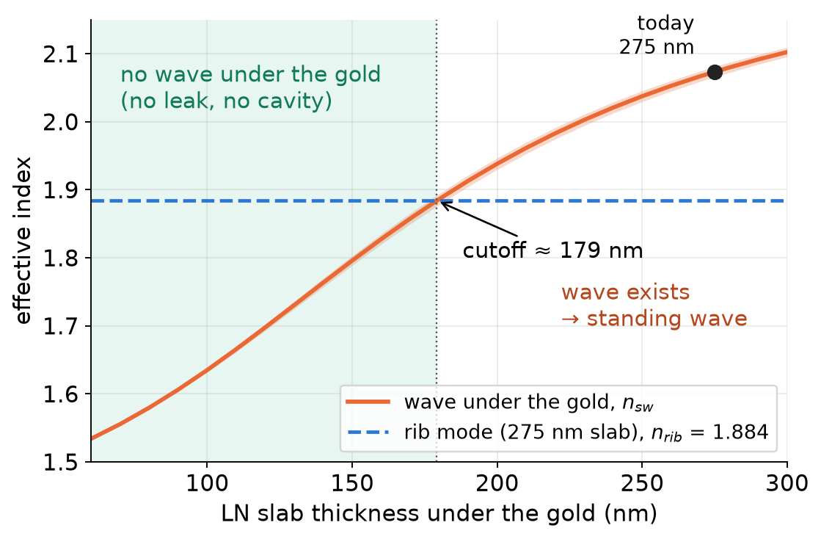
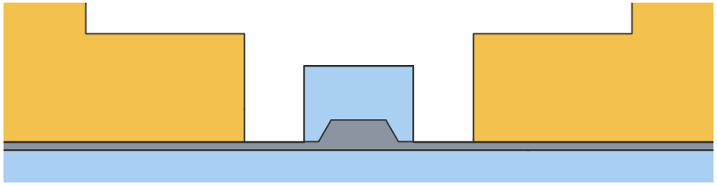
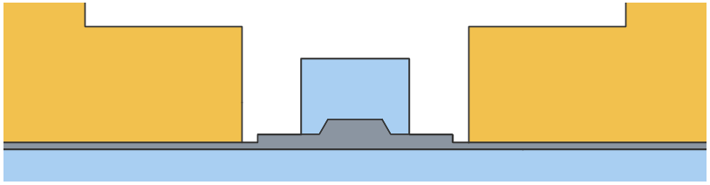
Countermeasure 2: no wave under the gold
A slab thinner than ~180 nm under the gold cannot carry the wave (1D model, 1575 nm)
A. deeper rib etch (one etch, 150 nm slab)
B. partial 2nd etch outside slab_w (125 nm)
Same materials, lift kept, no buffer
Notes:
The gold-bound wave under the electrodes needs enough LN: below ~180 nm its index drops under the rib-mode index and the lateral wave is cut off, exactly like the SiO2 buffer does. Two ways to get there without new materials: etch the rib deeper (one etch step, thin slab everywhere), or a second partial etch that thins the slab only outside slab_w, keeping the nominal 275 nm slab around the rib.

Slide 11
Option A: deeper rib etch
550 nm film, slab left after the rib etch: 275 nm (today) → 175 / 150 / 125 nm
slab | gap (µm) | IL (dB/cm) | Vπ·L (V·cm)
275 nm (today) | 4.2 | 0.18 – 0.89 | 2.27
200 nm | 4.2 | 0.0658 | 2.72
175 nm | 4.2 | 0.121 | 2.92
150 nm | 4.2 | 0.00344 | 3.15
150 nm | 3.6 | 0.0548 | 2.59
150 nm | 3.2 | 0.357 | 2.22
125 nm | 4.2 | 0.000585 | 3.43
125 nm | 3.6 | 0.011 | 2.81
125 nm | 3.2 | 0.0801 | 2.40
buffered 200 nm | 3.2 | 0.049 | 2.15
Ripple gone at ≤ 150 nm, but the thin slab weakens the EO overlap: Vπ·L +30 … +50 %
Narrowing the gap brings the gold onto the rib mode: IL rises
Notes:
Deeper rib etch: one process step, no new material. The ripple disappears (flat IL vs x_lift at 150 nm, nearly flat at 175 nm, close to the cutoff). But Vpi*L rises because less LN carries the DC field and the mode, and recovering it with a smaller gap puts the metal close to the mode.

Slide 12
Option B: partial second etch outside slab_w
Rib and 275 nm slab untouched; 125 nm LN left from slab_w outward; gap 4.2 µm
case | IL (dB/cm) | Vπ·L (V·cm)
slab_w 3.2 (step 0.5 µm before gold) | 0.00794 | 2.69
slab_w 3.6 (step 0.3 µm before gold) | 0.0176 | 2.54
slab_w 4.0 (step 0.1 µm before gold) | 0.0594 | 2.38
150 nm left, slab_w 3.6 | 0.0552 | 2.47
gap 3.2, slab_w 2.6, 100 nm left | 0.208 | 2.03
gap 3.2, slab_w 2.6, 125 nm left | 0.455 | 1.93
gap 3.2, slab_w 2.8, 125 nm left | 0.75 | 1.85
gap 3.4, slab_w 2.8, 125 nm left | 0.238 | 2.06
gap 3.6, slab_w 3.0, 100 nm left | 0.0569 | 2.27
gap 3.6, slab_w 3.0, 125 nm left | 0.124 | 2.18
buffered 200 nm, gap 3.2 | 0.049 | 2.15
step in the gap
step under the gold
Flat vs x_lift 6.5 – 7.5 µm: IL 0.0176 – 0.0176 dB/cm
Step must stay in the gap: under the gold it forms a short cavity (2.4 dB/cm at slab_w 4.4)
Notes:
Partial second etch: the slab is thinned to 125 nm from slab_w outward, so the gold sits on LN that cannot carry the lateral wave. IL is flat in x_lift. The DC field still crosses LN instead of air, so the Vpi*L penalty of the full etch is much smaller. Requirement: the thickness step must lie in the gap with margin for the litho overlay; if it falls under the gold, a short cavity forms.

Slide 13
All solutions: insertion loss vs Vπ·L
Each point is a ripple-free design (gap and thickness varied); lower-left is better
at Vπ·L | buffered | best alternative
≈ 1.95 V·cm | 0.141 dB/cm | 0.455 dB/cm
≈ 2.05 V·cm | 0.086 dB/cm | 0.208 dB/cm
≈ 2.27 V·cm | 0.026 dB/cm | 0.057 dB/cm
The buffer wins
At the same Vπ·L it has 2 – 3× lower IL than any thin-LN or etched variant
It needs no alignment-critical step
Notes:
Trade-off between loss and drive voltage. The buffered curve is its gap scan (2.4 to 3.6 um, 200 nm SiO2; computed with the previous SiO2 constant, ~2 % lower IL). Every alternative point lies above the buffered curve: for the same Vpi*L the alternatives absorb more, because thin LN under the gold still brings the metal closer to the mode, or the rib mode is less confined. The standard lifted design is a vertical bar: its IL depends on x_lift.

Slide 14
Countermeasures compared
λ = 1575 nm; IL range over the swept dimension (x_lift or slab_w)
Design | IL (dB/cm) | Ripple | Vπ·L (V·cm) | Extra process
Standard lifted, gap 4.2 µm | 0.18 – 0.89 | vs x_lift, period 0.9 µm | 2.27 | —
Etched, slab ends in gold | 0.04 – 7.4 | vs slab edge, period 0.9 µm | 2.26 | LN etch + alignment
Etched, slab past the edge | 0.18 – 0.89 | = standard (vs x_lift) | 2.27 | LN etch
Etched + SiO₂ spacer (100–600 nm) | 0.05 – 3.0 | shifted, not removed | 2.27 | not viable (fab)
Etched, slab ends in gap, gap 4.2 / 3.2 | ≤ 0.003 / 0.083 | none | 3.1 – 5.4 / 2.47 | LN etch + alignment
Deeper rib etch, 150 nm slab, gap 4.2 | 0.00344 | none | 3.15 | none (deeper etch)
Deeper rib etch, 125 nm slab, gap 3.2 | 0.0801 | none | 2.40 | none (deeper etch)
Partial 2nd etch, 125 nm, gap 4.2 | 0.0176 | none | 2.54 | 2nd LN etch + alignment
Partial 2nd etch, 100 nm, gap 3.6 | 0.0569 | none | 2.27 | 2nd LN etch + alignment
Buffered 200 nm SiO₂, gap 3.2 µm | 0.049 | none (flat ±0.2 %) | 2.15 | blanket oxide, no litho
Notes:
IL ranges: standard and slab-past-edge over x_lift 6.5-11 um; slab in gold over slab_w 4.2-14 um; spacer over slab_w 6-8 um for 100 and 300 nm. All at 1575 nm with Sellmeier SiO2 and Johnson & Christy gold. Buffered values from the buffered study (x_lift = 7 um).

Slide 15
Recommendation: keep the 200 nm SiO₂ buffer
Best IL – Vπ·L trade-off, flat IL, no alignment-critical step
0.049 dB/cm
2.15 V·cm
38 nm
IL, flat vs x_lift
(standard: 0.18 – 0.89)
Vπ·L at gap 3.2 µm
(standard: 2.27 at 4.2 µm)
cutoff thickness
200 nm = 5× margin
Why no geometric trick can replace it
Under the gold the wave cannot radiate (β > k₀n of every cladding): any termination reflects it → a cavity
Ripples vanish only if the wave is never launched: no slab under the gold (Vπ·L +35 % … +140 %) or a buffer above cutoff
Thin LN under the gold (deeper or partial etch) also kills the wave, but at equal Vπ·L its IL is 2 – 3× higher
Buffer: same materials, keeps the lift, one blanket SiO₂ deposition before the gold, no extra lithography
Notes:
Recommendation: keep the 200 nm buffered lifted design. Etching the slab either keeps the cavity (slab in the gold, or past the edge) or kills it at a large Vpi*L cost (slab in the gap).

