Slide 1
Arm imbalances in the TW-MZM model
Origin, effect on EO bandwidth and eye, and INTERCONNECT representation

Slide 2
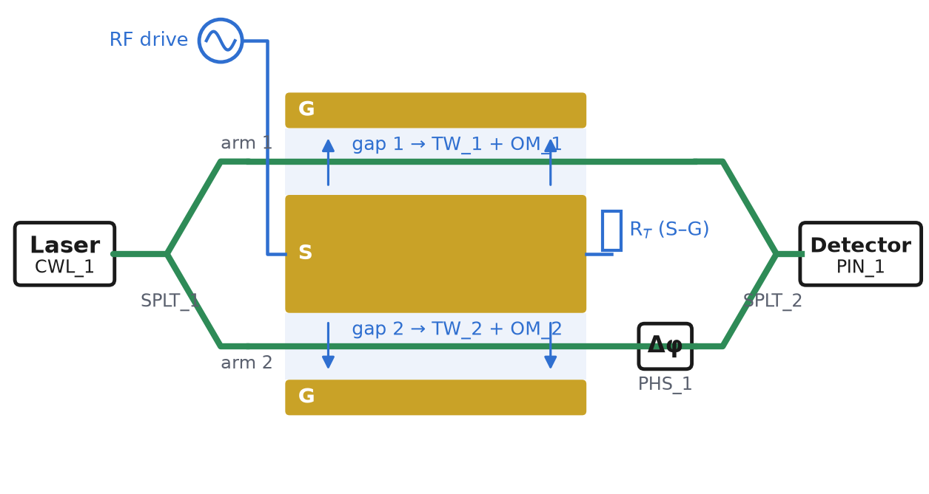
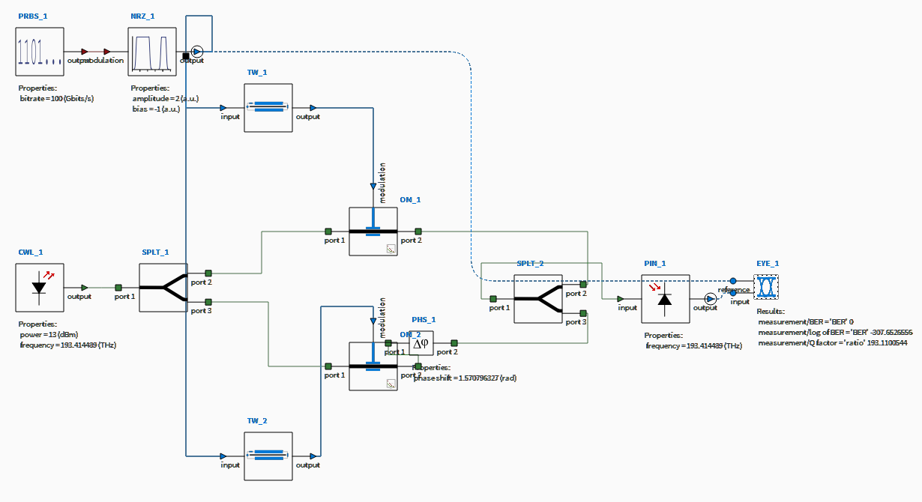
The model: MZM, block by block
The simple picture (left) is what INTERCONNECT simulates (right)
One GSG line → two TW blocks
Each arm sits in one S–G gap. Same line, same drive, opposite field: TW_1/OM_1 = gap 1, TW_2/OM_2 = gap 2.
CWL_1 laser
SPLT_1/2 Y splitter / combiner
TW_1/2 + OM_1/2 electrode gap + phase modulation
PHS_1 bias (quadrature)
PIN_1 photodetector
Reference device for every number: measured line 6NK0020 scaled to 16.5 mm · n_{g} = 2.27 · V_{π} = 4 V per arm → 2 V for the push-pull device · drive 2 Vpp · 100 Gb/s NRZ · EO BW without imbalance = 58.8 GHz

Slide 3
All considered imbalances
Six knobs, each one block in INTERCONNECT
1 Arm loss imbalance
one arm loses more light than the other
V_{π} (per arm): voltage on one S–G gap that alone shifts that arm's optical phase by π. In push-pull both arms move, in opposite directions, so the device V_{π} is half: 4 V per arm → 2 V for the device (16.5 mm).
2 Splitter imbalance
the input Y-branch does not split 50 : 50
Vpp: peak-to-peak drive voltage: the step between a '0' (−1 V) and a '1' (+1 V) for 2 Vpp. With Vpp = device V_{π}, the drive swings the MZM from minimum to maximum transmission.
3 Static phase error
the two optical paths differ: bias off quadrature
Extinction ratio (ER): power of the '1' level / power of the '0' level in the eye, in dB.
4 V_{π} imbalance
one arm gets less phase per volt
EO bandwidth: modulation frequency where the EO response is 3 dB below its low-frequency value.
5 Group-index imbalance
light travels at a different speed in each arm
6 Y-branch excess loss
both Y-branches lose light (common to both arms)
Balanced: the reference device, with no imbalance.

Slide 4
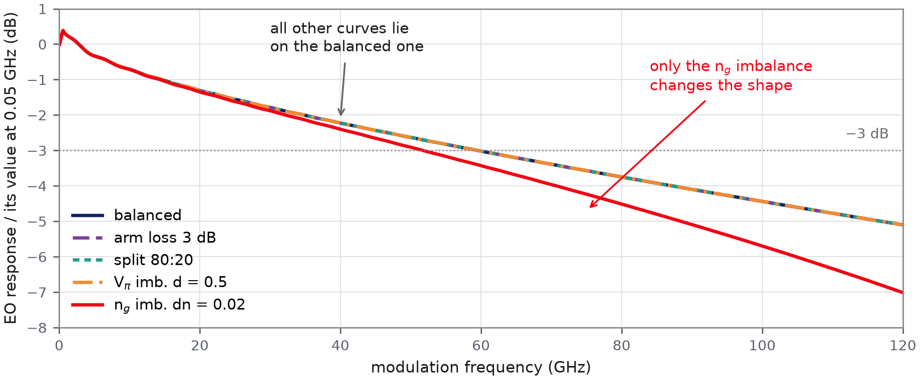
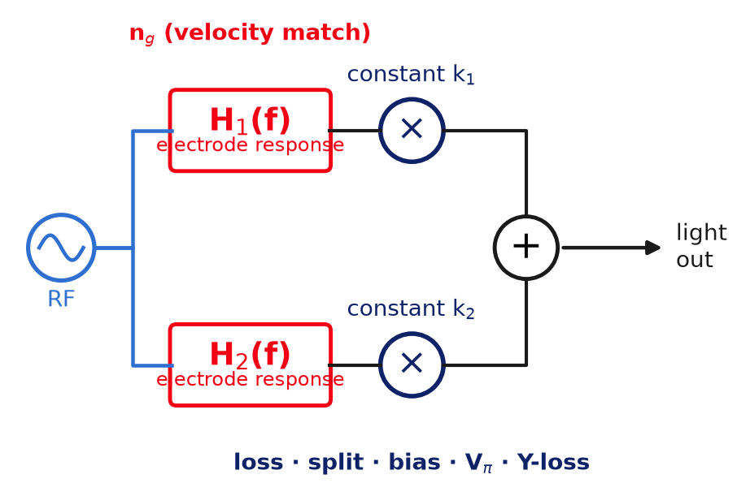
Why only one imbalance can move the EO bandwidth
Imbalances multiply each arm's electrode response H(f) by a constant, except n_{g}
Constant factors: loss, split, bias, V_{π}, Y-loss
H(f) describes how the electrode passes each frequency of the drive: long runs of equal bits are low frequencies, isolated single bits are high frequencies. A constant factor scales all of them equally, so the normalised curve, and the bandwidth, do not change. Optical loss cannot depend on the modulation frequency: the carrier is at 193 THz, the modulation below 100 GHz.
Frequency-dependent: group index n_{g}
n_{g} sets how long the light stays in step with the RF wave, i.e. the shape of H(f). Different n_{g} per arm → H₁(f) ≠ H₂(f) → their sum has a different shape → the bandwidth moves. The electrode RF loss is frequency-dependent too, but it is the same line for both arms: it is part of H(f), not an imbalance.

Slide 5
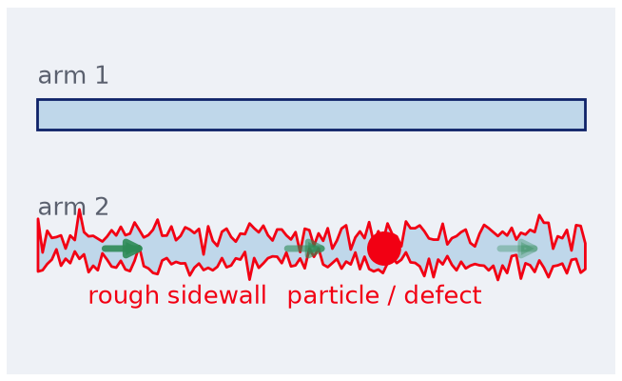
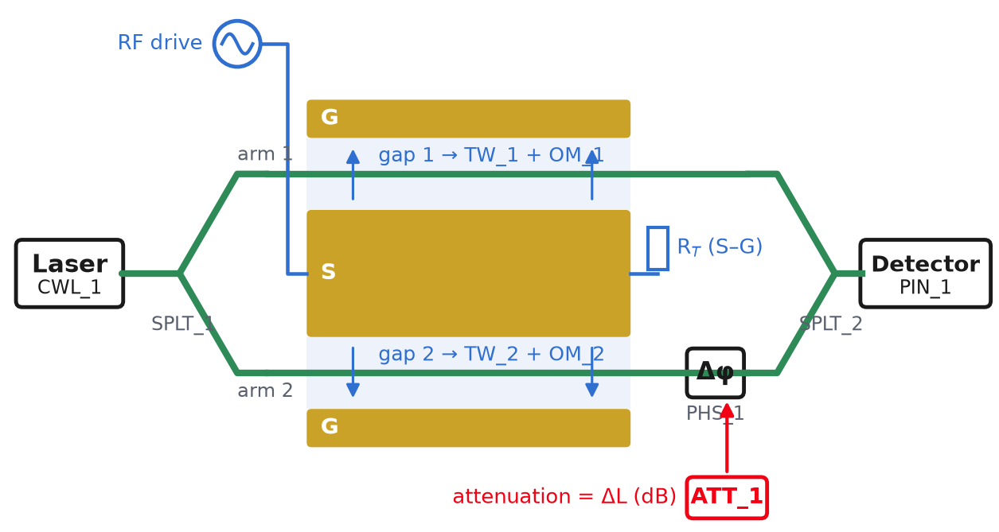
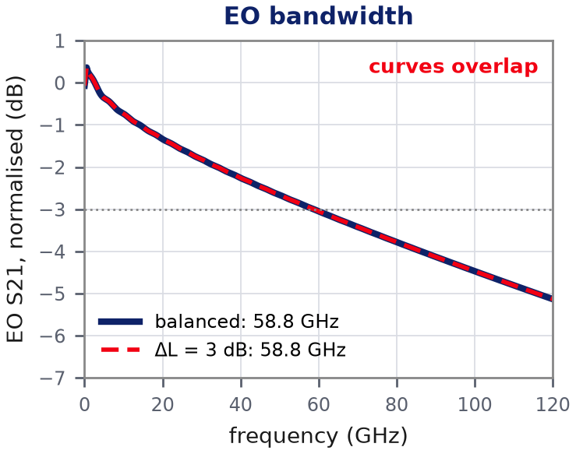
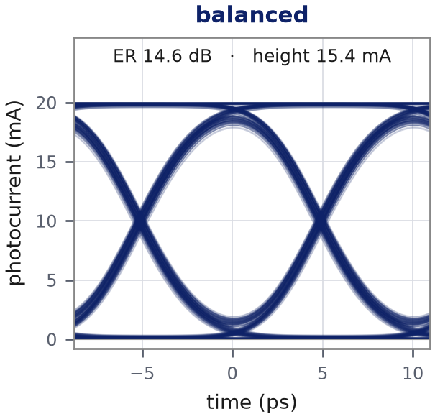
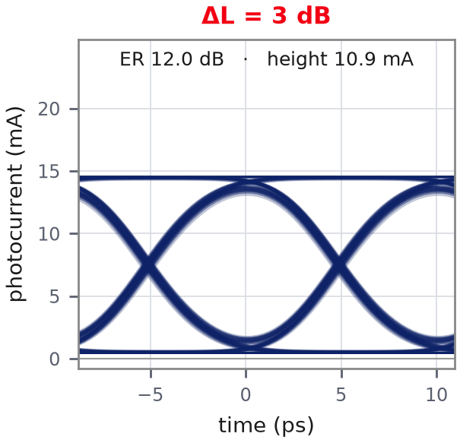
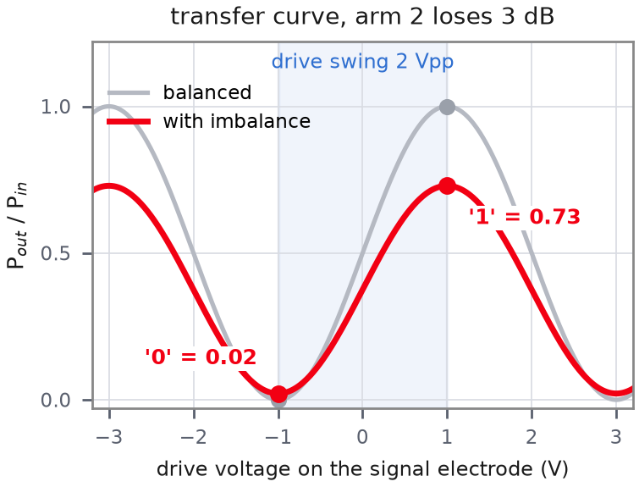
1 Arm loss imbalance
One arm loses more light: the '1' gets dimmer, the '0' no longer goes fully dark
Where it comes from
Where it enters the model
In INTERCONNECT
ATT_1
Optical Attenuator, arm 2
attenuation = ΔL (dB)
simulated: 1 and 3 dB
rough sidewall, particle or local defect in one arm
Why the eye changes
EO BW: unchanged: the optical loss is the same at every modulation frequency
Eye: the '1' needs the two fields to add, the '0' needs them to cancel. A weaker arm 2 lowers the sum a lot ('1': 1 → 0.73) but leaves a small difference ('0': 0 → 0.02). ER 14.6 → 12.0 dB at 3 dB

Slide 6
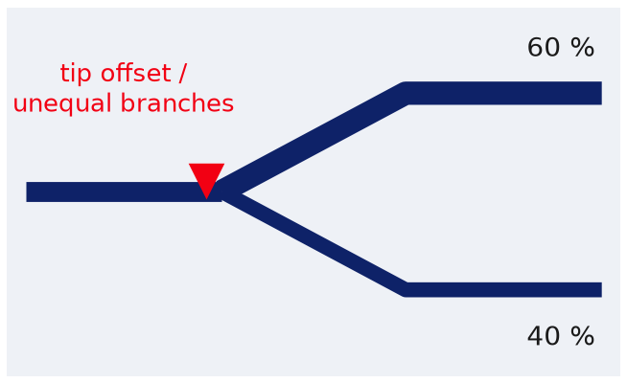
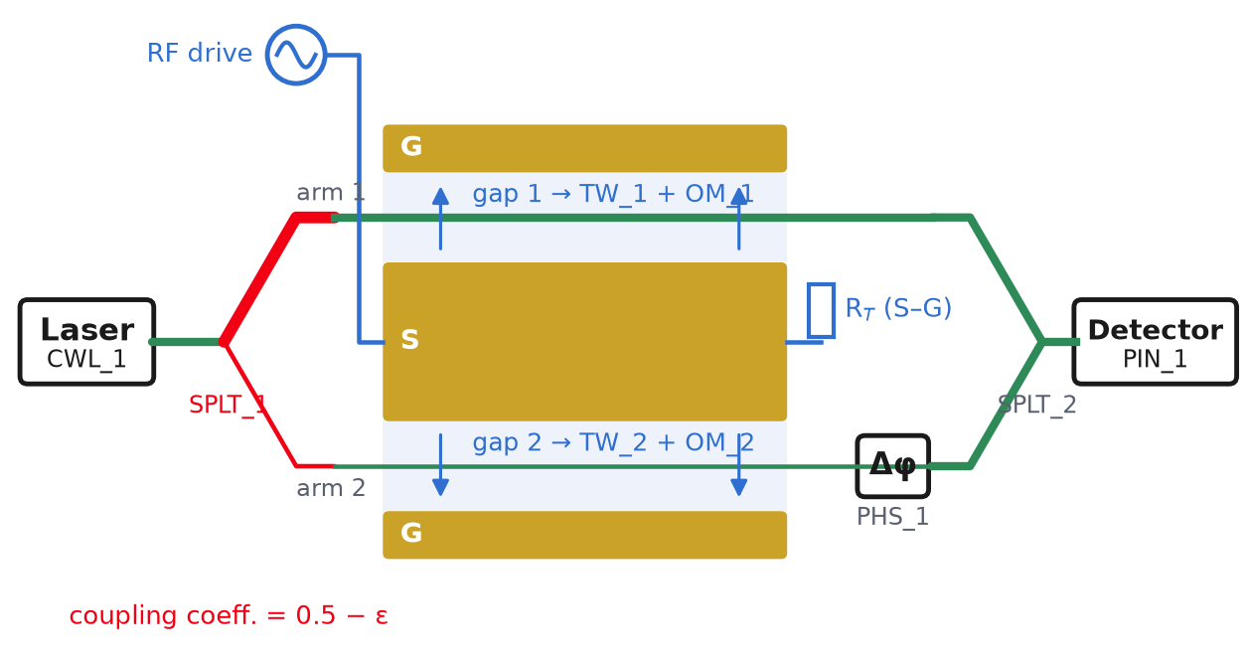
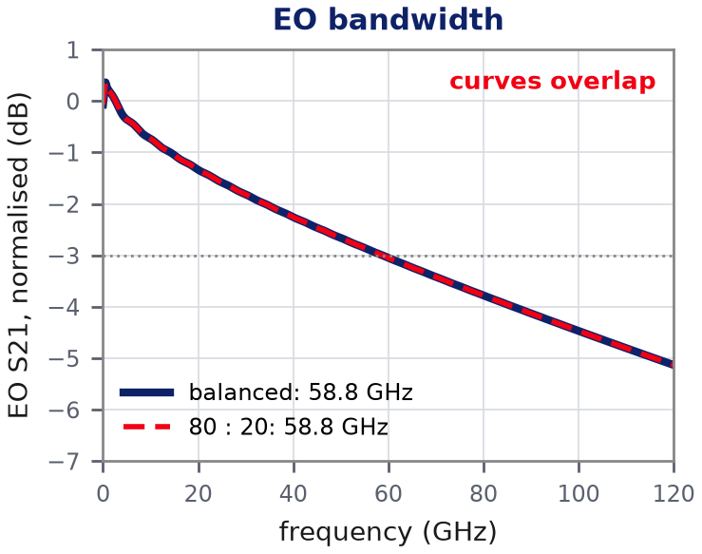
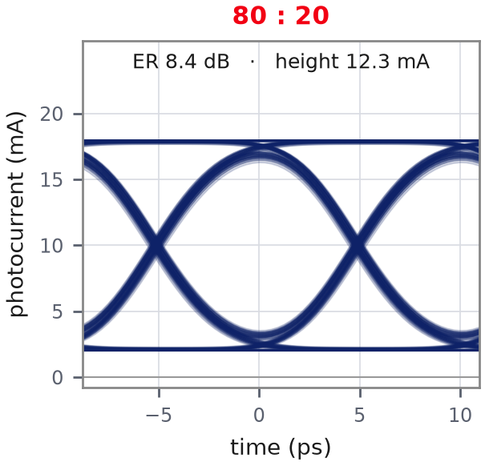
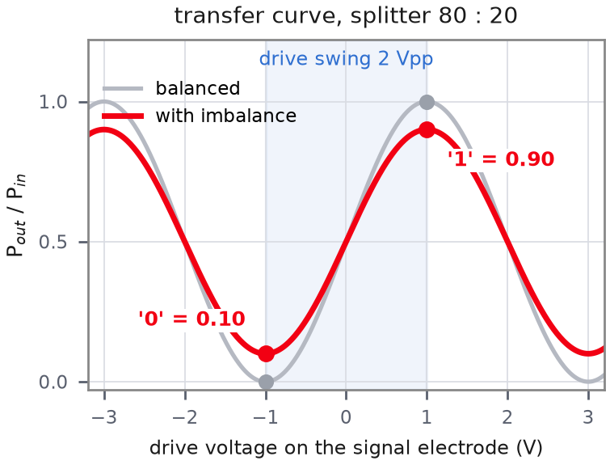
2 Splitter imbalance
Light shared unequally between the arms: the '0' rises, no light is lost
Where it comes from
Where it enters the model
In INTERCONNECT
SPLT_1
Waveguide Y Branch, input
coupling coefficient = 0.5 − ε
simulated: 60:40 and 80:20
Y-junction asymmetry: tip offset, unequal branches
Why the eye changes
EO BW: unchanged: a fixed power ratio, the same at every modulation frequency
Eye: no light is lost, so P('1') + P('0') stays 1: light moves from the '1' (1 → 0.90) to the '0' (0 → 0.10). ER 14.6 → 8.4 dB at 80:20, mean power unchanged

Slide 7
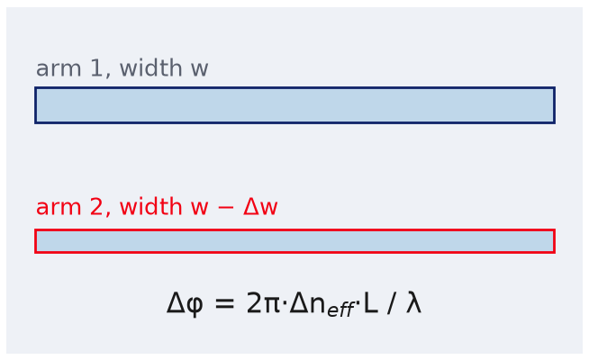
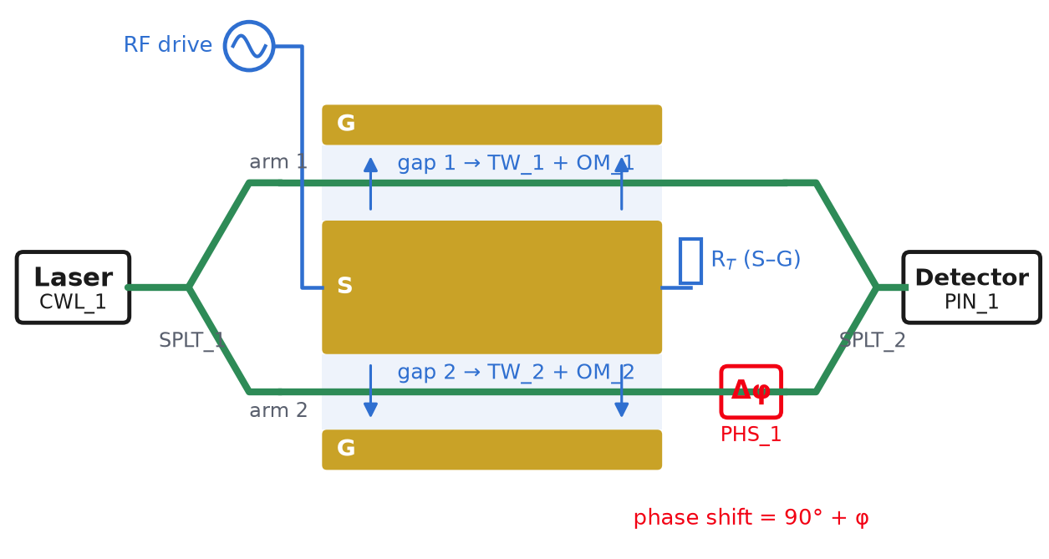
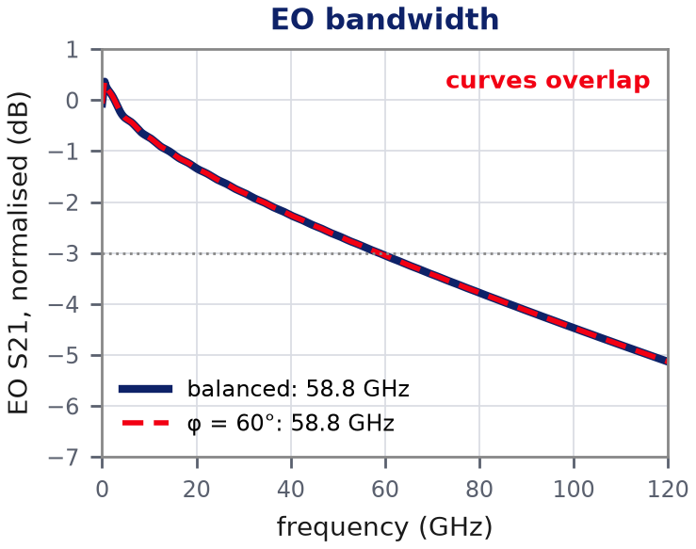
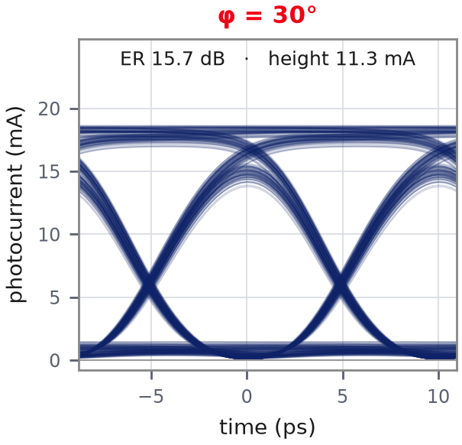
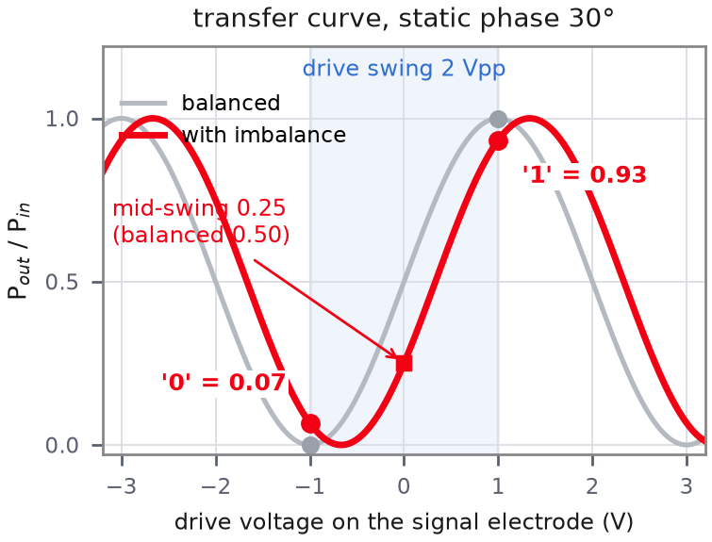
3 Static phase error
The two optical paths differ: the MZM sits off its mid-slope (quadrature) point
Where it comes from
Where it enters the model
In INTERCONNECT
PHS_1
Optical Phase Shift (bias)
phase shift = 90° + φ
simulated: 30°, 60°; in operation the bias loop sets φ → 0
different rib width → different n_{eff} → phase offset
Why the eye changes
EO BW: unchanged: a constant phase offset moves the operating point and scales the modulation equally at every frequency
Eye: the swing is no longer centred on the mid-slope, so rising and falling edges cross at 24 % of the eye instead of 50 %. Eye height 15.4 → 11.3 mA at 30°, 1.1 mA (nearly closed) at 60°

Slide 8
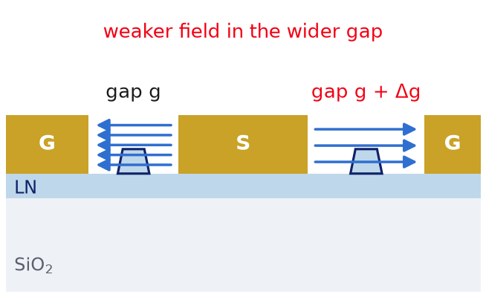
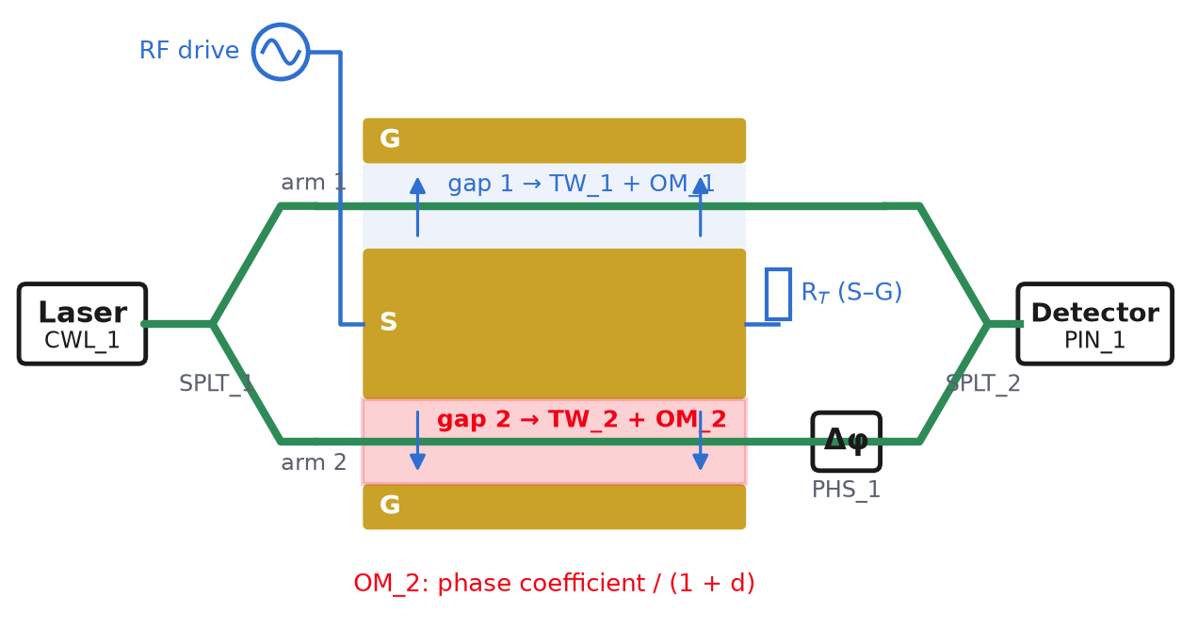
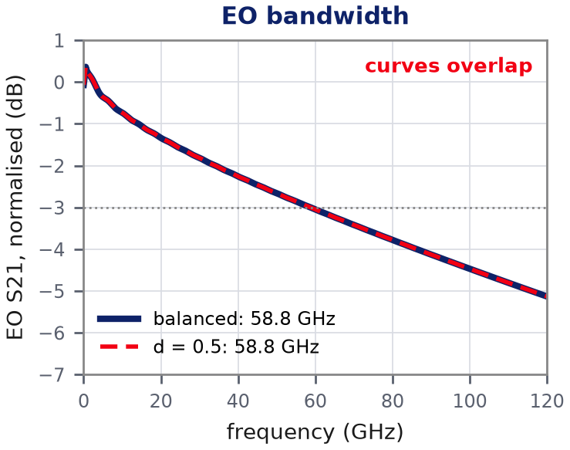
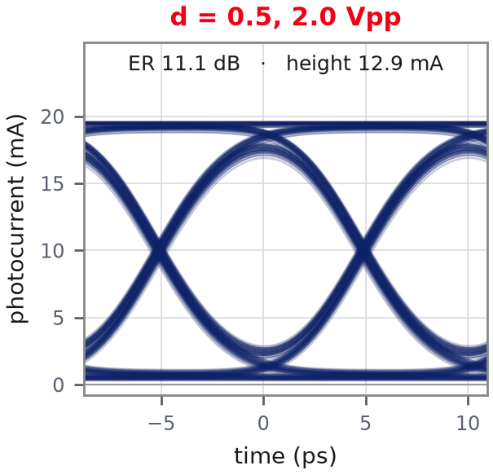
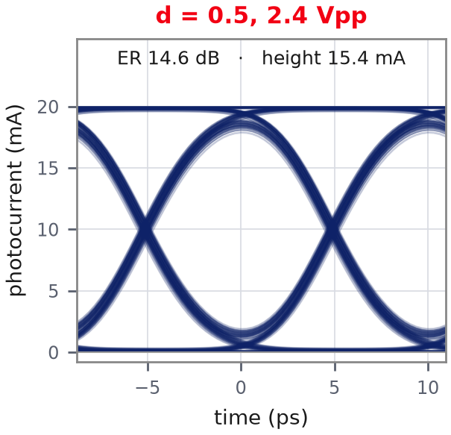
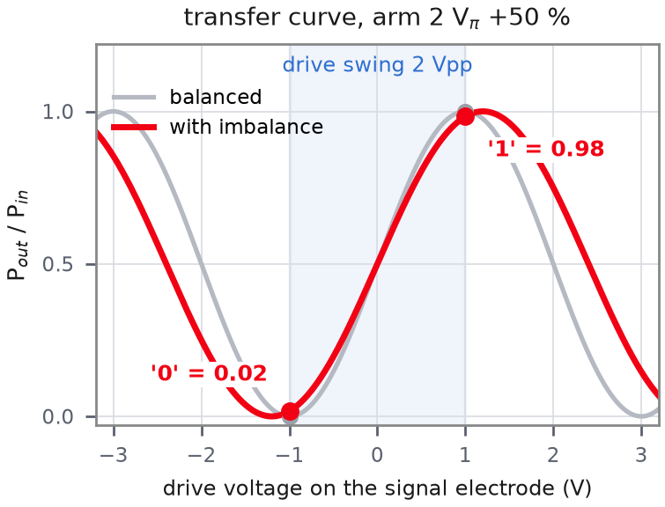
4 V_{π} imbalance
One arm gets less phase per volt: fixable by raising the drive
Where it comes from
Where it enters the model
In INTERCONNECT
OM_2
Optical Modulator, arm 2
phase coefficient × 1/(1+d)
simulated: d = 50 % (exaggerated)
different gap or overlap per arm
Why the eye changes
EO BW: unchanged: both arms keep the same electrode response; only arm 2's phase per volt is smaller
Eye: device V_{π} grows from 2.0 to 2.4 V, so 2 Vpp no longer reaches maximum and minimum: ER 14.6 → 11.1 dB. Drive raised to 2.4 Vpp → 14.6 dB again

Slide 9
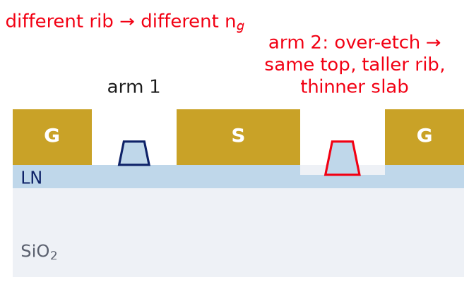
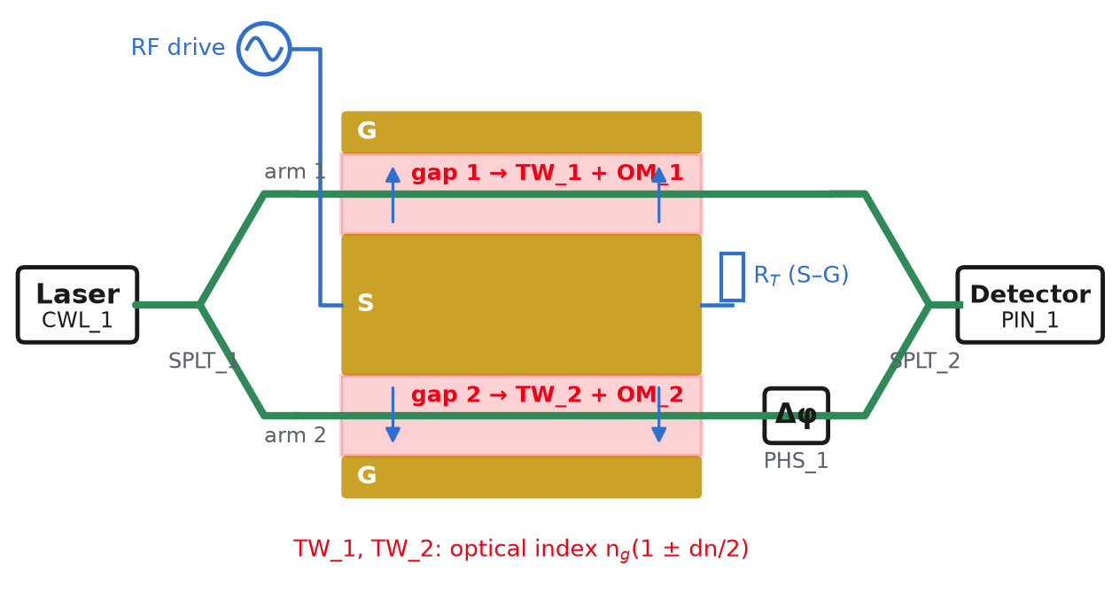
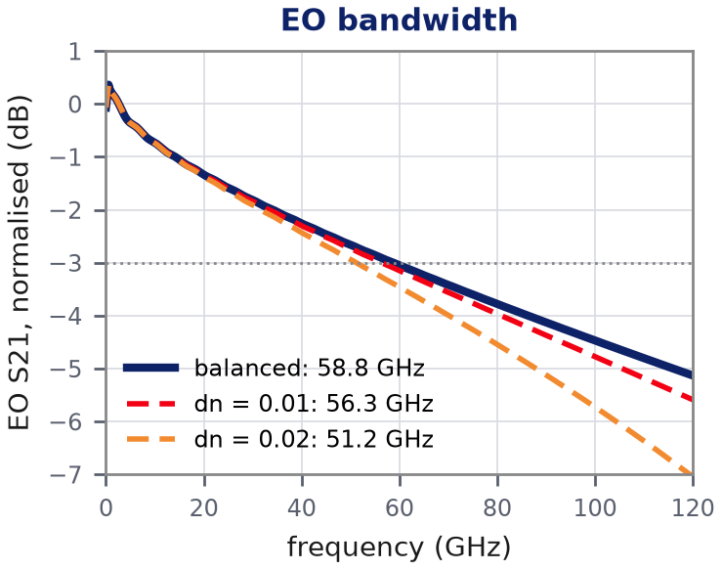
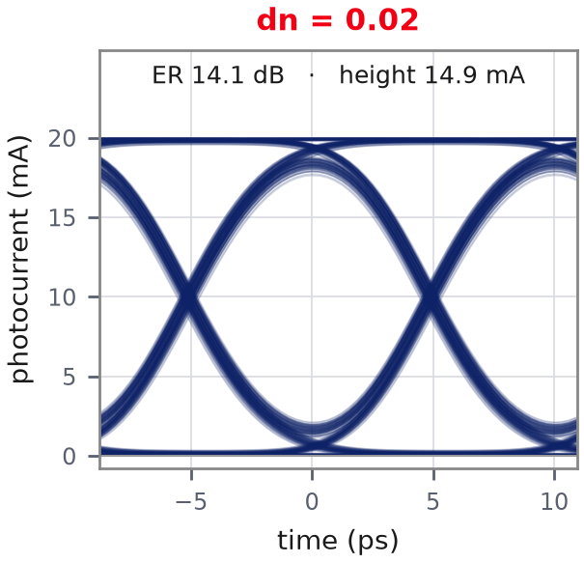
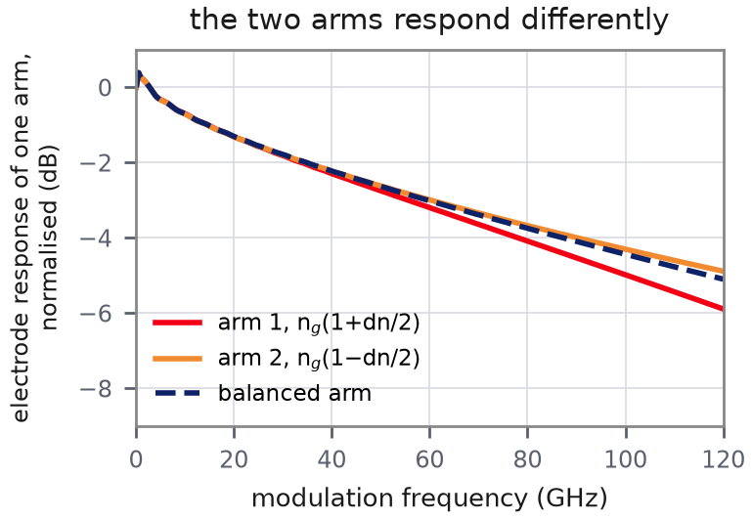
5 Group-index imbalance
The only imbalance that reshapes the frequency response
Where it comes from
Where it enters the model
In INTERCONNECT
TW_1, TW_2
Traveling Wave Electrode × 2
optical index = n_{g}(1 ± dn/2)
simulated: dn = 0.001, 0.01, 0.02
over-etch on one arm → different n_{g}
Why the eye changes
EO BW: −0.03 GHz at dn = 0.001, −2.4 GHz at 0.01, −7.6 GHz at 0.02
Eye: the transfer curve is unchanged; arm 2's light is slightly out of step with the RF wave, which smears the transitions: ER 14.6 → 14.1 dB even at dn = 0.02

Slide 10
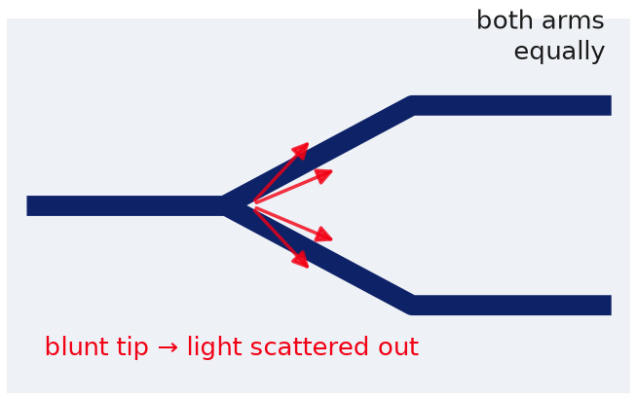
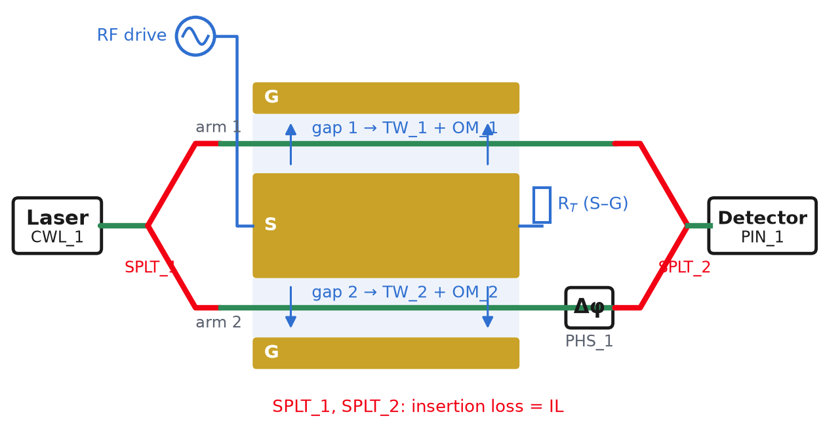

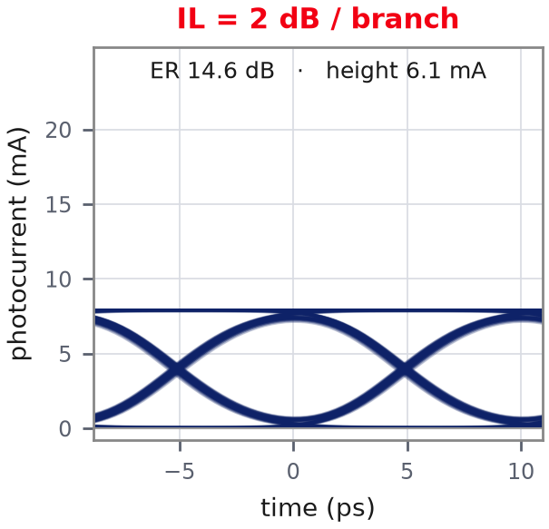
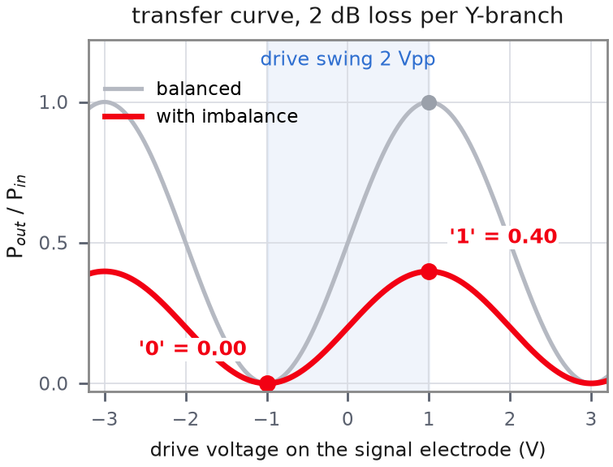
6 Y-branch excess loss
Common-mode: both arms lose the same fraction (not an imbalance)
Where it comes from
Where it enters the model
In INTERCONNECT
SPLT_1, SPLT_2
Waveguide Y Branch × 2
insertion loss = IL (dB)
simulated: 1 and 2 dB per branch
blunt tip: finite-width branching point (litho limit)
Why the eye changes
EO BW: unchanged: the same fraction is lost at every modulation frequency
Eye: both levels × 0.40 (2 dB in each of the two Y-branches = 4 dB): ER stays 14.6 dB; only the received power drops (eye height 15.4 → 6.1 mA)

Slide 11
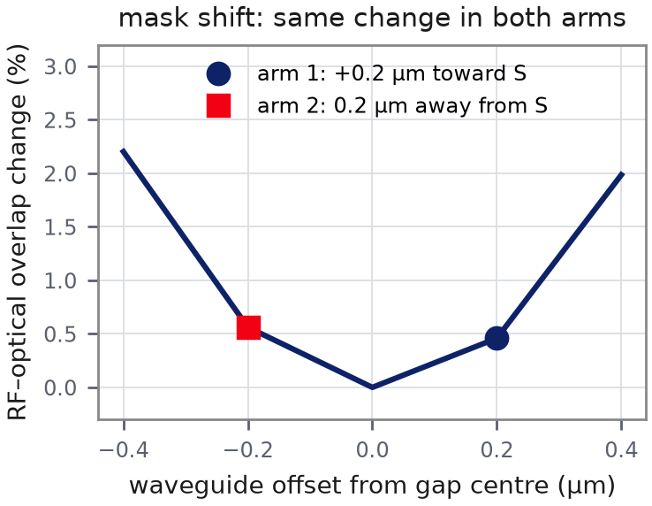
From process errors to imbalances
Each process error is one row: compute its components once, enter each in its own block → no double counting
Process error | Arm loss | Split | Static phase | V_{π} | n_{g} | Y-loss
Waveguide ↔ electrode mask shift | — | — | — | ≈ 0 (symmetric) | — | —
Electrode gap error, one side | — | — | — | ● main | — | —
Rib width / etch depth error, one arm | ○ small | — | ● main | ○ small | ○ tiny | —
Y-junction asymmetry | — | ● main | ○ small | — | — | ○ small
Sidewall roughness / defect, one arm | ● main | — | ○ small | — | — | —
Temperature / stress gradient | — | — | ● main | — | — | —
Blunt junction tips (both) | — | — | — | — | — | ● main
Why a mask shift gives no V_{π} imbalance
The field in each gap is symmetric about its centre. Both waveguides move off-centre by the same distance, one toward S and one away from it, so both see the same field.
No redundancy:
the six columns are six different physical quantities (amplitude, split, phase, efficiency, delay, common loss). One error can feed several columns, but each column receives each error only once.

Slide 12
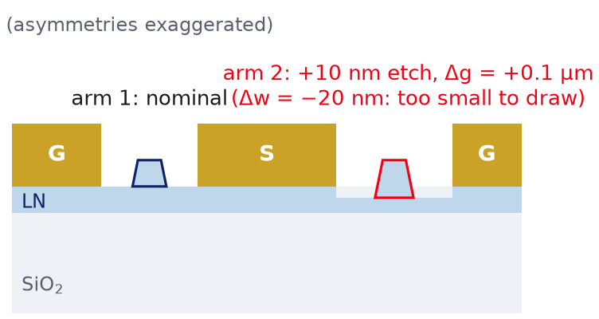
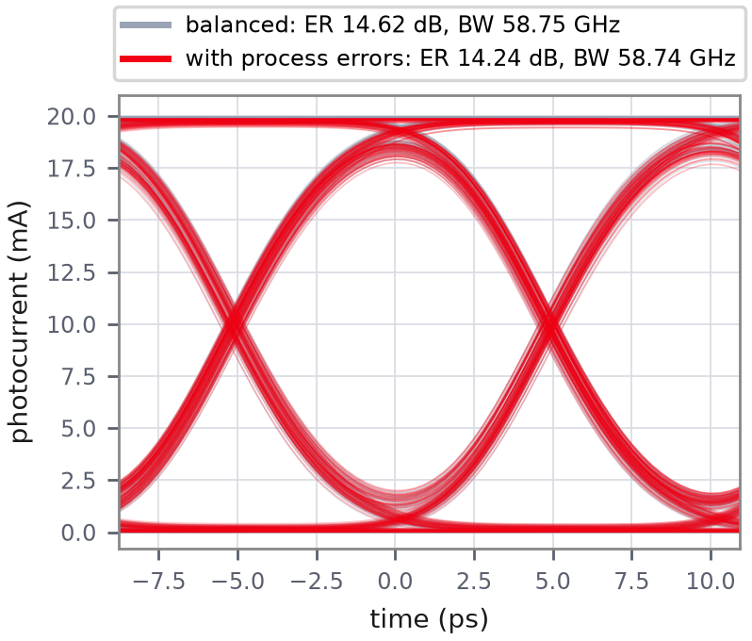
Real example: asymmetric over-etch + gap error + splitter
Assumed process errors: a large static phase (handled by the bias loop), everything else is small
Process error (arm 2) | Static phase | V_{π} d | n_{g} dn | Arm loss | Split
Rib 20 nm narrower, 10 nm deeper | 270 rad | 0.57 % | 5.2·10⁻⁴ | 0.036 dB | —
Electrode gap +0.1 µm (of 4.15) | — | 2.46 % | — | — | —
Y-junction 52 : 48 (assumed) | — | — | — | — | ε = 0.02
Total entered in the model | bias loop → 0° | 3.03 % | 5.2·10⁻⁴ | 0.036 dB | ε = 0.02
270 rad = 43 × 2π: the arms' optical paths differ by tens of wavelengths, so the bias point is arbitrary from die to die → a bias loop is mandatory
-0.38 dB
-0.01 GHz
-1.9 %
eye ER
EO bandwidth
eye height
Mode solver: semi-vectorial FD, 550 nm film, 275 nm etch, 1 µm rib (n_{g} = 2.26 vs 2.27 measured). RF field: thin-electrode conformal map. Arm loss assumes 0.3 dB/cm, all from sidewall scattering.

Slide 13
Summary
Imbalance | EO bandwidth | Eye | Physical reason | INTERCONNECT
1 Arm loss | — | ER ↓ | '0' not dark: unequal fields | ATT_1 attenuation
2 Splitter | — | ER ↓, power kept | '0' not dark: unequal fields | SPLT_1 coupling coeff.
3 Static phase | — | edges cross low, closes ~60° | off quadrature | PHS_1 phase shift
4 V_{π} | — | ER ↓ at fixed drive | swing < max→min; re-set drive | OM_2 phase coefficient
5 Group index | ● ↓ ∝ dn² | slight ISI | arms filter differently | TW_1 / TW_2 optical index
6 Y-branch loss | — | scaled, ER kept | common-mode | SPLT_1, SPLT_2 insertion loss
Take-away
Only the group index can move the EO bandwidth, and a 10 nm over-etch (dn ≈ 5·10⁻⁴) moves it by only 0.01 GHz. Process asymmetries show up mainly as a static phase (bias loop) and as small ER penalties (splitter, V_{π}). All six are single, independent knobs in the GUI and in INTERCONNECT.

