Slide 1
Electrical and electro-optic crosstalk:
from CST to INTERCONNECT
Two adjacent TFLN GSG electrodes · uniform line, pitch 200 µm · Python twin, GUI and INTERCONNECT model

Slide 2
Summary
A crosstalk model for any electrode length, in the GUI and in INTERCONNECT
−47 dB
−47 dB
10⁻¹⁴
FEXT at 30 GHz, 14 mm (−43 dB at 60 GHz)
EO crosstalk B/A at 30 GHz, 14 mm (−36 dB at 60 GHz)
INTERCONNECT element vs Python twin (code check)
Main message
Two coupled lines = an even line + an odd line, each the single-line element.
Inputs: average line from 3-D CST; even/odd split from the 2-D and eigenmode solvers.
Crosstalk vs length follows from closed-form formulas: no segmentation, no fitting.
Open points
Impedance split δ = 0.21–0.61 % (definition-dependent); 1 mm 3-D NEXT favours 0.23 %.
Port / pad coupling is not in the model.
Full MZM cascade: built, first INTERCONNECT run pending.

Slide 3
Workflow
Each simulation is used for what it resolves
3-D CST, time domain (coworker)
Pair, 1 mm and 5 mm, gold, real ports
→ average line: loss, n, Z
Mode tables (even, odd)
γ_{e,o} = γ ± jΔβ/2
Z_{e,o} = Z (1 ± δ/2)
coupled_even.txt
coupled_odd.txt
valid for any length L
Python twin + GUI
coupled_line.py
4 graphs, any length
2-D CST port modes
One port over both lines, 6 modes
→ Δn(f) of even/odd (PEC metal)
INTERCONNECT
"Coupled TL" scripted element
full MZM cascade
CST eigenmode, one 10 µm cell
Gold vs PEC, even and odd
→ gold correction of Δn (×1.146), δ band
Why not crosstalk straight from 3-D: the 3-D runs' numerical error (|S₂₁ − S₄₃| = −56 dB at 5 mm) is as large as the crosstalk itself.

Slide 4
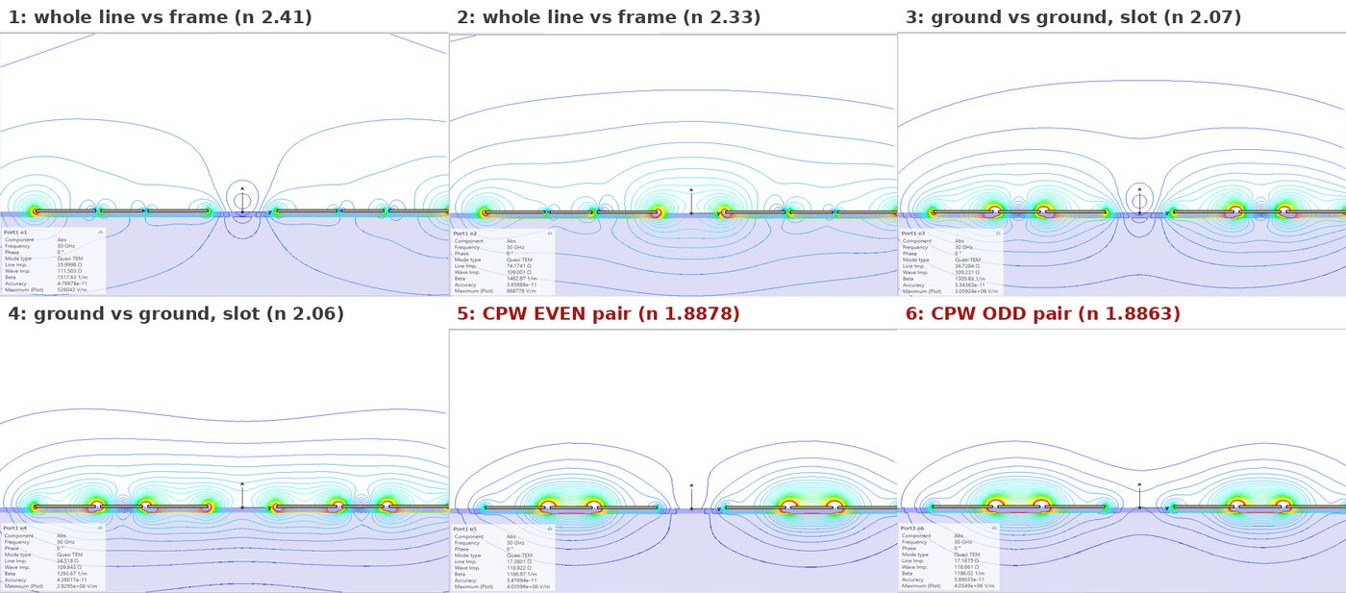
Only the even and odd coplanar modes are needed
A GSG launch excites line A in its coplanar mode = ½ even + ½ odd
Mode identification (not by eye)
7 conductors → exactly 6 quasi-TEM modes.
Modes 5/6: V_{A} = ±V_{B} (from exported fields); each line's grounds equal, net current zero.
Near-degenerate pair at the coplanar index (Δn = 1.5·10⁻³).
Why modes 1–4 are not excited
Grounds tied + current returning on own grounds → zero amplitude for the slot and line-vs-frame modes.
Condition
Holds for a symmetric GSG launch. Asymmetric pads, bends without ground bridges or poor ports can excite them.

Slide 5
Model inputs: index split Δn and impedance split δ
Two independent numbers from the two couplings of the pair
How Δn is extracted
2-D: n = βc/(2πf) of modes 5, 6.
Eigenmode: fixed β, Δn/n = (f_{o} − f_{e})/f.
Gold raises Δn by 15–20 % vs PEC.
k_{L}, k_{C}: inductive and capacitive coupling. In a homogeneous dielectric k_{L} = k_{C} → Δn = 0 (no FEXT).
 | Δn (30 GHz) | δ = Z_{e}/Z_{o} − 1
2-D port modes, PEC | 0.00151 | 0.30–0.45 %
Eigenmode, PEC | 0.00145 | +0.53 %
Eigenmode, gold | 0.00173 | +0.21 % … +0.61 %
Used in the model | 2-D × 1.146 | 0.21–0.61 % (band)
Why δ is a band
δ depends on the impedance definition: power–voltage +0.61 %, signal-to-own-grounds +0.21 %.
Physical (non-TEM, lossy gold, ground currents), not mesh (refinement: 2 %).
Model: same loss for both modes; n and Z split around the 3-D line:

Slide 6

The model: even line + odd line, recombined
Exact for a uniform pair; every quantity is closed-form
1. Each mode is a single uniform line between z₀ = 50 Ω ports:
2. Driving A1 alone = ½ even + ½ odd; the other line picks up the difference:
3. Line voltages recombine the same way (used for the EO response):
Checks
Matches a brute-force solution of the coupled telegrapher equations to 10⁻¹³ (S) and 10⁻⁷ (modulation).

Slide 7



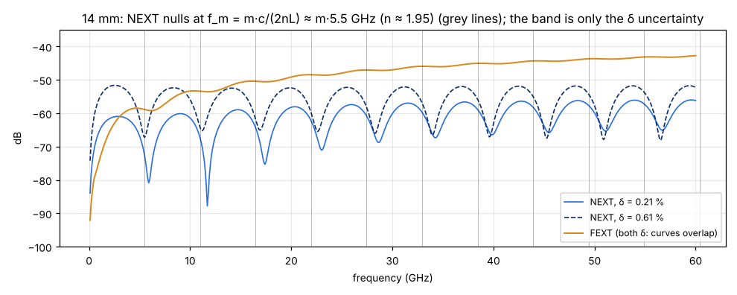
NEXT is set by δ, FEXT by Δn
First order in the even/odd differences (ΔZ = Zδ, Δγ = jΔβ)
NEXT saturates at ≈ δ/2 and has nulls at
≈ 5.5 GHz spacing at 14 mm
Why
NEXT = reflection difference: ∂S₁₁/∂Z is first order → ∝ δ. Δn enters only through Γ (mismatch).
FEXT = transmission difference: ∂S₂₁/∂t ≈ 1 → ∝ Δn. δ enters only as Γ·δ (second order).
14 mm, 30 GHz: Δn term −42 dB; δ term ≤ −60 dB.

Slide 8
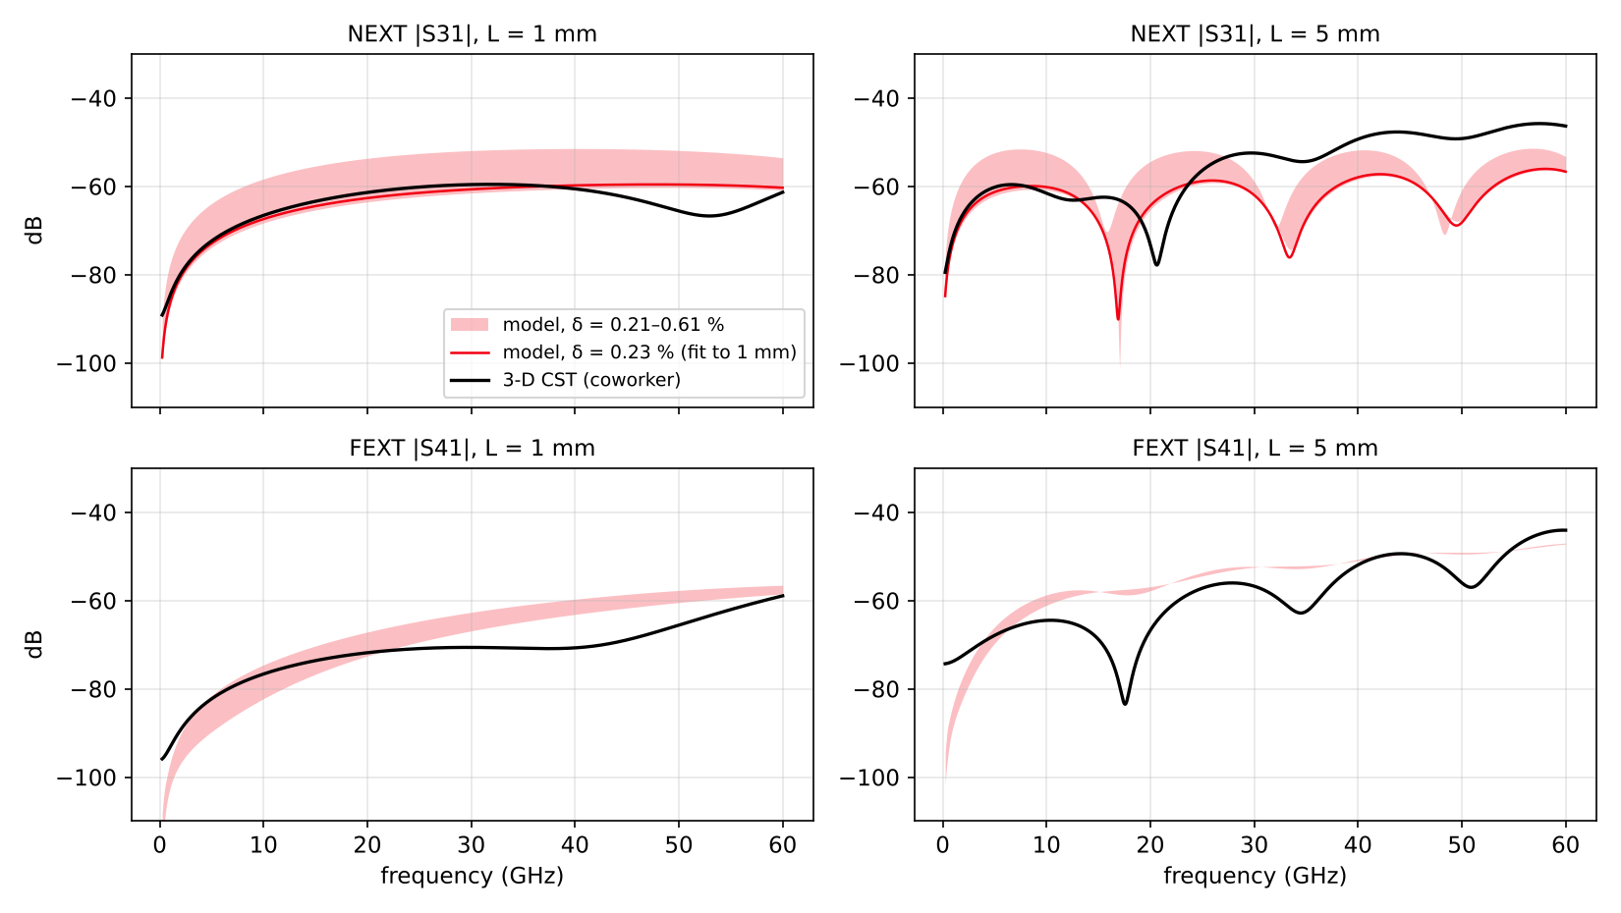
Model vs 3-D CST
1 mm agrees; 5 mm NEXT above 25 GHz is open (3-D at its error floor)
1 mm (reliable run)
FEXT and NEXT within a few dB.
Best-fit δ = 0.23 % (rms 1.9 dB): supports the signal-to-own-grounds value.
5 mm
FEXT envelope agrees.
NEXT > 25 GHz: 3-D has no nulls, 6–10 dB higher; it sits on the run's error floor (−56 dB).

Slide 9
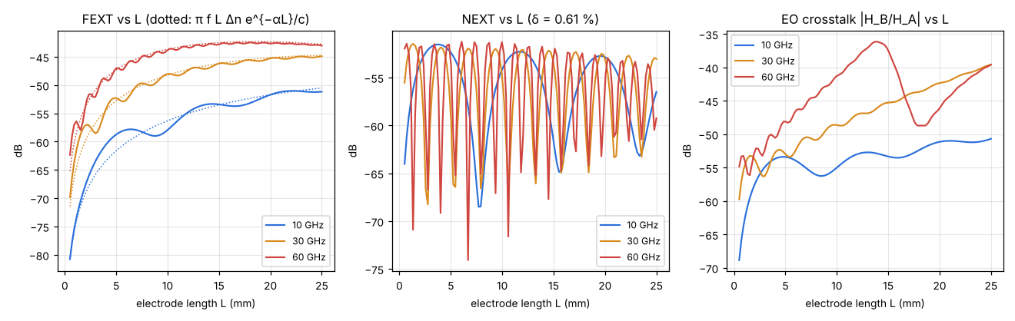
Crosstalk vs electrode length
Length enters only through e^{−γL}: one model for every length
FEXT
grows ∝ f·L·Δn, then flattens with loss
NEXT
oscillates with L; peak level ≈ δ/2
EO crosstalk
peaks where the aggressor's own walk-off null falls (60 GHz, ~14.7 mm)

Slide 10
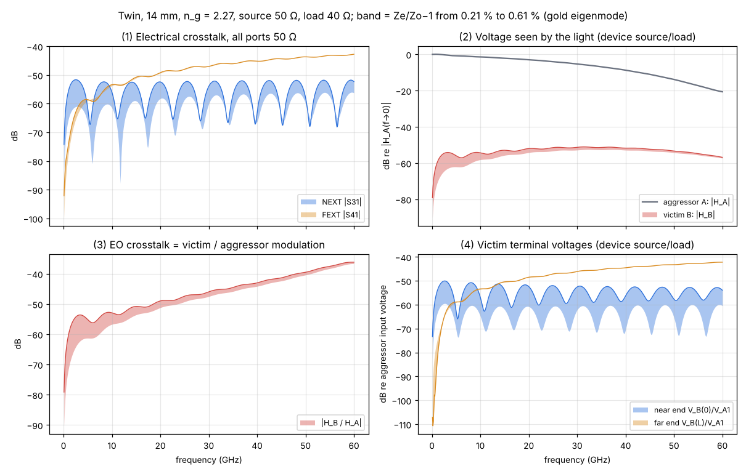
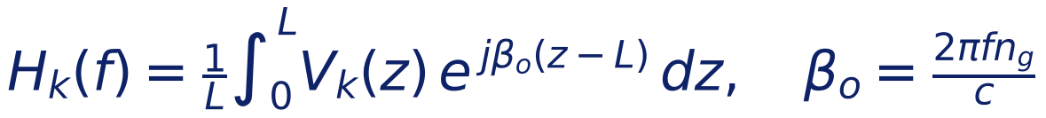
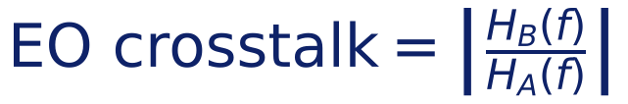
Crosstalk window: the four graphs
14 mm, n_{g} = 2.27, source 50 Ω, load 40 Ω; band = δ from 0.21 to 0.61 %
(1) Electrical, all ports 50 Ω
|S₃₁| NEXT, |S₄₁| FEXT, as a VNA measures
(2) Voltage seen by the light
Device source/load; A driven, B's input on its idle driver.
(3) EO crosstalk
(4) Victim voltages at B's two ends

Slide 11
INTERCONNECT: the "Coupled TL" scripted element
The single-line TL element, computed twice (even, odd) and recombined
TL line element (existing)
1 table: f, loss, n, Re Z, Im Z
2 ports + modulation output
exact V(z) integral, no slicing
Coupled TL element (new)
2 tables: coupled_even/odd.txt
ports A1, A2, B1, B2
modulation A, B (+ 2 A, 2 B), far/near end
Recombination
S own line = ½(S^{e} + Sº)
S other line = ½(S^{e} − Sº)
same for the modulation outputs
Tables coupled_even.txt / coupled_odd.txt
Columns: frequency (Hz), loss (dB/m), microwave index, Re Z₀, Im Z₀ (Ω).
Written by the GUI ("Export tables"): 3-D line fit ± the split (Δn × 1.146, δ = 0.61 %).
0.05 GHz to the Nyquist frequency; above 60 GHz, extrapolated with the single-line fit forms.
Code check
LSF code executed line by line vs Python twin: ≤ 4.5·10⁻¹⁴.
INTERCONNECT run (14 mm): aggressor within 0.09 dB / 0.44°; crosstalk error 72–84 dB below the aggressor.

Slide 12
INTERCONNECT test bench (PAIR_MOD / FE / NE)
Isolates the element: driver, idle victim driver, two terminations, analyser
ENA
output → driver
inputs 1, 2 ← two outputs
SRC
driver, Z_{s}
CTL
Coupled TL element
LOAD_A2 / B2
terminations R_{t}
Why this form
LOAD_B1 = Z_{s}: victim's input on its own idle driver.
Compound with scattering-data analysis on: only there are reflections exact (Step 0 result).
Three rows: an analyser reads two outputs; MOD = modulation A/B, FE = far end, NE = near end.
How it is compared
Scale, latency and phase convention measured on the aggressor (A).
The same corrections applied to the victim (B): its error is the coupling error alone.
Scale 2.00 = EMF vs incident-wave convention; 341 ps = FIR filter delay.

Slide 13
Full MZM cascade in crosstalk mode
Two modulators on one coupled electrode; built and dry-run, first INTERCONNECT run pending
Driver A (Z_{s})
ENA or PRBS/NRZ
Coupled TL (CTL_1)
A1 ───────── A2
B1 ───────── B2
outputs: modulation A, 2 A, B, 2 B
Load A (R_{t})
MZM A → PIN_A
ENA input 1 / EYE_1
Idle driver B (Z_{s})
Load B (R_{t})
MZM B → PIN_B
ENA input 2 / EYE_2
What it gives
ENA: B/A = EO crosstalk in the receiver, checked against the twin.
Eyes: A's eye on the coupled line; EYE_2 = crosstalk reaching B (driver idle).
Optics, bias, drive, source/load from the sidebar.
Reading the ENA
The raw ENA trace is a flat level with a fast ripple: a delay-free spike of the optical path, ~10× the response.
The tool removes it (time gate + cos(πf/f_{s}) correction) and saves the cleaned EO response and B/A.

Slide 14
Limits and next steps
Limits
δ band 0.21–0.61 %: NEXT uncertain by ~9 dB; FEXT and EO only ±1 dB.
Port / pad coupling not modelled (Istanbul 3-D: port FEXT term ≈ −43 dB, dominant on short lines).
5 mm NEXT above 25 GHz unresolved (3-D error floor).
Straight electrode only in the cascade; data to 60 GHz.
200 µm pitch uniform line only.
Next steps
1. First INTERCONNECT run of the full cascade (ENA, then eyes).
2. Narrow δ: second reliable 3-D length (long line, fine symmetric mesh) → keep 0.21–0.25 % if confirmed.
3. Lab: check that probes/pads tie each line's grounds.
4. Victim driven with its own pattern: combined eye penalty.
5. Slow-wave (Istanbul) line: split from 3-D lengths or a matched eigenmode cell.

