Slide 1
Lifted electrodes on a SiO₂ buffer:
removing the lift-position standing wave
femwell / scikit-fem eigenmode study at λ = 1575 nm
Notes:
Lisbon lifted electrodes show an insertion loss that oscillates with the lift position. We show where it comes from, how a 200 nm SiO2 buffer removes it, what it costs in Vpi*L, and the final buffer/gap choice.

Slide 2
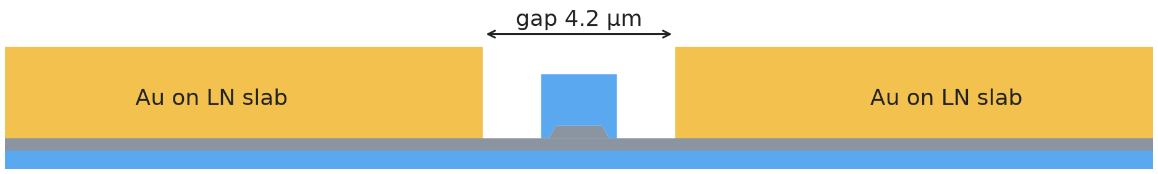
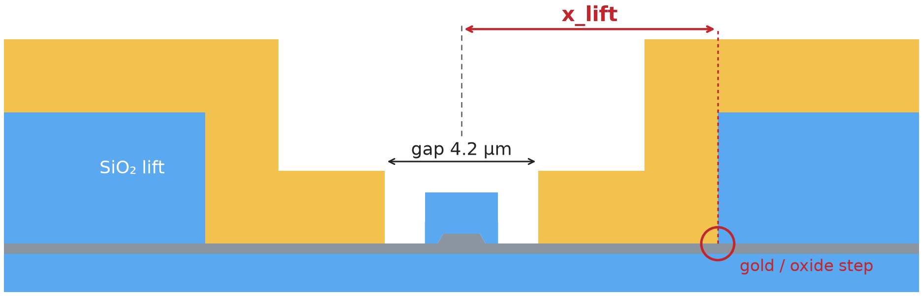
Lifting the gold: same Vπ·L, but IL oscillates with x_lift
Cordoba (gold flat on the LN slab) vs Lisbon (gold lifted onto SiO₂ at x_lift), both with a 4.2 µm gap
Cordoba (legacy)
Lisbon (lifted)
2.260 | 2.265
x_lift
+80 %
0.18 – 0.88
Vπ·L [V·cm], Cordoba | Lisbon
identical (Δ 0.2 %)
distance from the rib centre
to the gold/oxide step
IL for a 100 nm shift of x_lift
(0.33 → 0.60 dB/cm)
IL range [dB/cm] within
0.4 µm of x_lift (period 0.9 µm)
Notes:
Geometries drawn from the model polygons, same scale. x_lift = distance from the rib centre to the point where the gold leaves the LN slab and climbs onto the SiO2 lift. Vpi*L: Cordoba 2.260, Lisbon 2.265 V*cm at the same 4.2 um gap. IL of Lisbon oscillates between 0.18 and 0.88 dB/cm with a 0.9 um period around the Cordoba value 0.42 dB/cm. Red points: 7.1 -> 7.2 um, the steepest 100 nm step (0.33 -> 0.60 dB/cm). Lithography/overlay errors of this size are realistic, so the IL of a fabricated device is not predictable. Data: results/lift_sweep.csv.

Slide 3
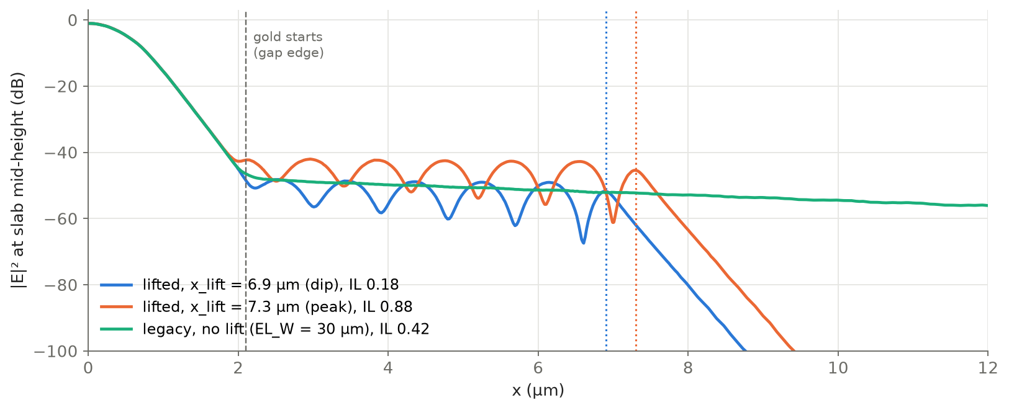
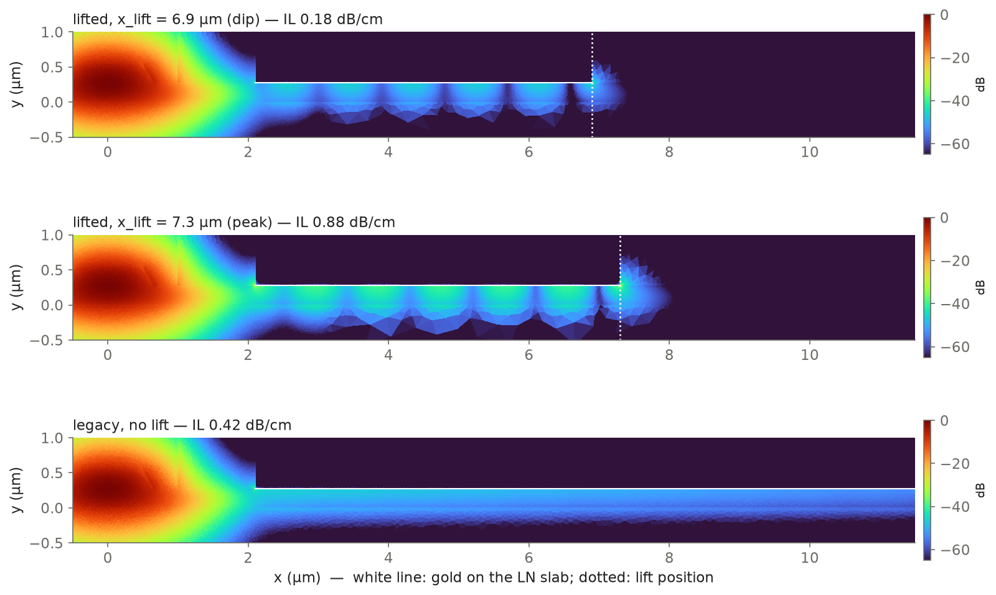
Origin: a standing wave under the gold
|E|² along the slab: ripples appear under the gold in the lifted design, not in the legacy one
Gold on the LN slab guides a surface wave
n = 2.07 > n_rib = 1.88
The rib mode leaks into it; the wave travels sideways
and is reflected at the gold/oxide step
Standing wave: period 0.9 µm
IL peaks when x_lift makes the cavity resonant
Cordoba: no step, so the wave simply travels away and is absorbed: smooth curve, no x_lift dependence.
Notes:
Left: |E|^2 at slab mid-height vs x. Dip (x_lift 6.9 um, IL 0.18) and peak (7.3 um, IL 0.88) show ripples between the gap edge and the lift; legacy (no lift) shows a smooth, slowly decaying travelling wave. Right: field maps, same dB scale. The gold/LN interface supports a lossy surface wave with index about 2.07, above the rib mode index 1.884, so it is phase-matched to leak sideways. The step where the gold leaves the slab reflects it; the reflected wave interferes with the incoming one. Ripple period 0.90 um = pi/k_x predicted by a 1D model (0.91 um).

Slide 4
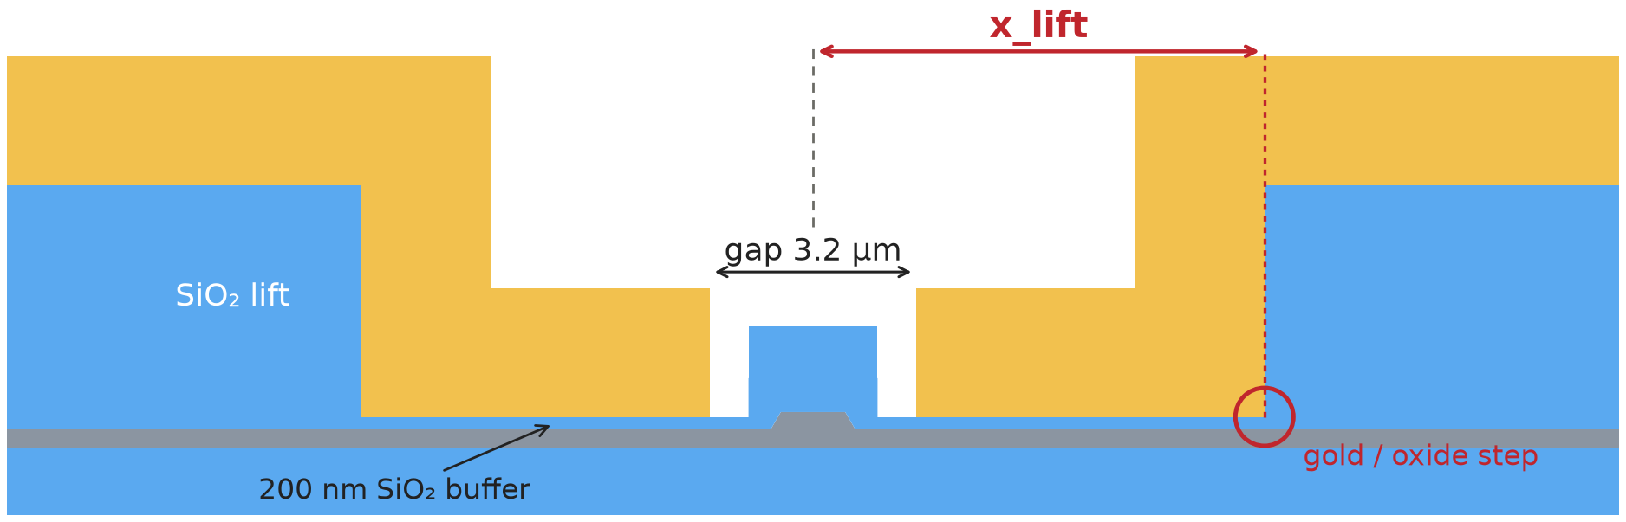
SiO₂ buffer: the standing wave can no longer form
200 nm SiO₂ under the whole electrode and across the gap; bottom gap 4.2 → 3.2 µm
Lisbon on a SiO₂ buffer
Above 38 nm the wave under the gold falls below the rib index: it is cut off.
At 200 nm it decays by 29 dB/µm: nothing reaches the step, nothing is reflected.
Result: IL = 0.048 dB/cm, flat (±0.1 %) for x_lift 3.8–30 µm.
Check: the 1D cutoff model reproduces the 2D ripple periods and decay rates within about 5 %.
Notes:
Chart top right: 1D effective index of the wave guided under the gold vs buffer thickness (mean of the two in-plane LN permittivities; cutoff 37-39 nm). Below the rib index the wave cannot be phase matched, so the rib mode cannot couple into a propagating wave: there is no standing wave to form, whatever x_lift. The 1D model matches the 2D simulations (period 0.90 vs 0.91 um at 0 nm; decay 28.98 vs 28.95 dB/um at 200 nm). Bottom: 200 nm buffer, 88 lift positions 3.8-30.1 um, IL 0.0480-0.0481 dB/cm. Chart shows up to 12.6 um; flat also at 16-30 um. Without buffer at gap 3.2 IL would be 4-30 dB/cm and still oscillating.

Slide 5
The price: higher Vπ·L, recovered with a narrower gap
The DC field must cross the low-ε oxide (ε 3.75 vs 28 in LN); narrowing the gap compensates
Trade-off: at a fixed gap the buffer raises Vπ·L by 30 % (1.65 → 2.15 V·cm at 3.2 µm).
Buffer 200 nm: 5× the 38 nm cutoff, safe against thickness errors. 150 nm would cut Vπ·L by only 3 % and raise IL by 41 %.
Gap 3.4 µm: Vπ·L 2.27 V·cm, the same as the original 4.2 µm design (2.26), with IL 0.026 dB/cm and no x_lift dependence.
Final design: buffer 200 nm, gap 3.4 µm
2.27
0.026
1.65 V
Vπ·L [V·cm]
IL [dB/cm], flat
Vπ on the line (< 1.7 V)
Vπ = Vπ·L / (L × duty) = 2.27 / (1.484 cm × 0.925) = 1.65 V
line L = 14.84 mm, duty cycle 0.925
Notes:
Left: Vpi*L vs buffer thickness at gap 3.2 um, x_lift 7 um (150, 250 nm added for this deck). 150 nm: Vpi*L 2.077 vs 2.148 V*cm (-3.3 %), IL 0.068 vs 0.048 dB/cm. Centre/right: gap scan at 200 nm (GAP_TOP fixed at 10 um). Vpi*L grows linearly with the gap, IL falls exponentially. Gap 3.4 um: Vpi*L 2.2707 V*cm, IL 0.0260 dB/cm, flat for x_lift 4.5-16 um (2.270-2.275 V*cm). On the 14.84 mm line with duty cycle 0.925: Vpi = 1.654 V. The 1.7 V limit allows Vpi*L up to 2.334 V*cm (gap about 3.5 um), so 3.4 um keeps about 0.05 V of margin. Gold loss over the line: 0.039 dB.

