Slide 1
RF impact of the 40 nm Al₂O₃ (ALD) layer
on CORDOBA 8 mm lines
Wafers 4CA0162 and 4CA0163 · 15 lines each · measured before and after ALD · n_{m}, Z₀, α, S₂₁

Slide 2
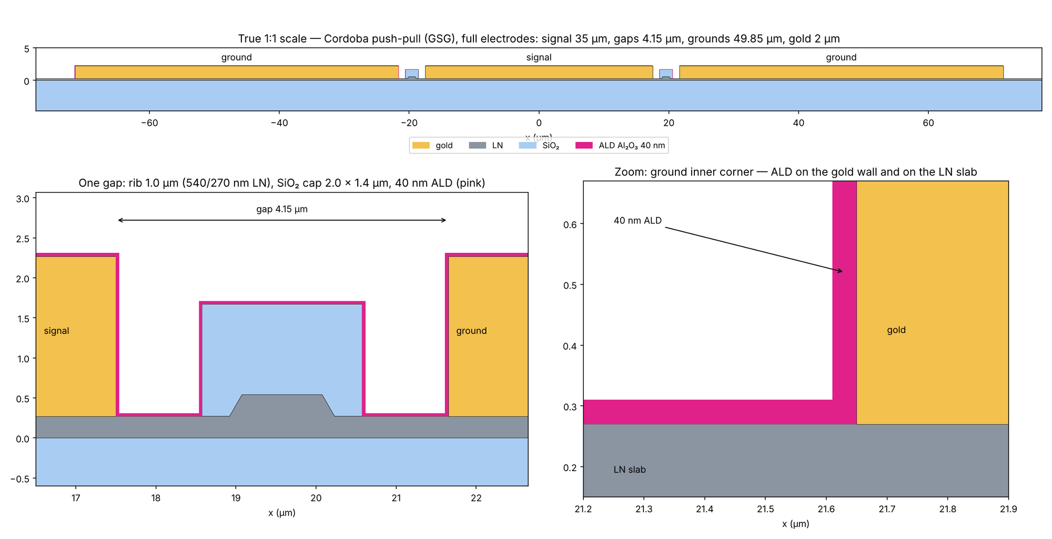
Device and measurement set
CORDOBA push-pull GSG line, 8 mm, coated with 40 nm Al₂O₃
Samples
2 wafers: 4CA0162, 4CA0163
15 fields per wafer, one 8 mm line each
Same line measured before and after ALD
Measurement
2-port VNA, 40 MHz–60 GHz, 1601 points, 50 Ω
File checks: reciprocity < 1 %, passivity OK
Excluded: 4CA0163 line 04 (bad ALD file)
Signal 35 µm, gaps 4.15 µm, grounds 49.85 µm, gold 2 µm; ALD conformal on gold walls, SiO₂ cap and LN slab.

Slide 3
Figures of merit from the Touchstone file
ABCD de-embedding of the measured 2-port as one uniform line, L = 8 mm
Touchstone
S₁₁, S₂₁, S₁₂, S₂₂
ABCD
A, B, C from the S-matrix
Z_{ref} = 50 Ω
Line
Z_{c} = √(B/C)
e^{γL} = A + B/Z_{c}
Figures of merit
α = Re γ (dB/cm)
n_{m} = c·Im γ / ω
Z₀ = Re Z_{c}
S₂₁ and S₁₁
Measured values, no processing.
S₂₁ in the boxplots: computed from the fitted line
(α, n_{m}, Z_{c}) between 50 Ω ends → the trend, not the pad ripple.
Limit: pads are part of the 2-port
Pad/probe reflections travel the 8 mm line:
ripple with period c / (2 n_{m} L) ≈ 8.2 GHz, mostly in Z_{c}.
After ALD: ripple 0.6 → 2.3 Ω (std), both wafers.

Slide 4
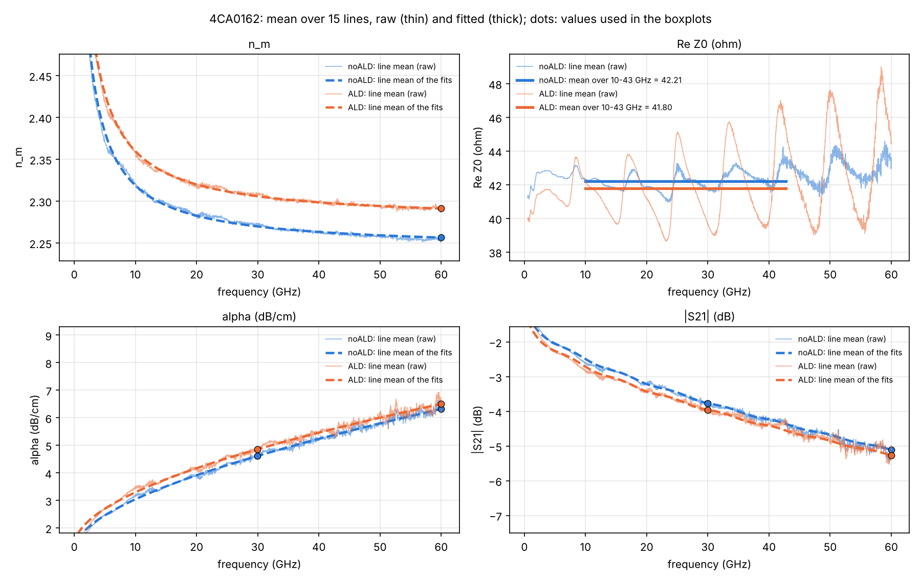
Line averaging and fits
Fits on each line; the line mean is shown only for display
FOM | Fit on each line | Why
α | a√f + b f + c, a, b ≥ 0 | conductor + dielectric; physical
n_{m} | saturating dispersion | bounded, no run-away
Z₀ | mean over 10.0–42.8 GHz | 4 ripple periods: ripple cancels
S₂₁ | from the fitted line, 50 Ω | trend, not pad ripple
Line mean (curves in frequency)
At each frequency: plain mean over the lines,
separately before / after ALD (dB values for S-parameters).
Thick: mean of the per-line fits; dots: values used in the boxplots.
Robust fit (soft-L1): ripple and spikes do not steer it.

Slide 5
One value per line, then boxplots
Single-point values from the fits; checked for stability and bias
FOM | Value per line | Stability* | Bias**
n_{m} | fit @ 60 GHz | ≤ 0.002 | ≤ 0.004
Z₀ | raw mean 10–43 GHz | ≤ 0.11 Ω† | —
α | fit @ 30 GHz | ≤ 0.003 dB/cm | ±0.02 dB/cm
α | fit @ 60 GHz | 0.03–0.07 dB/cm | −0.06…−0.09 dB/cm
S₂₁ | fitted line @ 30, 60 GHz | follows α | follows α
Why 30 and 60 GHz
60 GHz: top of the band, requested reference.
30 GHz: ≥ 10× more stable for α.
Z₀ fitted at 60 GHz is off by 2–4 Ω (ripple): not used.
Boxplot
Box: median, quartiles; whiskers 1.5 × IQR.
Each line one colour, before (o) → after (s).
Reported: median of the per-line change (paired), not the change of the medians.
* change when the fit stops at 50 GHz ** raw data near the point minus the fit
† change of the ALD shift for a band moved by half a period or one period shorter

Slide 6
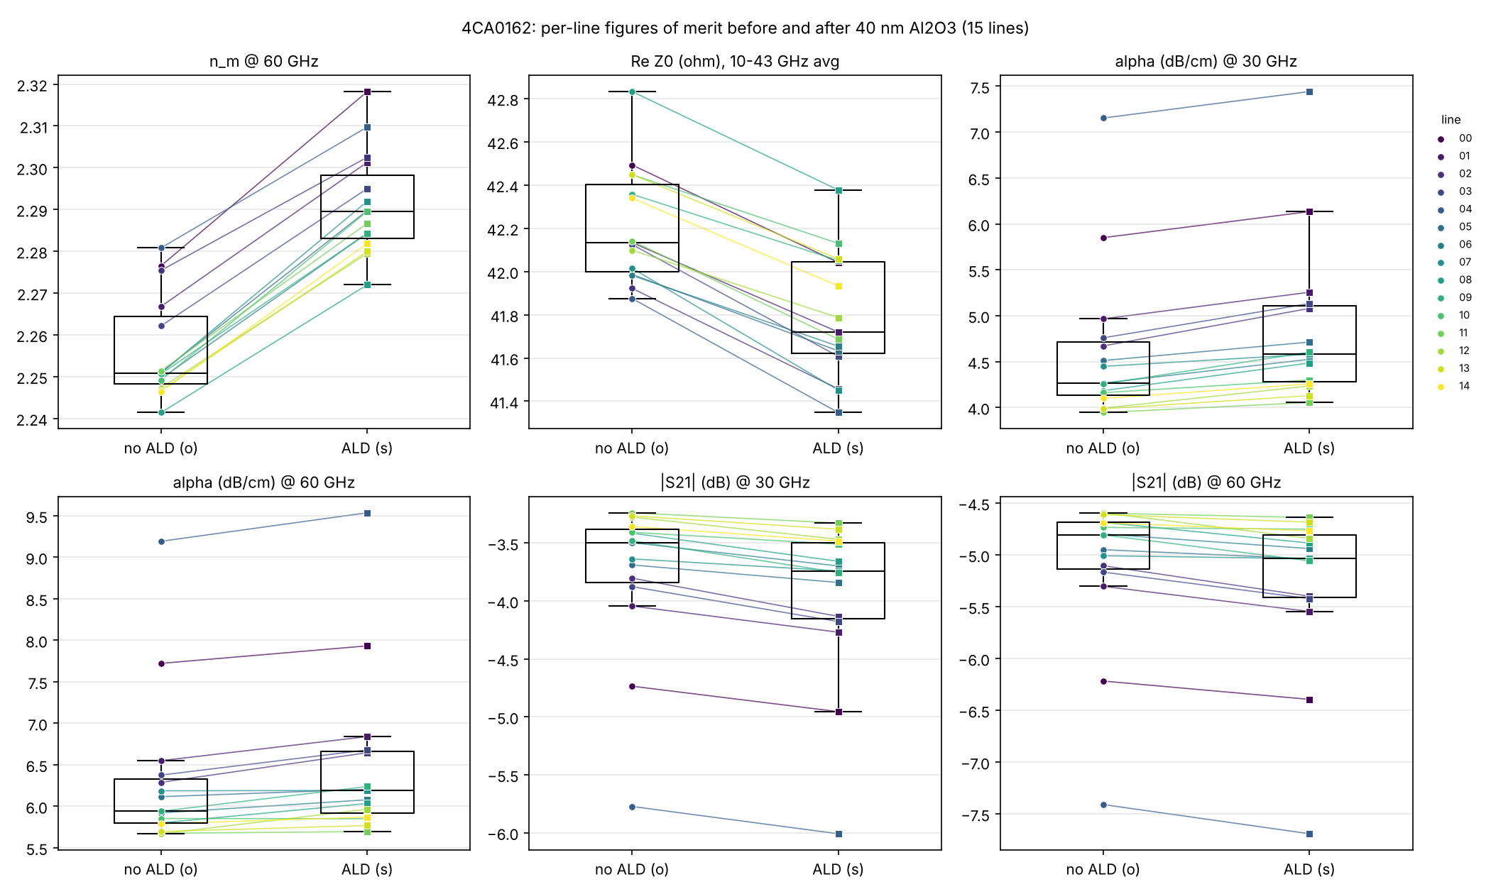
Wafer 4CA0162: results
15 lines · line means with fits (left) · per-line values (right)
Median change: n_{m} +0.034 · Z₀ -0.41 · α +0.259 @30 · α +0.211 @60 · |S₂₁| -0.201 @30 · |S₂₁| -0.177 @60

Slide 7
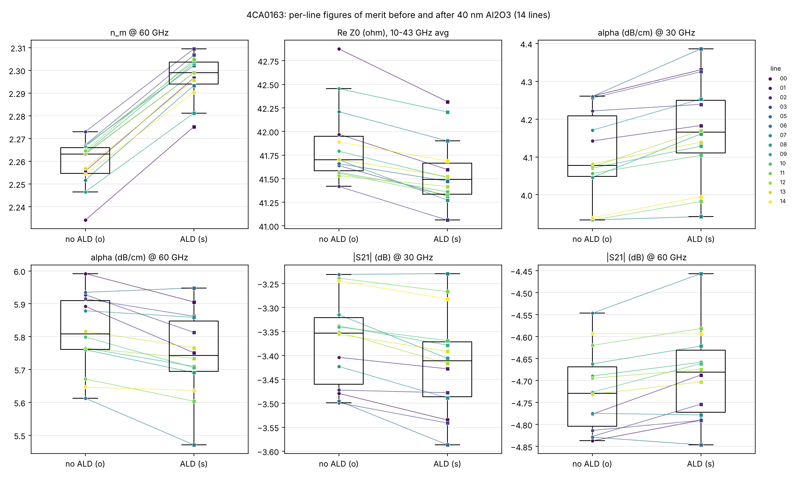
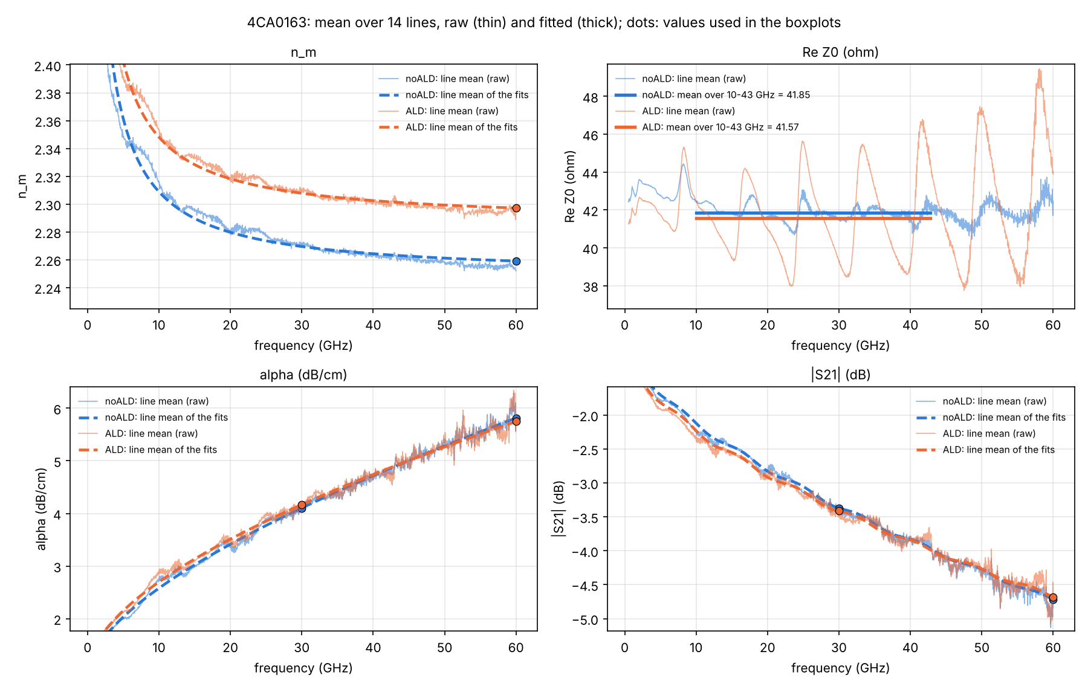
Wafer 4CA0163: results
14 lines (line 04 excluded) · line means with fits (left) · per-line values (right)
Median change: n_{m} +0.038 · Z₀ -0.26 · α +0.058 @30 · α -0.062 @60 · |S₂₁| -0.039 @30 · |S₂₁| +0.035 @60

Slide 8
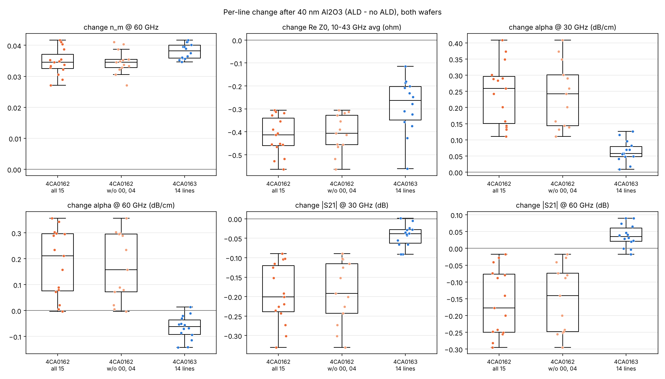
Wafer comparison and the high-loss lines
Per-line change ALD − no ALD: median (lines that went up / lines)
FOM | 4CA0162 (15) | 4CA0162 w/o 00, 04 (13) | 4CA0163 (14)
n_{m} @ 60 GHz | +0.034 (15/15 up) | +0.034 (13/13 up) | +0.038 (14/14 up)
Z₀ (Ω), 10–43 GHz avg | -0.41 (0/15 up) | -0.41 (0/13 up) | -0.26 (0/14 up)
α (dB/cm) @ 30 GHz | +0.259 (15/15 up) | +0.242 (13/13 up) | +0.058 (14/14 up)
α (dB/cm) @ 60 GHz | +0.211 (14/15 up) | +0.158 (12/13 up) | -0.062 (1/14 up)
|S₂₁| (dB) @ 30 GHz | -0.201 (0/15 up) | -0.192 (0/13 up) | -0.039 (1/14 up)
|S₂₁| (dB) @ 60 GHz | -0.177 (0/15 up) | -0.141 (0/13 up) | +0.035 (11/14 up)
Agree
n_{m} up on every line
Z₀ down on every line
α @ 30 GHz up on every line
Differ
α increase ≈ 4× larger on 4CA0162
α @ 60 GHz: +0.21 vs −0.06
(−0.06 within the ±0.07 uncertainty)
High-loss lines 00, 04 (4CA0162)
~2–3 dB/cm more loss at 60 GHz, before and after ALD.
Removing them: n_{m}, Z₀, α @ 30 GHz unchanged; α @ 60 GHz 0.21 → 0.16 dB/cm.

Slide 9
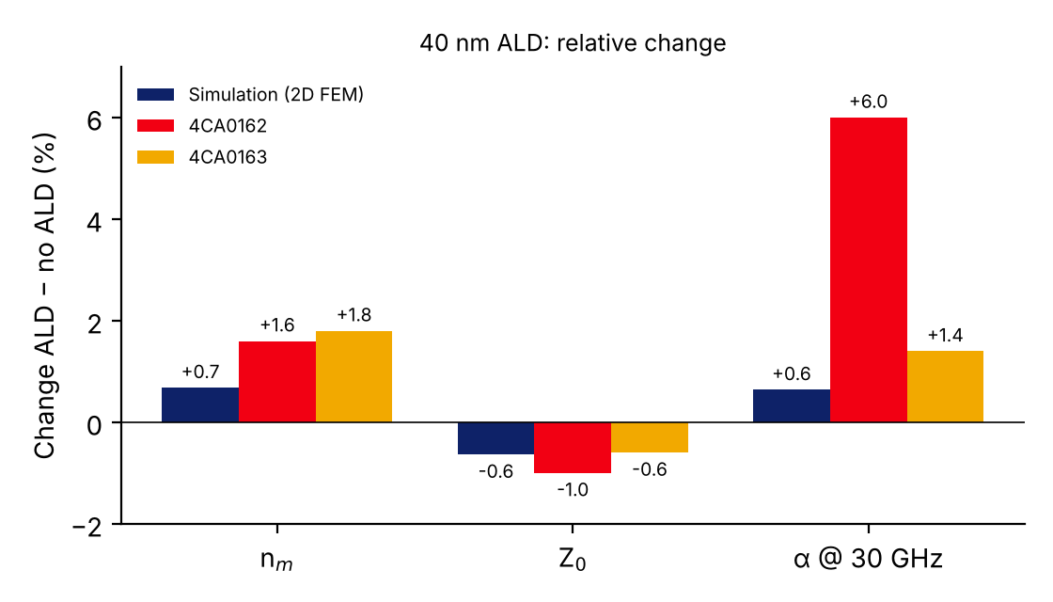
Simulation vs measurement
2D FEM (volumetric gold, ALD εr 9.8, lossless) vs per-line median change, CORDOBA 8 mm
FOM | Simulation | 4CA0162 | 4CA0163 | Agreement
Δnm @ 60 GHz | +0.014 (+0.68 %) | +0.034 (+1.6 %) | +0.038 (+1.8 %) | sign ✓, ~2.5× low
ΔZ0 (Ω) | −0.23 (−0.64 %) | −0.41 (−1.0 %) | −0.26 (−0.6 %) | ✓ good
Δα @ 30 GHz (dB/cm) | ≈ +0.02–0.03 | +0.26 | +0.06 | 4CA0163 ✓, 4CA0162 ~10×
Δα @ 60 GHz (dB/cm) | +0.035 (+0.64 %) | +0.21 | −0.06 (±0.07) | 4CA0163 ✓, 4CA0162 ✗
Δα, tan δ = 0.05 | +0.07 @ 60 GHz | — | — | upper bound, still < 0.21
Agree
All signs: nm ↑, Z0 ↓, α ↑
Z0: −0.64 % sim vs −0.6…−1.0 %
→ ALD capacitance (εr 9.8) captured
α on 4CA0163 within ±0.07 dB/cm
Differ
Δnm 2.5× larger than sim; Δn/n + ΔZ/Z ≈ +1 % → L also rises: not a cross-section effect
Δα on 4CA0162: 10× sim; ALD tan δ cannot explain it
Likely cause of the gaps
Pads/tees are inside the 8 mm de-embedding; the 2D model has the uniform line only.
Pad ripple 0.6 → 2.3 Ω after ALD: the ends changed.
Wafer-dependent α: probe contact / gold process, not ALD loss.
Next: multi-length or TRL extraction before/after ALD.

Slide 10
Conclusions: measured effect of 40 nm ALD
Same effect on every line where it exceeds the uncertainty; loss increase is wafer-dependent
+1.5–1.7 %
−0.6–1.0 %
+1.4–6 %
n_{m} (+0.035 / +0.038 at 60 GHz), every line, both wafers
Z₀ (−0.41 / −0.26 Ω, 10–43 GHz), every line, both wafers
α at 30 GHz (+0.06 / +0.26 dB/cm), every line; size differs by wafer
Reading
ALD adds capacitance: n_{m} up, Z₀ down (consistent signs).
Loss: up at 30 GHz on both wafers; at 60 GHz the change
is within ±0.07 dB/cm on 4CA0163.
S₂₁ (8 mm): −0.20 / −0.04 dB at 30 GHz.
Open points
Why the loss increase differs by wafer: same ALD run?
same measurement session (probes, calibration)?
Pad/probe ripple grows after ALD (0.6 → 2.3 Ω) on both wafers.
Z₀ at 60 GHz not resolvable from these structures.

