Slide 1
MADRID: a very-low-Vπ modulator for C + L band
All simulations at λ = 1625 nm · femwell 2D FEM (optical mode + anisotropic DC)
min Vπ·L
IL < 0.5 dB/cm
gap ≥ 3.0 µm
target
comfortably, at 1625 nm
preferably ≥ 3.5 µm
Fixed by the request
LN film 550 nm, rib etch 275 nm (slab 275 nm), 60° walls
Rib top 1.4 µm
Flat (non-lifted) Cordoba-type electrodes, 30 µm wide
SiO₂ cap wide and short: (gap − 0.2) × 0.5 µm
SiO₂ buffer under the gold and across the gap
Swept
Gap 3.0 → 4.0 µm, 0.1 µm step
Buffer 0 → 200 nm (case a: above cut-off ± 40 nm; case b: pure trade-off)
ALD Al₂O₃ 0 / 20 / 40 / 60 nm, and a full no-ALD sweep
Gold thickness MTX 0.3 → 3 µm
≈ 185 FEM runs, mesh checked (IL ±1.2 %, Vπ·L ±0.02 %)
Notes:
Madrid notebook: VPI_Madrid.ipynb (USE_ALD switch). Mesh: MESH_SCALE 1.4 vs 1.0 at gap 3.5/buffer 100/ALD 40: IL 0.2476 vs 0.2447, VpiL 1.8587 vs 1.8590.

Slide 2
Starting point: what our tapeouts taught us
Simulated values at each design's own wavelength
Tapeout / variant | λ (nm) | Film / slab | Gap (µm) | Vπ·L (V·cm) | IL (dB/cm)
Cordoba (flat electrodes) | 1575 | 550 / 275 | 4.2 | 2.17 | 0.43
Cordoba + 40 nm ALD | 1575 | 550 / 275 | 4.2 | 2.11 | 0.93
Istanbul + 200 nm buffer | 1575 | 550 / 275 | 3.65 | 2.42 | 0.013
Lisbon lifted + 200 nm buffer, rib 1.4 | 1575 | 550 / 275 | 3.4 | 2.17 | 0.027
Lisbon buffered + 40 nm ALD | 1575 | 550 / 275 | 3.4 | 2.06 | 0.055
Danube | 1310 | 450 / 225 | 4.15 | 1.94 | 0.03
Jerez lifted + buffer, rib 1.4 | 1360 | 400 / 230 | 3.4 | 1.81 | 0.015
Levers
Gap sets Vπ·L; without buffer IL ∝ e^(−3.3·gap) plus Fabry–Perot ripples
SiO₂ buffer kills the ripple and lets the gap close
Buffered designs use only 5–10 % of a 0.5 dB/cm budget → room to trade
Wider rib / wider cap / ALD: −4 to −5 % Vπ·L each, for IL
Over-etch raises Vπ·L: avoid

Slide 3
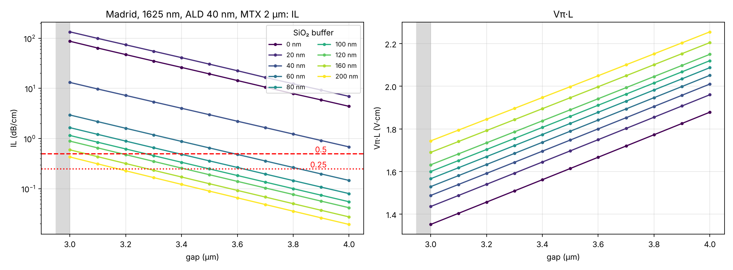
The buffer is mandatory: below ~60 nm the line is unusable
ALD 40 nm, Au 2 µm · IL and Vπ·L vs gap for each buffer thickness
Buffer | IL @ 3.5 µm | IL @ 4.0 µm
0 nm | 19.4 | 4.4
20 nm | 30.4 | 6.9
40 nm | 3.0 | 0.68
60 nm | 0.65 | 0.15
80 nm | 0.36 | 0.08
120 nm | 0.19 | 0.04
200 nm | 0.09 | 0.02
Cut-off of the lateral wave under the gold at 1625 nm: t_c ≈ 33 nm (1D model). A 20 nm buffer is worse than none (resonant); 40 nm is too close to cut-off. Each +0.1 µm of gap: Vπ·L +0.052 V·cm, IL ÷1.35.

Slide 4
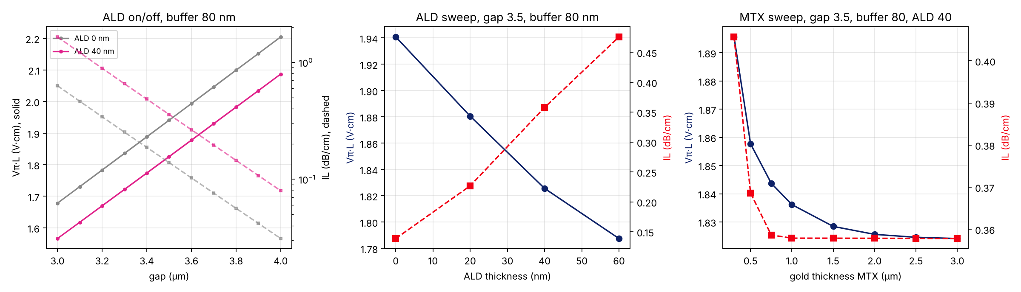
ALD and gold thickness
Gap 3.5 µm, buffer 80 nm
ALD (εr ≈ 9.8) fills the gap and the 0.1 µm cap/gold slots
Pulls DC field into the LN: Γ 0.488 → 0.519; Vπ·L −6 % for 40 nm, but IL ×2.6
Gold thickness saturates above ~1–1.5 µm
Vπ·L +1 % at 0.75 µm, +3.8 % at 0.3 µm (and IL rises). Keep MTX ≥ 1.5 µm

Slide 5
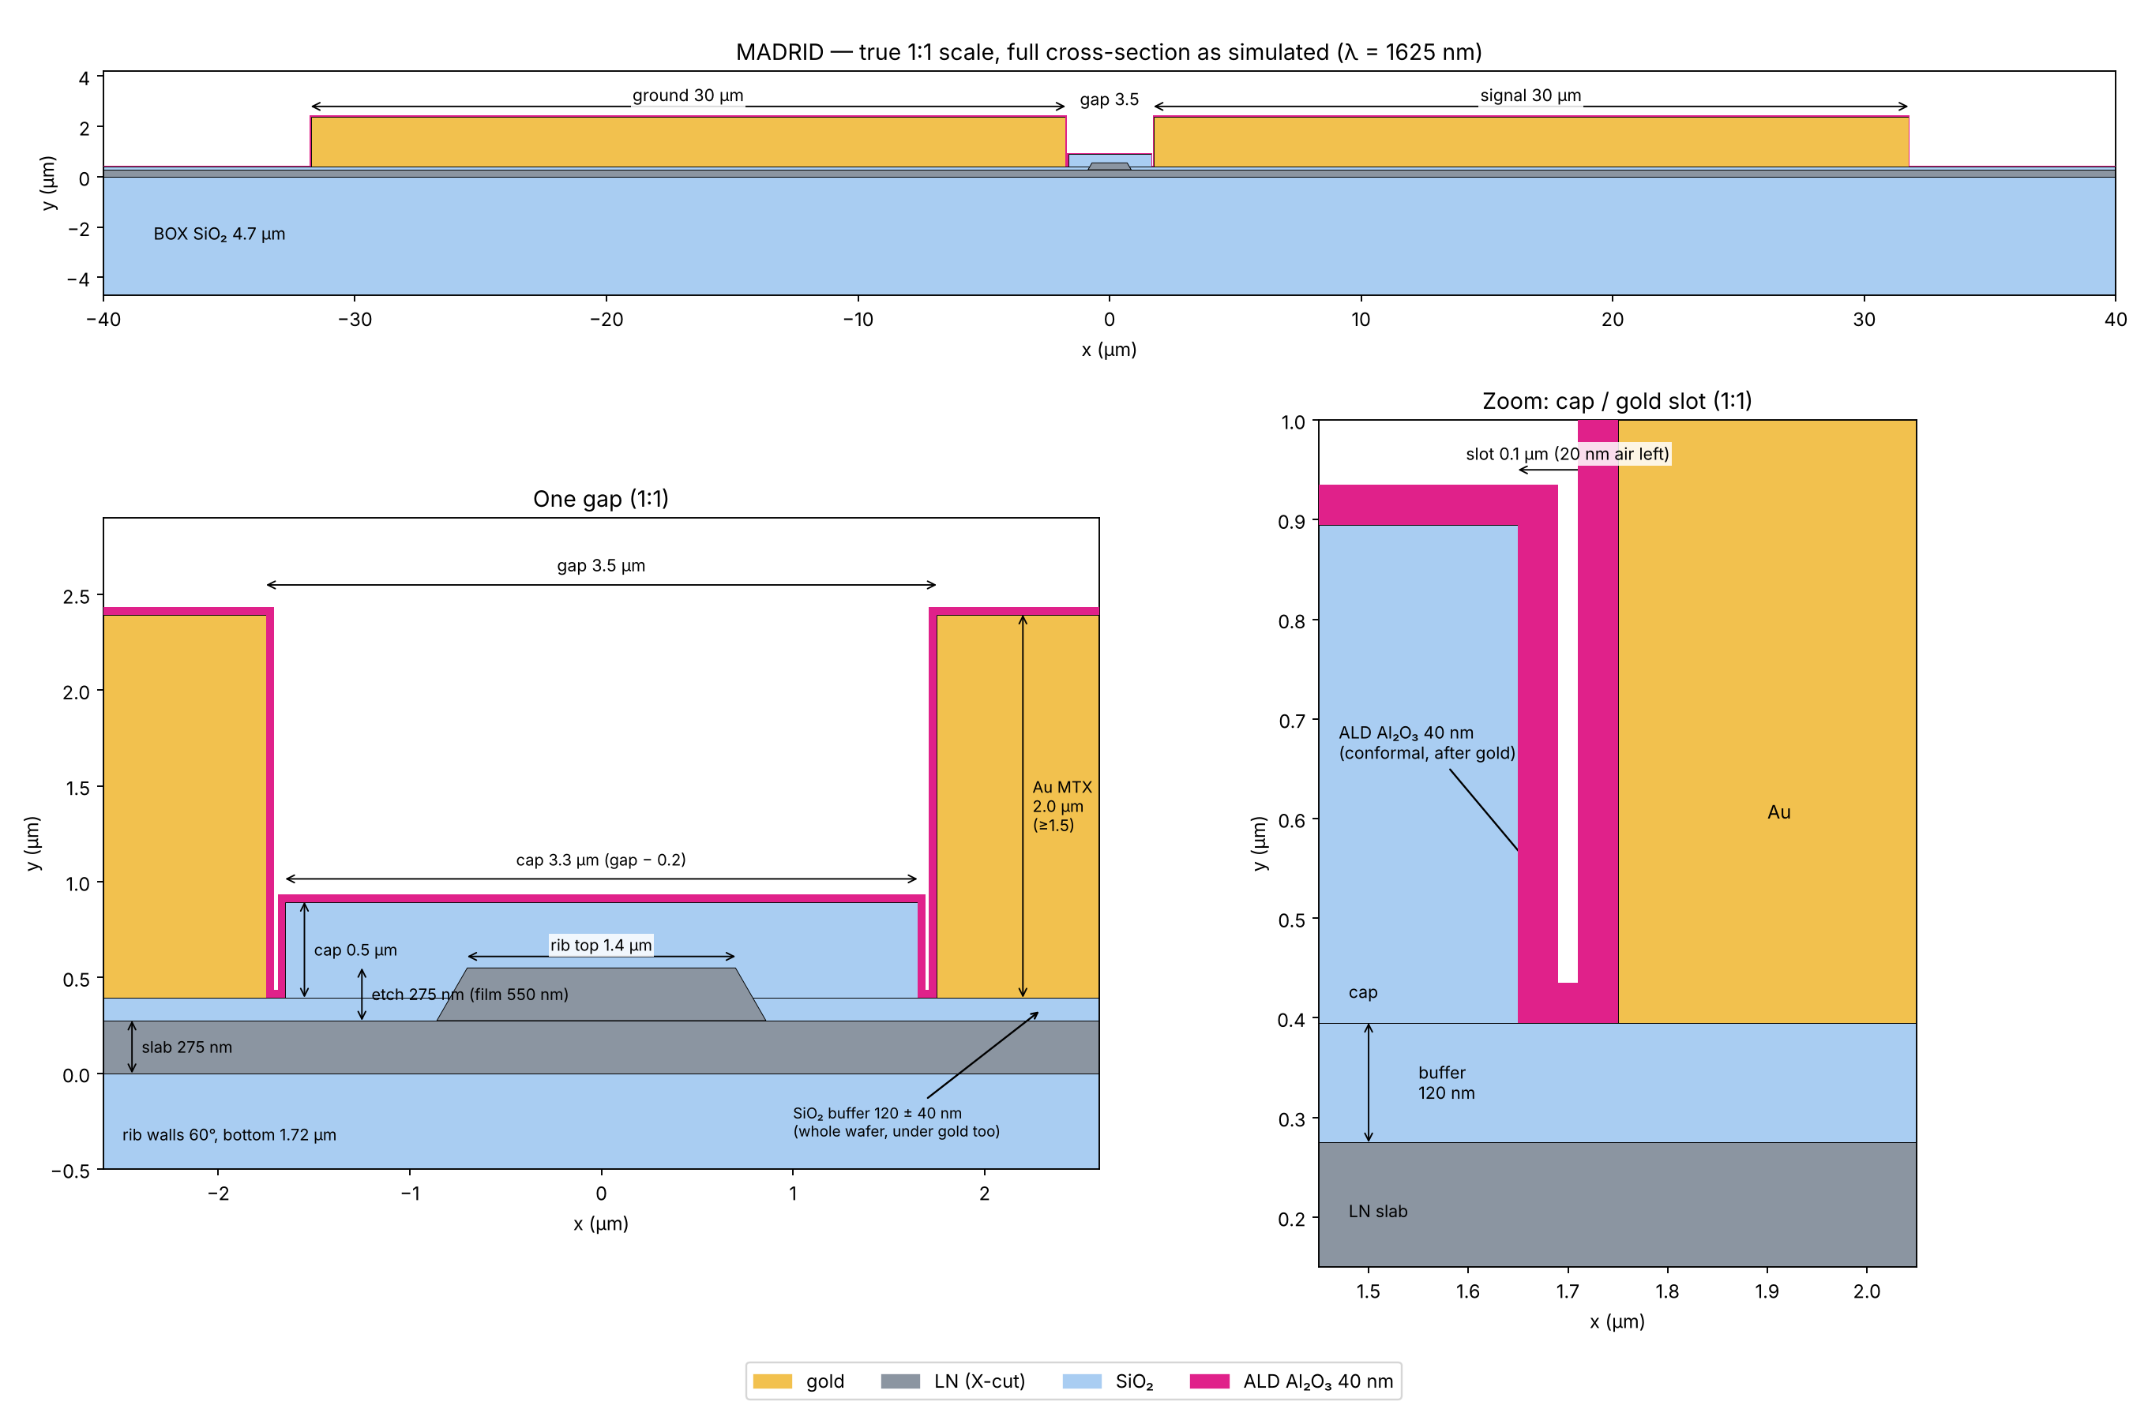
Proposed design A: with ALD
Gap 3.5 µm · buffer 120 ± 40 nm · cap 3.3 × 0.5 µm · ALD 40 nm · Au 2 µm · true 1:1 scale

Slide 6
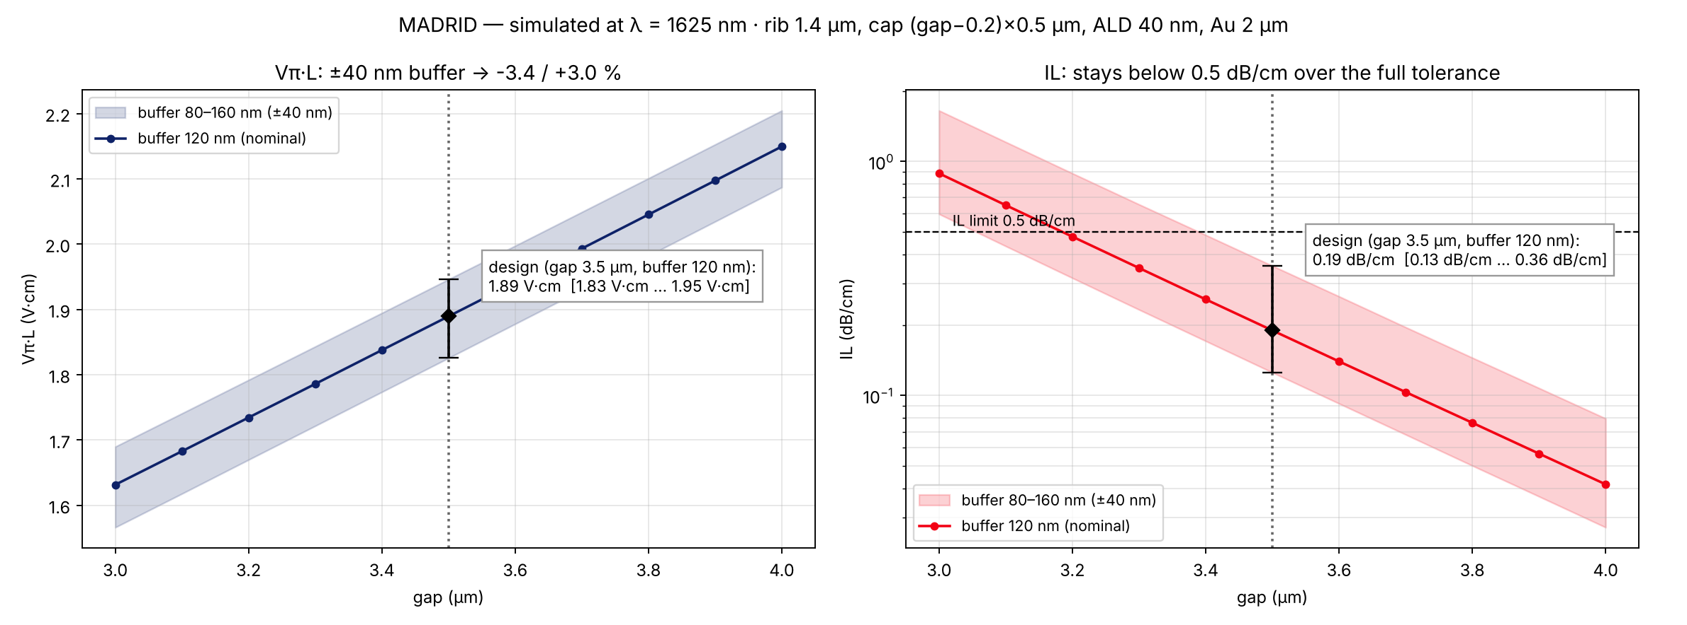
Design A at 1625 nm: ±40 nm buffer tolerance
Band = buffer 80–160 nm, line = nominal 120 nm
1.89 V·cm
0.19 dB/cm
3.5 µm
Vπ·L [1.83 … 1.95] (−3.4 / +3.0 %)
IL [0.13 … 0.36]
gap, as preferred

Slide 7
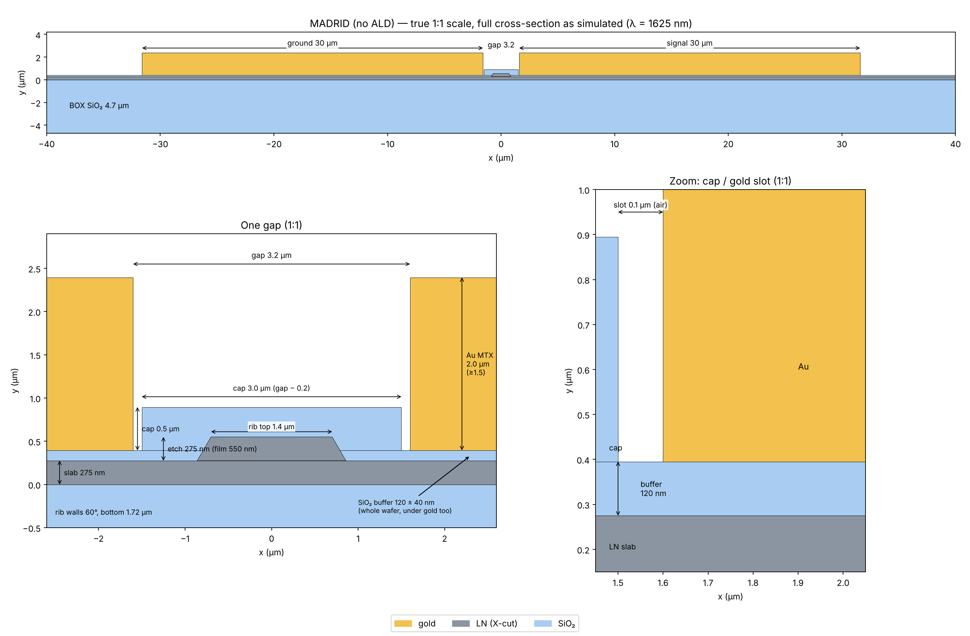
Proposed design B: no ALD
Gap 3.2 µm · buffer 120 ± 40 nm · cap 3.0 × 0.5 µm · Au 2 µm · true 1:1 scale

Slide 8
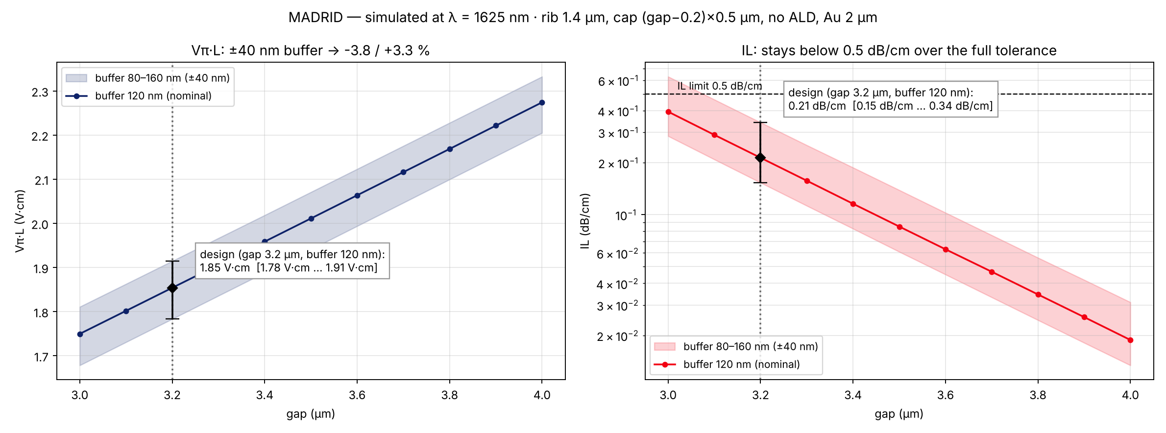
Design B at 1625 nm: ±40 nm buffer tolerance
Band = buffer 80–160 nm, line = nominal 120 nm
1.85 V·cm
0.21 dB/cm
3.2 µm
Vπ·L [1.78 … 1.91] (−3.8 / +3.3 %)
IL [0.15 … 0.34]
gap (≥ 3.0 µm)

Slide 9
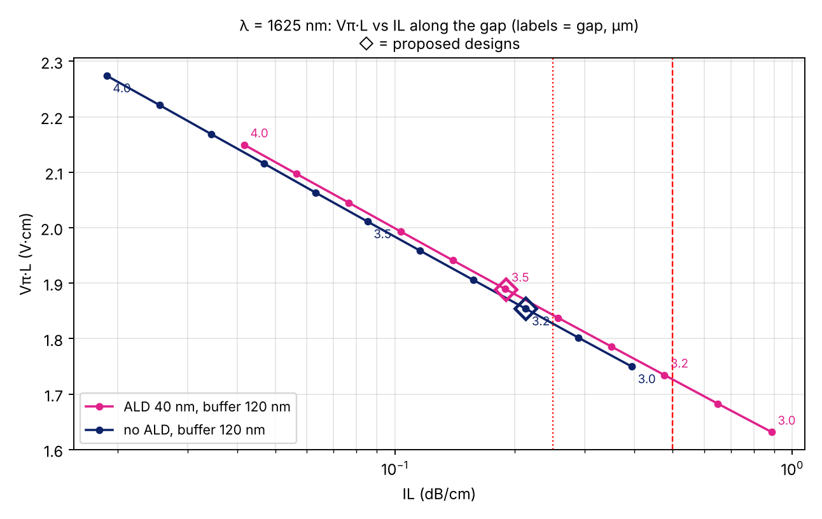
ALD vs no ALD
Same buffer (120 nm): no ALD gives a better Vπ·L–IL trade-off, but needs a narrower gap
Design | Gap | Vπ·L (V·cm) | IL (dB/cm)
A: ALD 40 nm | 3.5 | 1.89 [1.83–1.95] | 0.19 [0.13–0.36]
B: no ALD | 3.2 | 1.85 [1.78–1.91] | 0.21 [0.15–0.34]
B′: no ALD, gap held | 3.5 | 1.98 [1.90–2.04] | 0.11 [0.07–0.22]
Reading
At equal IL the no-ALD curve sits ~0.03–0.05 V·cm lower
ALD only wins when the gap is frozen at 3.5 µm
B′ uses buffer 100 ± 40 nm (60 nm worst case stays above cut-off)
Brackets: buffer ±40 nm

Slide 10
Conclusions and next steps
Madrid at 1625 nm
Vπ·L 1.85–1.89 V·cm with IL ≈ 0.2 dB/cm (Cordoba ≈ 2.2 at 1575 nm)
SiO₂ buffer 120 ± 40 nm: robust to process (Vπ·L ±3–4 %, IL < 0.4)
No lift needed: flat electrodes with buffer are ripple-free
Without ALD: close the gap to 3.2 µm for the same result
Gold ≥ 1.5 µm
Next
RF study (60 GHz): narrow gap + ALD lower Z0 and raise n_m
Check IL across 1525–1625 nm
Buffer thickness control on wafer (target ±20 nm)
Decide ALD (A) vs no ALD (B)

