Slide 1
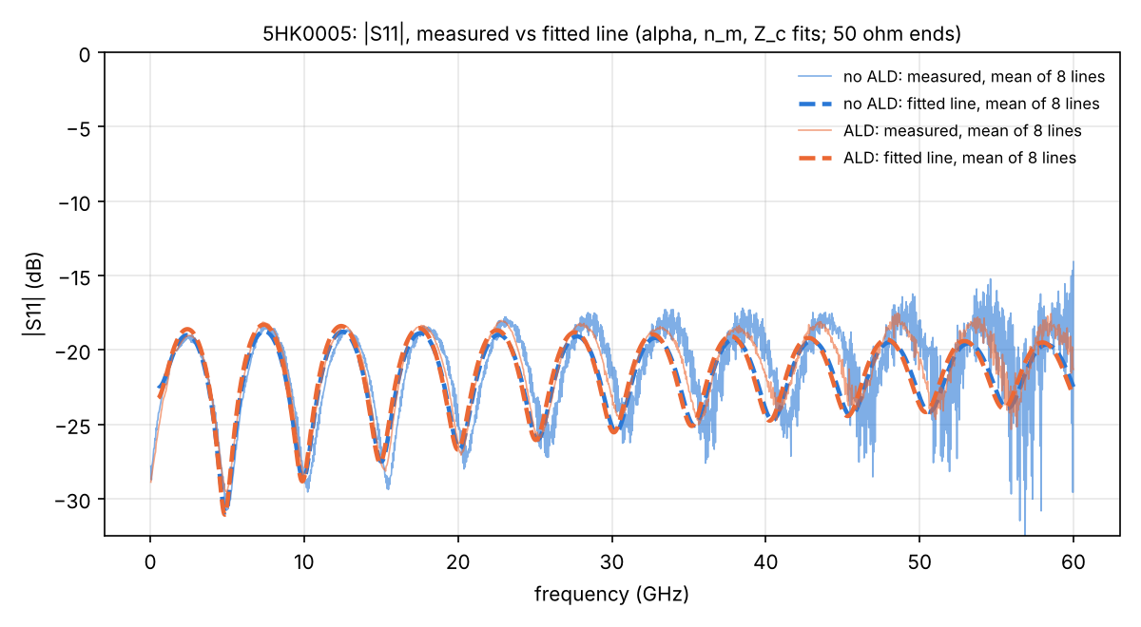
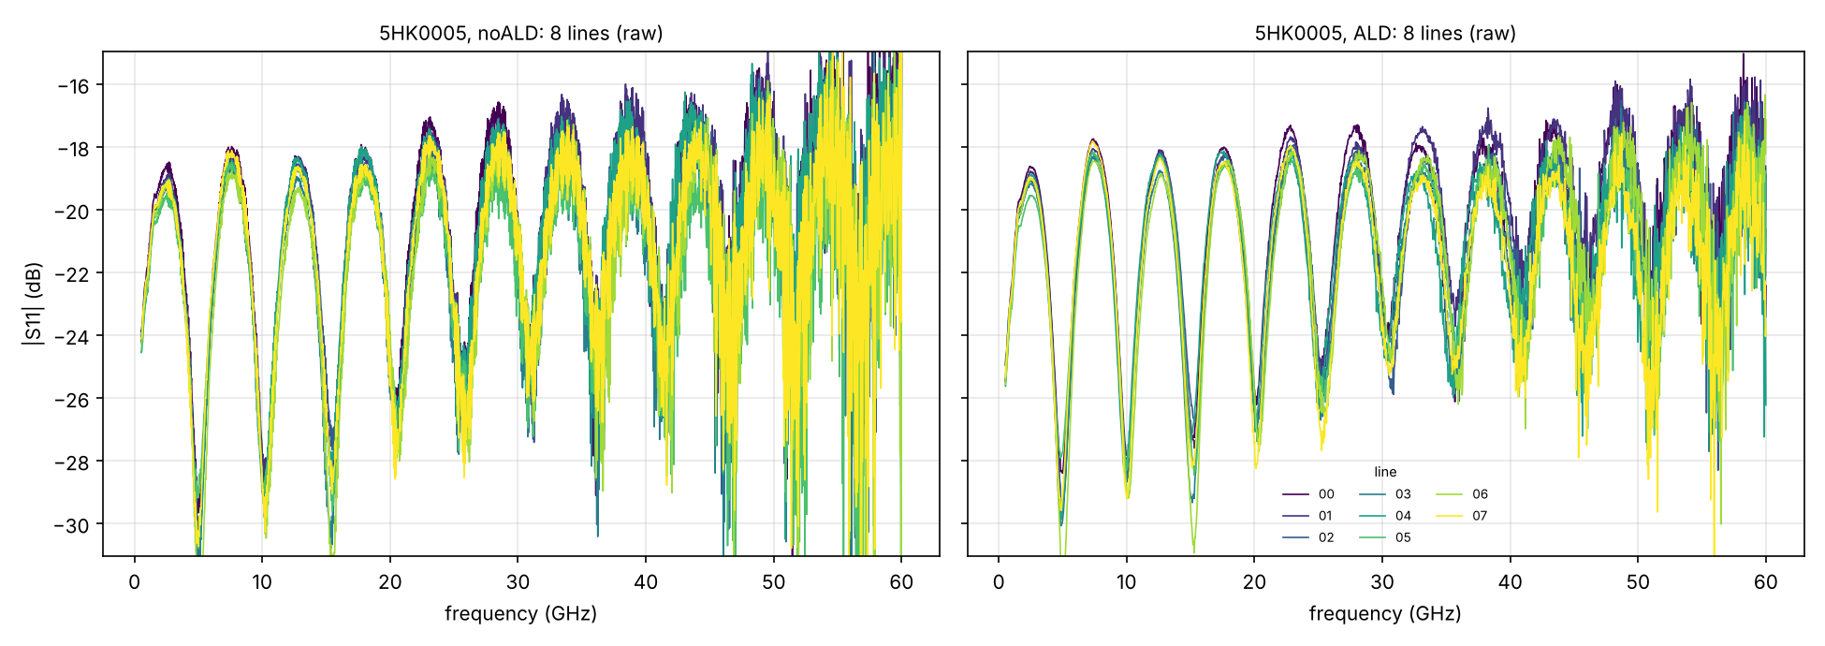
Wafer 5HK0005: return loss |S₁₁|
8 chips · measured, before and after ALD
Chip mean (left)
Measured mean and fitted-line mean, no ALD vs ALD; 50 Ω ends.
No ALD → ALD, 1–60 GHz
Median |S₁₁|: −20.5 → −20.5 dB · maximum: −13.6 → −16.5 dB (medians over chips).

