Slide 1
RF impact of the Al₂O₃ (ALD) layer
on HELSINKI 13 mm lines
Wafer 5HK0005 · 8 chips measured before and after ALD · n_{m}, Z₀, α, S₂₁

Slide 2
Samples and method
Same extraction and figures of merit as the CORDOBA and JEREZ ALD studies
Samples
Wafer 5HK0005, 8 chips, one 13 mm line each.
Same chip measured before and after ALD: paired comparison.
FOM | Value per chip
n_{m} | saturating dispersion fit, at 60 GHz
Z₀ | Re Z_{c}, mean over 10.0–41.5 GHz (6 pad-ripple periods of 5.25 GHz)
α | fit a√f + b f + c (a, b ≥ 0), at 30 and 60 GHz
S₂₁ | fitted line between 50 Ω ends, at 30 and 60 GHz
Measurement
2-port VNA, 40 MHz–60 GHz, 1601 points, 50 Ω.
All 16 files pass the checks: reciprocity 0.8–1.2 % (median), passivity ≤ 0.93. No chip excluded.
Extraction
ABCD de-embedding of each 2-port as one uniform line, L = 13 mm (pads included, same bias before and after ALD).
Reported change: median of the per-chip difference ALD − no ALD.

Slide 3
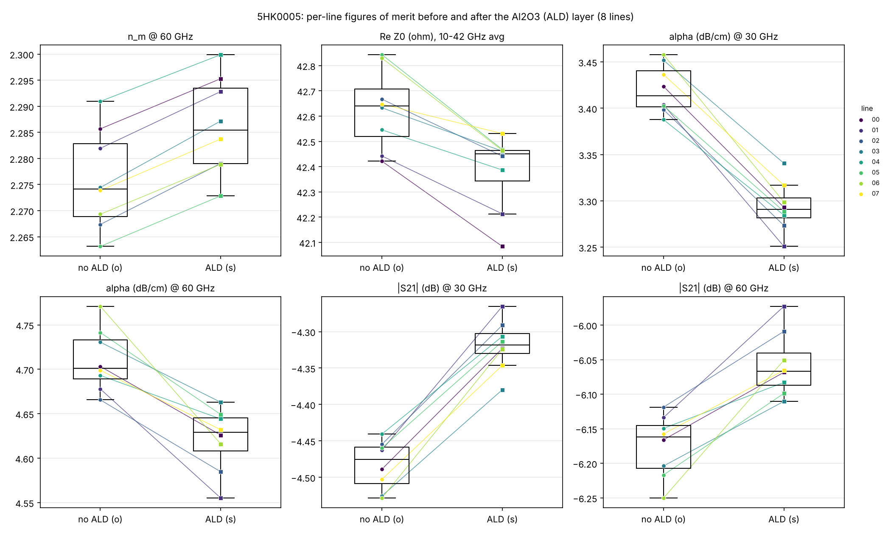
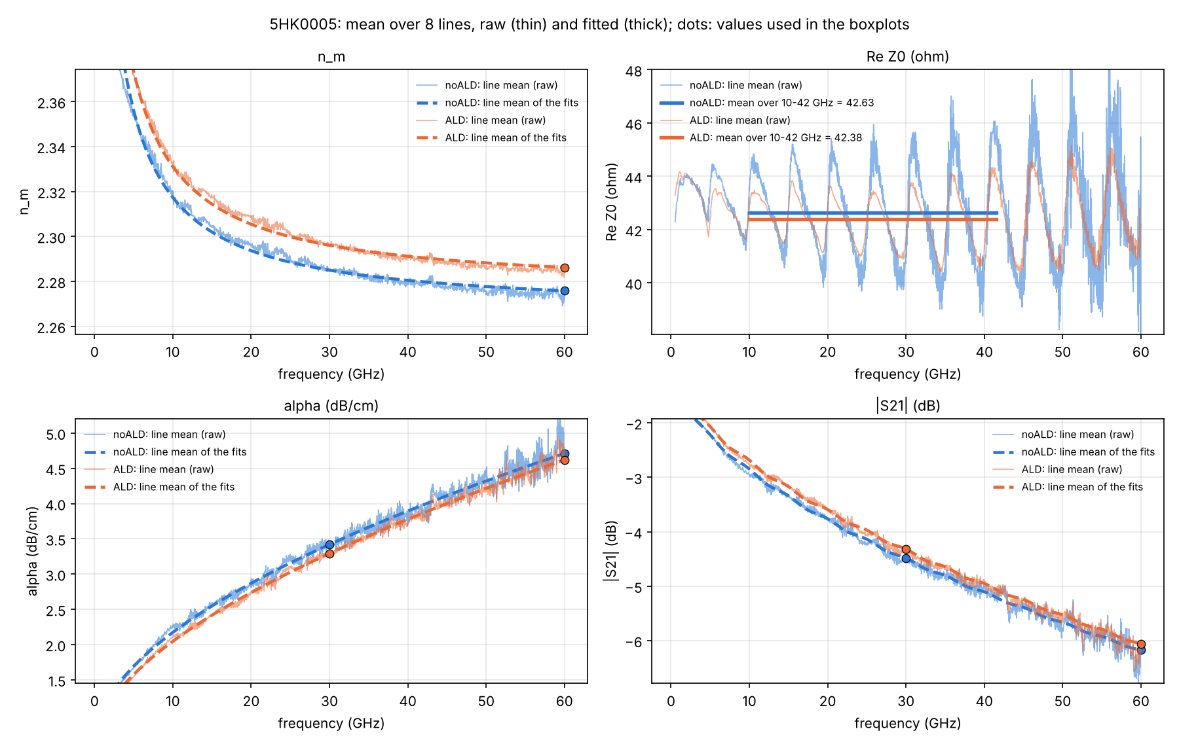
Wafer 5HK0005: results
Chip means with fits (left) · per-chip values, before (o) and after (s) (right)

Slide 4
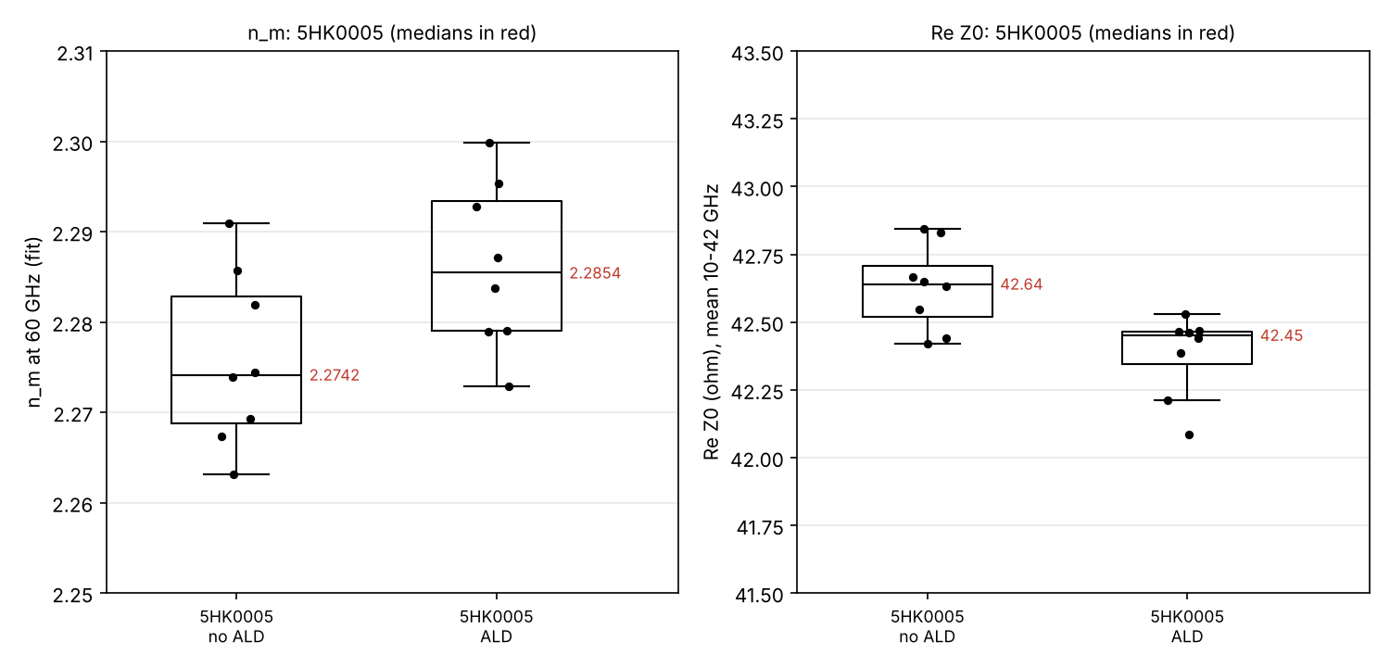
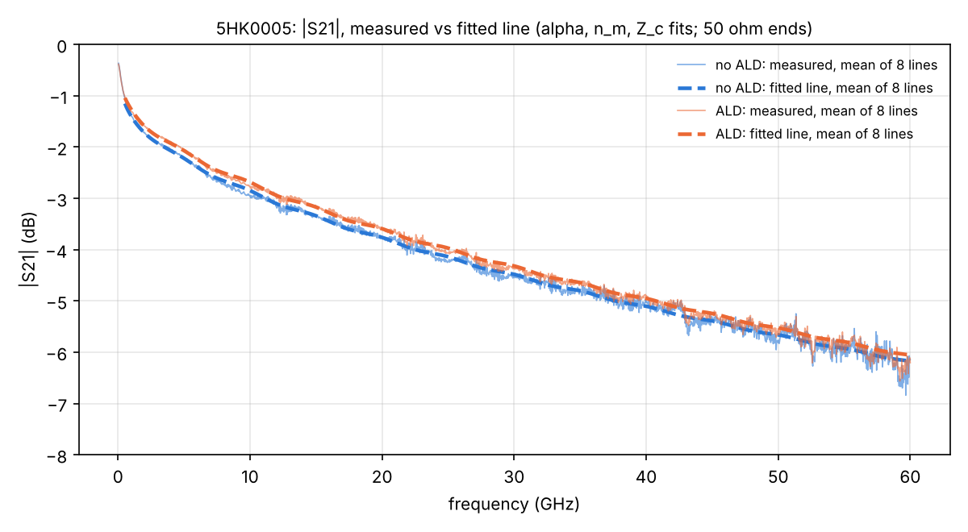
Median change after ALD
8 chips; Up = chips with a higher value after ALD
FOM | No ALD | ALD | Change | Up
n_{m} @ 60 GHz | 2.274 | 2.285 | +0.010 | 8/8
Z₀ (Ω), 10–41.5 GHz avg | 42.64 | 42.45 | -0.23 | 0/8
α (dB/cm) @ 30 GHz | 3.414 | 3.291 | -0.122 | 0/8
α (dB/cm) @ 60 GHz | 4.701 | 4.629 | -0.079 | 0/8
|S₂₁| (dB) @ 30 GHz | -4.476 | -4.318 | +0.160 | 8/8
|S₂₁| (dB) @ 60 GHz | -6.162 | -6.067 | +0.104 | 8/8
Z₀ changes below about 0.5 Ω are not resolved (pad ripple); α at 60 GHz carries about ±0.07 dB/cm (CORDOBA fit check).

Slide 5
Conclusions
+0.4 %
−3.6 %
+0.16 dB
n_{m} at 60 GHz (+0.010), every chip
α at 30 GHz (−0.12 dB/cm), every chip
|S₂₁| at 30 GHz over 13 mm, every chip
Reading
ALD raises n_{m} on every chip: added capacitance.
Loss decreases on every chip, at 30 and 60 GHz (−0.12 / −0.08 dB/cm).
Z₀ −0.23 Ω on every chip, below the 0.5 Ω resolution; pad ripple smaller after ALD (1.8 → 1.0 Ω std).
Compared with JEREZ and CORDOBA
n_{m} increase smallest: +0.010 (JEREZ +0.018, CORDOBA +0.035 / +0.038).
Loss decrease as on JEREZ, about 4× larger at 30 GHz; CORDOBA showed an increase.
Pad ripple shrinks after ALD; on CORDOBA it grew.

